Slide 1
Electronic System Design 3 Lecture 7.2: How to build an Instrumentation Amps
Dr Duncan Bremner

Slide 2
Difference Amplifier
First shot at building an INA:
Vp
Vn
Assume perfect opamp Vn ==Vp

Slide 3
Difference Amplifier (2)
Works as a gain of 1 instrumentation amplifier.
Can we have gain >1?

Slide 4
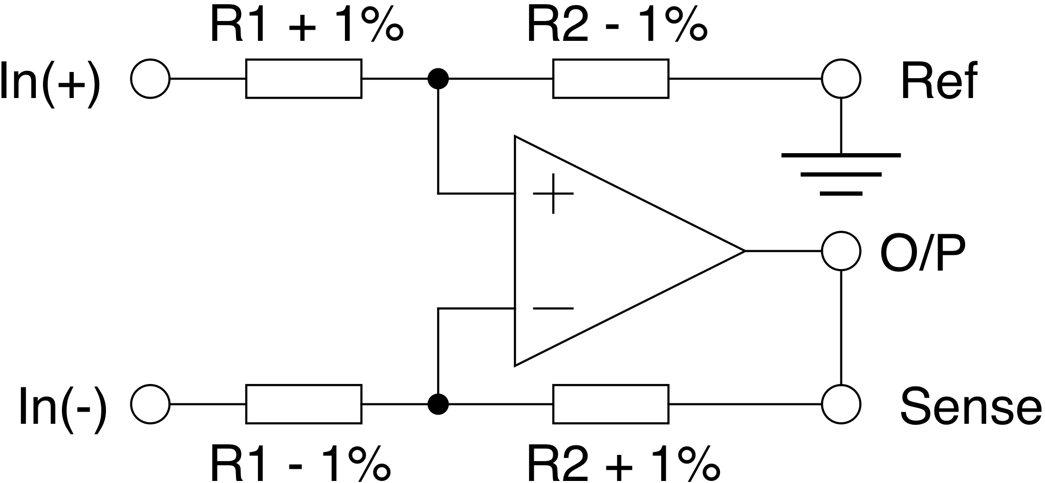
Difference Amplifier (3)
Circuit rejects common-mode signals because it is symmetrical.
Problem arises due to resistor tolerance which makes the circuit unsymmetrical.
Worst case error when sides are maximally unbalanced:
(Assume all Resistors are +/- 1%)
Gain 2%
too small
Gain 2%
too big

Slide 5
Difference Amplifier (4)
Easier to calculate if we amalgamate the errors in each side:
is the error in R2 (in Ohms!). In the above case the TOTAL error can be up to 2% for 1% resistors
(i.e. 1% error in R1 plus 1% error in R2)

Slide 6
Difference Amplifier (5)
Assume differential gain ≈ 1, so R2 = R1

Slide 7
Difference Amplifier (6)
Calculate Common-Mode and Differential gain separately:

Slide 8
Difference Amplifier (7)
Differential gain ≈ 1

Slide 9
Difference Amplifier (8)
Ohms
Ohms

Slide 10
Difference Amplifier (9)
Resistor mismatch gives a small error in differential gain (trivial)
e.g. 1% resistors, CMRR = 50 (often expressed in dB “34dB”)
0.1% resistors, CMRR= 500 (54dB)

Slide 11
Difference Amplifier (10)
Can use precision resistors…...
But Sensitive to impedance mismatch at input
Stray errors due to:-
• Contact resistance, PCB tracks
• Thermocouple wire resistances (e.g. Cu / Constantan)
• Oxidation, bad soldering
Gets worse with age

Slide 12
Difference Amplifier (10)
Can fix source impedance variation by buffering
But still limited by resistor matching. Best case ~ 0.01% (discrete)
Monolithic ~0.001% (Texas INA105, Analog Devices AMP03)

Slide 13
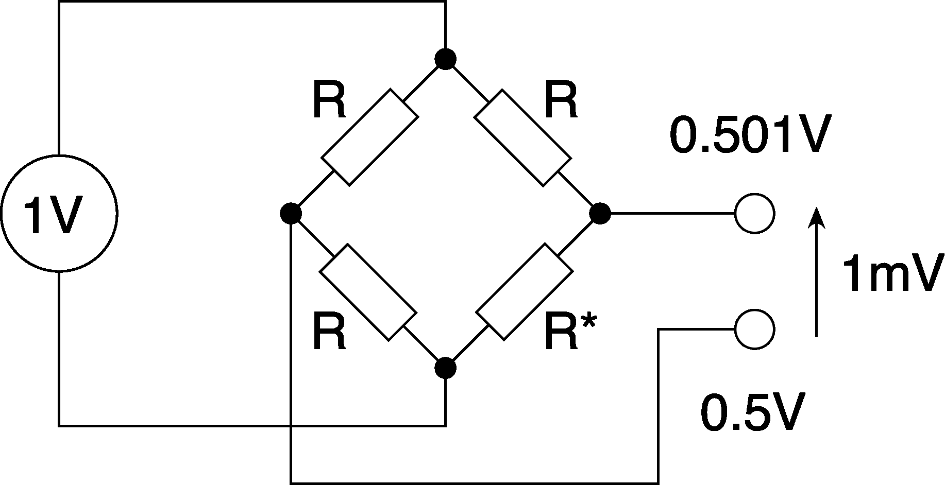
Difference amplifier (11)
Typical example: bridge amplifier (scales / load cell)
(Full scale)
Need common-mode rejection ratio of 54dB (0.1%) to see anything
Need common-mode rejection ratio of 114dB to resolve 1g in 1kg
Expensive resistors then trim. Calibrate often.
Ugh!

Slide 14
Typical Load Cell Spec

Slide 15

Thank you
谢谢

