Slide 1
Electronic System Design 3: The Instrumentation Amplifier Lecture 8.1 Example Application
Dr Duncan Bremner

Slide 2
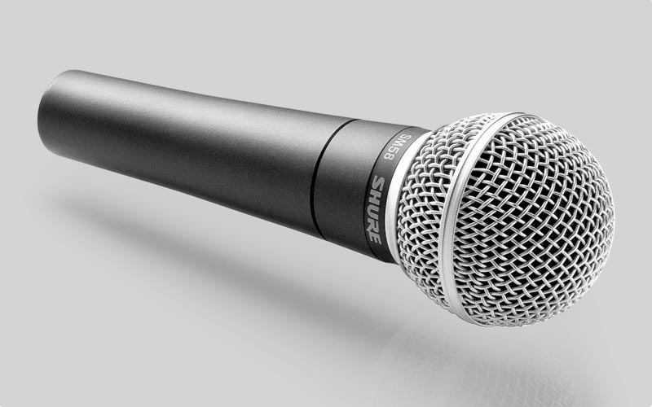
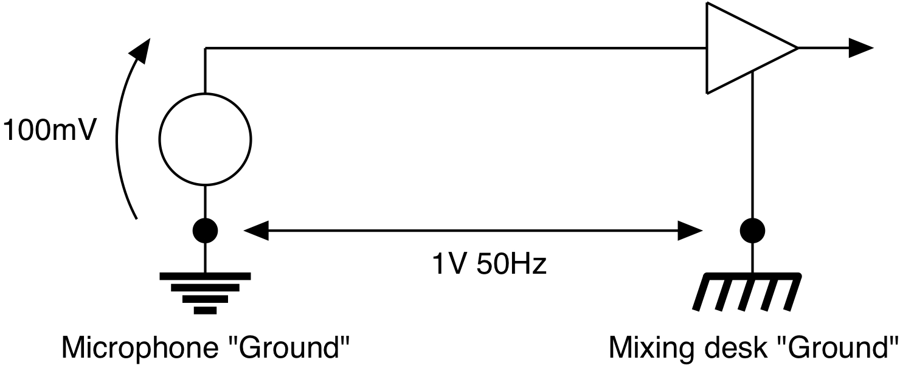
Instrumentation Amplifier Example
A microphone produces an output of 100mV peak and is input to a mixing desk
The ground connection used by the microphone has a 50Hz (Mains) signal of 1V amplitude on it, relative to the ground used by the mixing desk.

Slide 3
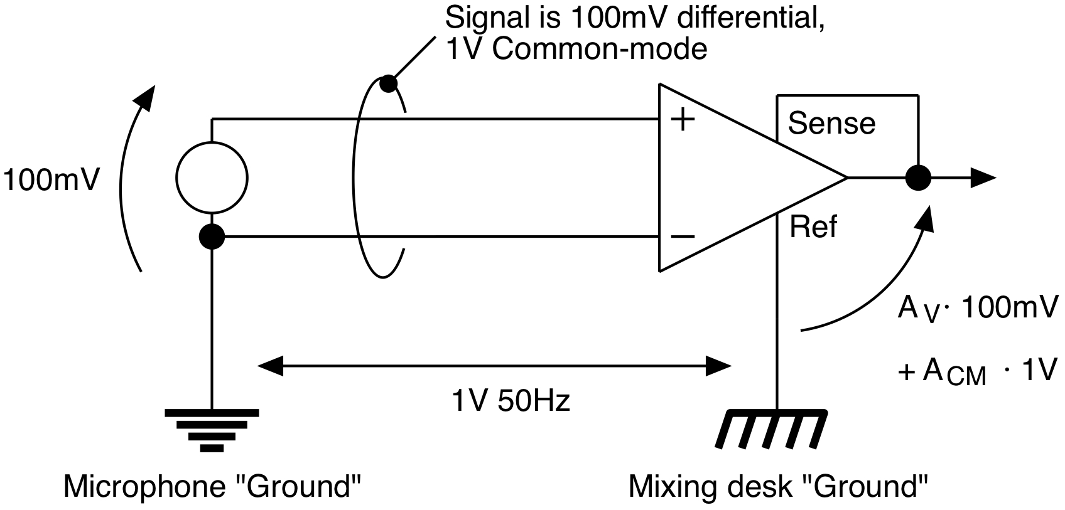
Instrumentation Amplifier Example (2)
If we just use the single potential from the microphone the 50Hz interference (1V) will add to the signal (100mV max) and the system won’t work.
Use an instrumentation amplifier to amplify the difference between the microphone signal and the microphone ground, and output with respect to the mixing desk ground:
A_{CM} << A_{V}

Slide 4
Instrumentation Amplifier Example (3)
If the amplifier has a ratio of 10, then the
microphone signal will have an amplitude equal to the 50Hz.
If we want the microphone signal to be 1000x bigger than the 50Hz, then we require a CMRR of 10 000. (80dB)
To get a big CMRR using a 3-opamp instrumentation amplifier we use a big gain in the input stage.
±15V power supply; Let the output be no bigger than 10V

Slide 5
Instrumentation Amplifier Example (4)
Specification:
Put all the gain into the input stage: Input stage gain = 100
Input stage:
Hence output stage:
Implies the use of 0.5% resistors

Slide 6
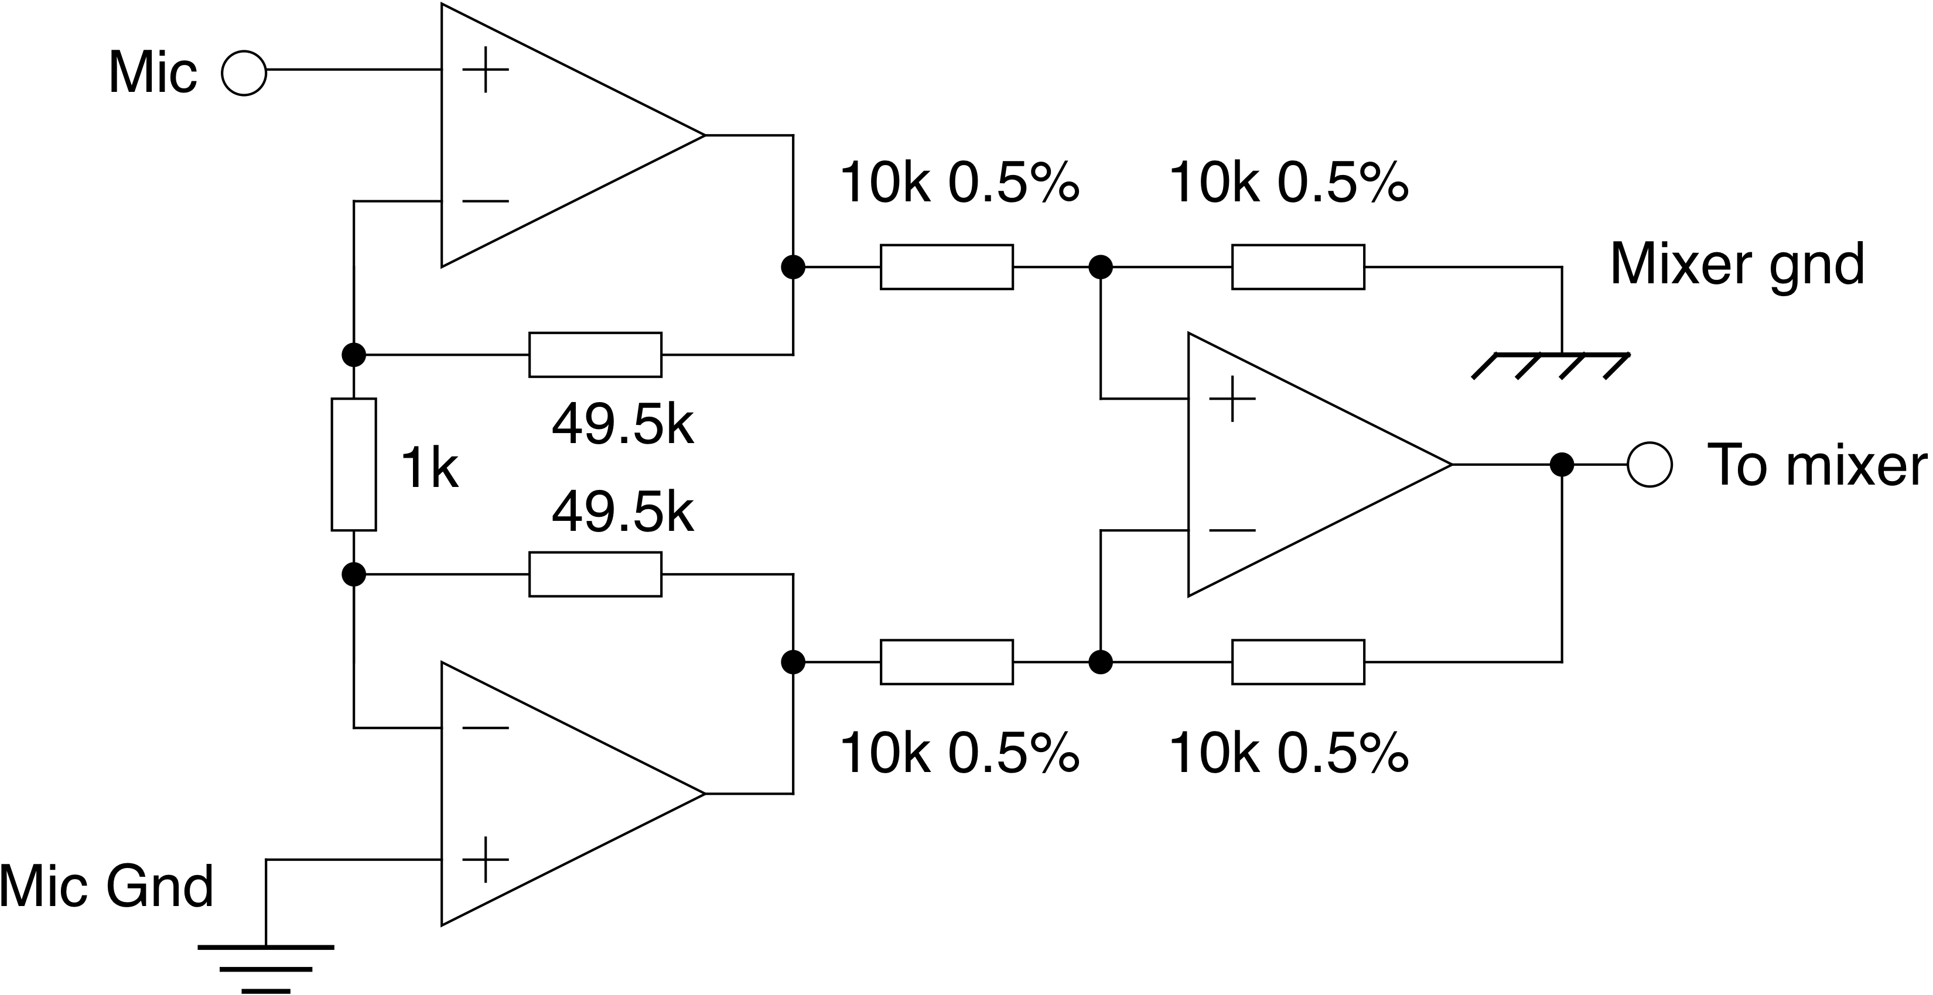
Instrumentation Amplifier Example (5)
Hence final design:
These are different grounds!

Slide 7
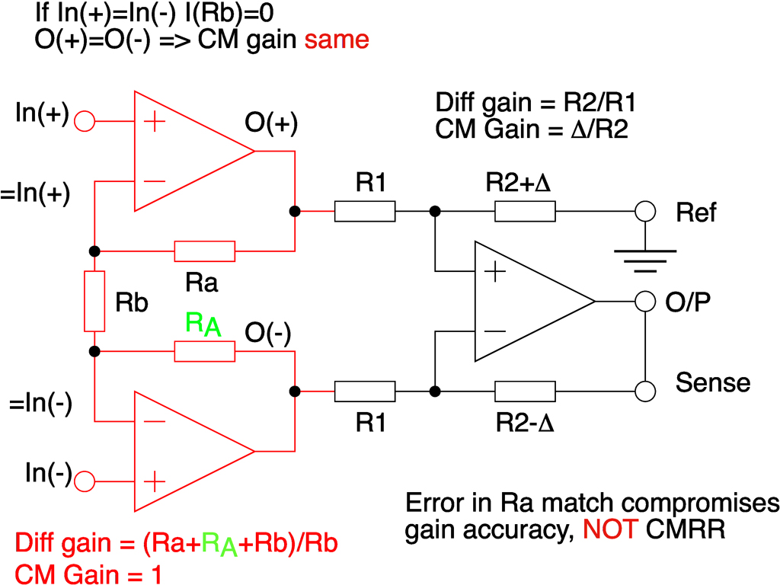
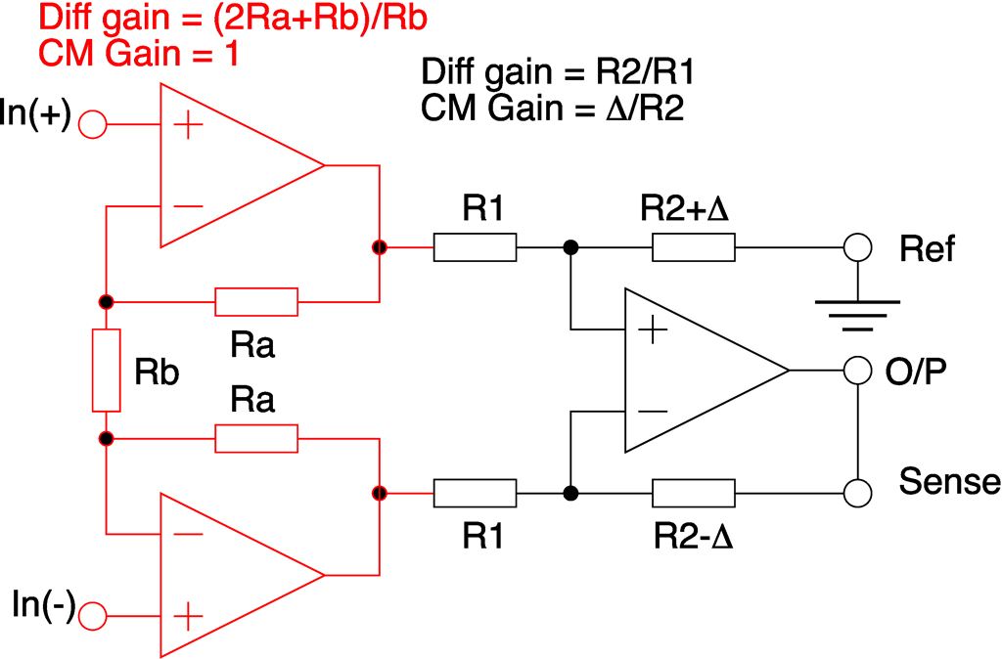
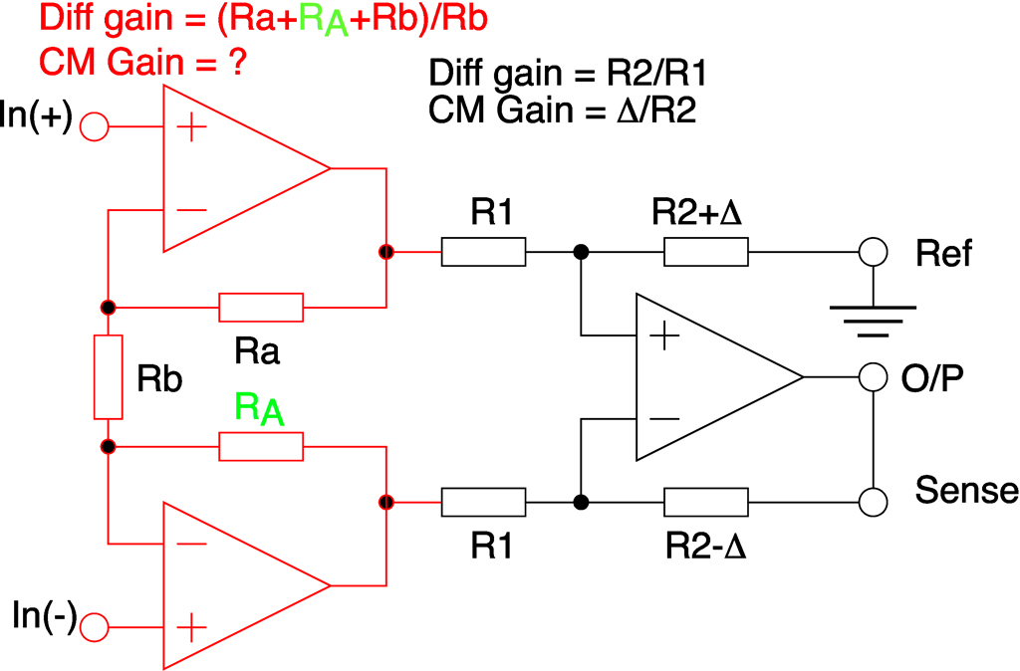
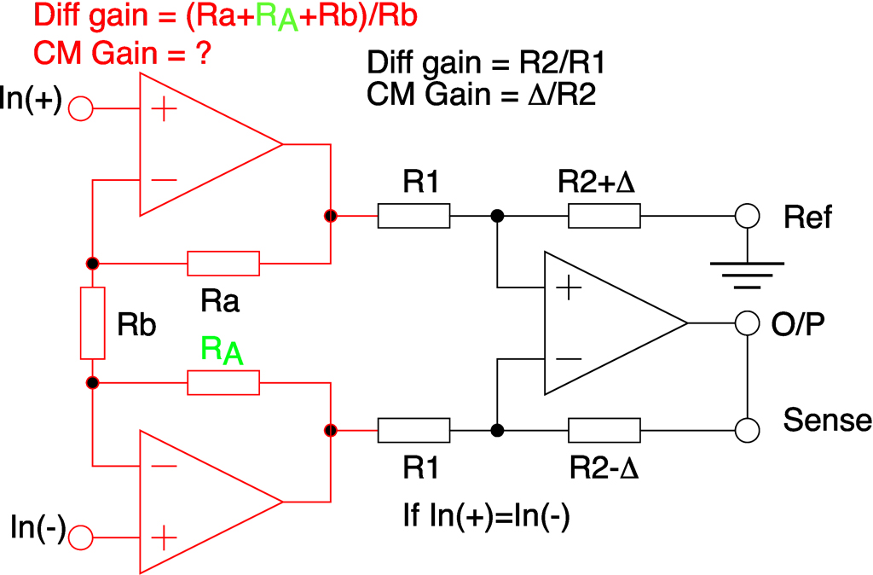
Instrumentation Amplifiers (cont)
Error in Ra matching affects differential gain accuracy; NOT CMRR

Slide 8
Instrumentation Amplifiers (2)
CMRR is Independent of Ra match
CMRR is Proportional to input stage gain
CMRR is Proportional to R1/R2 match
Can we get arbitrarily large CMRR?
E.g. Input gain = 80dB, R1/R2 match 0.01% CMRR = 154dB
1Volt Common Mode corresponds to 20nV differential signal
Oh No It Doesn't!
Why? We have assumed perfect opamps

Slide 9

Thank you
谢谢

