Slide 1
Electronic System Design 3: The Instrumentation Amplifier Lecture 8.3 More INA Applications
Dr Duncan Bremner

Slide 2
Application
Classic application: Bridge amplifier (Perhaps a load cell)
*
Typically, R1=R2, R3=R4(1+Δ)

Slide 3
Application (2)
Limit on sensitivity is CMRR:

Slide 4
Application (3)
Magnetic compass
IC includes 2 perpendicular magnetic sensors (one shown)
All 4 resistors approximately equal. All vary.

Slide 5
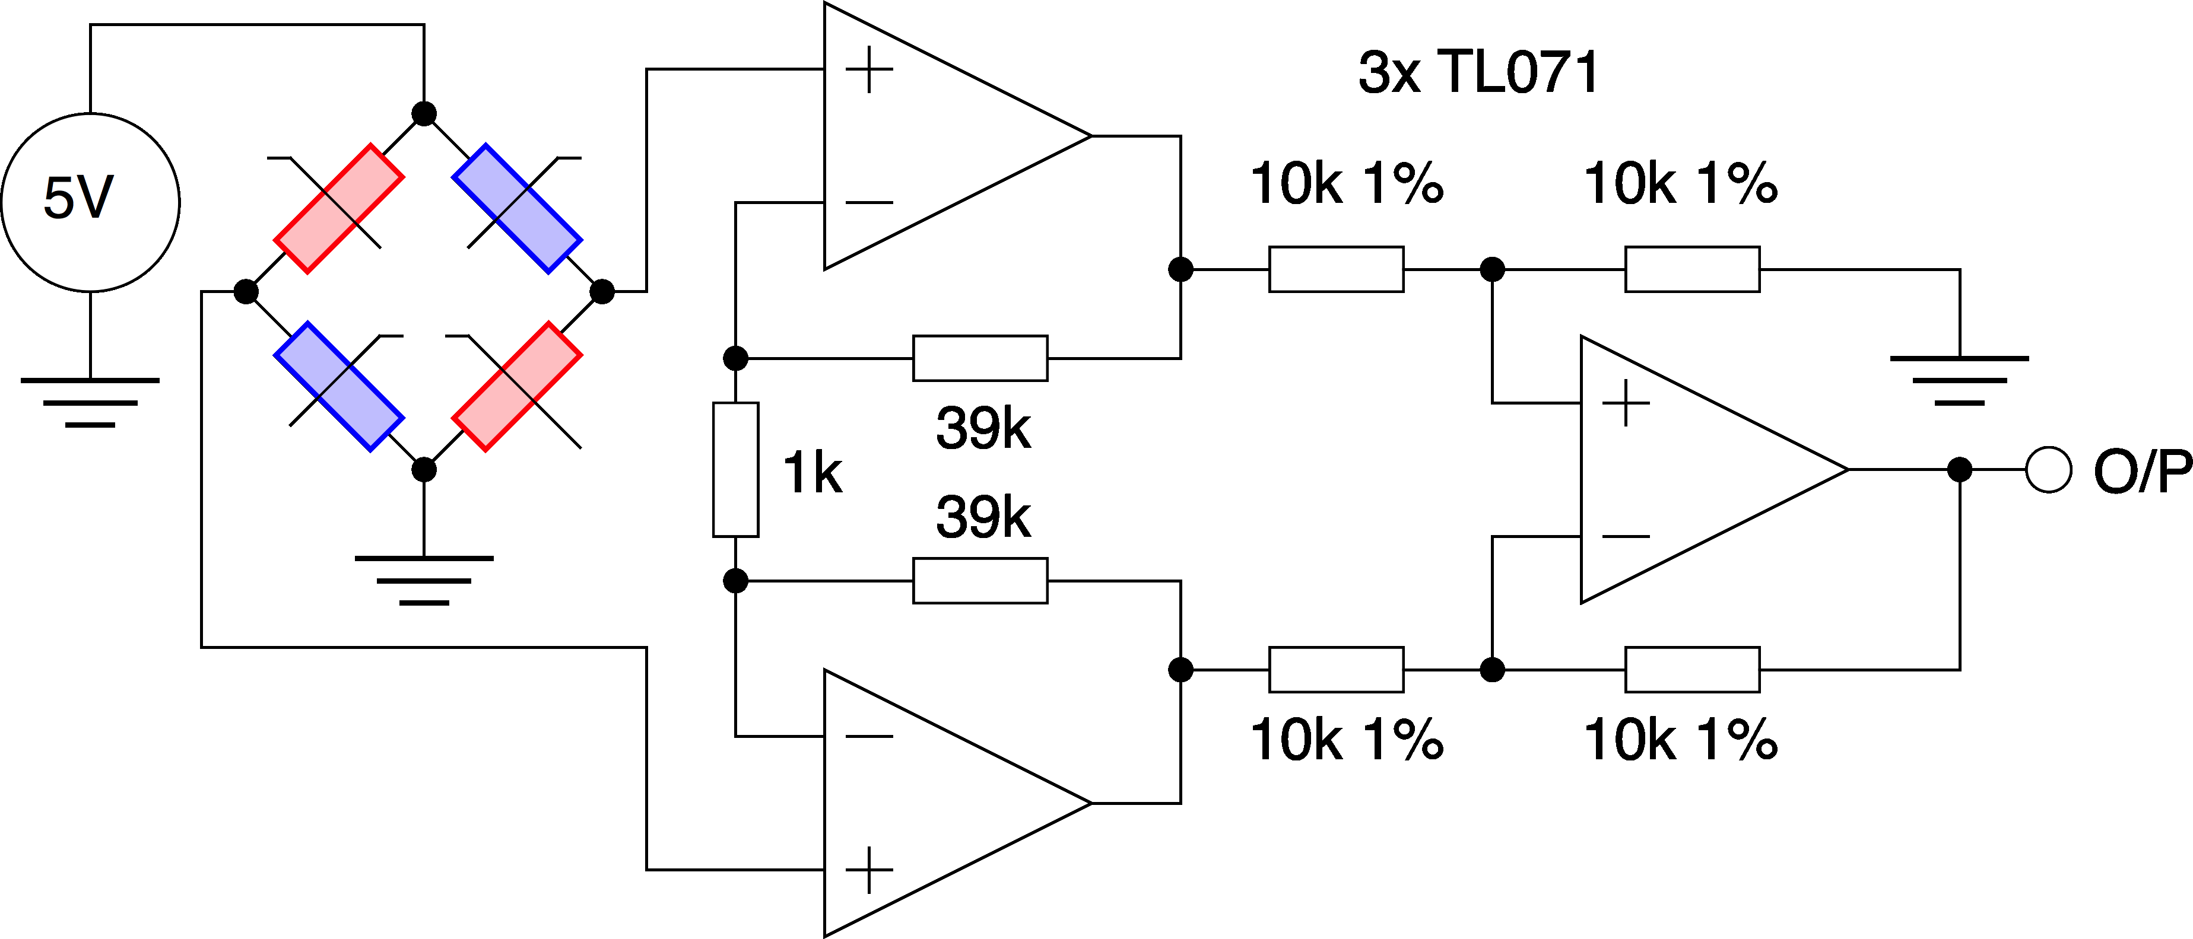
Application (4)
Specification: Condition signal with O/P = 1V/Gauss
Total additive error = 0.0175 Gauss (earth ~0.4 Gauss)
= 218µV RTI
=12.5mV * 0.0175Gauss
Naïve Design (gain = 80):

Slide 6
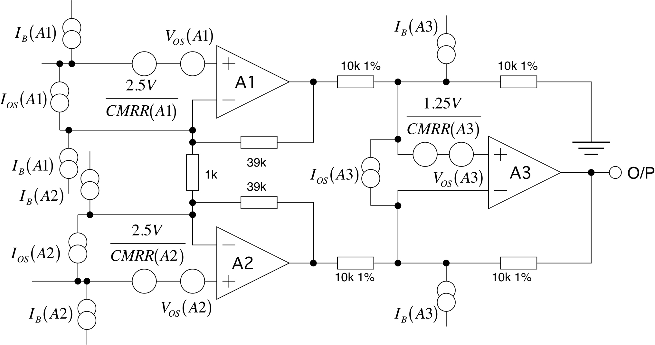
Application (5)
There are a LOT of error sources in this design!

Slide 7
Application (6)
Need to simplify, so we can focus on the important sources of error.
1: Gain of input stage is large: All errors due to A3 can be
neglected (they are 40x less important)
2: The bias currents of A1 and A2 are different: The offset
current cannot be larger than the bias current, so we can
ignore it (there is no matching of input currents for
A1 and A2)
3: Reduce the impedance of the feedback network round
A1, A2 so that it is less than the impedance of the bridge,
then only I_{B}(+) will matter, ~ I_{B}

Slide 8
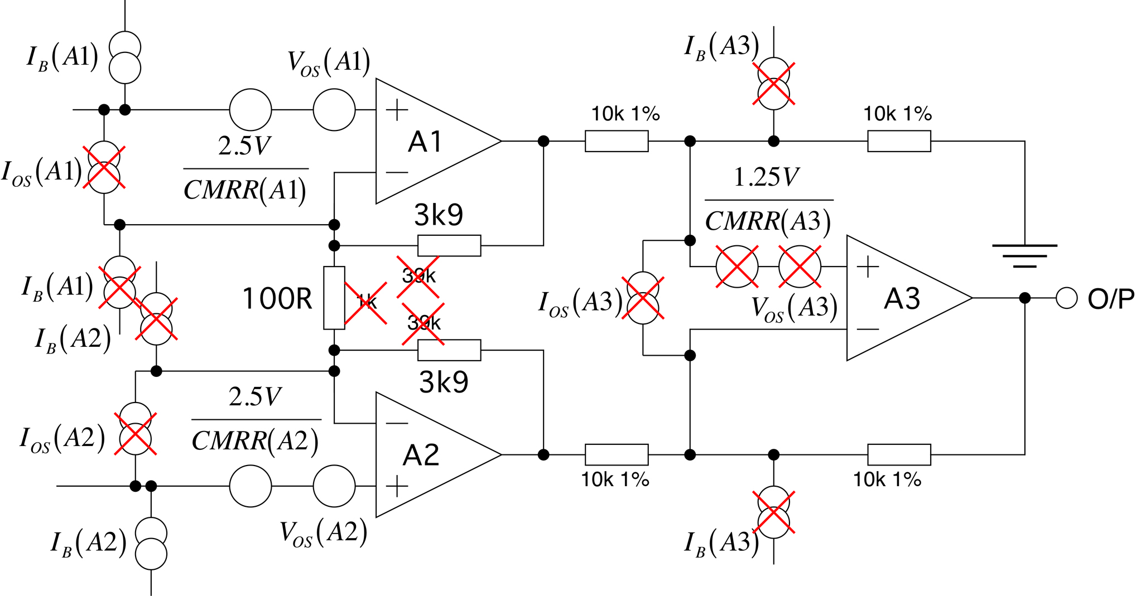
Application (7)
Errors now due to I_{B} flowing in the bridge, opamp CMRR and
Offset voltage in A1,A2 and resistor CMRR in A3.

Slide 9
Application (8)
Opamp VOS(mV) Ib(nA) CMRR(dB) Price
TL071C 10 0.2 70 0.60
Sources of error: (Total error budget = 218µV)
Budget = 62.5µV
(0.1% resistors: £££)
Gives 218 - 62.5µV = 150µV as total opamp error budget

Slide 10
Application (9)
Use total opamp error as
figure of merit;
(resistor CMRR is fixed)
OPA177GP is the lowest cost component that meets the spec!

Slide 11
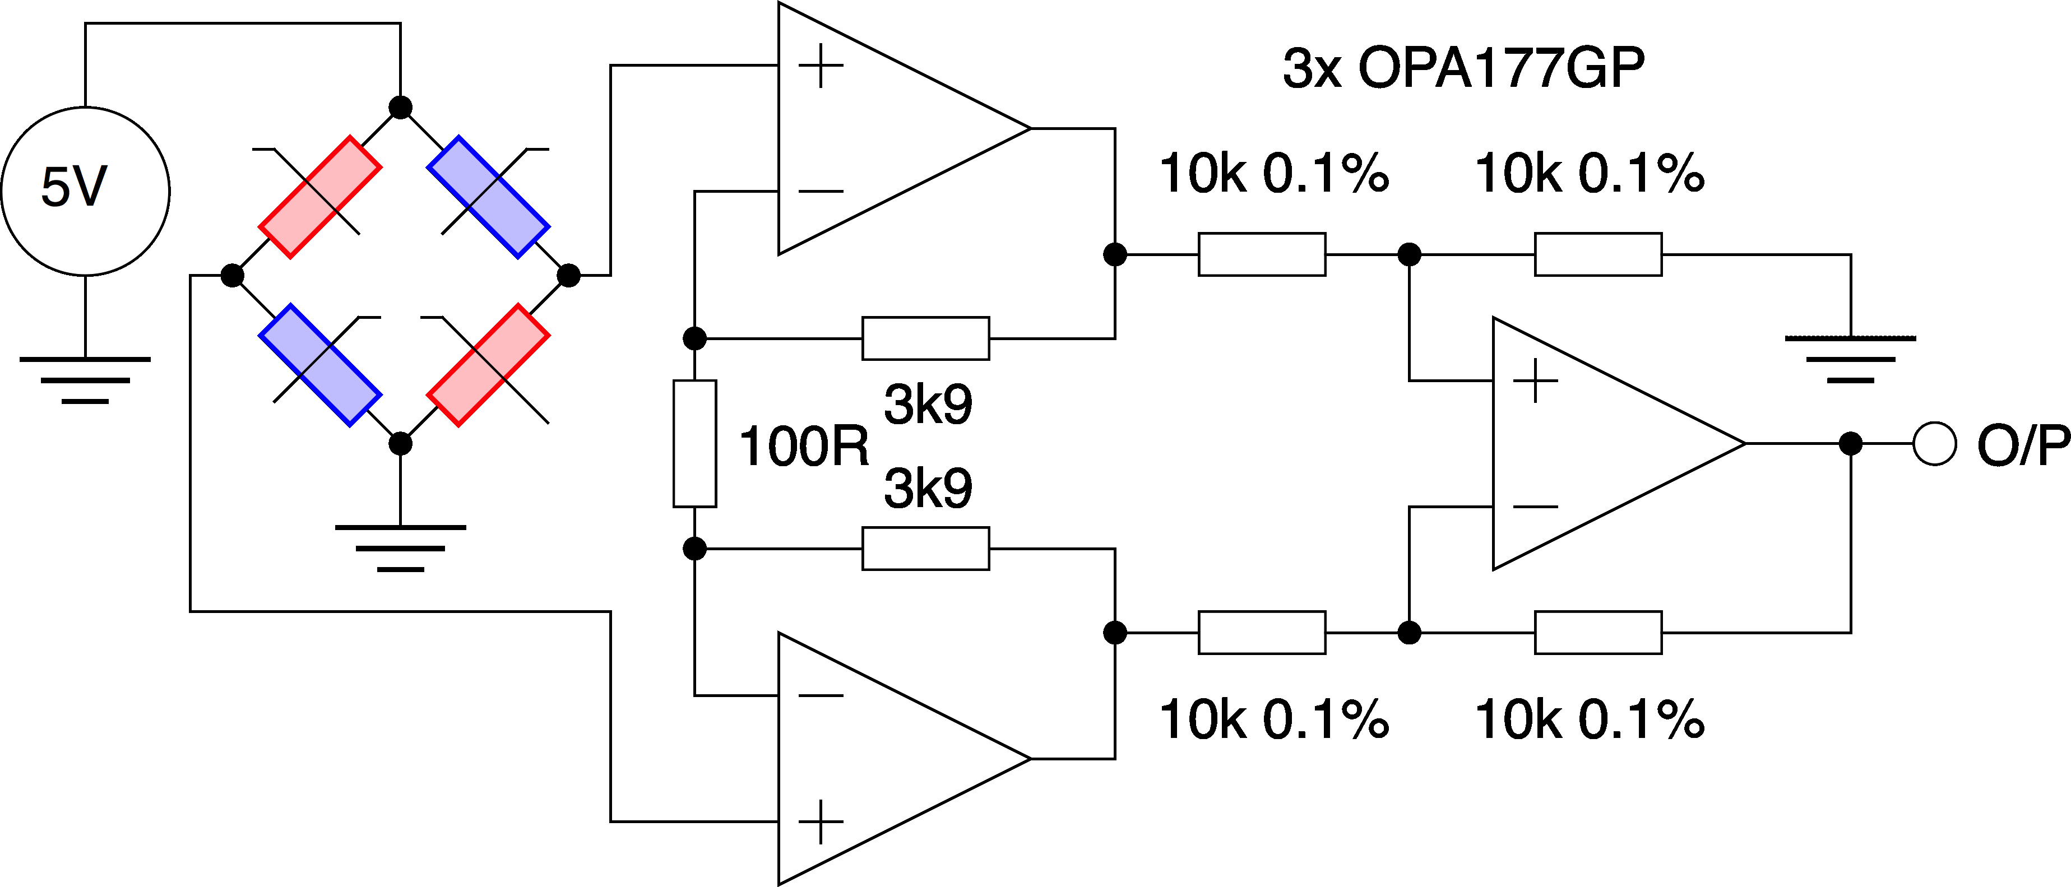
Application (10)
Hence complete circuit

Slide 12

Thank you
谢谢

