Slide 1
Electronic System Design 3: The Instrumentation Amplifier Lecture 8.4 Monolithic INAs
Dr Duncan Bremner

Slide 2
Monolithic Instrumentation Amplifiers
Discrete Instrumentation amplifiers are limited by
• Amplifier CMRR
• Output stage resistor match
Monolithic ICs can match CMRR of input amps (because on the same chip)
Monolithic ICs can trim resistor match
Monolithic ICs can trim V_{OS} match (trim opamps as a pair)
Monolithic instrumentation amplifiers can be cheaper & better

Slide 3
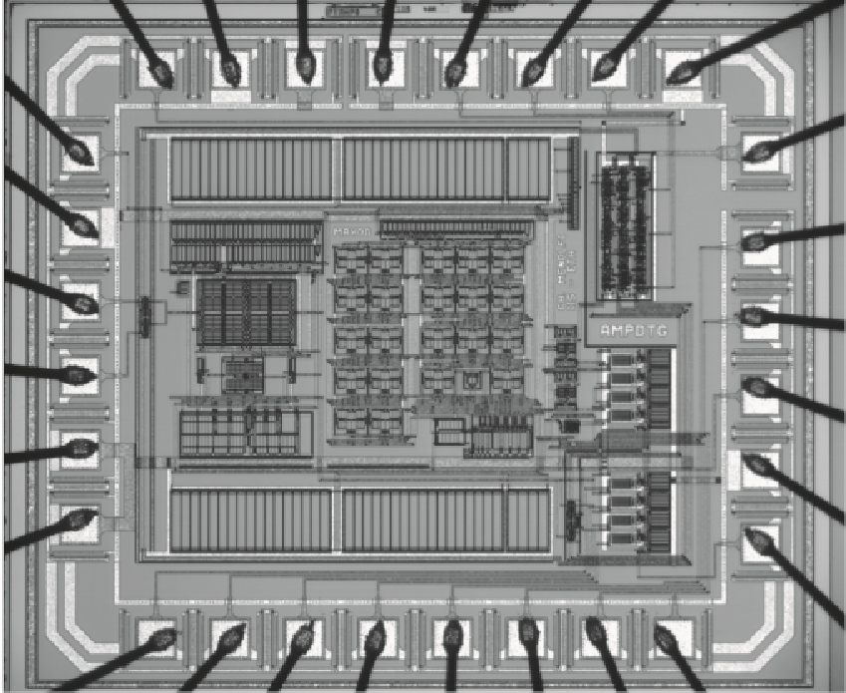
What does a monolithic INA look like?
Careful Resistor Matching
Read the paper on Moodle!
Qiuting Huang, Christian Menolfi:
A 200nV Offset 6.5nV/√Hz Noise PSD 5.6kHz Chopper Instrumentation Amplifier in 1µm Digital CMOS; ISSCC 2001

Slide 4
Monolithic <-> Discrete Comparison
OPA177G
+ 0.1% R (R_{A},R_{B})
(Gain = 100)
INA131A
Offset voltage (max)
120µV (2*60uV)
125µV
Bias Current (max)
2.8nA
5nA
CMRR
94dB
110dB
Gain Error
2.2% (0.4%)
0.1%
Gain Error Drift
130ppm K⁻¹ (60)
20ppm K⁻¹
Price
£7.73 (£10.50)
£5.19
Also area, power consumption, CMRR vs. freq….

Slide 5
Monolithic to Discrete Comparison
(Gain = 100) | OPA177G + 0.1% R (R_{A},R_{B}) | INA131A
Offset voltage (max) | 120µV (2*60uV) | 125µV
Bias Current (max) | 2.8nA | 5nA
CMRR | 94dB | 110dB
Gain Error | 2.2% (0.4%) | 0.1%
Gain Error Drift | 130ppm K⁻¹ (60) | 20ppm K⁻¹
Price | £7.73 (£10.50) | £5.19
Other benefits are board area, power consumption, CMRR vs. freq….

Slide 6
Some Good ICs
General Application
INA114 / 131 Like an OPA177
131 has fixed gain (100) and better dynamics
INA111 Good FET (Ib = 2pA)
INA105 / AMP03 4 resistors (0.001% match) and an opamp
INA128 Good dynamics, Power supply 700µA
Exotic / High Precision
INA116 Electrometer: I_{b} = 3fA (about 18,700 electrons/sec)
AD8429 Low noise (1nV Hz ^{-1/2}),
Fast (1.2MHz G=100) (Current feedback)
Bad bias current (300nA)
(Microphone preamp!)

Slide 7
Another example (June 2001)
Motor impedance =4.9Ω
Question: If CMRR error budget is 1% of measured current, what is required CMRR?

Slide 8
Jun 2001 (2)
Voltages
e.g. at 5V Differential voltage = 5V-4.9V = 0.1V
Common mode voltage = (4.9V+5.0V)/2 = 4.95V

Slide 9
Jun 2001 (3)
Assume: If the output stage has CMRR = 54dB (0.1% resistors),
Therefore minimum input gain = 20dB, giving an output of 1V at max current.
If an output of 10V may be tolerated, the gain of I/P stage can be increased to 40dB.
O/P CMRR then required is 34dB (1% resistors)
Remember to think about Common mode AND differential signal gains on the output !!!

Slide 10
Jun 2001 (4)
Alternatively, use a better different circuit layout:
Same differential voltage, common - mode voltage ≈ 0 (50mV)
INA just rejects a few mV on the ground power return line.
BUT… is the schematic change acceptable to user?

Slide 11

Thank you
谢谢

