Slide 1

3.9 Boundary Conditions for Electrostatic Fields
What is the boundary condition?
Why to study BC?
Sub1
How to discuss BC?
Sub2
A real EM question is come forward in terms of a specific space. The space may be composed by different media. BC outline the relationship that are satisfied by the EM vectors on that boundary surface between any two different media, that is the basic quality for the EM field on the surface of different media.

Slide 2
Physical：due to the abrupt change of the characteristic parameters on the both sides of a interface, the field on the two side will change as well. The integral form of the Maxwell’s equation lost meaning on the both sides of the interface, the BC is necessary.
Mathematics：Maxwell’s equations are integral functions, the solution of them are not determinative, the BC play the role of identify the determinative solution
The integral form of Maxwell’s equation is still suitable for the surface of different media, which is helpful derive the expression of the BC in terms of different media

Slide 3
（1）The tangential directional BC
On the dual sides of the interface of medias, selecting a small loop as the graph herein, and setting Δh →0，Since
Or
The tangential component of an E field is continuous across an interface
Sub1
Sub2

Slide 4
（2） The normal directional BC
Defining a point P on the interface between two medias，and drawing a flat cylinder surface S enclosing the point.
Sub1
S
P
Sub2
Δh→0，then
so
if
or
The normal component of D field is discontinuous across an interface where a surface charge exists;
the amount of discontinuity being equal to the surface charge density.

Slide 5
5
Basic equation (general problems)
Differential
forms ：
Integral
forms ：
Constitutive relations：
Boundary conditions (general problems)
Or
Special problems According to the classification of medium
Perfect dielectric
conductor

Slide 6
6
Ideal dielectric
The natural boundary conditions on the dielectric surface
Sub1
Direction relation of the field vector at the two sides of the interface
Sub2
Conductor
Electrostatic balance
Sub
The electric field inside the conductor is zero
Boundary conditions on the surface of a conductor
Conductor
OR

Slide 7
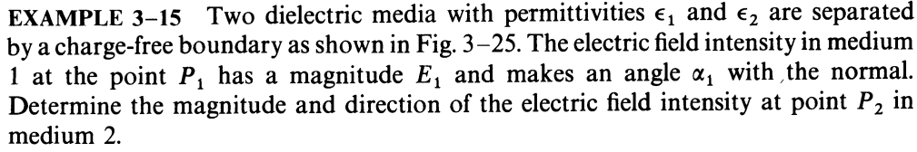
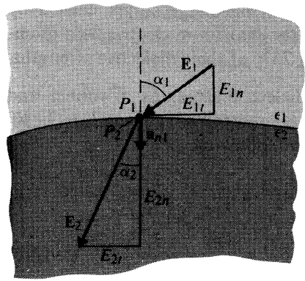
Solution: there is no free charge on the surface, from the boundary condition
Q: Whether ε₁ is large or smaller than ε₂?

Slide 8
Boundary conditions of electrostatic potential (arbitrary electrostatic field)
Typical conditions for electrostatic field
The interface between two perfect medium (No free charge ）
On the surface of conductors
constant ，

Slide 9
Ex Two infinite grounded conductor planes are located at x=0 and x=a, there is a uniformly charged plane at x=b with surface charge density of . Find the electric potential and electric field intensity between these two plane.
Solution:
y
o
b
a
x
Two infinite plane
So

Slide 10
Determine the coefficient
Applying the B.C.
So

Slide 11
3.10 Capacitance and Capacitors
A conductor in an electrostatic field is an equipotential body.
Suppose the potential due to a charge Q is U. Increasing the total charge will increase the potential as well;
The ratio Q/U remains unchanged.
Capacitors can have advantage such as Storage, filtering, phase shift, blocking, bypass, frequency selection etc.
Capacitors can have disadvantage such as electromagnetic compatibility problems

Slide 12
12
Capacitance
Isolated conductor capacitance
Capacitance of the capacitor composed of two conductors
Conductors form part of the capacitor system in a multi-conductor system

Slide 13
13
The factors to determine
The capacitance
Depends on the structure, size, shape and the surrounding dielectric of the conductor system.
Independent to the charge and the electric potential of the conductor.

Slide 14
14
Method for solving capacitance
（Electrical capacitance is independent of the charge quantity and potential of the conductor）
Method One ：
Method two：
Assume charge q /±q of the conductor/ between two conductors
Find the potential / voltage of the conductor/ between two conductors
Assume the potential / voltage of the conductor/ between two conductors
Solve the charge q on the conductor surface .
According to the
definition for capacitance

Slide 15
15
Ex: Concentric spherical capacitor with inner conductor radius of a and outer conductor radius of b, homogeneous medium with ε Find the Capacitance of the spherical capacitor.
Solution：Charge q ，according to Gauss theorem
The voltage between the concentric conductor:
Capacitance:
Capacitance for Isolated conductor ball

Slide 16
Ex: Coaxial line with inner conductor radius a and outer conductor radius b, a dielectric of permittivity εis filled up in between. Find the capacitance per unit length.
16
Solution: assume the line charge density is and for the inner and outer conductor, applying Gauss’s Law and the electric field between two conductor is:
Potential difference between inner and outer conductor
Coaxial line
the capacitance
per unit length:

Slide 17
Ex: The parallel dual-transmission line with the conductor radius of a, and distance of D (D >> a ), find the capacitance per unit length of this system
17
Solution: assume the line charge density is and for two conductors, since D >> a , the charge is considered to be uniformly distributed on the surface, and the electric field between two conductor is:
Potential difference between two conductors is:
the capacitance
per unit length:

Slide 18
3.11 Electrostatic Energy
Under the influence of electrostatic fields, a positively charged body will be moved along the direction of the electric field. In this case, work is being done by the field.
In order to do this work the electrostatic field must lose energy, implying that the electrostatic field has stored energy.
If the charged body is moved into the electrostatic field from infinity by an applied force, work is being done against the electric force.
This work will become part of the energy stored in the field, and the total energy of the electrostatic field will be increased.

Slide 19
The total energy stored in an electrostatic field can be determined from the work done to assemble the charges giving rise to the field.
Calculate the energy of an isolated body with charge Q. Assuming that the charge Q was moved in from infinity.
Since there was no field in space at the beginning, the applied force did not need to do the work to move in the first element dq.

Slide 20
When the second element dq was moved in, the applied force had to do the work against the electric field.
If the electric potential at the charge is ϕ , then the work by the applied force is ϕ dq . Hence, the increment in the energy of the electric field is ϕ dq.
The electric potential of a charged body will be increased gradually as more charge is brought in. When the charge is increased to the final value Q, the total work by the applied force is given by

Slide 21
The electric potential ϕ of an isolated conductor is equal to the ratio of the charge q to the capacitance C, i.e.
We find the energy of the isolated conductor with the charge Q is
or
The total energy of n charged bodies can be calculated, in the same way assuming the charges of all charged bodies are increased by the same ratio from zero.

Slide 22
Let the final electric potential of the i-th body be Φ_{i} and the final charge on it be Q_{i}. At the moment when the charge of the i-th body is increased to , the electric potential of the charged body is then .
In this way, when the charges of all bodies are increased by the same ratio α, the work by the applied force, and hence the incremental electrostatic energy of the charged system is
When the charges of all bodies are increased to the final values
, the total energy of the system is given by
We have

Slide 23
If the charge is distributed in a volume, on a surface, or at a line, considering , then the total energy of the body with the distributed charge can be written accordingly as
Where ϕ is the electric potential at the element volume dV, the element surface dS, or the element line dl , respectively.
From the point of view of the field, the electrostatic energy is distributed in the entire space where the electric field is found. We now discuss how to calculate the energy density of electro-static field.
The energy density of electrostatic field is denoted by small letter character w_{e}.

Slide 24
Suppose the charges distributing in volume V is Q.
Integral will be unchanged if the integral is in a infinite sphere
We can see that the energy density of the electrostatic field is

Slide 25
For linear isotropic dielectrics, , we have
The energy of an electrostatic field is proportional to the square of the magnitude of the field intensity. Consequently, the energy does not obey the principle of superposition.
The total energy is not equal to the sum of their energies when they exist on their own.
Reason: When the second charged body is introduced, work needs to be done against the electric field due to the first charged body, and this work done becomes the energy stored in the field. This energy is called mutual energy, while the energy is called self energy when the charged body is alone.

Slide 26
Calculated by potential
Distribution of Body Charge
Distribution of plane Charge
Storage of Capacitor energy
—— Charge of the i conductors
Where:
—— potential of the i conductors

Slide 27
Calculated by distribution
energy density of electric field ：
Total energy of electric field ：
Integral region is the whole space of the electric field
For linear and isotropic medium

Slide 28
Ex. Find the energy of a conducting sphere with radius a and charge Q. The permittivity of the dielectric around the conductor is ε .
Solution: Three methods can be used.
(1) The electric potential of a conducting sphere with radius a and charge Q is
We find
(2) Since the surface of a conductor is an equipotential surface, and

Slide 29
(3) The electric field intensity caused by a conducting sphere with charge Q is
And the energy density is
Integrating over the region outside the conductor gives
Three results above are in agreement !

Slide 30
Homework
3-11, 3-12, 3-22, 3-25, 3-33, 3-37

