Slide 1
Chapter 4 Solution of Electrostatic Problems
Wuqiong Luo

Slide 2
Classification and analysis for solving electromagnetic problems
According to the change of time
Static electromagnetic field
Electromagnetic wave
Chapter
3,4,5,6
Chapter
7, 8,9,10,11

Slide 3
Classification analysis to solve the problem of static electromagnetic field
According to the types of field
Static electric field
Static magnetic field

Slide 4
Static electric field problems
Starting from
Conditions
Maxwell equations
Constitutive relations
boundary conditions
Classification according to the charge static or motion
Static
Arbitrarily
Uniform motion
Finite
Electrostatic field
Steady current field

Slide 5
Contents
4.1 Introduction
4.2 Poisson’s and Laplace’s Equations
4.3 Uniqueness of Electrostatic Solution
4.4 Method of Images
4.5 Boundary-Value Problems in Cartesian Coordinates

Slide 6
4.1 Introduction
Problems of electrostatic field: electric potential, electric field intensity, and electric charge distribution.
If the charge distribution is given, the electric field intensity and the electric potential can be found by

Slide 7
In many practical problems the exact charge distribution is unknown (with conducting boundary).
When the conducting bodies have boundaries of a simple geometry, the method of images may be used.
Differential equations must be solved subject to the appropriate boundary conditions. These are boundary-value problems.

Slide 8

4.2 Poisson’s and Laplace’s Equation
The two fundamental governing equations for electrostatics are
The electric potential is defined such that

Slide 9

The differential equation of ϕ
In a simple medium: linear and isotropic, ε is a constant.
Scalar poisson equation
Charge
Sub-1
When，
Sub-2
Laplace equation
Cartesian
Coordinates:

Slide 10
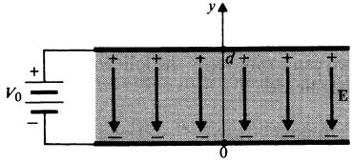
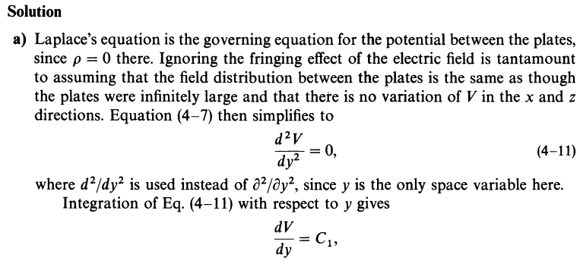

Ex. The two plates of a parallel-plate capacitor are separated by a distance d and maintained at potentials 0 and V₀. Assuming negligible fringing effect at the edges, determine (a) the potential at any point between the plates, (b) the surface charge densities on the plates.

Slide 11
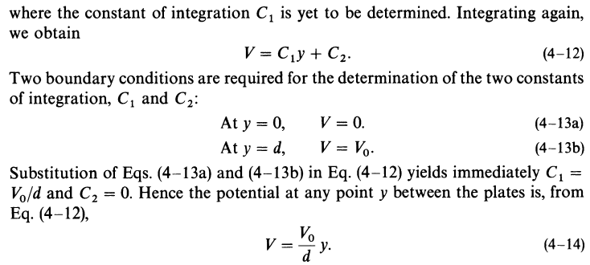
The potential increases linearly from y=0 to y=d

Slide 12
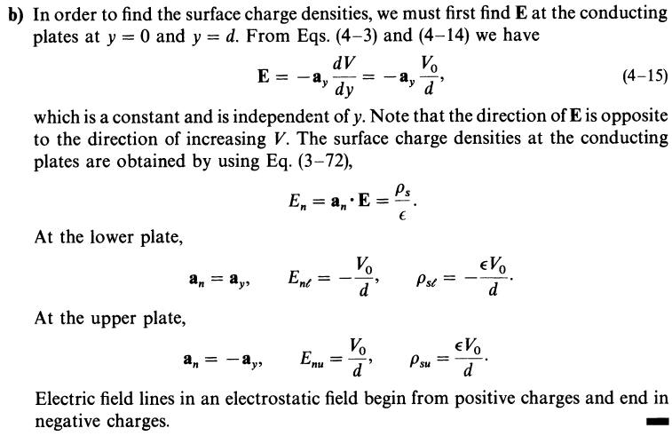

Slide 13
13
Solving boundary-value problems ：
Description of boundary value problems
Solution of boundary value problem:
Method of images
Method of Separation of variables
Finite difference method
……..

Slide 14
4.3 Uniqueness of Electrostatic Solutions
There may be more than one method for one problem.
Will these methods obtain different solutions?
The uniqueness theorem
A solution of Poisson’s equation (of which Laplace’s equation is a special case) that satisfies the given boundary conditions is a unique solution.
The implication of the uniqueness theorem is that a solution of an electrostatic problem satisfying its boundary conditions is the only possible solution, irrespective of the method by which the solution is obtained.

Slide 15
The uniqueness theorem
Keep the equations of unknowns unchanged in the solution domain V; at the same time, keep the boundary value of or unchanged on the boundary surface S ; then the solution of the Poisson’s equations or the Laplace’s equations in the solution domain V is unique
The importance of uniqueness theorem
V： solution domain
S：Surface is surrounded by V
Give the condition of the boundary-value problems with a unique solution.
Provide a theoretical basis for solving the field problems with different methods
Provide a criterion for the correctness of the solution.

Slide 16
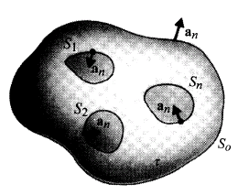
Suppose a volume τ is bounded outside by a surface S₀.
Inside the closed surface S₀ there are a number of charged conducting bodies with surfaces S₁, S₂, S₃,…., S_{n} at specified potentials.
Now assume that there are two solutions, V₁ and V₂ to Poisson’s equation in τ,
Prove

Slide 17

Also assume that both V₁ and V₂ satisfy the same boundary conditions on S₁, S₂, S₃,…., S_{n} and S₀. Define a new differential potential:
We see that V_{d} satisfies Laplace’s equation in τ.
Recalling the vector identity,
and letting f = V_{d} and A = grad V_{d}; we have

Slide 18

where the first term on the right side vanishes. Integration of the Eq. over the volume τ yields
where surface S consists of S₀ as well as S₁, S₂, S₃,…., S_{n}. Over the conducting boundaries, as well as over the large surface S₀, V_{d} = 0. We have
Since the integrand is nonnegative everywhere,
V_{d} = 0 throughout the volume.

Slide 19
4.4 method of Images
4.4.1 The basic principle of image method
4.4.2 Point charge and conducting planes
4.4.3 Point charge and conducting sphere
4.4.4 Line charge and conducting cylinder

Slide 20
4.4.1 The basic principle of image method
1. Introduce the questions
Several examples
A point charge near the grounded conducting plane.
No uniformly induced surface charge
q
Equivalent charge
q′

Slide 21
A point charge near the grounded conducting sphere.
Equivalent charge
q′
q
Non-uniformly induced charge
A line charge near the grounded conducting cylinder, which is similar with the one above, but the equivalent charge is line charge。
Question: ：Does this equivalent charge exist?
Is this equivalent method reasonable?

Slide 22
2. Principle of the method of image
Essence: The effect of the boundary is replaced by one or several equivalent charges, and the original inhomogeneous region with a boundary becomes an infinite homogeneous space.
Key：To determine the number, the positions and the values of the image charges.
Restriction：These image charges may be determined only for some special boundaries and charges with certain distributions.

Slide 23
2. Principle of the method of image
Purpose: Change the complex boundary-value problem into the problem with infinite single medium space.
Basis：The principle of uniqueness. Therefore, these charges should not change the original boundary conditions. These equivalent charges are at the image positions of the original charges, and are called image charges, and this method is called the method of images.

Slide 24
3. The key points of the application of image method
Determination of the image charge
The number, position and value of the image charge
——"Three key elements"
Explicit “the effective field” of equivalent solution
4. Two principles of determining image charge
The image charge must be located outside the solution domain
The choice of the number, the position and the charge quantity of the image charge is to keep the boundary conditions of the problem unchanged.

Slide 25
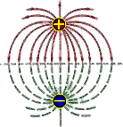
4.4.2 Point charge and conducting planes
1. The image of the point charge on an infinite grounded plane conductor
q
Effective domain
q
The image charge
The potential functions
When z = 0，
It satisfies the original boundary value problem, and the result is correct!

Slide 26

Solving the induced surface charge density and the total induced charge of the grounded conducting plane
The induced surface charge density in the conductor plane is
q
The total induced charge on the conducting plane is

Slide 27
2. The image of the line charge on an infinite grounded plane conductor
Boundary
Value
Effective
domain
The images of line charge ：
The potential functions ：
It satisfies the original boundary value problems ,The results are correct！
When z = 0 ，

Slide 28
3. The image of point charge between the Intersecting semi-infinite grounded conducting plane
q for plane 1:
The image charge is q₁=－q，located at(－d₁, d₂ )
q for plane 2:
The image charge is q₂=－q， located at( d₁, －d₂ )
1
d₁
ε
d₁
q₁
q
q₁ for plane 2 and q₂ for plane 1:
The image charge is q₃=q， located at( -d₁, －d₂ )
R₁
R
d₂
d₂
2
The solution of the potential function is ：
R₃
R₂
d₂
d₂
q₂
q₃
d₁
d₁

Slide 29
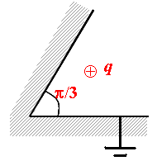
For the semi-infinite wedge conducting boundary, the method of images is also applicable. However, the images can be found only for conducting wedges with angle given by where n is an integer. In order to keep the wedge boundary at zero-potential, 2n-1 image charges are required.

⊕
q
⊕
π/3


⊕
When an infinite line charge is nearby an infinite conducting plane, the method of images can be applied as well, based on the principle of superposition.

Slide 30

Ex: The distance between a point charge q and an infinite conducting plane is d ，If moves it to infinity, how much work needs to be done?
x
Solution：
q
ε₀
d
-d
σ =∞
q'

Slide 31
4.4.3 Point charge and conducting sphere
1. The image of the point charge in the grounded conducting sphere
P
r
R
a
q
d
Question：
Method: ?
P
r
R
Boundary conditions！
R'
q
a
q'
d'
d

Slide 32
P
a
R
R'
q
O
q'
Constant
d'
d
Position of the image charge
Charge of the image charge

Slide 33
Find the induced surface charge density and the total induced charge on the conducting sphere
The induction surface charge density on the sphere is
The total induced charge on the conducting sphere is
The total induced charge on the surface of the conducting sphere is equal to the image charge of placement.

Slide 34
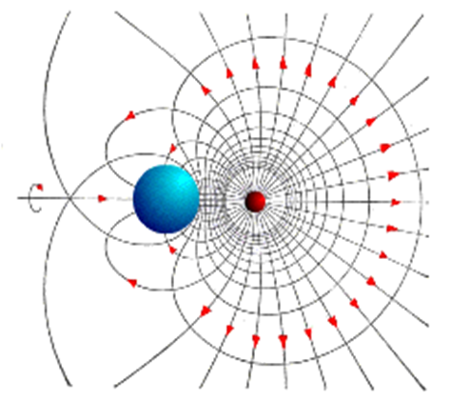
Electric Field for a point charge located near a grounded conductor sphere.

Slide 35

The image charge of a point charge located inside the grounded hollow conducting spherical shell
a
a
r
R'
b
R
O
o
q
q
q'
d
d
| q'|>|q|
It has nothing to do with the outer radius b （Why？）
d'

Slide 36
Find the induced charge density and the total induced charge on the inner surface of the conductor spherical shell
The induced surface charge density is ：
The total induced charge on the inner surface of the conducting spherical shell is
Is equivalent charge always equal to the total of induced charge ？
NO！

Slide 37
2 . The image of point charge on the ungrounded conducting sphere
P
The ungrounded conducting sphere ：
r
R
An non-zero equal potential body.
q
a
The total induced charge on the spherical surface is zero.
O
d
The surface distribution of the induced charge is ：
Is negative charge distribution the same as the grounded sphere？
Is positive charges uniformly distributed?
P
r
R
q"
R'
q
a
O
q'
d
d'

Slide 38
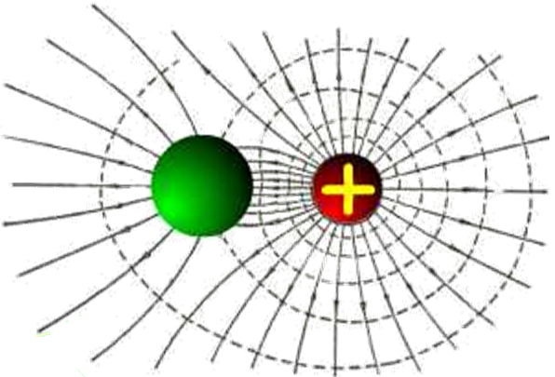
Electric Field for a point charge located near an ungrounded conductor sphere.
Electric Field for a point charge located near a grounded conductor sphere.

Slide 39
4.4.4 Line charge and conducting cylinder
P
a
r
O
-ρ_{l}
ρ_{l}
d
f
An image line charge is put in to represent the charge on the cylinder and placed parallel to it, at a distance d from the axis.
The electric field intensity produced by an infinite line charge of density given by
The electric potential with respect to a reference point at a distance r from the line electric charge is

Slide 40
If is also taken as the reference point for the electric potential produced by the image line charge , then and produce an electric potential at a point P on the surface of the cylinder given by
Since the conducting cylinder is an equipotential body, in order to satisfy this boundary condition the ratio must be a constant.
Let , we find

Slide 41
Using image method to solve the problems
1. Grounded conducting plane
2. Grounded conducting sphere (including the inside and outside of the sphere)
3. Ungrounded conducting spherical (including the inside and outside of the sphere)
Question：
Find the potential function of area with a point charge on the ungrounded infinite conducting plane ？

Slide 42
Analysis method summary
Methods have been learned and we can solve the problems
1. The problem of infinite single medium space （ 1D,2D,3D problems)
Field—source directly integration method
Integral equation method （Integral form of the Maxwell’s equations ）
Differential equation method (differential form of Maxwell’s equations, Poisson’s equations)
2. Single / non-single medium space problem (1D problems)
Gauss's law and Ampere's Law (the integral equation is simplified to the algebraic equation)
Poisson’s equations (partial differential equation is simplified to ordinary differential equation).
3. Higher dimensional problems in non-single medium space
√ The method of images

Slide 43
Boundary-value problem:
In the given boundary conditions, the solution of the Poisson's equations or Laplasce's equations
Solving boundary value problems ：
Description of boundary value problems
Solution of boundary value problems

Slide 44
4.5 Boundary-Value Problems in Cartesian Coordinates
Method of image is useful in solving problems involving free charges near conducting boundaries that are geometrically simple.
Problems consists of a system of conductors maintained at specified potentials and with no isolated free charges, requires the solution of Laplace’s equation.
Problems governed by partial differential equations with prescribed boundary conditions are called boundary-value problems.

Slide 45
Types of boundary value
The first boundary-value problems (or Dirichlet problems)
Given
The second-boundary value problems (or Newman problems)
Given
V： solution domain
S：Surface is surrounded by V
The third boundary-value problems (or mixed boundary-value problems)
Given

Slide 46
Natural boundary condition（open space）
Requirements：master the mathematical description method to solve complex problems with the idea of boundary-value problems

Slide 47
Ex：
（ The first boundary value problems ）
Ex:
（ The third boundary value problems ）

Slide 48
Different specified boundary conditions will require the choice of different potential functions, but the procedure of solving these types of problems is the same-the method of separation of variables;
The solutions of Laplace’s equation are called harmonic functions.

Slide 49
The basic principle of method of separation of variables
Method of Separation of variables is a general method to solve boundary-value problems
The basic idea of method of separation of variables ：
The dependency relation of the unknown function on several variables (high dimension problem) is changed into Separate dependent relations of each variable (variables can be separated), so that high dimensional problem can be transformed into one dimensional problem.
The theoretical basis of the method of separation of variables is uniqueness theorem

Slide 50
In rectangular coordinate system, Laplace’s Equation for electric potential is
Let
Substituting it into the above equation, and dividing both sides by X(x)Y(y)Z(z), we have
Where each term involves only one variable. The only way the equation can be satisfied is to have each term equal to a constant.
Let these constants be , and we have

Slide 51
where k_{x} ，k_{y} ，k_{z} are called the separation constants, and they could be real or imaginary numbers.
The three separation constants are not independent of each other, and they satisfy the following equation
The three-dimensional partial differential equation is separated to three ordinary differential equations, and the solutions of the ordinary differential equations are easier to obtain.
The solution of the equation for the variable x can be written as
or
where A, B, C, D are the constants to be determined.

Slide 52
The separation constants could be imaginary numbers. If is an imaginary number, written as , then the equation becomes
or
The solutions of the equations for the variables y and z have the same forms. The product of these solutions gives the solution of the original partial differential equation.
It is very important to select the forms of the solutions, which depend on the given boundary conditions.
The constants in the solutions are also related to the boundary conditions.

Slide 53
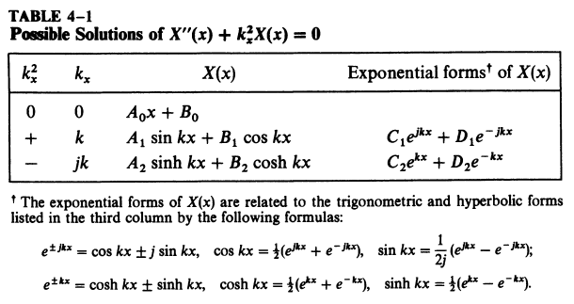

Slide 54
In the Cartesian coordinate system， If the potential function has nothing to do with Z ， then the Laplace’s equations is
The ϕ (x, y) is expressed as the product of two one-dimensional functions X( x ) and Y( y ) ，that is
It will be substituted into the Laplace’s equation ，then
Then divided by X( x ) Y( y ) ，next
Separation
constant

Slide 55
Ifλ＝－k² ，then
When
when

Slide 56
If all possible ϕ (x, y) are linearly superimposed., we can get a general solution of the potential functions，that is
Separation constant and undetermined coefficients in the general solution is determined by the given boundary conditions.
If λ＝k² ,Similarly , we can get that

Slide 57
Ex: A cover plate is on the infinite rectangular mental conductor slot, which are isolated with each other. The potential of the cover plate is U0, mental conductor slot is grounded. Find the potential distribution in the conductor slot.
Solution：
Since ϕ (0 , y)＝0、 ϕ (a , y)＝0，So the general solution is

Slide 58
Determinate the coefficient

Slide 59
Expand the U₀ using as Fourier series on (0,a)
where

Slide 60
then
So:

Slide 61
Ex: Two semi-infinite, grounded conducting planes are parallel to each other with a separation of d. The finite end is closed by a conducting plane held at electric potential ϕ ₀ , and is isolated from the semi-infinite grounded conducting plane with a small gap. Find the electric potential in the slot constructed by the three conducting planes.
y
ϕ = 0
ϕ = ϕ₀
d
O
x
ϕ = 0
Solution: Select rectangular coordinate system. Since the conducting plane is infinite in the z-direction, the potential in the slot must be independent of z, and this is a two-dimensional problem. The Laplace’s Equation for the electric potential becomes

Slide 62
Using the method of separation of variables, and let
The boundary conditions for the electric potential in the slot can be expressed as
In order to satisfy the boundary conditions and
, the solution of Y(y) should be selected as
From the boundary condition , we have ϕ = 0 at y = 0 , and the constant B = 0. In order to satisfy , the constant k_{y} should be

Slide 63
We find
Since ，we obtain
The constant k_{x} is an imaginary number, and the solution of X(x) should be
Since ϕ → ∞ at x = 0 , the constant C = 0, and
Then
Where the constant C = AD .

Slide 64
Since ϕ = ϕ ₀ at x = 0 , and we have
The right side of the above equation is variable, since C and n are not fixed. To satisfy the requirement at x = 0, one needs to take the linear combination of the equation as the solution, leading to
In order to satisfy the boundary condition x = 0, ϕ = ϕ₀ , and we have

Slide 65
The right side of the above equation is Fourier series. By using the orthogonality between the terms of a Fourier series, the coefficients C_{n} can be found as
Finally, we find the electric potential in the slot as
y
ϕ = 0
Electric field lines
ϕ = ϕ₀
d
Equipotential surfaces
0
x
ϕ = 0

Slide 66
Summary
Uniqueness: a solution of an electrostatic problem satisfying its boundary conditions is the only possible solution, irrespective of the method by which the solution is obtained.
Method of Images: when the conducting bodies have boundaries of a simple geometry, the method of images may be used.
Boundary-Value Problems: three types, correctly describe;
Method of separation of variables: transform the high dimensional problem into one dimensional problem

Slide 67
Homework
4-1, 4-6, 4-7, 4-14, 4-15, 4-21

