Slide 1
Chapter 6 Static Magnetic Fields
Wuqiong Luo

Slide 2
Contents
6.1 Fundamental Postulates of
Magnetostatics in Free Space
6.2 Vector Magnetic potential
6.3 The Biot-Savart Law and Applications
6.4 Magnetization and Equivalent Current Densities
6.5 Magnetic Field Intensity and Relative Permeability
6.6 Boundary Conditions for Magnetostatic Fields
6.7 Inductances and Inductors
6.8 Magnetic Energy

Slide 3

6.1 Fundamental Postulates of Magnetostatics in Free Space
When a small test charge q is placed in an electric field E, it experiences an electric force F_{e}, which is a function of the position of q.
When the test charge is in motion in a magnetic field, it experiences another force F_{m}, magnetic force, which is expressed as
where v is the velocity vector, and the magnetic flux density B is measured in webers per square meter (Web/m²) or teslar (T).
The total electromagnetic force on a charge q is called Lorentz’s force equation.

Slide 4
Fundamental Postulates of Magnetostatics in Free Space
The two fundamental postulates of magnetostatics are
where µ₀ is the permeability of free space:
J is the current density. Since the divergence of the curl of any vector field is zero, we obtain
which is consistent with the equation of continuity.

Slide 5
Equations for Steady Magnetic Fields in Free Space (integral form)
Ampere’s circuital law
circulation of the magnetic flux density in free space around any closed path is equal to µ₀ times the total current flowing through the surface bounded by the path.
where μ₀ is the permeability of vacuum, and I is the current enclosed by the closed curve.

Slide 6
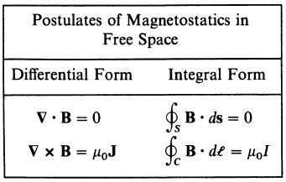
1. The total magnetic flux through a closed surface is equal to zero.
2. The magnetic field lines are closed everywhere, with no beginning or end. This may be called the principle of magnetic flux continuity.
Summary

Slide 7
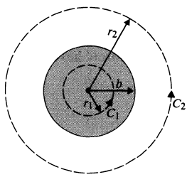
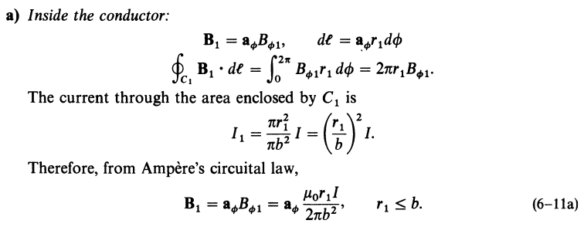
Ex: An infinitely long, straight conductor with a circular cross section of radius b carries a steady current I. Determine the magnetic flux density both inside and outside the conductor.
Example
Solution：

Slide 8
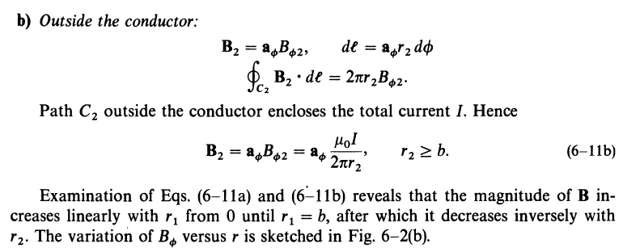
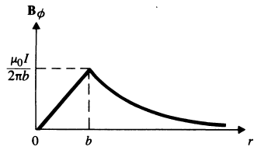

If it is not a solid cylindrical conductor but a very thin circular tube carrying a surface current density Js, then it is obvious:
Magnetic flux density of an infinitely long circular conductor carrying a current I

Slide 9

6.2 Vector Magnetic Potential
The divergence-free postulate of B, assures that B is solenoidal.
As a consequence, B can be expressed as the curl of another vector field, say A, such that
The vector field A so defined is called the vector magnetic potential.
The definition of a vector field requires the specification of both its curl and its divergence.
How do we choose divergence of A?

Slide 10
How to find out the potential function?
1. Definition of vector magnetic potential
is called vector magnetic potential or Magnetic vector potential.
Advantage: The divergence of the magnetic vector potential can be chosen arbitrarily.
Usually specified in a steady magnetic field ，called Coulomb gauge 。

Slide 11
2. Differential equations of magnetic vector potential (general problems)
Vector Poisson’s equation
In the source free area ：
Vector Laplace’s Equation

Slide 12

3. The problems in infinite uniform medium space (special problems)
The analogy method to solve

Slide 13
Ex. Find the magnetic vector potential of an infinite long line carrying current I long z axis.
Solution: the magnetic vector potential for 2L line, current element to , the
z
L
y
x
-L
The magnetic vector potential for

Slide 14
6.3 The Biot-Savart Law and Applications
Steady magnetic field：Magnetic field generated by DC (constant current)
Key Features: The field has the effect on the current element located in a magnetic field。
1. Ampere’s force law
Practice：

Slide 15
2. Magnetic flux density
According to Ampere’s force law
Biot-Savart Law
which： is independent of I₂ ，we call it magnetic flux density generated by I₁ ，and its unit is T。
Magnetic flux density generated by current element
Line current element
Surface current element
Volume current element

Slide 16
Magnetic flux density produced by arbitrary current loop C
Magnetic flux density produced by surface current
Magnetic flux density produced by volume current

Slide 17
3. Magnetic flux densities of several typical current distributions
The magnetic flux density of current carrying line segment ：
（ Finite long）
line segment carrying
current
（Infinite long ）
Magnetic flux density on the axis of current carrying circular ring ：
circular ring carrying current

Slide 18
Ex. Calculate the magnetic flux density at arbitrary point at the center of the circular ring.
Solution： Establish a best coordinate system ,as shown in Figure .
For the magnetic flux density at arbitrary point on the axis P (0, 0, z ), because：
so
So： Magnetic flux density at P ( 0, 0, z ) is
Current carrying ring

Slide 19
for ，so
Discussion
Why the magnetic field at P only has Z component ？
Where is the maximum magnetic flux density ?
At the center of the ring ，as z = 0：
What about the far field？（When z >> a ）

Slide 20
Divergence and curl of steady magnetic field
Divergence of constant magnetic field （ Differential form ）
Principle of continuity of magnetic flux （ Integral form ）
Curl of constant magnetic field （ Differential form ）
Ampere circuital law
（ Integral form ）
Conclusion：
A steady magnetic field is a solenoidal and rotational field,
which is a non-conservative field
Current is the vortex source of the magnetic field
The magnetic flux line is a closed curve with no start
and end point

Slide 21
Laws and methods of steady magnetic field to the methods of analyzing problems
Laws
Methods
Current sources
Known current distribution, solve the distribution of magnetic field
Superposition principle
Vortex source of the magnetic field
Known the distribution of magnetic field
Conduct differential operation
Known current distribution
Solving differential equations
The circulation of the magnetic field is proportional to the current
Known magnetic field distribution, solve its circulation
Solving integral equations
Known current, solve its magnetic field
Solving integral equations

Slide 22
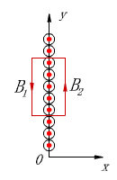
A simple way to solve magnetic flux density
--using Ampere's circuital law
Condition： Problem has symmetry ， The integral equation can be transformed to algebraic equation ！
Example: When surface current density is ,find magnetic
flux intensity produced by infinite current sheet.
Solution： Establish a best coordinate system
so ：
Based on the symmetry, the loop integral is:

Slide 23
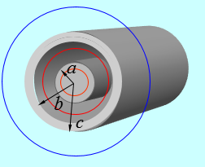
Ex. Find the magnetic flux density of the infinite long current carrying coaxial cable.
Solution:
Choose cylindrical coordinate system
，so
Choose ampere loop ，the current of the cross link is
Applying Ampere's circuital law

Slide 24
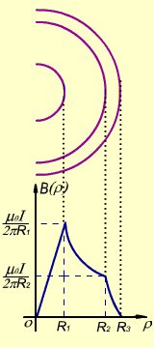
Applying Ampere's circuital law

Slide 25
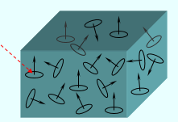
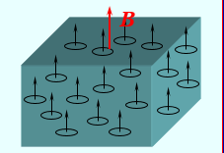
6.4 Magnetization and Equivalent Current Densities
1. Magnetization of medium
Conclusion
1） Under the effect of external magnetic field, the magnetic moments of the medium molecules are oriented, resulting in the magnetic phenomenon (showing magnetism).
2） The magnitude of the magnetization is determined by the number of magnetic moment in the medium.
Definition of magnetic moment
No external magnetic field
External magnetic field applied

Slide 26
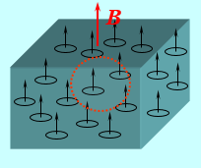
2. Magnetization vector
Definition： Sum of the magnetic dipole moment per unit volume of the medium, that

Slide 27
Discussion
1） When the medium has no external magnetic field
2） With external magnetic field
There, n is the number of magnetized molecules in the unit volume
No external magnetic field
No external magnetic field

Slide 28
Conclusion
1） The magnitude of the magnetization vector is related to the dielectric material
2） The magnitude of the magnetization is also related to the intensity of the applied field
After the medium is magnetized, extra magnetic field will be generated in the space
The total magnetic field in the medium inside and outside space is
Experimental results：
For linear and isotropic media ， is proportional to ，that
where，
is called as the magnetic susceptibility of the medium

Slide 29
Magnetic flux density on the axis of the current carrying circular ring ：
Circular ring carrying I

Slide 30
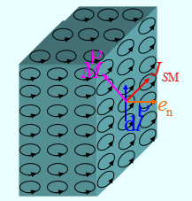
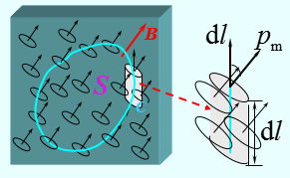
Further discussion on magnetization phenomenon
After medium is magnetized, net current distribution could appear internally ,that is the generation of volume magnetization current.
After medium is magnetized ，net current distribution could appear at interface of medium, that is the generation of surface magnetization current .

Slide 31
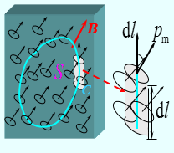
Calculation of volume magnetic current density
Calculation Principle ：
As，
so，
Calculation of surface magnetic current density
At the interface of media ：
As，
so，

Slide 32
Question： When magnetized current exist, additional magnetic field will be generated and affect the total magnetic field distribution. Then when we calculate the total field, is it necessary to calculate the magnetic field generated by the magnetic current in advance?

Slide 33
6.5 Magnetic Field Intensity and Relative Permeability
The macroscopic effect of magnetization can be studied by incorporating the equivalent volume current density.
Introduce magnetic field intensity:
, so
then
The integral form is

Slide 34
Conclusion
When there are medium in space ，the problems of steady magnetic field can be described by the following basic equations.
（ Differential form ）
（integral form）
The process of solving the problems can use following route ：
,
,

Slide 35
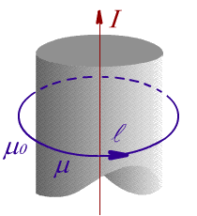
Ex. There is an infinite conducting magnetic cylinder, with permeability of µ and radius of a ,and a line current I exist on the axis of it. Outside the cylinder is air （µ₀ ），find the distribution of B , H and M outside the cylinder.
Solution: Applying Ampere's law, then
Magnetic field intensity
Magnetic flux density
Magnetization intensity

Slide 36
Classification and constitutive relation of magnetic medium
Classification :
Diamagnetic substance
Paramagnetic substance
Ferromagnetic substance
Water：0.99999
Air： 1.0000004
Iron： 4000
Constitutive relation :
Magnetic susceptibility
(dimensionless)
Magnetic permeability
Relative magnetic permeability
(dimensionless)

Slide 37
6.6 Boundary Condition for Magnetostatic Fields
1. Magnetic flux density B
Choose a point P on the interface, make a cylindrical surface S enclosed the point P
Sub1
S
P
Sub2
Since Δh →0，then
So
Or

Slide 38
2. Magnetic field intensity H
Choose the closed path as the contour C at the both sides of the interface, SinceΔh →0，then
Sub1
So
Sub2
Or

Slide 39
Two perfect dielectric
Perfect dielectric and perfect conductor

Slide 40
Boundary conditions of Magnetic vector potential

Slide 41
Ex. The air between two conductor plate (z = 0 and z = d) , the electric field intensity is known as
Find: (1) Magnetic field intensity H ；
(2)The surface current density Js.
Solution (1) As

Slide 42
Calculate the time integral of above equation
（2） The current density of the conductor surface at z = 0
The current density of the conductor surface at z = d

Slide 43
6.7 Inductances and Inductors
1. Magnetic Flux and Flux linkage
Φ
Magnetic Flux (磁通)
loop
C
Features: the circuit can be any geometric loops
Flux linkage (磁链)
Total flux of all current loop hinges
Ψ
current loop
Features：
The loop is current loop
Include all the current loops
Each loop includes the total magnetic flux linkage of the hinge
I
C
I

Slide 44
Magnetic flux calculation
Ψ
Single turn coil
thin loop
C
I
Multi turn coil
n: is the ratio the current of the magnetic field hinge to the current of the circuit current I（ Not necessarily integer ）
Ψ_{o}
Ψ_{i}
thick loop
C
I
Thick wire loops
Ψ_{o} : External magnetic flux ；Ψ_{i} :Internal magnetic flux

Slide 45
2. Self-inductance
Ψ_{o}
Ψ_{i}
Thick loop
called the self inductance coefficient of circuit C, short for self-inductance 。
C
I
Features: the magnetic flux is generated by I.
Self-inductance of thick conductor loop ：
L = L_{i} + L_{o}
—— Internal self inductance ；
—— External self inductance ；
The characteristics of self-inductance：
self-inductance is related to geometry of loops , size and the surrounding magnetic medium, and not related the value of the magnetic flux and current 。

Slide 46
3. Mutual inductance
C₂
C₁
I₁
Mutual inductance coefficient of loop C₁ to loop C₂ ,short for mutual inductance 。
I₂
Features: the magnetic flux in the C₂ is generated by I₁
The total flux in the C₁ :Ψ_{1总} =Ψ₁+Ψ₁₂
The total flux in the C₂ :Ψ_{2总} =Ψ₂ +Ψ₂₁
Similarly, the mutual inductance of the loop C₂ to the loop C₁ is
Features: the magnetic flux in the C₁ is generated by I₂
Question ： Ψ_{1total} =？； Ψ_{2total} =？
Neumann’s formula

Slide 47
4. Proof of the Newman’s formula
C₁
C₂
I₁
I₂
And：
R
o
Then：
Newman’s formula
So：
Similarly：

Slide 48
Ex. Find the slef-inductance for coaxial line。
Solution：find the internal self-inductance first
so
Magnetic Flux for surface element at ρ
Flux linkage:

Slide 49
Total flux linkage in inner conductor is
internal self-inductance per unit length
Find the external self-inductance between two conductors
so
External self-inductance per unit length
Total self-inductance per unit length

Slide 50
Ex. Find the self-inductance per unit length of a two-wire transmission line.（D >> a ）
Solution: Applying Ampere’s circuital law and superposition
I
I
P
External flux linkage，
External self-inductance per unit length:

Slide 51
internal self-inductance per unit length for two wires
The total self-inductance per unit length of a two-wire transmission line

Slide 52
Ex. Calculate the mutual inductance between an infinitely long straight line and a rectangular coil. The line and the coil are at the same plane, and in vacuum.
z
Solution: Select cylindrical coordinate system, and let the infinitely long straight line to be at the z-axis. The magnetic flux density produced by current I₁ is then
b
I₁
μ₀
a
S₂
I₂
D
The magnetic flux linkage Ψ₂₁ with current I₂ by current I₁ is
r
dr
If the flowing direction of the current I₂ is clockwise, dS and B₁ have the same direction. Then
We have
If the flowing direction of the current I₂ is counter clockwise, then the B₁ and dS are opposite, and M₂₁< 0.

Slide 53
6.8 Magnetic Energy
Experimental evidence of magnetic field energy
Distribution space of magnetic field energy
Where there is a magnetic field, there is the energy of the magnetic field ！

Slide 54

1. Calculation of magnetic field energy by magnetic field distribution
Energy density of magnetic field ：
The magnetic field energy in the integral domain V
Energy of magnetic field ：
For linear, isotropic medium it can be written as:

Slide 55
2. Calculation of magnetic field energy by magnetic vector potential
Volume current distribution
Surface current distribution
Line current of a circuit loop

Slide 56
3. Calculation of magnetic field energy by inductance
Inductive energy storage
（Single current-carrying loop）：
Inductive energy storage
（N current-carrying loops ）：
For example, two loops current-carrying

Slide 57
Ex. Find the magnetic energy and self inductance in a coaxial line per unit length.
Solution：from Ampere’s circuital law

Slide 58
The magnetic energy per unit length in three area:

Slide 59
The total magnetic energy per unit length
The total self-inductance per unit length
Internal self-inductance
for inner conductor
External self-inductance
between two conductors
Internal self-inductance
for outer conductor

Slide 60
Summary
1. Basic equations (general problems):
Differential forms ：
Integral forms：
Constitutive relations：
2. Boundary conditions (general problems):
OR
3. Magnetized current density:
4. Inductance:
L = L_{i} + L_{o}
5. Magnetic energy density:
6. Magnetic energy:

Slide 61
Homework
6-4, 6-6, 6-10, 6-15, 6-22, 6-27

