Slide 2

Chapter 9 Guided Electromagnetic Waves
Hongyan Tang

Slide 3
Several wave guiding systems, Electromagnetic waves in rectangular and circular waveguides
Coaxial line，Cavity resonator
1. TEM Wave, TE Wave, and TM Wave
2. Equations for Electromagnetic Waves in Rectangular
Waveguides
3. Characterization of Electromagnetic Waves in Rectangular
Waveguides
4. TE₁₀ Wave in Rectangular Waveguides
5. Group Velocity
6. Circular Waveguides
7. Transmitted Power and Loss in Waveguides
8. Resonant Cavity
9. Coaxial Lines

Slide 4
The electromagnetic waves to be transmitted along a confined path are called guided electromagnetic waves, and the systems to transmit the guided electromagnetic waves are called the wave guiding systems.
Two-wire line, coaxial line, strip line, microstrip, and metal waveguides are often used in practice.
we will discuss the metal waveguides and the coaxial line only.

Slide 5
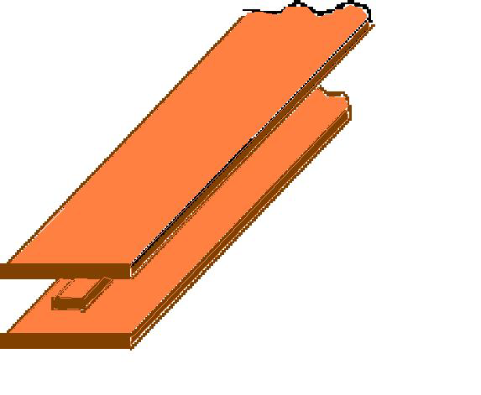
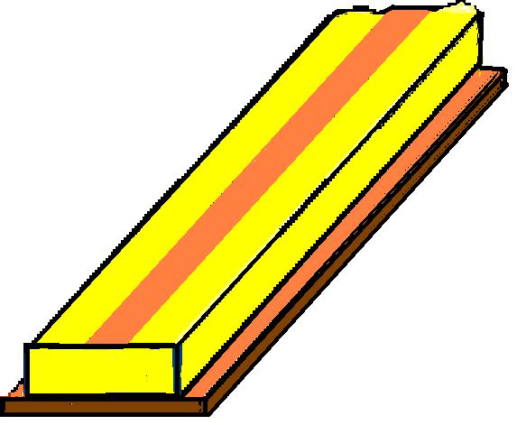
Two-wire line
Coaxial line
Rectangular waveguide
Circular waveguide
Strip line
Microstrip line
Dielectric waveguide,
Fiber optic

Slide 6
1. TEM Wave, TE Wave, and TM Wave
E
E
E
e_{s}
e_{s}
e_{s}
H
H
H
TEM wave
TE wave
TM wave
The wave guiding systems in which an electrostatic field can exist must be able to transmit TEM wave.
From Maxwell’s equations we can prove that the metal waveguide cannot transmit TEM wave.

Slide 7
The main properties of several wave guiding systems
Systems | Wave types | EM shielding | Wave band
Two-wire line | TEM wave | Poor | > 3m
Coaxial line | TEM wave | Good | > 10cm
Strip line | TEM wave | Poor | Centimeter
Microstrip line | Quasi-TEM wave | Poor | Centimeter
Rectangular waveguide | TE or TM wave | Good | Centimeter Millimeter
Circular waveguide | TE or TM wave | Good | Centimeter Millimeter
Fiber optic | TE or TM wave | Poor | Optical wave

Slide 8
The general approach to study the wave guiding systems
Suppose the wave guiding system is infinitely long, and let it be placed along the z-axis and the propagating direction be along the positive z-direction. Then the electric and the magnetic field intensities can be expressed as
where k_{z} is the propagation constant in the z-direction, and they satisfy the following vector Helmholtz equation:

Slide 9
The above equation includes six components, and
, in rectangular coordinate system, and they satisfy the scalar Helmhotz equation.
Based on the boundary conditions of the wave guiding system and by using the method of separation of variables, we can find the solutions for these equations.
From Maxwell’s equations, we can find the relationships between the x-component or the y-component and the z-component as
Where .
These relationships are called the representation of the transverse components by the longitudinal components.

Slide 10
We only need to solve the scalar Helmholtz equation for the longitudinal components, and then from the relationships between the transverse components and the longitudinal components all transverse components can be derived.
In the same way, in cylindrical coordinates the z-component can be expressed in terms of the r-component and φ–component as

Slide 11
2. Equations for Electromagnetic Waves in Rectangular
Waveguides
Select the rectangular coordinate system and let the broad side be placed along the x-axis, the narrow side along the y-axis, and the propagating direction be along the z-axis.
For TM waves, H_{z} = 0 , and according to the method of longitudinal fields, the component E_{z} should first be solved, and from which the other components can be derived.
y
b
ε ,μ
x
a
z
The z-component of the electric field intensity can be written as

Slide 12
It satisfies the following scalar Helmholtz equation, i.e.
And the amplitude is found to satisfy the same scalar Helmholtz equation, given by
In order to solve the above equation, the method of separation of variables is used. Let
We obtain
where X" denotes the second derivative of X with respect to x, and Y" denotes the second derivative of Y with respect to y.

Slide 13
The second term on the left side of the above equation is a function of y only, while the right side is a constant. The only way the equation can be satisfied is that both terms on the left side are constants.
Now let
where k _{x} and k _{y} are called the separation constants, and they can be found by using the boundary conditions.
Obviously
The two equations are second order ordinary differential equations, and the general solutions, are respectively
where all the constants C₁ , C₂ , C₃ , C₄ , and k _{x} , k _{y} , depend on the boundary conditions.

Slide 14
Since the component E_{z} is parallel to the walls, we have E_{z} = 0 at the boundaries x = 0, a and y = 0, b . Using these results we find
And all the field components are

Slide 15

(c) If m or n is zero, then ( for TM wave), and all components will be zero. Thus the m and n are non-zero integrals, and they have clear physical meanings. The value of m stands for the number of half-cycle variations of the fields along the broad side, while n denotes that for the narrow side.
(e) The modes with larger m and n are called the modes of higher order or the higher modes, and that with less m and n are called the modes of lower order or the lower modes. Since both m and n are not zero, and the lowest mode of TM wave is TM₁₁ in the rectangular waveguide.
(d) Since m and n are multi-valued, the pattern of the field has multiple forms, also called multiple modes. A pair of m and n lead to a mode, and it is denoted as the TM_{mn} mode. For instance, TM₁₁ denotes the pattern of the field for m = 1 , n = 1 , and the wave with this character is called TM₁₁ wave or mode.
(b) The plane z = 0 is a wave front. Because the amplitude is related to x and y, the TM wave is a non-uniform plane wave.
(a) The phase of the electromagnetic wave is related to the variable z only, while the amplitude to the variables x and y. Hence, a traveling wave is formed in the z-direction, and a standing wave is in the x-direction and y-direction.

Slide 16
Similarly, we can derive all the components of a TE wave in the rectangular waveguide, as given by
where , but both should not be zero at the same time.
TE wave has the multi-mode characteristics as the TM wave. The lowest order mode of TE wave is the TE₀₁ or TE₁₀ wave.

Slide 17
3. Characterization of Electromagnetic Waves in Rectangular
Waveguides
Since , or , if , then . This means that the propagation of the wave is cut off, and is called the cutoff propagation constant.
From , we can find the cutoff frequency corresponding to the cutoff propagation constant , as given by

Slide 18
The propagation constant k_{z} can be expressed as
if , is a real number, and the factor stands for the wave propagating along the positive z-direction.
If , is an imaginary number, then
which states that this time-varying electromagnetic field is not transmitted, but is an evanescent field.
For a given mode and in a given size waveguide, is the lowest frequency of the mode to be transmitted. In view of this, the waveguide acts like a high-pass filter.

Slide 19
From , we can find the cutoff wavelength corresponding the cutoff propagation constant as
The cutoff frequency or the cutoff wavelength is related to the dimensions of the waveguide a, b and the integers m, n . For a given size of waveguide, different modes have different cutoff frequencies and cutoff wavelengths. A mode of higher order has a higher cutoff frequency, or a shorter cutoff wavelength.
The cutoff wavelength of the TE₁₀ wave is 2a, and that of TE₂₀ wave is a.
TE₀₁
TE₁₀
TE₂₀
TM₁₁
The left figure gives the distribution of the cutoff wavelength for a waveguide with .
0
a
2a
λ_{c}

Slide 20
If , then the corresponding mode will be cut off. From the figure we see that if , all modes will be cut off.
If , then only TE₁₀ wave exists, while all other modes are cut off .
TE₀₁
TE₁₀
Cutoff area
If , then the other modes will be supported.
TE₂₀
TM₁₁
Hence, if the operating wavelength satisfies the inequality
0
a
2a
λ_{c}
Then the transmission of a single mode is realized, and the TE₁₀ wave is the single mode to be transmitted.
The transmission of a single mode wave is necessary in practice since it is helpful for coupling energy into or out of the waveguide.
TE₁₀ wave is usually used, and it is called the dominant mode of the rectangular waveguide.

Slide 21
In practice, we usually take to realize the transmission of the single mode TE₁₀ in the frequency band .
To support the TE₁₀ mode the sizes of the rectangular waveguide should satisfy the following inequality
The lower limit for the narrow side depends on the transmitted power, the allowable attenuation, and the weight per unit length.
In practice, we usually take and or .
As the wavelength is increased, the sizes of the waveguide must be increased proportionally to ensure the dominant mode is above cutoff. If the frequency is very low, the wavelength will be very long so that it may not be convenient for use.
Consequently, metal waveguides are used for microwave bands above 3GHz.

Slide 22
The phase velocity can be found from the phase constant as
Where . If the inside of the waveguide is vacuum, then
Since the operating frequency and the operating wavelength
, we have for a vacuum waveguide. Hence, the phase velocity does not represent the energy velocity in a waveguide.
The phase velocity depends on not only the sizes of the waveguide, the modes, and the properties of the media within the waveguide, but also the frequency. Hence, an electromagnetic wave will also experience dispersion in a waveguide.

Slide 23
Based on the relationship between the wavelength and the phase constant, we find the wavelength of the electromagnetic wave in a waveguide, , as
where λ is the operating wavelength. The quantity is called the guide wavelength.
Due to ， ，thus .
The ratio of the transverse electric to the transverse magnetic field intensities as the waveguide impedance of the waveguide. For a TM wave the waveguide impedance is

Slide 24
In the same way, we find the waveguide impedance of a TE wave as
If , , then and are both imaginary numbers. This means that the transverse electric field and the transverse magnetic field have a phase difference of . Hence, there is no energy flow in the z-direction, and it indicates that the propagation of the electromagnetic wave is cut off.
Example. The inside of a rectangular metal waveguide is vacuum, and the cross-section is 25mm×10mm. What modes can be transmitted if an electromagnetic wave of frequency enters the waveguide? Will the modes be changed if the waveguide is filled with a perfect dielectric of relative permittivity ?

Slide 25
Solution: Due to the inside is vacuum, the operating wavelength is
and the cutoff wavelength is
Then the cutoff wavelength of TE₁₀ wave is , that of TE₂₀ wave is , and that of TE₀₁ wave is . The cutoff wavelength of the higher modes will be even shorter. In view of this, only TE₁₀ wave can be transmitted in this waveguide.
If the waveguide is filled with a perfect dielectric of , then the operating wavelength is
Hence, TE₁₀ and TE₂₀ waves can be transmitted, and some other modes TE₀₁，TE₃₀，TE₁₁，TM₁₁，TE₂₁，TM₂₁ can exist.

Slide 26
4. TE₁₀ Wave in Rectangular Waveguides
Let , we find
And .
The corresponding instantaneous values are

Slide 27
The above equations are simplified as
y
E_{y}
H_{z}
z
H_{x}
λ_{g}
Where A, B, C are positive real numbers.
y
H_{z}
H_{x}
The right figure gives the distributions of the TE₁₀ wave along the z-direction and x-direction at t = 0 .
x
E_{y}
a
A standing wave is found in the x -direction, while a traveling wave is seen in the z -direction.
The amplitude of H_{z} follows a cosine function, while the amplitudes of H_{x} and E_{z} depend on x with the sine function. But all of them are independent of the variable y.

Slide 28
The electric and magnetic field lines and the currents of TE₁₀ wave .
z
y
Electric field lines
⊗
⊗
⊗
⊗
⊗
⊗
⊗
⊗
⊗
⊗
⊗
⊗
a
Magnetic field lines
⊗
⊗
⊗
⊗
x
λ_{g}
x
z
b
y
y
The electric currents on the inner walls
z
x

Slide 29
The modes with higher orders
TE₁₀
TE₁₁
TE₂₀
TE₂₁
TM₁₁
TM₂₁
Electric field lines
Magnetic field lines

Slide 30
Let m = 1, n = 0, we find the cutoff wavelength of TE₁₀ mode as
It means that the cutoff wavelength of the TE₁₀ wave is independent of the narrow side.
The phase velocity and the guide wavelength can be found as
To visualize the physical meaning of the phase velocity, the energy velocity, as well as the guide wavelength for the TE₁₀ wave, the expression of electric field intensity E_{y} is rewritten as

Slide 31
Furthermore, we have
which states that a TE₁₀ wave can be considered as the resultant wave comprising two uniform plane waves with the same propagation constant k .
The propagating directions of the two plane waves are laid on the xz-plane. They are parallel to the broad wall, and the two plane waves are combined into a plane wave taking a zigzag path between the two narrow walls.
z
a
θ
θ
②
①
x
If , then . The plane wave will be reflected vertically between two narrow walls. Hence it cannot propagate in the z-direction and is cut off.

Slide 32
when the wave loops of the two plane waves meet, a wave loop of the resultant wave is formed. A wave node of the resultant wave is formed when the wave nodes of the two plane waves meet.
The bold lines denote the wave loops of plane wave ①, and the dashed lines denote that of plane wave ②.
z
B
②
A
a
θ
D
①
θ
C
Obviously, the length of the line AB is equal to the guide wavelength , and the length of the line AC is equal to the operating wavelength .
x
If the inside of the waveguide is vacuum, then the length of the line AC is equal to the wavelength in vacuum. From the figure, we find

Slide 33
The space phase of plane wave ① is changed by 2π from A to C, while that of the resultant wave is changed by 2π over the distance AB. In view of this, the phase velocity of the resultant wave is greater than that of the uniform plane wave v,
z
B
②
A
a
θ
D
①
θ
C
x
From the point of the view of energy, when the energy carried by plane wave ① arrives at C from A, the movement in z-direction is just over the distance AD. Hence, the energy velocity is less than the energy velocity of the uniform plane wave v. From the figure, we find the energy velocity as

Slide 34
Example. The broad side of a rectangular waveguide filled with air satisfies the condition , and the operating frequency is 3GHz. If the operating frequency is required to be higher than the cutoff frequency of the TE₁₀ wave by 20% and less than the cutoff frequency of the TE₀₁ by 20%. Find: (a) The sizes for a and b. (b) The operating wavelength, the phase velocity, the guide wavelength, and the wave impedance for the designed waveguide.
Solution: (a) The cutoff wavelength of the TE₁₀ wave is , and the cutoff frequency is . The cutoff wavelength of TE₀₁ wave is , and the cutoff frequency is . According to the given condition, we have
We find , . Take , .

Slide 35
(b) The operating wavelength, the phase velocity, the guide wavelength, and the wave impedance:

Slide 36
5. Group Velocity
When the phase velocity is frequency dependent, a single phase velocity alone cannot account for the speed at which a wave consisting of multiple frequency components propagates.
As an example, we consider an amplitude-modulated wave to illustrate the concept of the group velocity.
Suppose an electromagnetic wave propagating in the z-direction has two components with frequencies close to each other as given by
with the resultant signal
where

Slide 37
Since , and . Therefore, in a very short time interval, the first cosine function show little change, but the second cosine function has large variations. So represents the carrier frequency while is the frequency of the envelope or the modulating frequency.
This is an amplitude-modulated signal with a slower variation in the amplitude.
If the medium is non-dispersive, the envelope of the amplitude is moving together with the carrier, both maintaining the sinusoidal behavior in the movement. Therefore, by the locus of a stationary point on the envelope, we can find the velocity of the envelope, and this velocity is called the group velocity, denoted as .
Let , we find

Slide 38
For non-dispersive media, the relationship between k and ω is linear, and . We obtain
Let , and we find the phase velocity of the carrier as
Since in non-dispersive media, we find the group velocity as
In non-dispersive media, the group velocity is equal to the phase velocity.

Slide 39
For dispersive media, the relationship between k and ω is non-linear. In this case, for a given operating frequency , can be expanded by Taylor series around as
For a narrow band signal, take only the first two terms as approximation, so that
Consider , we have
With a nonlinear relation between the propagation constant k and ω the frequency for a dispersive medium, the phase velocity is frequency dependent and it is not the same as the group velocity.

Slide 40
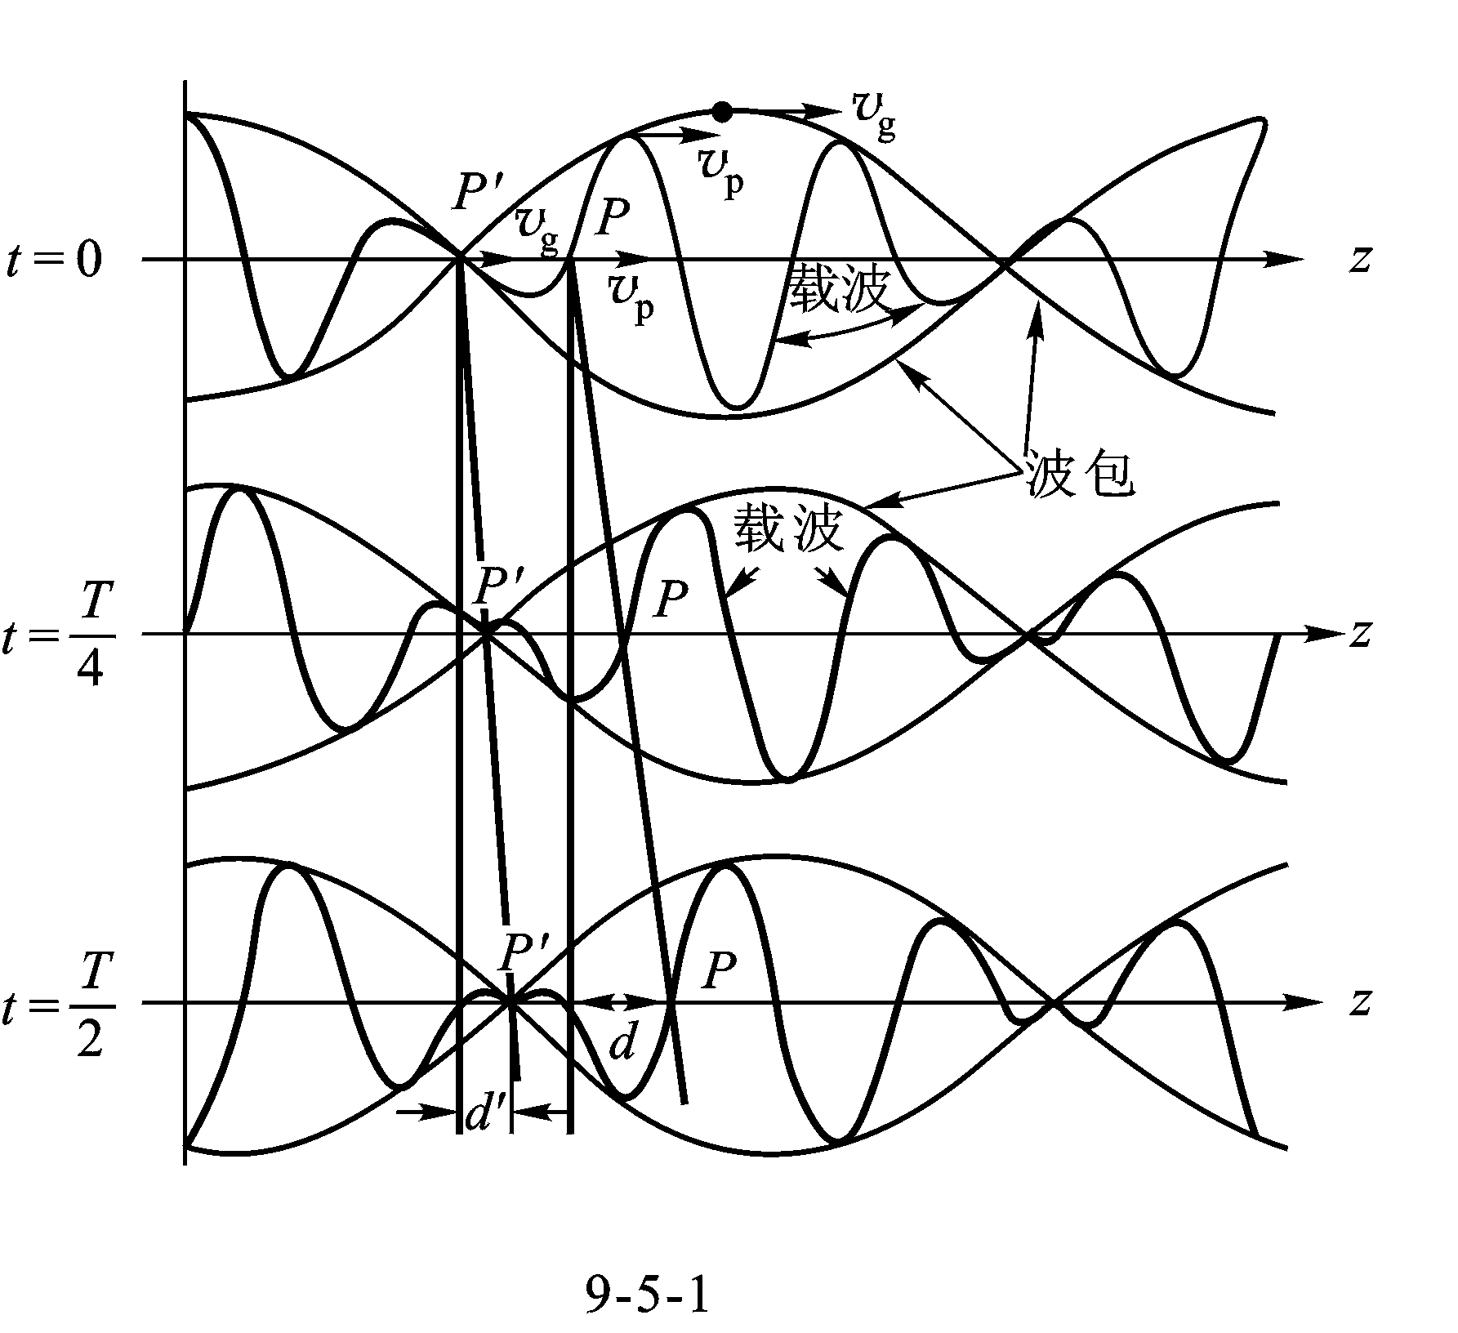
Carrier
Envelope
Carrier
It gives the waveforms of the above narrow band signal at three different moments for the case of . is a stationary point on the envelope, and P is that for the carrier. When the displacement of the point P is d, the point is moved only by because the velocity of the envelope is less.
The actual signal waveform will be modified as it propagates.

Slide 41
Consider , we find
For the narrow band signal, the above equation becomes
If the phase velocity is independent of frequency, , then
If , then , and the dispersion is called normal dispersion.
If , then , and it is called abnormal dispersion.

Slide 42
For a rectangular waveguide, , it is normal dispersive and the group velocity is
The group velocity is equal to the energy velocity in the rectangular waveguide, which is the same behavior for all normal dispersive media.
The phase velocity v_{p} and the group velocity v_{g} in a waveguide satisfy the following equation
When an electromagnetic wave is propagating in a conductive medium, abnormal dispersion is observed. In this case, the group velocity is not equal to the energy velocity, and the above equation is not valid for this case.

Slide 43
6. Circular Waveguides
The inner radius a is the only dimension to be specified. Select the cylindrical coordinate system, and let the z-axis be the axis of the cylinder.
Similar to the rectangular wave-guide, the longitudinal components E_{z} or H_{z} is first obtained, from which the transverse components E_{r} , E_{φ} , H_{r} , H_{φ} can be derived.
y
a
ε ,μ
x
The field intensities in the waveguide can be written as
z
The corresponding longitudinal components are, respectively

Slide 44
For a TM wave, H_{z} = 0 . In a source-free region, E_{z} satisfies the scalar Helmholtz equation given by
Expanding this equation in cylindrical coordinate system, we have
Using the method of separation of variables is used, and let
Substituting it into the above equation gives
where and are the second and the first derivatives of the function R with respect to r, respectively, and is the second derivative of the function Φ with respect to φ .

Slide 45
Using the same derivation as before，we obtain the equation for the function Φ as
The general solution is
Since the period of variation of the field with the angle is 2π . Hence m must be integers so that
The circular waveguide is symmetrical with respect to the z-axis; thus the plane can be chosen arbitrarily. In this way, we can always select the plane properly so that the first term
or the second term vanishes.
Therefore, the solution of Φ can be expressed as

Slide 46
We find
Let , then the above equation becomes the standard Bessel equation
The general solution is
where is the first kind of Bessel function of order m, and is the second kind of Bessel function of order m. If , , then
. But the field should be finite in the waveguide. Hence the constant . The solution should then be
Consider all results above, we find the general solution of E_{z} as

Slide 47
And the transverse components are
where is the first derivative of Bessel function . The constant depends on the boundary condition.
The components E_{z} and are tangential to the inner wall of the circular waveguide; hence, at .
We find
is the n -th root of the first kind of Bessel function of order m.

Slide 48
The values of
m
n
1
2
3
4
0
2.405
5.520
8.654
11.79
1
3.832
7.016
10.17
13.32
2
5.136
8.417
11.62
14.80
A pair of m and n corresponds to a , and that corresponds to a kind of field distribution or a mode. Hence, the electromagnetic waves have multiple modes in a circular waveguide also.
For the TE wave, E_{z} = 0. We can use the same approach to find the component H_{z} first, and then the other transverse components can be determined.

Slide 49
TE wave:
Based on the boundary conditions, we find
Where is the root of the first derivative of Bessel function.

Slide 50
The values of
m
n
1
2
3
4
0
3.832
7.016
10.17
13.32
1
1.841
5.332
8.526
11.71
2
3.054
6.705
9.965
13.17
As with the rectangular waveguide, if , then the propagation constant , meaning that the wave is cut off, so that propagation ceases.
From
For TM wave, we have
For TE wave, we have

Slide 51
The following figure gives the cutoff wavelength of several modes in a circular waveguide.
The TE₁₁ wave has the longest cutoff wavelength, and the next one is the TM₀₁ wave.
TE₁₁
TM₀₁
Cutoff area
TE₂₁
TE₀₁
The cutoff wavelengths of the TE₁₁ and TM₀₁ waves, respectively, as
0
a
2a
3a
4a
λ_{c}
If the operating wavelength λ satisfies the following inequality
The transmission of a single mode (TE₁₁ wave) can be realized, and the TE₁₁ wave is the dominant mode for the circular waveguide.
If the operating wavelength λ is given, to realize the transmis-sion of only the TE₁₁ wave, the radius a must satisfy the following inequality:

Slide 52
From the cutoff frequencies or the cutoff wavelengths, the phase velocity, the group velocity, the guide wavelength and the wave impedance of each mode can be found using the same equations as those for the rectangular waveguide.
⊗
⊗
⊗
⊗
⊗
⊗
TE₁₁
⊗
⊗
⊗
⊗
⊗
⊗
⊗
⊗
⊗
⊗
⊗
⊗
⊗
Electric field lines
⊗
⊗
⊗
⊗
⊗
⊗
⊗
TE₀₁
⊗
Magnetic field lines
⊗
⊗
⊗
⊗
⊗
⊗
⊗
⊗
⊗
⊗
⊗
⊗
⊗
⊗
TM₀₁
⊗
⊗
⊗
⊗
⊗
⊗
⊗

Slide 53
Example. A circular waveguide of radius a = 5mm is filled with a perfect dielectric of relative permittivity ε_{r} = 9 . If it is to be operated in the dominant TE₁₁ mode, find the permissible frequency range.
Solution: To operate on the mode TE₁₁, the operating wavelength must satisfy the following inequality
Hence
The corresponding range of the operating frequency is

Slide 54
7. Transmitted Power and Loss in Waveguides
The longitudinal component of the complex energy flow density vector is given by the cross product of the transverse components of the electric and magnetic fields. The integration of the real part over the cross-sectional area of the waveguide gives the transmitted power.
Take the TE₁₀ wave as an example, we find the transmitted power as
Where is the amplitude of the electric field in the middle of the broad side
If the dielectric strength of the filling dielectric is , then the maximum transmitted power of the rectangular waveguide is
In practice, the transmitted power is limited as for safety purpose.

Slide 55
The two major mechanisms for energy loss are imperfect dielectric and finite conductivity of the waveguide walls.
The effect of the dielectric can be accounted for by introducing the equivalent permittivity to replace the original one, i.e.
A vigorous analysis of the waveguide walls is very complicated. An approximation that retains the magnetic field that would have existed if the walls were perfectly conducting may be employed.
If we assume the attenuation constant is , then the amplitude of the electric field intensity propagating along the positive z-direction has the form
The transmitted power can be expressed as

Slide 56
Take the derivative of the above equation with respect to z, we find the power attenuation per unit length as
Obviously, that is the power loss per unit length, so that
Hence, the attenuation constant is obtained as
To calculate the loss of the walls, we consider a piece of conductor making up the broad side wall, with unit width and length and a thickness equal to δ .
The current in the conductor is flowing in the z-direction. The resistance of the piece of conductor is given by
y
1
1
δ
⊗
⊗
1
⊗
z
⊗
where σ is the conductivity of the wall.
is called the surface resistivity.
⊗
x

Slide 57
The surface resistivities of three types of metal
Metals | Silver | Copper | Aluminum
The surface current density is the current per unit width. Hence the power loss per unit length and width of the waveguide wall is
where the surface current , and is the magnetic field intensity on the surface of the wall.
Taking the integration of over the inner wall for a section of the waveguide of unit length, the power loss per unit length of the wall can be obtained.

Slide 58
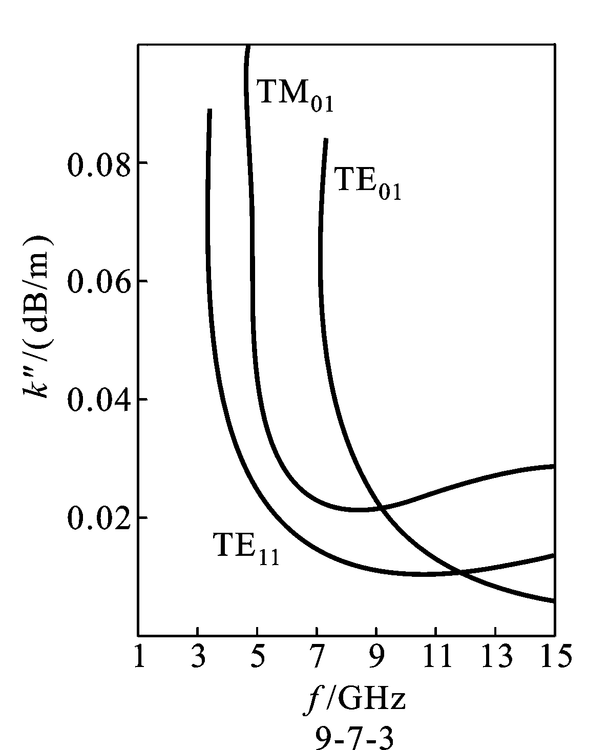
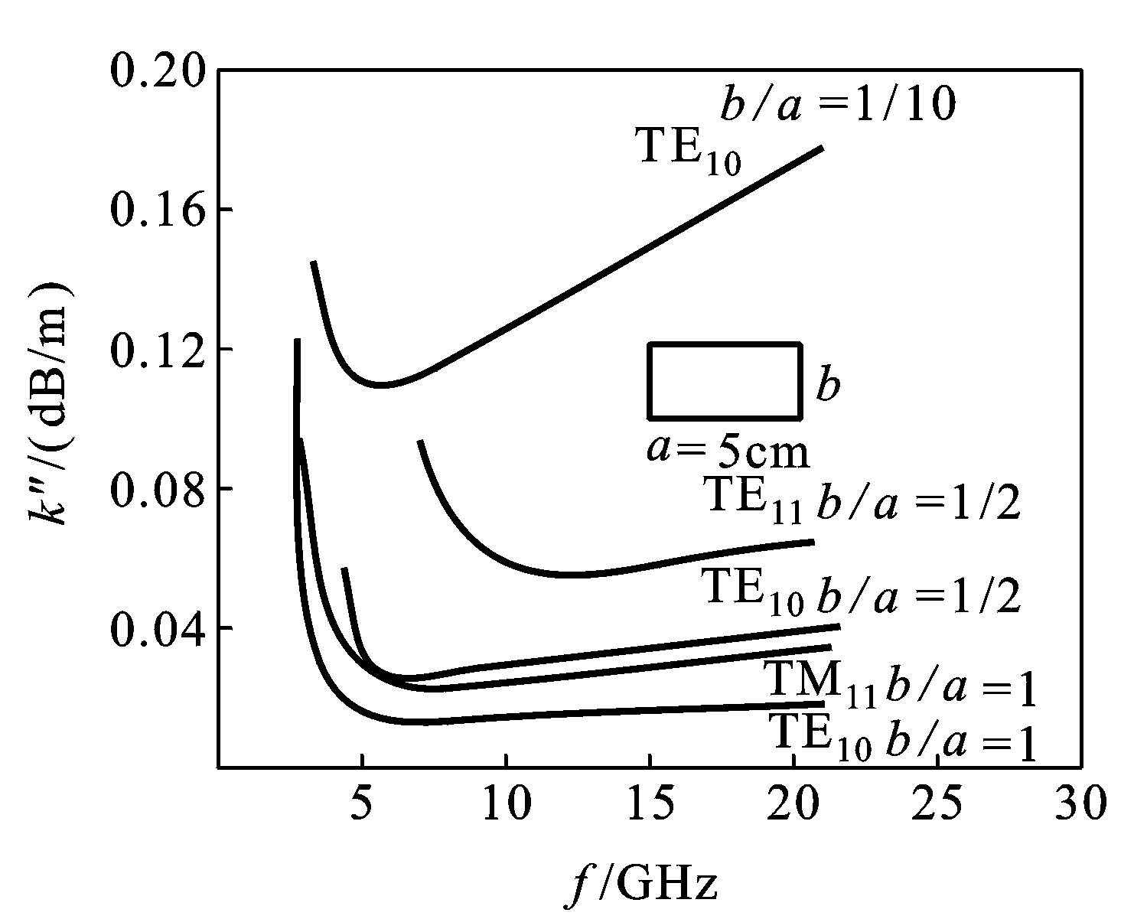
For a given size of rectangular waveguide, the loss of the TE₁₀ wave is minimum. For a given width, the smaller is the narrow wall, the larger will be the attenuation constant.
TM₁₁
The loss of the TE₀₁ wave in a circular waveguide is minimum in the higher frequency range. 。
r
The cutoff wavelength of the TE₀₁ wave is not the largest. In order to realize the transmission of the single mode TE₀₁, the modes TM₀₁, TE₂₁ and TE₁₁ have to be suppressed.

Slide 59
For the same cross-section, the perimeter of a rectangle is larger than that of a circle, and the loss in a circular waveguide is less than that of the rectangular waveguide.
However, when a TE₁₁ wave is propagating in a circular waveguide, the fields could be rotated.
An elliptical waveguide does not result in the rotation of the fields, and the loss is less also.
E
In addition, in order to reduce the wall losses, the inner surface should be polished, and plated with silver or gold. To prevent oxidation of the surface, the waveguide may be filed with inert gas.

Slide 60
Example. Calculate the attenuation caused by finite conductivity of the wall when a TE₁₀ wave is propagating in a rectangular waveguide.
Solution: When a TE₁₀ wave is propagating in a rectangular waveguide, there are x-component and z-component of the surface currents on the broad sides, while there is only the y-component on the narrow sides.
y
Therefore, the power loss per unit length of the broad wall is
z
x
Where , .

Slide 61
The power loss per unit length of the narrow wall is
Where .
Then the total power loss per unit length is
Based on the transmitted power P and the total power loss per unit length , we find the attenuation constant as

Slide 62
8. Resonant Cavity
In microwave band, the lumped LC tank circuits cannot be used, we usually employ a transmission line to construct a resonant device, and it is called cavity resonator.
with the increase of the resonant frequency the inductance and the capacitance must be reduced. However, for small L and C, distributed effects cannot be neglected. The inductance of the lead wires of capacitors, the distributed capacitances among the coils or the devices have to be considered. This means that a pure capacitor or a pure inductor is very difficult to be made at microwave frequencies.
Furthermore, with the increase in frequency, the radiation effect of the circuits becomes significant, and the power loss in the dielectric of the capacitor is more severe as well. All of these will result in the decrease of the quality factor Q of the lumped tank circuit.

Slide 63
When a metal plate is placed at the end of a waveguide, the electro-magnetic wave will be completely reflected, leading to a standing wave.
For a rectangular waveguide operating in the dominant mode, the closed end corresponds to a wave node for the electric field since it is tangential to the metal plate. Another wave node for the electric field appears at a distance from the closed end. If one more metal plate is placed there, the boundary condition is still satisfied,
In this way, there is a standing wave in the cavity formed by the waveguide walls and the end plates. Based on the field intensity and the boundary condition, we find the equations for the standing waves in the cavity as follows:
y
d
b
z
a
λ_{g} /2
x

Slide 64
There are standing waves of the electric and the magnetic fields along both the x-direction and the z-direction, but they are out of the time phase by . When the electric energy is maximum, the magnetic energy is zero. Conversely, when the magnetic energy is maximum, the electric energy is zero.
The electromagnetic energy is exchanged between the electric field and the magnetic field, and this phenomenon is called resonance. So the cavity is called a resonant cavity, and it is used as a resonant device in microwave circuits.

Slide 65
For a given cavity, resonance occurs only at certain frequencies. The particular frequency is called resonant frequency, and the corresponding wavelength is called the resonant wavelength.
If the length of the cavity is
Then the boundary condition can be satisfied, and the resonance will happen. Hence, the resonant frequency or wavelength of a resonant cavity is multi-valued, and it is called multiple resonance.
since the guide wavelength is related to the mode, different modes have different resonant frequencies.
Consider , when , , ,
and we find

Slide 66
From , we find
The resonant wavelengths and frequencies depend on not only the sizes of the cavity, but also the mode.
A set of mnl corresponds to a mode. For instance, TE₁₀₁ stands for that a rectangular waveguide cavity operating on a TE₁₀ wave, and the length of the cavity is half of the guide wavelength.
In order to properly design the coupling and the tuning devices of the cavity, knowledge about the distribution of the fields in the cavity is required.

Slide 67
The figure gives the distribution of the fields in a rectangular cavity operating at the TE₁₀₁ mode.
d
y
As with other resonant devices, a real cavity always has some loss.
z
a
In order to assess the loss of a resonant device, the quality factor Q is usually employed, and its definition is
x
x
z
b
Electric field lines
y
Magnetic field lines
where ω₀ is the resonant angular frequency, W is the total energy, P_{l} is the power loss in the cavity.
The maximum value of the energy density of the electric field in the cavity is

Slide 68
In order to calculate the power loss of the cavity wall, the same method for waveguide analysis may be applied. We find the power loss of a rectangular cavity operating with the TE₁₀₁ mode as
and the Q value is
The resonant angle frequency for the TE₁₀₁ mode is
Therefore, the Q value for the TE₁₀₁ mode can be expressed as
where .

Slide 69
Since the circular waveguide has less loss, the Q value of the cylindrical cavity is higher, and it is more popular than the rectangular cavity.
The method for calculating the resonant frequency and the Q value of a cylindrical cavity is the same as that above.
TM wave:
TE wave:

Slide 70
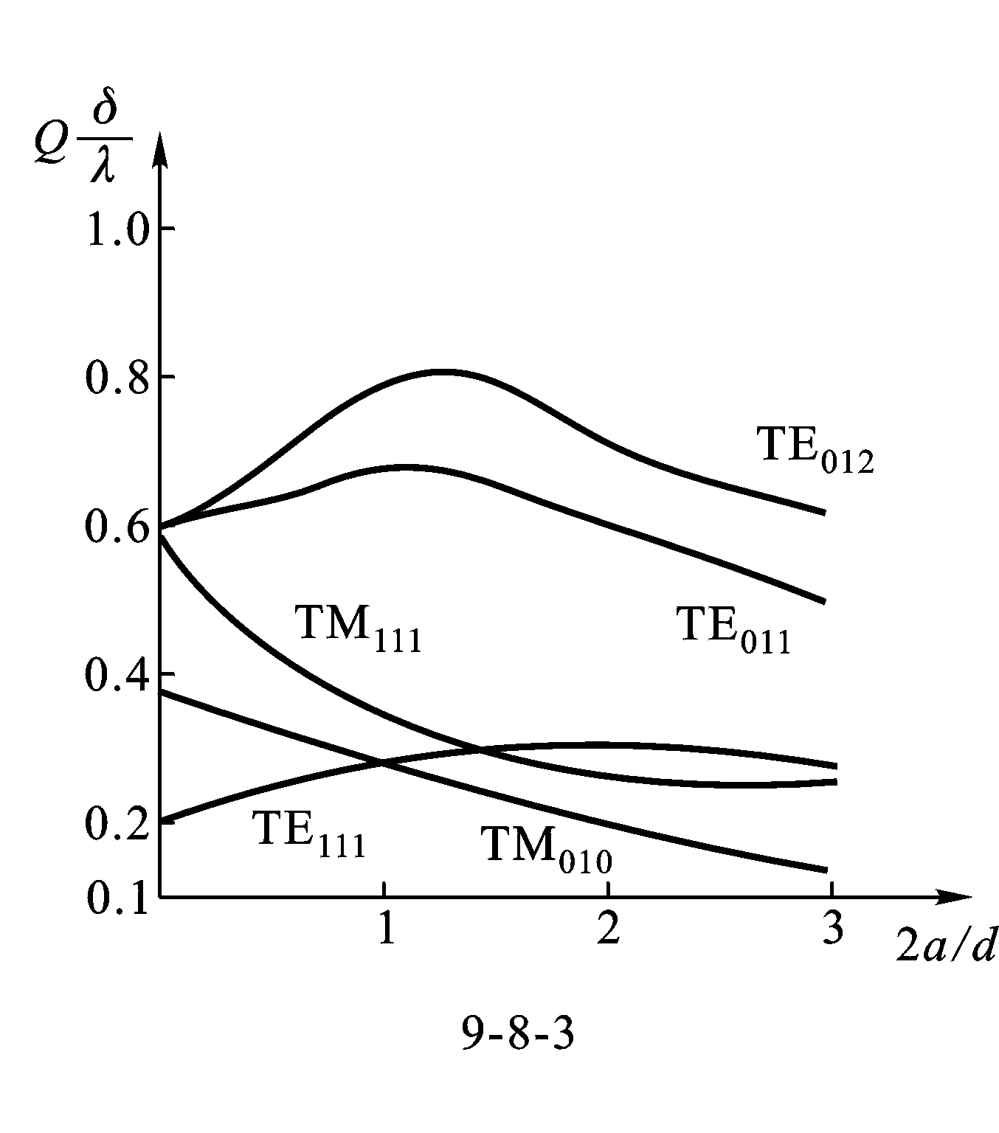
TE_{01l} modes have higher Q values, and the maximum Q value of the TE₀₁₁ mode occurs around d ≈ 2a. If λ = 3cm, then Q value will be 10⁴~4×10⁴. 。
The approach to increase the Q value is the same as that of decreasing the loss of waveguide wall.
In addition, the volume of the cavity should be as larger as possible to increase the stored energy, while the area of the walls should be as small as possible to decrease the loss.

Slide 71
Example. Show that for any mode the resonant wavelength of the cavity can be expressed as
where is the cutoff wavelength, and d is the length of the cavity.
Solution:
Consider
If the length , then and . Resonance will occur.
And due to , , we find
Rewriting the equation gives the general formula.

Slide 72
9. Coaxial Lines
A coaxial line is shown in the figure, with an inner radius a and an outer radius b. The electromagnetic wave propagates in the region between the two conductors, which may be filled with air or a dielectric.
The coaxial line is a good transmission line in microwave band. It possesses the electromagnetic shielding function as the waveguides, but it has a wider frequency range of operation.
y
b
x
z
a
The coaxial line is a typical TEM wave transmission line a coaxial line, and the electric field lines are along with the radial direction , while the magnetic field lines are a set of circles.
Electric field lines
Magnetic field lines

Slide 73
A coaxial line can also be considered as a circular waveguide that supports TE and TM waves, besides the TEM wave. However, if we properly design the dimensions according to the operating frequency, these non-TEM waves can be restrain .
The method for analyzing non-TEM waves in a coaxial line is similar to that for a circular waveguide. However, the coaxial line has an internal conductor, the range of the variable r is , and . Hence, the second kind of Bessel function with the singularity at r = 0 should be the solution of Bessel equation as well, i.e.
TE₁₁
TM₀₁
For TM and TE waves，based on the boundary conditions the cutoff propagation constant are found first, then the cutoff wavelengths can be obtained.
TE₁₀
0
π(b - a)
π(a + b)
λ_{c}

Slide 74
The TE₁₁ wave has the longest cutoff wavelength, and it is .
TE₁₁
TM₀₁
TEM wave
TE₁₀
To restrain the non-TEM wave, the operating wavelength λ must satisfy the following inequality
0
π(b - a)
π(a + b)
λ_{c}
In other words, the dimensions of the coaxial line should satisfy the following inequality
Hence, in order to eliminate the higher order modes in a coaxial line, the dimensions have to be decreased as the frequency increases. But small sizes will result in the increase of loss and the restriction of the transmitted power. For this reason, the coaxial line is usually used for the frequencies below 3GHz.
However, the operating frequency has no lower limit, and the coaxial line can also be used to construct a cavity.

Slide 75

Thanks！

