Slide 1
UESTC1008: Microelectronic Systems
Analogue to Digital Conversion (ADC)
Lecture 11
xxx
School of Engineering
University of Glasgow

Slide 2
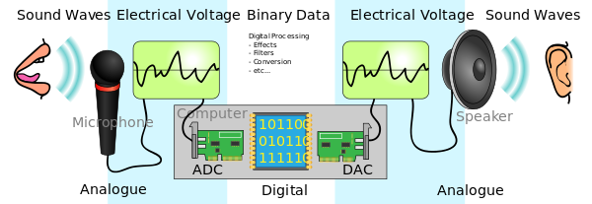
ADC and DAC Conversions

Slide 3
ADC
As mentioned before, most sensors of temperature, sound, and acceleration have analog outputs. However, these analog outputs have to be converted into digital signals before they can be stored or used in calculations by the microcontroller.
Analog signals are converted into digital representations with a resolution and a rate determined by the Analog to Digital Converter (ADC)
An ADC is a circuit whose digital output is proportional to the analog input
Effectively, an ADC measures the input analog voltage, and gives a binary output proportional to the size of the input signal
The input range of the ADC is usually determined by the value of a voltage reference

Slide 4
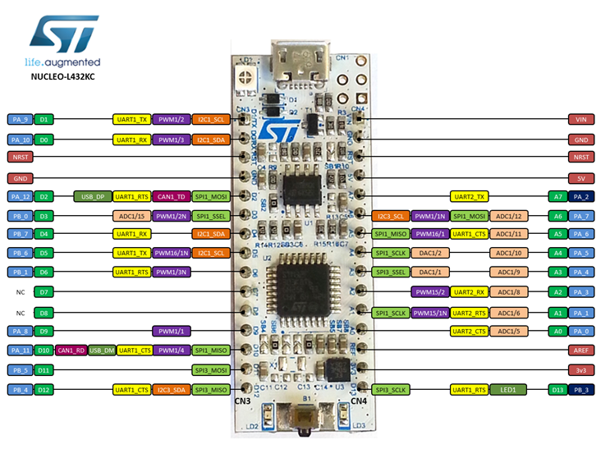
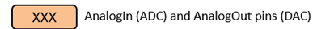
mbed – ADC and DAC pins

Slide 5
ADC Block Diagram
The conversion process is started by a digital input called SC, start convert
It takes a finite time to perform the conversion, depending on the clock frequency
The ADC signals that the conversion is completed via the EOC, end of conversion line
The resulting data can then be written onto the output data bus, when the output enable, OE control line, is high
Voltage Reference
+
+ Analogue
to Digital
₋ Converter
Analog Input
+
Analo
gue
Digital Output
(n bits)
uuee
to Digital
-
Converter
SC
(Start Convert)
EOC
(End of Conversion)
OE
(Output Enable)
Example Control Lines

Slide 6
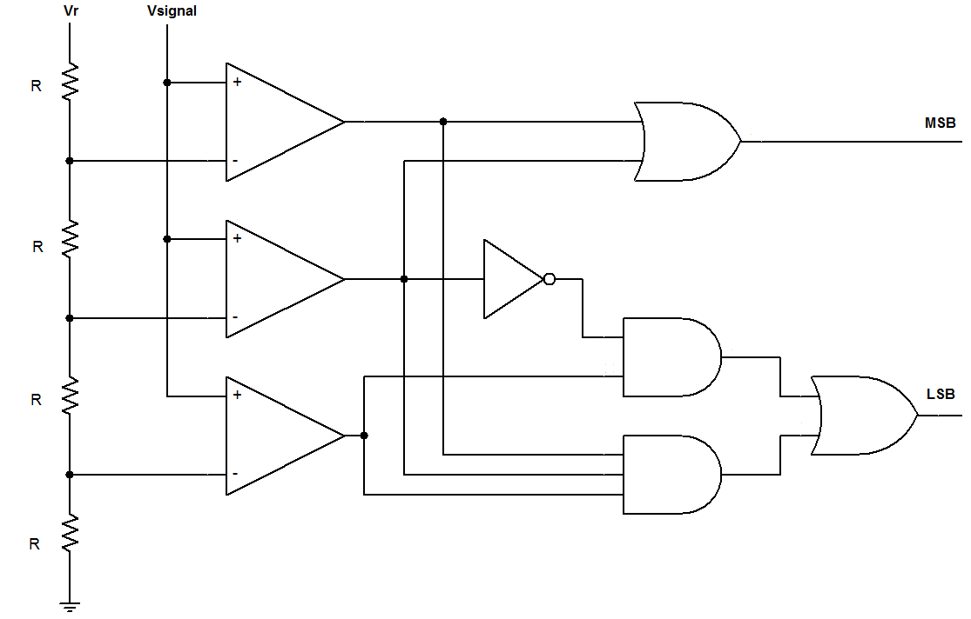
2 bit Flash ADC
Priority encoder circuit

Slide 7
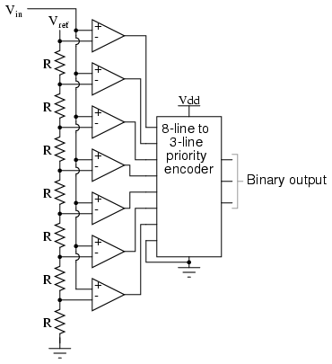
3 bit Flash ADC

Slide 8
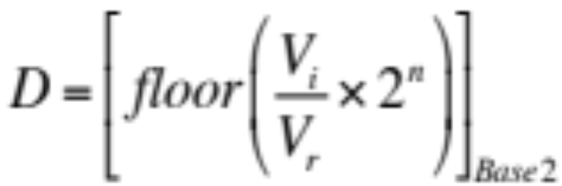
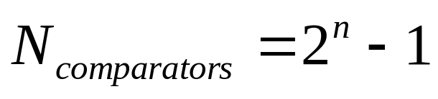
ADC
Many ADCs follow the relation where:
    D is the digital output value
      Note that D will never be equal to base₂ (2^{n}) as the range of the ADC is limited to 2^{n} – 1
    V_{i} is the analog input voltage
    V_{r} is the reference voltage
    n is the number of bits in the converter output
How many voltage comparators are needed for a 12-bit ADC?

Slide 9
ADC
The output binary number is an integer, and for an n-bit number can take any value from 0 to (2^{n} – 1 )
The ADC process rounds (truncates) the calculation to produce an integer output
An ADC will have maximum and minimum input values that it convert. The difference is the range
    Often the minimum value is 0 V, so the range is then just the maximum possible input value. Analog input values that exceed the maximum or minimum will likely be digitized as the maximum or minimum values (a limiting or clipping action occurs)

Slide 10
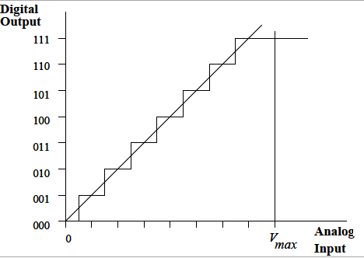
3 bit ADC
As input voltage goes from 0 V to V_{max}, the digital output will step from 000 to 111 or (2³-1)
Range of analog values all represented by 100
This shows that in making the conversion, an approximation is involved as any one digital output value has to represent a range of analog input signals
    For example, if the output value of 100 is precisely correct in the middle of the step, the greatest errors will occur at either end

Slide 11
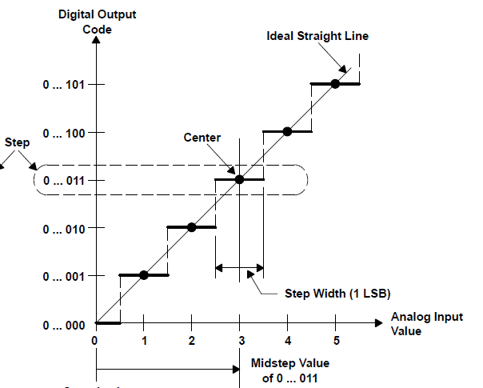
Error Made by ADC
From Understanding Data Converters, Texas Instruments Application Note

Slide 12
Quantisation Error
The greatest quantisation error is one half of the step width, or half of one least significant bit (LSB) equivalent on the voltage scale.
  To reduce the quantisation error, the “step width” should be narrowed. This can be achieved by increasing the number of bits in the ADC process
    This increases complexity and cost, and often the time taken to undertake the conversion
  What is the step width and worst case quantisation error?
    The mbed ADC for STM32L432kc is 12 bit
    The reference voltage is taken from the regulated 3.6 V supply

Slide 13
Summary Formulas
The digital output
Number of voltage comparators
Step width
Worst quantization error

Slide 14
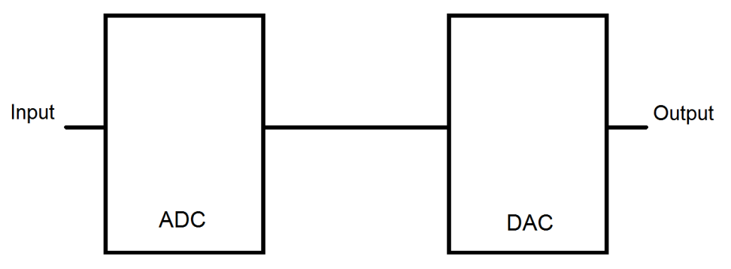
Example: An engineer designed a 3-bit ADC where the input signal can be between 0 V to 12 V. The engineer also designed a 3-bit DAC where the output signal is between 0 V to 5 V. The reference voltage (Vr) for the ADC is 12 V and the reference voltage for the DAC is 5 V. The engineer connects the output of the ADC to the input of the DAC, as shown in Figure.
The input voltage to the ADC is 9.3 V.
What is the digital signal that is outputted by the ADC?
How many voltage comparators are used in the design of the ADC?
How large is the quantization error of the ADC?
What is the output voltage of the DAC?
How many bits should the DAC have to obtain a resolution of about 10 mV from the DAC?

Slide 15
Sample and Hold
When performing an analog to digital conversion, a “sample” is taken of analog signal and quantized to the accuracy defined by the resolution of the ADC
  The signal is held, which means that it is stored temporally while the signal is compared to the reference voltage and the digital signal is generated
Sometimes, the digital signal is generated by averaging the results of several analog samples. The more samples taken, the more accurate the digital data will be as long as the analog signal is not changing
  Sampling is generally done at a fixed frequency, called the sampling frequency

Slide 16
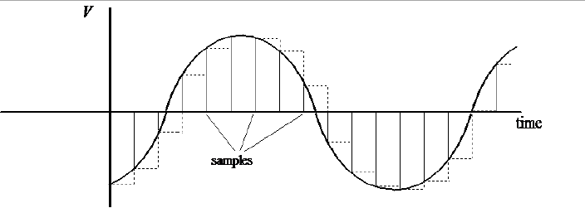
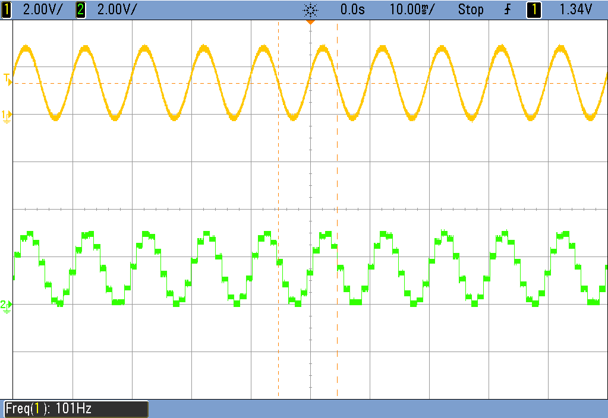

Slide 17
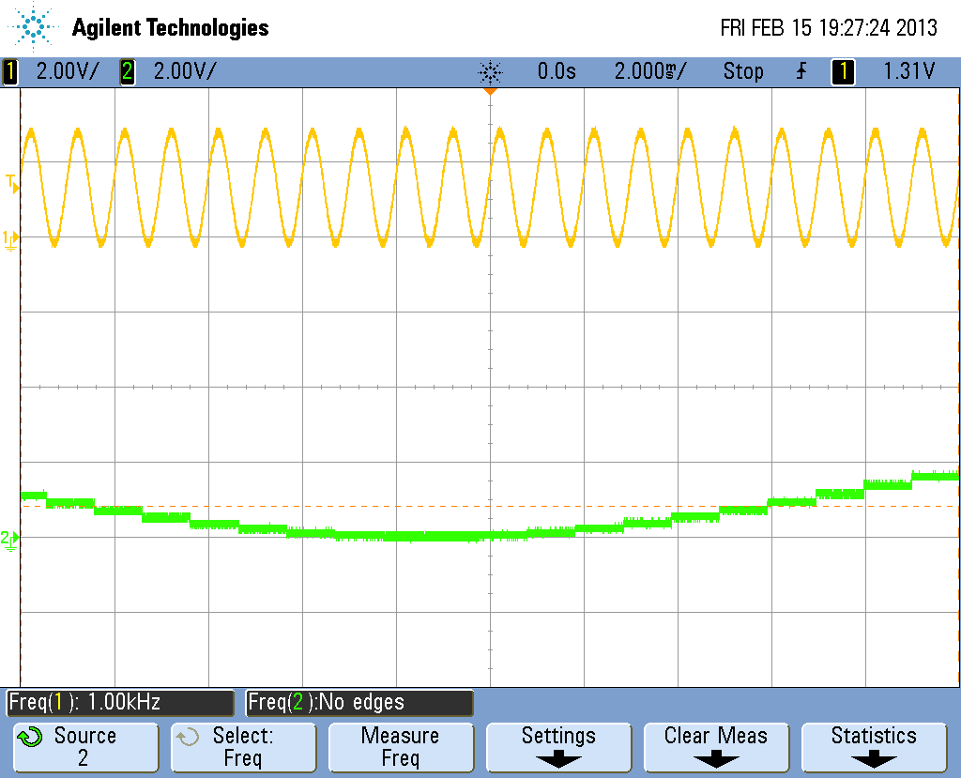
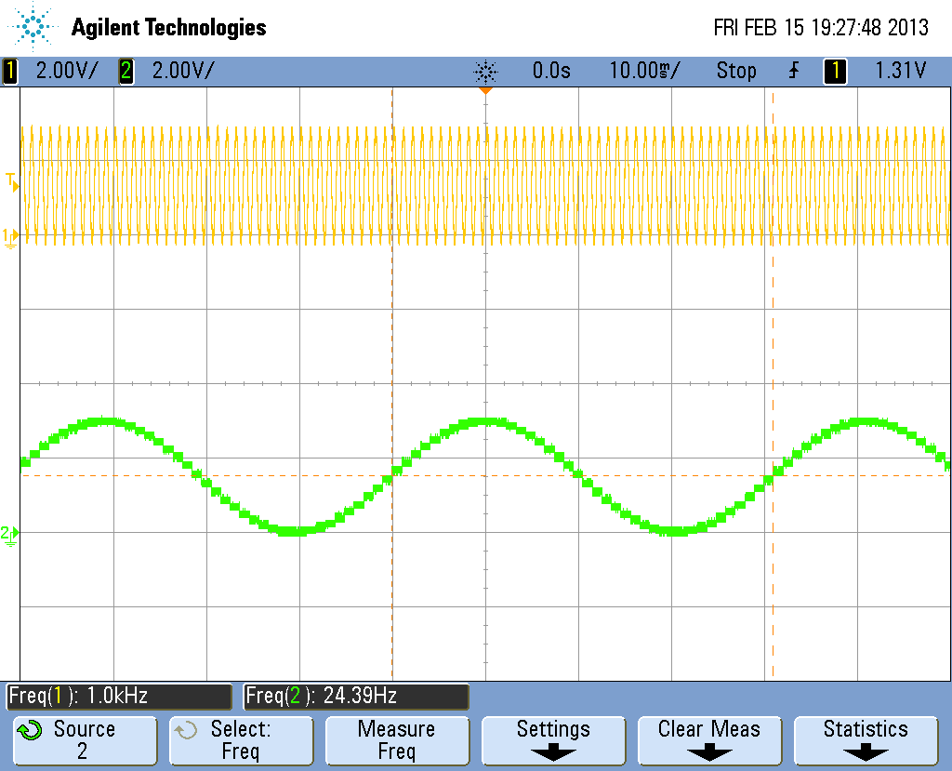
Sampling Frequency
The ideal sampling frequency depends on the maximum frequency of the signal being digitised. If the sampling frequency is too low, then rapid changes in the analog signal may not be represented in the resulting digital data.
Waveforms showing that undersampling results in the digitised output (lower traces) not representing the input waveforms (upper traces)

Slide 18
Nyquist-Shannon Sampling Theorem
The Nyquist-Shannon sampling criterion states that the sampling frequency must be at least double that of the highest frequency of interest.
  However, it is generally agreed that the sampling frequency should be 5+ times the highest frequency found in the analog signal.
    If the highest frequency that is created when a human speaks is 3.5 kHz, what is the minimum sampling frequency that should be used?
      The name of the criterion is usually shortened one or the other names – Nyquist criterion or Shannon Criterion.

Slide 19
ADC/DAC Program
/*Program to explore some of the time-related aspects of the mbed DAC and ADC/
#include "mbed.h"
AnalogOut Aout(A4);
AnalogIn Ain (A6);
DigitalOut test(D3);
float ADCdata;
int main(){
while(1){
ADCdata=Ain; //Perform an ADC conversion
test=1;
test=0; //1 pulse on D3 shows end of the ADC conversion
Aout=ADCdata; //Perform a DAC conversion
test=1;
test=0;
test=1; //2 pulses on D3 show end of the DAC conversion
test=0;
}
}

Slide 20
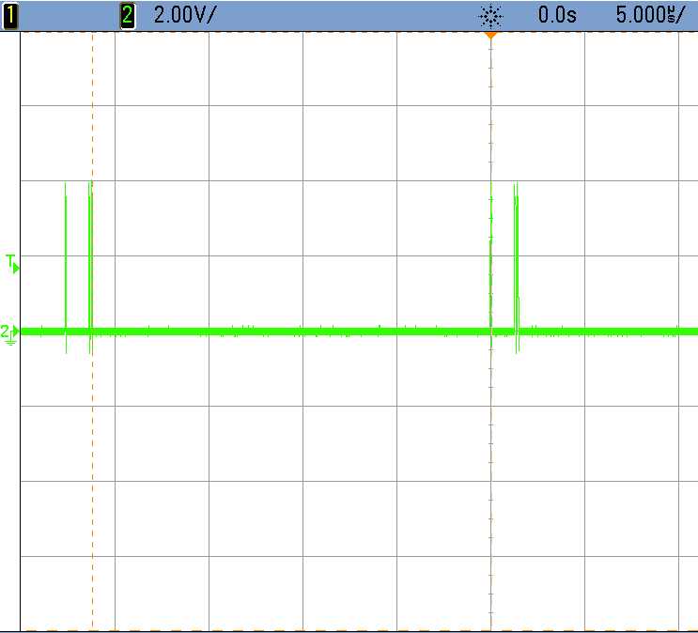
Timing issues and consequences
DAC
conversion
DAC
conversion
ADC Conversion
Single pulse
Double pulse
Single pulse
Double pulse

Slide 21
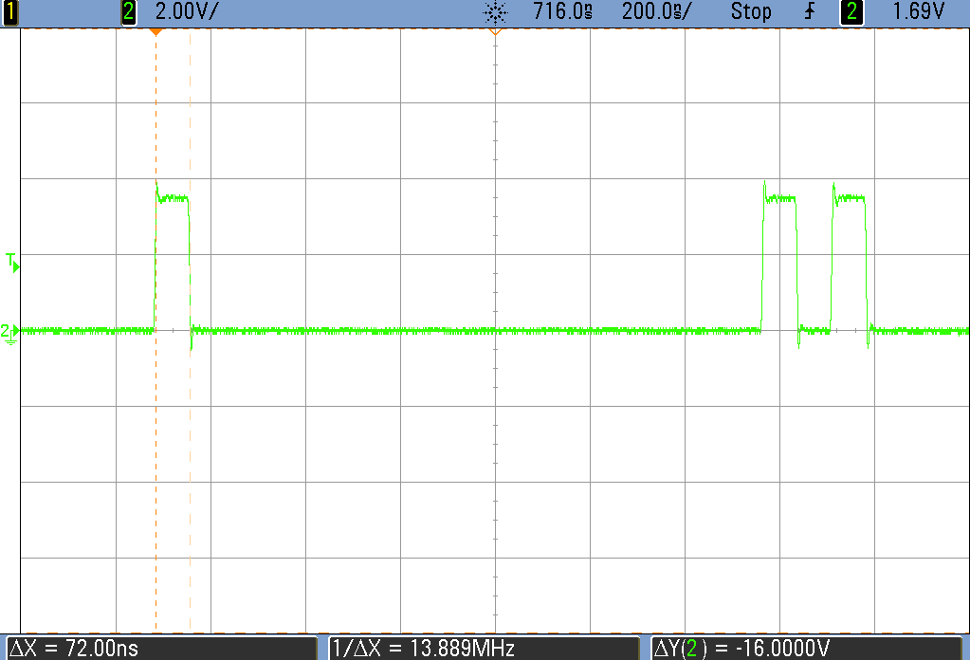
Switching a digital output on or off takes ~72 ns cf 1 clock period = 1/96 MHz = 10.4 ns

Slide 22
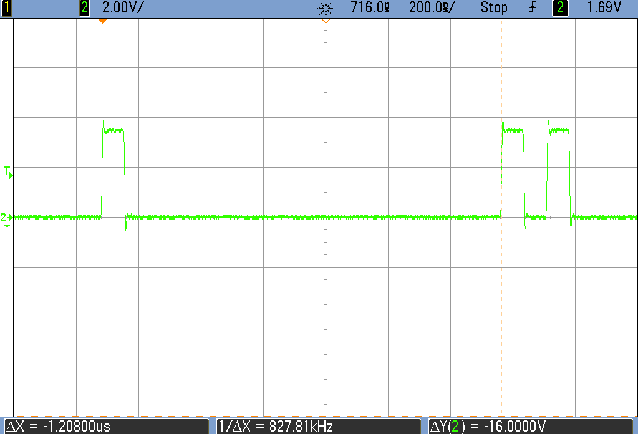
Performing a D to A conversion takes ~1.2μs

Slide 23
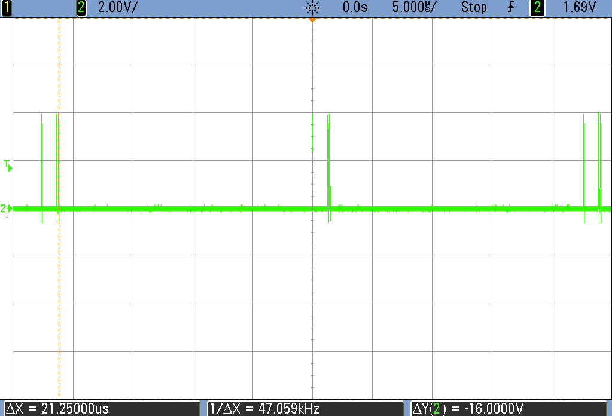
Performing A to D conversion takes
~22 μs

Slide 24
Sampling rate
/*Program to explore some of the time-related aspects of the mbed DAC and ADC/
#include "mbed.h"
AnalogOut Aout(A4);
AnalogIn Ain (A6);
DigitalOut test(D3);
float ADCdata;
int main(){
while(1){
ADCdata=Ain; //Perform an ADC conversion
test=1;
test=0; //1 pulse on p5 shows end of the ADC conversion
Aout=ADCdata; //Perform a DAC conversion
test=1;
test=0;
test=1; //2 pulses on p5 show end of the DAC conversion
test=0;
wait (0.001) // shows sampling rate
}
}

Slide 25
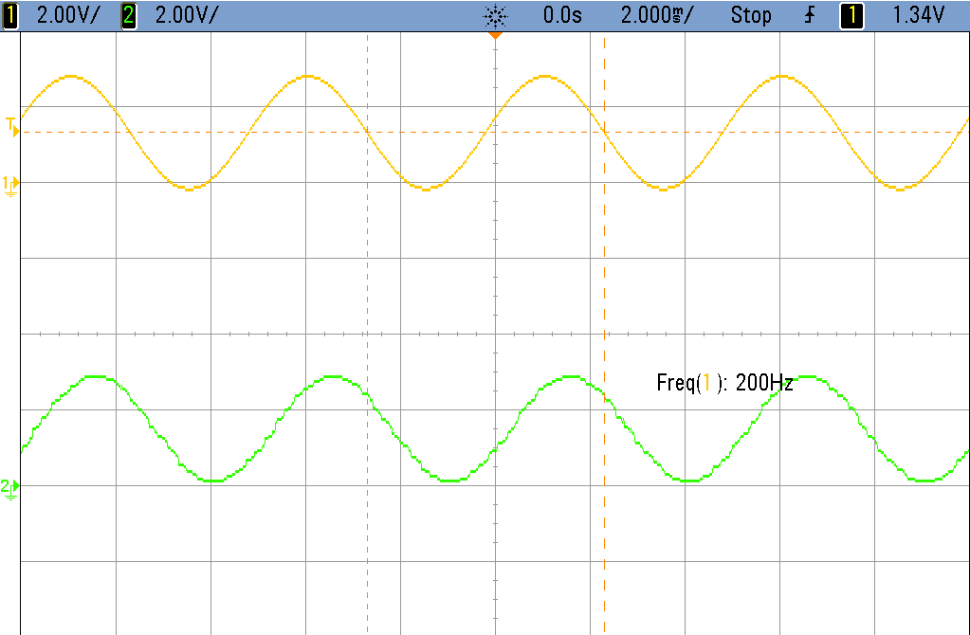
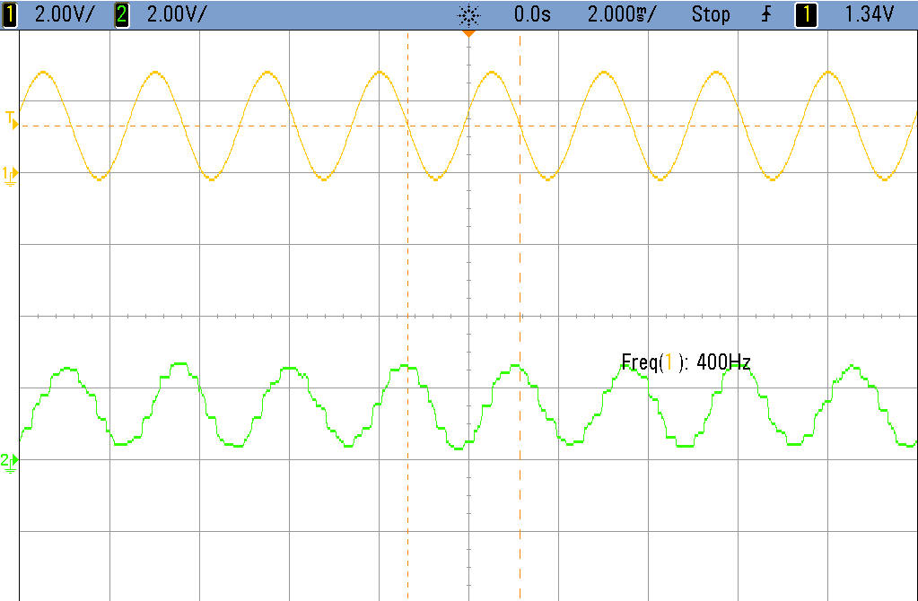
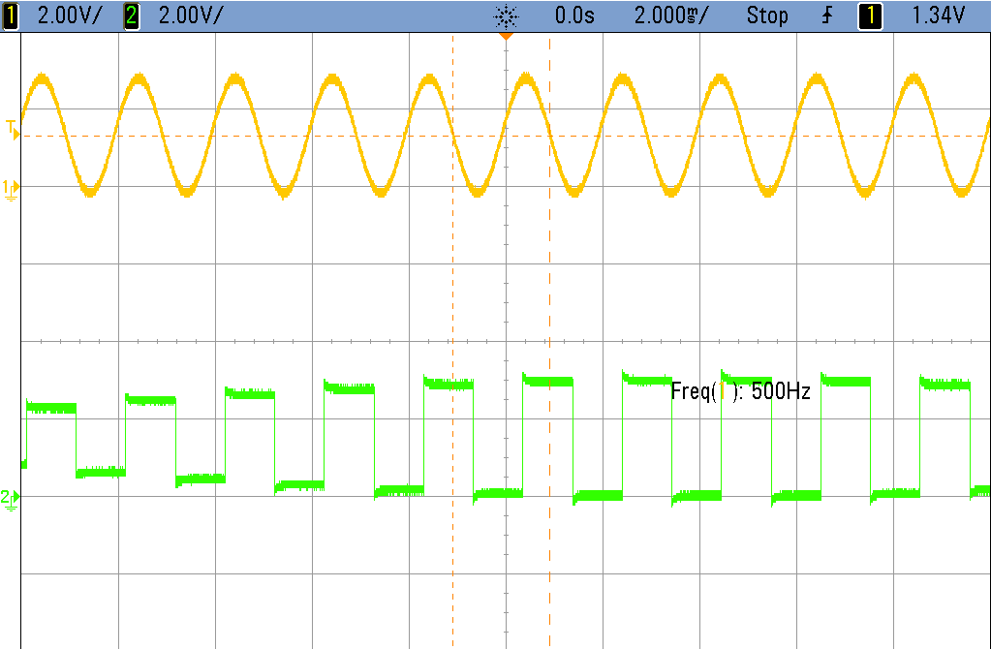
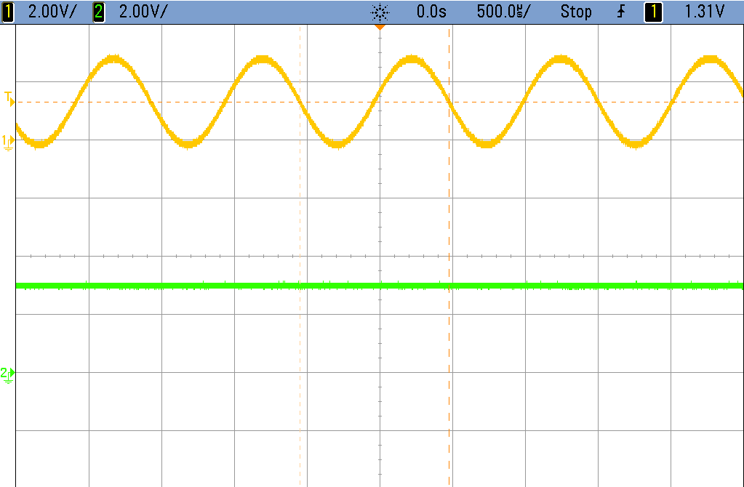
wait = 1ms
Maximum frequency < 500 Hz
A_{in} = 200 Hz
A_{in} = 400 Hz
A_{in} = 500 Hz
A_{in} = 976 Hz

Slide 26
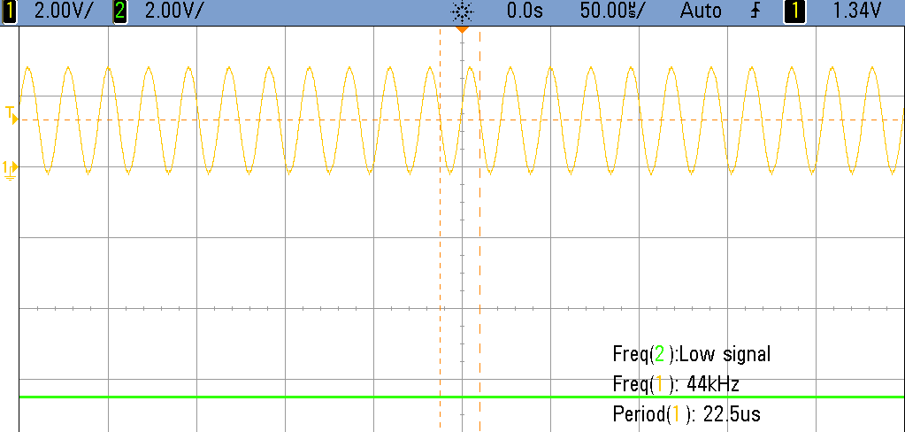
wait = 0 ms. What is Nyquist frequency ?
Looks ~ 44 kHz.
Standard audio CDs are sampled at played back at 44.1 kHz, to adhere to Nyquist sampling criteria as it relates to human auditory system which extends to ~ 20 kHz. Coincidence?

