Slide 1
UESTC1008: Microelectronic Systems
Memory and Flip-Flops
Lecture 11
Qammer H. Abbasi, Lei Zhang, Sajjad Hussain, Muhammad Ali Imran and Guodong Zhao
{qammer.abbasi,Lei.zhang,sajjad.Hussain,Muhammad.Imran,guodong.zhao}@glasgow.ac.uk

Slide 2
Overview
The following topics are covered in this lecture:
  Memory
  Combinational and sequential logic
  Basic set–reset (SR) Latch
  Data (D) Latch
  Edge-Triggered Flip-Flops
  D type Flip-flop
  SR Flip-flop
  Control Inputs

Slide 3
Memory
Stuff that needs to be remembered is data and it is held in memory
It can be stored, (modified) and retrieved for use
Physically there are several media on which we can store the data – the memory system
  The choice comes down to speed, cost, power consumption, size etc.
A memory bit is “bistable”, i.e., stable in two positions either 0 or 1.
A flip flop can be used as a memory bit. Combining few billion of flip flops together can make a memory stick.

Slide 4
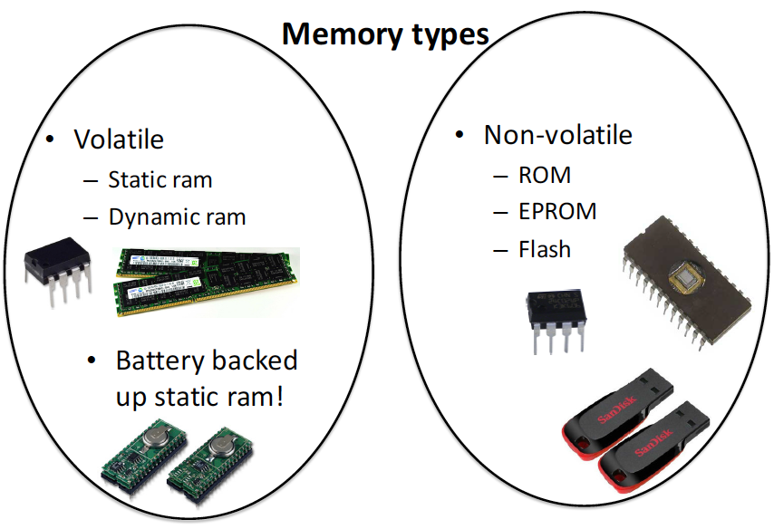
Memory

Slide 5
Volatile (RAM)
Static RAM (SRAM)
Flip flops
  6 transistors per bit
It is static since it just stays put and remembers
Faster
Processor cache memory is usually SRAM
Slightly bigger area
More expensive
Low power
Simple interface
Easy to use
Dynamic RAM (DRAM)
Capacitor
  1 capacitor and 1 transistor per bit
It is dynamic since it looses it’s charge and has to be continually refreshed
Slower
Small area – high information density
Computer RAM is usually DRAM
Higher power consumption
Needs complicated controller

Slide 6
Non-volatile (ROM)
Electrically erasable programmable read only memory : EEPROM
UV erasable, or one time programmable ROM also available
Flash memory
NOR or NAND flash
Invented in 1980 but rapidly took off (music players etc.)
Technology of choice for portable data transfer
Replacing hard drives due to speed

Slide 7

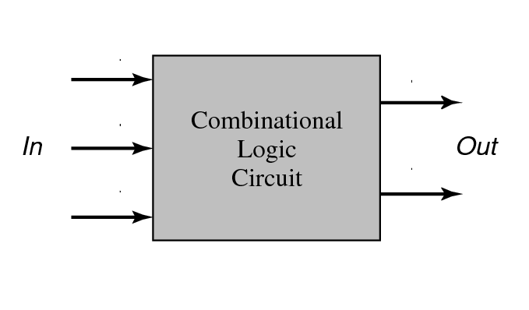
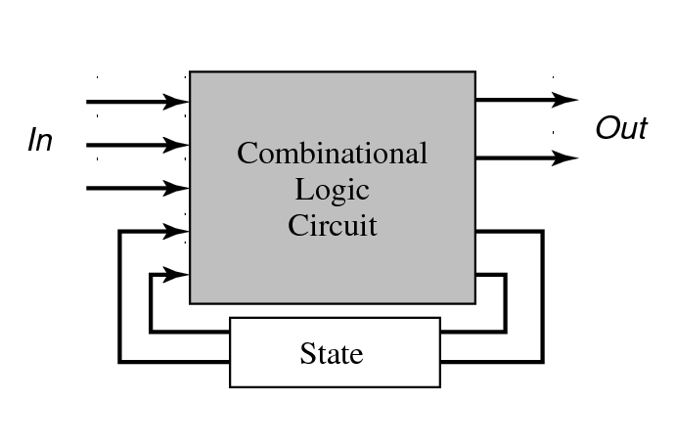
Simple Digital Systems

Slide 8
Combinational Logic
In combinational logic circuit, the outputs depend only on the state of the inputs all of the time
Any change in the state of one of the inputs will ripple through the circuit immediately
    Examples of combinational logic are AND, OR, NAND, NOR, XOR and XNOR gates, Inverters, and Buffers. These logic gates form the basis of almost all combinational logic circuits
Circuits that change the state of the output in this manner are also known as asynchronous circuits
    However, not all asynchronous circuits are combinational logic circuits

Slide 9
Sequential Logic
Sequential logic has memory; the circuit stores the result of the previous set of inputs
The current output depends on inputs in the past as well as present inputs
The basic element in sequential logic is the bistable latch or flip-flop, which acts as a memory element for one bit of data.
Sequential logic is used in circuits like Arithmetic Logic Unit (ALU) in microprocessors.

Slide 10
Clocked Circuits
      Most flip-flops are clocked so that they change state at precisely determined times
        Usage varies — in this course, ‘flip-flops’ will be used for clocked circuits (synchronous ) and ‘latches’ for circuits that are asynchronous
A common clock ensures that all parts of a digital system change state at the same time. Such circuits are known as synchronous system
The core of a flip-flop is the set–reset or SR latch
Notes:
A common clock used in many flip-flips in one circuit ensures that all parts of a digital system change state at the same time. This is called a synchronous system

Slide 11
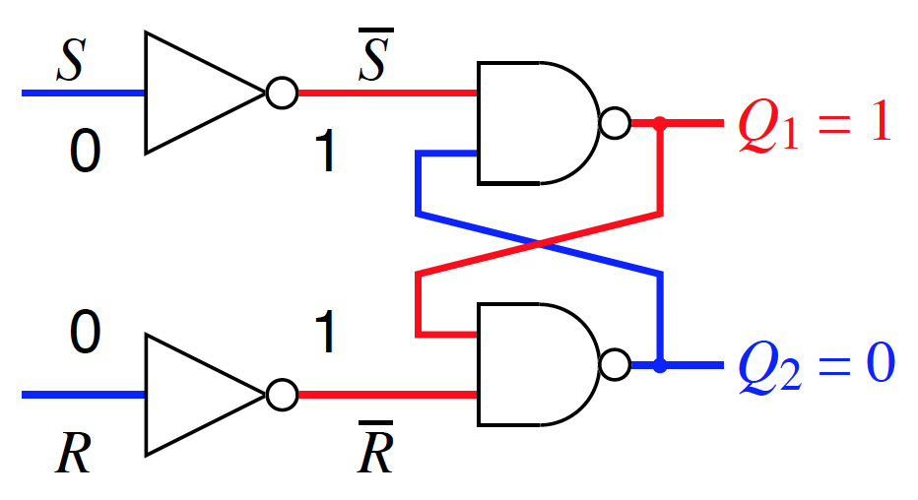
Basic set–reset (SR) Latch
Acts as a simple memory with two stable states when S = R = 0:
Q
Q

Slide 12
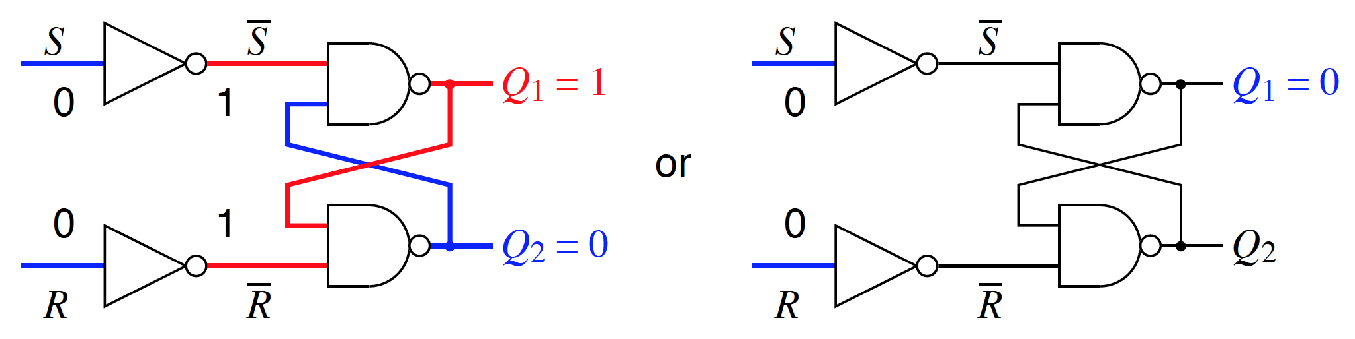
Basic set–reset (SR) Latch
Acts as a simple memory with two stable states when S = R = 0:
Q
Q
Q
Q

Slide 13
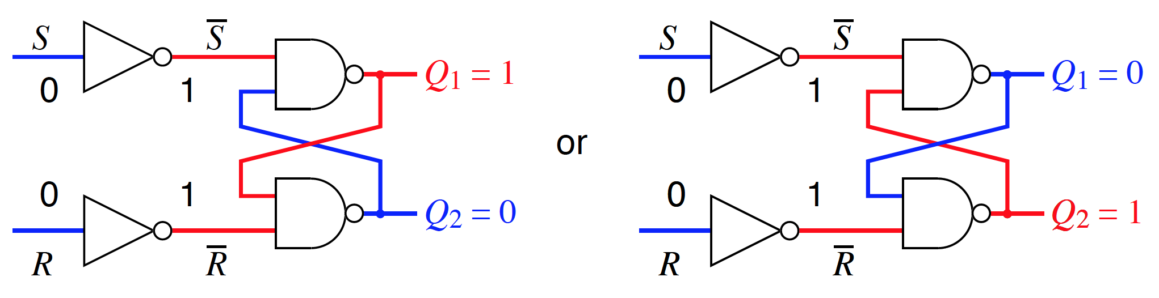
Basic set–reset (SR) Latch
Acts as a simple memory with two stable states when S = R = 0:
Q
Q
Q
Q
The latch
  holds (stores) when S = R = 0
  is set (to 1) by bringing S = 1 with R = 0
  is reset (to 0) or cleared by bringing R = 1 with S = 0
The condition S = R = 1 must be avoided because it leads to an
indeterminate or unpredictable condition. In other words, you don’t know what state the flip-flop will enter when the inputs return to hold, S = R = 0
Notes:
When S=R=1, both outputs are 1. Let’s say at next instant S=R=0, one of the outputs shall reach back at the input of the nand gate first turning the output of that nand gate to 0 and the other output will become 1. However, this is a race condition as we don’t know whether Q shall be feedback or Q’.

Slide 14
Basic set–reset (SR) Latch
Acts as a simple memory with two stable states when S = R = 0:
Q
Q
Q
Q
S | R | Q
0 | 0 | Last Q
0 | 1 | 0
1 | 0 | 1
1 | 1

Slide 15
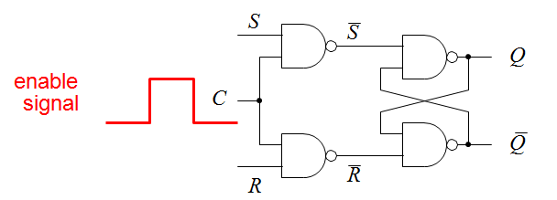
set–reset (SR) Latch with Enable
The S and R inputs are now effective only when the enable input C is high. This controls when the latch responds to its inputs.
The latch holds (stores) its value while the enable input is low — latches it!
Any changes in the inputs during the time when enable is high will affect the output immediately: the circuit is said to be transparent
This circuit still has a major problem: the stored value is indeterminate if S = R = 1 when the clock goes low

Slide 16
set–reset (SR) Latch with Enable
S | R | C | Q
0 | 0 | 1 | Last Q
0 | 1 | 1 | 0
1 | 0 | 1 | 1
1 | 1 | 1
X | X | 0 | Last Q

Slide 17
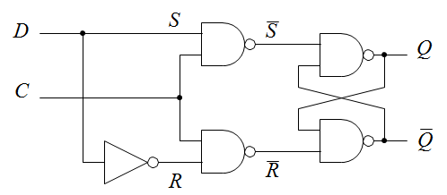

Data (D) Latch
The problem with S = R = 1 can be avoided using a common input D as shown above so that
The output of the latch now:
  follows the D input while C = 1 (transparent)
  holds its value while C = 0 (i.e. holds the value on D when C went low) regardless of any changes on the input
This circuit is often called a transparent latch. It can be bought as an integrated circuit, usually with several latches in a package (often 8 so that a complete byte of 8 bits can be latched)
  The input C may be called control, clock, gate, or enable

Slide 18
Data (D) Latch
 | D Q C Q
C | D | Q | Q’
0 | 0
0 | 1
1 | 0
1 | 1

Slide 19
Data (D) Latch
 | D Q C Q
C | D | Q | Q’
0 | 0 | Latch | Latch
0 | 1 | Latch | Latch
1 | 0 | 0 | 1
1 | 1 | 1 | 0

Slide 20
Operation of a Transparent Latch
 | D Q C Q
D
Q
The symbol has a plain terminal for the clock input.

Slide 21
Operation of a Transparent Latch
 | D Q C Q
D
C output follows input
output remains constant: input ‘latched’
Q
The symbol has a plain terminal for the clock input.

Slide 22
Operation of a Transparent Latch
 | D Q C Q
D
C output follows input
output remains constant: input ‘latched’
Q
The symbol has a plain terminal for the clock input.
Transparent latches have important applications but for most systems it is far more convenient if the behavior depends on the inputs only at a particular time, not during an interval
use edge-triggered flip-flops

Slide 23
Edge-Triggered Flip-Flops
These respond to their inputs on either the rising or falling edge of the clock — a precise point in time rather than an interval.
Positive edge triggered
Negative edge triggered
rising edge of clock
falling edge of clock
D
Q
D
Q
additional of a circle means that there is negative edge triggering
wedge shows positive
edge triggering
Older flip-flops may be ‘pulse-triggered’, or ‘master–slave’ types but these are now obsolete.

Slide 24
Excitation Tables
Logic tables show the state of the output(s) of a logic circuit as a function of its inputs at the same time
Since, clocked digital systems have memory, their behaviour depends on inputs in the past as well as the present values of the inputs
Thus, flip-flops cannot be described by simple truth tables. Instead, we use excitation or transition tables. These show:
  output before the clock transition — often labelled Q_{n}
  inputs at the clock transition — such as S and R
  occasionally the type of clock transition – positive/negative edge-triggered
  the resulting output after the clock transition — often labelled Q_{n+1}
It is important to remember that Q_{n} and Q_{n+1} describe the same signal but at different times. The notation can vary, e.g. Q₀ and Q instead.

Slide 25
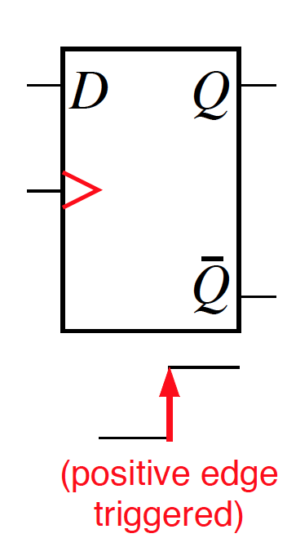
Data or Type D Flip-Flop – A Simple Memory
D | _{C} | Q_{n} | Qn+1 | description
0 |  | 0 | 0 | Clear (reset)
0 |  | 1 | 0
1 |  | 0 | 1 | Set
1 |  | 1 | 1
input at clock
output before clock
output after clock
Q_{n+1} = D
A D flip-flop simply stores the value on its D input at the clock transition. The previous value stored, Q_{n}, has no effect, unlike other flip-flops.
It therefore acts as a simple memory or ‘latch’.
The most widely used flip-flops: simple to build and design with.
A register comprises several D flip-flops, one for each bit to be stored.

Slide 26
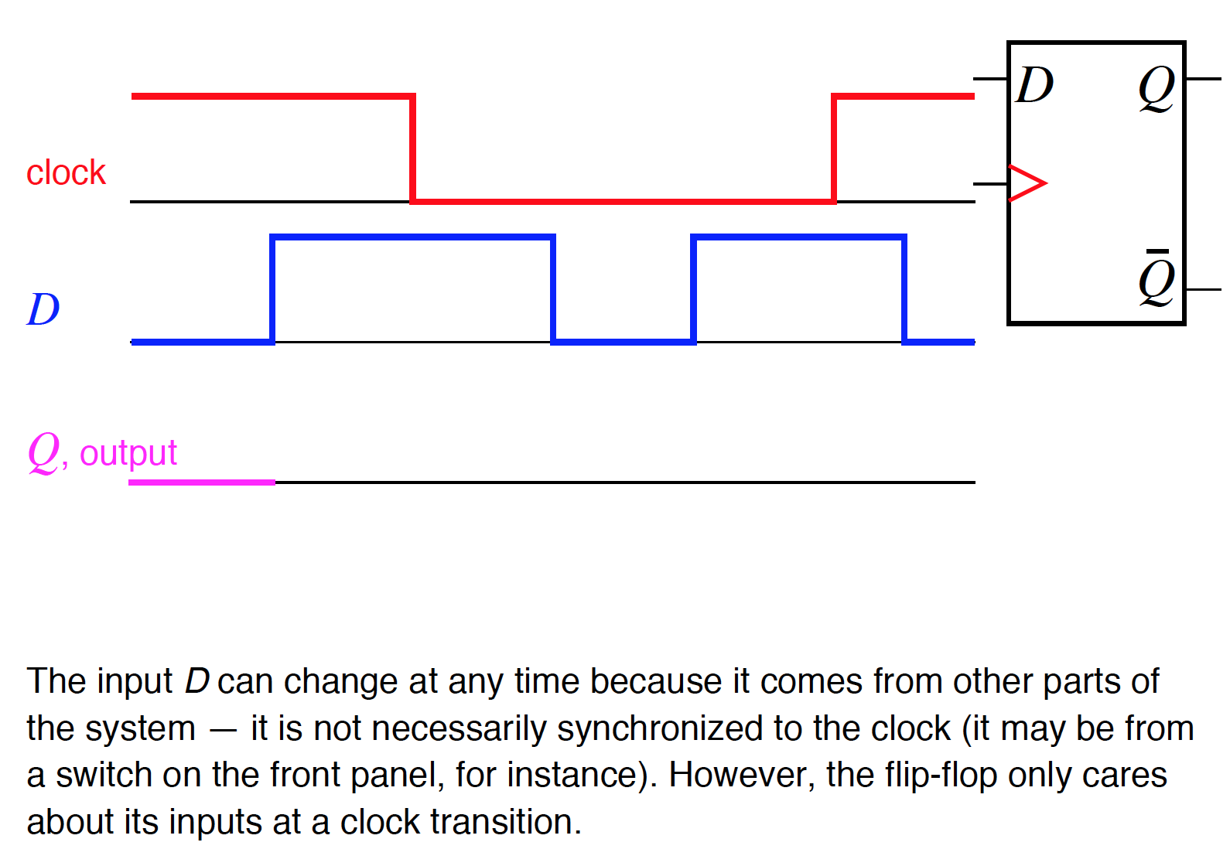
Transitions in a Positive Edge Triggered D Flip-flop

Slide 27
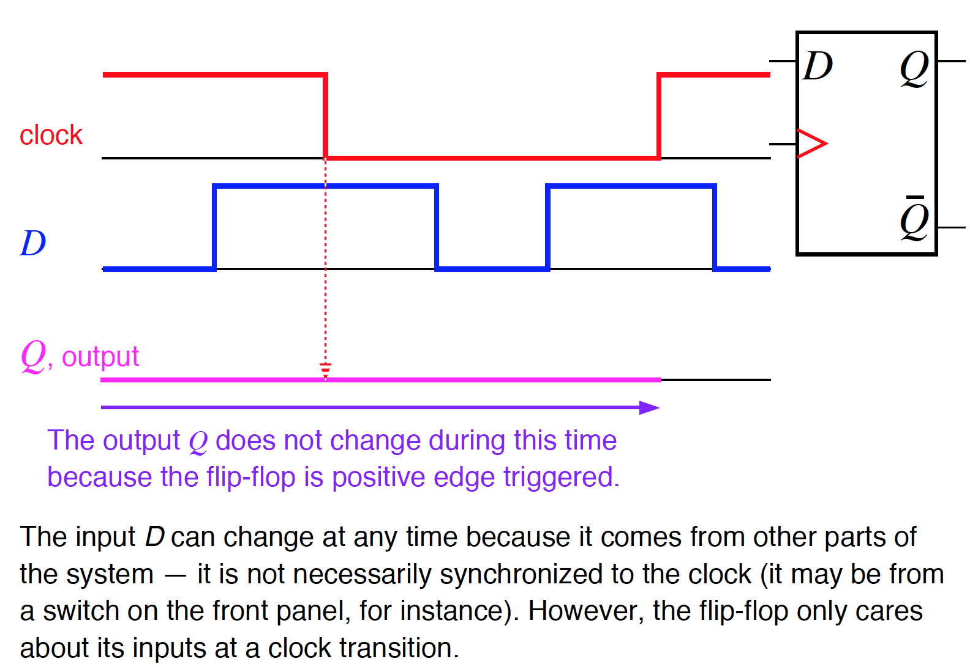
Transitions in a Positive Edge Triggered D Flip-flop

Slide 28
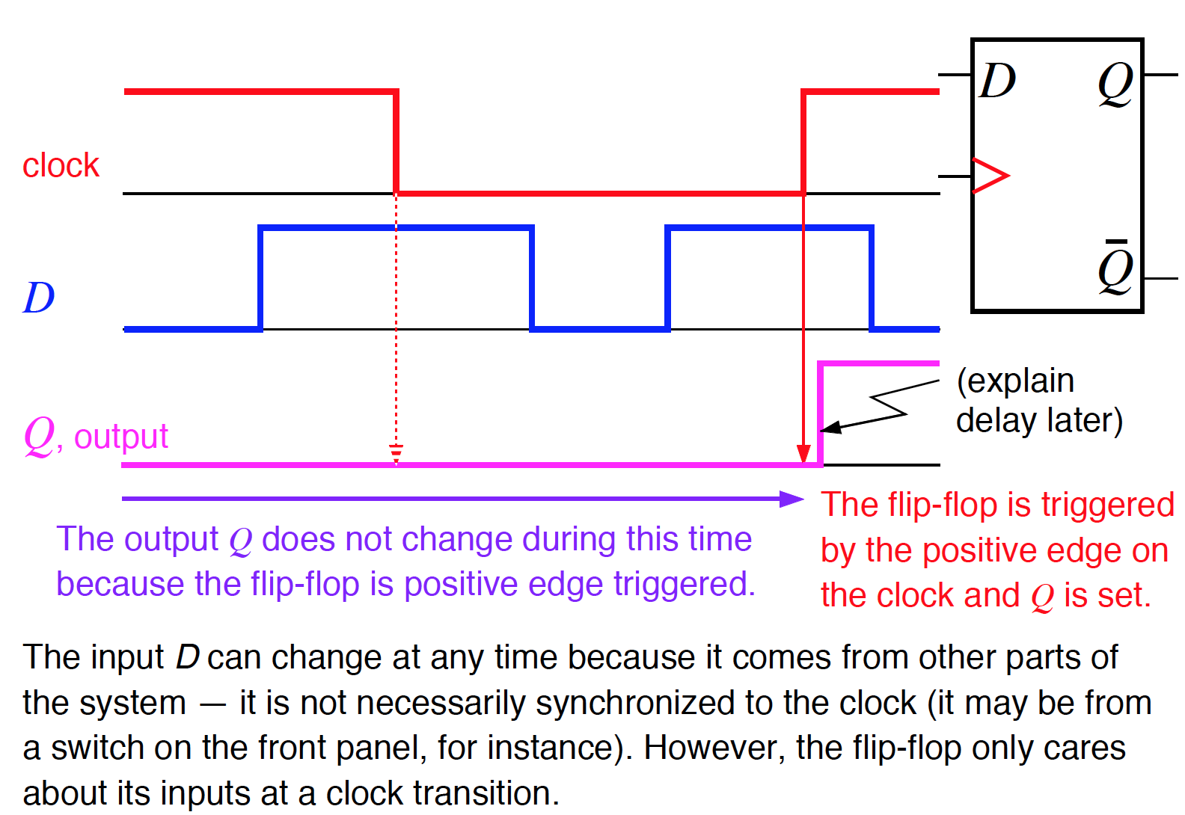
Transitions in a Positive Edge Triggered D Flip-flop

Slide 29
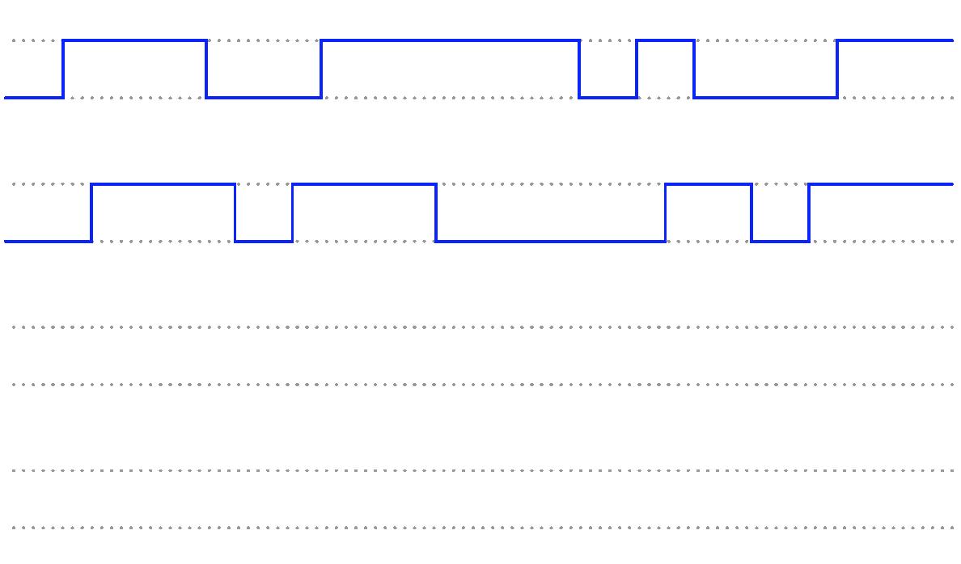
Example – Data (D) Latch
Determine the Q and Q output states of this D-type gated latch, given the following input conditions:
 | D Q C Q
D
C
Q
Q

Slide 30
Example – Data (D) Latch
D
C
Q
Q

Slide 31
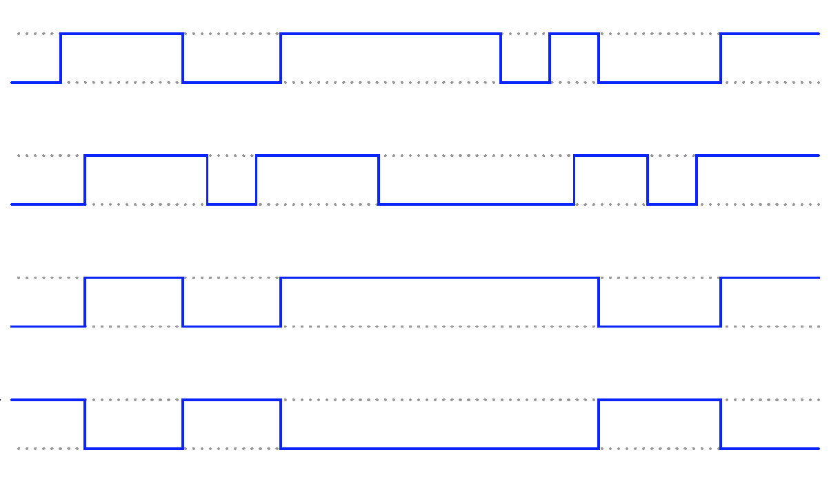
Example – Data (D) Latch
D
C
Q
Q

Slide 32
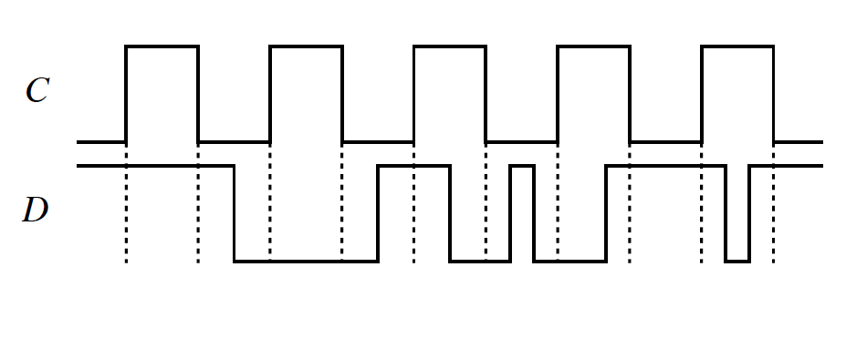
Example – D Flip-flop
The signals shown in the diagram below are applied to the inputs of two, separate D flip-flops. Flip-flop ‘+’ is positive edge triggered and its output is called Q+; flip-flop ‘−’ is negative edge triggered with output Q−. The clock signal is C. Sketch Q+ and Q− as a function of time, showing clearly the timing of their outputs compared with the clock and D. Ignore the propagation delay. Both flip-flops are initially cleared, which means Q+ = Q− = 0 at the start.

Slide 33
Example – D Flip-flop
D
Q
Q₊
Q
Positive edge triggered FF
D
Q
Q₋₋
Q
Negative edge triggered FF

Slide 34
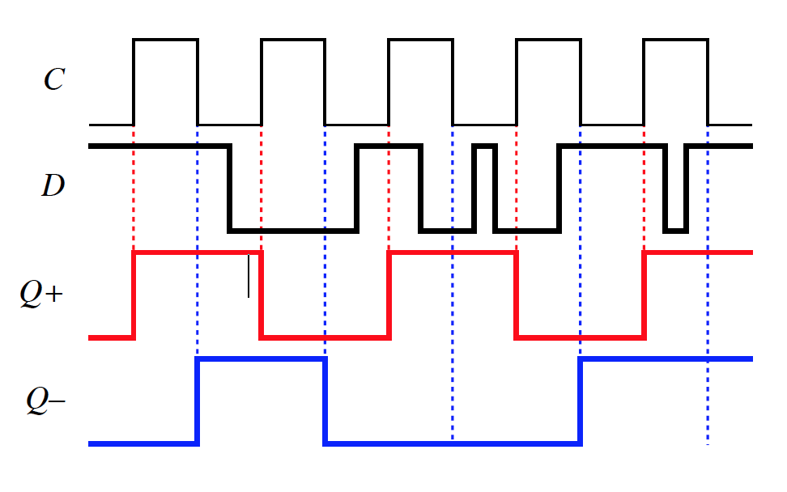
Example – D Flip-flop
D
Q
Q₊
Q
Positive edge triggered FF
D
Q
Q₋₋
Q
Negative edge triggered FF
Notes:
You need to know the behaviour of D flip-flop for this, either from its equation or the excitation table. The output is sketched below for the two cases, Q+ for positive edge triggering and Q− for negative edge. Note that the two short pulses have no effect because they do not overlap either a positive or negative edge of the clock I haven’t shown the propagation delay.

Slide 35
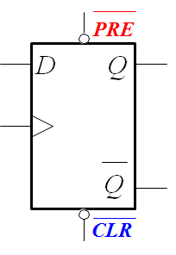
Control Inputs
Flip-flops and more complicated circuits often have inputs, such as clear, preset, enable, and load. The state of the control pins has priority to the D and Clock inputs when determining the state of the output
Clear (CLR) resets the flip-flop output to 0 — the most common control input
Preset (PRE) sets the flip-flop output to 1
More complicated circuits such as counters may have additional control inputs for up/down, count/hold, load, etc. Microprocessors usually have a reset pin

Slide 36
Active Low Controls
Control inputs are often active low, shown by a bar over the label or a circle for negation (or both as in the component below).
Active low inputs should be:
kept high for normal operation
changed to low to preset or clear the device.
The reason for making these active low is historical.
Check the data sheet to be sure!
Notes:
Only active when low

Slide 37
Asynchronous Control
Another feature of control inputs is that they are often asynchronous. This means that they take effect immediately and do not wait for a clock transition.
Compare
  D takes effect only at a clock transition (positive edge)
  clear and preset act immediately to ‘overrule’ D
Asynchronous inputs are sometimes called direct or jam inputs
Always check the data sheet because some control inputs are synchronous!

Slide 38
Limitations on Circuit: t_{pd}
The propagation delay is important for several reasons:
It limits the speed at which circuits can be clocked
Signals that pass through different numbers of components receive different delays. Time must be allowed for all outputs to settle down before the system attempts to change state again
The delay helps to keep digital circuits with feedback stable (this applies to virtually all practical circuits)
  each device ‘reads its inputs’ at the clock transition…
  the outputs change after the propagation delay…
  which in turn affects the inputs because they are connected to outputs…
  but the devices are no longer interested in their inputs…
  until the next clock transition arrives

Slide 39
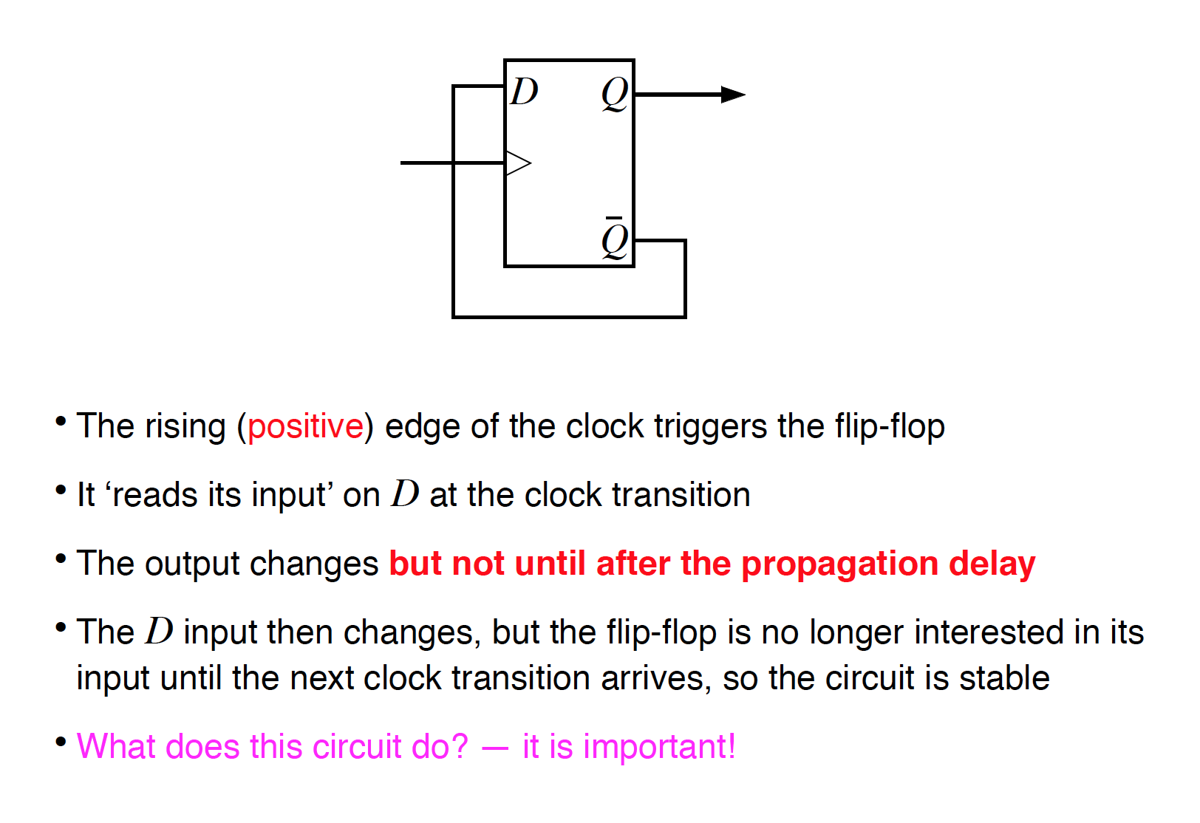
A Simple Circuit with Feedback

Slide 40
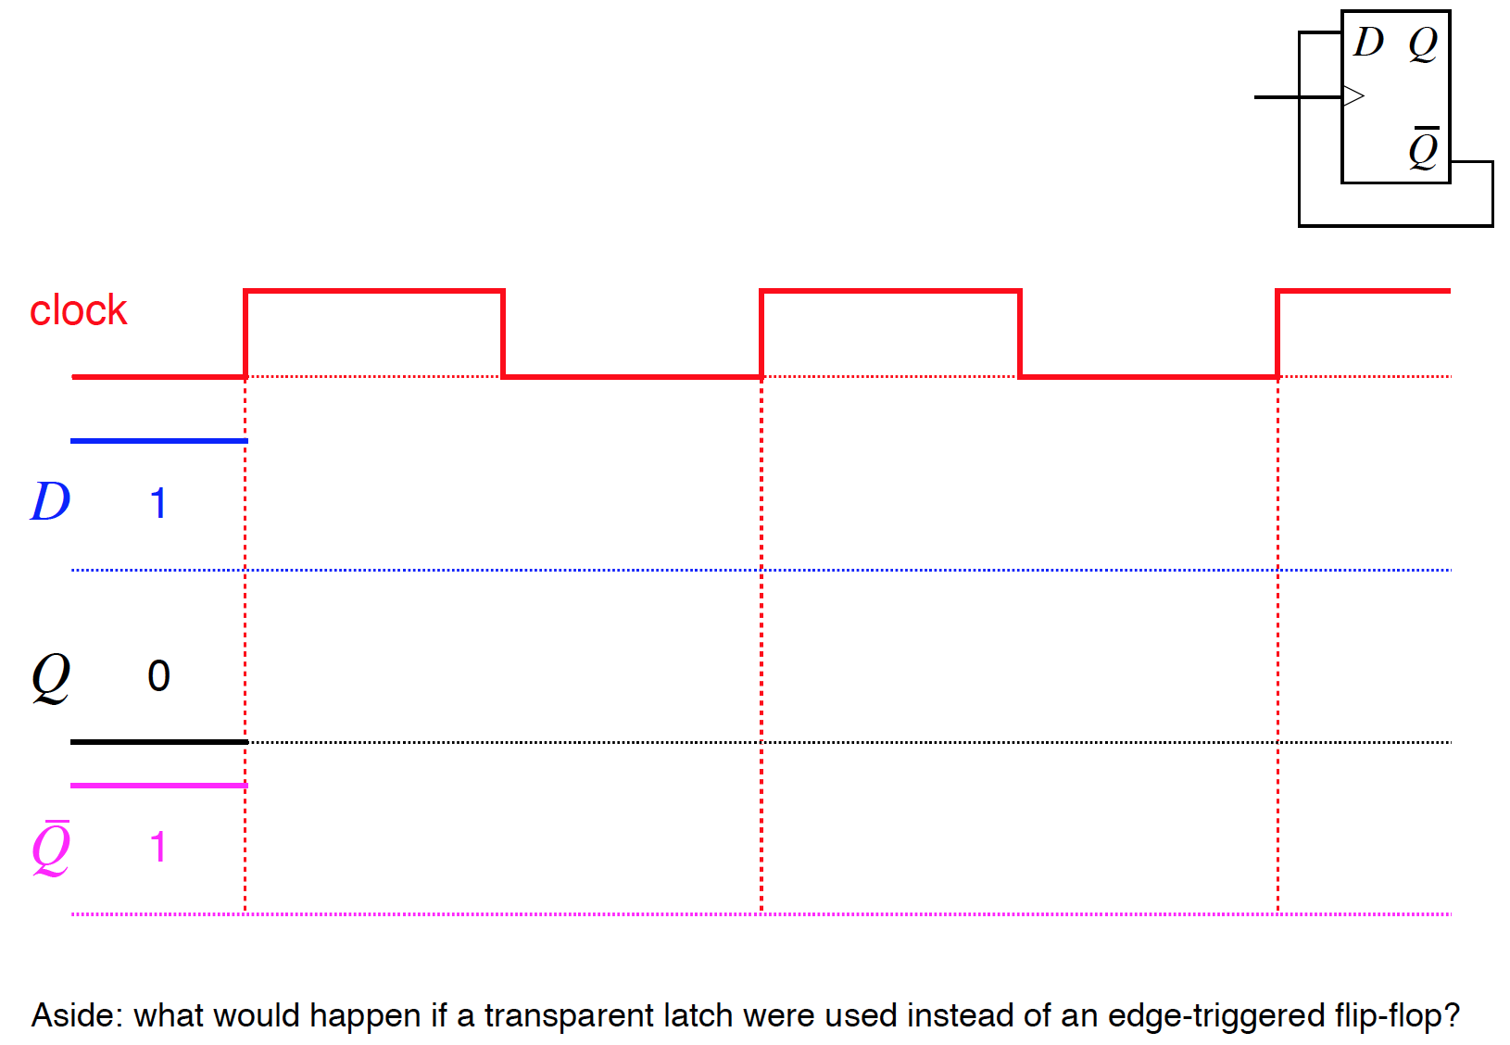
A Simple Circuit with Feedback
Notes:
It works like this.
• Initially the flip-flop is cleared so Q = 0 and D = Q¯ = 1.
• The flip-flop reads its D input at a positive transition of the clock. At the first transition this is 1.
• Thenewly read value of D appears at Q after the propagation delay tpd so Q changes from 0 to 1, while ¯Q changes from 1 to 0.
Nothing more happens until the next positive transition of the clock, when Q and ¯Q reverse (toggle).
The output therefore toggles shortly after every positive clock transition.
The same outputs would be seen with negative edge triggering but displaced in time to follow the negative edges rather than the positive edges.
The circuit would be unstable if a transparent latch were used instead of an edge-triggered flip-flop. The problem is that the latch would try to update itself continuously to match D = ¯Q while the latch was transparent. Unfortunately the latch gives Q = D, or ¯Q = ¯D. It would probably oscillate. In contrast, the edge-triggered device is perfectly stable.

Slide 41
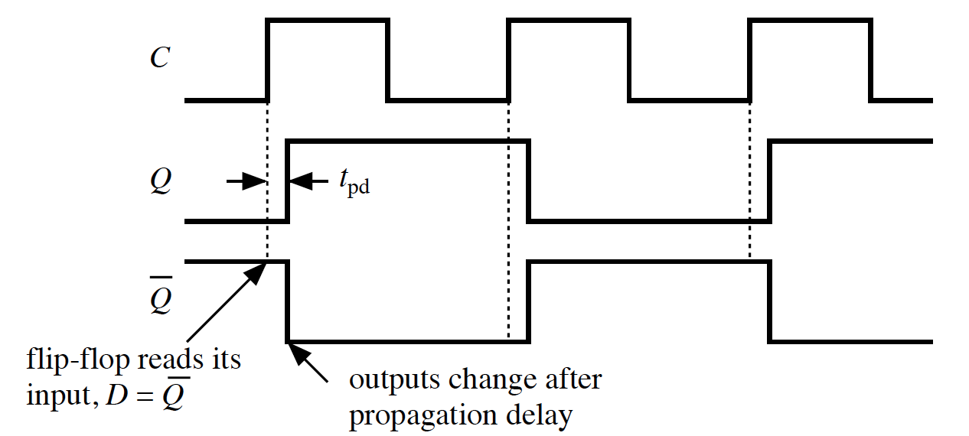
A Simple Circuit with Feedback
Notes:
It works like this.
• Initially the flip-flop is cleared so Q = 0 and D = Q¯ = 1.
• The flip-flop reads its D input at a positive transition of the clock. At the first transition this is 1.
• Thenewly read value of D appears at Q after the propagation delay tpd so Q changes from 0 to 1, while ¯Q changes from 1 to 0.
Nothing more happens until the next positive transition of the clock, when Q and ¯Q reverse (toggle).
The output therefore toggles shortly after every positive clock transition.
The same outputs would be seen with negative edge triggering but displaced in time to follow the negative edges rather than the positive edges.
The circuit would be unstable if a transparent latch were used instead of an edge-triggered flip-flop. The problem is that the latch would try to update itself continuously to match D = ¯Q while the latch was transparent. Unfortunately the latch gives Q = D, or ¯Q = ¯D. It would probably oscillate. In contrast, the edge-triggered device is perfectly stable.

Slide 42
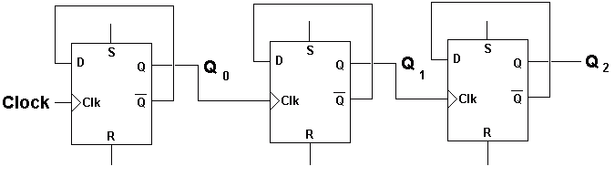
Would this circuit work?
What would happen if t_{pd} is longer than the period of the clock?
What would happen if t_{pd} is about equal to the clock’s period?

Slide 43
Lecture Review Questions
What is the fundamental difference between combinational and sequential logic?
What inputs should you put on a SR flip-flop to set it (to 1)?
Why must S = R = 1 be avoided?
Why do sequential logic circuits need a clock?
Describe the operation of a D (Data) latch. For what are they used?
What is meant by the term edge-triggered flip-flop?
Describe the operation of a type D flip-flop. For what are they used?
Why do some flip-flops have control inputs? In what ways do they differ from the normal inputs?
What is the propagation delay? Why is it important?

