Slide 1
UESTC1008: Microelectronic Systems
Digital to Analogue Conversion (DAC)
Lecture 6
Muhammad Ali Imran
School of Engineering
University of Glasgow

Slide 2
Why is conversion needed?
The other day I went to the market to buy something. The sales girl would not understand English. How do we communicate then?
  Use Translator >>> Language Converter
Digital devices (PCs, Phones etc.) want to connect to real world but real world is Analogue and digital world is Digital. How to make them talk?

Slide 3
Why is conversion needed?
Most signals in the world are analogue
Microprocessors and most computers use digital signals
  Analogue to Digital Converters (ADCs) change analogue signals to digital signals that are then used by the microprocessor
  Digital to Analogue Converters (DACs) may be used to change digital signals to analogue signals that are then used by the peripherals attached to the microprocessor

Slide 4
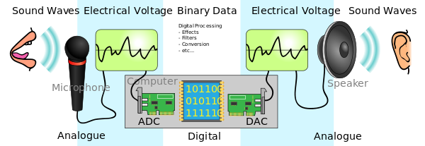
Why is conversion needed?

Slide 5
ADCs and DACs
ADCs tend to be more common on a microprocessor.
  The number of peripherals that have ADCs and DACs integrated inside is increasing so the microprocessor may not need this capability in the future.
    Why? Because more peripherals are manufactured with integrated ADCs. However, you then need to decide type of format that the digitized data will be transferred to your microprocessor
      Examples: I²C, CAN, SPI, ethernet, USB

Slide 6
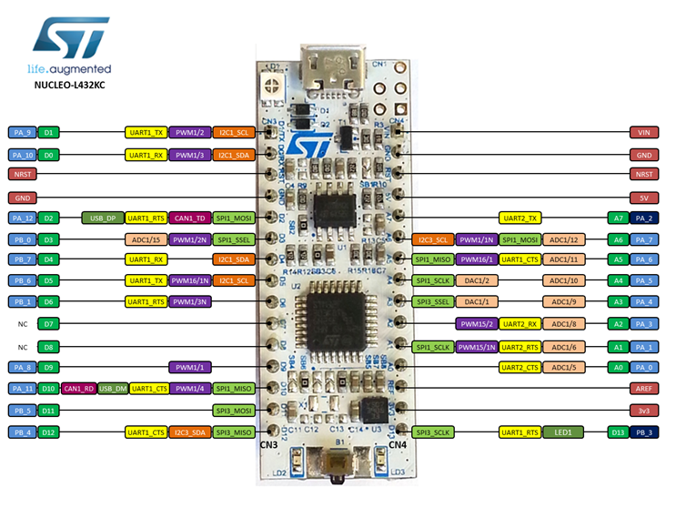
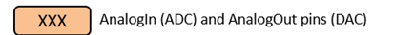
mbed – ADC and DAC pins

Slide 7
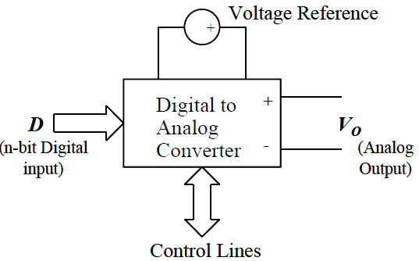
Digital to Analogue Conversion (DAC)
Want to convert a binary input number into an analogue output. As a block diagram, we are looking at something like
D is the digital input.
Vo is the Analog output.
V_{r} is a precise, stable, known voltage reference,
There are some control lines that are used to determine how often the DAC should convert the input signal, for example.

Slide 8
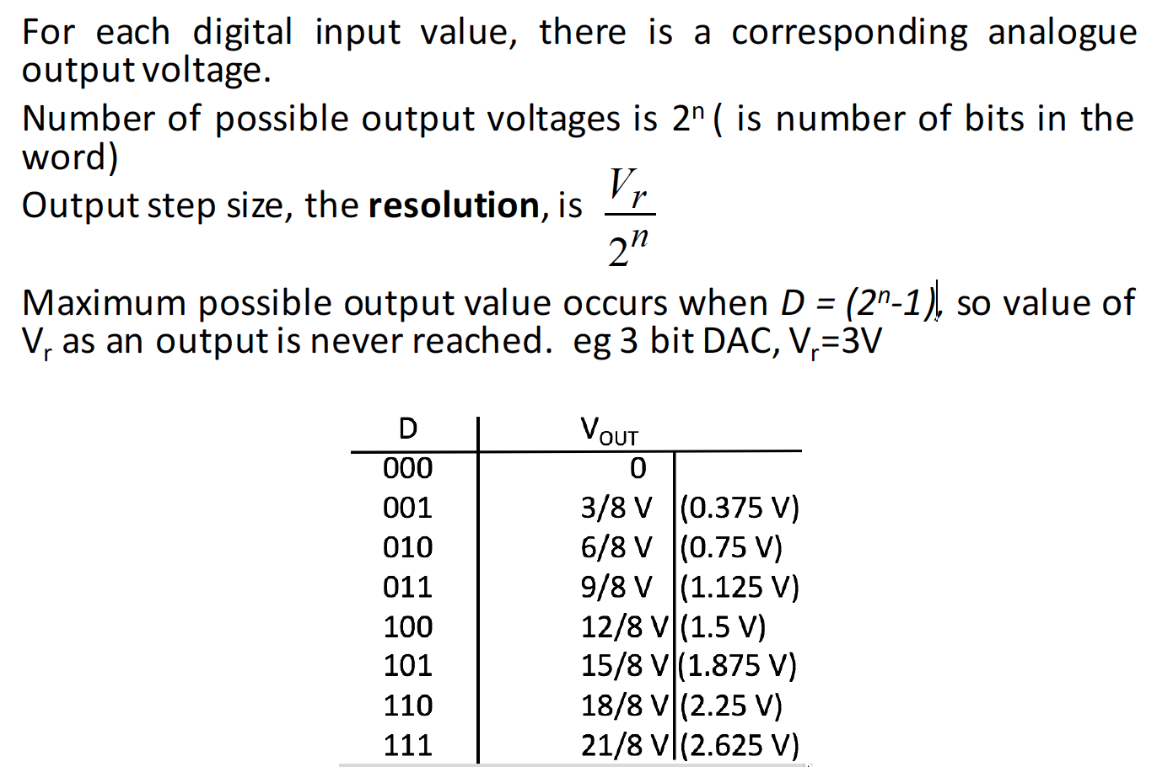
Digital to Analog Conversion (DAC)

Slide 9
DAC - Example
A bit sequence 010101011001110 (starts with 010) is given at the input of a 3-bit DAC. Draw the analogue output waveform.
v
t

Slide 10

Output values
A simple relationship usually relates the digital input to the analog output, such as
V_{o} is the analog output voltage
D is the value of the binary input word
n is the number of bits in the input word
V_{r} is the value of the voltage reference
D
V_{o} = _{n} V_{r}
2
V_{r} (2^{n}-1)V_{r}/2^{n} (2^{n}-2)V_{r}/2^{n}
2V_{r}/2^{n}
V_{r}/2^{n}
0
…
000
001 010
2^{n}-2 2^{n}-1
₂n
D (input binary number)

Slide 11

Construction: R-2R ladder
^{D}n-1 V_{out} – Analog Out
MSB
2R Ω
R Ω
2R Ω
^{D}n-2
. .
A relatively straightforward DAC can be realised using a resistor network, a common type is the R-2R ladder
D₂
2R Ω
R Ω
D
1
2R Ω
R Ω
D_{o}
LSB
2R Ω
2R Ω

Slide 12
Analog Output
The range of the DAC is the difference between the maximum and minimum output values
The resolution of the DAC is the step size between each analog value
Conversion speed is the inverse of the time that it takes the DAC to act on changes to the input

Slide 13
Key Features of the STM32L432KC
Ultra-low-power with FlexPowerControl
  1.71 V to 3.6 V power supply
  -40 °C to 85/105/125 °C temperature range
  8 nA Shutdown mode (2 wakeup pins)
  28 nA Standby mode (2 wakeup pins)
  280 nA Standby mode with RTC
  1.0 μA Stop 2 mode, 1.28 μA with RTC
  84 μA/MHz run mode
  Batch acquisition mode (BAM)
  4 μs wakeup from Stop mode
  Brown out reset (BOR)
  Interconnect matrix
Core: Arm® 32-bit Cortex®-M4 CPU with FPU, Adaptive real-time accelerator (ART Accelerator™) allowing 0-wait-state execution from Flash memory, frequency up to 80 MHz, MPU, 100DMIPS and DSP instruction
Memories
  Up to 256 KB single bank Flash, proprietary code readout protection
  64 KB of SRAM including 16 KB with hardware parity check
  Quad SPI memory interface
Rich analog peripherals (independent supply)
  1x 12-bit ADC 5 Msps, up to 16-bit with hardware oversampling, 200 μA/Msps
  2x 12-bit DAC output channels, low-power sample and hold
  1x operational amplifier with built-in PGA
  2x ultra-low-power comparators
14x communication interfaces
  USB 2.0 full-speed crystal less solution with LPM and BCD
  1x SAI (serial audio interface)
  2x I2C FM+(1 Mbit/s), SMBus/PMBus

Slide 14
mbed - Example
The L432kc has a 12 bit DAC, and uses its regulated 3.6 V power supply as the voltage reference.
  What are
    the number of steps,
    the resolution,
    the range, and
    the conversion speed of the L432kc DAC? Assume that it takes 5μs per conversion.
    How many clock cycles does this conversion take?

Slide 15
mbed - Example
The mbed L432kc chip has a 12-bit DAC (i.e. n = 12)
The mbed uses its own 3.6 V power supply as voltage reference
  There will therefore be 2^{n} steps in the mbed DAC output characteristic, i.e. 4096.
  The step size, or resolution, is therefore be 3.6/4096, i.e. 0.87890625mV per bit
  The range is (2¹² – 1)/ 2¹² * 3.6 = 3.599 V
  The conversion speed is 200,000/s.
  The clock speed is 80 MHz so the conversion time is equivalent to 400 clock cycles
There is another specification called the sampling frequency. The maximum sampling frequency provides a limit to the speed at which the digital signal can be sent to the DAC

Slide 16
Digital to Analog Conversion (DAC)
It is relatively easy to check the resolution of the DAC.
For example, create an extremely slow sawtooth. In this case, it takes 10,000 steps to reach the max value with a 1 second interval between each step. The period of the waveform is about 2 hours 45 minutes, but this is not the point.
/* Program to check DAC resolution of mbed*/
#include “mbed.h”
AnalogOut Aout(A4);
DigitalOut led1(LED1);
float i;
int main(){
while(1){
for (i=0;i<1;i=i+0.0001){
Aout=i;
wait(1);
led1=!led1;
}
} }
Note: By the end of this course, you should be able to go through a simple program and describe what each line of code means and what the mbed will do as a result. You should also be able to write a simple program for the mbed .

Slide 17
Measurement
Connect the AnalogOut pin to a voltmeter or an oscilloscope
LED flashes each time that a new analog value is outputted by the DAC
However, 10,000 is larger than the maximum number of steps for the mbed DAC
So, the DAC output voltage only changes on approximately every 2nd step and when it does, the output voltage changes by about .87 mV
The float value is rounded to the nearest digital input to the DAC

Slide 18
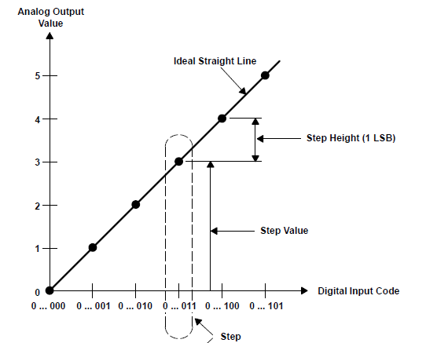
Ideal DAC
From Understanding Data Converters, Texas Instruments Application Note

Slide 19
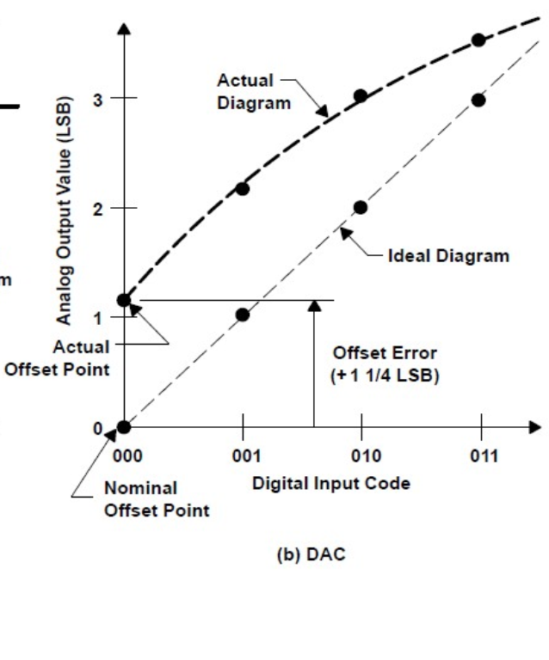
Offset Error
From Understanding Data Converters, Texas Instruments Application Note

Slide 20
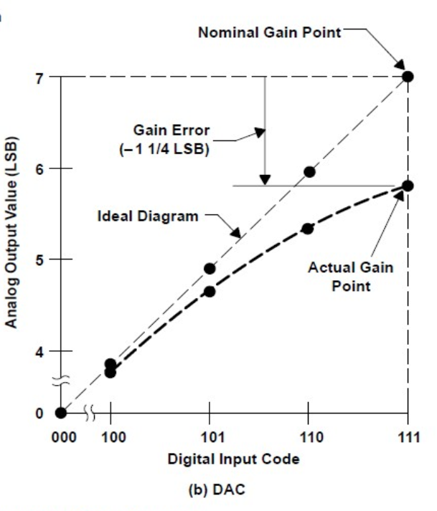
Gain Error
From Understanding Data Converters, Texas Instruments Application Note

Slide 21
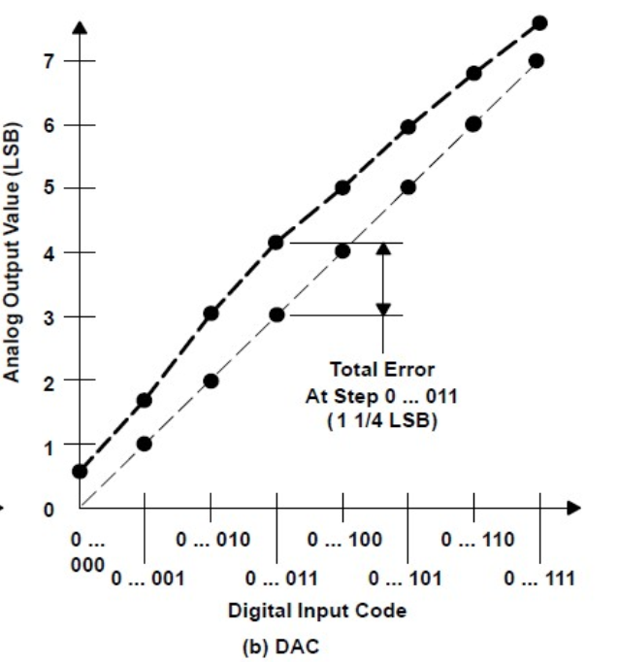
Gain Error
Offset Error Nonlinearity Error
Total Error
From Understanding Data Converters, Texas Instruments Application Note

