Slide 1
Signals and Systems
Lab experiment #2 Introduction
Wang Lingfang (UESTC)
Oct 26, 2021
19:00—22:00

Slide 2

Lab2
Analysis LTI system using MATLAB

Slide 3
References book：
John R.Buck, Michael M. Daniel, Andrew C. Singer. Computer Exploration in Signals and Systems —— Using MATLAB.
lab report template
lab report _template.doc
Required instruments
Computer, MATLAB

Slide 4
Chief objects for 4 Labs:
Lab1 : Represent signals using MATLAB;
Lab2 : Analysis LTI systems using MATLAB;
Lab3 : Frequency domain analysis using MATLAB ;
Lab4: Transform domain analysis using MATLAB.

Slide 5
Contents
1. Introduction of Lab2
2. Theoretical background and commands

Slide 6
1. Introduction
■ Objective：
Be further familiar with the properties of linear time-invariant (LTI) systems.
Perform convolution using MATLAB.
Compute the output of causal LTI system characterized by linear constant-coefficient differential/ difference equations.
■Related commands: conv, filter, lsim
■ Submit your report to my TA(时鑫) before Dec 31, 2021
Notes:
1. The MATLAB function conv computes the convolution sum;
2. The filter command computes the output of a causal, LTI system for a given input when the system is specified by a linear constant-coefficient difference equation.
3. The function lsim can be used to simulate the output of continuous-time, causal LTI systems described by linear constant-coefficient differential equations of the form

Slide 7
1. Introduction of lab2
■ Exercises ：
Perform convolution. 2.1(c)
Compute the output of causal LTI system characterized by linear constant-coefficient difference equations . 2.2(a)(b)(c)(d)(e)(g)

Slide 8
Contents
1. Introduction of Lab2
2. Theoretical background and commands

Slide 9
Contents
2. Theoretical background
2.1 conv
2.2 filter
2.3 lsim

Slide 10

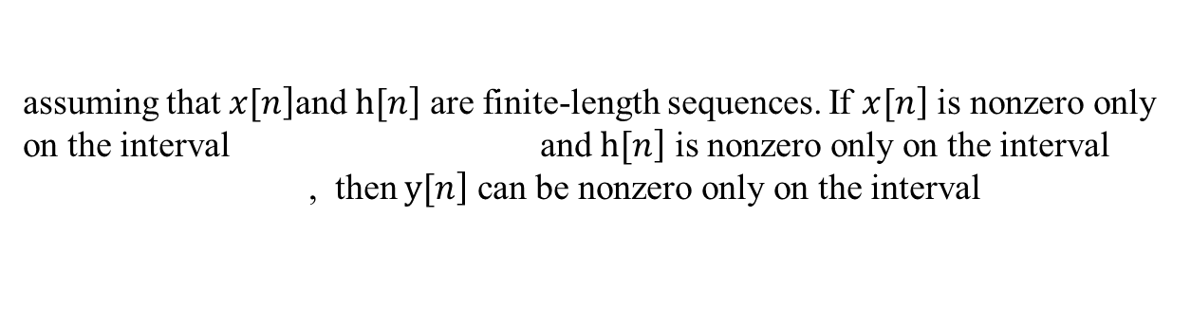
2.1 conv
■ Convolution sum
The MATLAB function conv computes the convolution sum
assuming that $\left.x[n\right]$and $\left.h[n\right]$ are finite-length sequences. If $\left.x[n\right]$ is nonzero only on the interval and $\left.h[n\right]$ is nonzero only on the interval
, then $\left.y[n\right]$ can be nonzero only on the interval
$$N_{x}+N_{h}−1$$
meaning that conv need only compute y[n] for the samples on this interval.

Slide 11
2.1 conv
■ conv
■ Function
Computing the Convolution Sum
■ Command call
y = conv(h,x);
h : a vector , such as h = [1,3,4,6];
x : a vector , such as x = [1,3,4,6];

Slide 12
2.1 conv
■ ex1
x=[ones(1,6)];
y=conv(x,x);
ny=[0:length(y)-1];%L=6+6-1-1
stem(ny,y);
xlabel('n');
ylabel('y[n]');
title('the figure of the signal y[n]=x[n] * x[n]);
grid on;
■ Code
■ Figure

Slide 13
Contents
2. Theoretical background
2.1 conv
2.2 filter
2.3 lsim

Slide 14
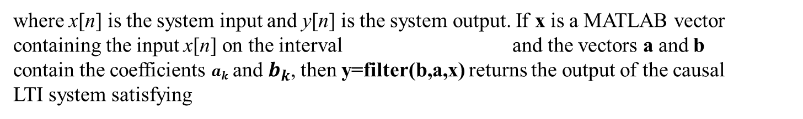
2.2 filter
The filter command computes the output of a causal, LTI system for a given input when the system is specified by a linear constant-coefficient difference equation. Specifically, consider an LTI system satisfying the difference equation
where x[n] is the system input and y[n] is the system output. If x is a MATLAB vector
containing the input x[n] on the interval and the vectors a and b
contain the coefficients $a_{k}$ and $b_{k}$, then y=filter(b,a,x) returns the output of the causal
LTI system satisfying

Slide 15
2.2 filter
■ filter
■ Function
computes the output of a causal, LTI system for a given input when the system is described by a linear constant-coefficient difference equation.
■ Command call
y=filter(b,a,x)
b : constant coefficient of x[n];
a : constant coefficient of y[n];
x: the input of the system;
y: the output of the system.

Slide 16
2.2 filter
■ ex2
x=[0 0 0 ones(1,3)];
nx=[0:5];
b=[0:5];
a=1;
ny=[0:5];
y=filter(b,a,x);
figure(1);
subplot(2,1,1);
stem(nx,x);xlabel('n');ylabel('x[n]');title('the figure of x[n]');grid on;
subplot(2,1,2);
stem(ny,y);xlabel('n');ylabel('y[n]');title('the figure of y[n]');grid on;
■ Code
■ Figure

Slide 17
Contents
2. Theoretical background
2.1 conv
2.2 filter
2.3 lsim

Slide 18

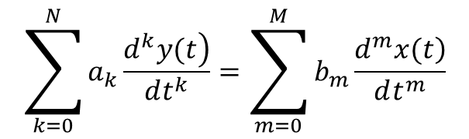
2.3 lsim
■ Linear constant-coefficient differential equations
$$\sum_{k=0}^{N}{a_{k}\frac{\left.d^{k}y(t\right)}{dt^{k}}}=\sum_{m=0}^{M}{b_{m}\frac{\left.d^{m}x(t\right)}{dt^{m}}}$$
$$\begin{matrix}a_{k}:\text{Constant} \text{coefficient} \text{of} \frac{\left.d^{k}y(t\right)}{dt^{k}}\text{;} \\ b_{m}:\text{Constant} \text{coefficient} \text{of} \frac{\left.d^{m}x(t\right)}{dt^{m}}\text{;} \\ \frac{\left.d^{k}y(t\right)}{dt^{k}}:the \text{differential} of the output; \\ \frac{\left.d^{m}x(t\right)}{dt^{m}}:the \text{differential} of the input;\end{matrix}$$

Slide 19
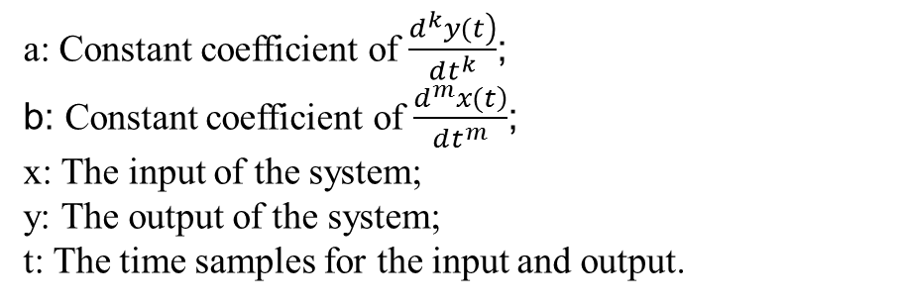
2.3 lsim
■ lsim
■ Function
Simulates the output of continuous-time, causal LTI systems described by linear constant-coefficient differential equations.
■ Command call
y=lsim(b,a,x,t)
a: Constant coefficient of $\frac{\left.d^{k}y(t\right)}{dt^{k}}$;
b: Constant coefficient of $\frac{\left.d^{m}x(t\right)}{dt^{m}}$;
x: The input of the system;
y: The output of the system;
t: The time samples for the input and output.

Slide 20
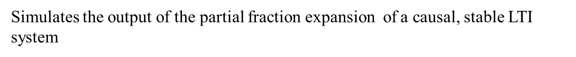
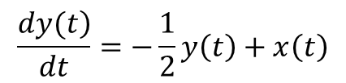
2.3 lsim
■ ex3
Simulates the output of the partial fraction expansion of a causal, stable LTI system
$$\frac{\left.dy(t\right)}{dt}=−\frac{1}{2}y\left(t\right)+x\left(t\right)$$
■ code
t=[0:10];
x=ones(1,length(t));
b=1;a=[1 0.5];
y=lsim(b,a,x,t); plot(t,y,'--'); xlabel('t'); ylabel('y');
■ figure

Slide 21
Thanks
2021.10.26

