Slide 1
Signals and Systems
Lab experiment #3 Introduction
Wang Lingfang (UESTC)
Office Room: KB204
Nov 9, 2021
19:00—22:00

Slide 2

Lab3
Frequency domain analysis using MATLAB

Slide 3
References book：
John R.Buck, Michael M. Daniel, Andrew C. Singer. Computer Exploration in Signals and Systems —— Using MATLAB.
lab report template
lab report _template.doc
Required instruments
Computer, MATLAB

Slide 4
Chief objects for 4 Labs:
Lab1 : Represent signals using MATLAB;
Lab2 : Analysis LTI systems using MATLAB;
Lab3: Frequency-domain analysis using MATLAB;
Lab4: Transform domain analysis using MATLAB.

Slide 5
Contents
1. Introduction
2. Theoretical background and commands

Slide 6
1. Introduction
■ Objective：
Perform the Fourier series using MATLAB
Perform the Fourier transform using MATLAB
Further understand the properties of Fourier transform.
Apply Fourier transform in modulation.
■Related commands:
fft, fftshift, freqz, freqs, filter, residue, Isim
■ Submit your report before: Dec 31, 2021

Slide 7
1. Introduction of lab3
■ Exercises ：
Compute the Discrete-time frequency response with freqz.3.2.
Describe the system function by using lsim. 3.3.
Frequency response of a Continuous-time System. 3.9(a)(b).
Properties of the Continuous-Time Fourier Transform. 4.3(a)-(f) .
Perform Partial Fraction Expansion. 4.5(b).

Slide 8
Contents
1. Introduction of Lab3
2. Theoretical background and commands

Slide 9
Contents
2. Theoretical background
2.1 fft and fftshift
2.1 fft and fftshift
2.2 freqz and filter
2.3 freqs, residue and lsim

Slide 10
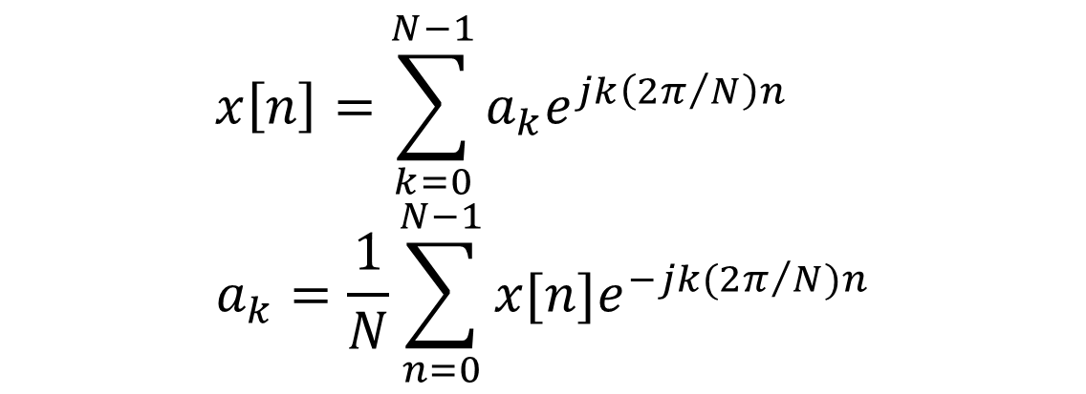
2.1 fft and fftshift
■ Discrete-Time Fourier Series
For a signal x[n] with fundamental period N, the DTFS synthesis and analysis equations are given by
$$x\left[n\right]=\sum_{k=0}^{N−1}{a_{k}e^{jk\left(2π/N\right)n}}$$
$$a_{k}=\frac{1}{N}\sum_{n=0}^{N−1}{x[n]e^{−jk(2π/N)n}}$$

Slide 11
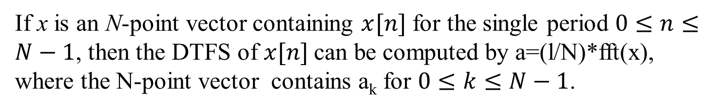
2.1 fft and fftshift
If x is an N-point vector containing $x[n]$ for the single period $0≤n≤N−1$, then the DTFS of $x[n]$can be computed by a=(l/N)*fft(x), where the N-point vector contains a_{k} for $0≤k≤N−1$.
■ fft
■ Function
Computing the Discrete-Time Fourier Series
■ Command call
y = fft(x);
x : a vector , such as x = [1,3,4,6];
y : the Discrete-Time Fourier Series of x

Slide 12
2.1 fft and fftshift
■ ex1
N=100;
k=(-50:49);
fs=2*pi;
w=fs*k/N;
M=(0:9);
y=ones(1,10);
X=fft(y,N);
Pxx=abs(X)/100;
plot(w,Pxx(1:100));
title('y=fft(x)')
xlabel('x');ylabel('y')
■ Code
■ Figure

Slide 13
2.1 fft and fftshift
■ fftshift
■ Function
The function fftshift re-orders the output of fft so that the samples of Y(jω) are ordered in Y from the most negative to most positive frequencies.
■ Command call
y = fftshift(fft(x));
x : a vector , such as x = [1,3,4,6];
y : the Discrete-Time Fourier Series of x, from the most negative to most positive frequencies.

Slide 14
2.1 fft and fftshift
■ ex2
N=100;
k=(-N/2:(N/2)-1);
fs=2*pi;
w=fs*k/N;
M=(0:9);
y=ones(1,10);
X=fftshift(fft(y,N));
Pxx=abs(X)/100;
plot(w,Pxx(1:100));
title('y=fftshift(fft(x))')
xlabel('x');ylabel('y')
■ code
■ figure

Slide 15
Contents
2. Theoretical background
2.1 fft and fftshift
2.2 freqz and filter
2.2 freqz and filter
2.3 freqs, residue and lsim

Slide 16
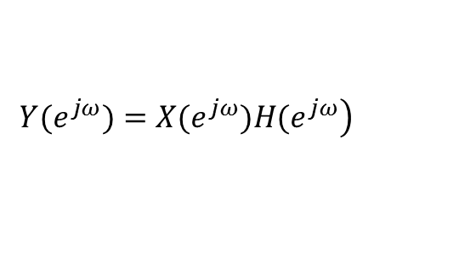
2.2 freqz and filter
■ The frequency response
For an LTI system, if H(e^{jω}) is the frequency response, then
$$\left.Y(e^{jω})=X(e^{jω})H(e^{jω}\right)$$

Slide 17
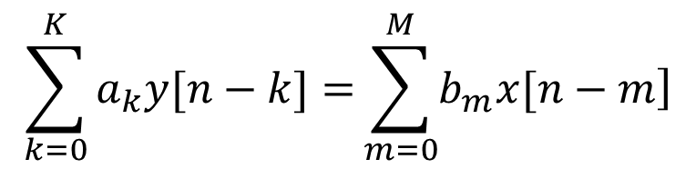
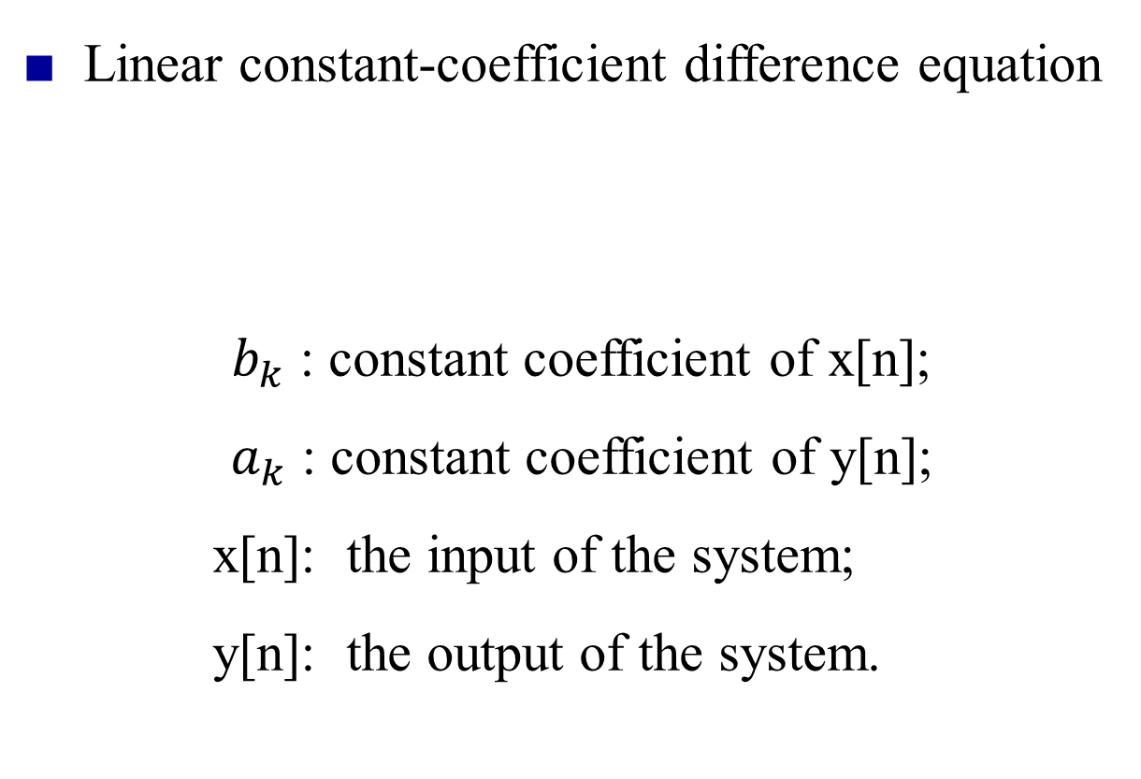
2.2 freqz and filter
■ Linear constant-coefficient difference equation
$b_{k}$ : constant coefficient of x[n];
$a_{k}$ : constant coefficient of y[n];
x[n]: the input of the system;
y[n]: the output of the system.
$$\sum_{k=0}^{K}{a_{k}y[n−k]=}\sum_{m=0}^{M}{\left.b_{m}x[n−m\right]}$$

Slide 18
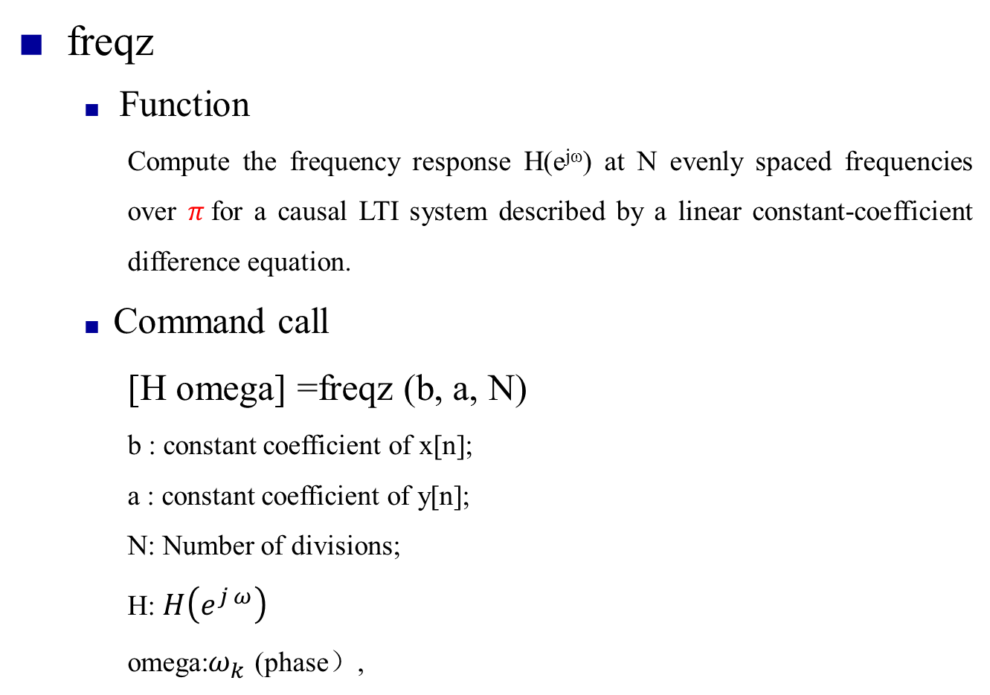
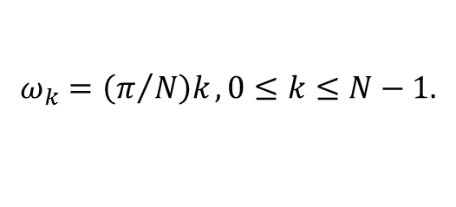
2.2 freqz and filter
■ freqz
■ Function
Compute the frequency response H(e^{jω}) at N evenly spaced frequencies over $π$for a causal LTI system described by a linear constant-coefficient difference equation.
■ Command call
[H omega] =freqz (b, a, N)
b : constant coefficient of x[n];
a : constant coefficient of y[n];
N: Number of divisions;
H: $H\left(e^{j ω}\right)$
omega:$ω_{k}$ (phase）,
$$ω_{k}=\left(π/N\right)k , 0≤k≤N−1.$$

Slide 19
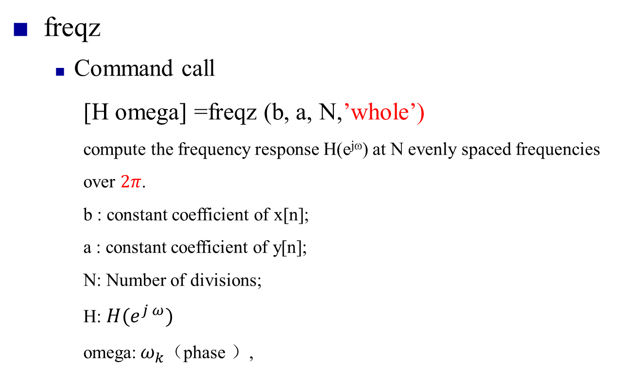
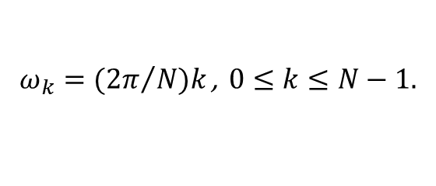
2.2 freqz and filter
■ freqz
■ Command call
[H omega] =freqz (b, a, N,’whole’)
compute the frequency response H(e^{jω}) at N evenly spaced frequencies over $2π$.
b : constant coefficient of x[n];
a : constant coefficient of y[n];
N: Number of divisions;
H: $H(e^{j ω})$
omega:${ ω}_{k}$（phase ）,
$$ω_{k}=({2π}/N)k \text{, } 0≤k≤N−1.$$

Slide 20
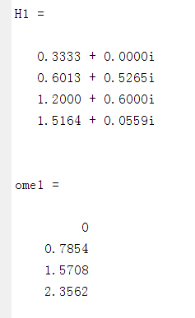
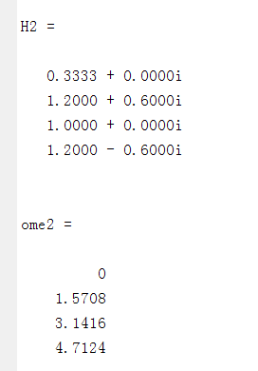
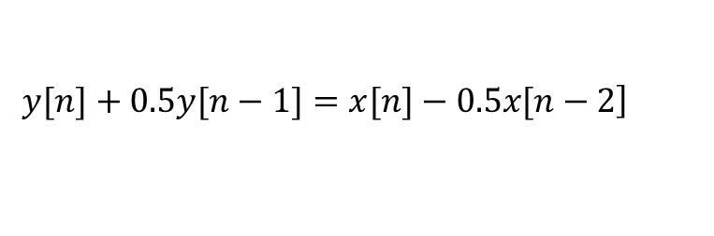
2.2 freqz and filter
■ ex3
describe the causal LTI system specified by the system function
$$\left.y[n]+0.5y[n−1]=x[n]−0.5x[n−2\right]$$
■ code
a = [1,0.5,0];
b = [1,0,-0.5];
[H1, ome1]=freqz(b,a,4)
[H2, ome2]=freqz(b,a,4, 'whole')
■ figure

Slide 21
2.2 freqz and filter
■ filter
■ Function
computes the output of a causal, LTI system for a given input when the system is described by a linear constant-coefficient difference equation.
■ Command call
y=filter(b,a,x)
b : constant coefficient of x[n];
a : constant coefficient of y[n];
x: the input of the system;
y: the output of the system.

Slide 22
Contents
2. Theoretical background
2.1 fft and fftshift
2.2 freqz and filter
2.3 freqs, residue and lsim
2.3 freqs, residue and lsim

Slide 23

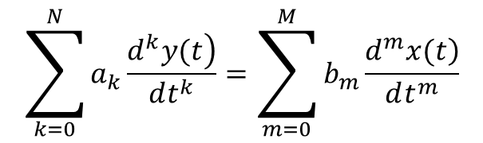
2.3 freqs, residue and lsim
■ Linear constant-coefficient differential equations
$$\sum_{k=0}^{N}{a_{k}\frac{\left.d^{k}y(t\right)}{dt^{k}}}=\sum_{m=0}^{M}{b_{m}\frac{\left.d^{m}x(t\right)}{dt^{m}}}$$
$$\begin{matrix}a_{k}:\text{Constant} \text{coefficient} \text{of} \frac{\left.d^{k}y(t\right)}{dt^{k}}\text{;} \\ b_{m}:\text{Constant} \text{coefficient} \text{of} \frac{\left.d^{m}x(t\right)}{dt^{m}}\text{;} \\ \frac{\left.d^{k}y(t\right)}{dt^{k}}:the \text{differential} of the output; \\ \frac{\left.d^{m}x(t\right)}{dt^{m}}:the \text{differential} of the input;\end{matrix}$$

Slide 24
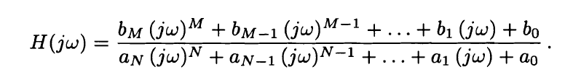
2.3 freqs, residue and lsim
■ Linear constant-coefficient differential equations
■ the frequency response of LTI systems whose input and output satisfy linear constant-coefficient differential equations is easily determined.

Slide 25
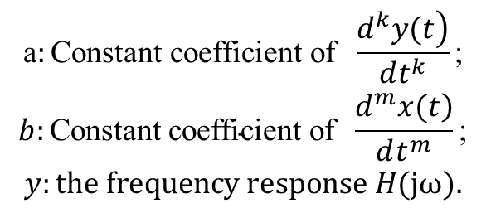
2.3 freqs, residue and lsim
■ freqs
■ Function
calculates and plots the frequency response of LTI systems whose input and output satisfy linear constant-coefficient differential equations, where the vectors b and a contain the coefficients b_{k}, and a_{k.}
■ Command call
y=freqs(b,a)
$$\begin{matrix}\text{a}:\text{Constant} \text{coefficient} \text{of} \frac{\left.d^{k}y(t\right)}{dt^{k}}\text{;} \\ b:\text{Constant} \text{coefficient} \text{of} \frac{\left.d^{m}x(t\right)}{dt^{m}}\text{;} \\ y:the frequency response H(j\text{ω}).\end{matrix}$$

Slide 26
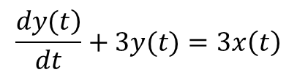
2.3 freqs, residue and lsim
■ ex4
Describe The frequency response of a causal, stable LTI system
$$\frac{\left.dy(t\right)}{dt}+3y(t)=3x\left(t\right)$$
■ code
b = [3];
a = [1,3];
freqs(b,a);
■ figure

Slide 27
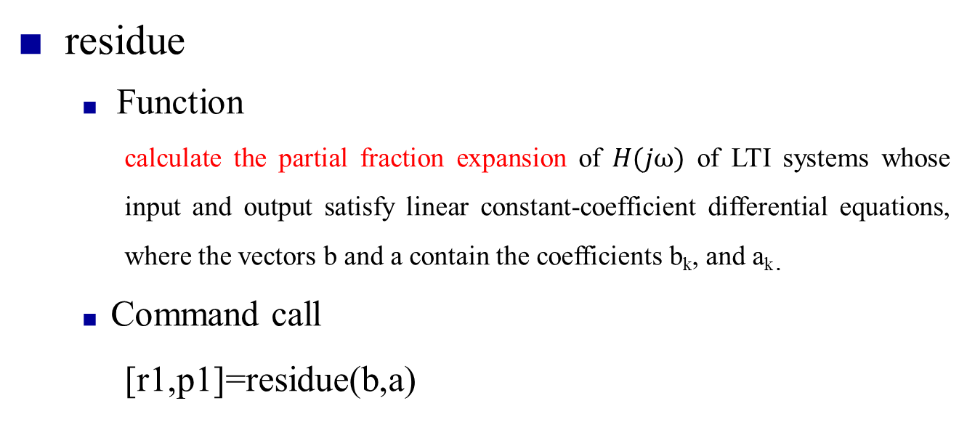
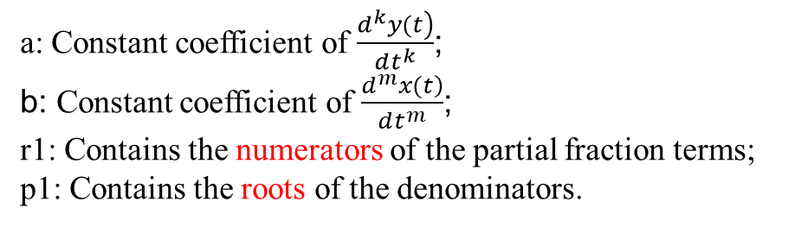
2.3 freqs, residue and lsim
■ residue
■ Function
calculate the partial fraction expansion of $H\text{(}j\text{ω}\text{)}$ of LTI systems whose input and output satisfy linear constant-coefficient differential equations, where the vectors b and a contain the coefficients b_{k}, and a_{k.}
■ Command call
[r1,p1]=residue(b,a)
a: Constant coefficient of $\frac{\left.d^{k}y(t\right)}{dt^{k}}$;
b: Constant coefficient of $\frac{\left.d^{m}x(t\right)}{dt^{m}}$;
r1: Contains the numerators of the partial fraction terms;
p1: Contains the roots of the denominators.

Slide 28
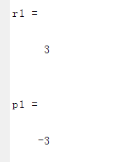
2.3 freqs, residue and lsim
■ ex5
Disp the partial fraction expansion of$H\left(jω\right)$of a causal, stable LTI system
$$\frac{\left.dy(t\right)}{dt}+3y(t)=3x\left(t\right)$$
■ code
b = [3];
a = [1,3];
[r1,p1]=residue(b,a)
■ figure

Slide 29
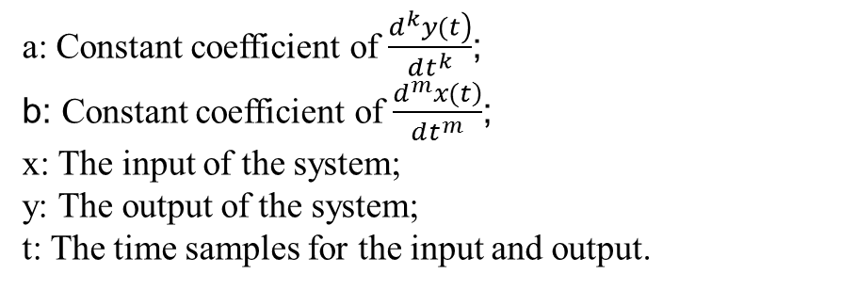
2.3 freqs, residue and lsim
■ lsim
■ Function
Simulates the output of continuous-time, causal LTI systems described by linear constant-coefficient differential equations.
■ Command call
y=lsim(b,a,x,t)
a: Constant coefficient of $\frac{\left.d^{k}y(t\right)}{dt^{k}}$;
b: Constant coefficient of $\frac{\left.d^{m}x(t\right)}{dt^{m}}$;
x: The input of the system;
y: The output of the system;
t: The time samples for the input and output.

Slide 30
Thanks
2021.11.9

