Slide 1
Signals and Systems
Lab experiment #4 Introduction
Wang Lingfang (UESTC)
Office Room: KB204
Nov 23, 2021
19:00—22:00

Slide 2

Lab 4
Transform domain analysis using MATLAB

Slide 3
References book：
John R.Buck, Michael M. Daniel, Andrew C. Singer. Computer Exploration in Signals and Systems —— Using MATLAB.
lab report template
lab report _template.doc
Required instruments
Computer, MATLAB

Slide 4
Chief objects for 4 Labs:
Lab1 : Represent signals using MATLAB;
Lab2 : Analysis LTI systems using MATLAB;
Lab3: Frequency-domain analysis using MATLAB;
Lab4: Transform domain analysis using MATLAB.

Slide 5
Contents
1. Introduction of Lab4
1. Introduction of Lab4
2. Theoretical background and commands

Slide 6
1. Introduction
■ Objective：
1. Understand the sampling theorem and verify the aliasing phenomenon due to undersampling.
2. Perform Single-Sideband AM with Hilbert Transform.
3. Make pole-zero plot for CT and DT system.
4. Understand the pole location’s influence on the frequency response of a system.

Slide 7
1. Introduction
■Related commands: fft, freqs, freqz, filter, conv, roots, zplane, dpzplot
■ Submit your report before: Dec 31, 2021

Slide 8
1. Introduction of lab3
■ Exercises ：
1. Verify the aliasing phenomenun due to undersampling. 7.1 (a)(b)(c)(d)
2. Make pole-zero plot using MATLAB. 9.1 (a)(c), 10.2 (a)
4. Obtain the frequency response of a second-order system. 9.2 (a)(b)

Slide 9
Contents
1. Introduction of Lab4
2. Theoretical background and commands
2. Theoretical background and commands

Slide 10
Contents
2. Theoretical background
2.1 sampling
2.2 The Hilbert Transform and Single-Sideband AM
2.3 Making Continuous-Time Pole-Zero Diagrams/Making Discrete- Time Pole-Zero Diagrams
2.4 Obtain the frequency response of a second-order system

Slide 11
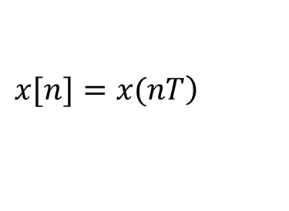
2.1 sampling
■ Related exercises:
7.1 (a)(b)(c)(d)
■ Sampling
If a continuous-time signal x(t) is sampled every T seconds, then its samples form the discrete-time sequence .
$$\left.x[n]=x(nT\right)$$
(Shannon) Sampling theorem
Let x(t) be a band-limited signal with X(j ω)=0 for |ω|> ω_{M} . Then x(t) is uniquely determined by its samples x(nT), n=0, ±1, ±2 , …, if
ω_{s}>2 ω_{M}, where ω_{s}=2π/T .

Slide 12
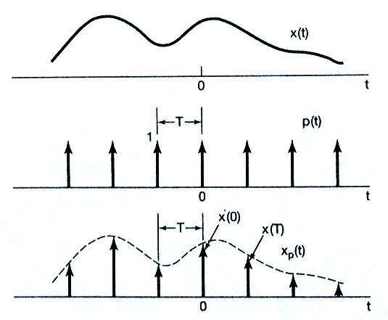
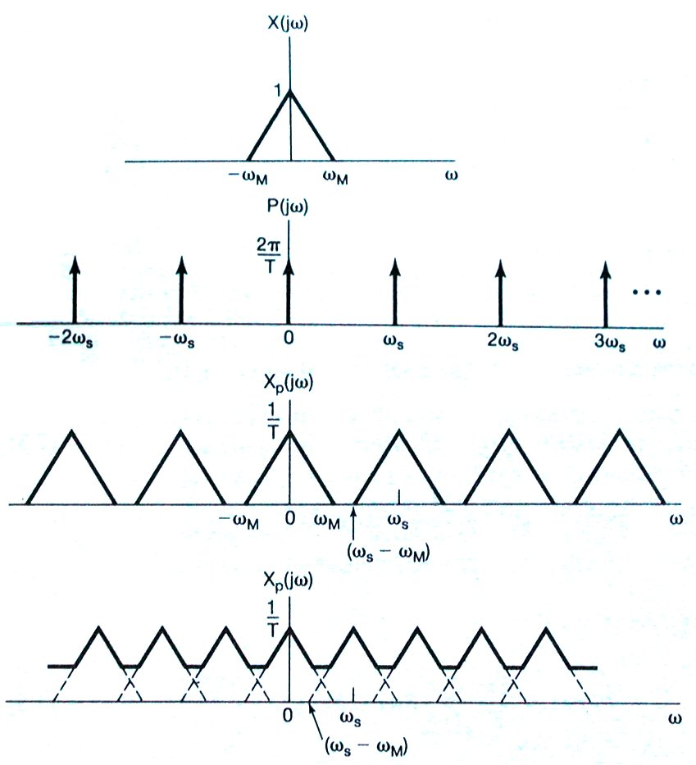
2.1 sampling
■ Sampling
ω_{s}> 2ω_{M}
ω_{s}< 2ω_{M}

Slide 13
Commonly Used Interpolation Methods
plot (t ,x)
Bandlimited Interpolation
• Zero-Order Hold (E.g. movie projection)
• First-Order Hold —Linear interpolation, Commonly used in plotting.
The zero-order hold of interpolation is a rough interpolation;
Higher order holds can be a smoother interpolation strategy.

Slide 14
■ ctfts(x,T)
■ Function
CTFTS calculates the continuous-time Fourier transform (CTFT) of a periodic signal x(t) which is reconstructed from the samples in the vector x using ideal bandlimited interpolation. The vector x contains samples of x(t) over an integer number of periods, and T contains the sampling period.
■ Command call
[X,wl]= ctfts(x,T)
x : contains samples of x(t) over an integer number of periods.
T: contains the sampling period.
X: contains the area of the impulses.
w: stored the frequency values.

Slide 15
2.1 sampling
■ ex1
T=1/4096;
n=[0:4095];
t=n./4096;
x=sin(1000*pi*t);
[X,w]=ctfts(x,T);
figure;
plot(w,abs(X));
xlabel('w');
ylabel('|X|');
title('The magnitude of X versus w');
■ Code
■ Figure

Slide 16
Contents
2. Theoretical background
2.1 sampling
2.1 sampling
2.2 The Hilbert Transform and Single-Sideband AM(no exercise)
2.3 Making Continuous-Time Pole-Zero Diagrams/Making Discrete- Time Pole-Zero Diagrams
2.4 Obtain the frequency response of a second-order system

Slide 17
2.2 The Hilbert Transform and Single-Sideband AM
■ Related exercises:
8.1 (c)(d)(e) (i)-(n)
■ The Hilbert Transform

Slide 18
2.2 The Hilbert Transform and Single-Sideband AM
Upper
sideband
Upper
sideband
Lower
sideband
Double Sideband Modulation (DSB)

Slide 19
2.2 The Hilbert Transform and Single-Sideband AM
Retain the upper sideband
Upper
sideband
Upper
sideband
Retain the lower sideband
Lower
sideband
Single Sideband Modulation (SSB)

Slide 20
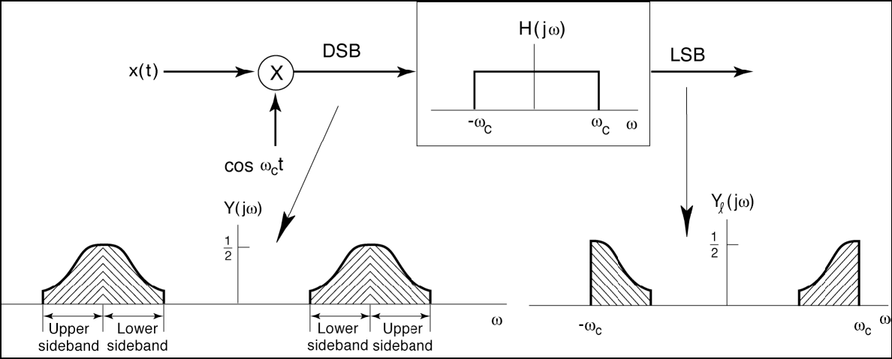
2.2 The Hilbert Transform and Single-Sideband AM
Single Sideband Modulation

Slide 21
2.2 The Hilbert Transform and Single-Sideband AM
■ Single-Sideband AM using the Hilbert Transform
90º phase-shift

Slide 22
2.2 The Hilbert Transform and Single-Sideband AM
■ Single-Sideband AM using the Hilbert Transform

Slide 23
2.2 The Hilbert Transform and Single-Sideband AM
Lower Sideband

Slide 24
2.2 The Hilbert Transform and Single-Sideband AM
The impulse response of the ideal Hilbert transform is both noncausal and has infinite length.

Slide 25
2.2 The Hilbert Transform and Single-Sideband AM
Hilbert transform is also called a 90°-phase shifter
In these problems you will consider a shifted and windowed version of the impulse response of the ideal Hilbert transform. The windowing provides an impulse response with finite length, and the shifting is required to make a causal approximation of the impulse response.

Slide 26
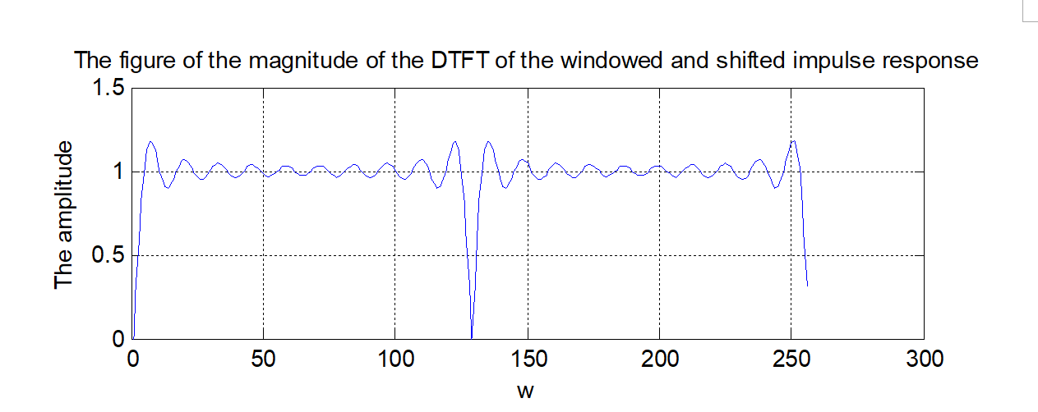
2.2 The Hilbert Transform and Single-Sideband AM
Barrier Effect

Slide 27
2.2 The Hilbert Transform and Single-Sideband AM
■ Related Matlab commands
■ Limit
- Compute limit of symbolic expression
This MATLAB function computes bidirectional limit of the symbolic expression expr when x approaches a.
limit(expr,x,a)
limit(expr,a)
limit(expr)
limit(expr,x,a,'left')
limit(expr,x,a,'right')

Slide 28
2.2 The Hilbert Transform and Single-Sideband AM
■ Related Matlab commands
■ Set
- sets the graphics object properties.
In this exercise, the function is used to set the marking of the horizontal ordinate.
set(gca,'Xtick',[0,pi/4,pi/2,3*pi/4,pi,5*pi/4,3*pi/2,7*pi/4,2*pi]);
set(gca,'XTickLabel',{‘-pi’,‘-3*pi/4’,‘-pi/2’,‘-pi/4’,‘0’, ‘pi/4’, ‘pi/2’,‘3*pi/4’, ‘pi’});

Slide 29
2.2 The Hilbert Transform and Single-Sideband AM
■ ex2
n=-2:2;
y=sin(n)./n;
syms nx;
y(3)=limit(sin(nx)/nx,0);
stem(n,y);
set(gca,'Xtick',[-2,-1,0,1,2]);
set(gca,'XTickLabel',{'n1','n2','n3','n4','n5'});
xlabel('n')
ylabel('y')
title('y=sin(n)/n')
■ Code
■ Figure

Slide 30
Contents
2. Theoretical background
2.1 sampling
2.1 sampling
2.2 The Hilbert Transform and Single-Sideband AM
2.3 Making Continuous-Time Pole-Zero Diagrams/Making Discrete- Time Pole-Zero Diagrams
2.4 Obtain the frequency response of a second-order system

Slide 31
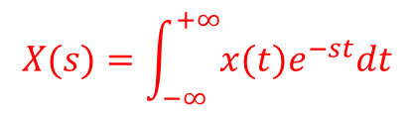
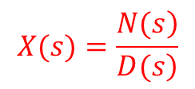
2.3 Making Continuous-TimePole-Zero Diagrams
■ Related exercises:
9.1 (a)(c) , 10.2 (a)
■ The Laplace Transform
The Laplace transform of a signal x(t),
is a generalization of the continuous-time Fourier transform.
For a large class of signals, the Laplace transform can be represented as a ratio of polynomials in s, i.e.,
$$X(s)=\int_{−∞}^{+∞}{x(t)e^{−st}dt}$$
$$X(s)=\frac{\left.N(s\right)}{\left.D(s\right)}$$

Slide 32
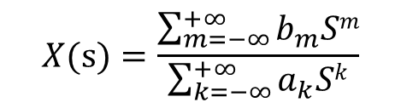
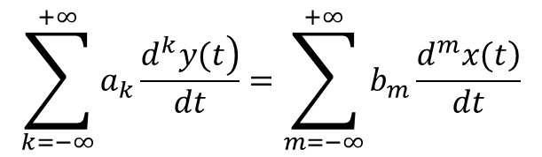
2.3 Making Continuous-TimePole-Zero Diagrams
■ X(s) of the differential equation
■ The differential equation
■ X(s) of the differential equation
$$\sum_{k=−∞}^{+∞}{a_{k}\frac{\left.d^{k}y(t\right)}{dt}}=\sum_{m=−∞}^{+∞}{b_{m}\frac{\left.d^{m}x(t\right)}{dt}}$$
$$X(s)=\frac{\sum_{m=−∞}^{+∞}{b_{m}Sm}}{\sum_{k=−∞}^{+∞}{a_{k}Sk}}$$

Slide 33


2.3 Making Continuous-TimePole-Zero Diagrams
We can use the command “roots” to compute the poles and zeros.
■ ex3
Computing the poles and zeros of the LTI system with system function
■ Code
■ Figure
b=[1 -1];
a=[1 3 2];
zs=roots(b)
ps=roots(a)

Slide 34
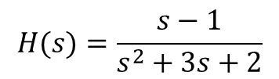
2.3 Making Continuous-TimePole-Zero Diagrams
■ ex4
Computing the poles and zeros of the rational system function using the function roots.
$$H(s)=\frac{s−1}{s^{2}+3s+2}$$
■ Code
■ Figure
b=[1 -1];
a=[1 3 2];
zs=roots(b);
ps=roots(a);
plot (real(zs), imag(zs), 'o');
hold on
plot(real(ps), imag(ps), 'x') ;
grid
axis([-3 3 -3 3]);
xlabel('Re')
ylabel('Im')
title('The pole-zero plot of H(s)')

Slide 35
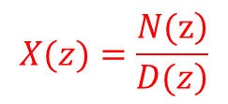

2.3 Making Discrete-Time Pole-Zero Diagrams
■ Related exercises:
10.1 (a)(b)
■ The z-Transform
The bilateral z-transform of a discrete-time signal x[n],
is a generalization of the discrete-time Fourier transform.
For a large class of signals, the z-transform can be
represented as a ratio of polynomials in z, i.e.,
$$X[n]=\sum_{n=−∞}^{∞}{x[n]z^{−n}}$$
$$X(z)=\frac{\left.N(z\right)}{\left.D(z\right)}$$

Slide 36
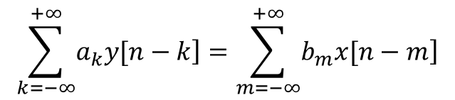
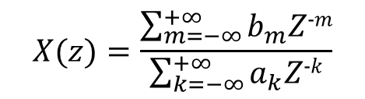
2.3 Making Discrete-Time Pole-Zero Diagrams
■ X(z) of the difference equation
■ The difference equation
■ X(z) of the difference equation
$$\sum_{k=−∞}^{+∞}{\left.a_{k}y[n−k\right]}=\sum_{m=−∞}^{+∞}{\left.b_{m}x[n−m\right]}$$
$$X(z)=\frac{\sum_{m=−∞}^{+∞}{b_{m}Z−m}}{\sum_{k=−∞}^{+∞}{a_{k}Z−k}}$$

Slide 37
2.3 Making Discrete-Time Pole-Zero Diagrams
■ dpzplot
■ Function
Plot the zero-pole diagram of a system function for a discrete system.
■ Command call
dpzplot(b,a);
b: store the coefficient of numerator polynomials;
a: store the coefficient of denominator polynomials.

Slide 38
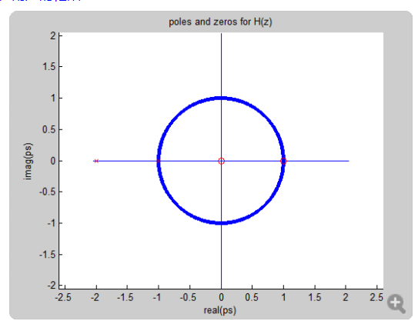
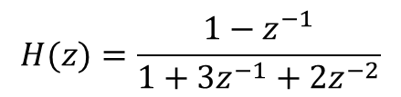
2.3 Making Discrete-Time Pole-Zero Diagrams
■ ex5
Computing the poles and zeros of the rational system function using the function dpzplot.
$$H(z)=\frac{1−z^{−1}}{1+3z^{−1}+2z^{−2}}$$
■ Figure
■ Code
b=[1 -1];
a=[1 3 2];
dpzplot(b,a)

Slide 39
Contents
2. Theoretical background
2.1 sampling
2.1 sampling
2.2 The Hilbert Transform and Single-Sideband AM
2.3 Making Continuous-Time Pole-Zero Diagrams/Making Discrete- Time Pole-Zero Diagrams
2.4 Obtain the frequency response of a second-order system

Slide 40
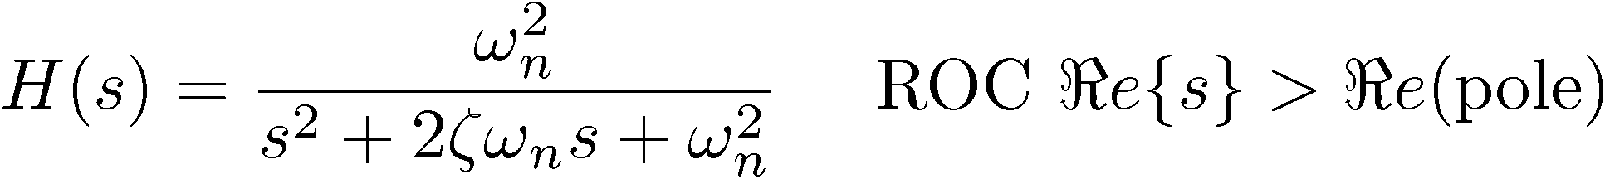
2.4 Obtain the frequency response of a second-order system
Examine the pole locations for second-order systems of the form the values of the damping ratio and undamped natural frequency ω, specify the locations of the poles, and consequently the behavior of this system.
damping ratio：
undamped natural frequency：
In this exercise, you will see how the locations of the poles affect the frequency response.

Slide 41
2.4 Obtain the frequency response of a second-order system

Slide 42
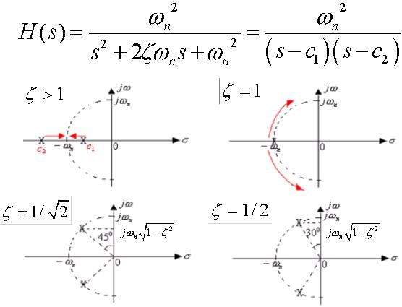
2.4 Obtain the frequency response of a second-order system
Overdamped
Critically damped
Underdamped

Slide 43
Thanks！
2021.11.23

