Slide 1
CA 1 - Machine Learning
Izaias de Oliveira Gomes Junior - 2023232
Dr. Muhammad Iqbal

Slide 2
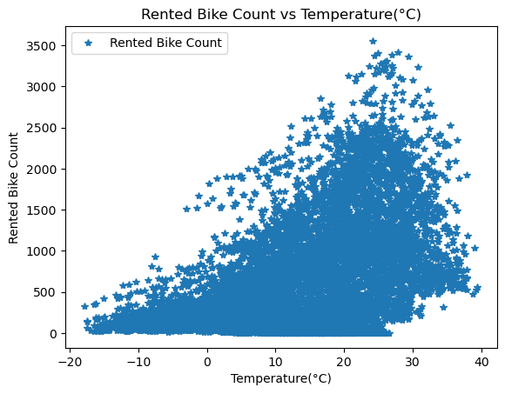
Hypothesis
The first hypothesis that I thought when I saw the dataset was the correlation between the weather variables and the number of rented bikes. As we can in the figure, the number of rented bikes increases as the temperature increases. It is not as strong as i thought as we have a sustained base, this might be the loyal clients that use the bike as a main of transportation independent of the weather.

Slide 3
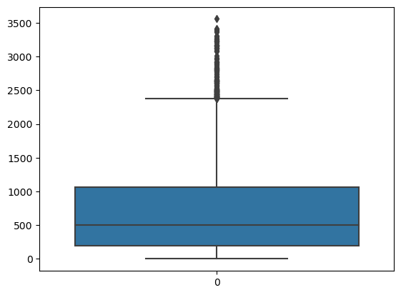
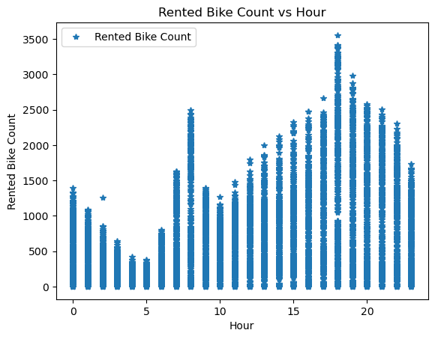
Outliers
The first figure is a boxplot of the variable Rented Bike Count and it shows the significant presence of outliers. They can be explained by the second figure where we can see that roughly we have two peak times (8h and 18h) and a higher concentration in the evening time.
In this case is important to keep the outliers as it is interesting to us to know the busiest time and its behaviour. As we have a regression problem we choose the Huber Loss as one of the quality scores, once it deals better with the outliers than other measures.

Slide 4
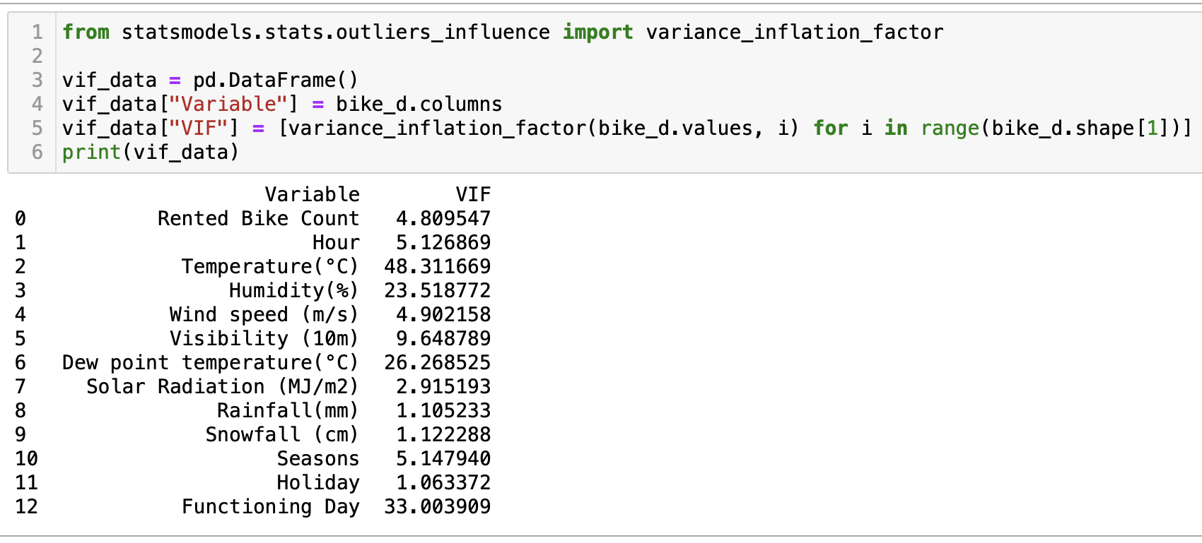
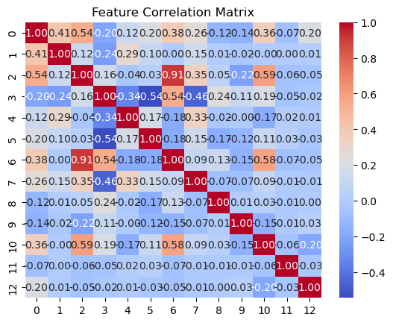
Correlation and Multicollinearity
I tried to deal with the correlations between the variables and avoid the problem of Multicollinearity but when I applied the models excluding the chosen variables the R2 was worse and the model was more overfitting. More study and research is needed for further analysis and future projects.

Slide 5
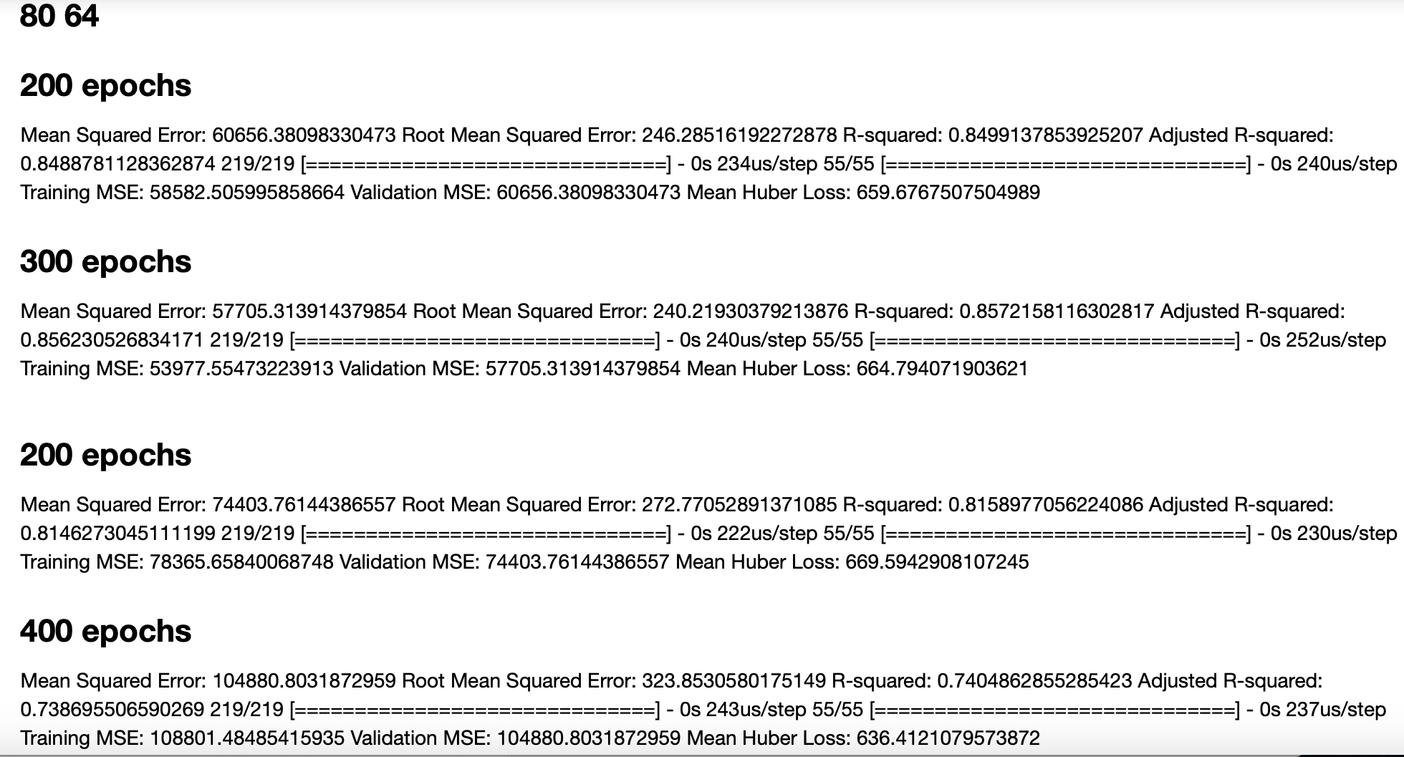
Tuning Parameters
The best model of our project was ANN and I could not make the code to find the best parameters work, so I did it manually which is so timing consuming and prone to error. Salvador did most of the visualisation part and it was really good, that is another thing that I need to improve it.

