Slide 1
My Java Project
A simple calculator with ...
By 宗永承 17130188021

Slide 2
Calculator
User Interface: Windows 10 Style
Functions:
Handle infix expression
Basic mathematical calculation(+ - * / etc)
Advanced operations like squared root
Exceptions Handling in Java

Slide 3
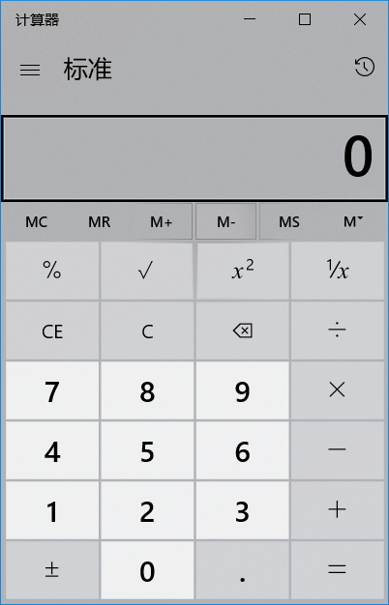
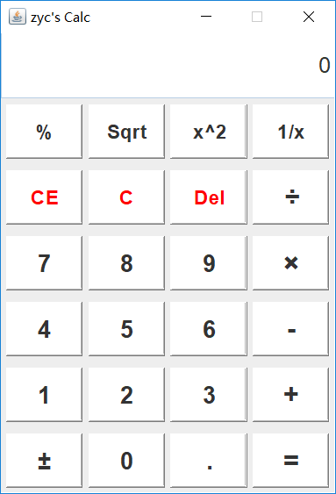
Appearance
Win10’s Calc
My Calc

Slide 4
Design and Implementation
Field
JTextField resultText; // Show the result of calculation
String num1, num2, result;
String operator; // num1 operator num2 ➔ result
boolean hasDone; // the calculation state
JFrame frame; // main frame
Inner class MyButton:
extends JButton implements ActionListener
Clicking each button on the panel generates an ActionEvent
Handling two numbers with one operator
Once pressing “=”, show the result

Slide 5
Design and Implementation
Method
Calculator() // Constructor
void Load() // initialize the frame
void exit() // exit
String doubleToStr(Double x) // set the result format
void handleUnaryOpr(String op) // handle Unary operator
void handleBinaryOpr(String op) // handle Binary operator
void handleNum(String num) // handle numbers
void handleCal() // calculate
etc...

Slide 6
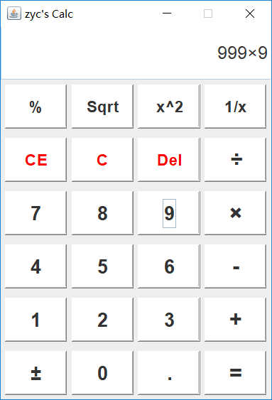
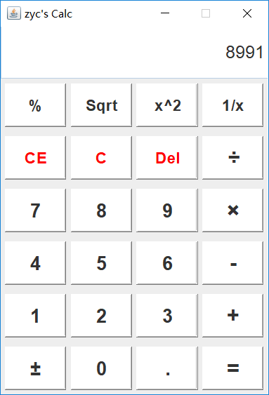
Demo

Slide 7
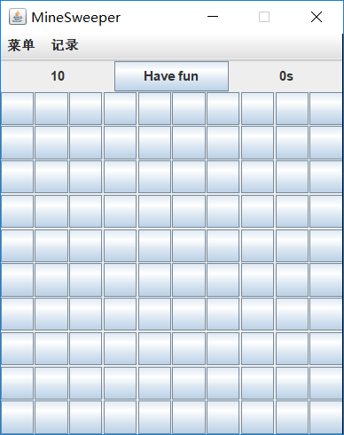
MineSweeper
When the result equals to 3.1415926536
You will find…
the game!

Slide 8
Package
main // extrance
Main.java
game // core algorithm
Game.java
gameframe // frame and menu
Gameframe.java
record // record ranking list
Record.java

Slide 9
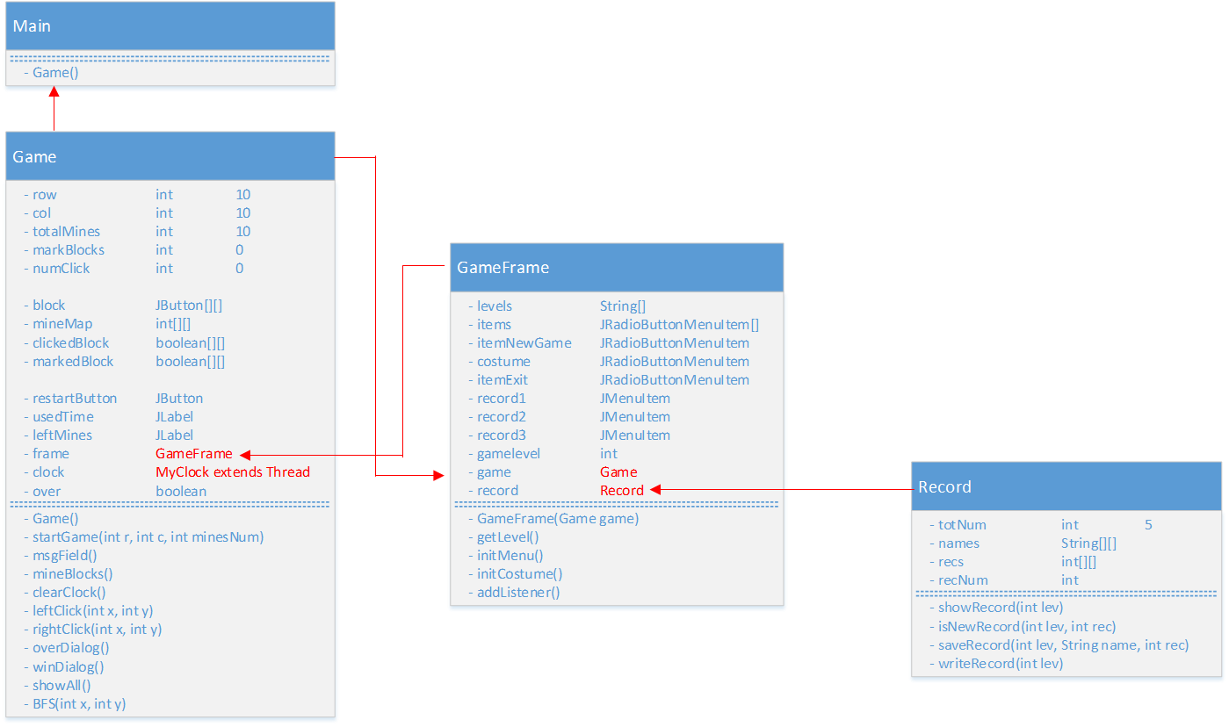
Class, Field and Method

Slide 10
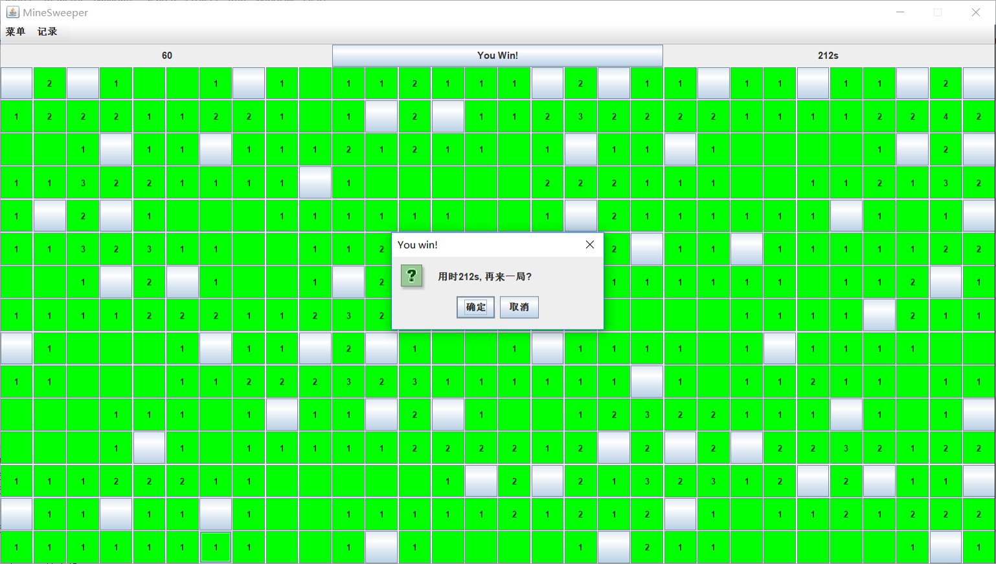
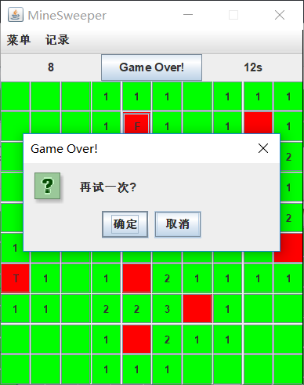
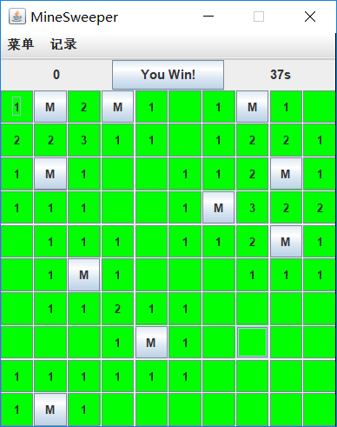
Play

Slide 11
Summary
“Everything is an Object”
Inheritance, (anonymous) inner class, GUI, I/O, Thread…
Debugging is easy in Java(auto memory management)
Spell-check and completion is helpful with IDE Eclipse

Slide 12
Thank You !

