Slide 1
Moroccan Studies For cities
Machine Learning Using K-means

Slide 2
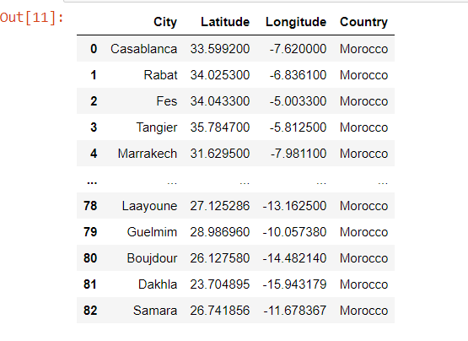
Moroccan cities and their GEOLOCATIONS:

Slide 3
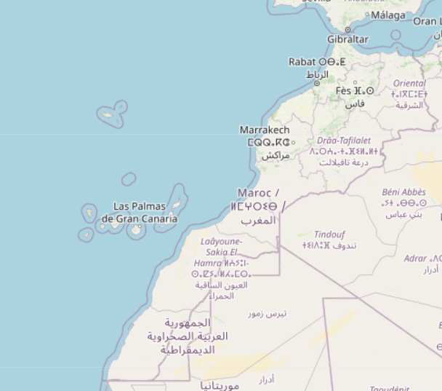
Moroccan map

Slide 4
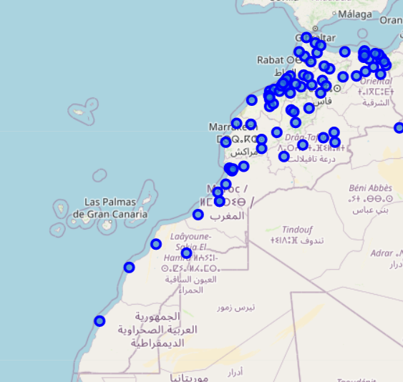
Cities of Morocco

Slide 5
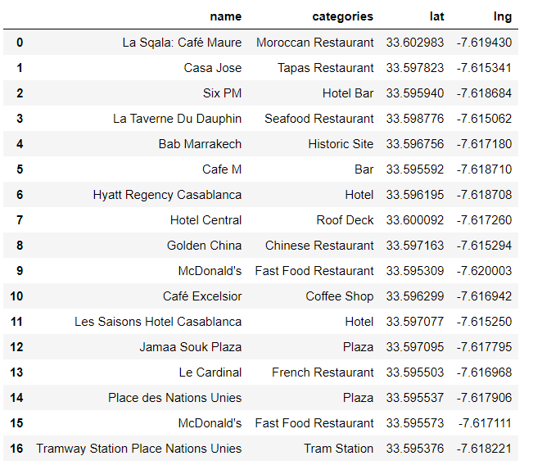
Liste of every Café shop or restaurant in morocco using Foursquare API

Slide 6
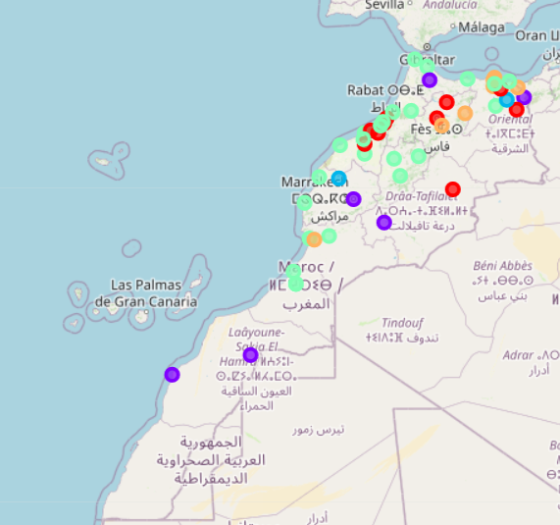
Clustered Moroccan Cities By K-means ML-Algorithme

Slide 7
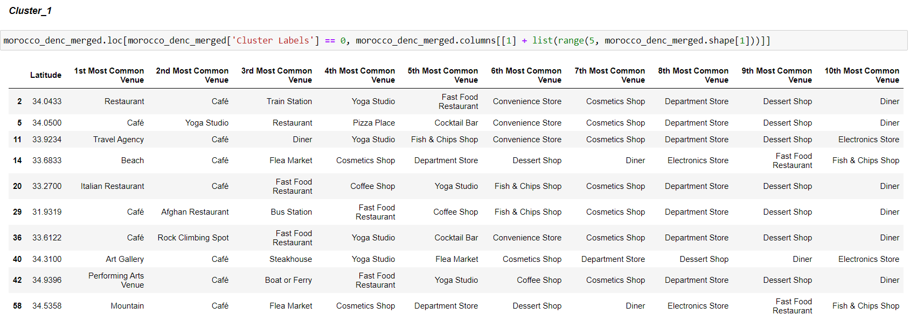
The 4 Principales Clusters

Slide 8
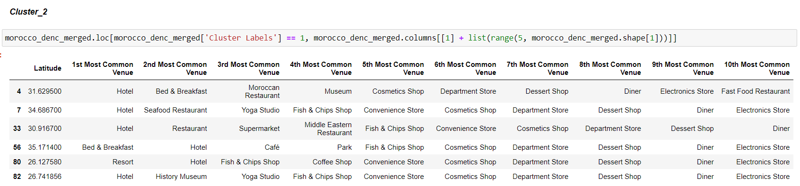

Slide 9
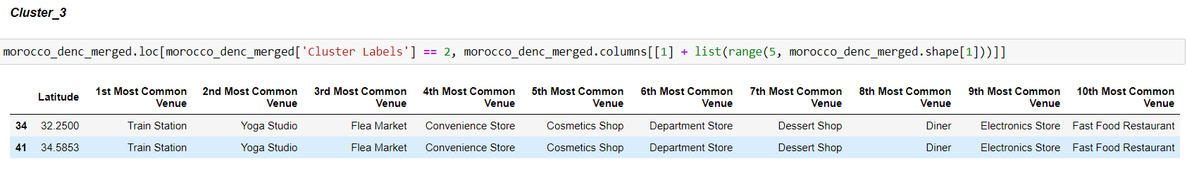

Slide 10
