Slide 1



WWW.HAMROGAS.COM
PROPOSAL DEFENSE
PRESENTATION ON:
HAMRO GAS
Prepared by:
Aman Mool (740303)
Jenish Prajapati (740317)
Manish Hyongoju (740321)
Manisha Gora (740322)
Presented By: John White

Slide 2








OVERVIEW
INTRODUCTION
SCOPE
OBJECTIVES
PROJECT MANAGEMENT
LITERATURE REVIEW
RESULTS
MOTIVATION
FUTURE ENHANCEMENTS

Slide 3


INTRODUCTION
LPG Gas booking system
Gas services through web
LPG short for liquefied petroleum gas
Flammable mixture of hydrocarbon gases
Used as fuel in heating appliances, cooking equipment etc.
Provides booking services
Manage customer details

Slide 4

OBJECTIVES
To provide Online gas Booking service to eradicate
queue problem

Slide 5

LITERATURE REVIEW
“NepalGas” website provides similar services but lacks
booking feature
Likewise similar website named “BharatGas” allows booking
but limited to India only.
Similarly, a website called “pickNdrop” allows booking and delivery
in Kathmandu and Lalitpur only.

Slide 6

MOTIVATION
Lack of computerized gas booking system in Nepal.
To reduce valuable time of people to stay in a queue.

Slide 7
SCOPE
The scope of our project is in every area where gas can be used.

Slide 8
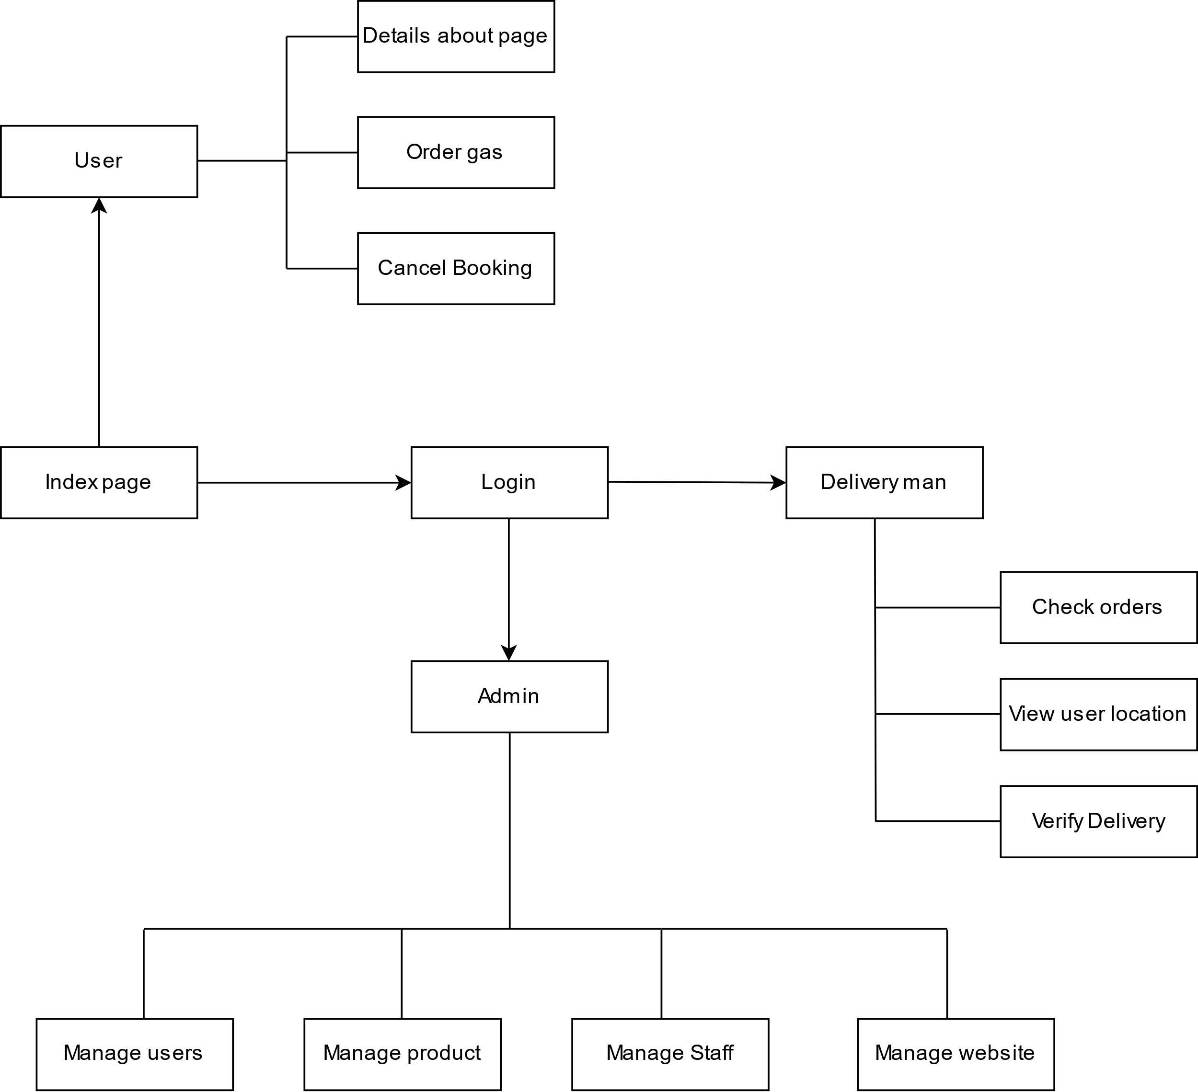
MODEL AND PROJECT MANAGEMENT

Slide 9
RESULTS
The results will be shown in demo part.

Slide 10

OUR SERVICES
Marketing
Support
Online Gas Booking
Mobile view support
Notification
Management
Notification on contact
Help Agency manage details

Slide 11
TOOLS AND PLATFORMS
PHP
MySQL
CSS, Bootstrap
JavaScript
XAMPP
Sublime Text Editor
Platform:Windows

Slide 12
FUTURE ENHANCEMENT
Payment methods can implemented using the gateway like e-Sewa etc.
Early prompt notification can be implemented.
Stability improvement and bug fix can be further done.

Slide 13
REFERENCES
[1] ”Nepal Gas”, http://www.nepalgas.com.np/booking [10/12/2019]
[2] “BharatGas”, https://www.ebharatgas.com/aboutus [11/12/2019]
[3] “pickNdrop”, https://www.pickndropnepal.com/ [11/9/2020]

Slide 14
THANK YOU
Any Queries???

