Slide 1
Outcome Based Education (OBE) and Bloom’s Taxonomy
EET142/2
Introduction to Electrical Engineering
Semester 1 2016/2017
Week #7 : 10/10/2016 – 14/10/2016

Slide 2
Definitions (Acronyms)
OBE - Outcome-Based Education
BEM - Board of Engineers Malaysia
CQI - Continual Quality Improvement
EAC - Engineering Accreditation Council
IEM - The Institution of Engineers, Malaysia
IHL - Institution of Higher Learning (includes public or private universities, and other institutions authorised by legislation to award engineering degrees)
MQA - Malaysian Qualification Agency

Slide 3
Definitions (Acronyms)
Graduate Engineer - A person registered under Section 10(1a), Registration of Engineers (Amendment) Act 2007.
Professional Engineer - A person registered under Section 10(2), Registration of Engineers (Amendment) Act 2007.
Stakeholders - Parties having an interest (direct or indirect) in the programme output, for example, employers, sponsors, lecturers and students.
External Examiner - A person with high academic standing appointed by the IHL to assess academic quality and standard of the programme.
Evaluation Panel - A panel of evaluators appointed by EAC to verify programme compliance with accreditation criteria.

Slide 4
Common Questions on OBE
What is OBE?
Why OBE?
Who to develop and implement OBE?

Slide 5
Outcome Based Education (OBE)
OBE is a process that involves assessment and evaluation practices in education to reflect the attainment of expected learning outcomes and showing mastery in the programme area.
IN OTHER WORDS…
OBE is an approach that focuses on outcomes, i.e. student achievement that is measurable, proven, and can be improved.

Slide 6
OBE in a nut shell
What do we want the students to have or able to do?
Knowledge, Skill, Affective
How can we help students achieve it?
Student Centred Delivery
How will we know what the students have achieved it?
Assessment
How do we close the loop?
CQI

Slide 7
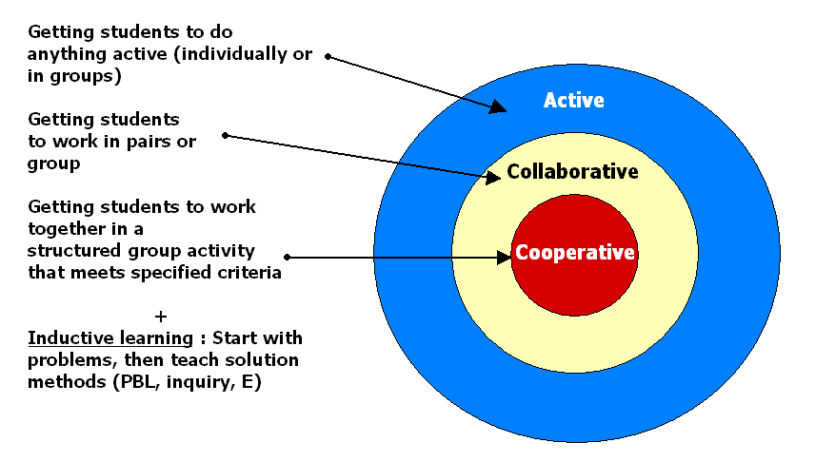
Student-Centered Learning

Slide 8

Continual Quality Improvement (CQI)
Planning
Implementation
Assessment
Corrective
action

Slide 9
What is OBE?
OBE is an educational process that is focused at achieving certain specified outcomes in terms of individual student learning.
A method of curriculum design and teaching that focuses on what students can actually do after they are taught
Students are expected to be able to do more challenging tasks other than memorize and reproduce what was taught
Outcomes are key things students should understand and be able to do or the qualities they should develop
If the outcomes are not achieved they are rethought as to ensure there is a Continual Quality Improvement (CQI) within the education system.

Slide 10
Why do we need OBE?
ALL Engineering Programme requires an official recognition by the Engineering Accreditation Council and Board of Engineers Malaysia [EAC/BEM]
This accreditation is the provision that enable the engineering students to register as BEM graduate member upon graduation and leading to their Registered Professional Engineer carrier after several years
OBE is the essential requirement for Malaysia by 2007 to become a fully signatory member of a multinational agreement for the mutual recognition of engineering degrees, i.e. The Washington Accord (WA)

Slide 11
Board of Engineers Malaysia (BEM)
The Board of Engineers Malaysia (BEM) registers graduates and professional engineers under the Registration of Engineers Act 1967 (Revised 2002).
The pre-requisite for registration as a graduate engineer is a qualification in engineering recognised by the Board.
BEM has a duty to ensure that the quality of engineering education/programme of its registered engineers attains the minimum standard comparable to global practice.

Slide 12
What is an Accredited Programme?
An engineering programme whose graduates are acceptable for graduate registration with BEM, and for admission to Graduate membership of IEM.
This is accorded to a programme that satisfies the minimum standard for accreditation set by Engineering Accreditation Council (EAC).

Slide 13
Objectives of Accreditation
To ensure that graduates of the accredited engineering programmes satisfy the minimum academic requirements for registration as a graduate engineer with the Board of Engineers Malaysia (BEM) and for admission to graduate membership of IEM.
To ensure that Continual Quality Improvement (CQI) is being practiced by IHLs. Accreditation may also serve as a tool to benchmark engineering programmes offered by IHLs in Malaysia

Slide 14
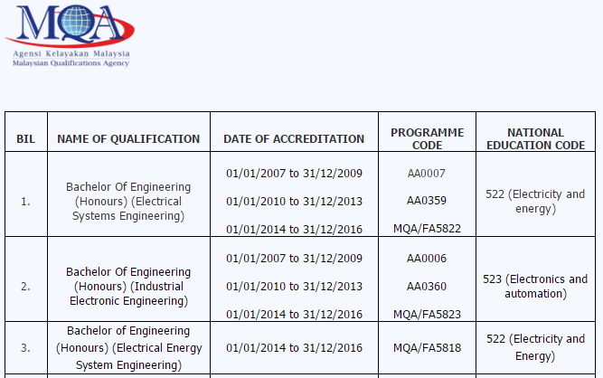
Accreditation of SoESE UniMAP
Source : http://electrical.unimap.edu.my/index.php/academik/accreditation

Slide 15
Strategy of OBE
Top down curricula design
Appropriate Teaching & Learning Methods
Appropriate Assessment & Evaluation Methods

Slide 16
Characteristics of OBE curricula
It has programme objectives (PEO), programme outcomes (PO), course outcomes (CO) and performance indicators.
It is objective and outcome driven, where stated objective and outcomes can be assessed and evaluated.
It is centered around the needs of the students and the stakeholders.
Suitable tools and methods are used to measure and evaluate attainment of the outcomes
Results from evaluation are used for CQI

Slide 17
Institutional
Mission Statement
Stakeholders Interest
Programme Objectives (PEO)
Programme Outcomes (PO)
(Knowledge, skills, attitudes of graduates)
Course Outcomes(CO)
(Ability to: explain, calculate, derive, design)
Assessment of Attainment Level
Continual Improvement

Slide 18
Different Levels of Outcomes
Mission and Vision
Programme Objectives
3-5 years after graduation
Programme Outcomes
Upon graduation
Based on the PEO
Course Outcomes
Upon course completion

Slide 19
Why measure and track Outcomes ?
Something that is not measured cannot be controlled.
All outcomes must be continually measured and tracked in order for UniMAP to control the quality of the programme.
This forms the basis of the CQI process.
The 3 levels of outcomes of interest are PEO, PO & CO.

Slide 20
OBE Implementation
Programme
Objectives
Review/input/survey by stakeholders
Programme Outcomes
Planning
Implementation
Assessments
Evaluations
CQI
Academic Divisions
Course Coordinator
Course Outcomes
(Course Document)
University Senate
Delivery
Jawatankuasa Pengurusan Akademik (JPA)
Assessment
Evaluation (CER)
Evaluation (PER)
School Board
HEA01 New/
HEA03
Programme Committee / stakeholder

Slide 21
Terms | Definition | Common terms for same concept
Objectives | Statements that describe the expected accomplishments of gradates during the first few years after graduation | Goals, outcomes
Outcomes | Statements that describe what students are expected to know and able to do by the time of graduation | Objectives, standards
Performance Criteria | Specific, measurable statements indentifying the performance (s) required to meet the outcomes; confirmable through evidence. | Standards, indicators rubrics, specifications metrics, outcomes
Assessment | Processes that identify, collect, use and prepare data that can be used to evaluate achievement. | Evaluation
Evaluation | Process of reviewing the results of data collection and analysis and making a determination of the value of findings and action to be taken. | Assessment

Slide 22
Assessment
is the process that identify, collect, use and prepare data that can be used to evaluate attainment.
is formative or/and summative; to demonstrate student’s competence in demonstrating a specific outcome
Do not assess those that have not been taught
Assessing Student/Cohort (Course Outcome)
Assessing Student/Cohort & Faculty (Programme Outcome)

Slide 23
Assessment Tools
Examples of Direct Methods
Samples of individual student work
Pre-test and post-test evaluations
Standardized tests
Case study/problems
Capstone papers, projects or presentations
Examples of Indirect Methods
Questionnaires and Surveys
Students
Graduating Seniors
Alumni
Employers
Syllabi and curriculum analysis
Transcript analysis

Slide 24
Course Coverage & Assessment
When assessing, an instructor must consciously assess and evaluate the applicable elements (Knowledge, Skills, Attitude).
An activity may be used to examine all the three elements
Model A
Model B
Competencies
Competencies
Knowledge
Knowledge
Skills
Skills
Attitude
Attitude

Slide 25
Programme Objectives (PEO)

Slide 26
Programme Objectives (PEO)
PEO are specific goals consistent with the mission and vision of the IHL, are responsive to the expressed interest of programme stakeholders, and describe the expected achievements of graduates in their career and professional life a few years after graduation.
What is expected (3-5 years) upon graduation?
What the programme is preparing graduates in their career and professional accomplishments
Should be stated such that a graduate can demonstrate in their career or professional life after graduation (long term in nature)

Slide 27
Programme Objectives (PEO)
Specific, Measurable, Achievable, Result oriented, and having a Time frame (SMART)
Processes and Results:
Clear linkage between Programme Outcomes and curricula design
A process of on-going assessment and evaluation that demonstrates the achievement with documented results
Evaluation results that are used in the continual improvement of the programme.

Slide 28
Programme Objectives Statements UniMAP
PEO1 | Graduates who effectively demonstrate engineering knowledge and entrepreneurial skills by providing practical solutions.
PEO2 | Graduates who effectively demonstrate professionalism in multi-disciplinary engineering environment, leadership quality and teamwork.
PEO3 | Graduates who make contributions to knowledge and establish best engineering practice through research and development.
PEO4 | Graduates who demonstrate an ethical commitment to the community and the profession through involvement with professional organizations and society.
PEO5 | Graduates who engage in life-long learning as demonstrated through career advancement.

Slide 29
Programme Objectives Statements School of Electrical Systems Engineering
PEO1 | Graduates who are leaders in the field of electrical engineering or chosen field as demonstrated via career advancement.
PEO2 | Graduates who are members of and contribute to professional society.
PEO3 | Graduates who engage in life-long learning or continuous education opportunities.
PEO4 | Graduates who contribute towards research and development.
PEO5 | Graduates who are entrepreneurial engineers.

Slide 30
PEO Attainment Assessment
On-going process, covers all cohorts which have graduated from the Programme.
Assessment are performed after each cohort been in the industry for 3-5 years.
The assessment of the attainments of the PEOs utilized the performance indicators.
Types of survey:
Alumni Survey
Employer Survey
Methods of survey:
Printed forms
Telephone interviews

Slide 31
Programme Outcomes (PO)

Slide 32
Programme Outcomes (PO)
PO are statements that describe what students are expected to know and be able to perform or attain by the time of graduation.
These relate to the skills, knowledge, and behaviour that students acquire through the programme.
There must be a clear linkage between Programme Objectives (PEO) and Programme Outcomes (PO)
Need to distribute the outcomes throughout the programme, and not one/two courses only addressing a particular outcome

Slide 33
Programme Outcomes Statements
No. | Area / Domain | Electrical Systems / Industrial Electronic / Electrical in Energy Systems Engineering Programme
1 | Engineering Knowledge | Ability to acquire and apply knowledge of mathematics, science, engineering and an in-depth technical competence in electrical engineering discipline to the solution of complex engineering.
2 | Problem Analysis | Ability to identify, formulate and solve electrical engineering problems.
3 | Design & Development of Solutions | Ability to design solutions for complex engineering problems and systems, component or processes to meet desired needs.
4 | Investigation | Ability to conduct investigation into complex problems as well as to analyze and interpret data.
5 | Modern Tool Usage | Ability to use techniques, skills and modern engineering tools necessary for complex engineering practices so as to be easily adaptable to industrial needs.
6 | The Engineer and Society | Understanding of the social, cultural, global and environmental responsibilities of a professional engineer.

Slide 34
No. | Area / Domain | Electrical Systems / Industrial Electronic / Electrical in Energy Systems Engineering Programme
7 | Environment and Sustainability | Ability to understand entrepreneurship, the process of innovation and the need for environmental and sustainable development.
8 | Ethics | Ability to understand the professional and ethical responsibilities and commitment to the community.
9 | Individual and Team-work | Ability to function on multi-disciplinary teams.
10 | Communication | Ability to communicate effectively on complex engineering activities with the engineering community and with society at large.
11 | Lifelong Learning | A recognition of the need for, and an ability to engage in life-long learning.
12 | Project Management and Finance | Demonstrate understanding of project management and finance principles.

Slide 35
PO Implementation
The approach implemented identifies
Enabling Courses (EC)
Culminating Courses (CC)
EC are the courses that help develop and nurture the intended outcomes at course level - build up the body of knowledge for that particular engineering field.
CC are the highest level courses which demonstrate the flow of knowledge through the semesters accumulated

Slide 36
PO Implementation
The CCs are used to measure the POs directly.
This is because these CC courses will demonstrate the student’s ability related to the outcomes. (e.g. Final Year Project)
To enable effective measurements for the PO attainments, Performance Criteria (PC) were developed which quantify the parameters of the POs
Notes:
In UEWS test, ...
A specimen filled with water at 65°C is loaded in a prescribed times versus pressure schedule which consists of cycle groups. Each group consists of ten one-minute cycles at pressure and one-minute cycles at no pressure, as shown here. The first Cyclic Test Pressure (CTP) shall be 10% of the expected pressure at UEWS. If the strain is completely reversible with strain difference of less than 3% registered, the test is continued on the next cycle group with CTP further increased by another 10%.

Slide 37
PO Implementation
The PO attainment procedures adopted are implemented in six (6) steps :
the consideration of the knowledge flow of the curriculum
the determination of the enabling (ECs) and culminating (CCs) courses
the determination of the assessment methods and grading tools for each of the performance criterion
Assessment method : Final Exam, Mini Project, Assignment etc.
Grading Tools : Raw marks / Rubric
the reporting of the attainments of:
individual students
the class (for each culminating course)
the cohort (cumulative, showing the attainment for all of the POs)

Slide 38
PO Implementation
Score, percentage score and level of PO attainment with respect to grade/marks obtained
Marks Range (%) | Grade | Score | Level
80-100 | A | 4 | Exemplary
75-79 | A-
70-74 | B+ | 3 | Accomplished
65-69 | B
60-64 | B-
55-59 | C+
50-54 | C
45-49 | C- | 2 | Developing
40-44 | D+
35-39 | D | 1 | Beginning
30-34 | D-
0-29 | F

Slide 39
PO Implementation
To illustrate the procedure, the assessment conducted for a particular subject (e.g. ENT 318) is detailed below :

Slide 40
Number of student for each score

Slide 41
Cohort attainment
Program Outcome |  | PO1 |  |  | PO2 |  |  | PO3 |  | PO4 |  |  | PO5 |  | PO6 |  | PO7 |  | PO8 |  | PO9 |  | PO10 |  |  | PO11 |  | PO12
Performance Criteria |  | PC1 | PC2 | PC3 | PC1 | PC2 | PC3 | PC2 | PC3 | PC1 | PC2 | PC3 | PC2 | PC3 | PC1 | PC2 | PC1 | PC2 | PC1 | PC2 | PC1 | PC2 | PC1 | PC2 | PC3 | PC1 | PC2 | PC1 | PC2
CC's Average mark | ENT 355 |  |  |  |  |  |  |  |  |  | 87.4 |  |  |  |  |  |  |  |  |  | 85.3 | 85.3
 | ENT 359 |  | 50.7 |  |  |  |  | 56.2
 | ENT 457 |  |  |  |  | 55.6
 | ENT 451 | 52.1 |  |  | 52.1
 | EUW 224 |  |  |  |  |  |  |  |  |  |  |  |  |  |  |  | 67.6 | 67.6
 | EUT 440 |  |  |  |  |  |  |  |  |  |  |  |  |  | 57.7 | 57.7 |  |  | 57.7 | 57.7
 | EUT 443 |  |  |  |  |  |  |  |  |  |  |  |  |  |  |  |  |  |  |  |  |  |  |  |  |  |  | 52.9
 | ENT 444 |  |  | 75.3 |  |  | 71.3 |  | 70.7 | 70.9 |  | 70.7 | 79.9 | 70.7 |  |  |  |  |  |  |  |  | 79.9 | 73.8 | 73.0 | 77.0 | 70.9 |  | 79.0
Cohort Average Mark |  | 52.1 | 50.7 | 75.3 | 52.1 | 55.6 | 71.3 | 56.2 | 70.7 | 70.9 | 87.4 | 70.7 | 79.9 | 70.7 | 61.5 | 61.5 | 67.9 | 67.9 | 61.5 | 61.5 | 85.3 | 85.3 | 79.9 | 73.8 | 73.0 | 77.0 | 70.9 | 60.8 | 79.0
Cohort Classification |  | 3 | 3 | 4 | 3 | 3 | 3 | 3 | 3 | 3 | 4 | 3 | 4 | 3 | 3 | 3 | 3 | 3 | 3 | 3 | 4 | 4 | 4 | 3 | 3 | 4 | 3 | 3 | 4

Slide 42
Cohort attainment

Slide 43
Bachelor of Engineering (Honours) (Mechanical Engineering)

Slide 44
Individual attainment
Name: |  | FARTINI BINTI MOHD SUHUT
Program Outcome |  | PO1 |  |  | PO2 |  |  | PO3 |  | PO4 |  |  | PO5 |  | PO6 |  | PO7 |  | PO8 |  | PO9 |  | PO10 |  |  | PO11 |  | PO12
Performance Criteria |  | PC1 | PC2 | PC3 | PC1 | PC2 | PC3 | PC2 | PC3 | PC1 | PC2 | PC3 | PC2 | PC3 | PC1 | PC2 | PC1 | PC2 | PC1 | PC2 | PC1 | PC2 | PC1 | PC2 | PC3 | PC1 | PC2 | PC1 | PC2
CC's Average mark | ENT 355 |  |  |  |  |  |  |  |  |  | 68.0 |  |  |  |  |  |  |  |  |  | 68.0 | 68.0
 | ENT 359 |  | 70.0 |  |  |  |  | 70.0
 | ENT 457 |  |  |  |  | 56.3
 | ENT 451 | 62.0 |  |  | 62.0
 | ENT 224 |  |  |  |  |  |  |  |  |  |  |  |  |  |  |  | 59.0 | 59.0
 | ENT 440 |  |  |  |  |  |  |  |  |  |  |  |  |  | 56.0 | 56.0 |  |  | 56.0 | 56.0
 | ENT 443 |  |  |  |  |  |  |  |  |  |  |  |  |  |  |  |  |  |  |  |  |  |  |  |  |  |  | 52.0
 | ENT 444 |  | 70.0 | 92.0 |  |  | 87.0 |  | 76.0 | 80.0 |  | 76.0 | 80.0 | 76.0 |  |  |  |  |  |  |  |  | 80.0 | 80.0 | 80.0 | 100.0 | 80.0 |  | 100.0
Cohort Average Mark |  | 62.0 | 70.0 | 92.0 | 62.0 | 56.3 | 87.0 | 70.0 | 76.0 | 80.0 | 68.0 | 76.0 | 80.0 | 76.0 | 61.5 | 61.5 | 67.9 | 67.9 | 61.5 | 61.5 | 68.0 | 68.0 | 80.0 | 80.0 | 80.0 | 100.0 | 80.0 | 60.8 | 100.0
Cohort Classification |  | 3 | 3 | 4 | 3 | 3 | 4 | 3 | 4 | 4 | 3 | 4 | 4 | 4 | 3 | 3 | 3 | 3 | 3 | 3 | 3 | 3 | 4 | 4 | 4 | 4 | 4 | 3 | 4

Slide 45
Individual attainment

Slide 46
electronic PO (ePO)
Electronic Programme Outcomes (ePO) was established in 2013, as a part of establishment of new implementation of OBE in UniMAP.
The main objective is to help all engineering programmes to measure the Programme Outcomes (PO) Attainments
It is a real-time acquisition data from Academic Management Information System (AMIS).
Cohort level
Course level
Student level

Slide 47
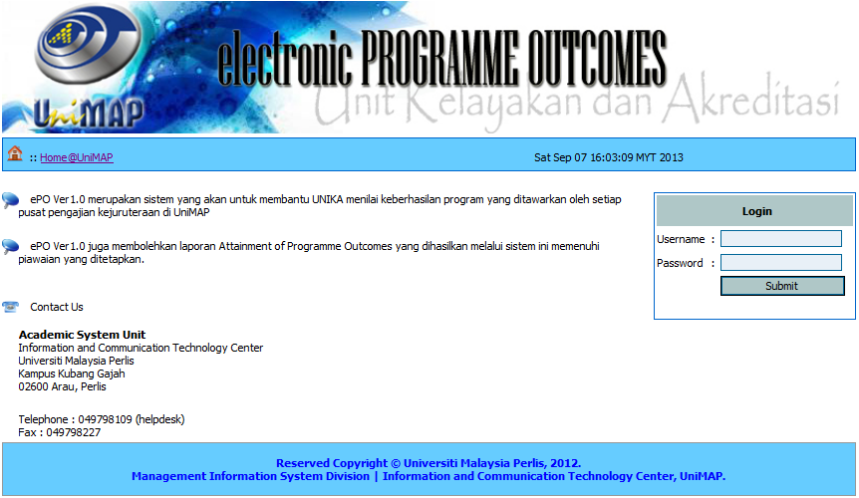
electronic PO (ePO)
http://epo.unimap.edu.my/EPO/

Slide 48
Continual Quality Improvement (CQI)
Programme
Objectives
Review/input/survey by stakeholders
Programme
Outcomes
Course Coordinator
Course Outcomes
(Course Document)
University Senate
Delivery
Jawatankuasa Pengurusan Akademik (JPA)
Academic Divisions
Assessment
School Board
Evaluation (CER)
Evaluation (PER)
HEA01 New/
HEA03
Programme Committee

Slide 49
Course Outcomes (CO)

Slide 50
Course Outcomes (CO)
CO are clear and concise statements that describe what the students are expected to develop, learn, or master by the end of a course.
The statements refer to specific knowledge, practical skills, areas of professional development, attitudes, higher-order thinking skills, etc.
The CO statements should be meaningful, observable and measurable.
Course Outcomes (CO) must satisfy the stated programme outcomes (PO). There is no need for ANY (individual) course to address all programme outcomes.

Slide 51
Course Outcomes
Statement … explain, calculate, derive, design, critique.
Statement … learn, know, understand, appreciate
non-observable
Understanding cannot be directly observed.
A student must do something observable to demonstrate his/her understanding.

Slide 52
Why are course outcomes important?
They are essential because they:
guide and organize the instructor and the learner.
define the breadth and depth of learning students are expected to achieve
provide an objective benchmark for formative, summative, and prior learning assessment
clearly communicate expectations to learners
clearly communicate graduates’ skills to the stakeholders
define coherent units of learning that can be further subdivided or modularized for classroom or for other delivery modes.

Slide 53
3 components of a course outcomes
1) Action verb
Ability to:
describe the principles used in designing X.
evaluate the strengths and weakness of …
Well-written verbs must be (SMART)
Specific
Measurable
Achievable
Realistic
Time frame
Observable
Try to avoid these:
- understand
- appreciate
know
learn
aware
familiar

Slide 54
3 components of a course outcomes
2) Condition
context under which the behaviour is to occur
describe the principles used in designing X.
orally describe the principles used in designing X.
design a beam.
design a beam using Microsoft Excel design template

Slide 55
3 components of a course outcomes
Standard
criteria of acceptable level of performance
describe the principles used in designing X.
orally describe the principles used in designing X.
orally describe the five principles used in designing X.
design a beam.
design a beam using Microsoft Excel design template .
design a beam using Microsoft Excel design template based on BS 5950:Part 1.

Slide 56
Course outcomes by adding a condition and standard
Poor
Students should be able to design research.
Better
Students should be able to independently design and carry out experimental and correlational research.
Best
Students should be able to independently design and carry out experimental and correlational research that yields valid results.
Source: Bergen, R. 2000. A Program Guideline for Outcomes Assessment at Geneva College

Slide 57
Objectives vs Outcomes
Objectives | Outcomes
Objectives describe WHAT A TEACHER NEEDS TO DO TO TEACH, AND WHAT NEEDS TO BE PLANNED TO TEACH. | Outcomes describes WHATSTUDENTS SHOULD KNOW,UNDERSTAND AND CAN DO UPON THE COMPLETION OF A STUDY PERIOD.
Objectives require the use of BASIC THINKING SKILLS SUCH AS KNOWLEDGE, COMPREHENSION, AND APPLICATION. | Outcomes require the use of HIGHER THINKING SKILLS SUCH AS ANALYSIS, SYNTHESIS, AND EVALUATION (as described in Bloom’s Taxonomy)
Objectives DO NOT NECESSARILY RESULT IN A PRODUCT. | Outcomes result in a PRODUCT THAT CAN BE MEASURED AND ASSESSED.

Slide 58
Bloom’s Taxonomy of Learning Domains
Source :
http://www.nwlink.com/~donclark/hrd/bloom.html
http://www.nwlink.com/~donclark/hrd/Bloom/psychomotor_domain.html
http://www.nwlink.com/~donclark/hrd/Bloom/affective_domain.html

Slide 59
Bloom’s Taxonomy
Bloom's Taxonomy was created in 1956 under the leadership of educational psychologist Dr Benjamin Bloom in order to promote higher forms of thinking in education, such as analyzing and evaluating concepts, processes, procedures, and principles, rather than just remembering facts (rote learning).
It is most often used when designing educational, training, and learning processes.
Teaching / Learning method may have to be integrated to include different delivery methods to complement the traditional Lecture method.

Slide 60
Three Domains in Learning
Psychomotor
Affective
Cognitive
Skills
Knowledge
Attitudes

Slide 61
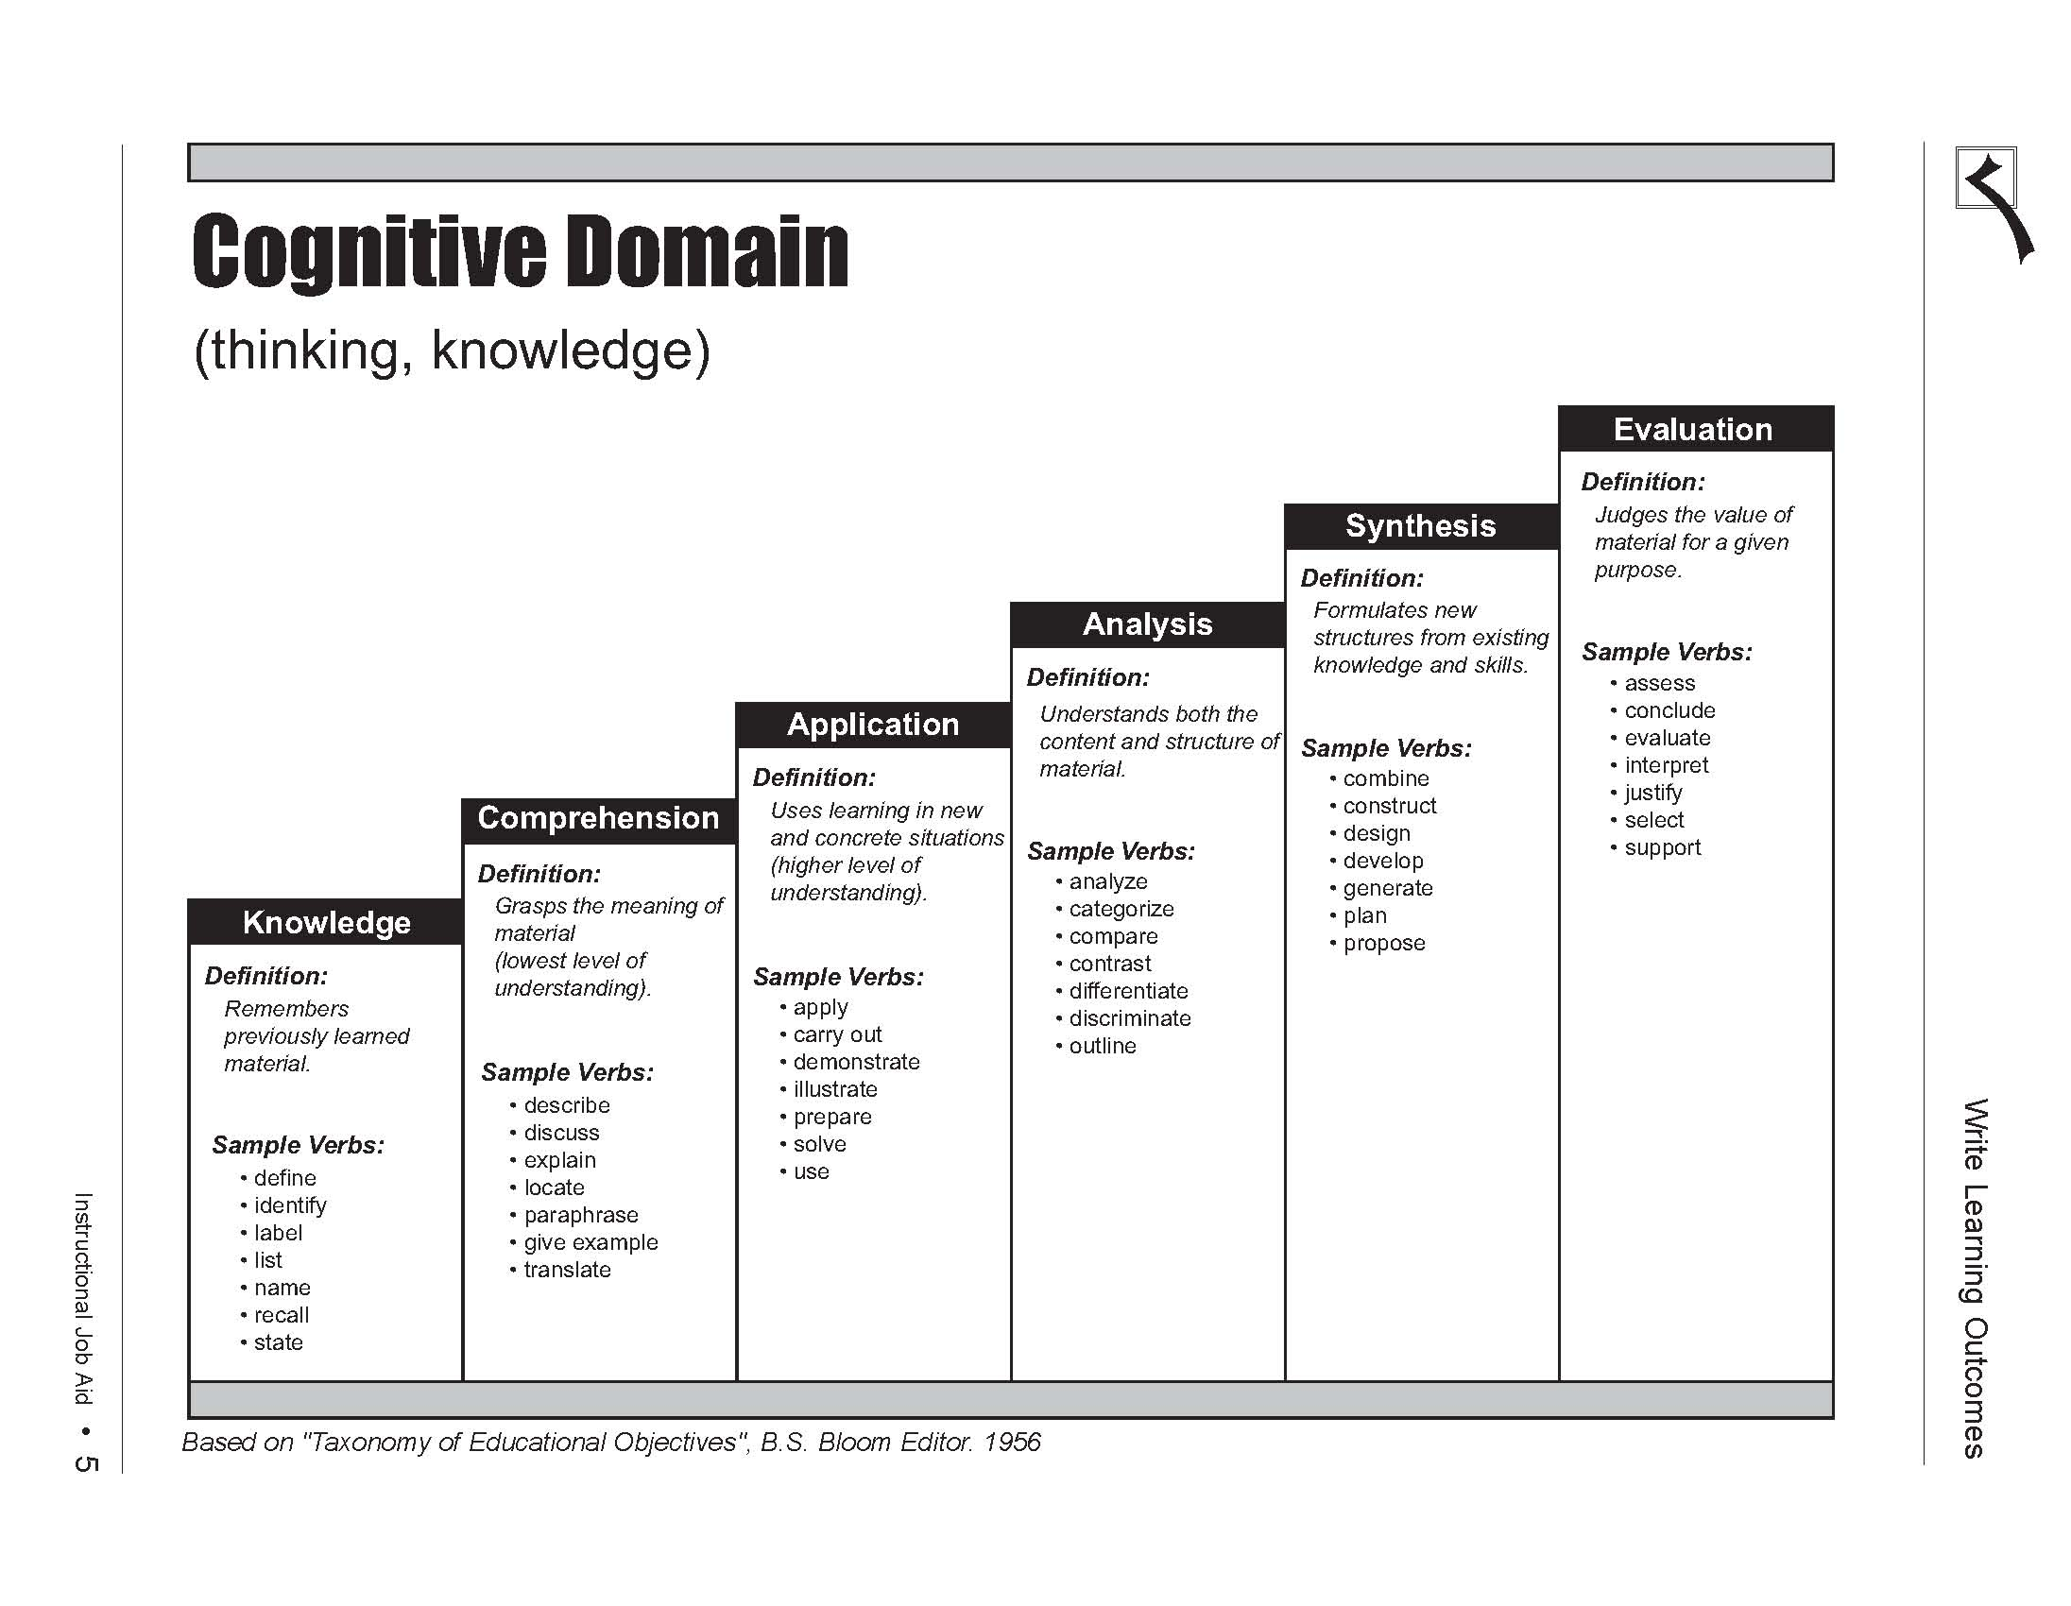
The cognitive domain involves knowledge and the development of intellectual skills
C1
C2
C3
C4
C5
C6
Lower order
Intermediate
Higher order

Slide 62
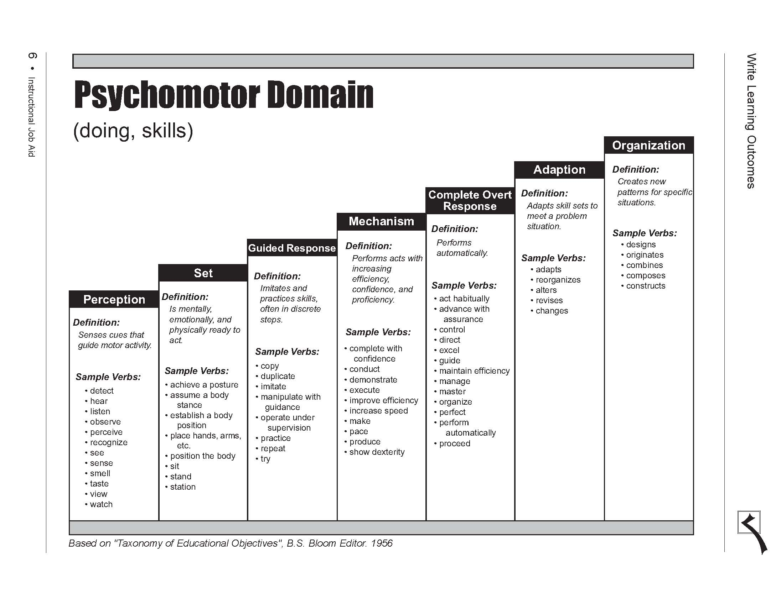
The psychomotor domain includes physical movement, coordination, and use of the motor-skill areas.
P1
P2
P3
P4
P5
P6
P7
Lower order
Intermediate
Higher order

Slide 63
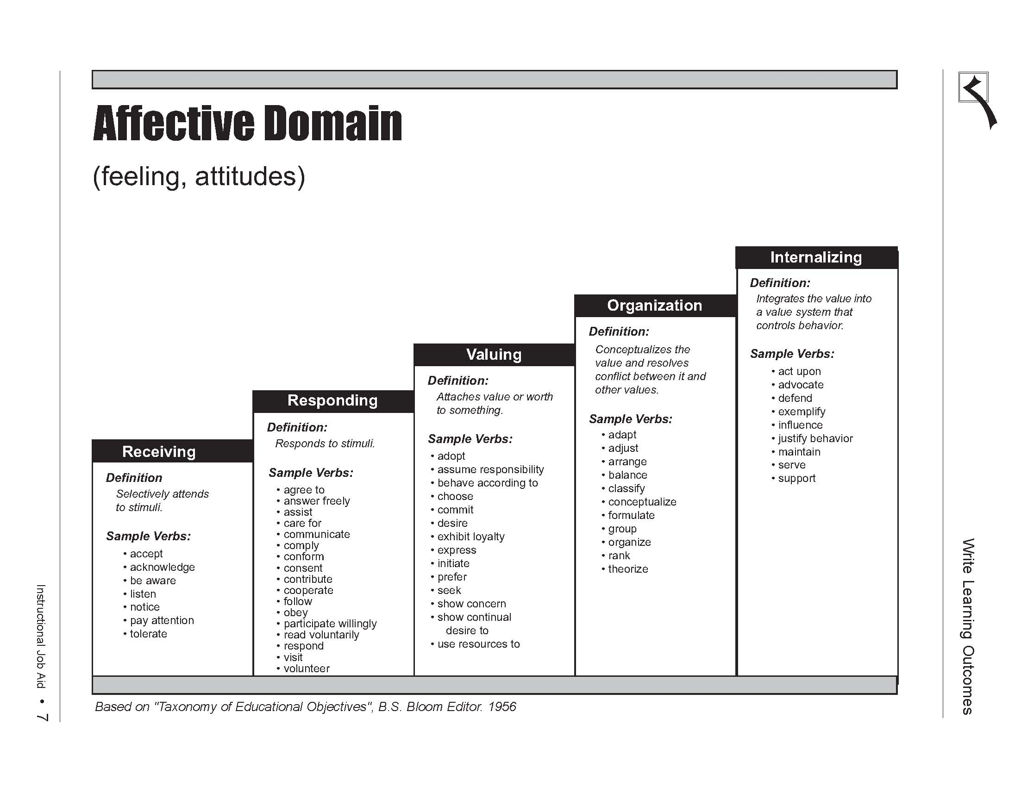
The affective domain includes the manner in which we deal with things emotionally, such as feelings, values, appreciation, enthusiasms, motivations, and attitudes.
A1
A2
A3
A4
A5
Lower order
Intermediate
Higher order

Slide 64
Domain and Complexity Level Distribution by Year of Students in All Engineering Degree Program
[ Reference from Workshop on Re-Alignment of Course Outcomes (CO) – Programme Outcomes (PO) Report.]

Slide 65
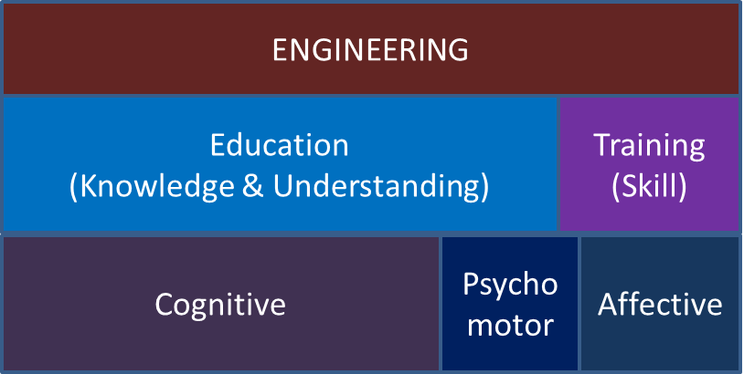
Distribution of Domains

Slide 66
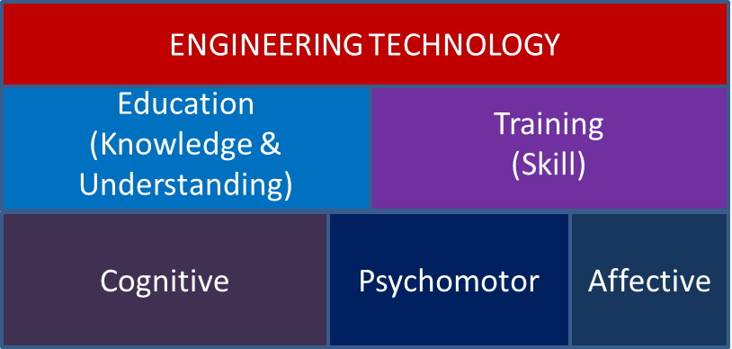
Eng. vs Eng. Tech

Slide 67
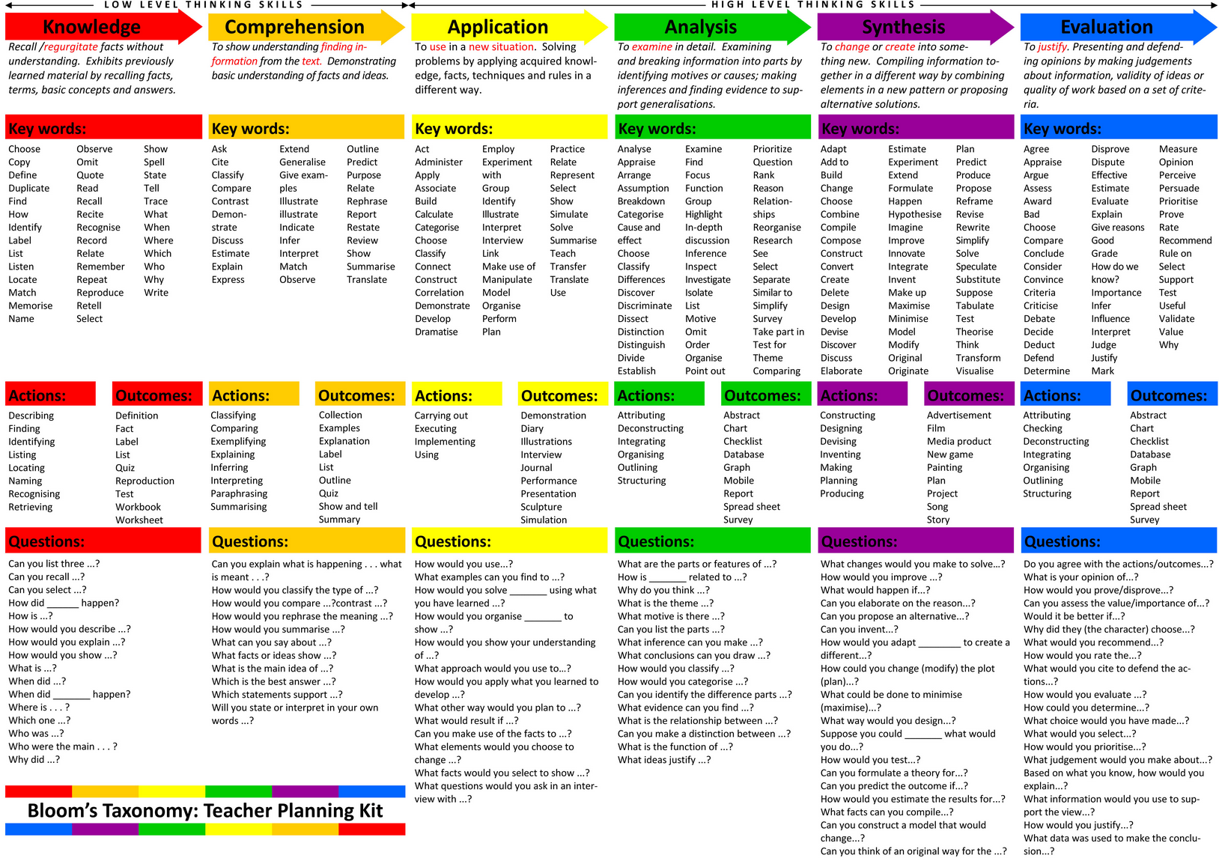

Slide 68
Course Outcomes (CO) contribution to Programme Outcomes (PO)
Implement design projects with multidisciplinary teams
Assignments that requires library, www searches
PO9:
Ability to function on multi-disciplinary teams.
PO11:
Life long learning

Slide 69
Course Outcomes of EET142 Introduction to Electrical Engineering (Lecture, Visit, Presentation)
Course Outcomes (CO) |  | PO mapping | Domain & Taxonomy level
CO1 | Ability to explore the career of an electrical engineer, scope, career advancement opportunity and contemporary issues in engineering. | PO1 | C4 A3
CO2 | Ability to communicate effectively through public speaking and technical report writing. | PO10 | P4, CS
CO3 | Ability to describe the background, procedure and output of the project undertaken. | PO6 | C3, P3, A3, EM

Slide 70
Course Outcomes of EET303 Electromagnetic Theory (100% Lecture, No Lab)
SYNOPSIS: The purpose of this course is to learn the basic theory and analysis of electromagnetic. Student should be able to understand the basic concept of electrostatics, magnetostatics and dynamics. Student should also understand the theory and application of transmission line.
Course Outcomes (CO) |  | PO mapping | Domain & Taxonomy level
CO1 | Ability to analyze the concept of vector analysis in electromagnetic theory | PO1 | C4
CO2 | Ability to investigate and analyze the concept of electrostatic and magnetic field | PO1 PO2 | C4, A2 CTPS
CO3 | Ability to relate and evaluate the concept of electromagnetic in transmission line analysis | PO1 PO11 | C6, A2, LL

Slide 71
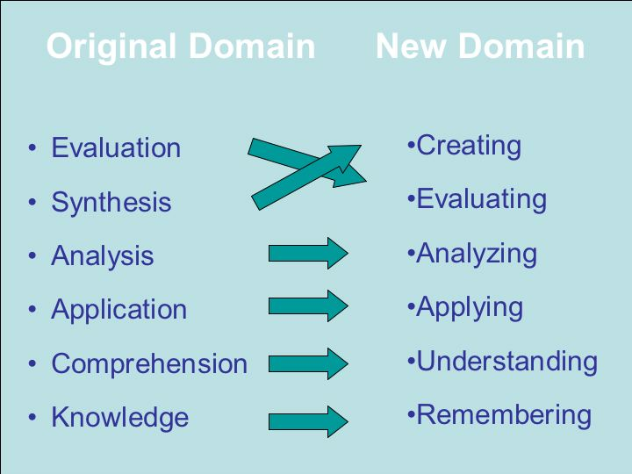
New Bloom’s Taxonomy
from noun to verb forms
reflects a more active form of thinking

Slide 72
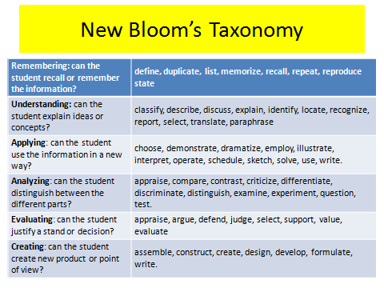

Slide 73
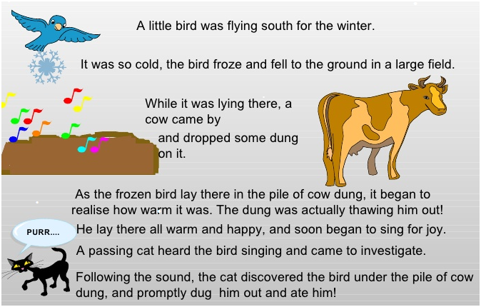

Slide 74
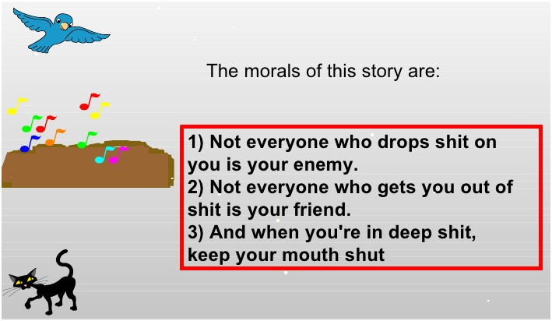

Slide 75
Thank you

