Slide 1

What are Tokens in Java and how to Implement them?
Created and Published By : - Girish Rathode

Slide 2
What are Tokens?
Tokens in Java are the small units of code which a Java compiler uses for constructing those statements and expressions.
Java supports 5 types of tokens which are:
Keywords
Identifiers
Literals
Operators
Special Symbols

Slide 3
1. Keywords
Keywords in Java are predefined or reserved words that have special meaning to the Java compiler.
Each keyword is assigned a special task or function and cannot be changed by the user.
You cannot use keywords as variables or identifiers as they are a part of Java syntax itself.
A keyword should always be written in lowercase as Java is a case sensitive language.
Java supports various keywords, some of them are listed below:

Slide 4
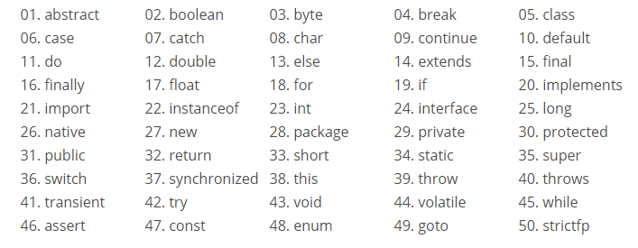
1. Keywords

Slide 5
2. Identifier
Java Identifiers are the user-defined names of variables, methods, classes, arrays, packages, and interfaces.
Once you assign an identifier in the Java program, you can use it to refer the value associated with that identifier in later statements.

Slide 6
2. Identifier
There are some de facto standards which you must follow while naming the identifiers such as:
Identifiers must begin with a letter, dollar sign or underscore.
Apart from the first character, an identifier can have any combination of characters.
Identifiers in Java are case sensitive.
Java Identifiers can be of any length.
Identifier name cannot contain white spaces.
Any identifier name must not begin with a digit but can contain digits within.
Most importantly, keywords can’t be used as identifiers in Java

Slide 7
2. Identifier Examples
//Valid Identifiers
$myvariable //correct
_variable //correct
variable //correct
dem_identifier_name //correct
dem2019var //correct
//Invalid Identifiers
Dem variable //error
&variable //error
23identifier //error
var/edu //error
Girish's //error

Slide 8
3. Literals
Literals in Java are similar to normal variables but their values cannot be changed once assigned.
In other words, literals are constant variables with fixed values.
These are defined by users and can belong to any data type.
Java supports five types of literals which are as follows:
Integer
Floating Point
Character
String
Boolean

Slide 9
3.Literals Example
public class DemoLiteral
{
public static void main(String[] args)
{
int du1 = 112; // Int literal
float du2 = 31.10; // Float literal
char du3 = ‘g' // char literal
String du4 = “Girish"; // String literal
boolean du5 = true; // Boolean literal
System.out.println(du1); //112
System.out.println(du2); //31.40
System.out.println(du3); //giri
System.out.println(du4); //Girish
System.out.println(du5); //true
}
}

Slide 10
4. Operators
An operator in Java is a special symbol that signifies the compiler to perform some specific mathematical or non-mathematical operations on one or more operands.
Java supports 8 types of operators. Below I have listed down all the operators, along with their examples:
Operator Examples
Operator Examples
Arithmetic + , – , / , * , %
Unary ++ , – – ,!
Assignment = , += , -= , *= , /= , %=
Relational ==, != , < , >, <= , >=
Logical && , ||
Ternary (Condition) ? (Statement1) : (Statement2);
Bitwise & , | , ^ , ~
Shift << , >> , >>>

Slide 11
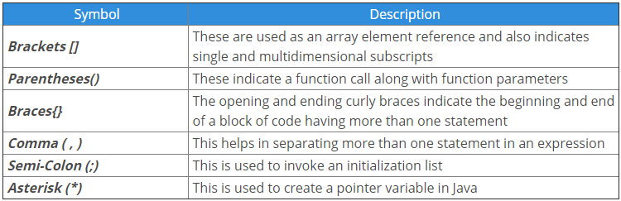
Special Symbols
Special symbols in Java are a few characters which have special meaning known to Java compiler and cannot be used for any other purpose.
In the below table I have listed down the special symbols supported in Java along with their description.

