Slide 1
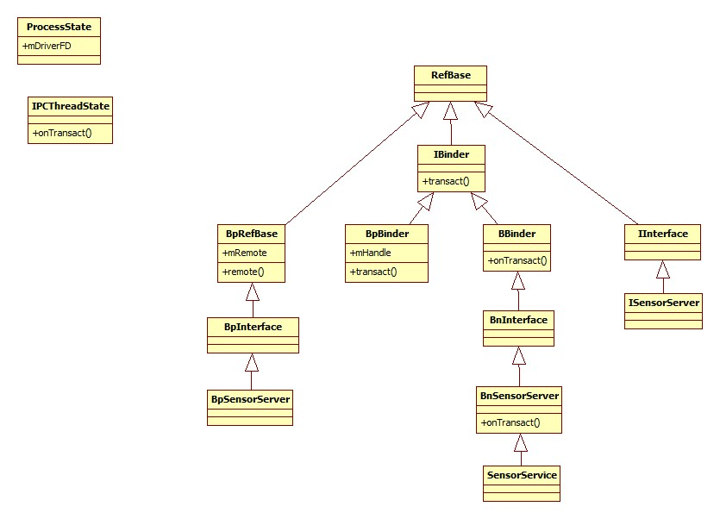
client
server
binder_ref
node -> binder_node
binder_node
cookie -> BBinder

