Slide 1
SIOP ML Competition 2025
Team ReLulu
Yizhen Egyn Zhu (Amazon)
Bao Ho (Bowling Green State University)

Slide 2


Team Members
Yizhen Egyn Zhu
Machine Learning Scientist
Amazon Global Hiring Science
Bao Ho
PhD Candidate
Bowling Green State University

Slide 3
Cognitive Ability A
Function calling on external website to get all possible English phrases (common phrase & proper noun)
Pass all possible phrases to LLM
Ask LLM (Claude 3.5 Sonnet v2) to select the most common phrase and provide a rationale
Pass the list of answers to LLM and ask to identify uncommon phrases
For items that did not have an answer or identified as uncommon, rerun the process with full dictionary

Slide 4
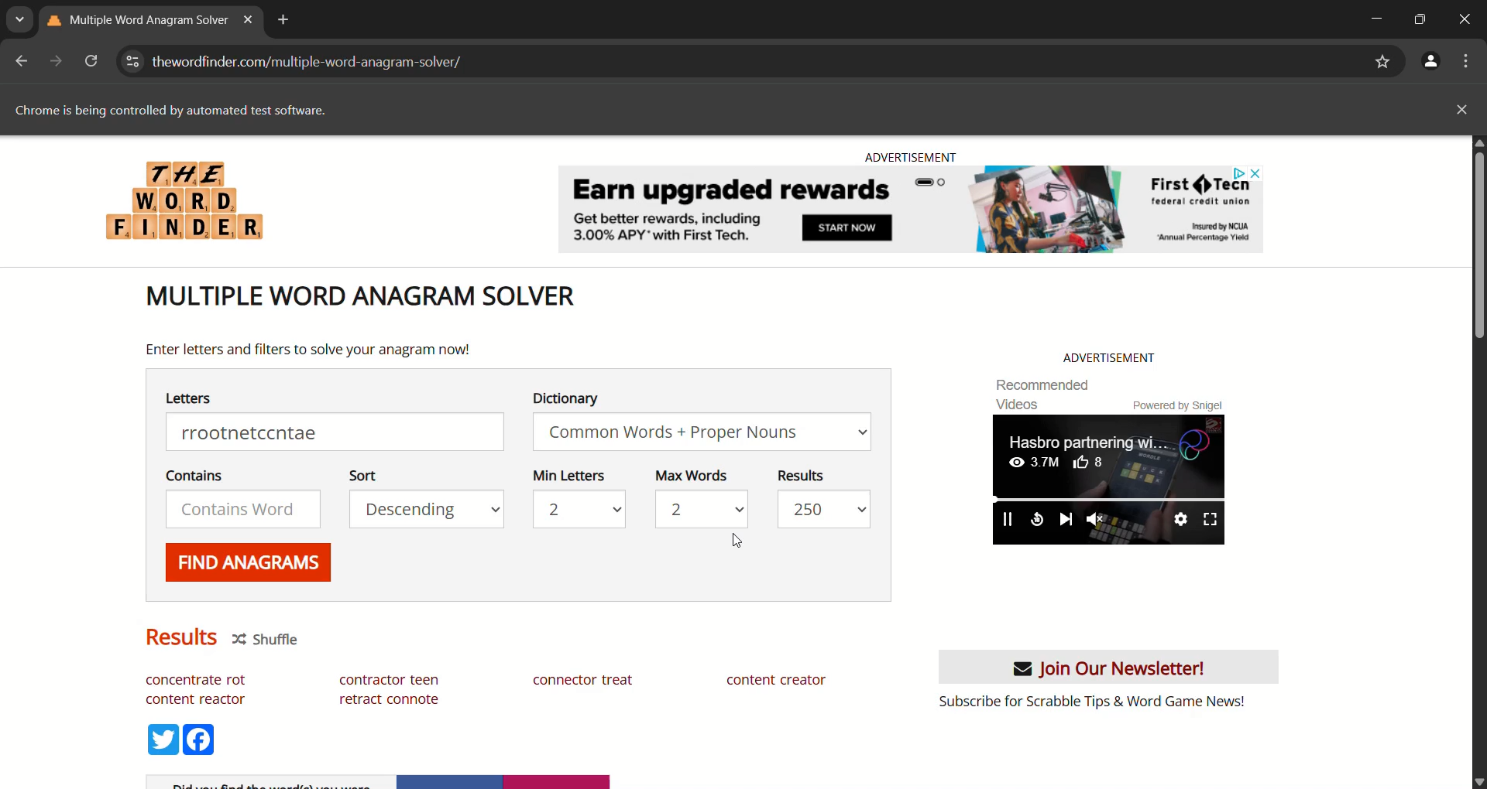

Slide 5
Cognitive Ability B
Parse questions into sequence and steps
Only 12 distinctive steps
Create 12 functions to process
Map text to function
Pass sequence through corresponding functions
100% Accuracy 😎

Slide 6

Cognitive Ability B (GenAI Version)
Parse questions by step
Call LLM API in a chatbot fashion
Example:
BedrockConverse
Pass a list of user + AI messages
Pass messages from previous steps
Step 1
Other step outputs disregarded
Step 2
Step 3
Step …
Final Answer

Slide 7
Cognitive Ability C
Heuristically find the type of sequence
Arithmetic
Alternating Arithmetic
Geometric
Second-order Geometric
Fibonacci
Calculate next number based on type 😎

Slide 8
Cognitive Ability C (GenAI Version)
Use a routing prompt to categorize the type of sequence
Send sequence to corresponding instruction prompt for each sequence type
Use LangGraph
Sequence
Routing Prompt
Sequence Prompt 1
Sequence Prompt 2
Sequence Prompt …
Answer

Slide 9
Personality Likert
Items are from NEO-P-R
For each job, ask LLM to rate whether each personality facets is required (Yes, No, Neither) for the job
Also ask LLM (Claude 3.5 Haiku) to provide rationale
Context
Job role, job advertisement
Convert to score
Yes = high facet score
No = low facet score
Neither = 5
Forklift Operator
Importance: YES
Rationale: High physical activity and energy are crucial for managing demanding warehouse tasks and operating heavy machinery.

Slide 10
Personality Choice
For each job, ask LLM to rate which statement is more preferred (A, B, Neither) for the job
Also ask LLM (Claude 3.5 Haiku) to provide rationale
Context
Job role, job advertisement
Convert to score
A or B = -2 or 2
Neither = 0
If both statements are from Neo-P-R, use Likert results to choose

Slide 11
Job Readiness
O*NET technology tools 🔥
If item exists on O*NET
5
If item does not exist on O*NET
1

Slide 12
Interview Questions
Question 1-5
Same SJT questions format for all jobs
→ Use same generic answer for all jobs
→ Ask LLM (Phi-4-unsloth) to answer as general as possible in one sentence
No context
Question 6-9
Behavioral questions
Ask LLM (Phi-4-unsloth) to answer the question in one sentence
No context

