Slide 1
ETHICAL AND SOCIAL ISSUES IN INFORMATION SYSTEMS
Chapter 4
VIDEO CASES
Case 1: Big Brother is Copying Everything on the Internet
Case 2: Delete: The Virtue of Forgetting in a Digital Age

Slide 2
CHAPTER 4: ETHICAL AND SOCIAL ISSUES IN
INFORMATION SYSTEMS
Content of Presentation
What ethical, social, and political issues are raised by information systems?
What specific principles for conduct can be used to guide ethical decisions?
Why do contemporary information systems technology and the Internet pose challenges to the protection of individual privacy and intellectual property?
How have information systems affected everyday life?
Notes:
Ask students what their first impressions are after seeing these objectives. Can they point to examples of how information systems have affected everyday life? If not, explain that they will be surprised to learn that information systems affect almost every area of daily life. Can students explain how the Internet poses challenges to privacy and intellectual property? Ask them how Google, Facebook, and peer-to-peer networks are related to these issues. What about breakdowns in important networks and software at banks, air traffic control, and other business firms?

Slide 3
CHAPTER 4: ETHICAL AND SOCIAL ISSUES IN
INFORMATION SYSTEMS
Understanding Ethical and Social Issues Related to Systems
Ethics
  Principles of right and wrong that individuals, acting as free moral agents, use to make choices to guide their behaviors
Notes:
There are numerous examples of business ethical failures to ask students about. You could ask how information systems or their absence might have been related to the current financial crisis in the United States, the investment banks that have suffered heavy losses, and individuals who were able to defraud investors of millions. What role did IS have in this crisis? The Madoff Ponzi scheme is instructive: systems were used for over twenty years to fool investors, regulators, and investigators about the true nature of Madoff’s business.

Slide 4
CHAPTER 4: ETHICAL AND SOCIAL ISSUES IN
INFORMATION SYSTEMS
Understanding Ethical and Social Issues Related to Systems
Information systems and ethics
  Information systems raise new ethical questions because they create opportunities for:
    Intense social change, threatening existing distributions of power, money, rights, and obligations
    New kinds of crime
Notes:
Ask students to describe some of the ethical dilemmas that are presented by information systems and new developments in technology. Privacy is an important issue – mention the opening case again and explain that Google, Facebook, and other similar sites often run into trouble regarding privacy invasions.

Slide 5
CHAPTER 4: ETHICAL AND SOCIAL ISSUES IN
INFORMATION SYSTEMS
Understanding Ethical and Social Issues Related to Systems
Model for thinking about ethical, social, political issues:
  Society as a calm pond
  IT as rock dropped in pond, creating ripples of new situations not covered by old rules
  Social and political institutions cannot respond overnight to these ripples—it may take years to develop etiquette, expectations, laws
    Requires understanding of ethics to make choices in legally gray areas
Notes:
Can students provide any examples of how IT has challenged some area of ethics, social life, or legal arrangements?

Slide 6
CHAPTER 4: ETHICAL AND SOCIAL ISSUES IN
INFORMATION SYSTEMS
Understanding Ethical and Social Issues Related to Systems
Five moral dimensions of the information age
  Information rights and obligations
  Property rights and obligations
  Accountability and control
  System quality
  Quality of life
Notes:
Give examples of each of the five major issues. For example, an issue dealing with information rights might be, “What rights do individuals possess with respect to themselves?” What do they have a right to protect? An issue dealing with quality of life might be, “What values should be preserved in an information- and knowledge- based society?” An issue dealing with system quality might be, “What standards of data and system quality should we demand to protect individual rights and the safety of society?”

Slide 7
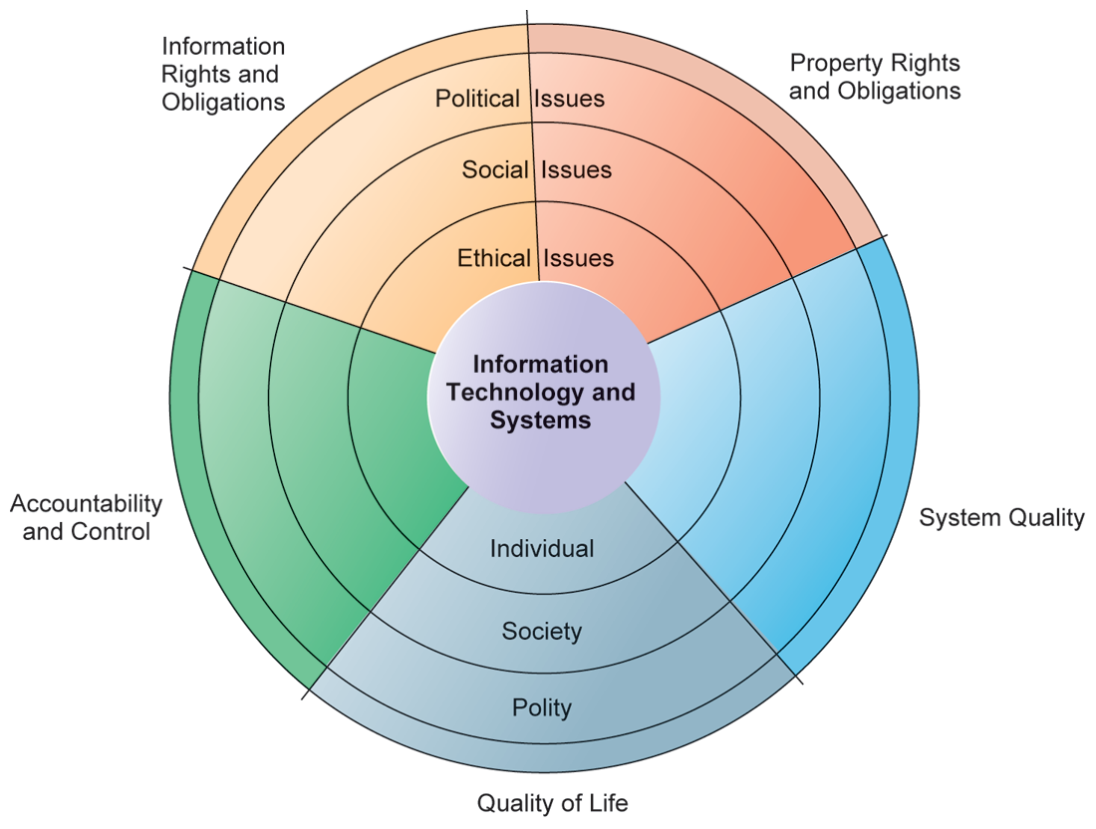
CHAPTER 4: ETHICAL AND SOCIAL ISSUES IN
INFORMATION SYSTEMS
Understanding Ethical and Social Issues Related to Systems
THE RELATIONSHIP BETWEEN ETHICAL, SOCIAL, AND POLITICAL ISSUES IN AN INFORMATION SOCIETY
The introduction of new information technology has a ripple effect, raising new ethical, social, and political issues that must be dealt with on the individual, social, and political levels. These issues have five moral dimensions: information rights and obligations, property rights and obligations, system quality, quality of life, and accountability and control.
Notes:
Explain to students that the graphic displays the five moral dimensions listed in the caption. Consider online p2p shared music as an example of how a new technology has ethical, social, and eventually political (legal) ramifications. If music can be ripped off, why pay any money for it? Why should anyone care about record labels or artist’s income?

Slide 8
CHAPTER 4: ETHICAL AND SOCIAL ISSUES IN
INFORMATION SYSTEMS
Understanding Ethical and Social Issues Related to Systems
Key technology trends that raise ethical issues
  Doubling of computer power
    More organizations depend on computer systems for critical operations
  Rapidly declining data storage costs
    Organizations can easily maintain detailed databases on individuals
  Networking advances and the Internet
    Copying data from one location to another and accessing personal data from remote locations is much easier
Notes:
This slide and the next discuss four main technology trends that raise ethical issues. Which of these trends do students believe might have the most adverse consequences? Why do they feel this way? Do the positives outweigh the negatives for all four issues? Why or why not?

Slide 9
CHAPTER 4: ETHICAL AND SOCIAL ISSUES IN
INFORMATION SYSTEMS
Understanding Ethical and Social Issues Related to Systems
Key technology trends that raise ethical issues (cont.)
  Advances in data analysis techniques
    Companies can analyze vast quantities of data gathered on individuals for:
      Profiling
        Combining data from multiple sources to create dossiers of detailed information on individuals
      Nonobvious relationship awareness (NORA)
        Combining data from multiple sources to find obscure hidden connections that might help identify criminals or terrorists
Notes:
Online profiling is one of the most controversial computer-related ethical, social and political issues today. While it is used fairly extensively on the Internet, it is also used by insurance firms, health insurance firms, casinos, and of course national authorities around the globe for finding potential terrorists.

Slide 10
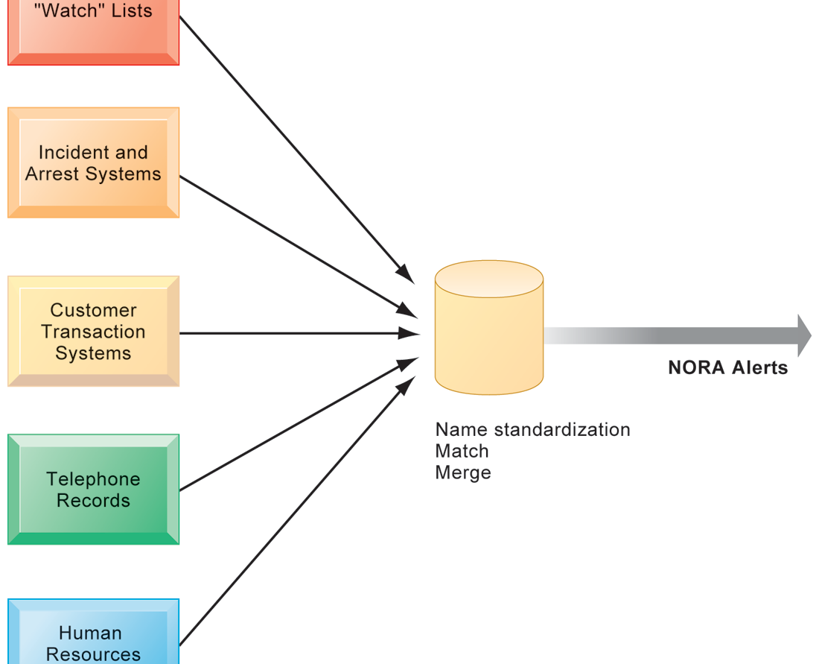
CHAPTER 4: ETHICAL AND SOCIAL ISSUES IN
INFORMATION SYSTEMS
Understanding Ethical and Social Issues Related to Systems
NONOBVIOUS RELATIONSHIP AWARENESS (NORA)
NORA technology can take information about people from disparate sources and find obscure, nonobvious relationships. It might discover, for example, that an applicant for a job at a casino shares a telephone number with a known criminal and issue an alert to the hiring manager.
FIGURE 4-2
Notes:
Explain that NORA is used by both the government and the private sector for its profiling capabilities. Ask students to provide potential examples of NORA (other than the one mentioned in the caption) for both governmental and business purposes. One such example might be an airline identifying potential terrorists attempting to board a plane. Another might government identifying potential terrorists by monitoring phone calls.

Slide 11
CHAPTER 4: ETHICAL AND SOCIAL ISSUES IN
INFORMATION SYSTEMS
Ethics in an Information Society
Basic concepts for ethical analysis
  Responsibility:
    Accepting the potential costs, duties, and obligations for decisions
  Accountability:
    Mechanisms for identifying responsible parties
  Liability:
    Permits individuals (and firms) to recover damages done to them
  Due process:
    Laws are well known and understood, with an ability to appeal to higher authorities
Notes:
Explain that information systems do not exist in a vacuum and that these concepts are instrumental in understanding the impact of systems and measuring their success. Ask students why liability and due process are such important ethical concepts. (A rough answer would be that they provide recourse to individuals negatively effected by mismanagement of information systems, providing incentive to ‘play by the rules’.)

Slide 12
CHAPTER 4: ETHICAL AND SOCIAL ISSUES IN
INFORMATION SYSTEMS
Ethics in an Information Society
Ethical analysis: A five-step process
  Identify and clearly describe the facts (WHAT)
  Define the conflict or dilemma and identify the higher-order values involved (WHY)
  Identify the stakeholders (WH0)
  Identify the Alternatives (HOW)
  Identify the potential consequences of your options (WHEN)
Notes:
Do students believe that any aspect of ethical analysis is lacking from this process? If so, what? Can students offer a brief example of an ethical dilemma and how they would resolve it using this process? One class exercise is to work with students to identify an ethical situation they are aware of, or that may have been in the news. Then, go through the ethical analysis described in the slide to illustrate the process of analyzing an ethical situation.

Slide 13
CHAPTER 4: ETHICAL AND SOCIAL ISSUES IN
INFORMATION SYSTEMS
Ethics in an Information Society
Six Candidate Ethical Principles
  Golden Rule
    Do unto others as you would have them do unto you
  Immanuel Kant’s Categorical Imperative
    If an action is not right for everyone to take, it is not right for anyone
    For example, the categorical imperative applies to an employee who tries to steal money from his employer. He SHOULDN’T do this, because if ALL employees attempted to do so, the company would fail.
Notes:
This slide and the next review six traditional ethical principles. Ensure students understand the difference between the categorical imperative and the rule of change. Briefly, the difference is that the categorical imperative spans the entirety of the populace, while the rule of change applies to the decisions of one person over time. For example, the categorical imperative applies to an employee who tries to steal money from his employer. He shouldn’t do this, because if all employees attempted to do so, the company would fail. The rule of change applied to the same situation might run as follows: while the employee’s stealing one dollar from the company would not lead to any true problem, repeatedly stealing one dollar, or stealing a lot of dollars, would be unacceptable and ultimately lead to the destruction of the company.

Slide 14
  Descartes’ Rule of Change
    If an action cannot be taken repeatedly, it is not right to take at all
    While the employee’s stealing one dollar from the company would not lead to any true problem, BUT repeatedly stealing one dollar, or stealing a lot of dollars, would be unacceptable and ultimately lead to the destruction of the company.
Notes:
The rule of change applied to the same situation might run as follows: while the employee’s stealing one dollar from the company would not lead to any true problem, repeatedly stealing one dollar, or stealing a lot of dollars, would be unacceptable and ultimately lead to the destruction of the company.

Slide 15
CHAPTER 4: ETHICAL AND SOCIAL ISSUES IN
INFORMATION SYSTEMS
Ethics in an Information Society
Six Candidate Ethical Principles (cont.)
  Utilitarian Principle
    Take the action that achieves the higher or greater value
  Risk Aversion Principle
    Take the action that produces the least harm or least potential cost
  Ethical “no free lunch” Rule
    Assume that virtually all tangible and intangible objects are owned by someone unless there is a specific declaration otherwise
Notes:
How does the “no free lunch” rule relate to copyrights, patents, and trademarks? (These concepts are discussed in later slides.)
Explain that the appearance of unethical behavior is as harmful as actual unethical behavior at times, so adherence to these principles are critical. In an age of “open software” how does the principle of “no free lunch” work out?

Slide 16
CHAPTER 4: ETHICAL AND SOCIAL ISSUES IN
INFORMATION SYSTEMS
The Moral Dimensions of Information Systems
Privacy:
  Claim of individuals to be left alone, free from surveillance or interference from other individuals, organizations, or state. Claim to be able to control information about yourself
Notes:
Do students believe that there are sufficient protections for privacy in law? If not, what are possible methods of developing appropriate privacy protections? Table 4-3 in the text lists a variety of other laws affecting both the government and private institutions, but few areas of the private sector are as well regulated with respect to privacy. Do an in-class poll and ask students who among them feel they can control the use of their personal information on the Internet. You should get no one raising their hand.

Slide 17
CHAPTER 4: ETHICAL AND SOCIAL ISSUES IN
INFORMATION SYSTEMS
The Moral Dimensions of Information Systems
  FIP principles:
  Notice/awareness (core principle)
  Web sites must disclose practices before collecting data
  Choice/consent (core principle)
  Consumers must be able to choose how information is used for secondary purposes;
  Access/participation
  Consumers must be able to review, contest accuracy of personal data
Notes:
These five Fair Information Practices provide the foundation for all privacy legislation in the United States, and much of Europe. You can ask students or explain what each means: (1) Notice/awareness: Web sites must disclose practices before collecting data; (2) Choice/consent: Consumers must be able to choose how information is used for secondary purposes; (3) Access/participation: Consumers must be able to review, contest accuracy of personal data; (4) Security: Data collectors must take steps to ensure accuracy, security of personal data; (5) Enforcement: There must be a mechanism to enforce FIP principles
In addition, you might go to a popular Web site, such as bestbuy.com, find its privacy policy, and see how well the site conforms to the principles above. Chances are good that the Web site you choose will have several statements in their policies which permit them to do anything they want with personal information. Also, do a search on “FTC privacy” and go to one of the reports listed. A search on “FTC behavioral targeting” also produces many fine reports on the topic.

Slide 18
CHAPTER 4: ETHICAL AND SOCIAL ISSUES IN
INFORMATION SYSTEMS
The Moral Dimensions of Information Systems
FTC FIP principles:
  Security
  Data collectors must take steps to ensure accuracy, security of personal data
  Enforcement
  There must be a mechanism to enforce FIP principles
Notes:
These five Fair Information Practices provide the foundation for all privacy legislation in the United States, and much of Europe. You can ask students or explain what each means: (1) Notice/awareness: Web sites must disclose practices before collecting data; (2) Choice/consent: Consumers must be able to choose how information is used for secondary purposes; (3) Access/participation: Consumers must be able to review, contest accuracy of personal data; (4) Security: Data collectors must take steps to ensure accuracy, security of personal data; (5) Enforcement: There must be a mechanism to enforce FIP principles
In addition, you might go to a popular Web site, such as bestbuy.com, find its privacy policy, and see how well the site conforms to the principles above. Chances are good that the Web site you choose will have several statements in their policies which permit them to do anything they want with personal information. Also, do a search on “FTC privacy” and go to one of the reports listed. A search on “FTC behavioral targeting” also produces many fine reports on the topic.

Slide 19
CHAPTER 4: ETHICAL AND SOCIAL ISSUES IN
INFORMATION SYSTEMS
The Moral Dimensions of Information Systems
Internet Challenges to Privacy:
  Cookies
  Web beacons/bugs
  Spyware
Google’s collection of private data; behavioral targeting
Notes:
What are students attitudes towards these technologies? Emphasize that cookies can be useful at trusted sites, but perhaps invasive at others. Have students had any experience with spyware or Web bugs on their own computers? Discuss how behavioral targeting amasses information on web users. Ask students why behavioral targeting could pose ethical issues? Can mistakes be made in behavioral targeting? Should private companies own more personal data on individuals than governments? Should the government keep track of what personal private information firms collect?

Slide 20
CHAPTER 4: ETHICAL AND SOCIAL ISSUES IN
INFORMATION SYSTEMS
The Moral Dimensions of Information Systems
Internet Challenges to Privacy:
  Cookies
    Tiny files downloaded by Web site to visitor’s hard drive to help identify visitor’s browser and track visits to site
    Allow Web sites to develop profiles on visitors
Notes:
What are students attitudes towards these technologies? Emphasize that cookies can be useful at trusted sites, but perhaps invasive at others. Have students had any experience with spyware or Web bugs on their own computers? Discuss how behavioral targeting amasses information on web users. Ask students why behavioral targeting could pose ethical issues? Can mistakes be made in behavioral targeting? Should private companies own more personal data on individuals than governments? Should the government keep track of what personal private information firms collect?

Slide 21
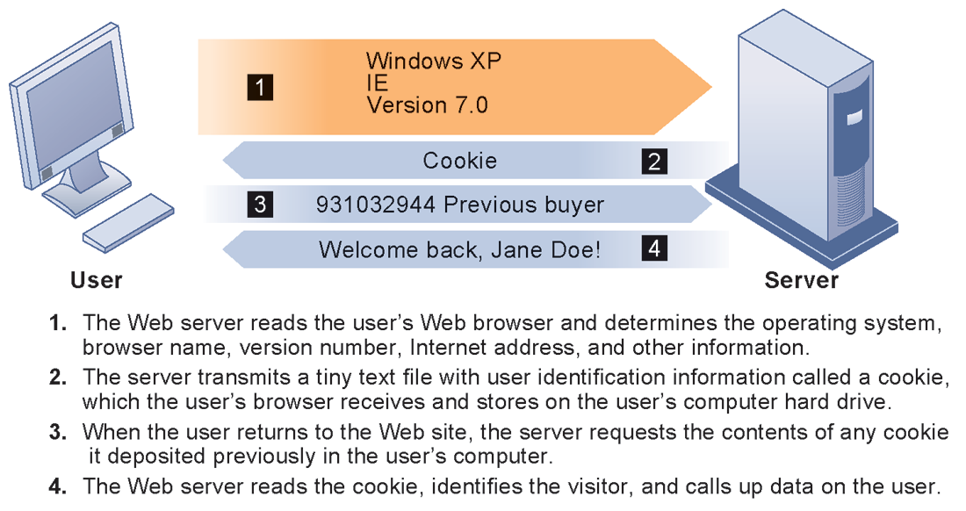
CHAPTER 4: ETHICAL AND SOCIAL ISSUES IN
INFORMATION SYSTEMS
The Moral Dimensions of Information Systems
HOW COOKIES IDENTIFY WEB VISITORS
FIGURE 4-3
Cookies are written by a Web site on a visitor’s hard drive. When the visitor returns to that Web site, the Web server requests the ID number from the cookie and uses it to access the data stored by that server on that visitor. The Web site can then use these data to display personalized information.
Notes:
Ask students to pinpoint where potential privacy invasions might occur in the process shown above. Students may suggest that no real privacy violation is occurring in the figure, which is a legitimate point of view. If so, ask them how they might feel about a Web site they did not trust engaging in the displayed process.

Slide 22
CHAPTER 4: ETHICAL AND SOCIAL ISSUES IN
INFORMATION SYSTEMS
The Moral Dimensions of Information Systems
  Cookies
    Some examples of companies that place cookies on your computer include the websites you visit and advertising companies that display ads to you.
Notes:
What are students attitudes towards these technologies? Emphasize that cookies can be useful at trusted sites, but perhaps invasive at others. Have students had any experience with spyware or Web bugs on their own computers? Discuss how behavioral targeting amasses information on web users. Ask students why behavioral targeting could pose ethical issues? Can mistakes be made in behavioral targeting? Should private companies own more personal data on individuals than governments? Should the government keep track of what personal private information firms collect?

Slide 23
CHAPTER 4: ETHICAL AND SOCIAL ISSUES IN
INFORMATION SYSTEMS
The Moral Dimensions of Information Systems
    Types of Cookies
  We generally talk about two kinds of cookies in digital marketing, First-party Cookies
  Third-party Cookies.
Notes:
What are students attitudes towards these technologies? Emphasize that cookies can be useful at trusted sites, but perhaps invasive at others. Have students had any experience with spyware or Web bugs on their own computers? Discuss how behavioral targeting amasses information on web users. Ask students why behavioral targeting could pose ethical issues? Can mistakes be made in behavioral targeting? Should private companies own more personal data on individuals than governments? Should the government keep track of what personal private information firms collect?

Slide 24
CHAPTER 4: ETHICAL AND SOCIAL ISSUES IN
INFORMATION SYSTEMS
The Moral Dimensions of Information Systems
First-party cookies
First-party cookies are placed on your computer by a site when you visit its pages.
Purpose:
First-party cookie is to help the site recognize a visitor.
First- party cookies can help sites automatically log in a person, associate her behavior with previous actions, customize content and experiences to previously expressed interests, and more.
Notes:
What are students attitudes towards these technologies? Emphasize that cookies can be useful at trusted sites, but perhaps invasive at others. Have students had any experience with spyware or Web bugs on their own computers? Discuss how behavioral targeting amasses information on web users. Ask students why behavioral targeting could pose ethical issues? Can mistakes be made in behavioral targeting? Should private companies own more personal data on individuals than governments? Should the government keep track of what personal private information firms collect?

Slide 25
CHAPTER 4: ETHICAL AND SOCIAL ISSUES IN
INFORMATION SYSTEMS
The Moral Dimensions of Information Systems
First Party Cookies
Generally, consumers don’t try to block first-party cookies because they add value to the experience, and because the individual actually chose to visit the site in the first place.
First-party cookies can serve great benefits to the consumer, like recognizing them when they revisit a site so they don’t have to log in again. In addition, a consumer that sets their browser to reject first-party cookies will find it very difficult to surf the web because many sites require them in order to gain access to content.
Notes:
What are students attitudes towards these technologies? Emphasize that cookies can be useful at trusted sites, but perhaps invasive at others. Have students had any experience with spyware or Web bugs on their own computers? Discuss how behavioral targeting amasses information on web users. Ask students why behavioral targeting could pose ethical issues? Can mistakes be made in behavioral targeting? Should private companies own more personal data on individuals than governments? Should the government keep track of what personal private information firms collect?

Slide 26
CHAPTER 4: ETHICAL AND SOCIAL ISSUES IN
INFORMATION SYSTEMS
The Moral Dimensions of Information Systems
Third-Party Cookies
Third-Party Cookies and Mobile Third-party cookies are placed on your computer by companies other than the site you visit.
Notes:
What are students attitudes towards these technologies? Emphasize that cookies can be useful at trusted sites, but perhaps invasive at others. Have students had any experience with spyware or Web bugs on their own computers? Discuss how behavioral targeting amasses information on web users. Ask students why behavioral targeting could pose ethical issues? Can mistakes be made in behavioral targeting? Should private companies own more personal data on individuals than governments? Should the government keep track of what personal private information firms collect?

Slide 27
CHAPTER 4: ETHICAL AND SOCIAL ISSUES IN
INFORMATION SYSTEMS
The Moral Dimensions of Information Systems
Most sites display content from a variety of sources when you request a web page. For example, an ad network might place a cookie on all browsers that are exposed to an advertiser’s banner ads.
Or if a site includes “like” buttons or embedded videos, these can also deliver third-party cookies.
Notes:
What are students attitudes towards these technologies? Emphasize that cookies can be useful at trusted sites, but perhaps invasive at others. Have students had any experience with spyware or Web bugs on their own computers? Discuss how behavioral targeting amasses information on web users. Ask students why behavioral targeting could pose ethical issues? Can mistakes be made in behavioral targeting? Should private companies own more personal data on individuals than governments? Should the government keep track of what personal private information firms collect?

Slide 28
CHAPTER 4: ETHICAL AND SOCIAL ISSUES IN
INFORMATION SYSTEMS
The Moral Dimensions of Information Systems
Purpose:
Third-party cookies help advertisers track what consumers do after they view or interact with content. This kind of measurement is important because most people exposed to an ad don’t click to visit an advertiser immediately but may subsequently visit. Advertisers want to be able to understand these “long-term” advertising effects.
Notes:
What are students attitudes towards these technologies? Emphasize that cookies can be useful at trusted sites, but perhaps invasive at others. Have students had any experience with spyware or Web bugs on their own computers? Discuss how behavioral targeting amasses information on web users. Ask students why behavioral targeting could pose ethical issues? Can mistakes be made in behavioral targeting? Should private companies own more personal data on individuals than governments? Should the government keep track of what personal private information firms collect?

Slide 29
CHAPTER 4: ETHICAL AND SOCIAL ISSUES IN
INFORMATION SYSTEMS
The Moral Dimensions of Information Systems
Technical solutions
The Platform for Privacy Preferences (P3P)
Allows Web sites to communicate privacy policies to visitor’s Web browser – user
User specifies privacy levels desired in browser settings
E.g. “medium” level accepts cookies from first-party host sites that have opt-in or opt-out policies but rejects third-party cookies that use personally identifiable information without an opt-in policy
Notes:
Explain that P3P is a standard of privacy intended to provide Web surfers more information about the sites they visit. Also explain that P3P is not universal, and that many sites are not members of the World Wide Web Consortium, which uses P3P.

Slide 30
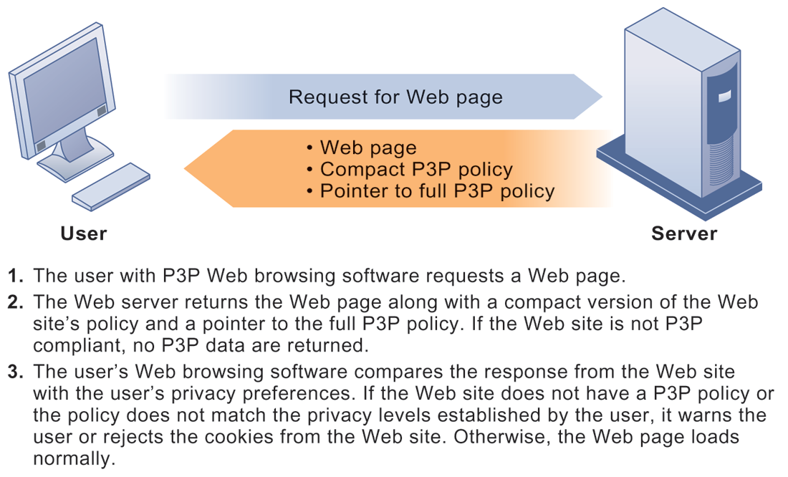
CHAPTER 4: ETHICAL AND SOCIAL ISSUES IN
INFORMATION SYSTEMS
The Moral Dimensions of Information Systems
THE P3P STANDARD
FIGURE 4-4
P3P enables Web sites to translate their privacy policies into a standard format that can be read by the user’s Web browser software. The browser software evaluates the Web site’s privacy policy to determine whether it is compatible with the user’s privacy preferences.
Notes:
Have students configured their own privacy preferences in such a way that they see messages like this at any point? If not, do they care? Are they concerned about the privacy policies of any of the sites they visit? (Students may be reluctant to answer this question!)

Slide 31
CHAPTER 4: ETHICAL AND SOCIAL ISSUES IN
INFORMATION SYSTEMS
The Moral Dimensions of Information Systems
Property rights: Intellectual property
  Intellectual property: Intangible property of any kind created by individuals or corporations
  Three main ways that protect intellectual property
    Trade secret: Intellectual work or product belonging to business, not in the public domain. Trade secrets protect valuable secret information.
    Ideas that must be kept confidential and others to whom they are disclosed to must also keep them confidential.
Notes:
Do students believe that the property rights guaranteed by trade secrets, copyrights, and patents are strong enough to avoid the theft of intellectual property online? Give an example of a trade secret (the formula for Coke; a method of doing business or business process). Give an example of a copyright (which could include the copyright of an online business process like Amazon’s One Click shopping). And give an example of a patent.

Slide 32
CHAPTER 4: ETHICAL AND SOCIAL ISSUES IN
INFORMATION SYSTEMS
The Moral Dimensions of Information Systems
Property rights: Intellectual property
Trade Secret______Example
come in an endless array of types, for example:
  R&D information
  Software algorithms
  Inventions
  Designs
  Formulas
  Ingredients
  Devices
  Methods
Notes:
Do students believe that the property rights guaranteed by trade secrets, copyrights, and patents are strong enough to avoid the theft of intellectual property online? Give an example of a trade secret (the formula for Coke; a method of doing business or business process). Give an example of a copyright (which could include the copyright of an online business process like Amazon’s One Click shopping). And give an example of a patent.

Slide 33
CHAPTER 4: ETHICAL AND SOCIAL ISSUES IN
INFORMATION SYSTEMS
The Moral Dimensions of Information Systems
Property rights: Intellectual property
Trade Secret______Example:
Google developed a search algorithm and continues to refine it. Some changes are announced but many are not. Google continues to modify its top secret algorithm to keep businesses and people from gaming the system.
Notes:
Do students believe that the property rights guaranteed by trade secrets, copyrights, and patents are strong enough to avoid the theft of intellectual property online? Give an example of a trade secret (the formula for Coke; a method of doing business or business process). Give an example of a copyright (which could include the copyright of an online business process like Amazon’s One Click shopping). And give an example of a patent.

Slide 34
CHAPTER 4: ETHICAL AND SOCIAL ISSUES IN
INFORMATION SYSTEMS
The Moral Dimensions of Information Systems
Property rights: Intellectual property
  Copyright:
  Copyright law applies to "works of authorship" that are fixed in a tangible medium of expression (such as a CD or a book)
  Statutory grant protecting intellectual property from being copied for the life of the author, plus 70 years. Copyrights protect original textual works and visual or artistic expressions.
Notes:
Do students believe that the property rights guaranteed by trade secrets, copyrights, and patents are strong enough to avoid the theft of intellectual property online? Give an example of a trade secret (the formula for Coke; a method of doing business or business process). Give an example of a copyright (which could include the copyright of an online business process like Amazon’s One Click shopping). And give an example of a patent.

Slide 35
CHAPTER 4: ETHICAL AND SOCIAL ISSUES IN
INFORMATION SYSTEMS
The Moral Dimensions of Information Systems
Property rights: Intellectual property
  Patents:
  Grants creator of invention an exclusive monopoly on ideas behind invention for 20 years.
  Patents protect new, useful, and non-obvious inventions (ideas!).
  An invention can be a device, a structure, process, machinery, etc.
Notes:
Do students believe that the property rights guaranteed by trade secrets, copyrights, and patents are strong enough to avoid the theft of intellectual property online? Give an example of a trade secret (the formula for Coke; a method of doing business or business process). Give an example of a copyright (which could include the copyright of an online business process like Amazon’s One Click shopping). And give an example of a patent.

Slide 36
CHAPTER 4: ETHICAL AND SOCIAL ISSUES IN
INFORMATION SYSTEMS
The Moral Dimensions of Information Systems
Challenges to intellectual property rights
  Digital media different from physical media (e.g. books)
    Ease of replication
    Ease of transmission (networks, Internet)
    Difficulty in classifying software
    Compactness
    Difficulties in establishing uniqueness
Notes:
Students may be unwilling to admit to infringing upon intellectual property rights themselves, but ask them whether they are familiar with the Internet and its ability to bypass intellectual property protections. Do they believe that legislation like the DMCA is having any effect? How many have friends who download “free” music from P2P sights? Free videos?

Slide 37
CHAPTER 4: ETHICAL AND SOCIAL ISSUES IN
INFORMATION SYSTEMS
The Moral Dimensions of Information Systems
Accountability, Liability, Control
  Computer-related liability problems
    If software fails, who is responsible?
      If seen as part of machine that injures or harms, software producer and operator may be liable
      If seen as similar to book, difficult to hold author/publisher responsible
      What should liability be if software seen as service? Would this be similar to telephone systems not being liable for transmitted messages?
Notes:
Using the example from the text, who do students consider to be the liable party for the incident involving TD Bank customers whose paychecks were denied due to an operating error at the bank’s computer center? Is it the designers of the systems at the center? The bank itself as a corporate entity? Is there no liability involved? If there is no liability, why would TD Bank try to prevent these events in the future? Explain that it is difficult to ascribe liability to software developers for the same reason that it is difficult to ascribe a publisher liability for the effects of a book. Does this analogy hold true? There are no guarantees that either books or software are fool proof. When the advice in books is followed, or software used, either could kill you.

Slide 38
CHAPTER 4: ETHICAL AND SOCIAL ISSUES IN
INFORMATION SYSTEMS
The Moral Dimensions of Information Systems
System Quality: Data Quality and System Errors
  What is an acceptable, technologically feasible level of system quality?
    Flawless software is economically unfeasible
  Three principal sources of poor system performance:
    Software bugs, errors
    Hardware or facility failures
    Poor input data quality (most common source of business system failure)
Notes:
Do students have any opinion about when software is ‘good enough?’ Does it depend on the particular product? For example, distinguish between software used by air traffic controllers and software used for word processing. Do students believe that there are different levels of acceptable quality for these products?

Slide 39
CHAPTER 4: ETHICAL AND SOCIAL ISSUES IN
INFORMATION SYSTEMS
The Moral Dimensions of Information Systems
Quality of life: Equity, access, and boundaries
  Negative social consequences of systems
    Balancing power: Although computing power decentralizing, key decision-making remains centralized
    Rapidity of change: Businesses may not have enough time to respond to global competition
    Maintaining boundaries: Computing, Internet use lengthens work-day, infringes on family, personal time
    Dependence and vulnerability: Public and private organizations ever more dependent on computer systems
Notes:
Ask students whether they have witnessed any of these negative consequences first-hand. It’s likely that they know someone who has become dependent on their computer to some extent or have even experienced something similar first-hand. Which of the above consequences do students feel is the most alarming?

Slide 40
CHAPTER 4: ETHICAL AND SOCIAL ISSUES IN
INFORMATION SYSTEMS
The Moral Dimensions of Information Systems
Computer crime and abuse
  Computer crime: Commission of illegal acts through use of compute or against a computer system – computer may be object or instrument of crime
  Computer abuse: Unethical acts, not illegal
    Spam: High costs for businesses in dealing with spam
Employment:
  Reengineering work resulting in lost jobs
Equity and access – the digital divide:
  Certain ethnic and income groups in the United States less likely to have computers or Internet access
Notes:
Ask students what their experience with spam is. A notable statistic is that spam accounts for over 90 percent of all business e-mail traffic and is relatively unlikely to decrease, because it is so difficult to regulate and so cheap to send. Do students believe that the end result of continuing advances in information technology will be rising unemployment and a small number of elite corporate professionals? Students may enjoy debating this idea, which is somewhat far-fetched, but conceptually stimulating.

Slide 41
CHAPTER 4: ETHICAL AND SOCIAL ISSUES IN
INFORMATION SYSTEMS
The Moral Dimensions of Information Systems
Health risks:
  Repetitive stress injury (RSI)
    Largest source is computer keyboards
    Carpal Tunnel Syndrome (CTS)
  Computer vision syndrome (CVS)
  Technostress
  Role of radiation, screen emissions, low-level electromagnetic fields
Notes:
Have students encountered any of these health risks, either from personal experience or from someone they know?

