Slide 1
Copyright ©2016 Cengage Learning. All Rights Reserved. May not be scanned, copied or duplicated, or posted to a publicly accessible website, in whole or in part.

Slide 2
Define e-commerce and describe its advantages, disadvantages, and business models
Explain the major categories of e-commerce
Describe the business-to-consumer e-commerce cycle
Summarize the major models of business-to-business e-commerce

Slide 3
Describe mobile-based and voice-based e-commerce
Explain three supporting technologies for e-commerce

Slide 4
E-Commerce
E-business
  Activities a company performs for selling and buying products and services using computers and communication technologies
E-commerce
  Buying and selling goods and services over the Internet
  Builds on traditional commerce by adding the flexibility that networks offer and the availability of the Internet

Slide 5
E-Commerce: Business Applications
Buying and selling products and services
Collaborating with other companies
Communicating with business partners
Gathering business intelligence on customers and competitors
Providing customer service

Slide 6
Value Chain and E-Commerce
Internet
  Increases the speed and accuracy of communication between suppliers, distributors, and customers
  Low cost means companies of any size can participate in value chain integration
E-commerce enhances a value chain
  Offers new ways to reduce costs or improve operations

Slide 7
E-Commerce vs. Traditional Commerce
Click-and-brick e-commerce: Mixes traditional commerce and e-commerce
  Capitalizes on the advantages of online interaction with customers
    Retains the benefits of having a physical store location

Slide 8
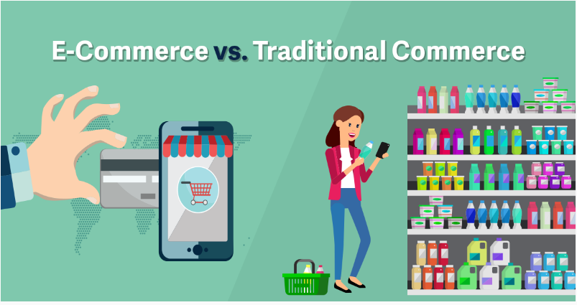
8.1 E-Commerce Vs. Traditional Commerce

Slide 9
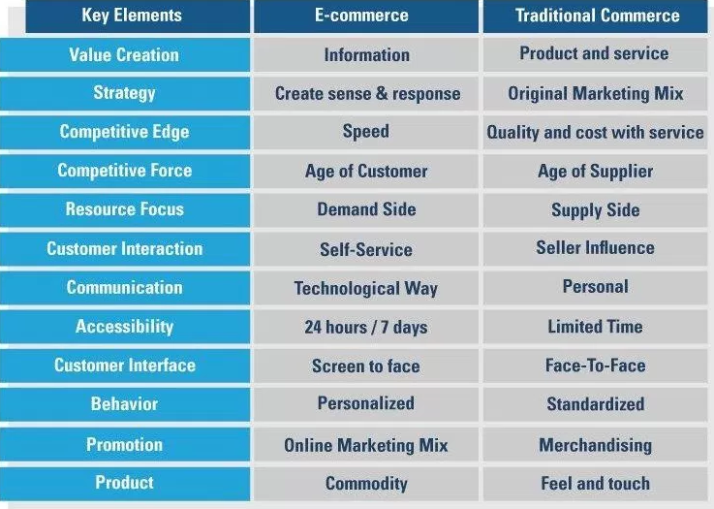
8.1 E-Commerce Vs. Traditional Commerce

Slide 10
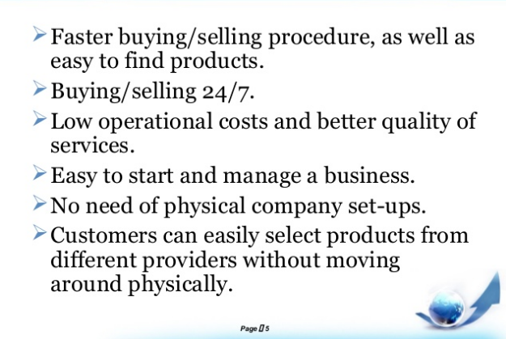
Advantages of E-Commerce

Slide 11
Advantages of E-Commerce
Increases:
  Flexibility and ease of shopping
  Number of customers
  Opportunities for collaboration with business partners
  Return on investment because inventory needs are reduced
Offers personalized services and product customization
Reduces administrative and transaction costs

Slide 12
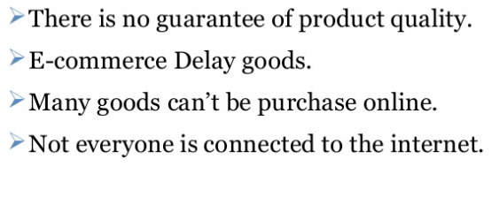
Disadvantages of E-Commerce

Slide 13
E-Commerce Business Revenue Models
E-commerce companies focus their operations in different parts of the value chain to achieve profitability.

Slide 14
Business Models Used in E-Commerce
Merchant
  Transfers the old retail model to the e-commerce world by using the medium of the Internet
Brokerage
  Brings sellers and buyers together on the Web and collects commissions on transactions between these parties
Advertising
  Extension of traditional advertising media
  Directories such as Yahoo! provide content to users for free

Slide 15
Business Models Used in E-Commerce
Mixed
  Generating revenue from more than one source
Informediary
  Sites collect information on consumers and businesses and then sell this information to other companies for marketing purpose
Subscription
  E-commerce sites sell digital products or services to customers

Slide 16
Major Categories Of E-Commerce
Business-to-consumer e-commerce (B2C)
  Companies sell directly to consumers
  Supplements traditional commerce with e-commerce
  Example:

Slide 17

Major Categories Of E-Commerce
Business-to-consumer e-commerce (B2C)
  Companies sell directly to consumers
  Supplements traditional commerce with e-commerce
  Example: Amazon. com

Slide 18
Major Categories Of E-Commerce
Business-to-business e-commerce (B2B)
  Involves electronic transactions between businesses
  Uses electronic data interchange (EDI) and electronic funds transfer (EFT)
  Example:

Slide 19

Major Categories Of E-Commerce
Business-to-business e-commerce (B2B)
  Involves electronic transactions between businesses
  Uses electronic data interchange (EDI) and electronic funds transfer (EFT)
  Example: Toyota,

Slide 20
Major Categories Of E-Commerce modes
Consumer-to-consumer e-commerce (C2C)
  Involves business transactions between users
  Reflected by people using online classified ads or online auction sites
  Example:

Slide 21
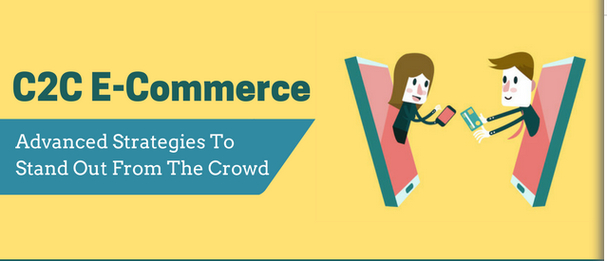
Major Categories Of E-Commerce modes
Consumer-to-consumer e-commerce (C2C)
  Involves business transactions between users
  Reflected by people using online classified ads or online auction sites
  Example: Olx.com

Slide 22
Major Categories Of E-Commerce modes
Consumer-to-business (C2B)
  Involves people selling products or services to businesses
  Example:

Slide 23
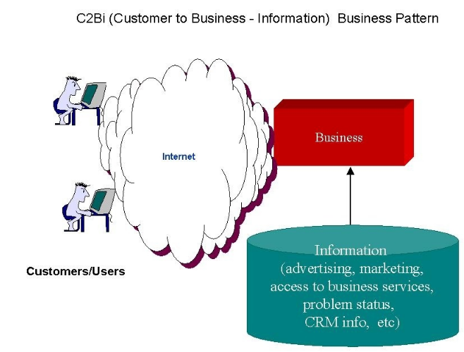
Major Categories Of E-Commerce modes
Consumer-to-business (C2B)
  Involves people selling products or services to businesses
  Example:
The famous C2B model in eCommerce are the Hiring Websites where businesses pay to get a service and consumers decide the salary is acceptable or not.

Slide 24
E-Government
Applications
  Government-to-citizen (G2C)
  Government-to-business (G2B)
  Government-to-government (G2G)
  Government-to-employee (G2E)
Services
  Tax filing
  Online voter registration
  Disaster assistance
  E-training for government employee

Slide 25
Major Categories Of E-Commerce
Nonbusiness organizations
  Universities
  Nonprofits
  Political and social

Slide 26
Organizational E-Commerce
Involves e-commerce activities that take place inside an organization via the organization’s intranet
Includes
  Exchange of goods, services, or information among employees
  Conducting training programs and offering human resource services

Slide 27
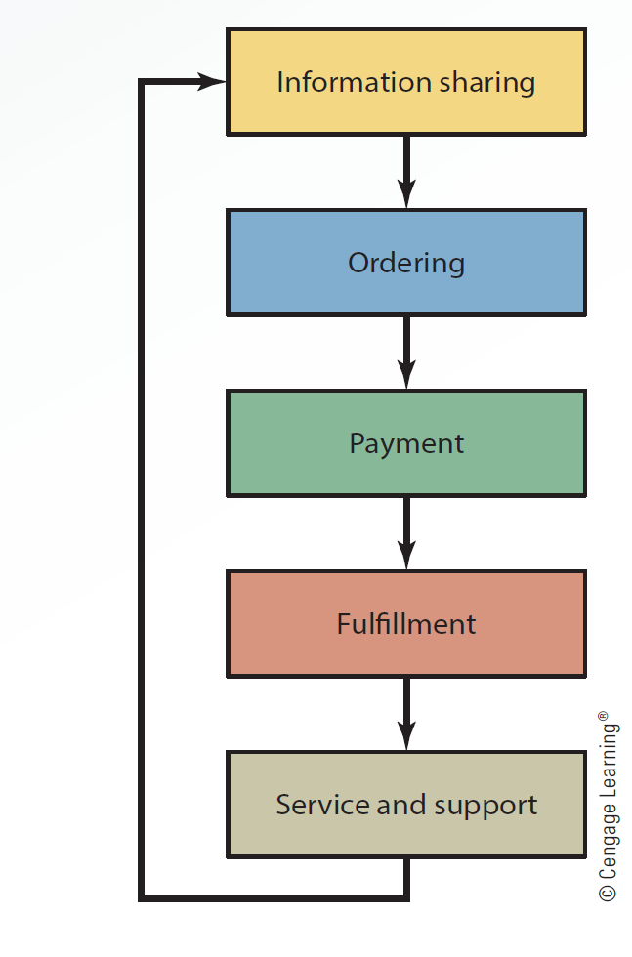
8.3 Major Activities in B2C E-Commerce

Slide 28
B2B E-Commerce: A Second Look
Technologies used
  Intranets
  Extranets
  Virtual private networks
  Electronic data interchange (EDI)
  Electronic funds transfer (EFT)
Reduces delivery time, inventory requirements, and prices
Helps business partners share relevant, accurate, and timely information

Slide 29
B2B E-Commerce: A Second Look
Lowers production costs and improves accuracy
  Creates invoices and tracking payments manually
Improves information flow among business partners
  Creates a direct online connection in the supply chain network

Slide 30
Major Models of B2B E-Commerce
Models based on who controls the marketplace
  Seller-side
  Buyer-side
  Third-party exchange

Slide 31
Seller-Side Marketplace
Sellers who cater to specialized markets come together to create a common marketplace for buyers
E-procurement
  Enables employees in an organization to order and receive supplies and services directly from suppliers
  Prevents purchases from suppliers that are not on the approved list of sellers
  Eliminates the processing costs of purchases

Slide 32
Buyer-Side Marketplace
Buyer, or a group of buyers, opens an electronic marketplace and invites sellers to bid
Helps the buyers:
  Manage the procurement process more efficiently
  Lower administrative costs
  Implement uniform pricing
Involves the goal of establishing new sales channels

Slide 33
Trading Party Exchange
Automate negotiating processes and enforce contracts between participating businesses
Allows business partners to send and receive bids, contracts, and information needed
Enables customers to submit documents via the Internet

Slide 34
Mobile Commerce
Using handheld devices to conduct business transactions
Based on the Wireless Application Protocol (WAP)
Technologies supported
  Wireless wide-area networks and 3G networks
  Short-range wireless communication technologies

Slide 35
Voice-Based E-Commerce
Relies on voice recognition and text-to-speech technologies
Method involves using e-wallets
Security features
  Call recognition
  Voice recognition
  Shipping to a set address that cannot be changed by voice commands

Slide 36
E-Commerce Supporting Technologies
Electronic payment systems
Web marketing
Search engine optimization

Slide 37
Electronic Payment Systems
Electronic payment
  Money or script that is exchanged only electronically
  Popular instruments for electronic payment
Smart cards
  Contains an embedded microprocessor chip
  Stores important financial and personal information

Slide 38
Electronic Payment Systems
E-cash: Secure and convenient alternative to bills and coins
  Complements credit, debit, and charge cards
  Adds convenience and control to everyday cash transactions
E-check: Electronic version of a paper check
  Offers security, speed, and convenience for online transactions

Slide 39
Electronic Payment Systems
E-wallets: Available for most handheld devices
  Offer a secure, convenient, and portable tool for online shopping
  Store personal and financial information
PayPal: Popular online payment system used for many online transactions
  Users with valid e-mail addresses can set up accounts and make secure payments

Slide 40
Electronic Payment Systems
Micropayments: Transactions on the Web involving very small amounts of money
  Began as a method for advertisers to pay for cost per view or cost per click

Slide 41
Web Marketing
Uses the Web and its supporting technologies to promote goods and services

Slide 42
Search Engine Optimization (SEO)
Method for improving the volume or quality of traffic to a website
  Higher ranking in search results generate more revenue for a website
Aims at increasing a website’s performance on search engines naturally
Includes techniques facilitating search engines to find and index a site for certain keywords

Slide 43
Advertising model
Brokerage model
Business-to-business (B2B)
Business-to-consumer (B2C)
Buyer-side marketplace
Click-and-brick e-commerce
Consumer-to-business (C2B)
Consumer-to-consumer (C2C)

Slide 44
e-business
e-cash
e-check
e-commerce
e-government
e-procurement
e-wallets
Electronic payment

Slide 45
Horizontal market
Informediary model
Merchant model
Micropayments
Mixed model
Mobile commerce (m-commerce)
Organizational (intrabusiness e-commerce)
Paypal

Slide 46
Search engine optimization (SEO)
Seller-side marketplace
Smart card
Subscription model
Third-party exchange marketplace
Trading partner agreements
Value chain
Vertical market

Slide 47
Voice-based e-commerce
Web marketing

Slide 48
E-commerce is buying and selling goods and services over the internet
E-commerce transactions occur among consumers, businesses, and government
B2B e-commerce lowers production costs and improves accuracy by eliminating many labor-intensive tasks
Number of technologies and applications support e-commerce activities

