Slide 1
Excel-Skills-for-Business Macquarie University on Coursera
Accomplished on June 5th, 2023
Issued by Ismi Ana Sulasiyah
annaismi17@gmail.com

Slide 2
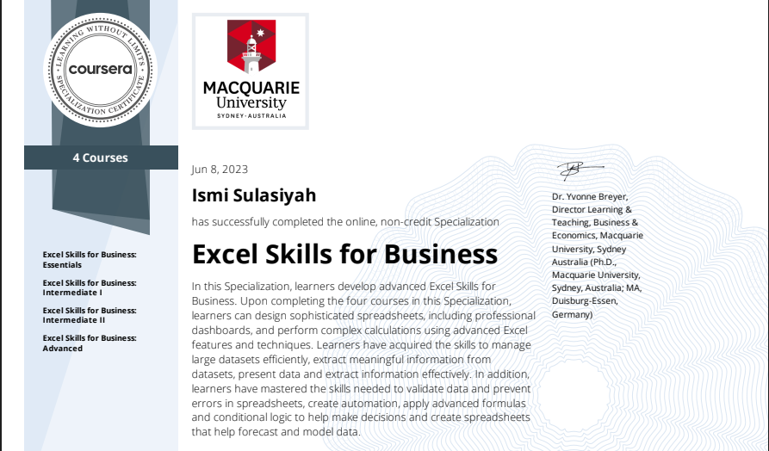
Content
Course Certificates Completed
Excel Skills for Business: Essentials
Included Type of Charts: Bar Chart, Pie Chart, Line Chart
Excel Skills for Business: Intermediate I
Included Pivot Table and Slicer
Excel Skills for Business: Intermediate II
Included Microsoft Excel Macro
Excel Skills for Business: Advanced
Included Dashboard

Slide 3
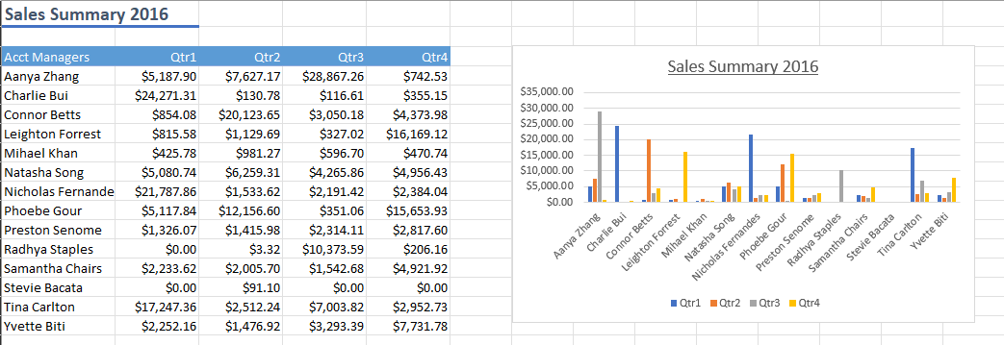
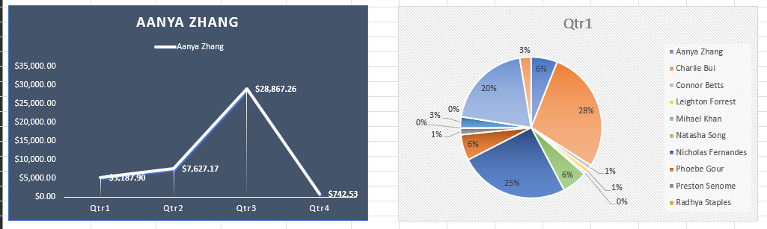
Excel Skills for Business: Essentials https://github.com/izmian/Excel-Skills-for-Business/blob/main/Essentials%20-%20Charts.xlsx

Slide 4
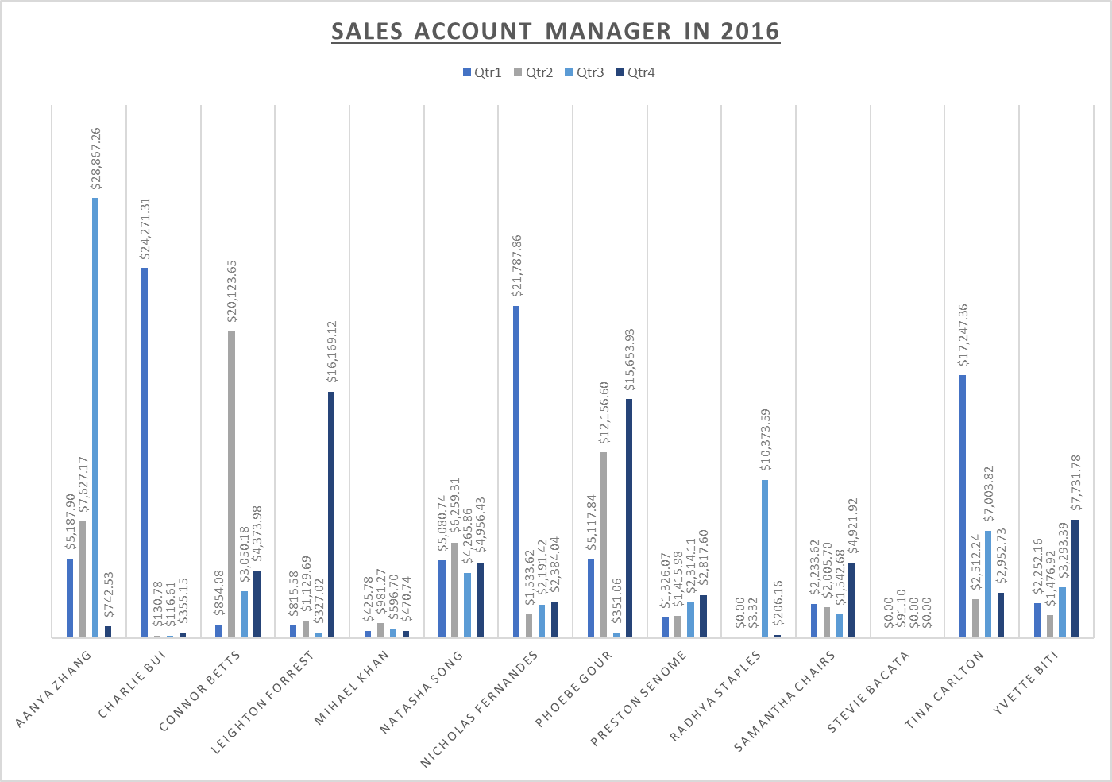
Excel Skills for Business: Essential Advance Bar Chart

Slide 5
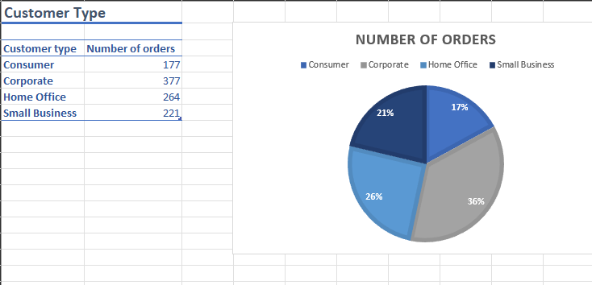
Excel Skills for Business: Essential Pie Chart

Slide 6
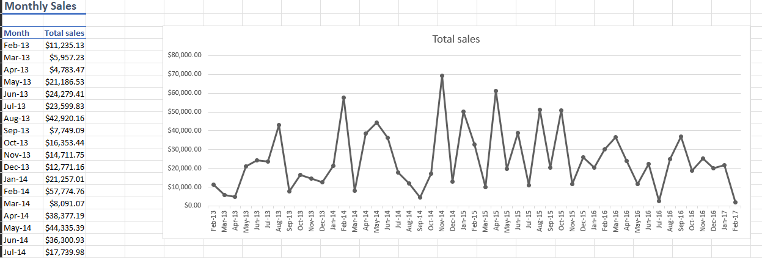
Excel Skills for Business: Essential Line Chart

Slide 7
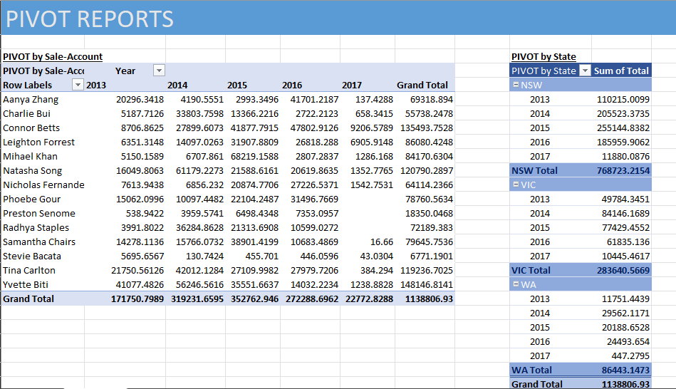
Excel Skills for Business: Intermediate I https://github.com/izmian/Excel-Skills-for-Business/blob/main/Intermediate%20I%20-%20Pivot%20Tables.xlsx

Slide 8
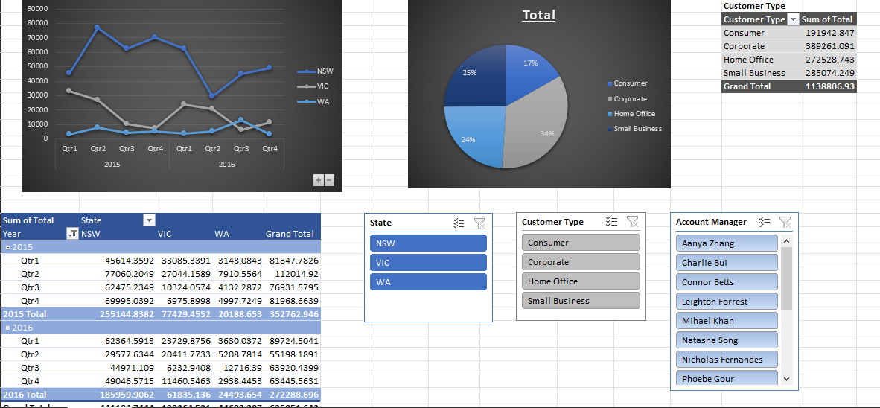
Excel Skills for Business: Intermediate I Pivot and Slicer

