Slide 1


MINIPROJECT III:
NLP
Presented by:
Iva Zdilar & Ekaterina Kuznetsova

Slide 2

LEARNING OBJECTIVES
Build a text classification model to distinguish between:
0 = Fake News
1 = Real News → Based on news headlines only
Task outline:
Loading data
Preprocessing & EDA
Tokenization & Lemmatization & Vectorization
Split data + Model Training
Model Evaluation
Prediction on Test Set

Slide 3
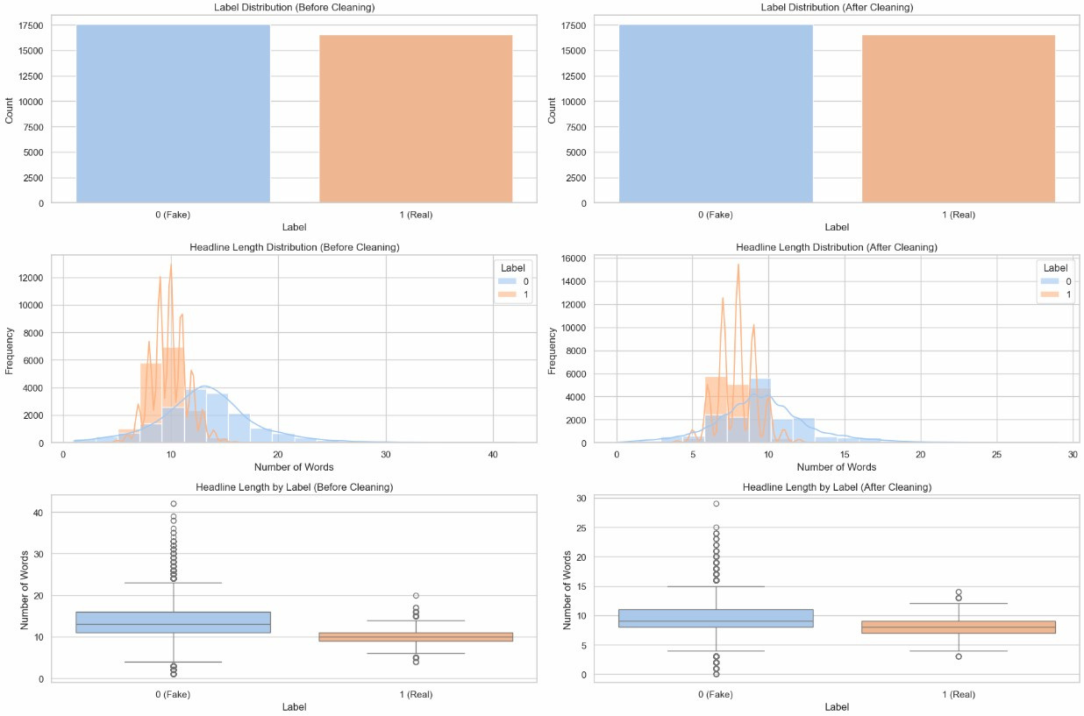

E
D
A
Notes:
Training dataset
- (before cleaning) 1st the labelled distribution before cleaning, the classes are almost evenly distributed
- (after cleaning) 2nd the class distribution remains the same after the cleaning
-how the headline length varies between the two classes "real" vs "fake"
*these are visualized as histograms. Before cleaning the fake news, follow a roughly bell-shaped distribution
- the 3rd row shows how the headline length varies between the two classes "real" vs "fake". "Fake news" has a broader distribution of headline length with significantly more outliers and they're larger range

Slide 4
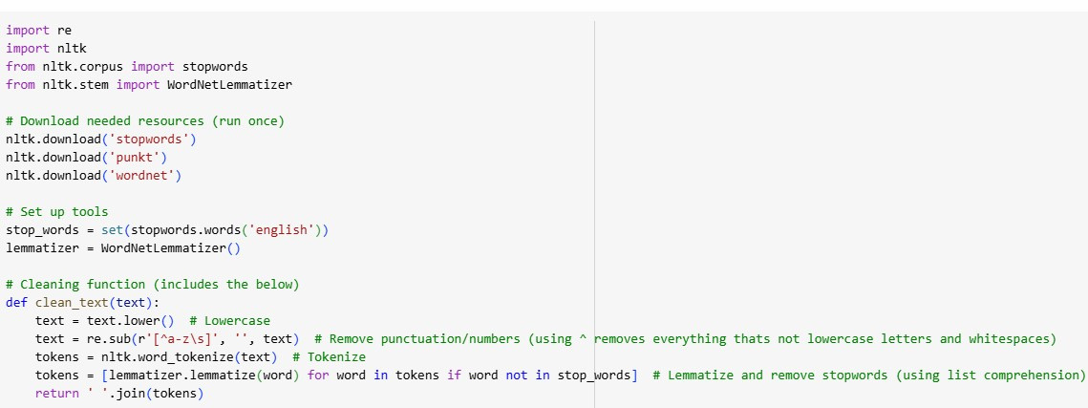
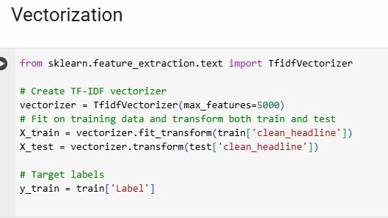
PREPROCESSING AND FEATURE ENGINEERING
Notes:
IZ:
The pre-processing outlined here only applies to model_1_linear regression. Model_4_RandomForest used TD-IDF vectorization to complete the preprocessing as we will see later. And lastely, the transformer models recieved some but not all of the pre-processing outlined here. They recieved the cleaned, lowercased, lemmatized strings (headlines) and applied their own tokenization.
Also note, the vectorization here also only applies to model_1 linear regression. We used a slightly different vectorization for the random forest model and the transformer model come with their own pretrained tokenizers such that the transformer converts raw or cleaned text directly into token IDs and embeddings, then feeds that into the model.
For the vectorization, we see that all defaults were used except for max_features:
-max_features limits the number of unique words (features) in the TD-IDF matrix to the top most important words. This is based on word frequency (how often a word appears) and inverse document frequency (how rare it is across all headlines). This helps to control dimensionality as using full dictionaries (30k+ words) can slow down training and lead to overfitting.
Preprocessing Details: We applied a full preprocessing pipeline using NLTK including tokenization and lemmatization to clean the headlines before vectorization and modeling:
1. Lowercasing → All text was converted to lowercase for consistency.
2. Punctuation and Number Removal → Used regex ([^a-z\s]) to remove everything that wasn’t a letter or space.
3. Tokenization → Used nltk.word_tokenize() to split each headline into individual word tokens.
4. Stopword Removal → Removed common words like “the”, “and”, “is” using NLTK’s English stopwords list.
5. Lemmatization → Used WordNetLemmatizer from NLTK to reduce each word to its base form (e.g., “running” → “run”).
2. Vectorization:
- After preprocessing, we used TF-IDF (Term Frequency-Inverse Document Frequency) vectorization to convert text into numerical features (numerical vectors).
- Used TfidfVectorizer from sklearn to build feature vectors.
- Limited to the top 5,000 most important words (based on frequency and uniqueness).
- Also tested with 10,000 features — predictions were 99.9% identical (only one row changed).

Slide 5
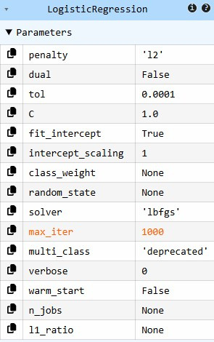
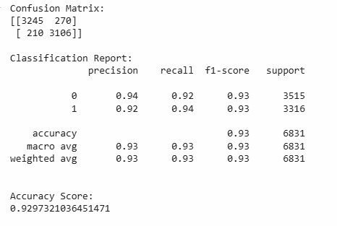
MODEL AND EVALUATION
Notes:
We used all default metrics except for max_iter=1000
-max_iter is number of iterations model runs to find best parameters. In logistic regression, solvers repeatedly update model weights until it converges (finds a minimum loss) or hits the max_iter limits.
Accuracy Estimation: Based on evaluation on the validation set, we estimate the model will achieve approximately 93% accuracy on the unseen test data.
- this accuracy score is high and satisfactory for a good model.
Other Metrics and Overall Evaluation:
- Confusion Matrix: We see the model has predicted:
- 3244 headlines as fake when they were actually fake (True Negatives)
- 209 headlines as fake when they were actually real (False Negatives)
- 271 headlines as real when they were actually fake (False Positives)
- 3107 headlines as real when they were actually real (True Positives)
- The model performs consistently well across both classes — fake (0) and real (1) news.
- Precision is high for both labels (~92–94%), meaning that when the model predicts an article is fake or real, it’s usually correct (low false positives).
- Recall is also high (~92–94%), indicating the model successfully identifies most of the true fake and real headlines (low false negatives).
- The F1-scores are balanced (~0.93 for both), confirming that the model doesn’t favor one class over the other.
- This balance is important in fake news detection, since both false positives (flagging real news as fake) and false negatives (missing actual fake news) carry consequences.
- Precision ≈ Recall ≈ F1: model is not biased towards any one class and doesn’t over or underpredict.
- Accuracy, precision, recall, and F1 are all aligned → balanced performance across classes
- Overall, the model is well-calibrated and generalizes well, as seen in its high validation accuracy of ~93%.

Slide 6
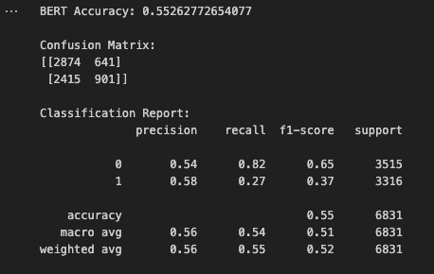
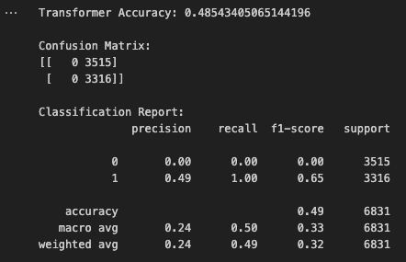

TRANSFORMER MODEL 1: DISTILBERT-BASE-UNCASED-FINETUNED-SST-2-ENGLISH
TRANSFORMER MODEL 2: MRM8488/BERT-TINY-FINETUNED-FAKE-NEWS-DETECTION
As expected, performance was weak, with low scores and
unbalanced results across metrics, because the model was not trained for truth classification, but for emotional tone.
Likewise, the model was not trained on our dataset.
This shows that while transformer models are powerful,
task-specific fine-tuning is critical.
As expected, performance was weak, low scores, unbalanced
results across metrics, because the model was not trained
on our dataset.

Slide 7
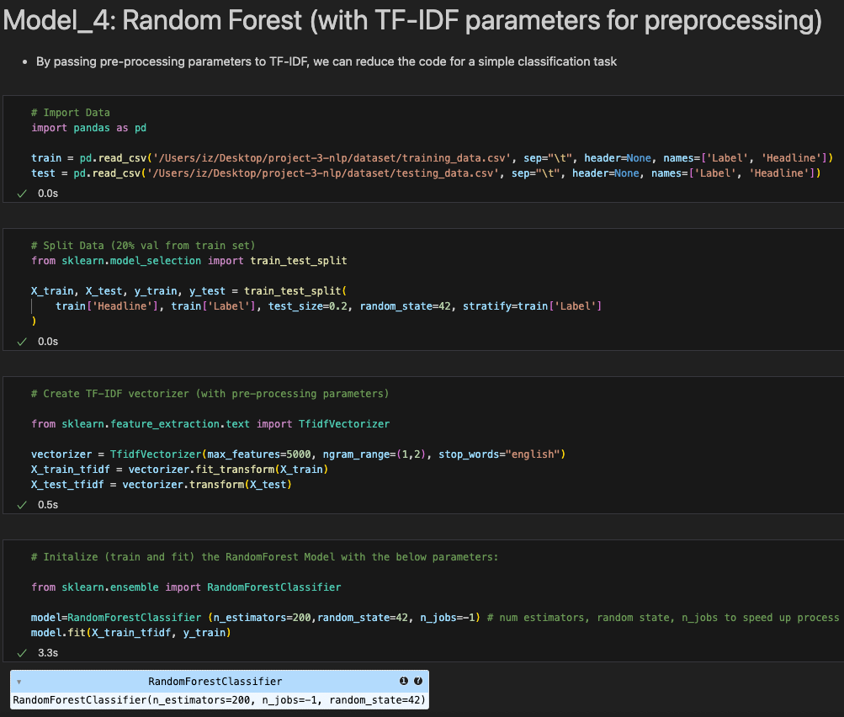
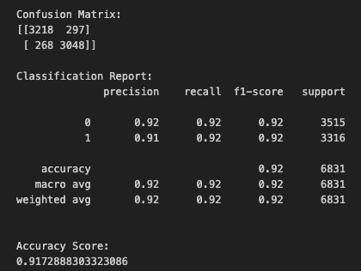
Model and Evaluation
Notes:
as stated, the randomforest model takes care of the pre-processing via TDIDF vectorization. We split the raw data (with the headers)->passed to TF-IDF, which handled basic preprocessing internally:
-note we must split before applying vectorization because we don’t want to do that to the full dataset first (that would leak test data into the train set)
Lowercasing
Stopword removal (stop_words="english")
Tokenization – default is regex (which basically is how it does a lot of the preprocessing)
Bi-grams (ngram_range=(1, 2)) – we use unigrams and bigrams (to allow the model to capture pairs of words that are meaningful)
Technically it also uses a regex tokenizer that handles punctuation but keeps some special characters
However, it did not perform lemmatization or deep cleaning
Evaluation:
The results are very similar to the LinearRegression model.
Confusion Matrix:
- 3218 headlines as fake when they were actually fake (True Negatives)
- 268 headlines as fake when they were actually real (False Negatives)
- 297 headlines as real when they were actually fake (False Positives)
- 3048 headlines as real when they were actually real (True Positives)
- The accuracy score ~92% is high and satisfactory for a good model.
- The model performs consistently well across both classes — fake (0) and real (1) news.
- Precision is high for both labels (~91–92%), meaning that when the model predicts an article is fake or real, it’s usually correct (low false positives).
- Recall is also high (~92%), indicating the model successfully identifies most of the true fake and real headlines (low false negatives).
- The F1-scores are balanced (~0.92 for both), confirming that the model doesn’t favor one class over the other.
- This balance is important in fake news detection, since both false positives (flagging real news as fake) and false negatives (missing actual fake news) carry consequences.
- Precision ≈ Recall ≈ F1: model is not biased towards any one class and doesn’t over or underpredict.
- Accuracy, precision, recall, and F1 are all aligned → balanced performance across classes
- Overall, the model is well-calibrated and generalizes well, as seen in its high validation accuracy of ~92%.

Slide 8
MAJOR OBSTACLES,
CONCLUSIONS & INSIGHTS
Blind Test Set (new data format):
No true labels in test_data
Created validation set from training
Evaluated and estimated model performance using validation set
predicted labels for test set -> exported to csv file -> will be used to evaluate model against true test set labels
Lemmatization and tokanization as new preprocessing methods
TF - IDF vectorization as a new technique for converting text into numbers
TF-IDF with parameters for preprocessing to shorten code
Next steps: transformer-based model (like BERT) trained/tuned to our dataset

Slide 9
THANK
YOU

