Slide 1
Examples of Traffic
2012

Slide 2
Video
Video Traffic (High Definition)
      30 frames per second
      Frame format: 1920x1080 pixels
      24 bits per pixel
Required rate: 1.5 Gbps
Required storage: 1 TB per hour
Video uses compression algorithm to reduce bitrate
© Jörg Liebeherr, 2012
ECE 466

Slide 3
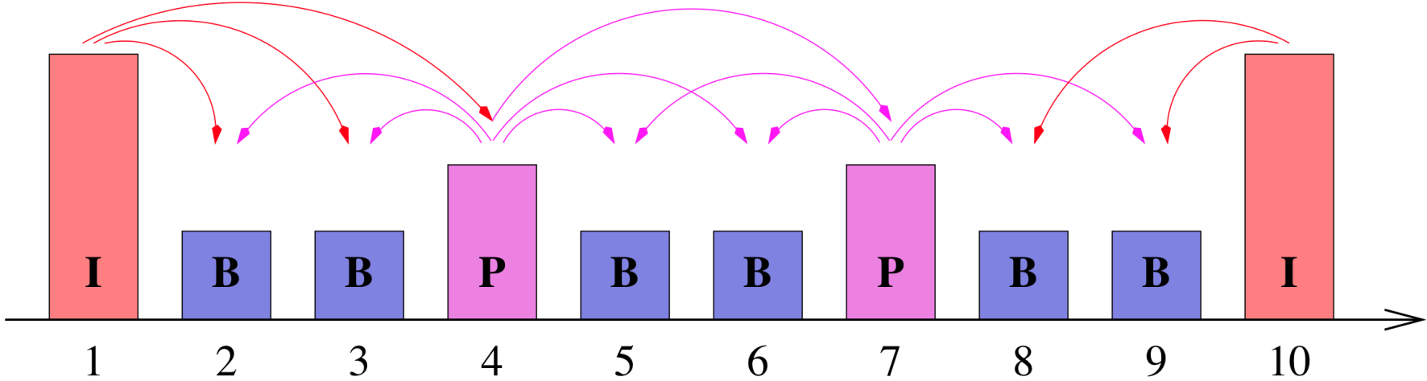
MPEG compression
I frames: intra-coded
P frames: predictive
B frames: bi-directional
Group of Pictures (GOP): IBBPBBPBB
© Jörg Liebeherr, 2012
ECE 466

Slide 4
Example: Harry Potter
30 minutes of Harry Potter movie with HD encoding
  Codec: H.264 SVC
  Resolution: 1920x1088
  Frames per second: 24 fps
  GOP: IBBBPBBBPBBBPBBB
Frame size (Bytes):
    Avgerage: 28,534
    Minimum: 109
    Maximum: 287,576
Mean Frame Bit Rate (Mbps): 5.48
Peak Frame Bit Rate (Mbps): 55.21
© Jörg Liebeherr, 2012
ECE 466
Notes:
Name: Harry_Potter
% CODEC: H.264
% Scalable (SVC)
% Encoded April 2009, updated May 2011
% Single Layer, including HD
% Selected Layer: 2
% Base Layer (0) Quantization scales: I=22, P=22, B=24
%# This trace was obtained from trace.eas.asu.edu
%# Sequence: Harry_Potter
%# Resolution: 1920x1088
%# FPS: 24
%# Encoder: JSVM (9.15)
%# Encoding type: High (Level 4)
%# GoP pattern: G16B3
%# Quantization parameters (I,P,B): 22, 22, 24
%# Layer: 2
%# Other:
%#
%# Frame Size Statistics
%# Compression Ratio: 109.81
%# Number of Frames: 86384
%# Minimum Frame Size (Bytes): 109
%# Maximum Frame Size (Bytes): 287576
%# Average Frame Size (Bytes): 28534.11
%# Frame Size Peak/Mean Ratio: 10.08
%# Coefficient of Variation of Frame Sizes: 0.912
%# Mean Frame Bit Rate (bps): 5478549.3
%# Peak Frame Bit Rate (bps): 55214592.0
%#
%# GoP Size Statistics
%# Number of GoPs: 5399
%# Minimum GoP Size (Bytes): 2246
%# Maximum GoP Size (Bytes): 1751880
%# Average GoP Size (Bytes): 456545.77
%# GoP Size Peak/Mean Ratio: 3.84
%# Coefficient of Variation of GoP Sizes: 0.536
%# Peak GoP Bit Rate (bps): 9343360.0
%#
%# Frame Quality Statistics
%# Minimum Frame Quality (dB): 40.421
%# Maximum Frame Quality (dB): 188.131
%# Average Frame Quality (dB): 45.777
%# Alternative Average Frame Quality (dB): 45.378
%# Frame Quality Peak/Mean Ratio: 4.11
%# Alternative Frame Quality Peak/Mean Ratio: 4.15
%# Frame Quality Standard Deviation (dB): 3.693
%# Alternative Frame Quality Standard Deviation: 0.723
%# Coefficient of Variation of Frame Qualities: 0.081
%# Alternative Coefficient of Variation of Frame Qualities: 0.384
%#
%# Frame Time [s] Type Size [Byte] PSNR-Y [dB] PSNR-U [dB] PSNR-V [dB] VQM (if exists)
%0 0 I 540 188.1308 188.1308 188.1308
%1 0.04167 B 109 188.1308 188.1308 188.1308
%2 0.08333 B 109 188.1308 188.1308 188.1308
%3 0.125 B 109 188.1308 188.1308 188.1308
%4 0.16667 P 128 188.1308 188.1308 188.1308
% INFO:
%http://trace.eas.asu.edu/vtraces2_scripts/trace_options.php?id=2&gopid=G16B3&fps=24&qI=22&qP=22&qB=24&path=/trace/traceWeb/htdocs/videotraces2/svc_single/1080/harrypotter/harrypotter1080_G16B3/222224
%Resolution: 1920x1088
%FPS: 24.0
%Encoder: JSVM (9.15)
%Enc_Type: High (Level 5)
%GoP Length: 16
%GoP Pattern: G16B15
%Other:

Slide 5
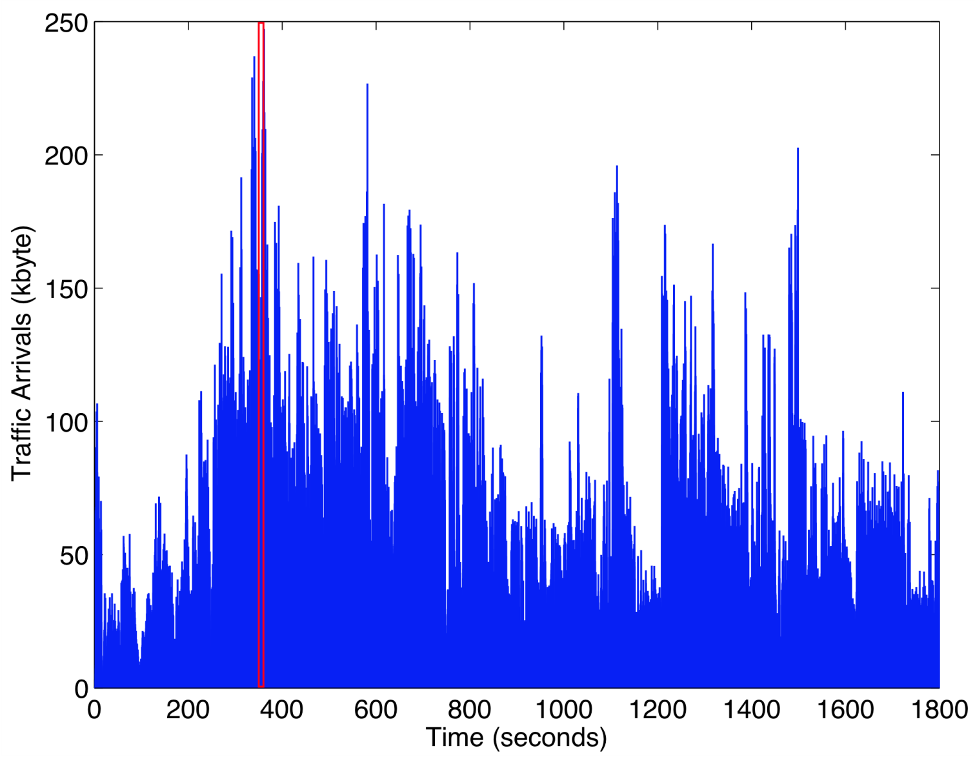
Harry Potter: 30 minutes
© Jörg Liebeherr, 2012
ECE 466

Slide 6
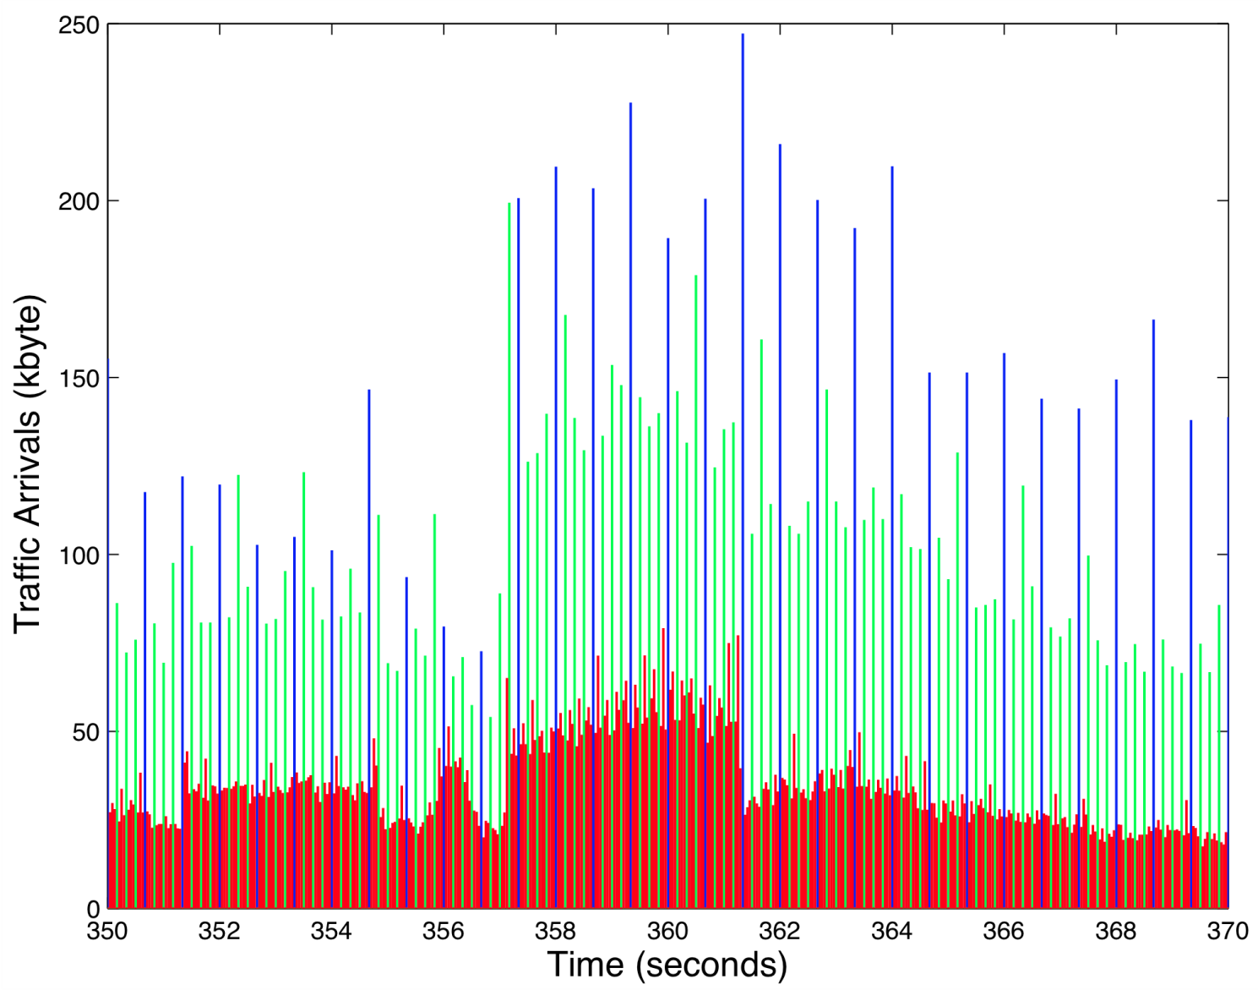
Harry Potter: 20 seconds
© Jörg Liebeherr, 2012
ECE 466

Slide 7
Voice
Standard (Pulse Code Modulation) voice encoding:
      8000 samples per second (8 kHz)
      8 bits per sample
      Bit rate: 64 kbps
Better quality with higher sampling rate and larger samples
CD encoding:
      44 kHz sampling rate
      16 bits per sample
      2 channels
      Bit rate: 1.4 Mbps
Packet voice collects multiple samples in once packet
Modern voice encoding schemes also use compression and silent suppression
© Jörg Liebeherr, 2012
ECE 466

Slide 8
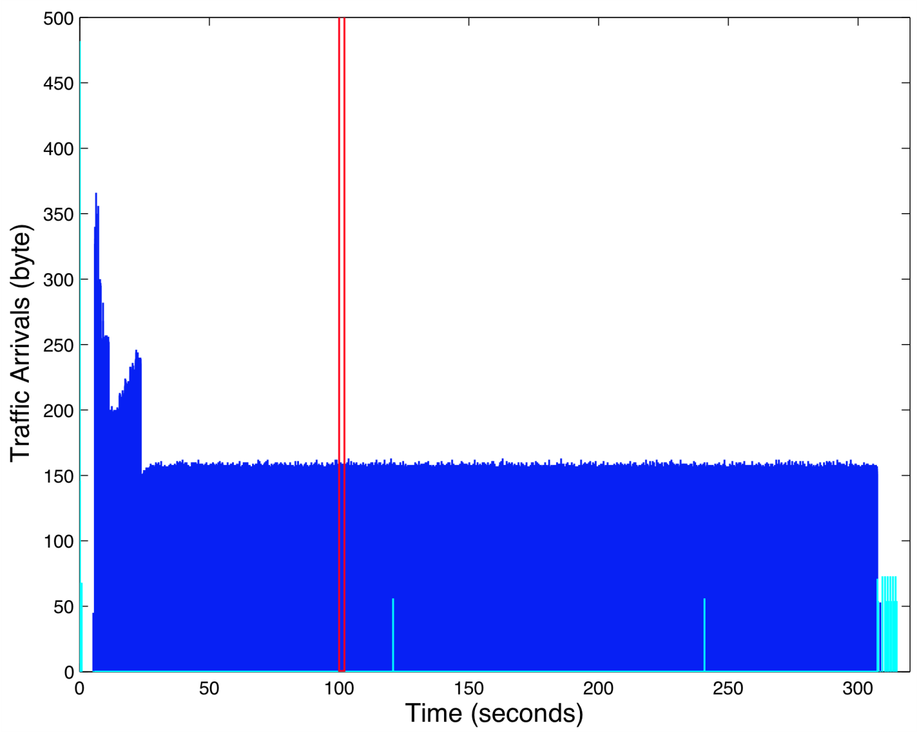
Skype Voice Call: 6 minutes
SVOPC encoding, one direction of 2-way call
© Jörg Liebeherr, 2012
ECE 466

Slide 9
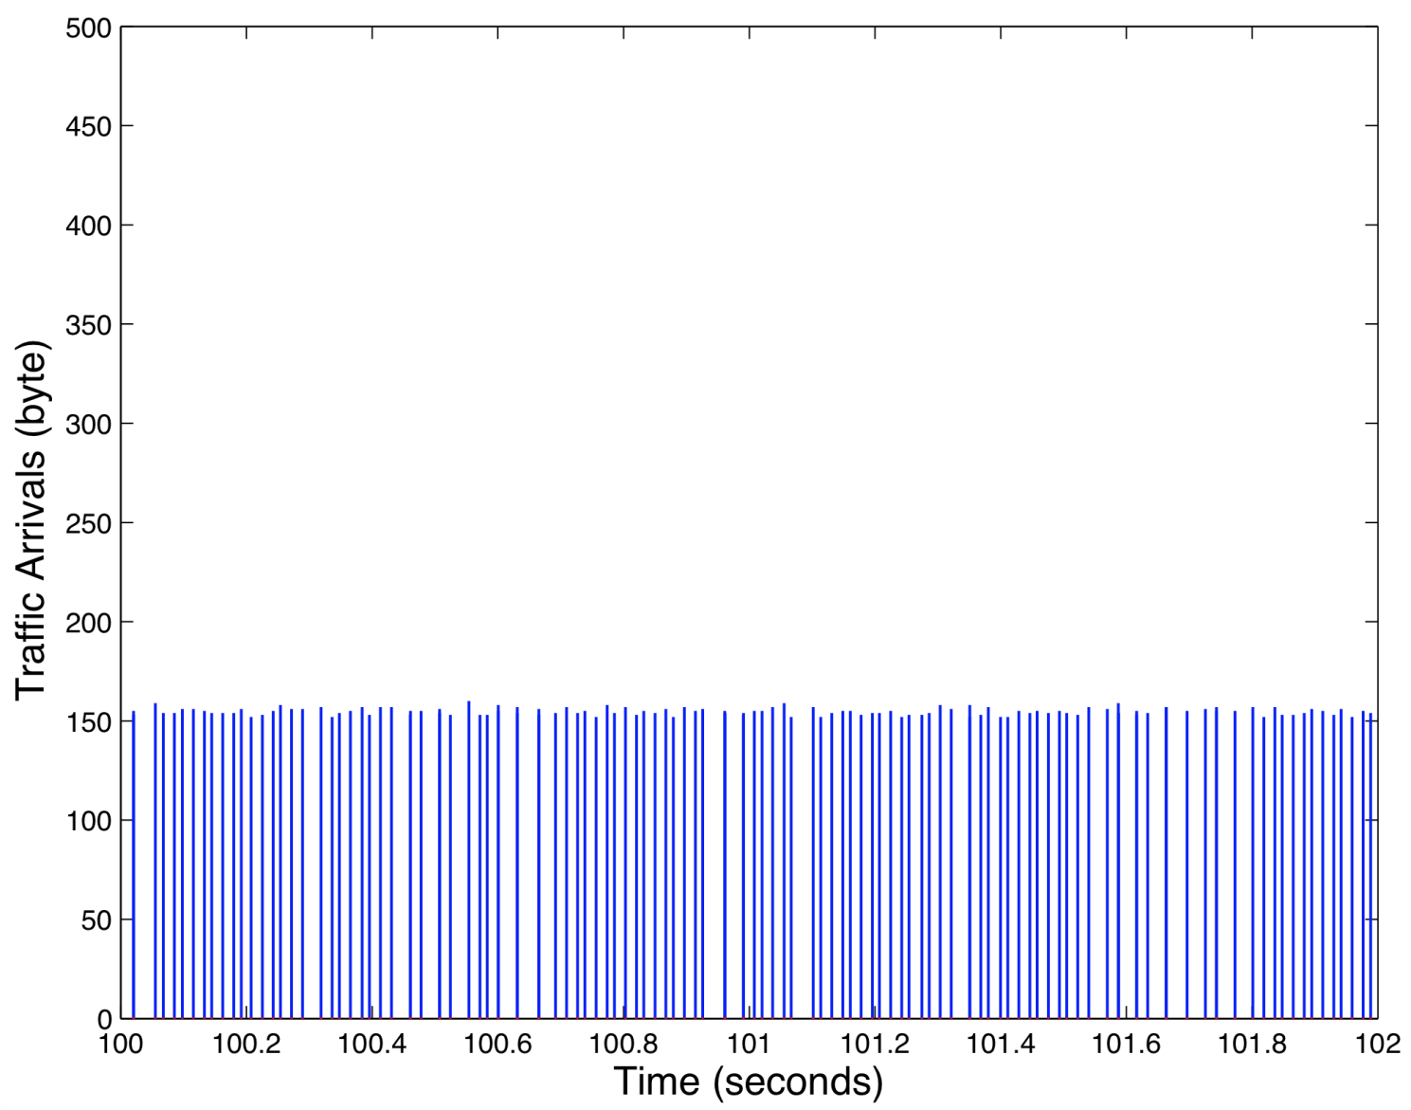
Skype Voice Call: 2 seconds
© Jörg Liebeherr, 2012
ECE 466

Slide 10
Data
Data measured on an Ethernet network at Bellcore Labs with 10Mbps
Data measures total (aggregate) traffic of all transmissions on the network
Measurements from 1989
One of the first systematic analyses of network measurements
© Jörg Liebeherr, 2012
ECE 466

Slide 11
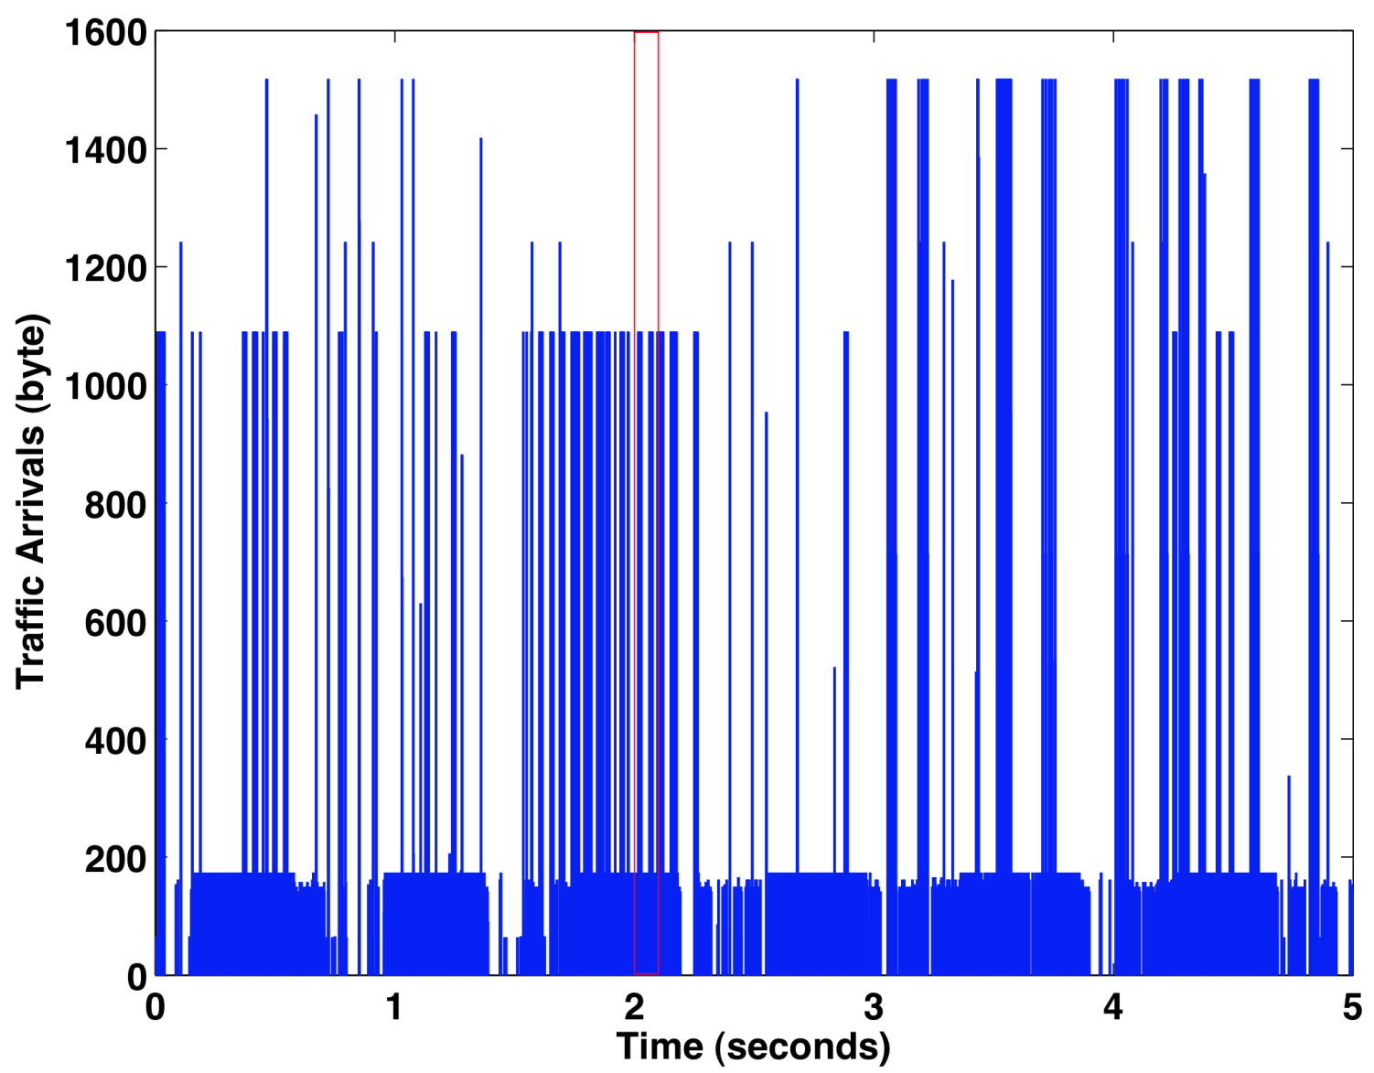
Data Traffic: 5 seconds
© Jörg Liebeherr, 2012
ECE 466
Notes:
%Source: http://tstat.tlc.polito.it/traces-skype.shtml
%
%Methodolody:
%Skype Traces
%The following traces (libpcap consistent) which are available for the research community, contain Skype traffic only. Traces have been collected and organized with the support of the RECIPE (Robust and Efficient traffic Classification in IP nEtworks) and MIMOSA (MIsure sperimentali e MOdelli di traffico dati multiServizio A pacchetto) projects.
%Skype Testbed Traces
%In order to characterize Skype calls traffic, we made up a testbed in laboratory, compounded by two hosts running Windows XP, connected to internet through a router. In these conditions, several sintetic traces have been generated, according to characterize Skype calls through their vocal codecs. Only most significant traces are available in gzip format.
%
%Skype E2E voice only
%Transport: UDP
%Voice codec: SVOPC (see http://ieeexplore.ieee.org/xpls/abs_all.jsp?arnumber=1495463)
%Measured : 2008-01-11 12:37:00 CET - 2008-01-11 12:42:15 CET
%Size: 4.6 MB
%URL: http://tstat.tlc.polito.it/tracce/Polito/2006/Skype_Testbed/File name:
%skype_call_110108_SVOPC.dump.anonim.gz
%
%
%No. Time Source Destination Protocol Length Info
% 1 0.000000 128.0.0.1 128.0.0.2 TCP 482 25414 > webadmstart [PSH, ACK] Seq=1 Ack=1 Win=64876 Len=428

Slide 12
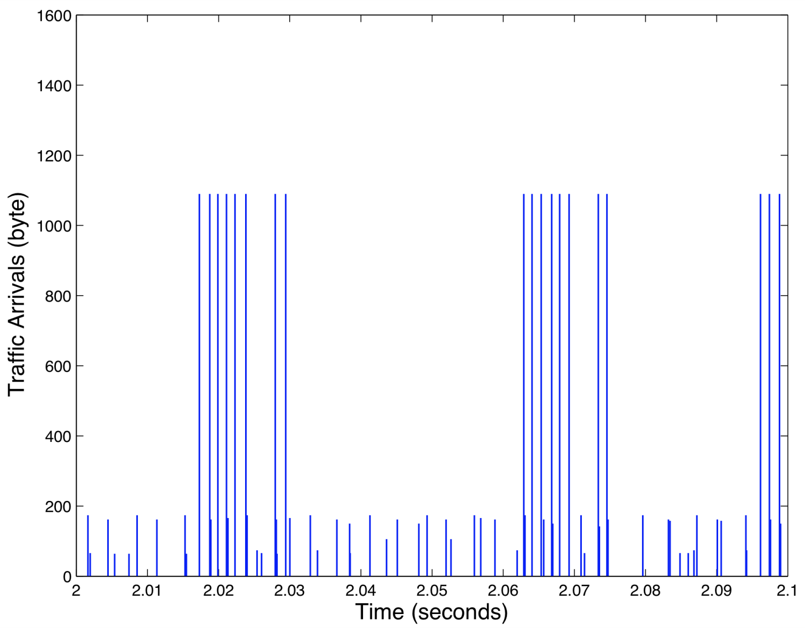
Data Traffic: 100 milliseconds
© Jörg Liebeherr, 2012
ECE 466

Slide 13
Internet Traffic
Data measured from a backbone link of a Tier-1 Internet Service provider
  Link measured: Chicago – Seattle
  Link rate: 10 Gbps (10 Gigabit Ethernet)
Data measures total (aggregate) traffic of all transmissions on the network
Data shown is 1ms: ~400 packets packet transmissions
  Average rate: ~2.6 Gbps
  Avg. packet size: 837 Bytes
  Min. packet size: 46 Bytes
  Max. packet size: 1504 Bytes
© Jörg Liebeherr, 2012
ECE 466

Slide 14
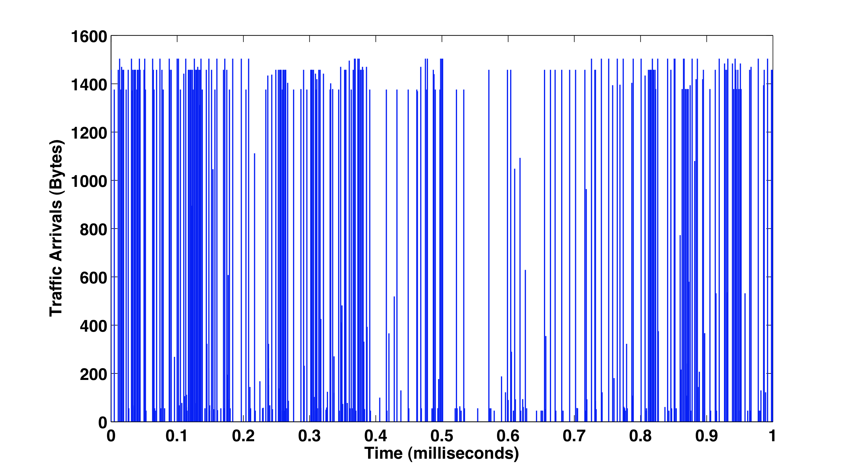
Internet Traffic
© Jörg Liebeherr, 2012
ECE 466
Notes:
%Source: http://tstat.tlc.polito.it/traces-skype.shtml
%
%Methodolody:
%Skype Traces
%The following traces (libpcap consistent) which are available for the research community, contain Skype traffic only. Traces have been collected and organized with the support of the RECIPE (Robust and Efficient traffic Classification in IP nEtworks) and MIMOSA (MIsure sperimentali e MOdelli di traffico dati multiServizio A pacchetto) projects.
%Skype Testbed Traces
%In order to characterize Skype calls traffic, we made up a testbed in laboratory, compounded by two hosts running Windows XP, connected to internet through a router. In these conditions, several sintetic traces have been generated, according to characterize Skype calls through their vocal codecs. Only most significant traces are available in gzip format.
%
%Skype E2E voice only
%Transport: UDP
%Voice codec: SVOPC (see http://ieeexplore.ieee.org/xpls/abs_all.jsp?arnumber=1495463)
%Measured : 2008-01-11 12:37:00 CET - 2008-01-11 12:42:15 CET
%Size: 4.6 MB
%URL: http://tstat.tlc.polito.it/tracce/Polito/2006/Skype_Testbed/File name:
%skype_call_110108_SVOPC.dump.anonim.gz
%
%
%No. Time Source Destination Protocol Length Info
% 1 0.000000 128.0.0.1 128.0.0.2 TCP 482 25414 > webadmstart [PSH, ACK] Seq=1 Ack=1 Win=64876 Len=428

