Slide 1

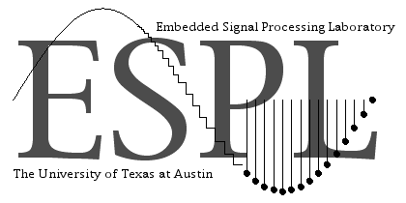
MODELING THE SELF-SIMILAR BEHAVIOR OF PACKETIZED MPEG-4 VIDEO USING WAVELET-BASED METHODS
Dogu Arifler and Brian L. Evans
The University of Texas at Austin
This work was supported by The State of Texas Advanced Technology Program and Texas Instruments
IEEE International Conference on Image Processing
Rochester, New York, September 22-25, 2002

Slide 2
Motivation
Network performance implications of self-similar nature of network traffic [Leland et al., 1993]
Long-range dependence (LRD) in variable bit rate (VBR) video [Beran et al., 1995]
  Video sources cannot be modeled accurately by traditional short-range dependent Markov chains
  LRD traffic sources may exhibit self-similar scaling
Modeling video sources for admission control and resource allocation for streaming video
  Need models that capture behavior of VBR video source at application-level at different time scales
  Difference between application-level self-similarity and network-level self-similarity [Ryu & Lowen, 1997]

Slide 3
Goals
Study scaling behavior in sample MPEG-4 traces
  Traces (time series) represent number of bytes per frame as generated by an MPEG-4 encoder
Investigate the effects of compression ratio on the self-similarity of video traces
  Self-similarity in network traffic is in general due to many factors such as user behavior, heavy-tailed file sizes, link diversity, and protocol diversity
  Compression might also contribute to self-similarity

Slide 4


Background
Scaling models
  Self-similarity (long time scales)
  Fractals, specifically multifractals
  (short time scales)
Wavelets provide natural framework for analyzing self-similar processes
  Enables analysis of a non-stationary
  process with stationary increments
  through a stationary sequence of
  wavelet coefficients
  Converts long-range dependent time
  series into sequences of short-range
  dependent wavelet coefficients

Slide 5


MPEG-4 Traces
Used MPEG-4 traces available from the Telecommunication Networks Group,
Technical Univ. of Berlin [Fitzek & Reisslein, 2000]
Studied traces of Star Wars IV and
Silence of the Lambs
Video resolution
  176 × 144 pixels (QCIF) with 8 bits/pixel
  Suitable for transmission over wireless networks to mobile devices
Traces measure number of bytes arriving in
40 ms (corresponding to 25 frames/s)

Slide 6
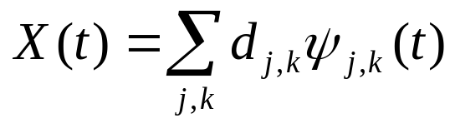
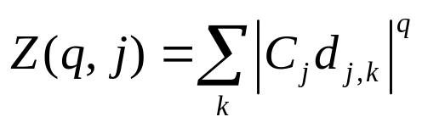
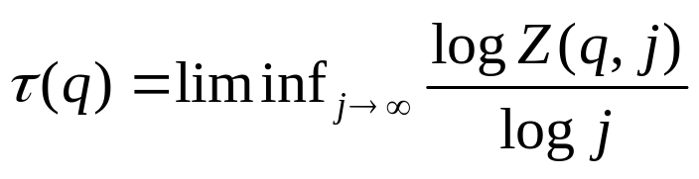
Methodology
Wavelet decomposition:
Partition function:
  Characterizes burstiness
  An abrupt burst will generate a large wavelet coefficient
  Large coefficient magnified by raising it to
  power q across scales
Scaling exponent:
  Represents asymptotic decay of
  partition function

Slide 7
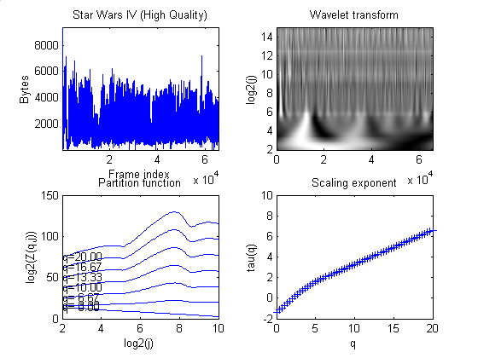

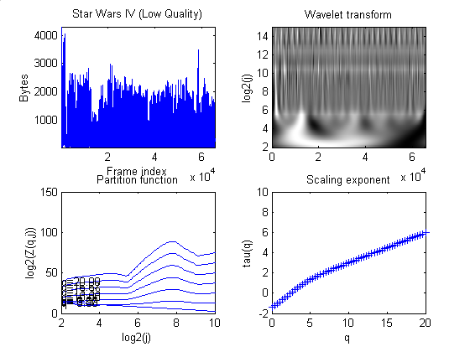
Star Wars IV
Quality | Compression Ratio
High | 27.62
Medium | 97.83
Low | 142.52

Slide 8
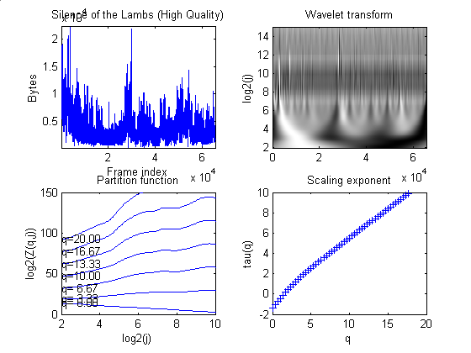
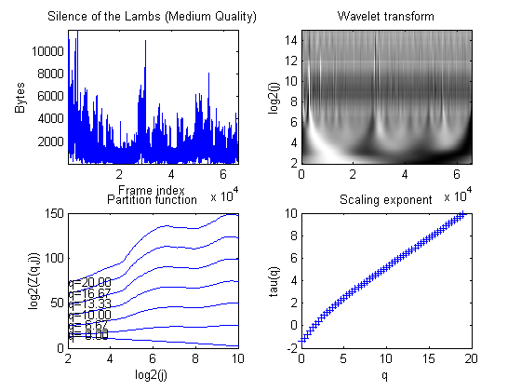

Silence of the Lambs
Quality | Compression Ratio
High | 13.22
Medium | 43.43
Low | 72.01

Slide 9
Analysis of Results
Trace of bytes/frame: burstiness, non-stationarity
Continuous Wavelet Transform
  Gaussian Wavelet
  Repetitive (or periodic) pattern of traffic over many scales (i.e. self-similarity)
Partition Function
  At fine scales, slope of curves increases non-linearly with increasing q
  Dips in the curve imply “interesting” fractal behavior [Gilbert, 2001]
Scaling Exponent
  Non-linearity of the curve implies that the time-series is multifractal

Slide 10
Conclusions
MPEG-4 encoder generates video traffic that has multifractal properties
Wavelets can be used to construct efficient models for self-similar and multifractal network traffic sources
The compression ratio does not affect multifractal behavior of video

