Slide 1

IZTECH IEEE Communications Society
C Programming Language Course

Slide 2
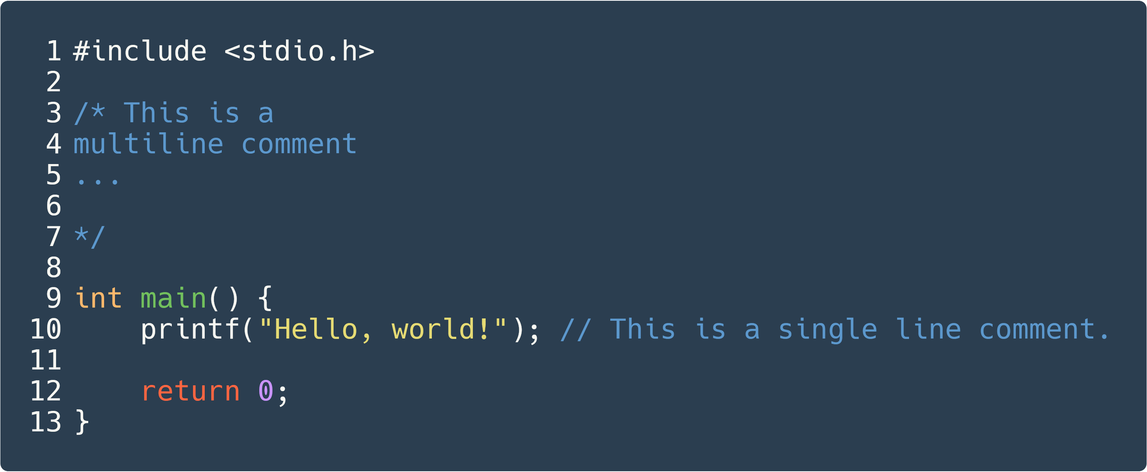

General Structure of a C Program
Notes:
Include, main falan anlat.

Slide 3
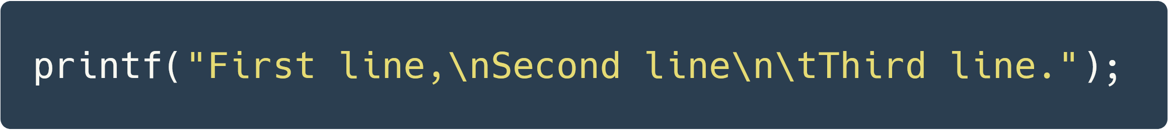
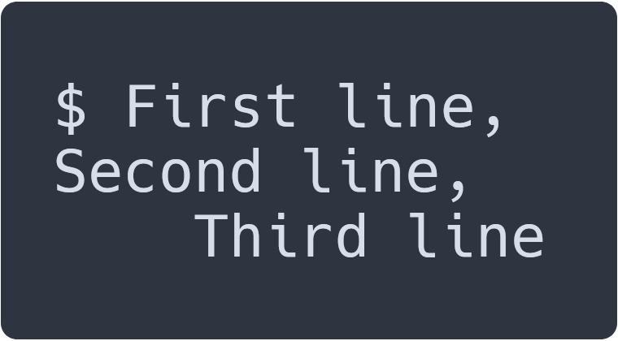
Printing to screen: printf
Special Representation | Name
\n | new line
\t | tab
\” | quote
\’ | single quote

Slide 4
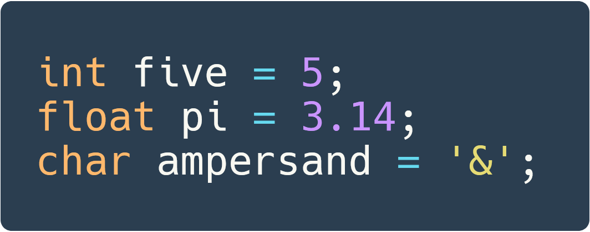

Variables
Type Name | Representation In ‘printf’ | Example Value
int | %d | 3, 9, 2555
double, float | %f | 3.14, 1.0
char | %c | a, A, b, *

Slide 5
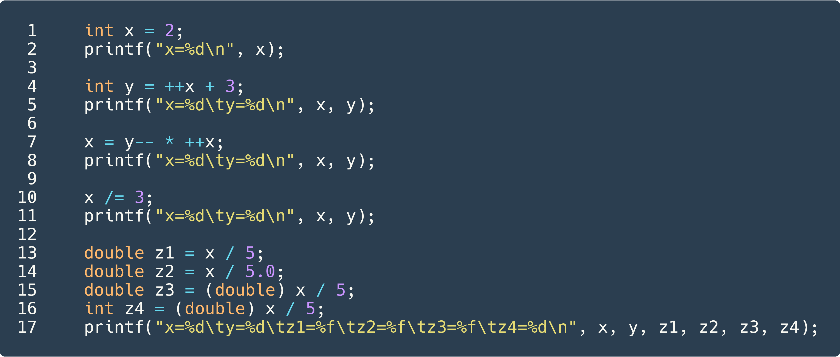
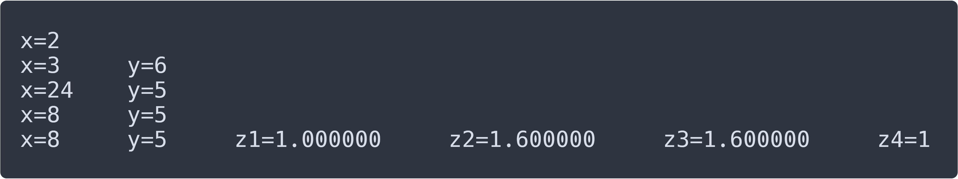
Mathematical Operators

Slide 6
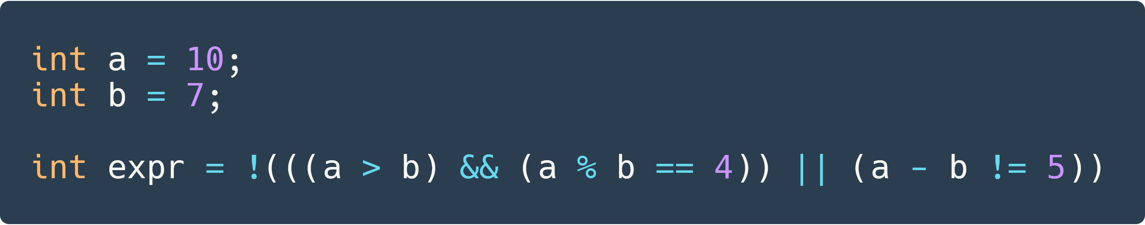
Logical Operators

Slide 7
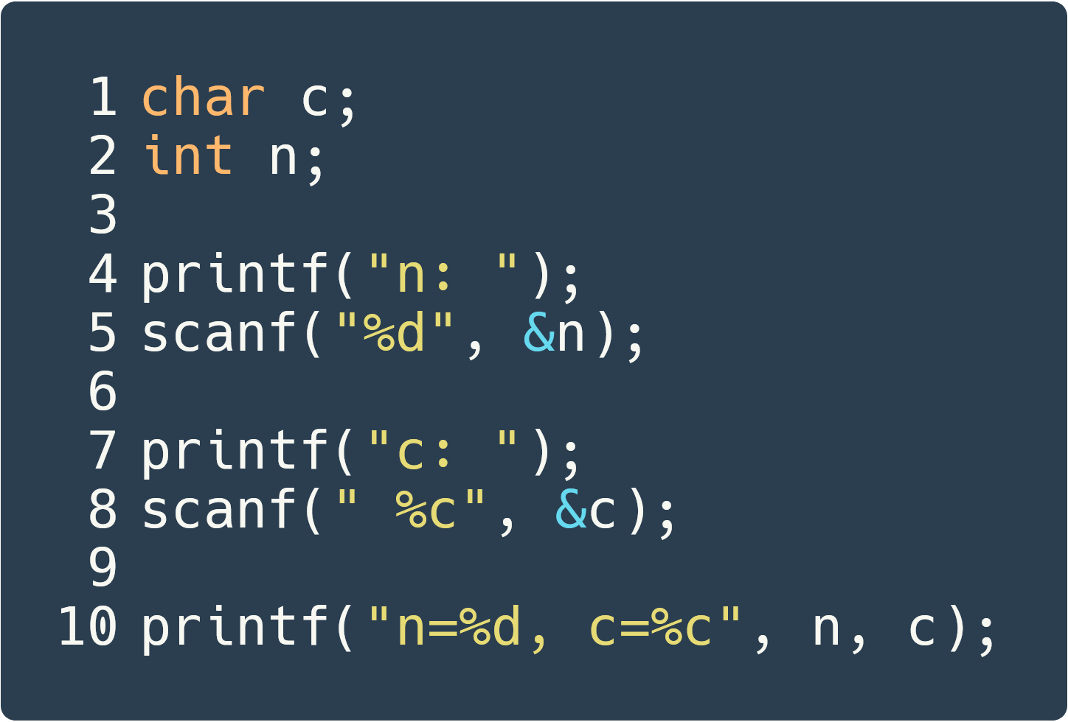
Reading from screen: scanf

Slide 8
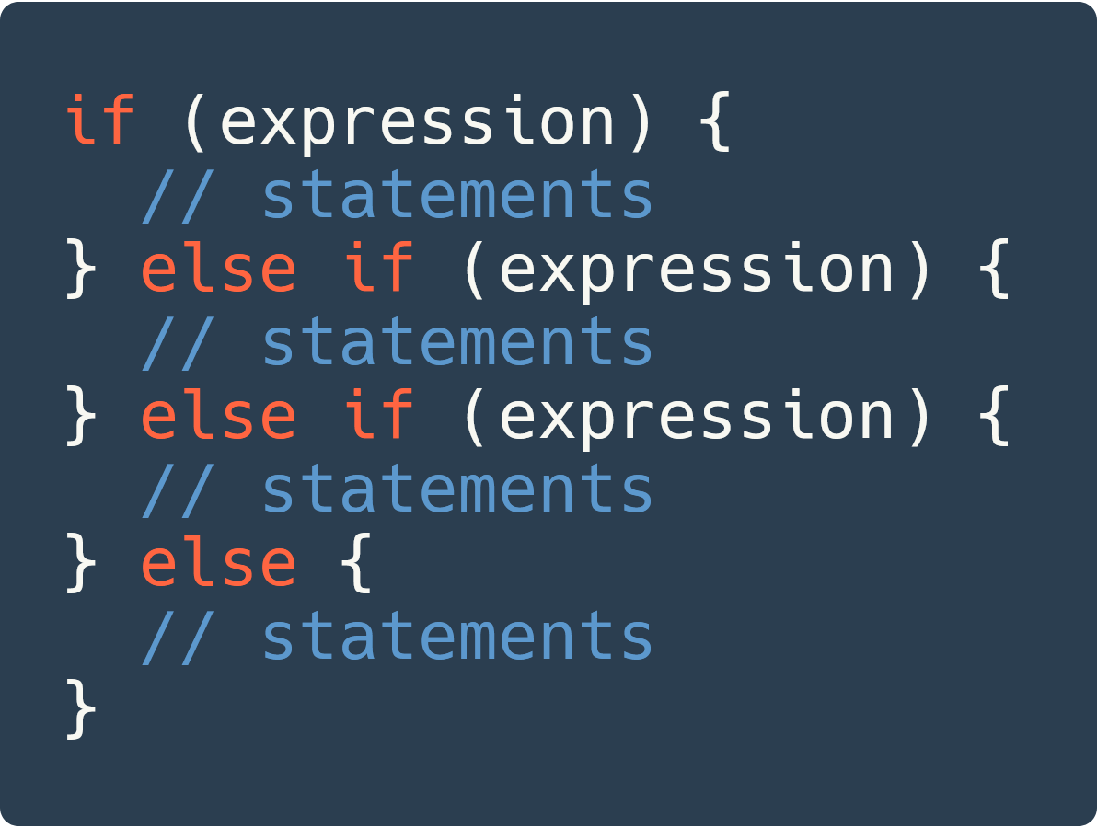
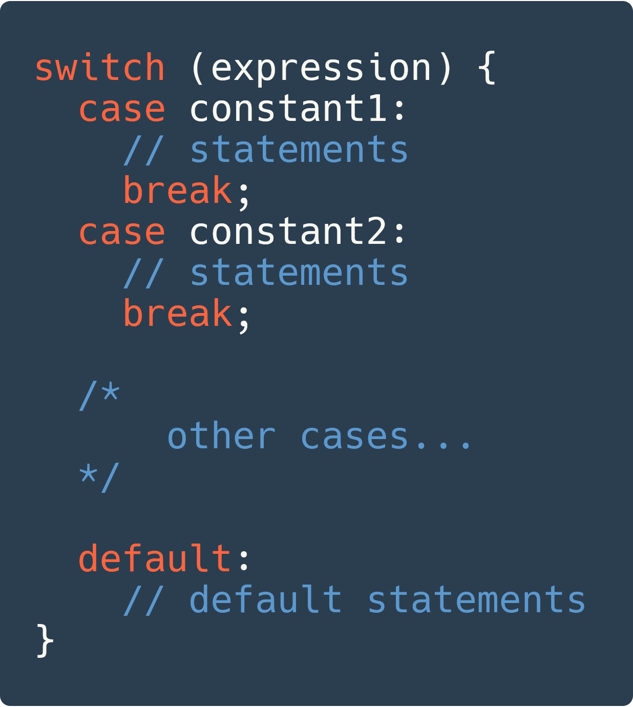
Flow Control

Slide 9
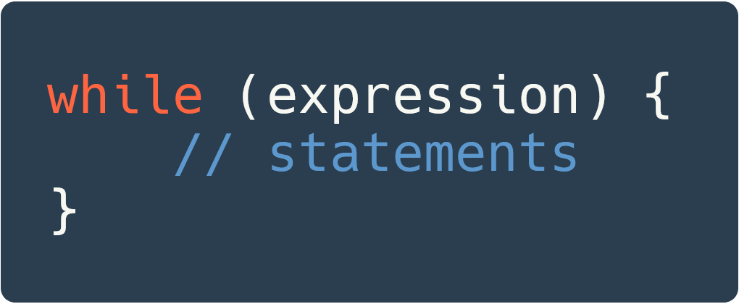
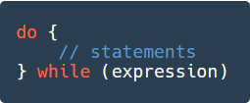
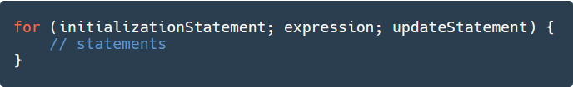
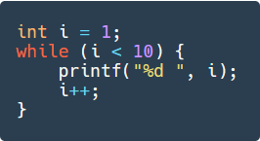
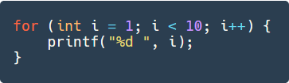
Loops

Slide 10
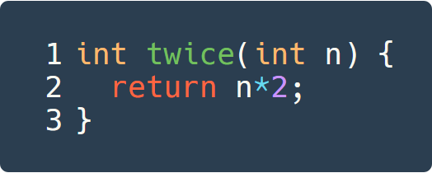
Functions

Slide 11
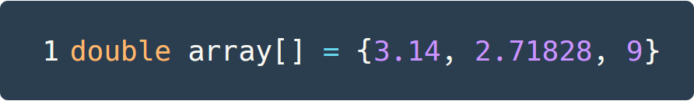

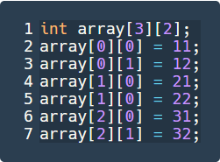
Arrays
Default value init???

Slide 12
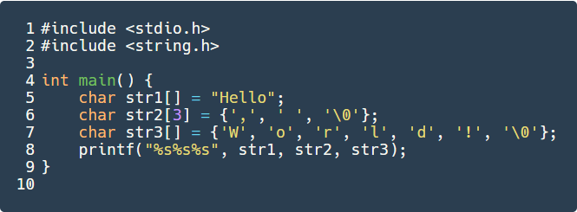

Strings
In the C language, strings are represented as char array whose last element is NUL (char ‘\0’) .

Slide 13

File I/0

