Slide 1
Type checking KGs
Iztok Savnik, University of Primorska
Kiyoshi Nitta, Yahoo Japan
March, 2022.

Slide 2
Problems
Type-checking queries
  Basic graph patterns; SPARQL
  We derive types of TPs and GP
  Derived types should be as specific as possible
    Note: Interpretation of a type is addressed by a TP! If there is a mechanism to locate the interpretation fast than it is of interest to have the most specific type subsuming all triples addressed.
  Possible errors are reported
Type-checking a knowledge graph
  For each triple determine a type
  Check this type against the stored schema
  Diagnose possible errors

Slide 3
Tasks
Compute a type of a literal
  Use class and predicate ontology
Compute a type of a triple
  From stored schema and types of SPO components
Determine a type of a TP
  Different strategies depending on the available info
  Is P available? Constants?
Determine a type of a GP
  What exactly is the target? Basic GPs? SPARQL?

Slide 4
Justification (not final)
What are the results of type-checking?
  The types of TPs from a GP
  Diagnostics of a TP and GP types
    Type mismatch
Usage of triple types
  Localizing the parts of SPARQL queries
  Interpretations of types are addressed in queries
  Distribution of triples on the type poset

Slide 5
Compute a type of a literal

Slide 6
(1) Base and lub type of a literal
Collect all types L associated to a literal l by rdf:type
  Classes from L are base types
  Type of l is the intersection of types from L!
    A literal has all types from L!
    Base type: T = ⋀t∈L t
  Lub type of l is T ≡ intersect. of types from lub(T)
    lub(L) = { t | ∀tl∈L(tl ≼ t) ∧ ∄t’(t’ ≺ t ∧ ∀tl∈L(tl ≼ t’)) }
    lub types define common properties of types from L!
    Lub type: T = ⋀t∈lub(L) t

Slide 7
(1) About the lub types of L
Each type from lub(L) is the least generalization of all types from L
  Types from lub(L) have the common links (properties) of all types from L
    They also include some different edges (common to L)
  Union of all links of types from lub(L) consists of all common links of types from L
  Each type from lub(L) covers one specific aspect of types from L (of l)
Notes
  When l is in S position, each particular type from lub(L) can lead (up) to different definition of some link p?
    Only if there are more types for the same predicate!

Slide 8
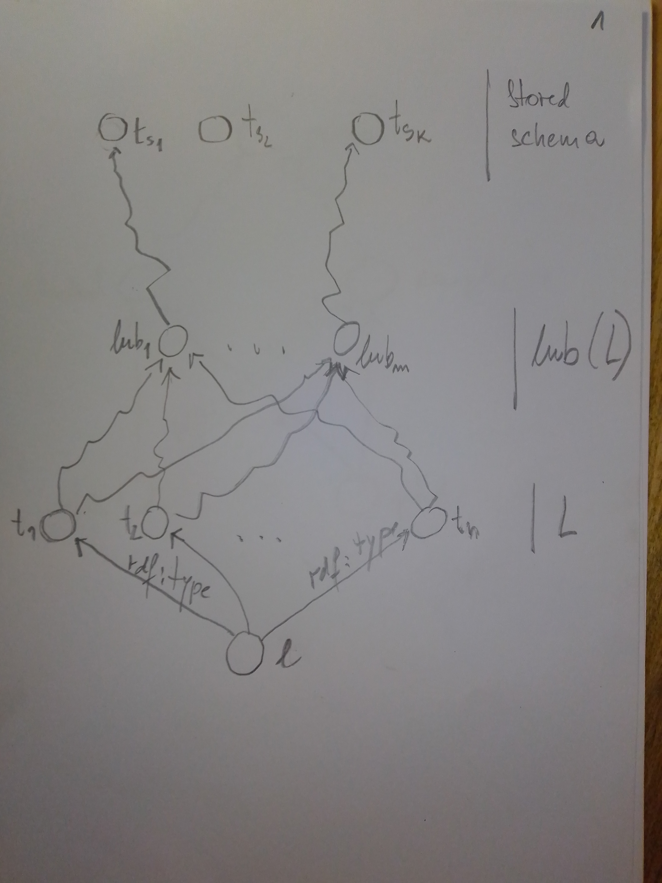
(1) Compute a type of a literal
General view
(1) Compute a type of a literal
General view

Slide 9
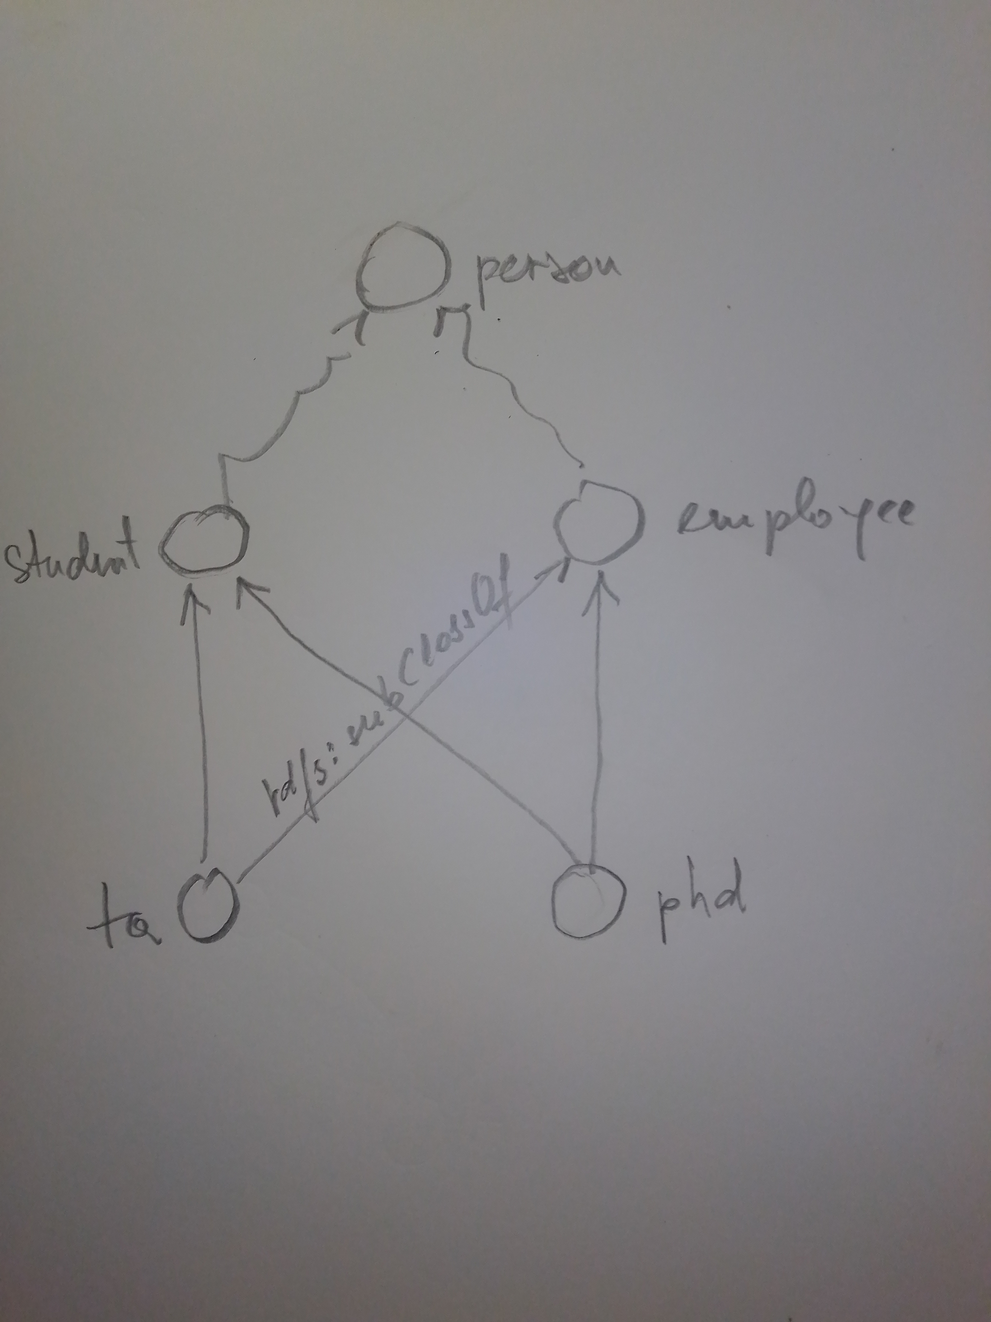
(1) Compute a type of a literal
Meaning of lub(L)

Slide 10
(1) KB view
A view from the S component of triples (KB view!)
  Intersection type gives tuple-based view of values
  Through inheritance an instance l of T obtains definitions of predicates from (through) all types from L
  We get UNION of predicate defs for intersection type ∧
  Example: Instance of student∧employee is linked by predicates defined for student and employee

Slide 11
(1) Notes on types of a literal
Notes
  What are relations between types from L (and lub(L)) to the stored schema triples (for a triple t=(s,p,o))?
    Must all types from lub(L) lead to the same stored schema triple? What are the possibilities?
    Most type-checking errors should be here!
  Valuation (state) function ν shoud be introduced
  L types are starting points for searching a type from ssg
  There may be paths from types in lub(L) to multiple different schema triples with the same predicate (only in the case there are more types for one predicate)
  We would need the most specific types (unrelated by s/g hierarchy) to catch the smallest interpretation (in TP, for example).

Slide 12
(1) Notes on types of a literal
Notes
  Determining types for a purpose, e.g, catching the smallest interpretations (the most specific types) for Tps.
  An instance of a set of general classes L can only be the instance of classes X that are more specific than some classes from L

Slide 13
Compute a type of a triple

Slide 14
(2) Compute a type of a triple
A schema triple (ts,tp,to) represents a type T = ts*tp*to
First we compute the possible stored types top- down
We compute the base types bottom-up
We examine paths from components of top-down types to the corresponding components of bottom- up types
The possible types of t (in a given position) are finally determined

Slide 15
(2) Compute a type top-down
Compute a type of t=(s,p,o) top-down (∈ ssg)
For a given predicate p we have ≥1 stored types
  Predicate p can have multiple domains and ranges
  Stored type may not be defined for p but for tp : p ≼ tp. Then the domain and the range types of p are inherited from tp ≽ p.
    In this case properties (as objects) inherit links from super-properties
In Yago, the properties seem to have, consistently, domain/range defined.

Slide 16
(2) Compute a type top-down
Type of t, named TA, is defined using ssg types
  ssg types are based on the definition of domains/ranges of properties
There are the following cases:
  Property p has domain and range defined
        We use Ts and To as defined previously.
  Property p inherits the properties rdfs:domain and rdfs:range from their super-properties
    Ordinary inheritance is used; multiple inheritance?
    Let’s call these two sets Ts and To
    Computation of Ts and To is presented

Slide 17
(2) Compute a type top-down
Computation of domains and ranges of property p
  The most specific definitions of domain/range property inherited from p and super-properties of p are taken.
  For each ps∈(p≼ps)
  For each po∈(p≼po)
    If (ps≼po ∨ po≼ps) ∧ (ps,rdfs:domain,ts)∈g ∧ (po,rdfs:range,to)∈g ∧ ∄ps'(ps'≻ps ∧ (ps',rdfs:domain,_)∈g) ∧ ∄po'(po'≻po ∧ (po',rdfs:range,_)∈g)
    Then
      add (ts,p,to) to T
  There can be domain and range defined for different properties but related by ≼.

Slide 18
(2) Compute a type top-down
Computation of domains and ranges of property p
  Now we assume a schema triple is either defined (it has rang and domain types) or it does not have any definition.
  For each p’∈(p≼p’)
    If (p’,rdfs:domain,ts)∈g ∧ (p’,rdfs:range,to)∈g ∧ ∄p’’(p’’≻p’ ∧ (p’’,rdfs:domain,_)∈g) ∧ ∄p’’(p’’≻p’ ∧ (p’’,rdfs:range,_)∈g)
    Then
      add (ts,p,to) to T

Slide 19
(2) Compute a type top-down
Comments on the algorithm:
  We do not assume that p or some super-property has both domain and range defined.
  We always select properties ps|o that are the closest to p in the predicate hierarchy above p.
  In the case of multiple inheritance all possible but the most specific types are selected.
  In the case we would need all possible definitions of types that may be defined higher in the hierarchy (not just the most specific), then we should visit the complete reversed tree of properties more general than p.
Top-down types of t are gathered in type TA
  TA = ⋁t∈T t

Slide 20
(2) Compute a type top-down
Notes:
  When constructing type T. Do we always have to use property p?
  Should domains defined higher in the property hierarchy be more general than those that are defined lower?
  It seems this should be treated by inheriting all domain/range values and then taking only the most specific.
    Alternative is to have a hierarchy of "properties" with the more-specific (general) ordering of objects (O part).
    Then only the most specific needs to be taken.
  Typing rule: i∈[1,n] ∧ l : ti / l : t1∨t2∨...∨tn
  Typing rule: (ts1∧ts2 ,p,to) / (tsi,p,to)
  Typing rule: (ts1∨ts2 ,p,to) / (ts1,p,to)∨(ts2,p,to)
    Reversed is also true.

Slide 21
(2) Determine a type bottom-up
Compute a type TB of t=(s,p,o) bottom-up
  For s and o we have sets: dn-typ(s) and dn-typ(o) (abbr. down-type)
    dn-typ(x) = { y | (x,rdf:type,y) ∈ g }
The construction of the lub type TB of a triple t
  Types of s and o:
    Ts = ⋀t∈lub(dn-typ(s)) t and To = ⋀t∈lub(dn-typ(o)) t
  TB = (Ts, p, To)=⋀ts∈lub(dn-typ(s)) ∧ to∈lub(dn-typ(o))(ts,p,to)
  Lub type can not capture definitions of some predicates
    Example: The domain of predicate p can be defined for ts∈ dn-typ(s)∧ ts∉Ts

Slide 22
(2) Determine a type bottom-up
The construction of the base type TB of a triple t
  Base types of s and o:
    Ts = ⋀t∈dn-typ(s) t and To = ⋀t∈dn-typ(o) t
  TB = (Ts, p, To)=⋀ts∈dn-typ(s) ∧ to∈dn-typ(o)(ts,p,to)
Note:
  Typing rule: l : t1∧t2∧...∧tn / ∀ti∈[1,n] l : ti

Slide 23
(2) Constrain t-down with b-up view
What we have for now:
  Type TA obtained from the stored schema
  The base type TB obtained bottom-up
Constraint TA with TB to obtain a final type of t
Search from two sides: above or below
  Above ≡ from TA⊆ssg down; Below ≡ from TB up
  Better idea is to start from below (linear complexity)
    Top-down strategy would search a tree using depth-first search

Slide 24
(2) Constrain t-down with b-up view
Bottom-up algorithm
  For each (ts,p,to)∈TA
  For each (ts1,p,to1)∈TB
    If (ts,p,to)≼(ts1,p,to1) then
      add (ts,p,to) to the result
Implementation of the algorithm
  The closure of a set {ts1} by the relation rdfs:subClassOf must include ts. The closure is computed step-by-step.
  Find paths rdfs:subClassOf+ from ts1 to ts and from to1 to to so that we have ts≼ts1 and to≼to1

Slide 25
(2) Constrain t-down with b-up view
Notes
  What do we get exactly as a result of the above algorithm? A set of types (ts,p,to) or just one?
  The existence of paths from (ts1,p,to1) to (ts,p,to) mean that (ts,p,to) is a stored type of t?
    Since ts1≼ts and to1≼to then t is an instance of (ts,p,to).

Slide 26
Compute a type of a triple-pattern

Slide 27
(3) Determine a type of a TP
Type of TP in general
  Use (1) to determine lub types of TP constants
  Compute TA for a TP with a predicate
    See definition of TA in (2)
  Compute TA for a TP without a predicate
    Use rdf:predicate if there is no predicate
    How to further restraint general set of types?
  Use algorithm presented in (2) to localize TA with types of TP constants
Notes
  We would need the most specific types of a TP in order to catch the smallest possible interpretations!

Slide 28
Compute a type of a basic graph pattern

Slide 29
(4) Determine a type of a GP
Type of a GP is a graph including the schema triples (types) in place of triple-patterns
Joining TPs requires using ∧ in the meeting points
  Q1: tp1=(c1,p1,?x); tp2=(?x,p2,c2)
    Suppose t1 and t2 are types of TPs components including ?x
    Values in the meeting point ?x have to be instances of both types
  Hence, we have typing ?x : t1∧t2
    What if t1 and t2 are related by rdfs:subClassOf? How can then t1∧t2 be computed?
    The smaller types should be used to narrow down the interpretation (rule used: t1∧t2⇒t1)
    Typing rule?: t1∧t2⇒ti, where ti has smaller interpretation

Slide 30
(4) Determine a type of a GP
Meeting point of more than two TPs
  Similar to the case of two TPs!
Joining TP can help to determine the type of a TP without the predicate
  Q1: (c1,p,?x) (?x,?y,c2)
    By knowing the type of ?x in tp1, it would be easier to determine type of ?x in tp2
Notes
  Types of certain points in query can be expressed as constraints. We get a system of constraints.

Slide 31
Plan
Determine the basic rules for union types
  Unions without tags (rdf:type to access tags)
Determine the basic rules for intersection types
  Refinement types (obtain exact SOTA)
Finalize construction
  Introduce valuation function
  Typechecking identifiers in ontology
  Rules for inheritance, linking predicates to classes
  Relations to be used by rules (model-based ops)
  Determine rules for typechecking BGP

Slide 32
Plan
Relations with typing in Description logic (OWL)
  Predicate logic with concepts from ontology
  Analogy AND/OR and union/intersection
Study particular cases of typing in Yago
Implement type-checking in b3s (epsilon)
  Merge epsilon with b3s (?)
  Typechecking of query trees in b3s

Slide 33
Literature
@inbook{10.5555/766951.766966,
author = {Pierce, Benjamin C.},
title = {Type Systems},
year = {2003},
isbn = {0387953493},
publisher = {Springer-Verlag},
address = {Berlin, Heidelberg},
abstract = {The study of type systems has emerged as one of the most active areas of research in programming languages, with applications in software engineering, language design, high-performance compiler implementation, and security. This chapter discusses the motivations and history of type systems and their role in programming language design.},
booktitle = {Programming Methodology},
pages = {293–307},
numpages = {15}
}

Slide 34
Literature
@article{10.1145/234313.234418,
author = {Cardelli, Luca},
title = {Type Systems},
year = {1996},
issue_date = {March 1996},
publisher = {Association for Computing Machinery},
address = {New York, NY, USA},
volume = {28},
number = {1},
issn = {0360-0300},
url = {https://doi.org/10.1145/234313.234418},
doi = {10.1145/234313.234418},
journal = {ACM Comput. Surv.},
month = {mar},
pages = {263–264},
numpages = {2}
}

Slide 35
Literature
@inproceedings{10.1145/351240.351259,
author = {Davies, Rowan and Pfenning, Frank},
title = {Intersection Types and Computational Effects},
year = {2000},
isbn = {1581132026},
publisher = {Association for Computing Machinery},
address = {New York, NY, USA},
url = {https://doi.org/10.1145/351240.351259},
doi = {10.1145/351240.351259},
booktitle = {Proceedings of the Fifth ACM SIGPLAN International Conference on Functional Programming},
pages = {198–208},
numpages = {11},
series = {ICFP '00}
}

Slide 36
Literature
@inproceedings{Freeman1991RefinementTF,
title={Refinement types for ML},
author={Timothy S. Freeman and Frank Pfenning},
booktitle={PLDI '91},
year={1991}
}
@article{Lovas2008ABR,
title={A Bidirectional Refinement Type System for LF},
author={William Lovas and Frank Pfenning},
journal={Electron. Notes Theor. Comput. Sci.},
year={2008},
volume={196},
pages={113-128}
}

Slide 37
Blank Slide

Slide 38
Side result: Schema operations
Many properties of things are described through the relationships to the schema
  How to relate literals, classes, triples and types?
    We must have lang. constructs to capture this
  Annotating TPs with types
    Annotating SPO TP components
    Constraints on TPs
  Relating objects on the basis of schemata and logic
  Use the formal operations from the construction of KGs!

Slide 39
Side result: Index based on types
We would like to efficiently retrieve all instances of a given type
Index should reflect the ordering of types
  Linearization of triple poset?
Interpretations of a type should be stored close together (to be read sequentially)
Ordering of types used for distribution of RDF store

