Slide 1

OncoSum
Revolutionizing Oncology Patient Care with AI-Powered Summarization
Qihuang Xie & Anmol Arora & Yizhou Yu

Slide 2






Cancer patients have key unmet support needs
Patients face unmet information needs
However, online information are:
Resulting in:
Overwhelming
Disempowered and unsatisfied patients
Health information seeking as coping mechanism
Significant stress and anxiety²
Not personalised
Patients often turn to the Internet for resources
Trouble retaining information discussed during consultations³
Contradicting
Less able to make informed decisions
Difficulty discerning the
quality of information
Unable to interpret technical medical information⁴
Notes:
Seyed-Mehdi Hashemi et al.: Prevalence of anxiety among breast cancer patients: a systematic review and meta-analysis
Maryam Hafsah Selamat et al. : Chemobrain Experienced by Breast Cancer Survivors: A Meta-Ethnography Study Investigating Research and Care Implications

Slide 3




Clinicians struggle with time and resource constraints to sufficiently address the patient concerns
Consultation time is spent on…
High administrative burden leading to burn-out among healthcare professional in oncology ^{5, 6}
Documentation and order examinations and procedures
Explaining procedures and treatment and getting patient consent
Insufficient time to address patient’s non-medical needs ⁷
Notes:
Yates M, Samuel V. Burnout in oncologists and associated factors: A systematic literature review and meta-analysis
Gomez-Urquiza, Jose L. "Prevalence, risk factors, and levels of burnout among oncology nurses: A systematic review."
Keri L. Rodriguez et.al.: How Oncologists and Their Patients with Advanced Cancer Communicate about Health-Related Quality of Life

Slide 4


Problem <-> solution
Problem
What OncoSum does:
Outcomes
Greater patient satisfaction
Reduce stress & anxiety
Make more informed decision
Better self management
Disempowered patients who may not be equip with the knowledge to make informed decisions and self manage
Provide patients with personalised and reliable health information
Reduce oncology healthcare professional burn-out
Greater efficiency in care delivery with less time spend on administration
Data integration & control
High administrative burden leading to burn out
Insufficient time to understand address patient’s needs
Provide clinicians with a Co-pilot to reduce administrative burden

Slide 5
Approach: A combination of fine-tuning and prompt engineering
Fine-tuning Open Source LLM
Prompt Engineering
Open-source model used | MedLlama (Llama 2-based model trained with MedQA dataset)
Dataset | Open-sourced Oncology specific real-conversations between patients and physicians
Fine-tuning method | QLoRa (An efficient fine-tuning approach for LLMs)
Expertise | You are a medical oncologist consultant
Instructions | [Clinician]: Write a detailed clinical documentation to document down items in the conversation notes you had with the patient in the electronic health record. [Patient]: Write a concise and clear summary to your patients in layman language on the items discussed during the conversations
Input document | “{conversation history}”
Specified output format | The output should be in the following format: [Clinician clinical notes output format] Chief Complaints, Status, Preferred language, Hx of presenting illnesses, Past med hx, Past surgical hx, Tobacco use, Social hx, Family hx, Assessment, Plan [Patients summary notes output format] Purpose of visit, summary of discussion, next steps
Notes:
Llama 2-based model trained with MedQA dataset

Slide 6
Exploration of different prompt engineering techniques
Conversation history
LLM + Prompt Template (Summarise)
Summary
Stuff
LLM + Prompt (extract all key information)
LLM + Prompt (Summarise)
Conversation history
Extracted information
Extract & Summarise
Summary
LLM + Prompt (summarise)
Chunks of documents
Summary 1
Conversation history
Chunks of documents
Summary 2
Summary
MapReduce
Chunks of documents
Summary 3
LLM + Prompt (summarise)
Chunks of documents
Summary 1
Conversation history
LLM + Prompt (Refine)
Chunks of documents
Summary2
Refine
Summary
Chunks of documents
Summary 3

Slide 7
Our Current Prototype

Slide 8
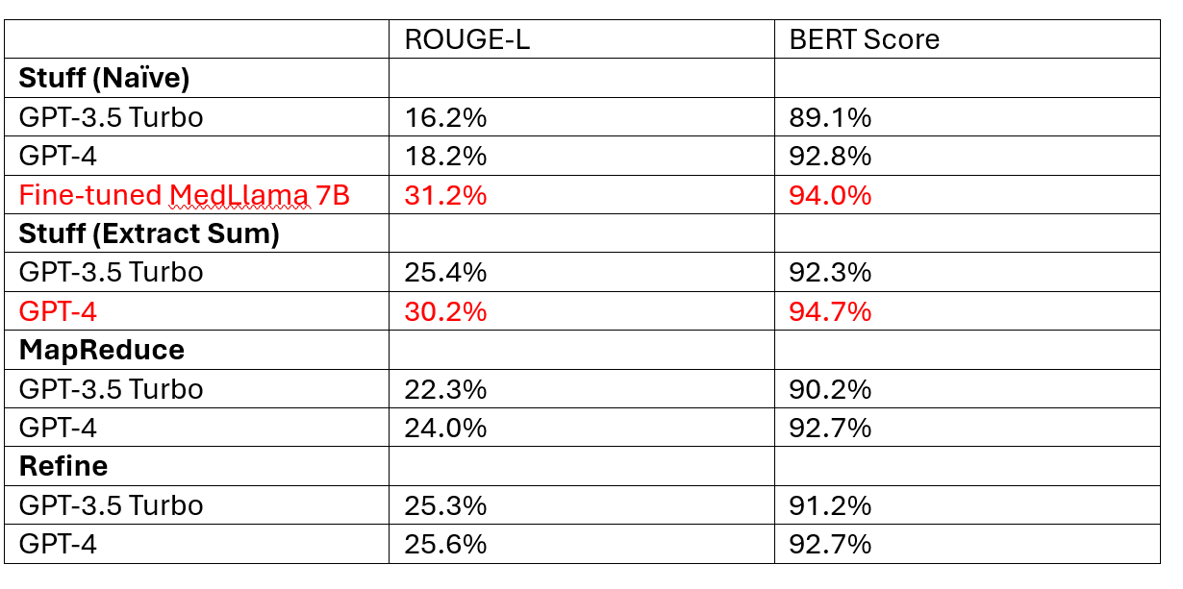
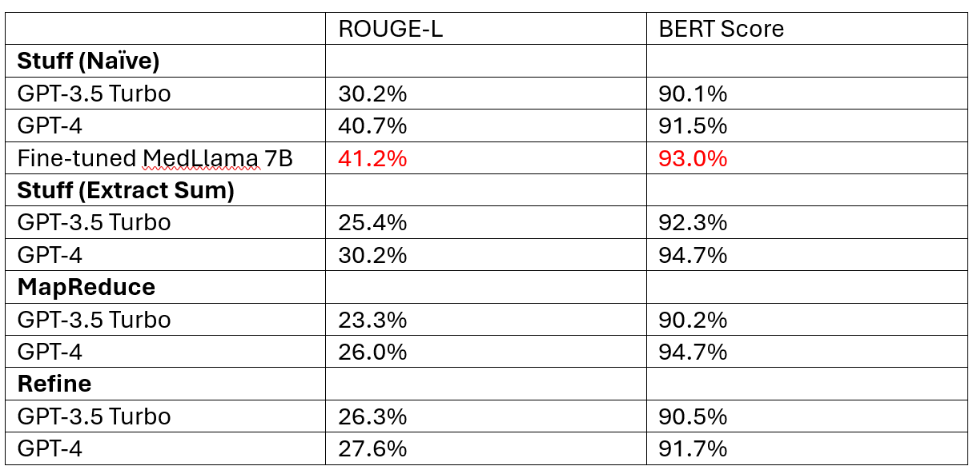
Performance of the models and prompt engineering techniques
Clinicians Documentation
Patient notes

Slide 9
Business Model
Big data integration & consultancy
Healthcare institutions
Integration with other apps

Slide 10

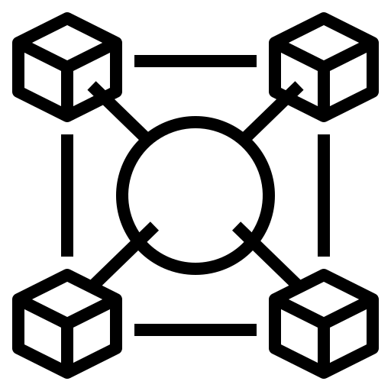


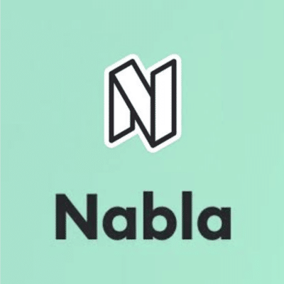




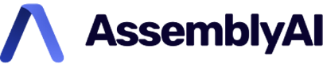

Our unique selling point and competitive edge centres around 4 key qualities
Interoperability
Secure
Fully integrated solution with EHR and any patient management tools compliant with FHIR specifications
Human-in-the-loop system and data is stored in hospital local cloud. Fully functioning as LLM-powered data processing layer
Anonymised
^{Latent data}
Specialist-trained model
Flexible
Conversation data, complementing patient’s diagnostic reports and medications, will be trained specifically breast cancer related data, and could be expanded to include all cancer types
Unlike our competitors focusing on clinicians, clients can choose between different modules for BOTH patients and healthcare providers
Notes:
Multi-lingual Support – We will support multi- and understand Singlish
Flexible – We have several different modules for both providers and patients. and providers can choose which modules to integrate with EHR
Work with breast cancer management app
Unlike our competitor, clients have the possibilities to choose between different modules for BOTH patients and healthcare providers

Slide 11









Our End Goal - LLM-as-a-service integrated with Electronic Health Record (EHR)
x
Other diagnostic reports & medication data
Speech-to-text module
Clinician summarisation module
Patient-healthcare provider Conversation / Telephone / Zoom calls
Conversation Transcript
Structured clinical notes
Healthcare Providers
Patient summarisation note module
Insights module#
Patient Management Tools*
Breast Cancer Patients
Patient friendly summary notes
Integration
module
Chat module
End User
Patient education information

Slide 12






Business Model
Patient Management Tools
Serve
Pay for patient module*
Pay for clinician /patient module
Serve
Integrates with
Breast Cancer Patients
Hospitals
Integrates with
Serve
Interface with
EHRs
Healthcare providers
*Pay for patient/clinician refers to a licensing model where MediPal is listed on the EHR and hospital interested in the technology will pay to access via their own EHR

