Slide 1

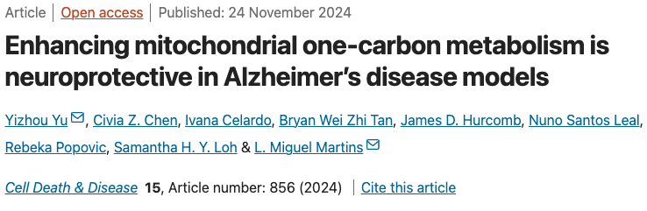

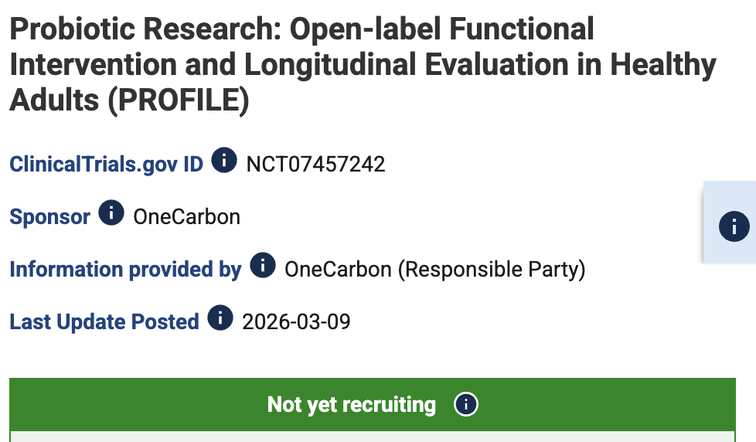
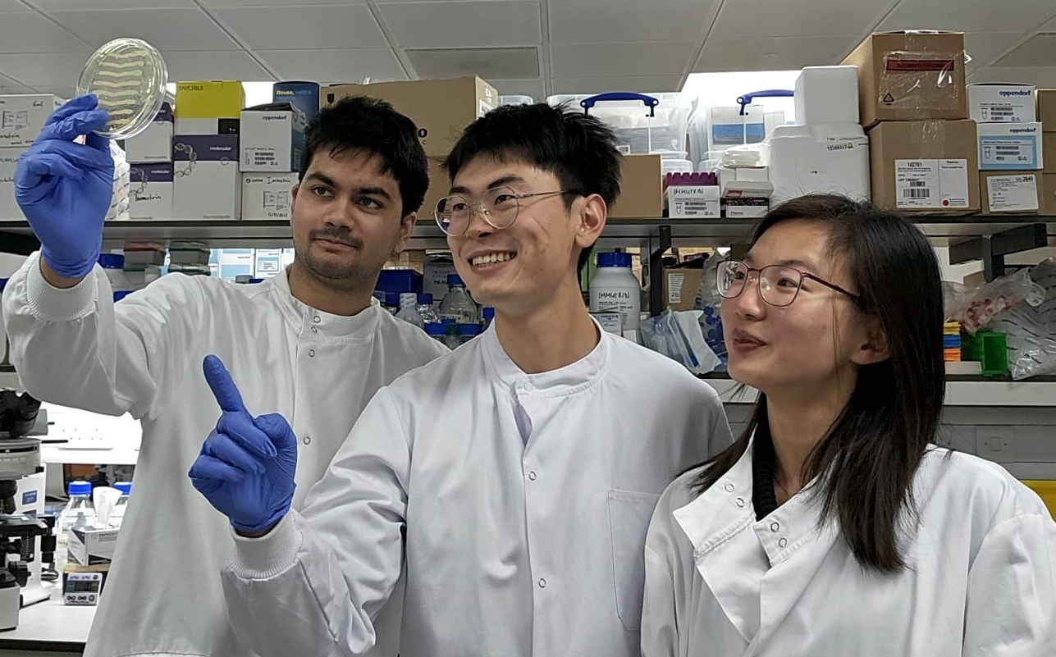
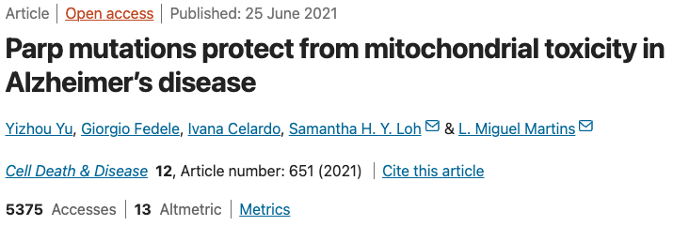

ROADMAP
Towards a safe, effective, early intervention for Alzheimer’s
2019–2024
2024–2025
2025–2026
2026–2027
2027–2029
Discovery
Strain evolution
RCT in Alzheimer’s
+
Marketing
Human pilot
Large trial
Yu et al., 2025, PMID: 41102145
Yu et al., 2026, In revision
Yu et al., 2024, PMID: 39582067
Yu & Martins, 2024, PMID: 38928008
Yu et al., 2019, PMID: 34172715
Yu & Popovic et al., 2023, PMID: 37083954
Wilson, Yu et al., 2024, PMID: 38467609
Yu, 2023, PMID: 37754354
And 10 other papers
Notes:
Join us in our journey to develop a safe, affordable and effective treatment to prevent Alzheimer’s disease

