Slide 1
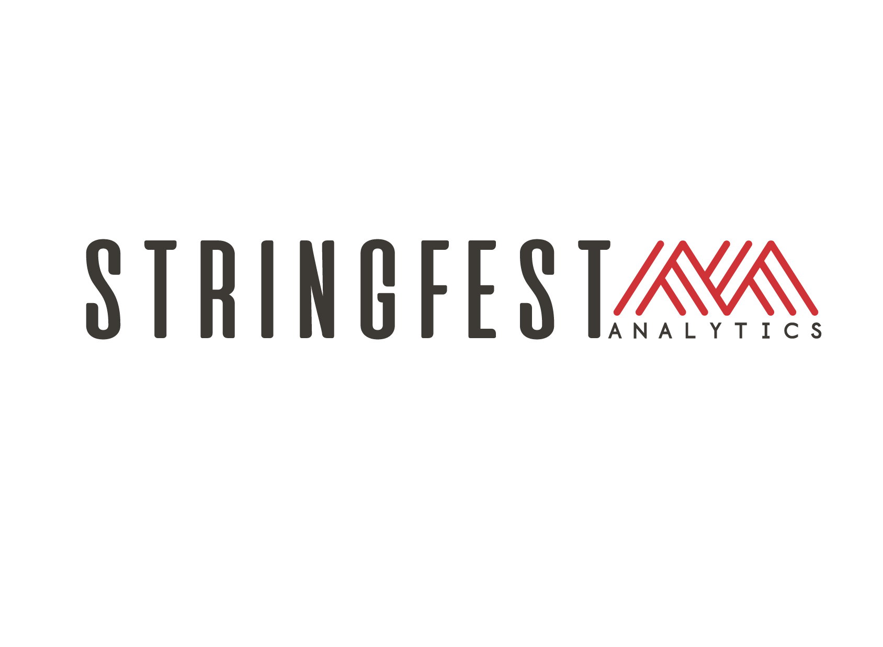
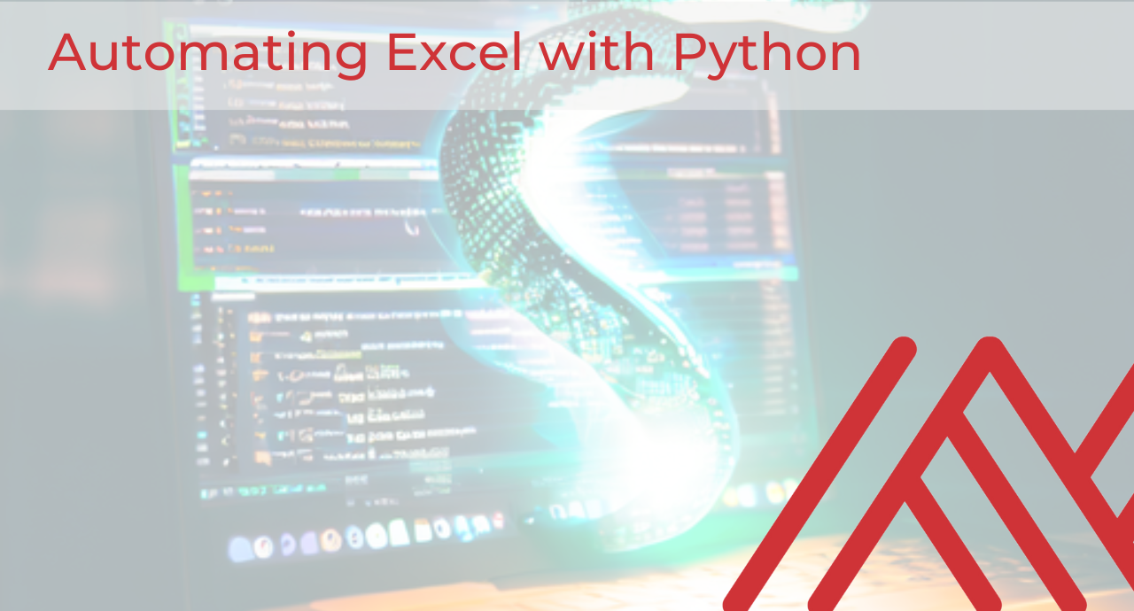
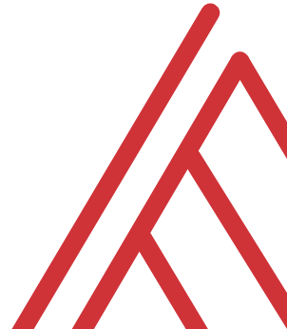
Advancing into Analytics: From Excel to R and Python
Notes:
Welcome everyone to the presentation, I am looking forward to it.

Slide 2


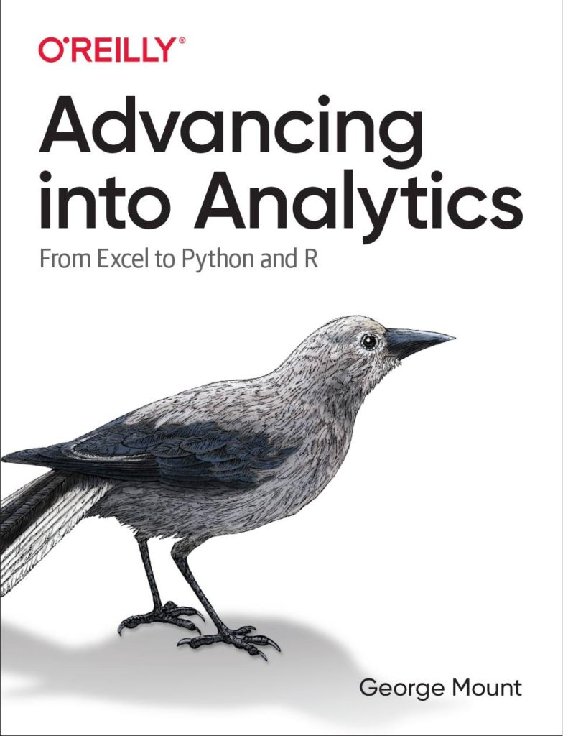
Hi, I’m George

Slide 3

Hi, I’m George

Slide 4
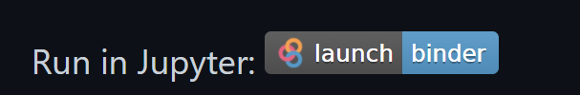
Follow along
Download resources: https://github.com/stringfestdata/automating-excel-with-python-webinar
Click through this link now to run during presentation:
(this could take some time so feel free to ask questions now)…

Slide 5
Learning objectives
Create an end-to-end Excel automation in Python
Situate pandas versus openpyxl versus Power Query

Slide 6
What can Python do that VBA cannot?
Version control
Git/GitHub have limited features for Excel workbooks
View contributions, revert to previous versions, and so forth
Unit testing
Automated checks for software working as intended
Quality check for users of various technical backgrounds
Cross-platform interoperability
The “glue” of modern software development
Seamlessly compatible with the cloud
Package development
Thousands of free packages for nearly any use case
Easier to maintain source codes than copy-and-pasted VBA modules

Slide 7

Demo
File: automating-excel.ipynb
pandas for data manipulation
openpyxl for Excel automation
seaborn for data visualization

Slide 8
Conclusion/Resources

Slide 9
Recommended reading
Advancing into Analytics by George Mount
More info about http://stringfestanalytics.com/book/ , including how to read for free!
“By the end of this book, you should be able to conduct exploratory data analysis and
hypothesis testing using a programming language.”
Notes:
By the end of this book, you should be able to conduct exploratory data analysis and
hypothesis testing using a programming language.

Slide 10
Get in touch
george@stringfestanalytics.com
stringfestanalytics.com/book
linkedin.com/in/gjmount

Slide 11
Questions?

