Slide 1

Healthcare Insurance Data Analysis Using Big Data Technologies
Authors: Felix Luca Krebs, MD Kamruzzaman Russel, Justus Izuchukwu Onuh
Course: Machine Learning

Slide 2
Introduction & Motivation
Background
Healthcare insurance companies operate in a high-risk, data-heavy environment.
Understanding customer behavior, predicting health-related risks, and optimizing claims are central challenges.
The Problem
Traditional analytics methods fall short due to:
Explosive data growth from hospitals, claims, public health databases
Multiple data formats and inconsistent entries
Delayed insights from manual processing

Slide 3
Introduction & Motivation
Motivation
Leverage the power of Big Data Technologies:
Apache Spark for distributed, in-memory processing
Apache Hive for SQL-based querying at scale
Python (Pandas, Seaborn) for flexible data manipulation and visualization
Project Objective
Understand and model customer behavior
Identify high-risk patients and costly hospitals
Track disease trends across the population
Optimize insurance products and risk management
Demonstrate how Big Data improves decision-making in healthcare

Slide 4
Project Architecture Overview.
🗂️ Step 1: Data Ingestion
Raw datasets: patient records, claims, diseases, hospitals
Format: CSV and JSON
🧼 Step 2: Data Cleaning & Preprocessing
Removed duplicates, handled missing values
Standardized data types (e.g., dates, floats)
🔗 Step 3: Data Merging
Combined claims with patients and subscribers via ID joins
Linked hospital data for institutional analysis
📊 Step 4: Exploratory Data Analysis (EDA)
Python (Pandas, Seaborn, Matplotlib)
Insight extraction through statistical plots

Slide 5
Dataset Description
Dataset | Description
Patients | Demographic info: ID, name, gender, birth date, city, hospital ID
Claims | Claim ID, patient ID, amount, type, status (approved/rejected), claim date
Diseases | Disease name linked to patients and claims
Subscribers | Policyholders connected to claims (via SUB_ID)
Hospitals | Institutional metadata used in claim analysis
Groups/Subgroups | Categorization information for segmentation

Slide 6
Dataset Description
Source & Format
Source: Adapted from the HELTHCARE-SYSTEM GitHub repository
Format:
CSV and JSON
Cleaned and stored under /data/processed/
Raw versions under /data/raw/

Slide 7
Data Cleaning
✅ Handled Duplicates
Removed exact and near-duplicate rows across datasets
Ensured uniqueness of key identifiers (patient_id, claim_id)
✅ Managed Missing Values
Dropped non-critical rows with too many missing entries
Imputed missing values where applicable (e.g., empty dates or genders)
✅ Standardized Data Types
Converted date strings → proper datetime format
Enforced numeric types on fields like claim_amount
✅ Normalized Column Names
Unified naming conventions (e.g., Patient_id → patient_id)

Slide 8
Data Merging Strategy
Claims ↔ Patients
Joined via patient_id to link claim info to demographic details
Claims ↔ Subscribers
Connected using SUB_ID to trace policyholder behavior
Claims ↔ Hospitals
Enabled claim-level hospital analysis via hospital_id

Slide 9
Exploratory Data Analysis (EDA)
Identifying high-risk patterns
Analyzing disease trends
Optimizing insurance decisions

Slide 10
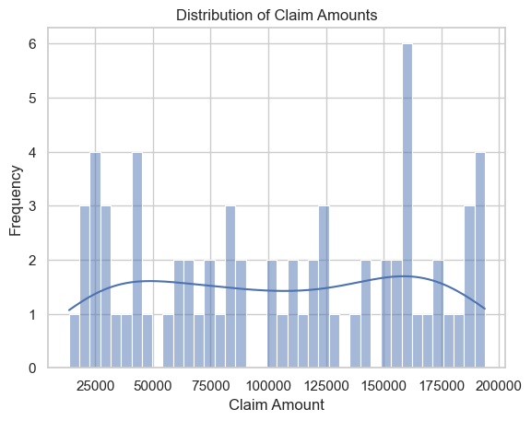
EDA: Distribution of Claim Amounts
Insight:
Most claims are low-value, but a few extreme cases drive costs
Claims ranged from 25,000 to 200,000, with no clear average pattern and visible cost spikes
Company can:
→ Adjust reserve strategy for high-cost events → Set manual review flags for extreme values

Slide 11
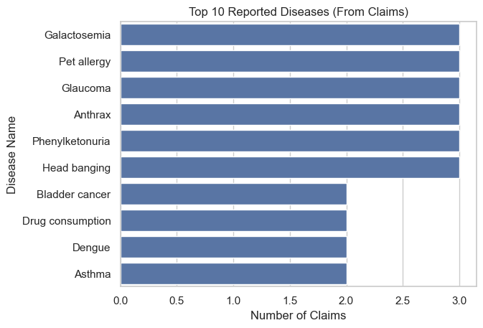
EDA: Top 10 Reported Diseases
Insight:
Common: Pet allergy, Anthrax, Glaucoma
Rare or suspicious: Asthma, Dengue, Drug consumption
Company can:
→ Design targeted insurance products → Verify rare disease entries for accuracy/fraud

Slide 12
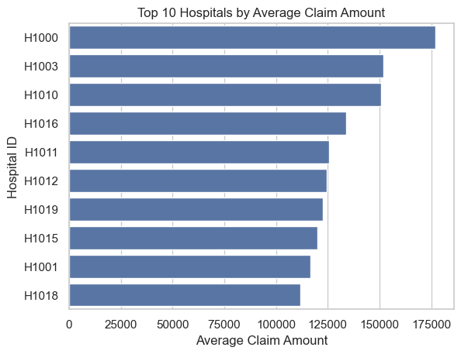
EDA: Top 10 Hospitals by Number & Cost of Claims
Insight:
Hospitals like H1000 filed highest average claims, potentially due to high-end treatments or cost padding
Company can:
→ Review billing patterns for these hospitals → Use insights in contract negotiation or exclusions

Slide 13
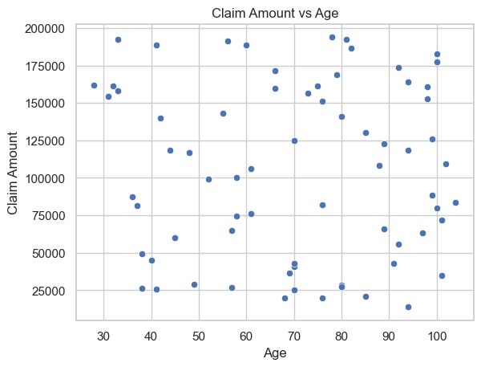
EDA: Claim Amount vs. Patient Age
Insight:
Older patients (>70) file more (expensive?) claims
Company can:
→ Use age-based premium adjustments → Offer preventive care programs for elderly groups

Slide 14
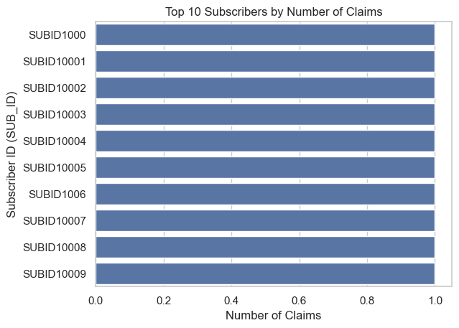
EDA: High-Frequency Claimants
Insight:
Top 10 SUB_IDs all submitted frequent claims
Company can:
→ Flag for chronic care management or potential misuse → Offer rewards to low-risk frequent users

Slide 15
Future Enhancements
Predictive Modeling
Use machine learning models to predict high-risk patients or costly claims before they occur.
Example techniques: Logistic Regression, Decision Trees, Random Forest
Goal: Enable proactive interventions and cost control
Interactive Dashboards
Develop a user-friendly dashboard to monitor trends in real time
Tools: Streamlit, Dash, Tableau (optional)
Use Cases: Management reports, claim monitoring, subscriber tracking

Slide 16
Future Enhancements
External Data Enrichment
Integrate public datasets to enhance analysis:
Demographics, environmental factors, regional disease stats
Adds context and precision to pricing and forecasting models
Anomaly & Fraud Detection
Train models or set rules to catch:
Unusual claim patterns
False diagnoses or billing practices
Useful for fraud control and risk auditing

Slide 17
Conclusion
Project Achievement
We successfully analyzed healthcare insurance data using Big Data thinking and Python-based tools, demonstrating how structured analytics can drive real business value in the healthcare sector.
What We Delivered
Cleaned and merged real-world-style insurance datasets
Extracted meaningful patterns in claim behavior, hospital billing, and disease trends
Identified frequent claimants, high-cost hospitals, and age-risk profiles
Turned raw data into actionable insights for decision-makers

Slide 18
Conclusion
Strategic Value
This project empowers insurance providers to:
→ Improve pricing models
→ Reward low-risk behavior
→ Detect fraud and outliers
→ Design better products based on real-world disease data

Slide 19
References
Data Source
GitHub Repository: HELTHCARE-SYSTEM Contains sample insurance datasets for claims, patients, diseases, and hospitals.
Tools & Libraries
Pandas – Data analysis and preprocessing https://pandas.pydata.org
Seaborn – Statistical data visualization https://seaborn.pydata.org
Matplotlib – Plotting library for Python https://matplotlib.org
Jupyter Notebook – Interactive Python analysis https://jupyter.org

