Slide 1
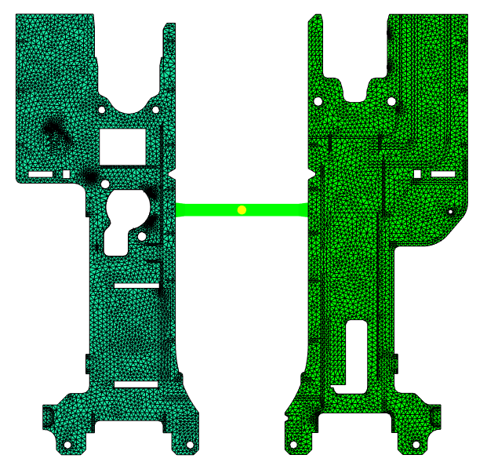
Preprocess and Mesh statistics
网格统计
Specification: the type of model used 3d meshes ansys
Tetrahedras
----------------------------------------
Entity counts:
Tetrahedra 768403
Connected nodes 138206
Connectivity regions 2
Volume by element types:
(Mold blocks and cooling channels are not included)
Tetra: 45.0684 cm^3
Total: 46.6374 cm^3
Volume by components:
Cavity: 45.0684 cm^3
Inserts: 0 cm^3
Mold blocks: 0 cm^3
Aspect ratio:
Maximum Average Minimum
96.55 8.02 1.09
Maximum dihedral angle: 176.9

Slide 2
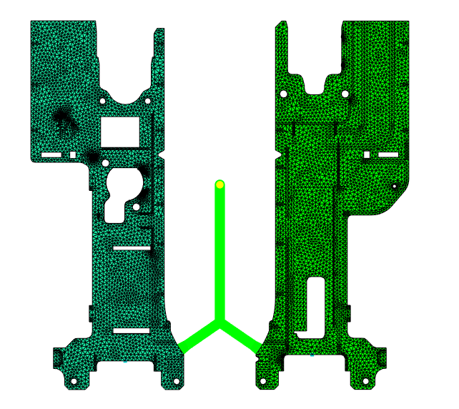
Preprocess and Mesh statistics
网格统计

Slide 3
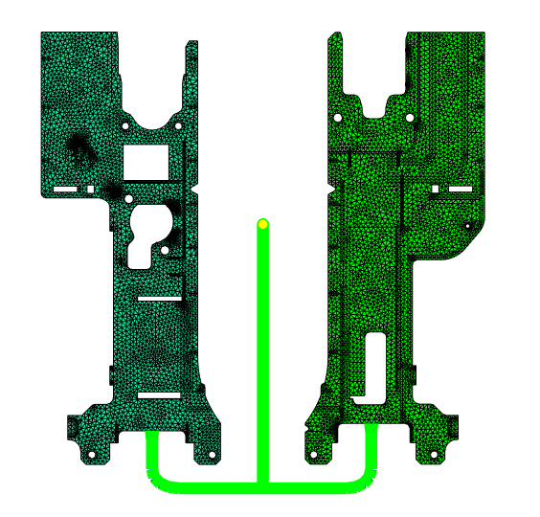
Preprocess and Mesh statistics
网格统计

Slide 4
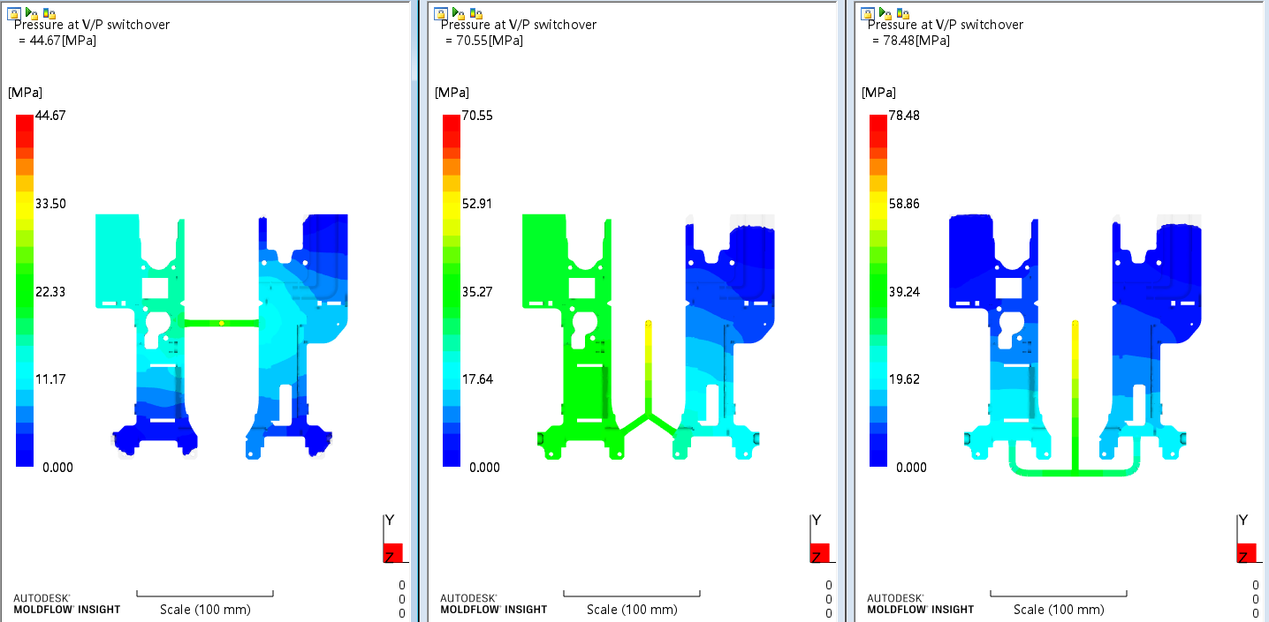
Pressure at V/P switchover
转保压压力
Above figure shows the pressure distribution through the flow path inside the mold, at the V/P switchover of the filling phase.

Slide 5
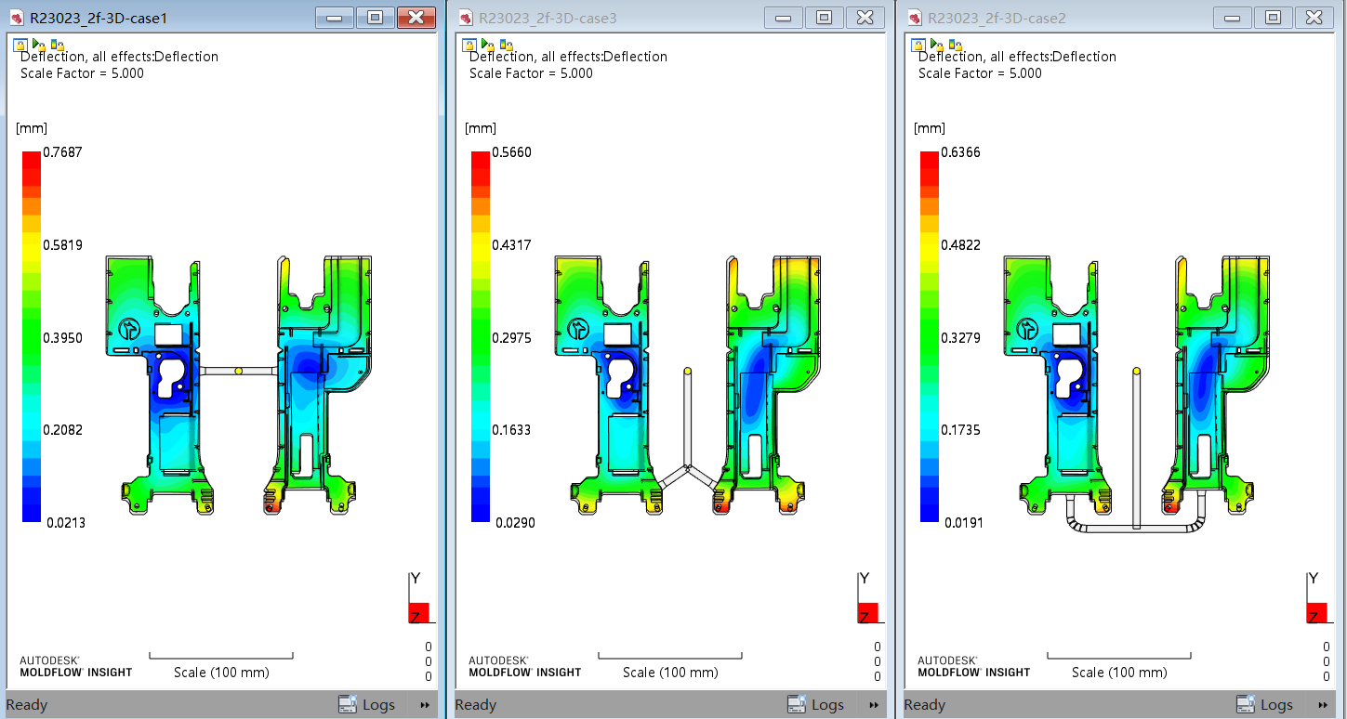
Deflection-All
产品整体收缩+变形
产品整体最大变形 +缩水在红色区域

Slide 6
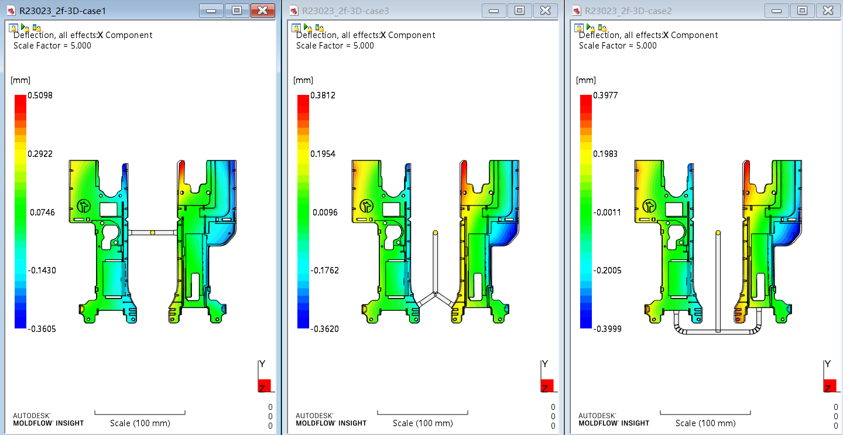
X-deflection
产品X方向变形
产品X方向最大变形 +缩水在红色和深蓝色区域

Slide 7
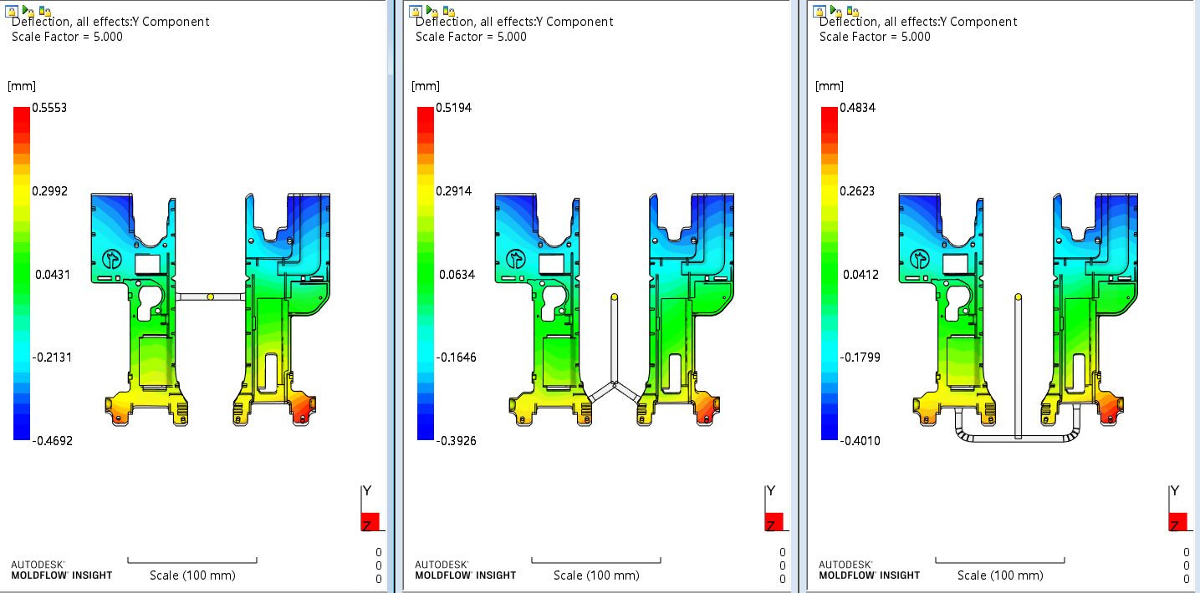
Y-deflection
产品Y方向变形
产品Y方向最大变形 +缩水在红色和深蓝色区域

Slide 8
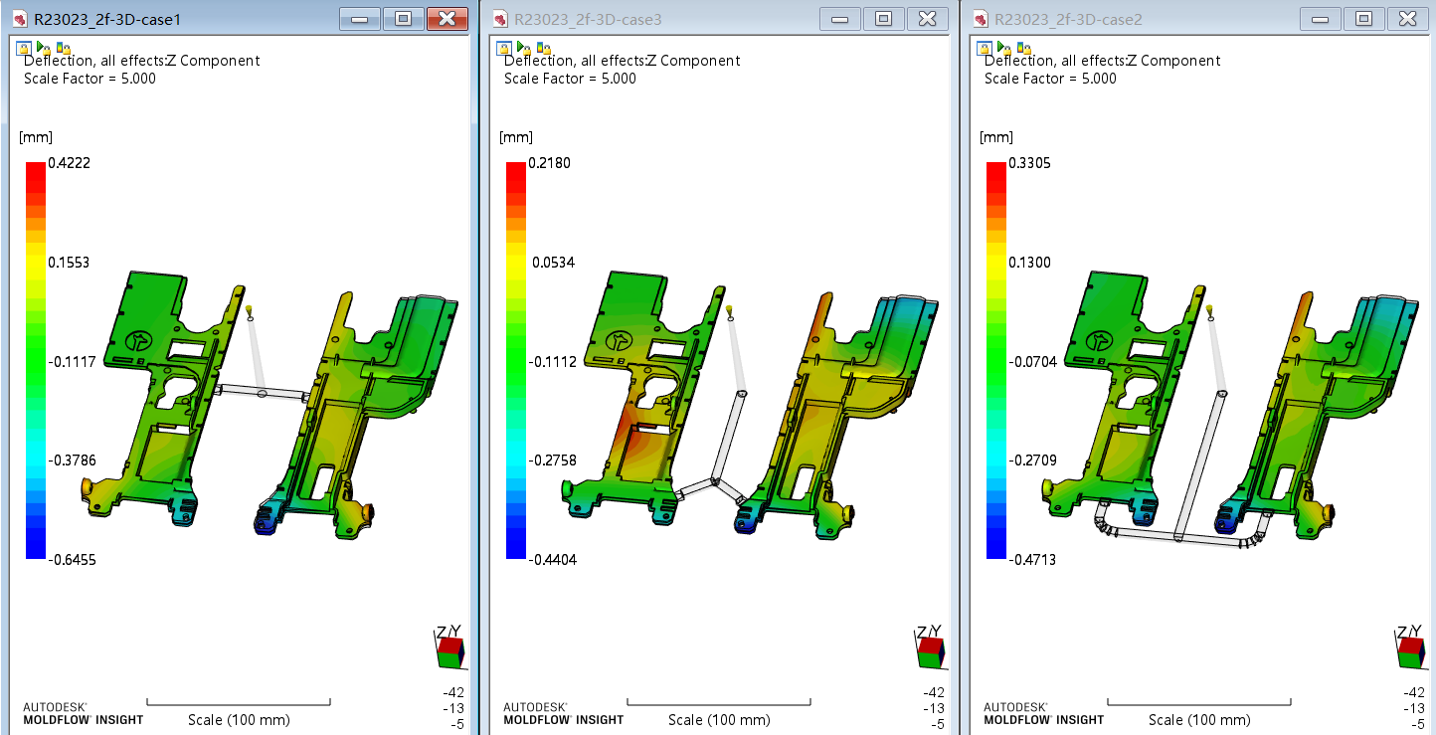
Z –deflection
产品Z方向变形
产品方向最大变形 +缩水在红色和深蓝色区域

