Slide 1


HRA NEWSDESK
HUMAN RESOURCES & ADMIN DEPARTMENT
FEBRUARY 2021
QUOTE OF THE MONTH
“Coming together is a beginning.
Keeping together is progress.
Working together is SUCCESS”

Slide 2

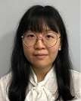
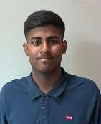
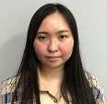
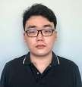
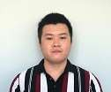

WELCOME ABROAD NEW COMERS
ID | NAME | DATE JOINED | DEPARTMENT / POSITION | PHOTO
4594 | TEY CHIEN LI | 28/12/2020 | HR & ADMIN / ASST. EXECUTIVE
4595 | THARRMA A/L TAMIL ARASAN | 4/01/2021 | QA / QC CHECKER
4596 | LUM YIK MEI | 5/01/2021 | FINANCE / COSTING EXECUTIVE
4597 | HERMAN LIM KIN OON | 11/01/2021 | IT / INTERN
4598 | MOO HONG HWEI | 11/01/2021 | IT / INTERN

Slide 3






WELCOME ABROAD NEW COMERS
ID | NAME | DATE JOINED | DEPARTMENT / POSITION | PHOTO
4599 | NG SEN JING | 11/01/2021 | IT / INTERN
4600 | GERARD NGAI KAH HOE | 11/01/2021 | IT / INTERN
4601 | WONG YEE LEK | 11/01/2021 | IT / INTERN
4602 | CHOO LI JUN | 11/01/2021 | IT / INTERN
4603 | CHEW KOK WING | 15/01/2021 | PRINTING/ALM / OPERATOR

Slide 4


LIST OF RESIGNATIONS
ID | NAME | DATE RESIGNED | DEPARTMENT / POSITION
4497 | NAFSAH BINTI ISMAIL | 29/12/2020 | PACKING / PACKER
4558 | HOW WENG FONG | 31/12/2020 | CONTINUOS IMPROVEMENT TEAM / INTERN
4358 | BAH MAT A/L BAH YIM | 1/1/2021 | LOGISTICS / PRODUCTION WORKER
3775 | RAIMI BIN ROSLI | 2/1/2021 | BINDING / OPERATOR
4206 | DIXE ELTON ANDREW | 2/1/2021 | QA / QC CHECKER
4586 | CALEB LEE CHEE YOONG | 4/1/2021 | QA / INTERNAL AUDITOR
2515 | NGUYEN THAI MANH | 15/01/2021 | PACKAGING / LINE LEADER
3381 | SHRESTHA YUNESH | 20/01/2021 | LOGISTICS / LOGISTIC WORKER
3329 | DAHAL TARA MANI | 20/01/2021 | PERSO / ASST. OPERATOR
4494 | AQHEEL AMZAR BIN ZAINUDDIN | 26/01/2021 | GENERAL STORE / ASST. EXECUTIVE
4306 | TAMIL SELVAM A/L VALAN | 27/01/2021 | GENERAL STORE / RM STORE ASSISTANT
4319 | TIONG KIE SIONG | 29/01/2021 | GENERAL STORE / PRODUCTION ENGINEER

Slide 5

INTERNAL VACANCY ADVERTISEMENT
DEPARTMENT | POSITION
FINANCE | ACCOUNT ASSISTANT
PURCHASING | PURCHASING EXECUTIVE
MARKETING | SALES ADMIN
QA | QC GLUING
 | QC SAMPLE
 | QC OUTGOING
 | QA ENGINEER
 | COMPLIANCE EXECUTIVE
OPERATION | SENIOR PRODUCTION ENGINEER
 | AUTOMATION ENGINEER
DIE CUT | DATA CLERK
 | ASST. OPERATOR
GENERAL STORE | STORE KEEPER
 | PRODUCTION WORKER
 | STORE SUPERVISOR
FLUTE | ASST. OPERATOR
GLUE | OPERATOR
 | ASST. OPERATOR
CUTTING | ASST. OPERATOR
PRINTING | ASST. OPERATOR
VARNISH | ASST. OPERATOR
LOGISTICS | PRODUCTION WORKER
 | LORRY ATTENDANT

Slide 6
FEBRUARY BIRTHDAY LIST
CONTINUOS IMPROVEMENT TEAM PREPRESS DEPT
₂₂/02
₂₁/02
ZULKIFLI BIN MUSA NORAIN BINTI NORDIN
FOONG WAI CHING
₂₆/02
LOGISTICS DEPT
₂/02
PURCHASE DEPT
ZAINI BIN SHAHBUDIN
₂₈/02
CHOONG WAI YEN
₁₀/02
YAP CHAN HONG
LIM SUET LI
₁₇/02
FINANCE DEPT
KAMARUDZAMAN BIN MAT SARIP
₂₅/02
MAK YAN YEE
₁₈/02
IT DEPT
GLUE DEPT
WAHIDATUL NASHRAH BINTI WAHI ANUAR
₈/02
ONG KHENG CHUAN
₁₄/02
QA DEPT
MKTG. & SALES DEPT
MOHD ZUHAIDI BIN CHE DEIN
₁/02
YEW YOKE YAN
₁₅/02
MUHAMMAD FRIDAUS BIN SHAHBUDIN
₁₂/02
SONY PACKING DEPT
HASNAH BINTI MOHAMAD NOR
₁₅/02
PAVE THERA A/P ELANGO
₄/02
AWALUDIN BIN OMAR
₂₅/02
HOT STAMPING DEPT
PACKAGING DEPT
DENNY YUNUS
₂₈/02
NORAINI BINTI SAARI
₈/02
SYAFEEQ SHAHARANI DAUD BIN SHAHARANI
₉/02
PACKING DEPT
AZLIN HALIDA BINTI RAMLI
PARVATHY A/P KRISHNAN
₁₉/02
GENERAL STORE DEPT
DIE CUT DEPT
LOH SOO HOCK
₉/02
ONG WEI LAM
₇/02
HOW BEE HONG
₂₂/02
MOHAMAD FAHRID BIN
MOHAMED RADZI
₁₇/02

Slide 7
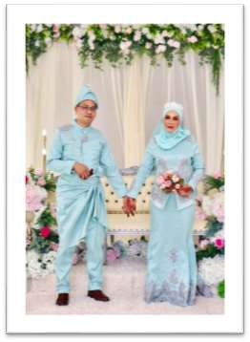

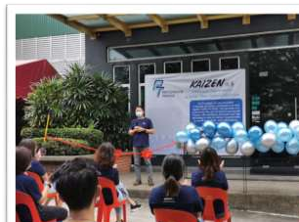
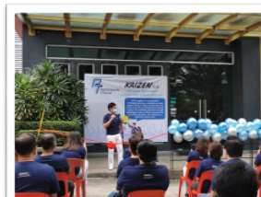
CONGRATULATIONS ON YOUR MARRIAGE
Saat Bin Kadir from Flute Lamination Dept, tied the knot with Norhaidah Binti Ahmad.
2021 KAIZEN LAUNCHING
Speech by Managing Director, Mr Jimmy Ong
Speech by Director cum General Manager, Mr Raymond Kang

Slide 8
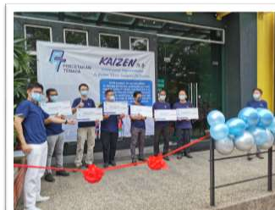
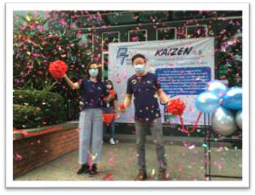
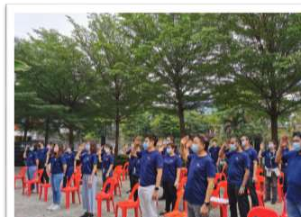
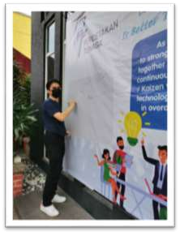
2021 KAIZEN LAUNCHING
Prizes presentation to 2020 Kaizen Winners
Ribbon cutting ceremony of the
2021 Kaizen Launching
Pledge ceremony lead by Operation Manager, Mr Teh
Commitment signature by Managers / HODs

Slide 9





Happy Chinese New Year
ON BEHALF OF THE MANAGEMENT TEAM OF PT, WE WOULD LIKE TO WISH ALL CHINESE EMPLOYEE:
辛 丑 年
May peace and prosperity come to you in the New Year!
Gong Xi Fa Cai!
https://www.print.my/
FEEDBACK TO US
For continuous improvement, please email any comments or suggestions to HR & Admin Dept.
https://www.facebook.com/Percet akanTenagaOfficial/
https://instagram.com/percetakant enagaofficial?igshid=4ygxtik7lgon
serene@pt-group.com.my

