Slide 1
@Home
Befriend your house!

Slide 2
What is @Home?
@Home is a cloud service that allows you to have conversations with your house.
Befriend your house via SMS.
You can request information from your house from various sensors, send commands to actuators and get alerted when someone is in your house or you have a fire!

Slide 3
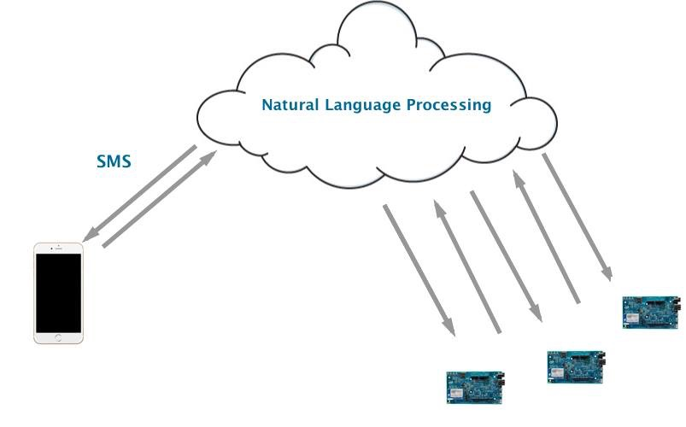
How it works?

Slide 4
Sensors
Temperature
Light
Motion
Camera
LCD Message

Slide 5
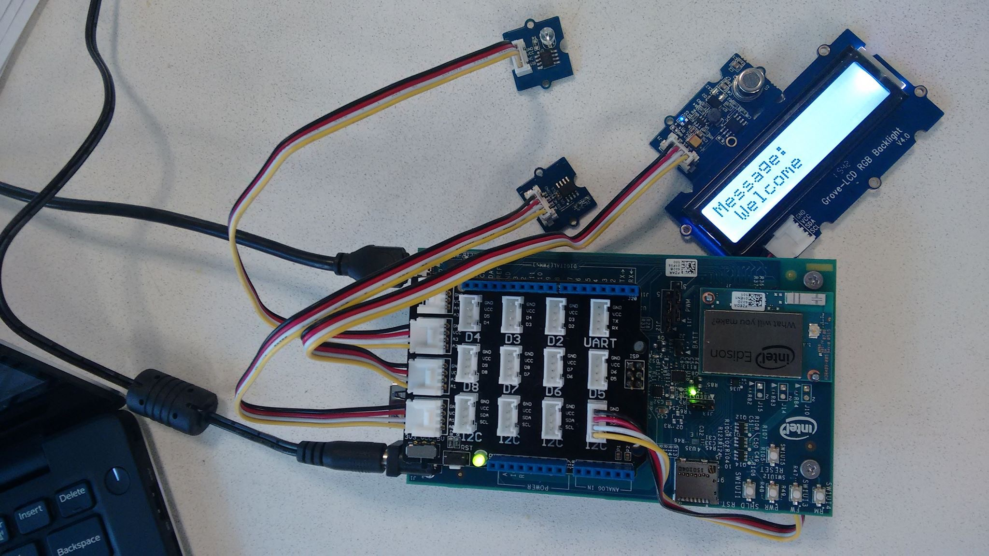
Live Demo

Slide 6
Marketing plan
Families/Home owners
Platform as a service
Customisable by the customer
Monthly fee

