Slide 1
@Home
Smart home system

Slide 2
How it works?
Scenario:
Want to find out what is happening at home when not there, and communicate with family at home.
Solutions:
  Use Grove Starter Kit Plus Intel IoT Edition temperature and light sensors, combined with a PIR motion sensor and Logitech webcam.
  Javascript/NodeJS codes for setting conditions for responses.
  Use Twilio API to receive and send text messages.
  Natural Language Processing codes to understand the context of the questions in the text message.

Slide 3
Main features
Temperature: When a user sends a text message from the phone to ask for the home temperature, the sensor detect the real time temperature and sends back a text with the temperature.
Light: Detects the light level at home, and send a message to tell the user if the light is on or off, and also the light level.
Motion: When a person goes past a motion sensor, a picture is taken from a Logitech webcam, with the image files stored locally. Will aim to send picture to the cloud and send a text message to the phone.
LCD: The LCD display at home can display messages sent from the user's phone, update his latest plans to his family.

Slide 4
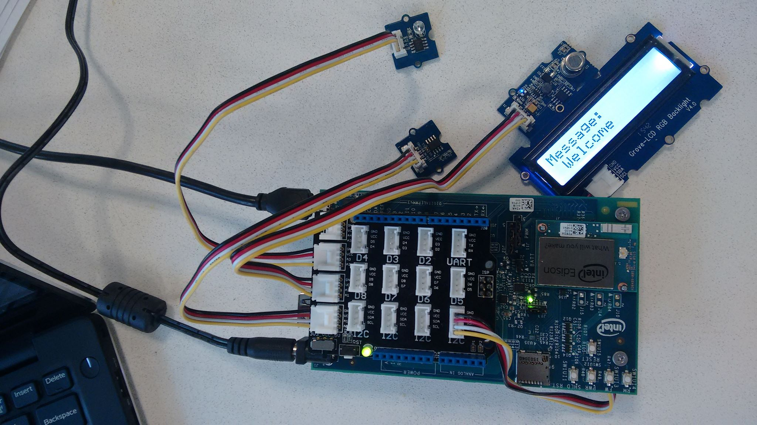
Live Demo

Slide 5
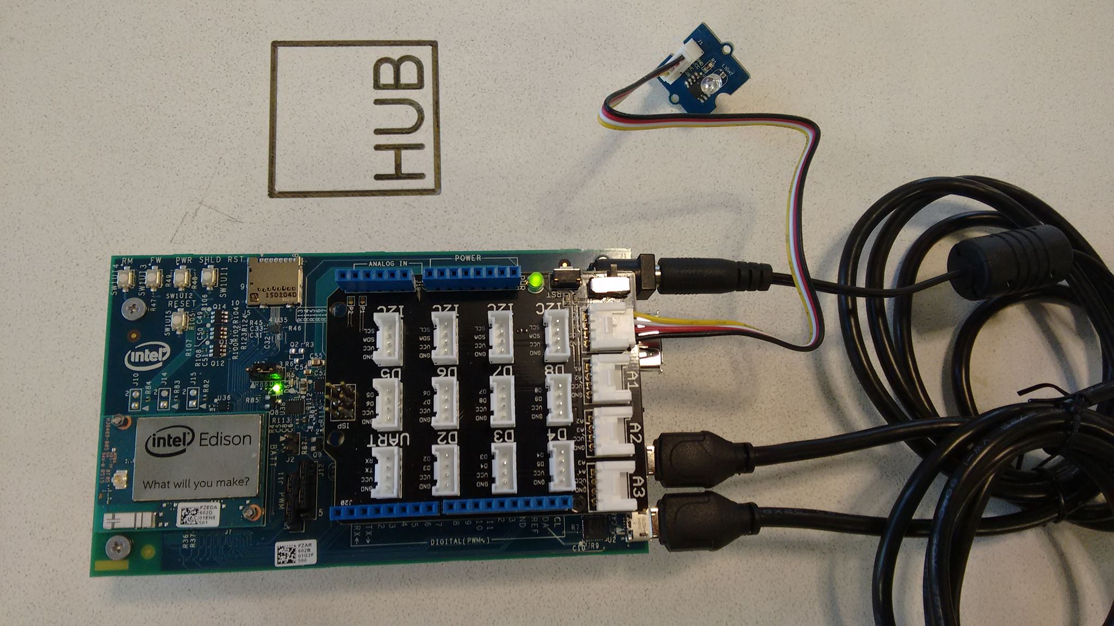
Live Demo

