Slide 1
Into the Tidyverse Session 1a
Course adapted from Tim Hargreaves’

Slide 2
About the course
Prerequisites
Previous programming experience will make learning easier but is not expected at all, this course is designed for complete beginners
Focus of the course:
More focus on immediate gains rather than complete mastery of the tidyverse
Exercises have a more practical focus

Slide 3
What you will learn
Set up R, RStudio, and the tidyverse on your computer
Import a data set from the web and clean it
Wrangle a data set from one form to another
Transform a data set to help answer a question
Visualise a data set using plots and graphs
Communicate data honestly and effectively

Slide 4
Teaching style
Fast and light
Goal is to show you what is available and where to find resources
We will go through some questions and examples but practice is so important when learning to code
You can practice with the homework questions available

Slide 5
Why use R/the tidyverse?
Far more powerful and expandable than Excel or Tableau
Open-source and free to use (unlike SAS or SPSS)
A large and beginner-friendly community
A lot more intuitive than more conventional programming languages (Python, Julia, JavaScript, etc.)

Slide 6
Course Agenda
The course will be ran over…. 10 weeks

Slide 7
What Is R ?

Slide 8
What is R?
Programming language for statistical computing and graphics
Built upon an historic language (S) which was developed in the mid-70s
Known for being highly extensible
Completely free and open-source with a large, friendly community
R is an incredibly powerful tool. It can be used for machine learning, statistical modelling, big data, and much more. It is also capable of producing websites, interactive notebooks, and presentations (such as this one!).

Slide 9
What is RStudio?
Problem: The standard R code editor is difficult to use, missing useful features, and frankly quite ugly
Integrated development environment (IDE) specifically made for programming in R
Contains a rich set of features to allow you to code in R with less hassle
Displays your code and its output in a much clearer way and gives you access to extra features such as help files, code history, and environment variables

Slide 10

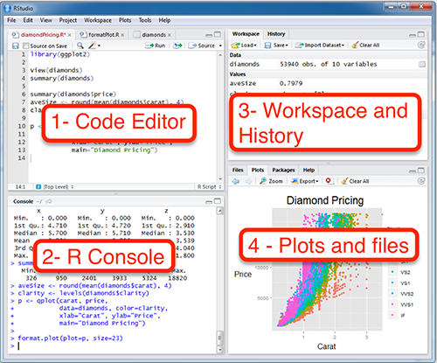
Navigating around RStudio

Slide 11
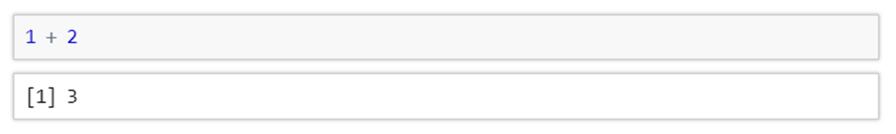
Running R code?
R code can be executed by typing directly into the console and pressing the enter key
For example, you can add together two numbers with
Here the first line shows what I typed into the console and the second shows the output that R gave us
Have a go at writing your own mathematical expressions!
The main operators are -, *, /, and ^. Figure out what these do by trying some simple examples.

Slide 12
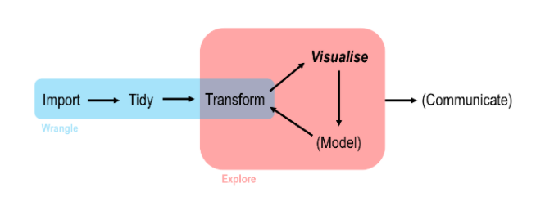
Data Analysis work flow in R

Slide 13
Tidyverse

Slide 14
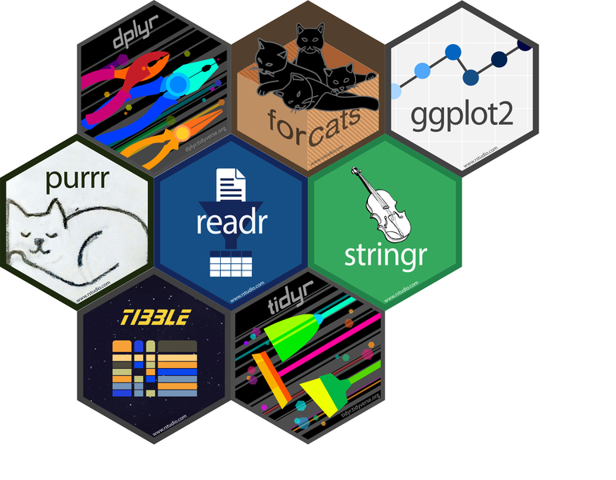
What is the tidyverse?
A package is a collection of functions, data, and documentation which extend the usual capacity of R
The tidyverse is a collection of packages for performing clean and efficient data analysis
For example there are packages for data importing, visualisation, and data manipulation

Slide 15
Installing and using Tidyverse?
The tidyverse can be installed by running the following command in the RStudio console
You only need to install this package once per computer, though running the command multiple times will do no harm
If you then wish to use the tidyverse, you must first run the command
This must be re-run each time you open RStudio

Slide 16
Data visualisation

Slide 17
Data visualisation
In beginning this course by learning how to perform data visualisation, we are taking things slightly out of order
The pay-off for learning data visualisation is very clear however, and so we will start there and return to earlier topics in the future

Slide 18

Ggplot2
ggplot2 is one of the many packages included in the tidyverse
It allows you to easy construct stylish graphs using a coherent and consistent system
A ggplot2 builds plots by adding layers one at a time making it easy to make very sophisticated plots

Slide 19
Datasets

Slide 20
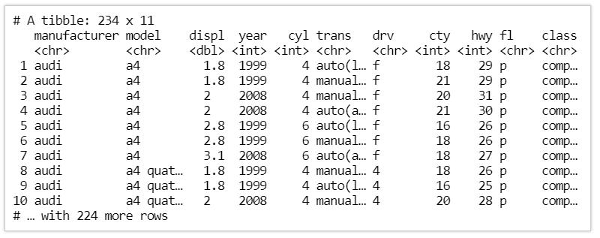
MPG
Built in dataframe
Type mpg into the command window and press enter

Slide 21
MPG
This dataset contains observations collected by the EPA on 38 models of cars
The variables in mpg include:
displ - a car's engine size (in litres)
hwy - a car's fuel efficiency on the highway (in miles per gallon)
We can use this dataset to answer the question “do cars with larger engines use more fuel than cars with smaller engines?”

Slide 22
Visualising with ggplot

Slide 23
First plot
We first start by calling the ggplot() function. This creates an empty graph which we can then add layers to
We pass in the mpg data frame as the data argument so that ggplot2 knows we will be using that for our plot
We then use the + symbol to add a new layer. Specifically we a point geometry using the geom_point() function
We need to tell ggplot2 which variables in the data frame to map to the various aesthetics of the plot. In this case, we just specify the variables mapping to the x and y coordinates

Slide 24
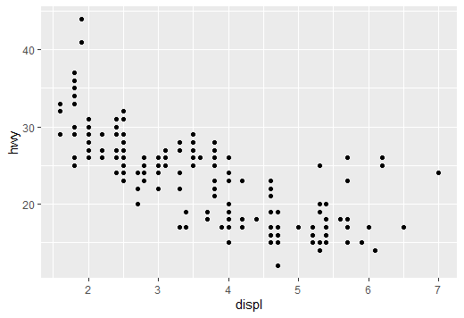
Output

Slide 25
Ggplot general code
In general our code has the format
All we have to do is fill in the blanks
Note, that the indentation and spaces are just to help readability; R doesn't care whether or not these are include though it is advised to do so

Slide 26
Exercises to try
What does the drv variable describe? You may want to use ?mpg to find out
Make a scatter plot of hwy vs cyl
What happens if you make a scatter plot of class vs drv ? Why is the plot not useful?

Slide 27
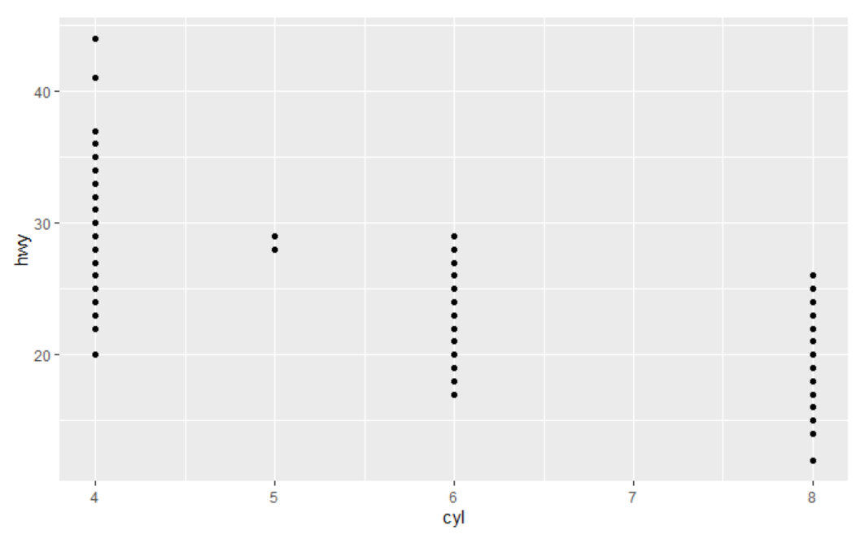

Answers 1)
As the number of cylinders increases high way miles per gallon decreases

Slide 28

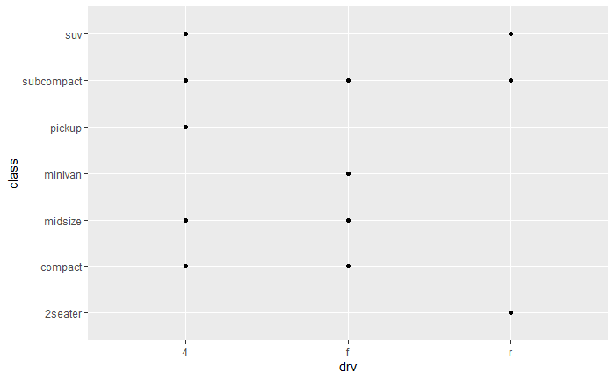
Answers 2)
There are several pairs of drive-type and class which relate to more than one car.
Therefore the points for these cars are plotted one on top of the other so we can’t see how many there are.
This is called over-plotting.

Slide 29
Bonus Questions

Slide 30
Common problems
Every ( is matched with a )
Every " is paired with another “
Sometimes you’ll run the code and nothing happens……
Check the left-hand of your console: if it’s a +, it means that R doesn’t think you’ve typed a complete expression and it’s waiting for you to finish it.
In this case, it’s usually easy to start from scratch again by pressing ESCAPE to abort processing the current command
In ggplot make sure the + sign is at the end of the line not the start
Make Sure ……

Slide 31


Spot the mistake
1)
2)
3)

Slide 32





Answers
1)
2)
3)

Slide 33
Into the Tidyverse Session 1b
Course adapted from Tim Hargreaves’

Slide 34
Handling data frames

Slide 35
Working your way around data frames
An entire data frame can be printed to the console simply by typing it's name
The first few rows of a data frame can be printed using the head() function
A specific number of rows can be printed by specifying the parameter n
tail() works the same as head() but gives you the bottom few rows

Slide 36
Working your way around data frames
The str() function displays the structure of a data frame (column names, data types, etc.)
The summary() function displays a statistical summary of each column of the data frame

Slide 37
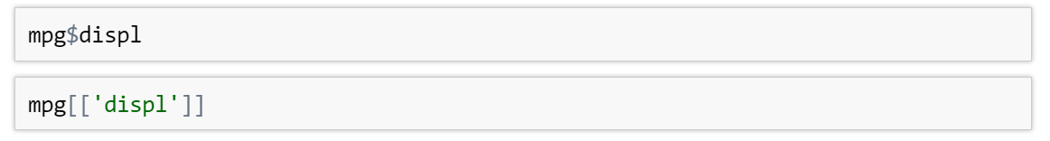
Working your way around data frames
A specific column a data frame can be accessed using either the $ or [[]] accessor
The latter approach is favoured if a column name contains spaces so I would always use SQUARE BRACKETS

Slide 38
Exercises to try
Try and select the bottom 7 rows of the mpg
What are the medians of each of the numeric columns in the mpg dataset. The summary() function might help you here
Access the cyl column of the dataset. Is this variable categorical, discrete, or continuous? Hint use class(<code to select column>)
Integer = discrete data
Character = categorical data
Float = continuous data (decimals )

Slide 39
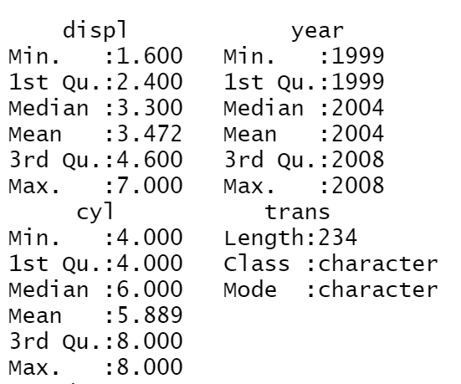
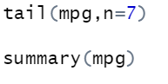

Solutions
1)
2)
3)
Therefore its discrete data !

Slide 40
Adding more features

Slide 41
Back to our first Graph
Looking at our graph, we appear to have a few outliers amongst the cars with large engines.
Perhaps introducing another variable into the plot will help us explain this

Slide 42
Explaining Outliers
Using our template from before all we have to do is add one more mapping to our list
Perhaps a sensible suggestion would be to colour the data points by the type of car (SUV, compact, pick-up, etc.)
This information is contained in the class column

Slide 43
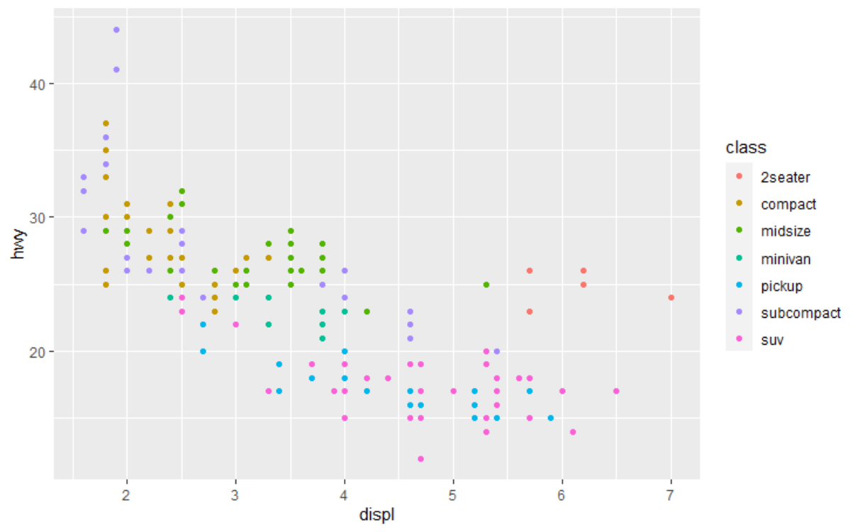
Explaining Outliers
To add colour to our plot, we simply add a new mapping to the code we had before
It appears that the anomalous points correspond to 2-seater sports cars

Slide 44
More Aesthetics

Slide 45
More Aesthetics
The point geometry can accept a wide range of aesthetics including:
size - the size of each point
alpha - the transparency of each point
shape - the shape of the plotting character for each point
Depending on what type of data you are using (continuous, discrete, categorical, etc.) certain mappings will be more appropriate

Slide 46
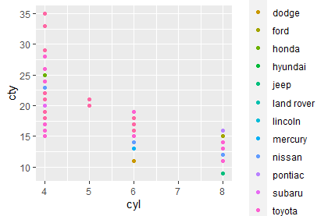
Exercises to try
Recreate the following graph with cyl on the x axis and cty on the y and colour by manufacturer
Execute the following code bellow what do you think will happen by putting colour = ‘orange’ outside of the aes() ?
ggplot(data= mpg) +
geom_point(mapping = aes(x = cyl, y = cty), colour = 'orange')

Slide 47
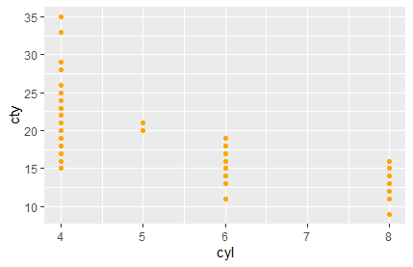
Answers:
1)
By mapping outside of the aes() function , it will manually set all points to orange giving us control over our visualisations
2)

Slide 48
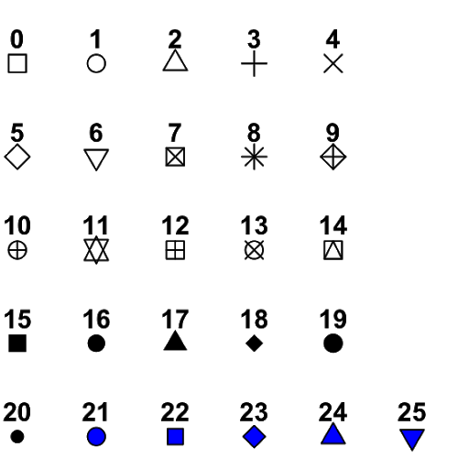



Variables to choose when manually setting Aesthetics
The name of a colour should be a character string or a colour code (e.g. '#467A9F’ )
The size of a point should be a number (in mm)
The shape of a point should be an integer chosen from the figure across

Slide 49
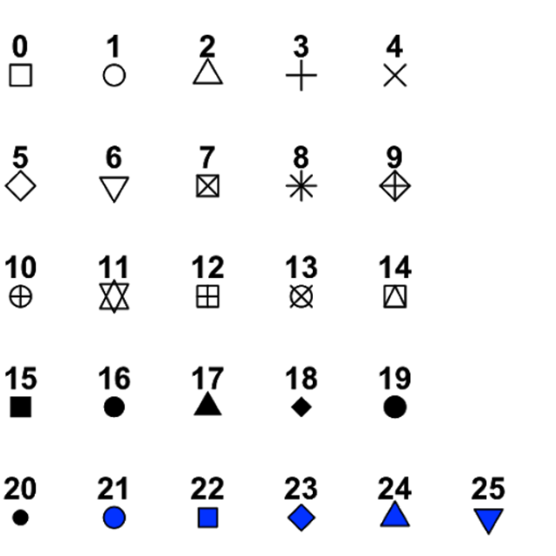
Exercises to try
Remake the scatter plot displ vs hwy plot using the mpg data set but make all of the points hollow diamonds using shape = 5

Slide 50
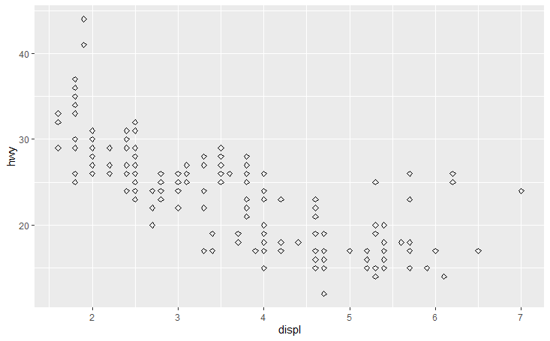
Answers:
1)

Slide 51
Facets

Slide 52
What are facets?
Aesthetics offer one method of adding additional variables to a plot
Another way, particularly when using categorical variables, is to split a plot into facets
Facets are sub-plots that each show a subset of the entire dataset
Facets can be generated in two ways using either the facet_wrap() or facet_grid() function

Slide 53
facet_wrap()
facet_wrap() is used to facet a plot by a single variable
The first argument of facet_wrap() should be a formula
A formula is created using the ~ symbol followed by a variable name
An example formula would be ~ class which you read as “by class”
The variable using in the formula should be discrete or categorical
You can control the layout of the facets using the nrow or ncol parameters

Slide 54

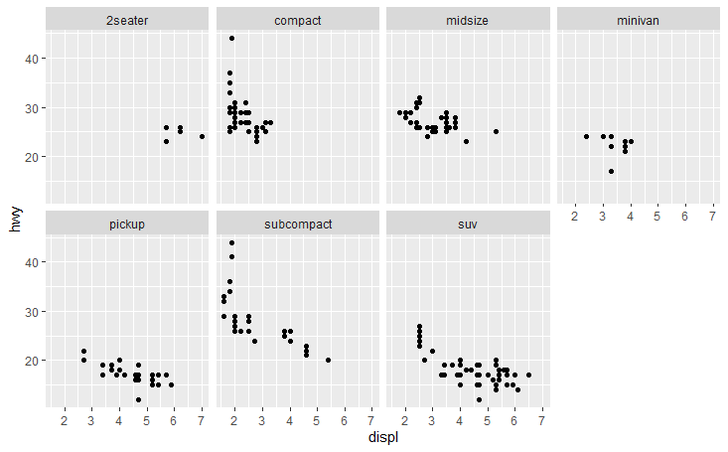
Using facet_wrap()

Slide 55
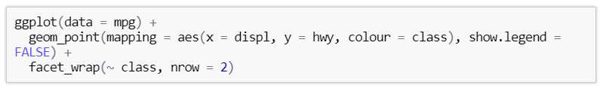
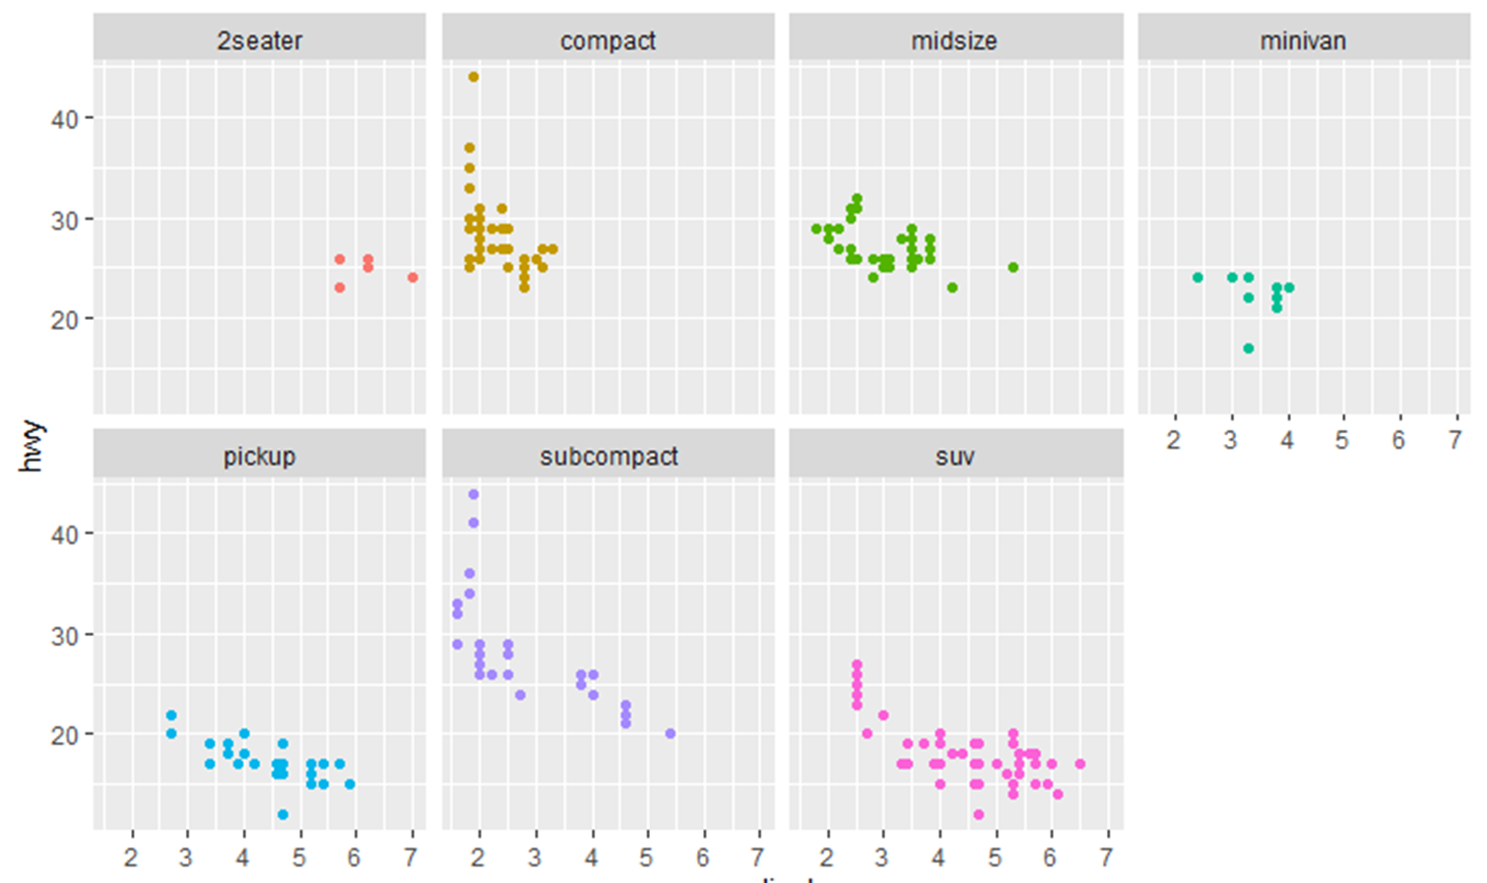
facet_wrap() and aesthetics
Facets can be combined with aesthetics
A common application of this is adding colour
In this case it is often worth specifying show.legend = FALSE in the geometry layer

Slide 56
facet_grid
facet_grid() is often used for faceting on a combination of two variables
As with facet_wrap(), the first argument of facet_grid() is also a formula
This time however the formula should contain two variable names separated by a ~
The first variable will be used to facet the rows and the second, the columns

Slide 57

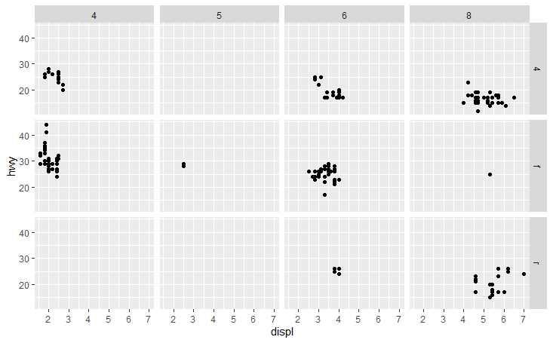
Using facet_grid

Slide 58
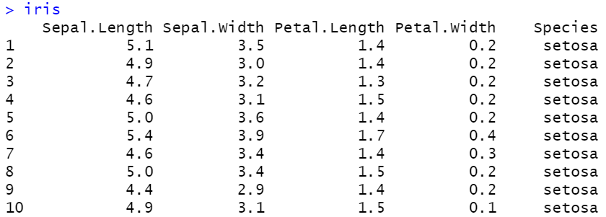
Iris Dataset
Note: Capitals and full stops in the column are really important make sure you use them when selecting the columns

Slide 59
Exercises to try
Template to follow:
ggplot(data= <insert dataframe name>) +
geom_point(mapping = aes(x=<insert col name>, y=<insert col name>, colour= <insert col name>),show.lengend=FALSE))+
facet_wrap(~ <insert col name>, nrow=<insert num of rows>)
Create a scatter plot of Petal.length vs Petal.width using the iris dataset and facet by Species
Repeat the above plot whilst also colouring the Species. Don’t forget to hide the colour legend

Slide 60
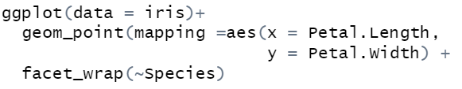
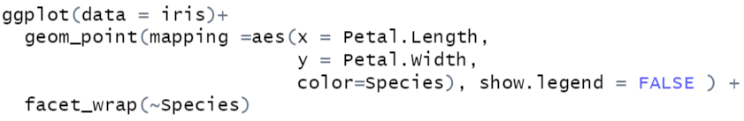
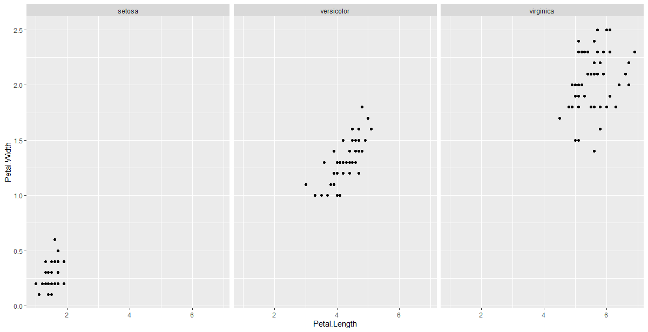
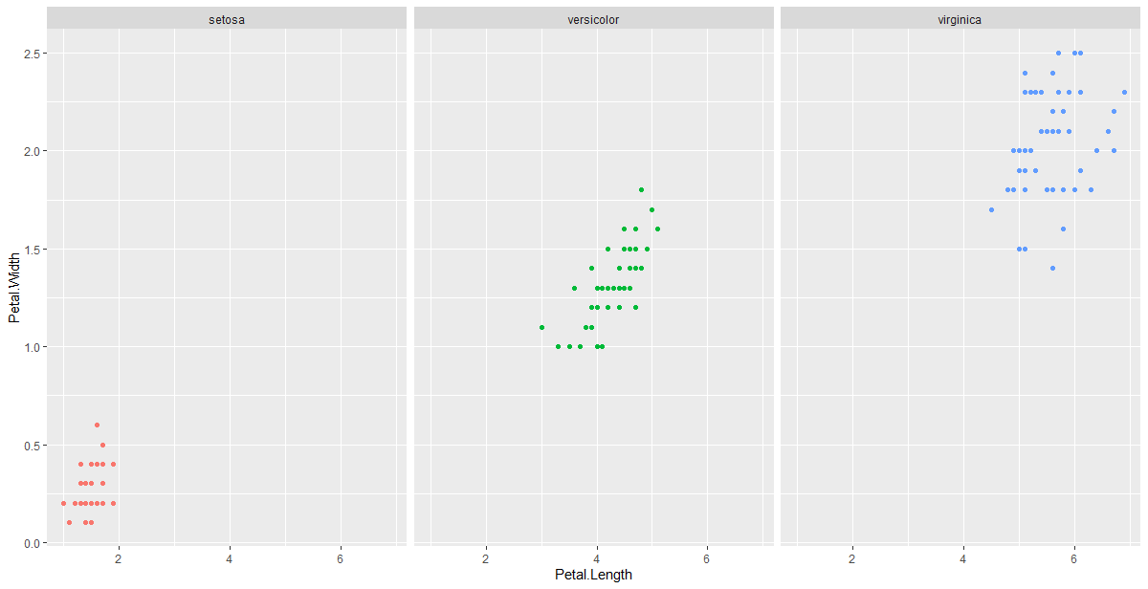
Answers:

Slide 61
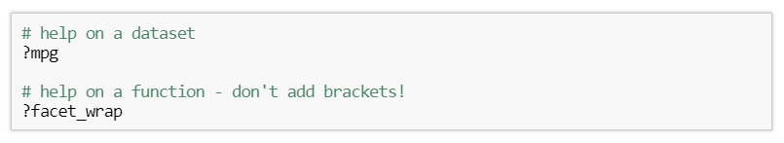
Help in R
The R language contains well-written and lengthy help documents
You can access these using the ? symbol

Slide 62
Bonus Questions

Slide 63
Exercises
Using the iris dataset create a scatter plot of Sepal.Length Sepal.Width
shape by Species
Set the all the transparencies using alpha = 0.5
Why should we reference alpha outside of our aes() ?

Slide 64
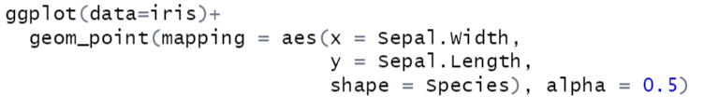
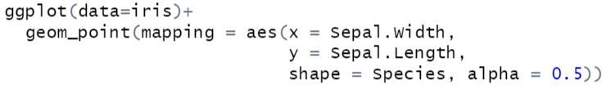
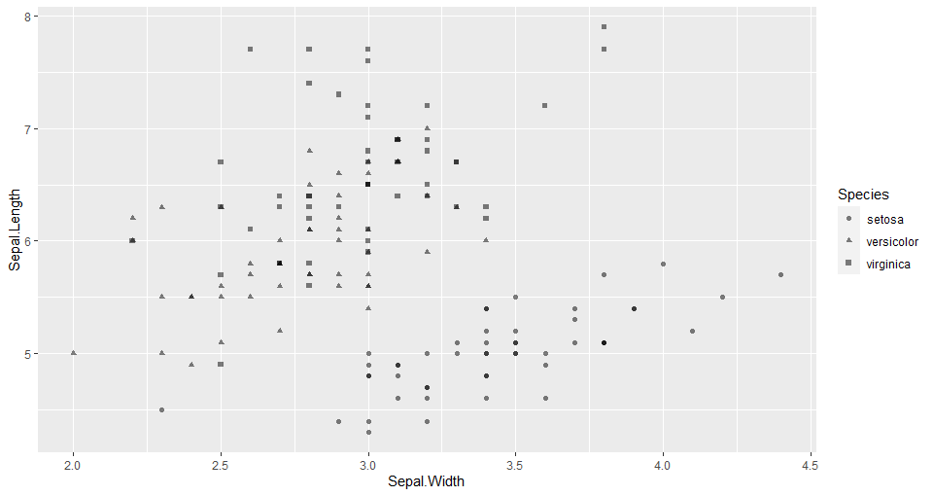
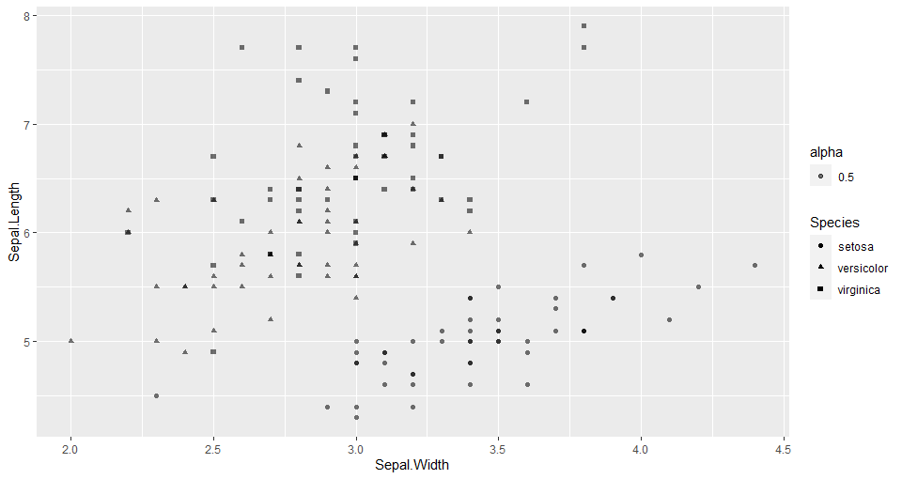
Answers 1)

Slide 65
Access to more questions
Homework sheets which can be found on github at this link :
https://www.r-exercises.com/ - specific topic questions
https://www.w3resource.com/

Slide 66
Next Time ….
Calculations in R
Assigning objects
Importing datasets
See you then !

