Slide 1
Into the Tidyverse Session 3a
Course written by Tim Hargreaves

Slide 2
Statistics in R

Slide 3
R for Statistics:
Statistics is R's speciality
Despite this we've barely even used this functionality
A statistic is a function of data points
Examples include mean, median, maximum, etc.

Slide 4
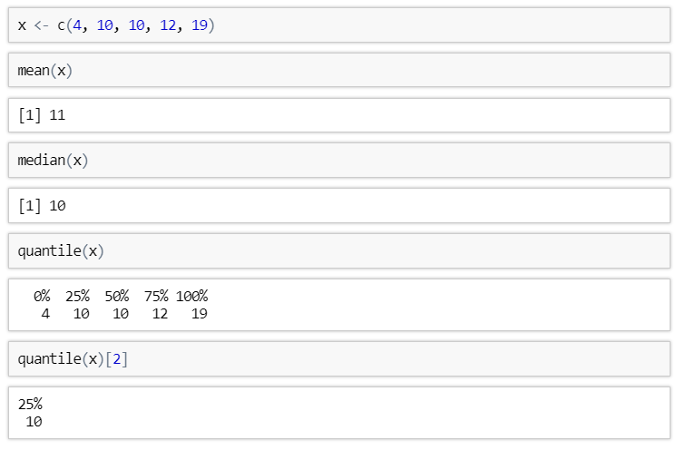
Measures of Location

Slide 5
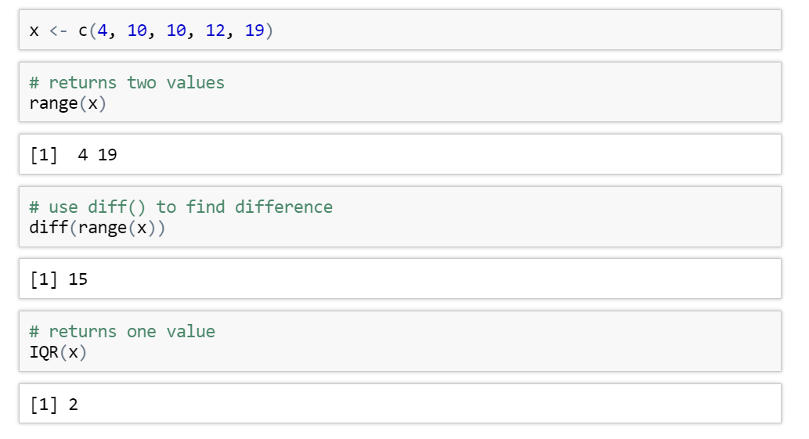
Measures of Spread

Slide 6
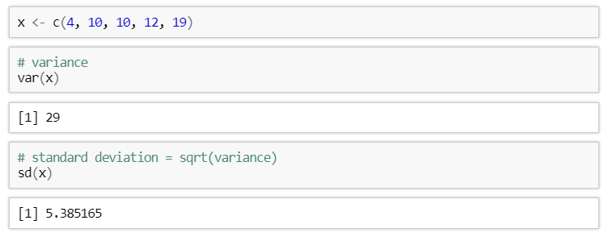
Measures of Spread

Slide 7
Exercises to try
dataframe_name$column_name
or
dataframe_name[[‘column_name’]]
Create an object called x extract the displ column from the mpg dataset
What is the mean and median of x?
Find the range of x
Find the upper(75%)and lower(25%) quantile of x
What is the variance and standard deviation of x?

Slide 8
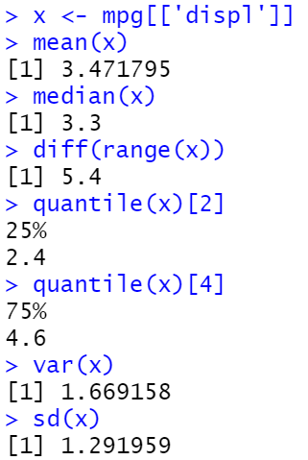
Answers

Slide 9
Careful of missing values

Slide 10
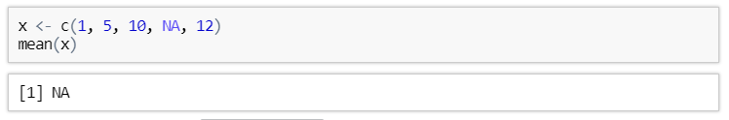
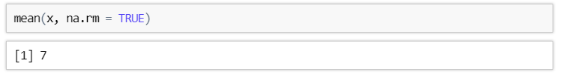
Handling a missing value
If a vector containing a missing value (NA) has a statistical transformation applied to it then the result will always be NA
This can be avoid by setting na.rm = TRUE

Slide 11
Exercises to try
What do you think the result of 5 + NA will be? Try it and see if you were correct
Replace + with some other arithmetic operators. Is the result always the same?
Calculate the median of the vector c(2, 6, 3, 4, NA), ignoring missing values

Slide 12
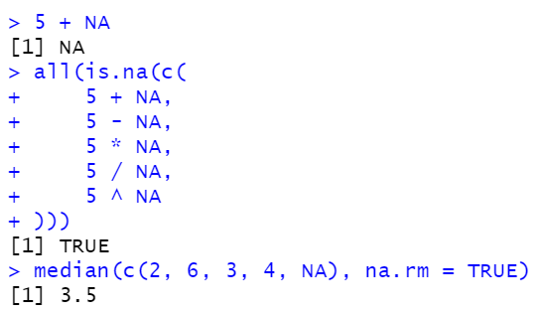
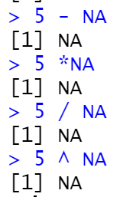
Answers

Slide 13
Making comparisons

Slide 14
comparisons
It is very useful to be able to compare two values and ask how they relate - Is one larger than the other? Are they the same value?
We can go even further by adding more then 1 comparison parameter together
This can be done with ‘Boolean operators’ and or

Slide 15
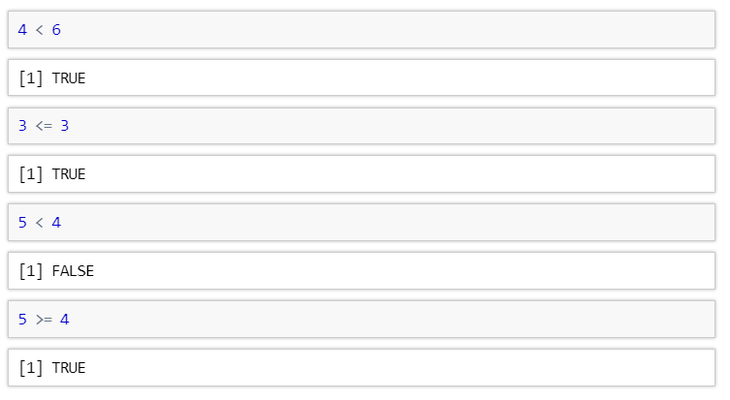
Ordering Comparisons

Slide 16
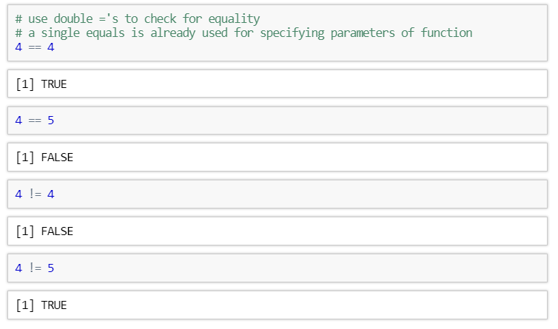
Equality Comparisons

Slide 17
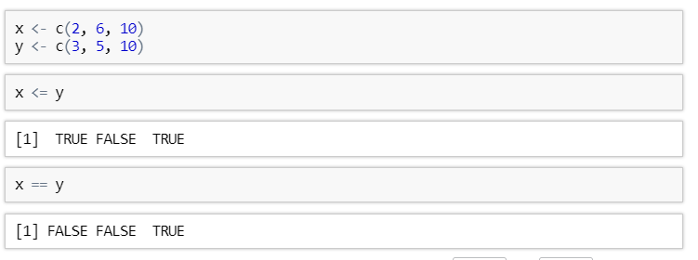
Comparisons on Vectors
All comparisons in R are vectorised.
This means that they act element-wise on vectors

Slide 18


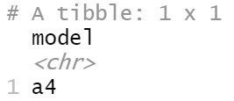
Selecting specific rows and columns of a data frame
dataframe_name[row number, column number]
When column number = blank every column is selected
Selects the first row from the 2nd column
Selects the data from the 10th row from every column

Slide 19

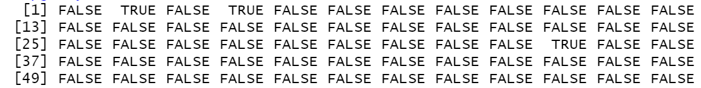

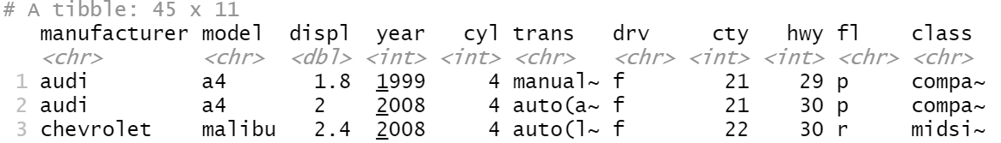



Comparisons on data frames
dataframe_name$column_name (>,<,==) value
We can make comparisons on a data frame to
select certain rows of the datafame
We can use this vector to tell r to filter out rows with FALSE values keep rows with TRUE values :

Slide 20
Comparisons on data frames general notation
Data frame name
Column name
Value
Comma !!!!
Data frame name
Operator : > , < , == , !=

Slide 21
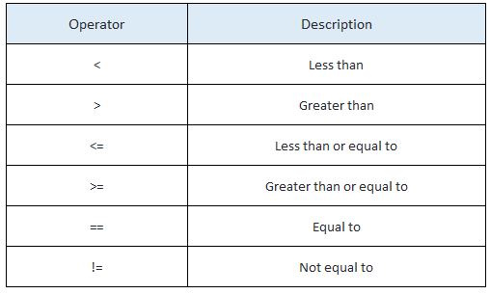
Exercises to try
Take the mpg dataset for these exercises
Filter values in the dataset by cyl column that are equal to 6
Filter values in the dataset by displ values that are greater than or equal to 3
Bonus: is the mean of cty column greater then the median of the cty column
dataframe_name[dataframe$column (> < ==) value, ]

Slide 22


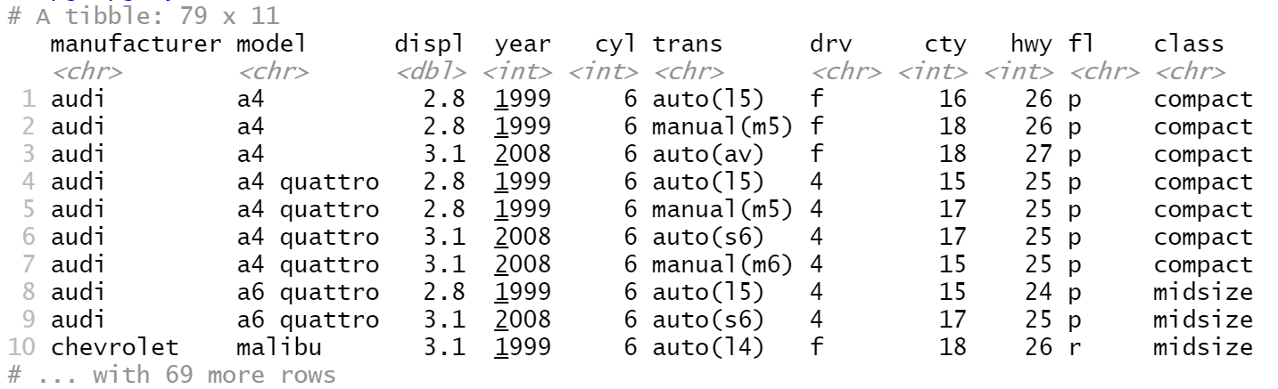
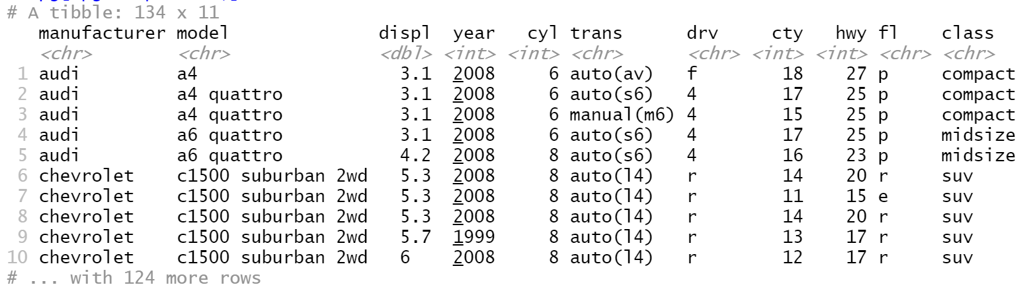

Answers
1)
2)
3)

Slide 23
Boolean Operators

Slide 24
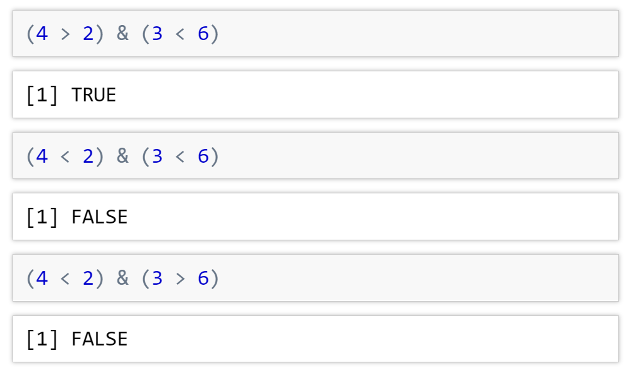






Boolean Operator and
The and operator (&) will return a true or false value
If both comparisons are true, the & statement will return true
If one or both of the comparisons are false, the & statement will return false

Slide 25
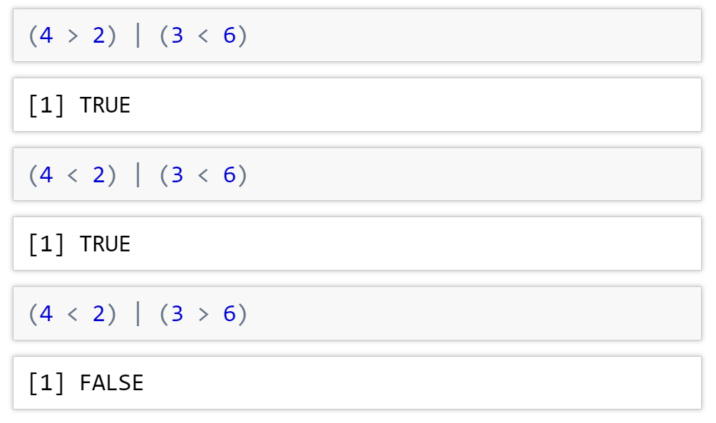
Boolean Operator or
The or operator (|) will return a true or false value
If one or both of the comparisons are true, the | statement will return true
If both of the comparisons are false, the | statement will return false

Slide 26
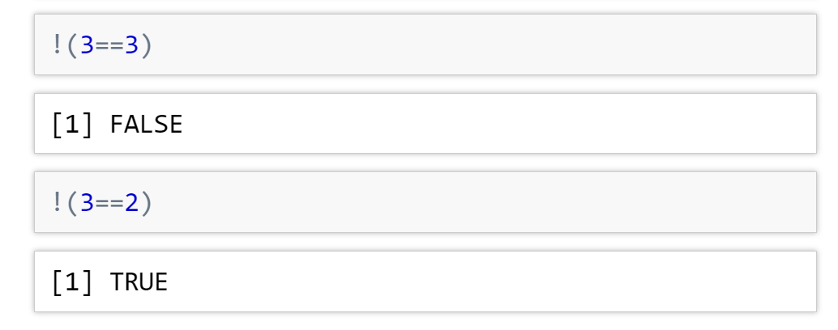


Boolean Operator not
The not operator (!) will return a true or false value
It asks R if the comparison is not true
If the comparison is true the ! Statement will return false
If the comparison is false the ! Statement will return true

Slide 27
Exercises to try
Predict what answers you will get from the following R statements:
((4 > 3) & (7 == 6)) | (5 <= 8)
((9 >= 6) | (4 != 6)) & (5 <= 8)
!(5==3) & (4 != 6)

Slide 28
Answers
FALSE
TRUE
((4 > 3) & (7 == 6)) | (5 <= 8)
((9 >= 6) | (4 != 6)) & (5 <= 8)
!(5==3) & (4 != 6)
= TRUE
= TRUE
= TRUE
TRUE
TRUE

Slide 29
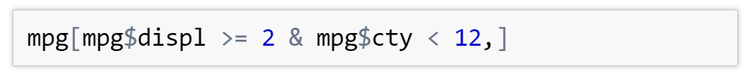
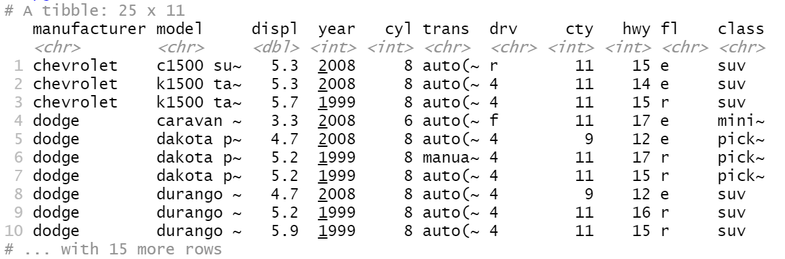

Boolean Operator to select rows of data frames
We can combine comparisons with a Boolean operator to select certain rows in a data frame
All rows selected have a engine displacement of greater then or equal to 2 and a city milage less then 12

Slide 30
Exercises to try
dataframe[dataframe$column >,==,> value &,| dataframe$column >,==,> value,]
Filter rows in the dataset that have a cyl value equal to 6 or have an hwy value less than or equal to 15
Filter rows in the dataset that have a displ value less then 2 and have an cyl value not equal to 6

Slide 31
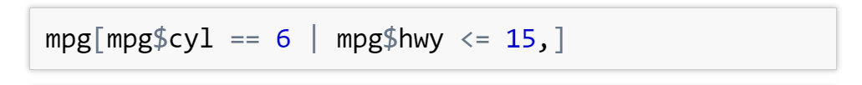
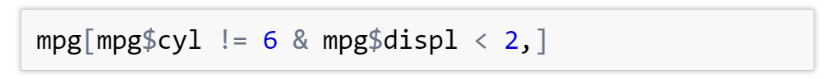
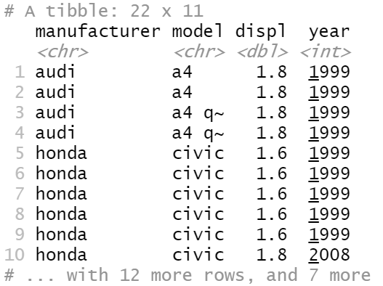
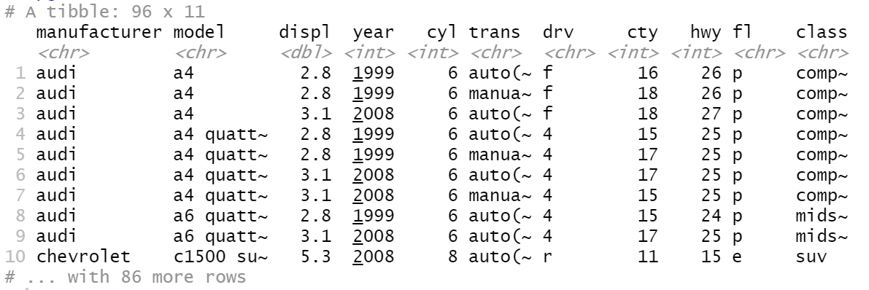
Answers

Slide 32
Bonus Questions

Slide 33
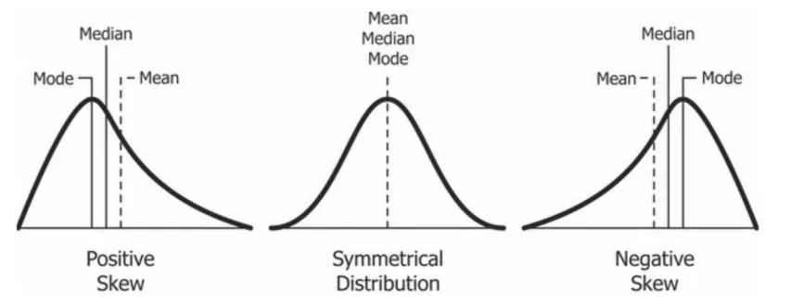
Testing if the data is skewed
Skew:
The relative position of the mean and median.
At 0, mean = median, and the data is normally distributed.
Kurtosis
The size of the tails in a distribution.
In R, values much different from 0 are non-normally distributed.

Slide 34
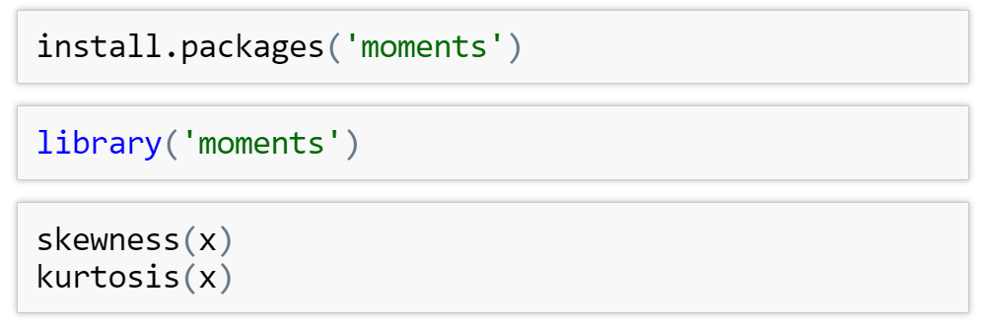
Skewness, Kurtosis and histogram distributions
These packages aren’t in our base R or tidyverse package we need to use ‘moments’

Slide 35
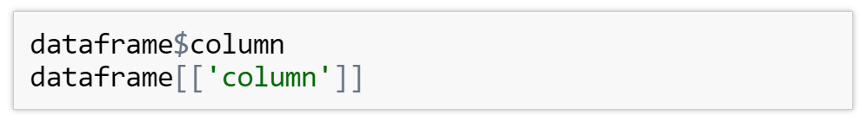
Exercises
Using the iris data select the column Sepal.Length and test its skewness() and kurtosis()
To select a column remember to use either

Slide 36
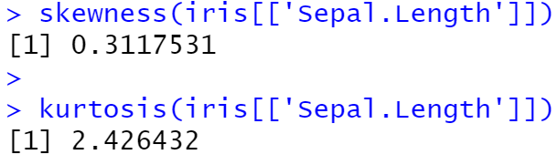
Answers

Slide 37
Value Meanings
Skewness:
A zero means no skewness at all (normal distribution).
A negative value means the distribution is negatively skewed.
A positive value means the distribution is positively skewed.
Kurtosis:
A kurtosis greater than 0 means that the distribution has a high peak with skinny tails.
A kurtosis less than 0 means that the distribution has a low peak and heavy tails.

Slide 38
Next Time ….
Manipulating Dataframes:
Mutating
Filtering
Selecting
Summarising
Arranging
See you then !

Slide 39
Into the Tidyverse Session 3b
Course written by Tim Hargreaves

Slide 40
Transforming Data
Taking a dataset, transforming it into a form that meets our needs, and using it to answer questions

Slide 41
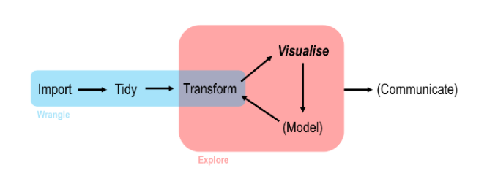
Data Analysis work flow in R

Slide 42

Dplyr
dplyr is the third tidyverse package that we will be looking at
It has five main features, referred to as the dplyr verbs
These allow you to filter a dataset or transform it by creating new variables/summaries
You can also use these to reorder your observations to make a dataset easier to work with

Slide 43
The dplyr Verbs
There are five key dplyr functions referred to as verbs.
These alone allow you to handle the majority of data manipulation tasks
They are:
filter() - pick observations by their values
arrange() – sort the dataframe by a particular column
select() - pick columns by their names
mutate() - create new column from existing columns
summarise() - collapse many values down to a single summary stat/count

Slide 44
Filtering

Slide 45
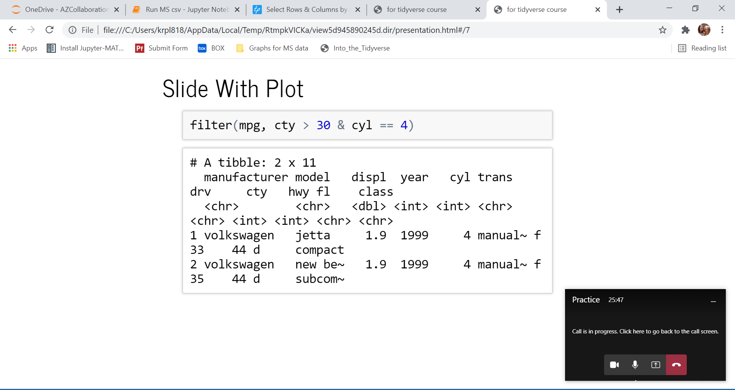
Filter Rows
Warning: Don't confuse == with = else you'll get an error
filter(dataframe, column (>,<,==,!=) value)

Slide 46
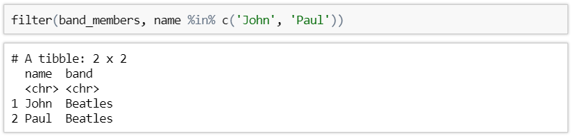
Filter using %in%
Another useful operator is %in% which checks if a value is in a column
filter(dataframe , column %in% vector )

Slide 47
Exercises to try
filter(dataframe , column (>,<,==,!=) value)
Filter the mpg dataset by manufacturer == ‘jeep’ and find out how many cars jeep makes ?
Hint use nrow() around the filter function to deduce the number of rows
Are there any flowers in the iris dataset with petals that are wider than they are long? (use columns Petal.Length and Petal.Width)
Filter the mpg dataset by manufacturers column selecting rows with either audi or volkswagen using the %in% method
filter(dataframe , column %in% c(“name_1”, “name_2”))

Slide 48
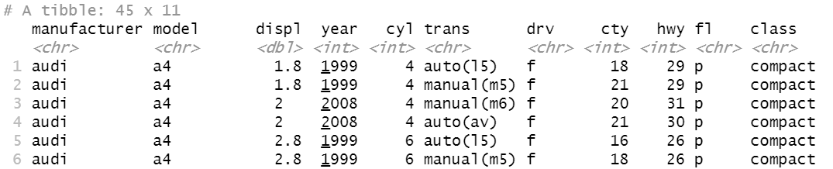
Answers
1)
2)
3)

Slide 49
Arranging

Slide 50
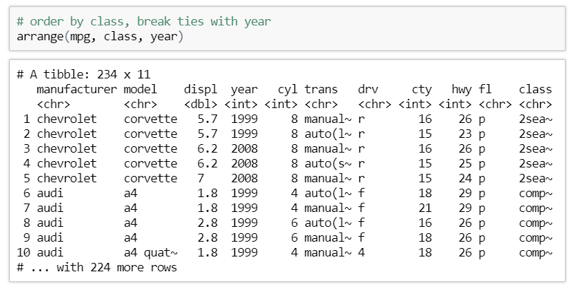
Arrange Rows
arrange() orders observations by one or more variables in ascending order
The observations are ordered by the first column, then ties are settled by the second, etc
Missing Values are sorted at
the end

Slide 51
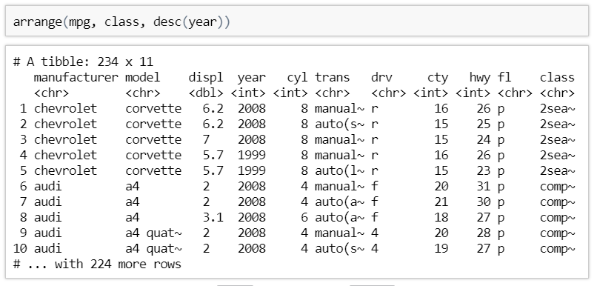
Descending Order
You can wrap a variable in desc() to use descending order for that column

Slide 52
Exercises to try
Using arrange(), arrange the mpg dataset by cty in descending order. What is the car with the best city millage (Bonus : What about the worst?)
Order the iris dataset by the product of the Petal.Length and Petal.Width by using this template:
Sorts in descending order
arrange(dataframe, desc(column))
Sorts by the product of 2 columns
arrange(dataframe, column1 *column2)

Slide 53
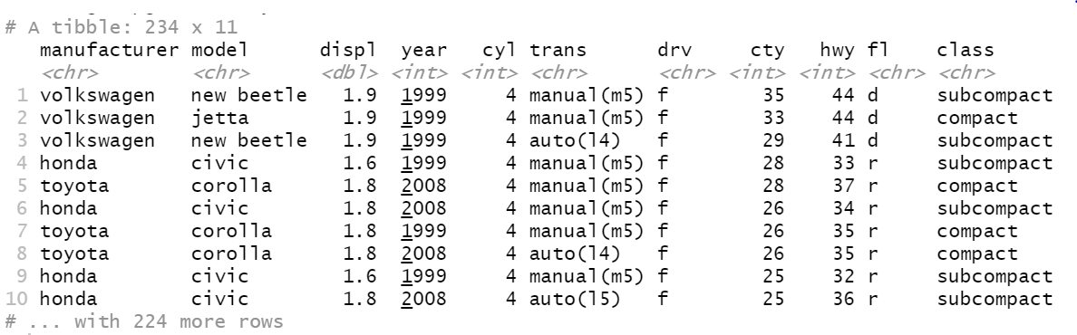

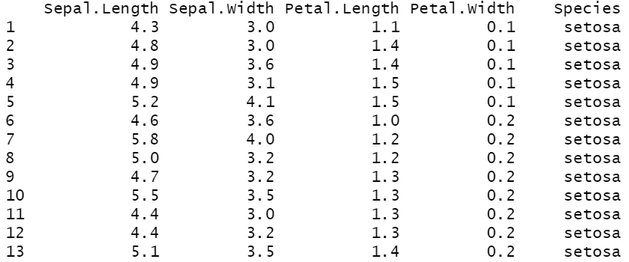
Answers
1)
2)

Slide 54
Selecting

Slide 55
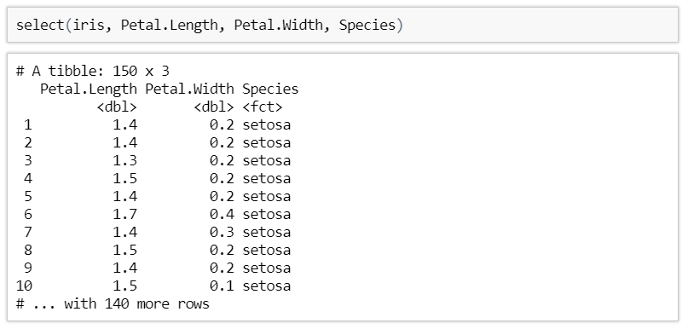
Select
It is not unusual to get be given a dataset with hundreds or even thousands of columns
In this case, you may want to narrow this down to variables you actually care about

Slide 56
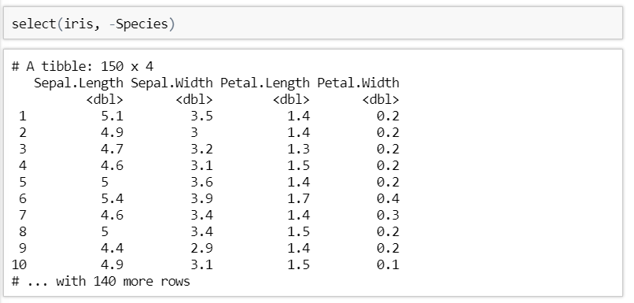
Dropping Columns
You can get rid of columns by prefixing their name with a - symbol

Slide 57
Helper functions
There are a number of helper functions you can use within select():
starts_with('abc’) –selects columns that start with ‘abc’
ends_with('xyz’) –selects columns that end with ‘xyz’

Slide 58
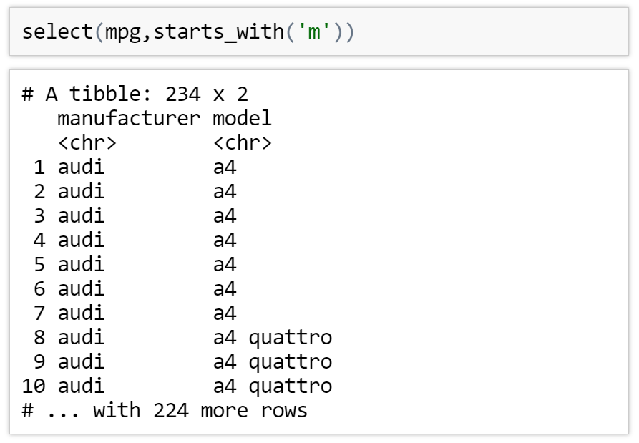
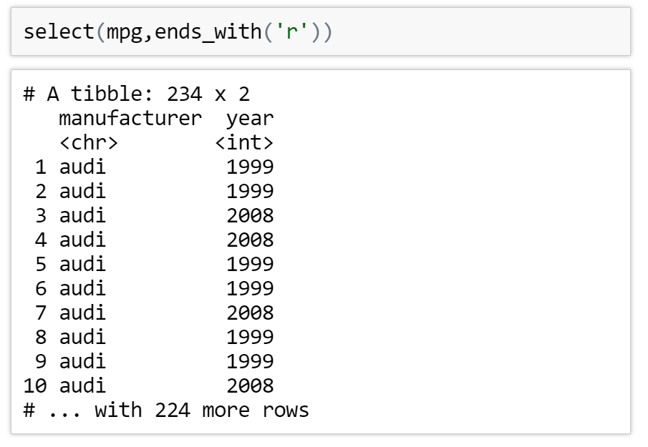
Helper function examples

Slide 59
Exercise to try
Select every column in the mpg dataset except model
select(dataframe, - column)

Slide 60

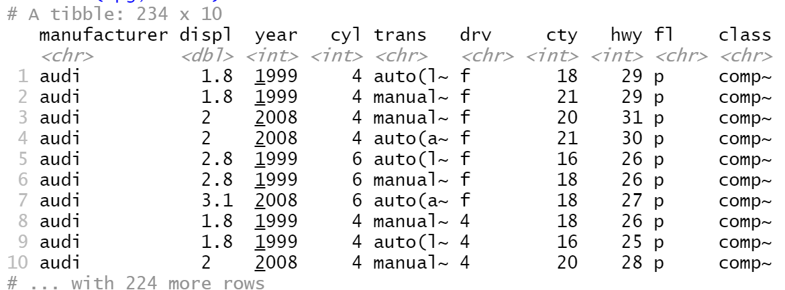

Slide 61
Mutating dataframes

Slide 62
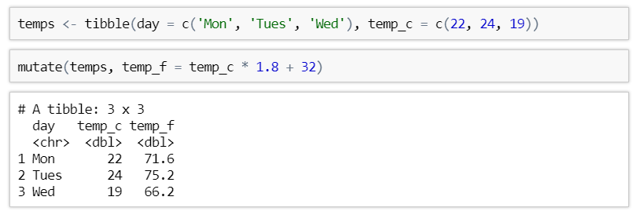
Adding new columns based on existing
mutate() lets you transform one or more variables currently in your dataset to create a new one
The new column is added at the end of the dataset

Slide 63
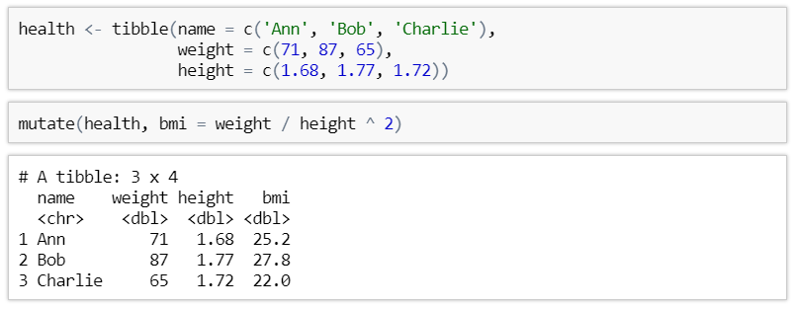
Mutate with multiple variables
You can use multiple variables to create a new column

Slide 64
Exercises to try
mutate(dataframe, new_column = old column (whatever function) )
Create a object called new_mpg assign it to the following task:
Using the mpg dataset, create a new column from the cty column called cty_km which measures the city mileage in kilometres instead of miles (Hint: 1 mile ~ 1.6 km)

Slide 65
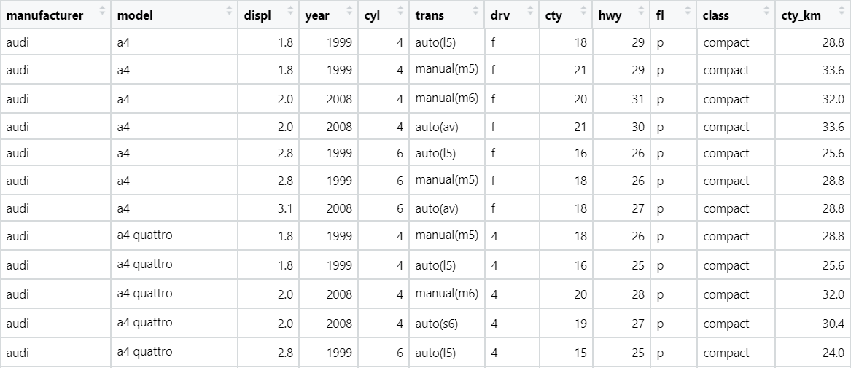
Answers

Slide 66
Summarising

Slide 67
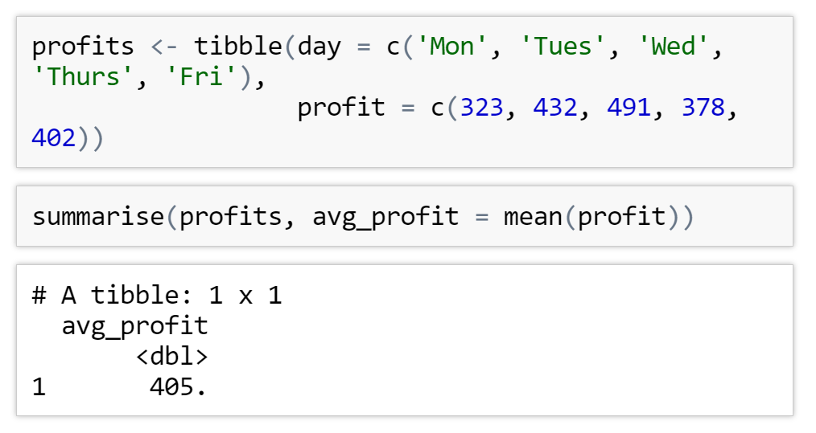
Summarize Function
summarise()allows you to collapse a data frame to a single row based on an mathematical functions
Functions to use e.g:
mean(column_name)
median(column_name)
n()
……………

Slide 68
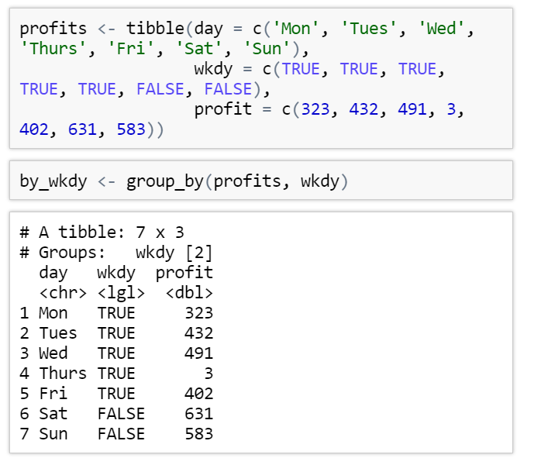
Group by Function
summarise() by itself is not very useful.
We could have done this with mean(profits$profit)
The real power comes when it is combined with the group_by() function

Slide 69
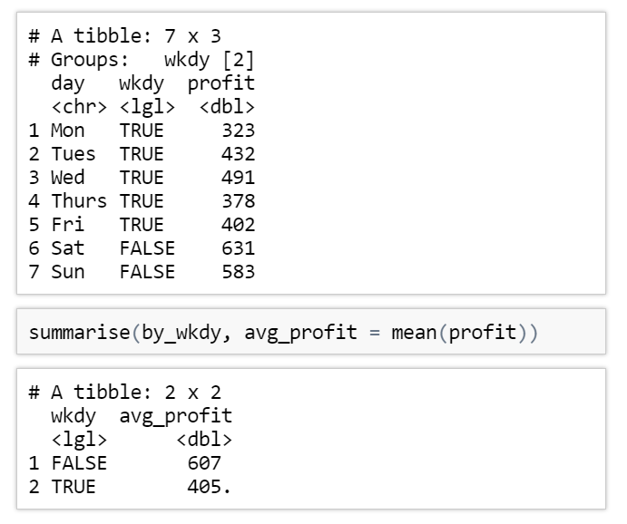
Group and Summarize
group_by takes values from the selected column and creates groups for every unique value in the column :
In this case our two groups are TRUE and FALSE
Then when summarise is used on the new grouped by table a mean will be created for each group in our case 1 for all rows with wkdy values of TRUE and 1 for wkdy values of FALSE

Slide 70
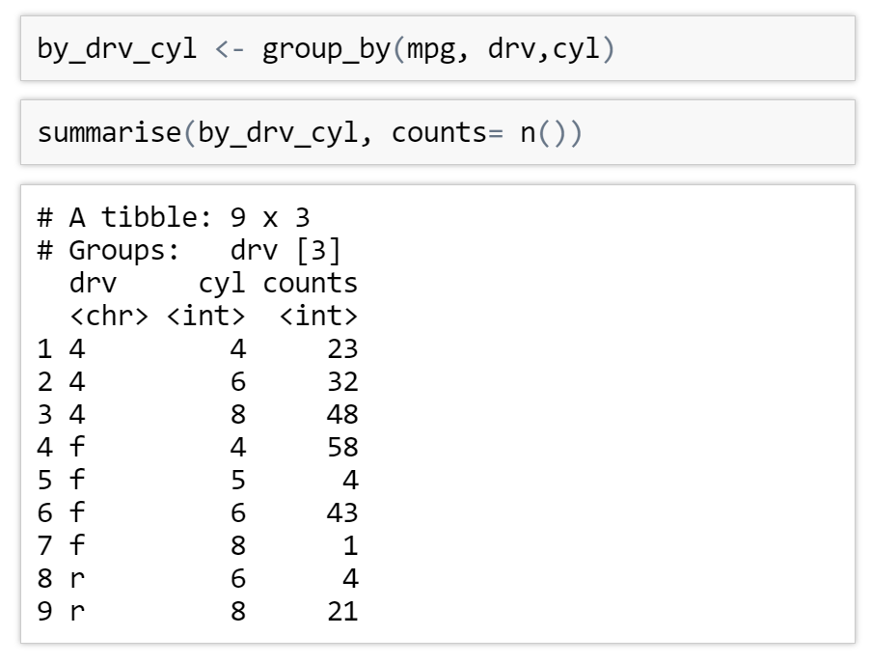
Multiple Summaries
You can group by multiple variables before summarising
n() just counts the number of rows in each group nothing needs to be put in the brackets

Slide 71

General Notation
Data frame name
Column name/s
Column to apply function to
Grouped data frame name
Mathematical function
New column name

Slide 72
Exercises to try
How many cars are there of each class in the mpg dataset? Group by class and then use the n()function to count
Group the mpg dataset by drv then summarise and create a new column mean_cty setting it equal to the mean(cty)
grouped_dataframe <- group_by(dataframe, column)
summarise(grouped_dataframe , ‘summary_column’ = n())
grouped_dataframe <- group_by(dataframe, column)
summarise(grouped_dataframe , ‘summary_column’ = mean(column))

Slide 73

Answers
1)
2)

Slide 74
Bonus Questions

Slide 75

Dpylr Piping
dpylr comes with an amazing tool called the pipe - %>%
This allows you to pass the output of one function into the first argument of the next
Using this, the previous code can by rewritten as
Essentially, you only need to mention a single data frame at the start and never need to create temporary objects

Slide 76
Exercises
Modify the last question we answered but use piping instead
How many cars are there of each class in the mpg dataset? Group by class and then use the n() function to count

Slide 77


Answers

Slide 78
Next Time ….
Tidying up our datasets:
What is a ‘tidy’ dataset
Gathering
Spreading
See you then !

