Slide 1
Into the Tidyverse Session 2a
Course written by Tim Hardgreeves

Slide 2
Calculations

Slide 3
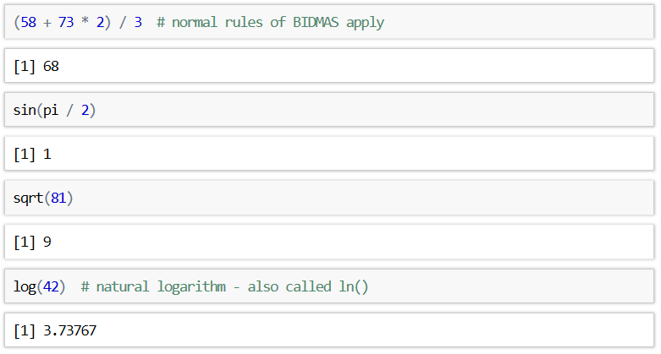
R as a calculator
We have already seen that R can be used as a basic calculator
This functionality extends beyond basic arithmetic

Slide 4
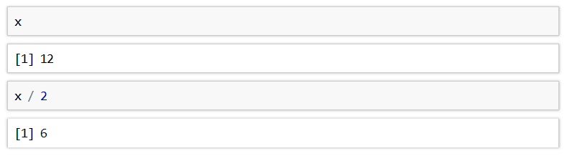
Objects
R is capable of storing any value in an object (also called variables)
Objects are simply a way of labelling a piece of data for later use
In R, objects are assigned using the <- operator
Once an object has been assigned a value, it can be referenced by using its name

Slide 5
Objects
All R statements where you create objects have the form
An object will retain its value until one of the following occur:
You close RStudio
You delete the object manually
You overwrite its value with another
You can see a list of all objects in the 'Environment' pane in RStudio
If you are getting tired of tying <- you can use the keyboard shortcut alt-minus in RStudio to insert

Slide 6
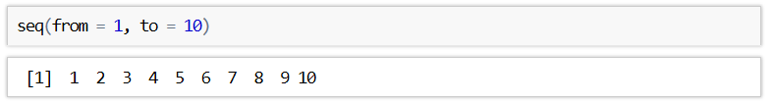
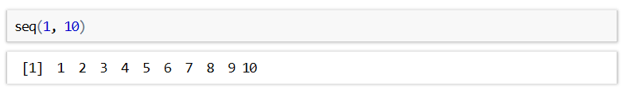
Functions
R has a large collection of built-in functions that are called like this:
An example of such a function is seq() which makes a regular sequence of numbers
For many functions, it is unnecessary to name the arguments as there is an obvious order that they should be entered in

Slide 7
Exercises to try
Create a sequence using the seq() function starting at 0 and ending at 100 assigning the output to an object called integers
Create a new vector called squares which contains the square of every value in integers……..You might want to use the ^ operator.
Create a new sequence called x containing 1000 numbers spaced uniformly between -6 and 6. You can do this by adding the length.out parameter to seq() and setting it to 1000 (this parameter must be specified by name, inside of the brackets)

Slide 8



Answers

Slide 9
Side note

Slide 10
Re-running code
When typing in the console, you can use the up and down arrow keys to jump between previously entered lines of code
This is especially helpful if you made a mistake in a line of code and which to correct it before re-running
You can see your full code history in the 'History' pane in RStudio

Slide 11
Common problems
If the symbol at the start of the R console changes from > to + then it means that R is expecting more input.
If you can't find how to make R happy, you can press the ESC key to exit the current statement and start afresh.
If you receive an object not found error then it is most likely that you've made a typo or have forgotten to assign a value to a variable you are referencing
If you are unsure of what arguments a specific function takes, have a look at the relevant help page using the ? operator

Slide 12
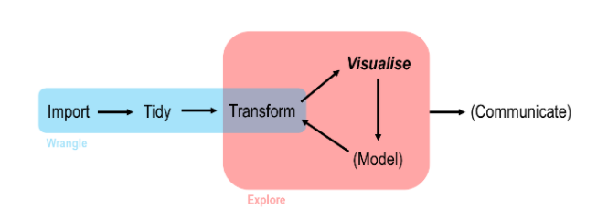
Data Analysis work flow in R

Slide 13
Readr

Slide 14

What is readr
readr is another of the many packages included in the tidyverse
It allows you to import data from a wide variety of storage formats
It is designed to balance import speed, ease-of-use, and consistency

Slide 15
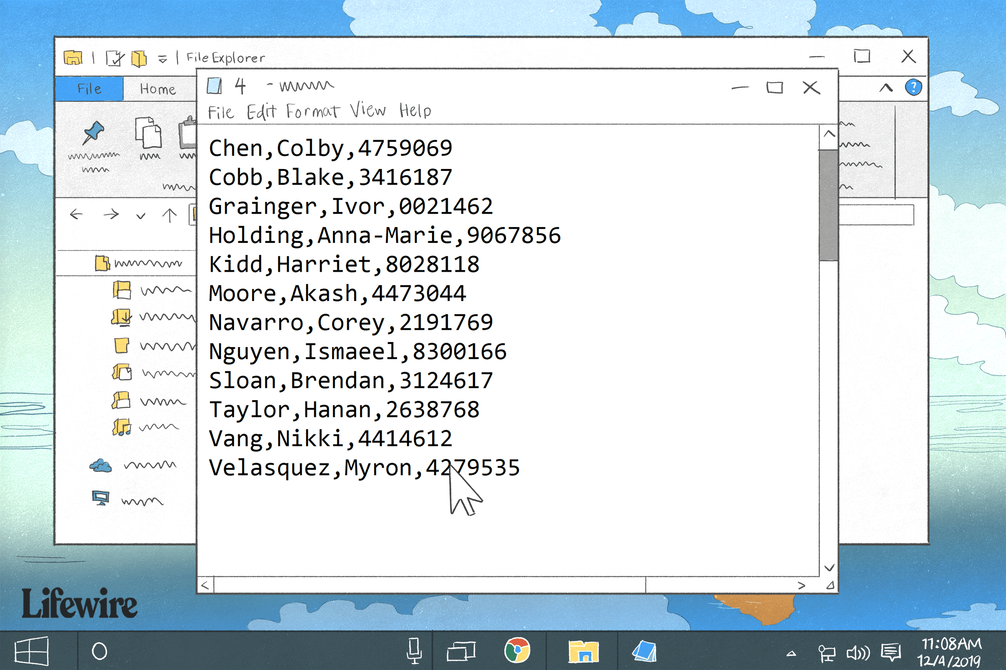
CSV files
Common-separated value (CSV) files are almost certainly the most common storage format for flat data
Each observation occupies its own line and fields are separated by commas (hence the name)
CSVs can contain a header row with column names, although this is not always the case

Slide 16
Data input

Slide 17
read_cvs
You can import a CSV file using the read_csv() function
The first argument is the most important; it's the path to the file to read
The path of the file should be relative to your current working directory
This can be changed using Session > Set Working Directory > Choose Directory or by using Ctrl+Shift+H

Slide 18
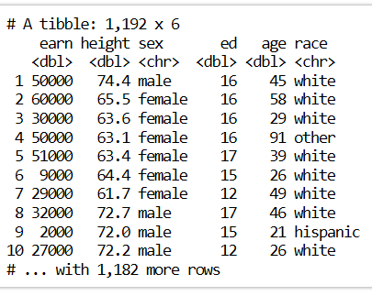
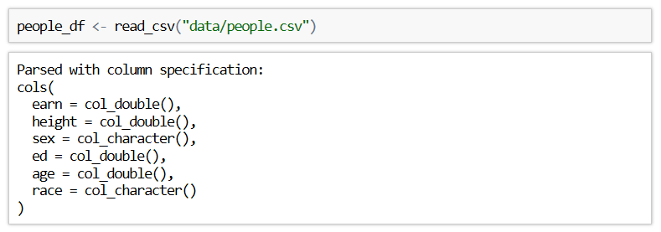
read_cvs
When using the read_csv() function, you are outputted a message containing the column names and types

Slide 19
Exercise to try
Read in the movies.csv file into r and assign it to an object called movies_df
Make sure to have changed your directory to the folder where the datasets are stored or alternatively write the whole path the the file in the command.

Slide 20

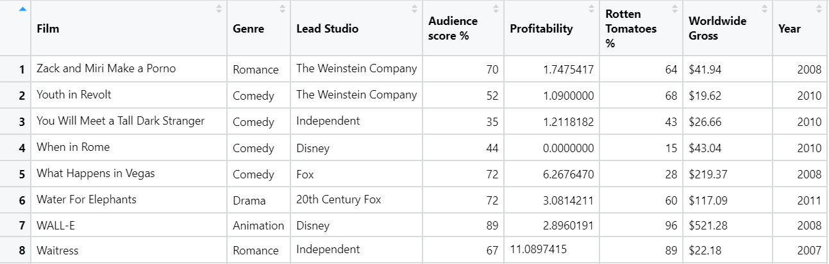
Answer

Slide 21
Tibbles

Slide 22
Tibbles
Tibbles are just standard R data frames, but they tweak some old behaviours to make life a little easier
Tibbles limit how many rows and columns to avoid flooding the console
They also give you useful tips such a column types and the dimension of the data frame
A standard R data frame can be converted to a tibble using the as_tibble() function

Slide 23
Data input

Slide 24
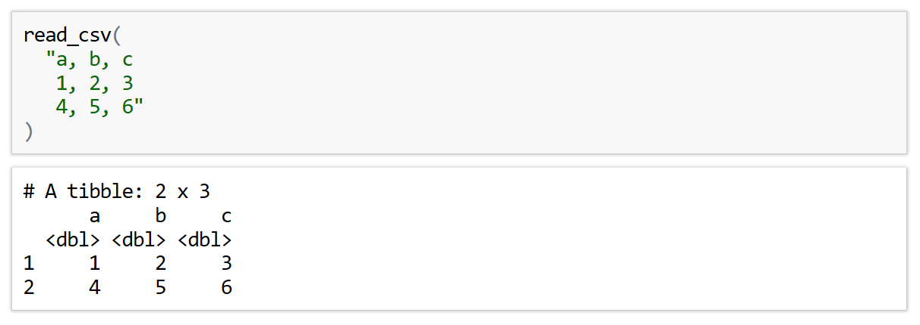
In-line CSV
For the purposes of testing code, the read_csv() function can process an in-line CSV
This is also important for creating reproducible examples

Slide 25
Readr parameters

Slide 26
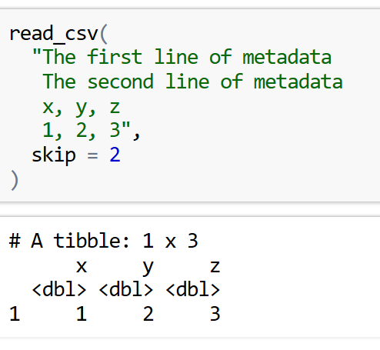
Skip Parameter
As seen in both previous examples, the default behaviour for read_csv() is to use the first line for column names
This convention can be circumvented by using either the skip or comment parameter
The skip parameter can be used to skip a specified number of rows in the CSV file before starting to read data
This is useful when your CSV contains metadata at the top of the file

Slide 27
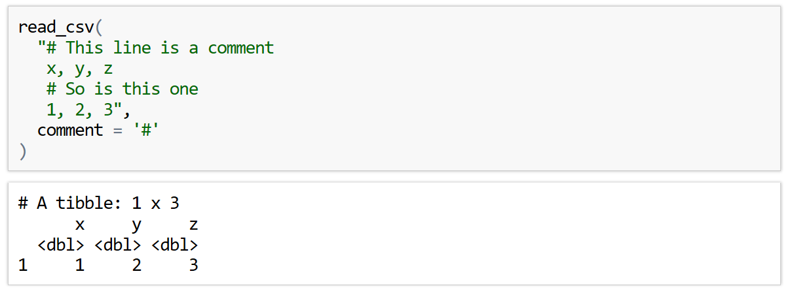
Comment Parameter
The comment parameter can be used to drop all lines starting with a specified character

Slide 28
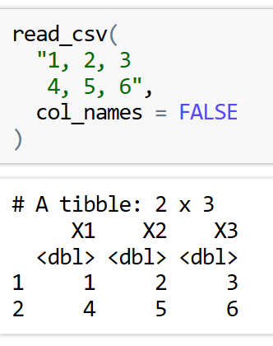
Manual Column names
It may be the case that the CSV file you are importing does not have column names
In this case you can use the col_names parameter to control what to do
Setting col_names = FALSE will tell read_csv() that the first row of the CSV file is data and that the column should be labelled using generic names 'X1', 'X2', etc.

Slide 29
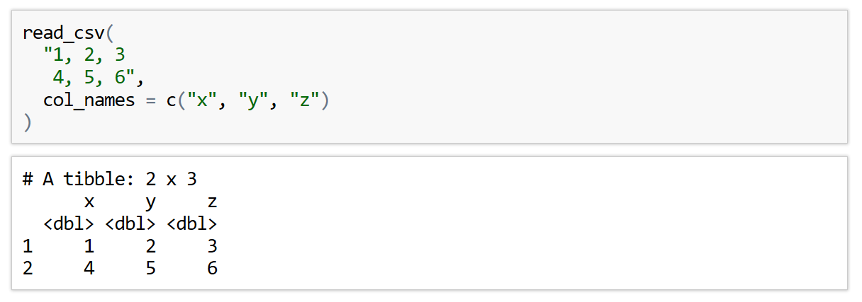
Manual Column names
Alternatively, if you know what the column names should be, you can specify then using a character vector

Slide 30
Exercise to try
Read the following in-line CSV into R.
The columns of this dataset are City, Area, Population.
Make sure you don’t try to read the comment line
"
Shanghai, 6341, Unknown
Tokyo, 627, 13515271
Seoul, 605, 9806000
>> Note: Mumbai was previously called Bombai
Mumbai, 438, 12442373"

Slide 31
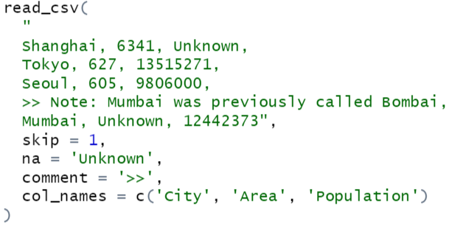
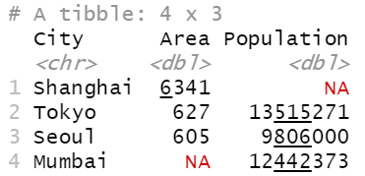
Answer

Slide 32
Bonus Questions

Slide 33
Web Scraping
Web scraping is a technique for converting the data present in unstructured format (HTML tags) over the web to the structured format which can easily be accessed and used
We can use Web browsers to retrieve these datasets
We first need to install rvest and robotstxt :
install.packages('rvest’)
install.packages(‘robotstxt’)

Slide 34
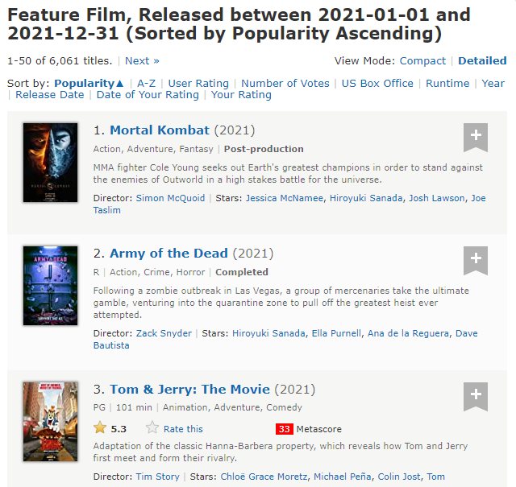












Looking at featured films dataset
We can scrape the following data categories:
Rank
Title
Description
Runtime
Genre
Rating
Director
Actor

Slide 35

Web Scraping
We’re going to looking at film data from this link:
https://www.imdb.com/search/title/?year=2021&title_type=feature&
Lets check if we can scrape data from It firstly
Opening it in R Studio:

Slide 36

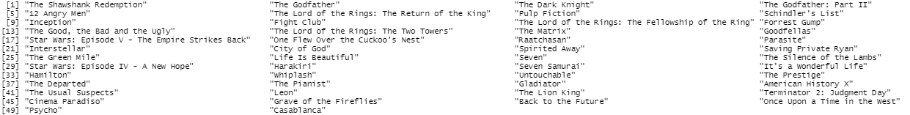
Accessing the categories
We have our variable webpage containing the html dataset but we want to access the data to see it:
Html object
Path to node

Slide 37
Access other variables using these paths
Have a go by copy and pasting these paths to access different categories of data
Year of release – ".lister-item-content h3 .lister-item-year"
Runtime – ".lister-item-content p .runtime"
Genre – ".lister-item-content p .genre"
Certificate – ".lister-item-content p .certificate"
More explanations and documentation can be found here for web scraping :
https://blog.rsquaredacademy.com/web-scraping/
If you want a have a go at creating some plots using this data or creating Dataframes from it have a read of this article:
https://towardsdatascience.com/introduction-to-data-frames-in-r-b9a6302d9a56

Slide 38
Next Time ….
Vectors
Plotting our new datasets
Line graphs
Global aesthetics
See you then !

Slide 39
Into the Tidyverse Session 2b
Course written by Tim Hardgreeves

Slide 40
Vectors

Slide 41
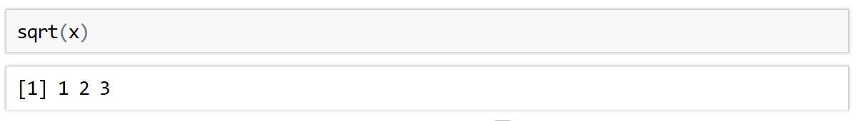
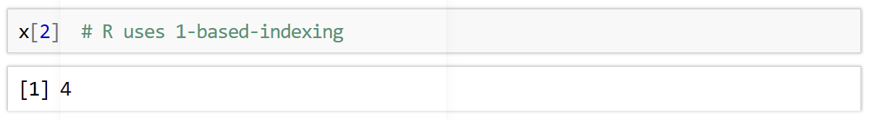
Vectors
In R, a vector is a collection of elements of the same type
There are integer vectors, character vectors, double vectors, and many more
Vectors are created using the c() function. This stands for combine:
Most mathematical functions in R act element-wise on vectors
A particular value of a vector can be accessed using [ ]

Slide 42
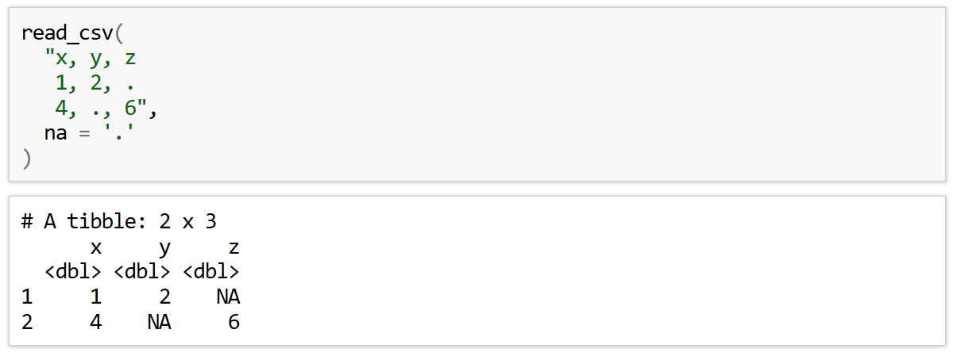
Missing Values
In the real world, it is rare to ever have a complete data set
Missing values can be encoded using a range of symbols - ., ?, N/A, -, etc.
You can tell readr() which symbol is used in a given CSV file using the na parameter

Slide 43
Exercise to try
Read the following in-line CSV into R.
Unknown is used here to represent missing values
There’s a few lines you will want to skip
"
Employee Database Version 3
name, age, job
John, 34, Analyst
Ann, 44, Consultant
Barry, 24, Unknown
Freya, Unknown, Developer"

Slide 44
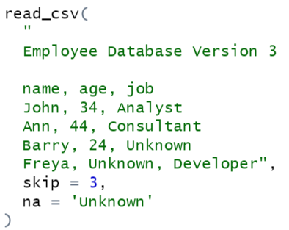
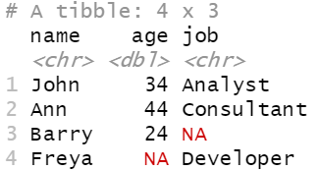
Answer

Slide 45
More file types

Slide 46
Other file types
More Delimited Files
read_csv2() - semicolon-separated files
read_tsv() - read tab-separated files
read_delim() - reads files with any delimiter
read_delim('path/to/file.txt', '|’)
These all accept the same additional arguments as read_csv()

Slide 47
Exercises to try
Facet the above plot by sex, colouring the points too. Make sure you hide the legend with show.legend = FALSE
Remember to set your working directory first with Session > Set Working Directory...
Read the people.csv file from this session’s data folder. Make sure you specify that sex and race are factors (categorical variables) and that earn and age are integers.
How does level of education affect salary? Make a scatter plot to find out. You should set position = 'jitter' in the geom_point() function to avoid over-plotting and perhaps also set transparency to 0.5.
Facet the above plot by sex, colouring the points too. Make sure you hide the legend with show.legend = FALSE

Slide 48
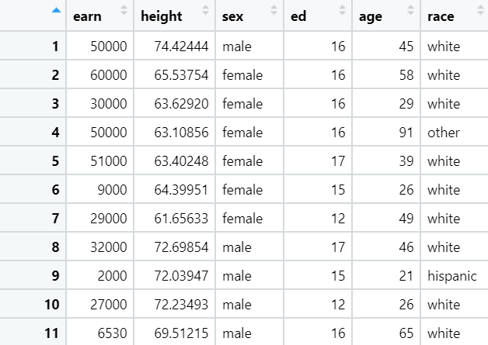
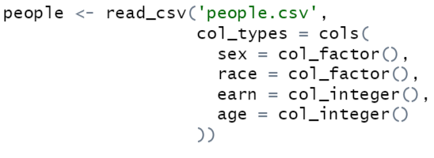
Answers 1)

Slide 49
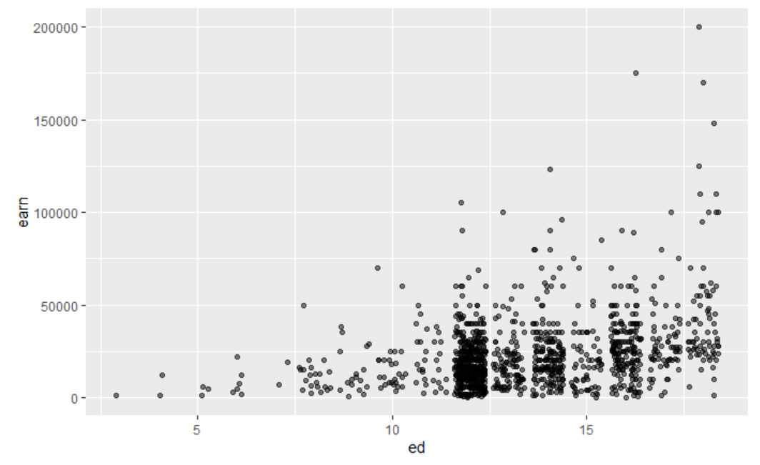
Answers 2)

Slide 50
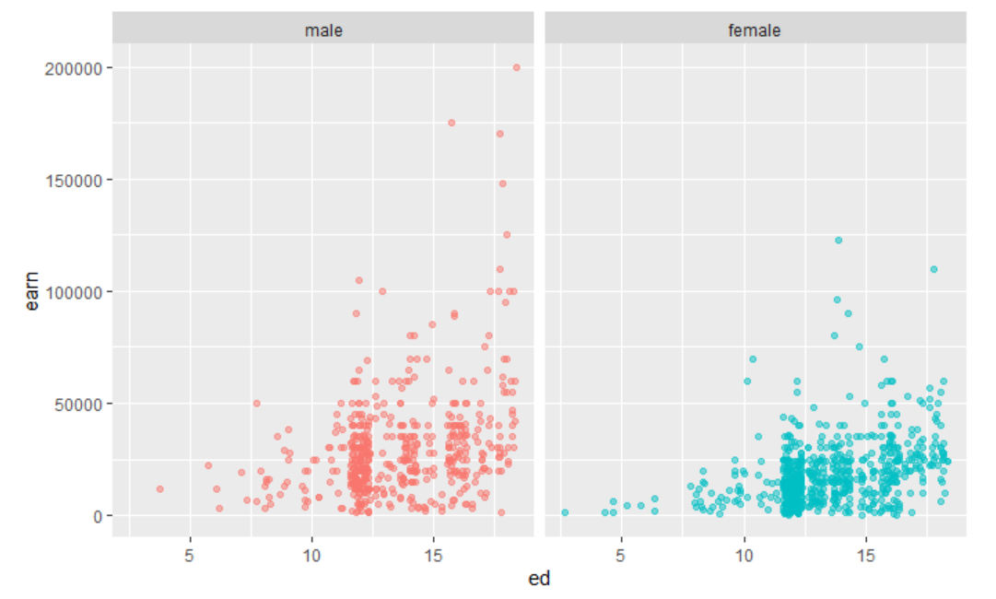
Answers 3)

Slide 51
More Data Visualisations

Slide 52
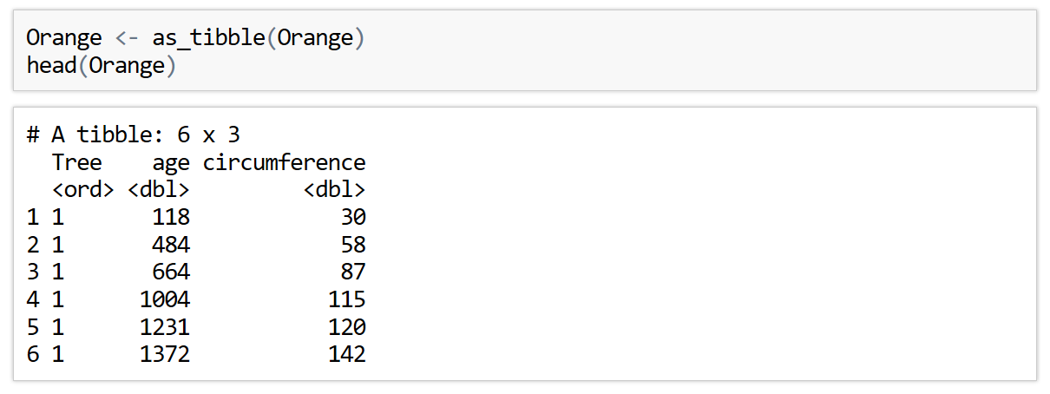
Line Plot
So far, we have only produced scatter plots and that's a bit boring
By changing which geometry we use, we generate a line plot
A dataset suited to this type of graph is the oranges dataset

Slide 53
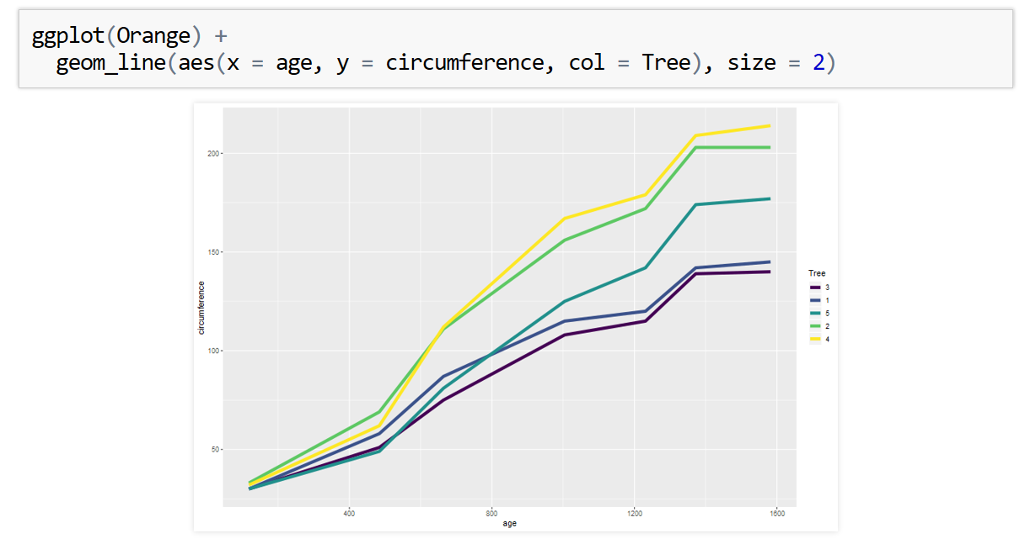
Line Plot
A line plot is produced by using the geom_line() geometry

Slide 54
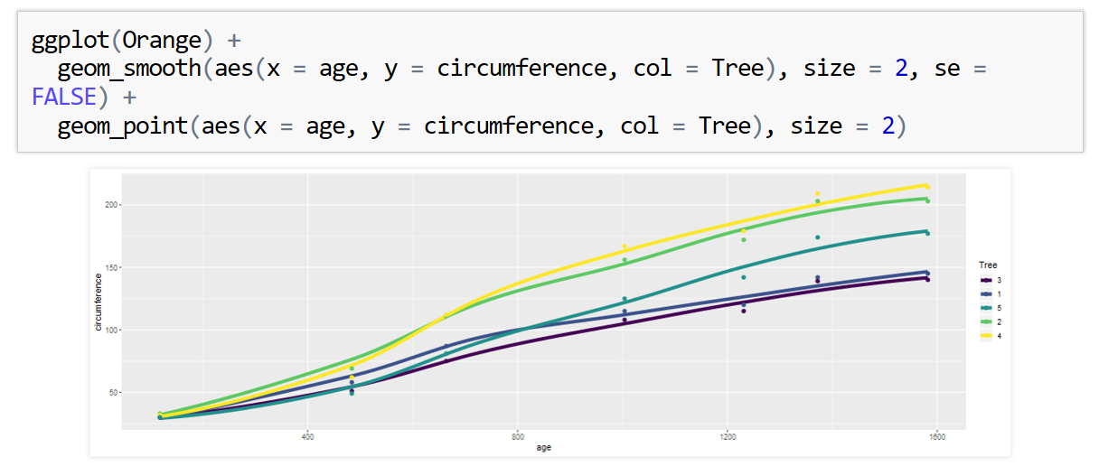
Smooth Line Plot
A similar geometry is geom_smooth(). This adds a smooth fitted line to a plot
This can be combined with geom_point() to create the following graph
Use can use the se parameter to control whether confidence intervals are shown. These are best turned off for now

Slide 55
Exercises to try
Using the built in dataset ChickWeight make a line plot of the chicken weight against time. Group by chick and colour by diet by adding group = chick inside the aes() function
Instead of using geom_line, use geom_smooth with the colour aesthetic set to Diet. Hide the error regions with se=FALSE
There is no need to specify the group in this case - why?
3) Add labels to the plot

Slide 56
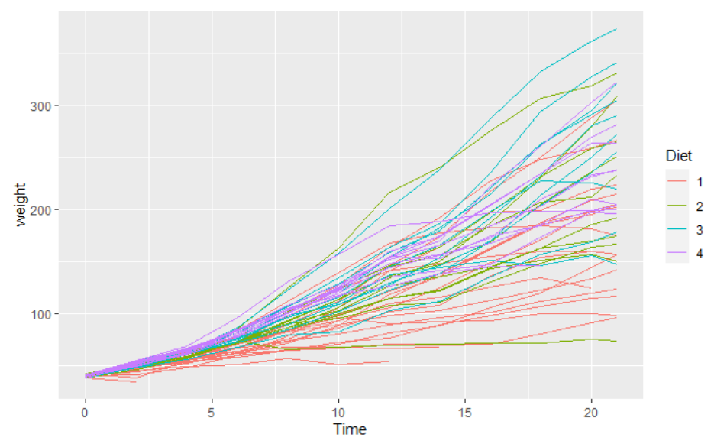
Answers 1)

Slide 57
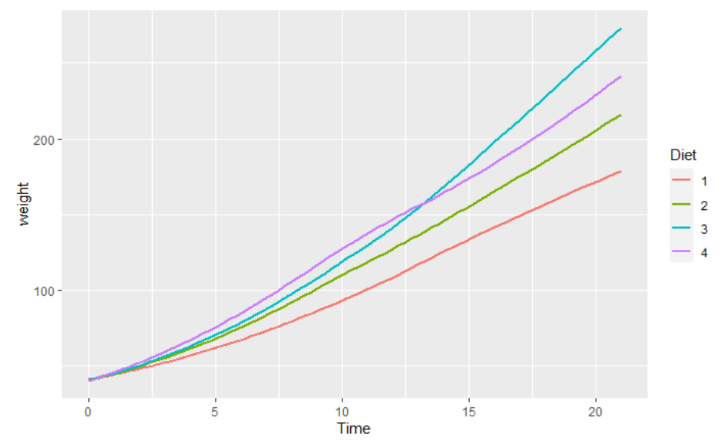
Answers 2)

Slide 58
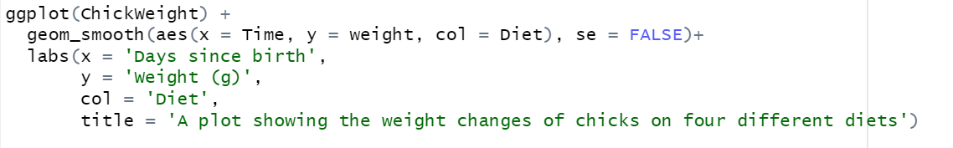
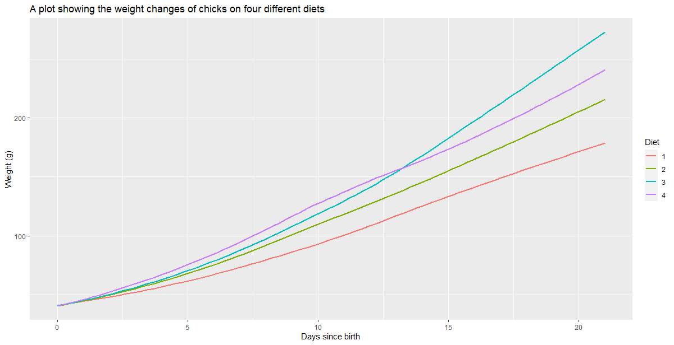
Answers 3)

Slide 59
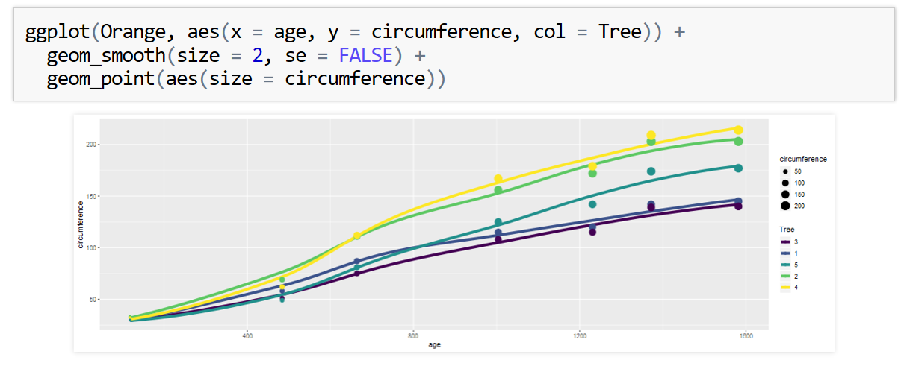
Global Aesthetics
The previous code is repetitive as we specify the mapping for aesthetics x, y, and col twice
We can instead specify these as the second argument of ggplot() in aes()
These will be treated as global variables mappings
You can still specify local mappings in either of the geometry functions

Slide 60
More Line Aesthetics
Both line graph geometries both come with a linetype aesthetic to control what type of line is used
This should have a categorical variable mapped to it or manually set to a positive integer value/name of a line type
Both aesthetics also has a group() aesthetic which allows you to separate the full data set before generating the lines (see exercises for examples of this)
This can be set to -1 to use no grouping

Slide 61
Bonus Questions

Slide 62
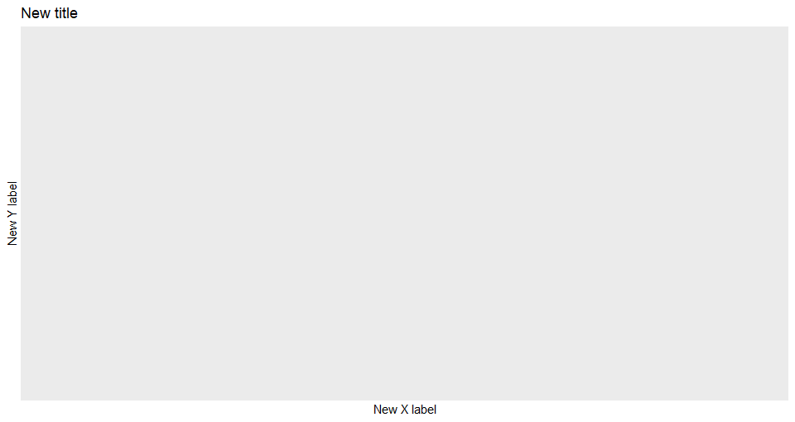
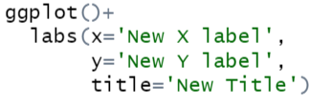
Labelling
We can change our x and y axis names in ggplot and add a title to our graph using a new layer labs()
It’s a simple case of adding more layers to our code as shown bellow:

Slide 63
Exercises to try
Add a new title and x and y axis names to the following plot from before
ggplot(ChickWeight) +
geom_smooth(aes(x=Time, y=weight, col=Diet), se=FALSE)

Slide 64
Answers 1)

Slide 65
Next Time ….
Basic statistical functions
Using comparisons to filter data
Using Boolean operators
See you then !

