Slide 1
Into the Tidyverse Session 4a
Course written by Tim Hargreaves

Slide 2
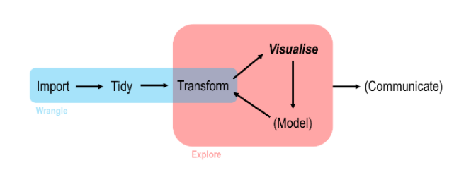
Data Analysis work flow in R

Slide 3
Tidyr

Slide 4

What is tidyr
Tidyr allows you to take a dataset in a ‘non-tidy’ form and transform it into tidy data
it can be used as input into a variety of other functions that may transform, model, or visualize the data quickly and easily

Slide 5
Tidy Data

Slide 6
Data Representations
You can represent the same underlying data in multiple ways
The following example shows four different ways to organise the same data
Each dataset shows the same values of four variables, country, year, population, and cases
Only one of these is tidy data

Slide 7
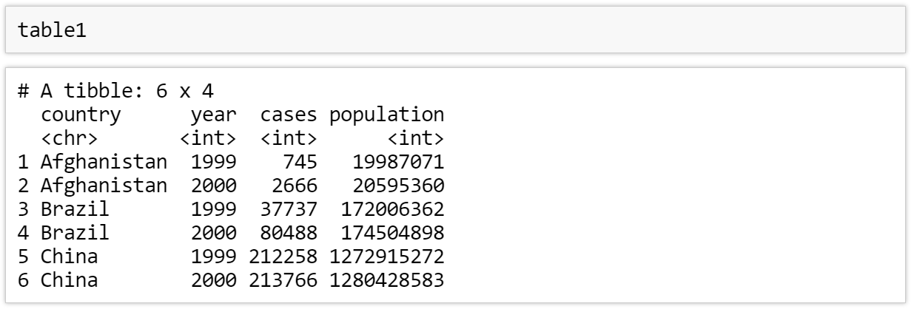
Table 1

Slide 8
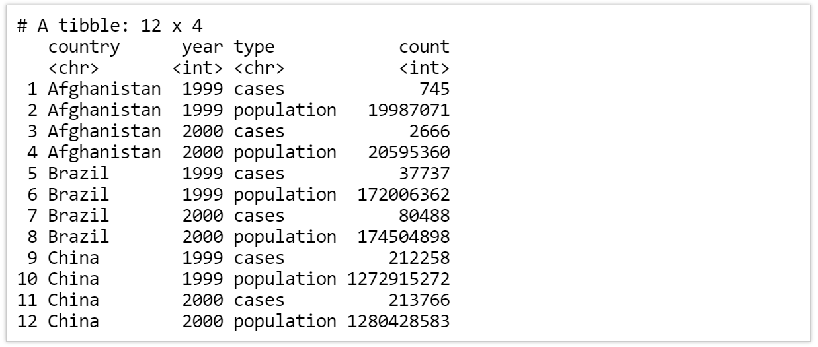
Table 2

Slide 9
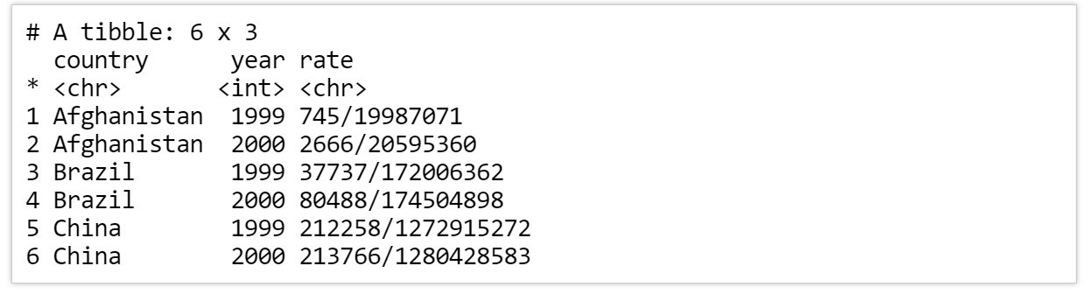
Table 3

Slide 10
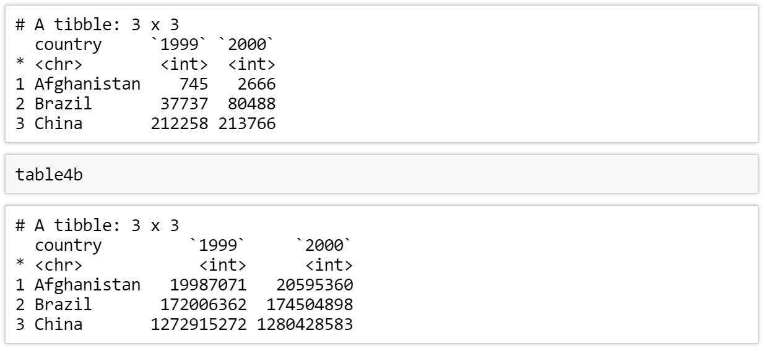
Table 4a and 4b

Slide 11
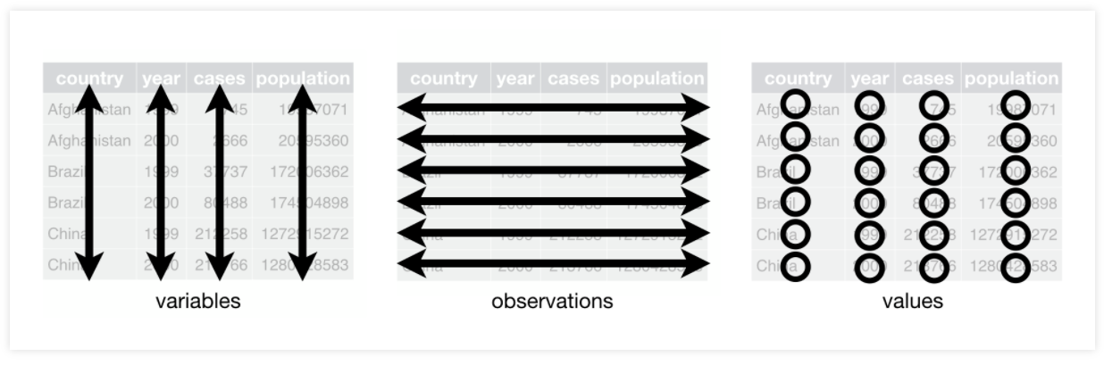
Rules of Tidy Data
There a three interrelated rules which make a dataset tidy:
Each variable (a value you can measure) must have its own column
Each observation (a thing which has measurable properties) must have its own row
Each value must have its own cell

Slide 12
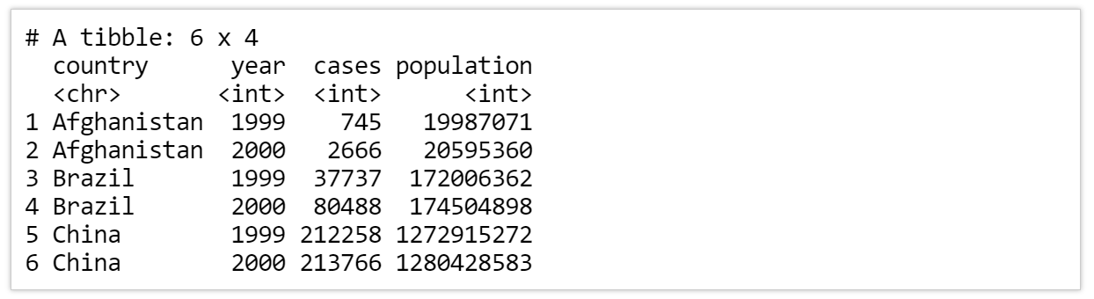
Satisfying the rules
Only the first representation was tidy
Variable 2
Variable 3
Variable 4
Variable 1
Observation 1
Observation 2
Observation 3
Observation 4
Observation 5
Observation 6
Values 1
Values 2
Values 3
Values 4

Slide 13
Table 2
Variable 2
Variable 1
Variable 3 and 4
Observation 1
Observation 1
Observation 2
Observation 2
Observation 3
Observation 3
Observation 4
Observation 4
Observation 5
Observation 5
Observation 6
Observation 6
Values 1
Values 2
Values 3 and 4

Slide 14
Table 3
Variable 2
Variable 3 and 4
Variable 1
Observation 1
Observation 2
Observation 3
Observation 4
Observation 5
Observation 6
Values 1
Values 2
Values 3 and 4

Slide 15
Table 4a and 4b
Variable 1
Observation 1 and 2
Observation 3 and 4
Observation 5 and 6
Values 1
Values 3
Variable 1
Observation 1 and 2
Observation 3 and 4
Observation 5 and 6
Values 1
Values 4

Slide 16
Basic steps for tidy data
If you conduct these steps you will end up with tidy data:
Put each dataset in tibble
Put each variable in its own column

Slide 17
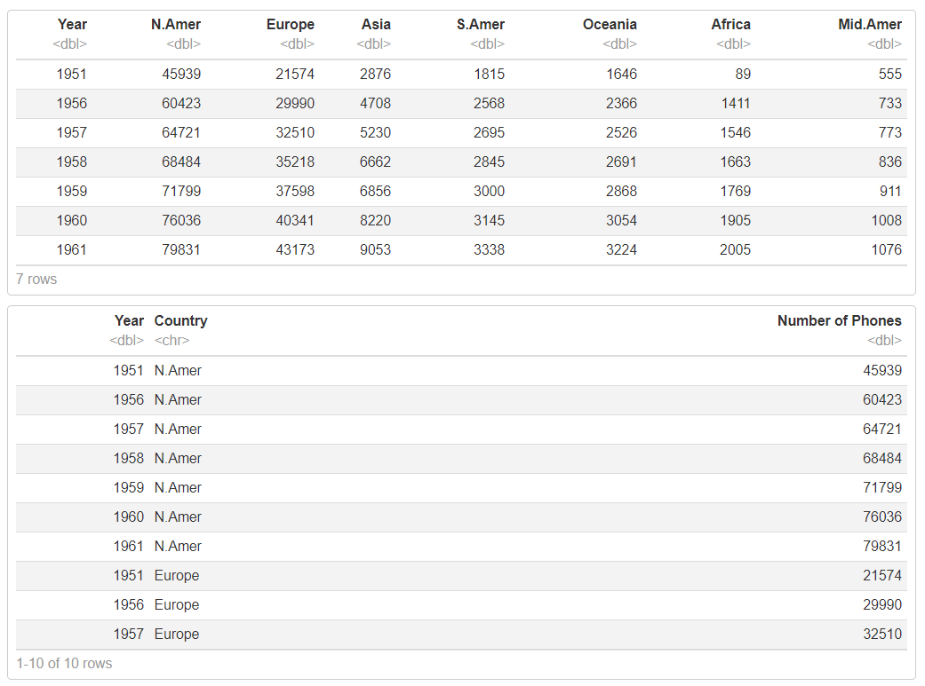
Exercises to try
You want to create a line plot showing how mobile phone usage has changed over time in the seven main geographic regions. Which of the following tables is this easiest to do with?
Which of the above forms is best if you just wish to view the raw data?

Slide 18
Answers
The latter table is much easier to work with.
Since the variable Country has its own column rather than having its values spread out across multiple columns, we can easily map the colour aesthetic to this variable.
The first table is much better if we only plan to look at the data.
It is much easier to find the mobile phone usage of a particular region in a particular year in this format
we can also see how different regions compare in a given year without having to filter the dataset first unlike with the latter form.

Slide 19
Gather

Slide 20
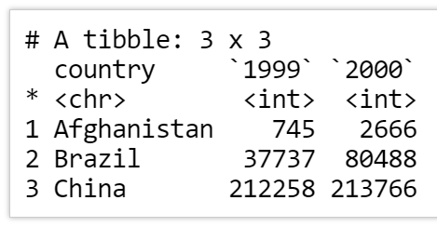
Untidy the Dataset- table 4
This representation violates the second rule of tidy data: ‘Each observation (a thing which has measurable properties) must have its own row’
Here we have two columns, 1999 and 2000, which do not represent variables
Therefore 2 observations are on one not their own individual rows

Slide 21
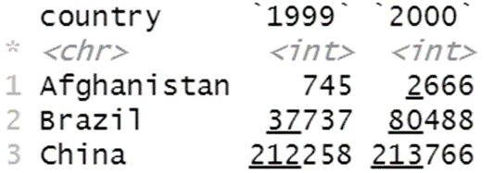
Gathering parameters
To tidy a dataset like this we need to gather those two non-variable columns into a new pair of variables
To describe this operation we need three parameters:
The set of columns that are not variables (1999 and 2000 in this case)
The name of the variable whose values form the column names (we said before that this is year). We refer to this as the key
The name of the variable whose values are spread over the cells (here it is cases of tb). We refer to this as the value

Slide 22
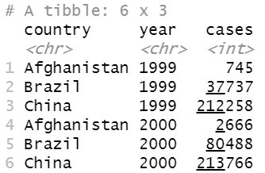
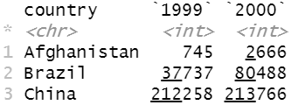

Gathering
We can use these parameters in a call to gather()
Key = variable name associated with the column names (in this case year)
Values

Slide 23
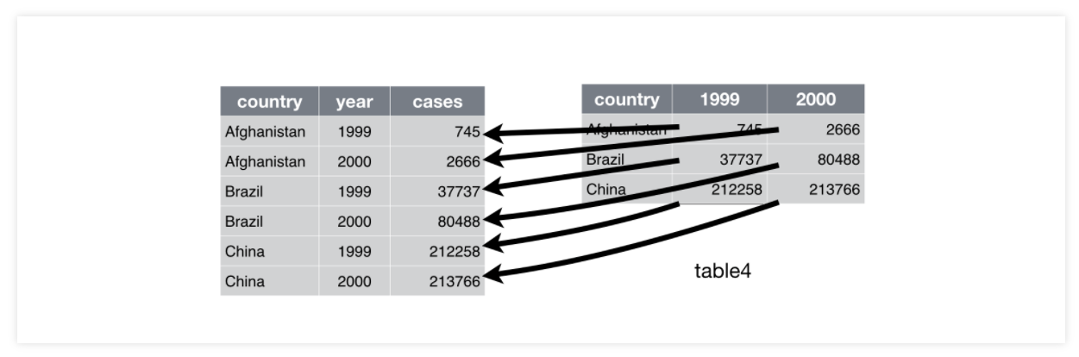
Visualising the transformation

Slide 24
Exercise to try
1) Using the construction dataset, gather up the columns : "Northeast" , "Midwest" , "South" , "West" into a new column called ‘Region’ with another column called ‘Num of units’ containing all the values.
This is saying gather columns from firstcolname to lastcolname
gather(dataframe , firstcolname : lastcolname, key=‘col name’, value=‘col name 2’)

Slide 25
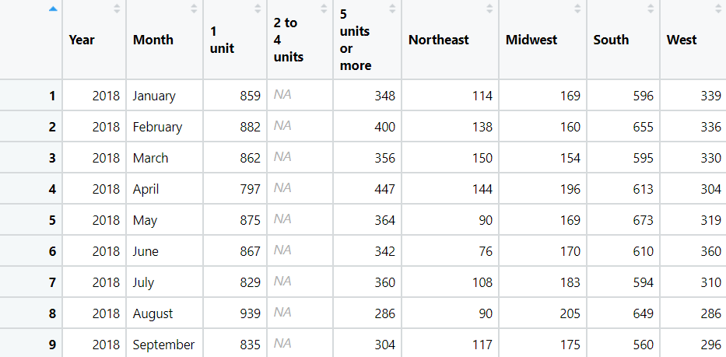
Construction dataset
Northeast: West

Slide 26
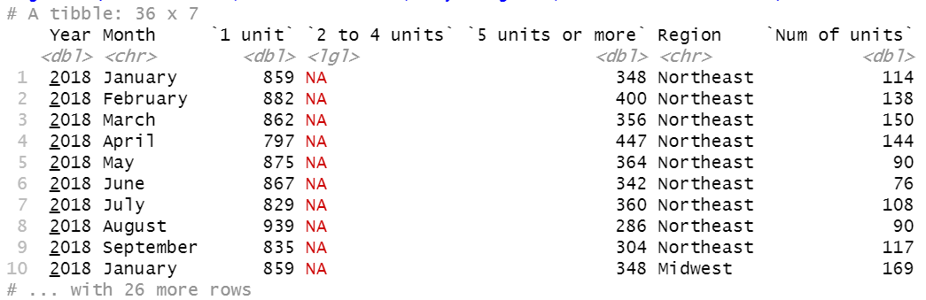
Answer

Slide 27
Spreading

Slide 28
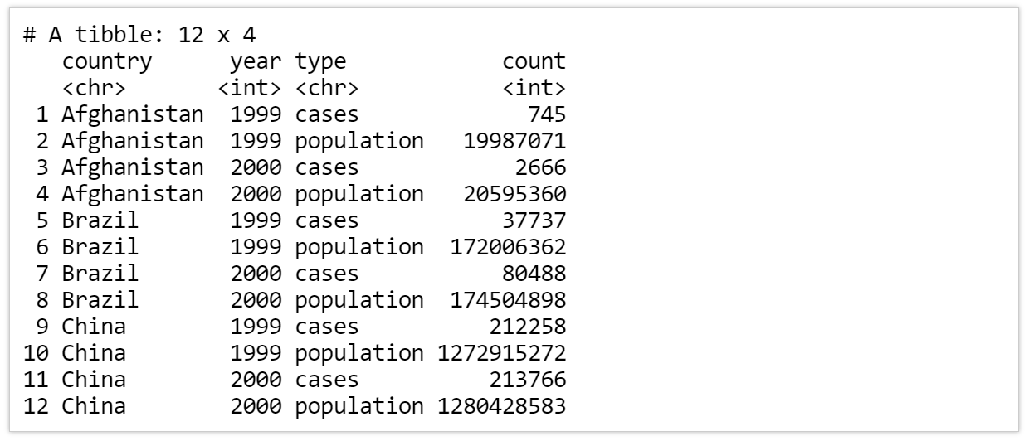
Another untidy example
This example suffers from the opposite problem of the last representation
Each observation is scattered across two rows and the values for cases and population are contained in the type column

Slide 29
Tidying using spread()
We can use the spread() function to fix this issue
This time we only need two parameters:
The column which contains the variable names (here, it's type) which we referred to as the key
The column that contains values from multiple variables (here it's count) which we referred to as the value

Slide 30
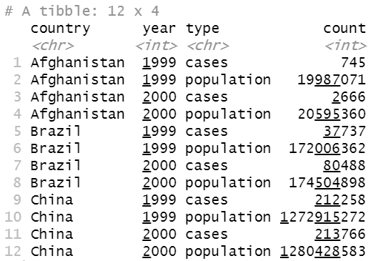
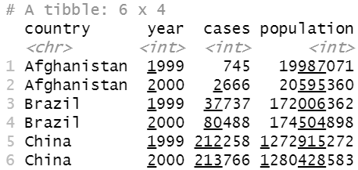
Tidying using spread()
We can use these parameters to call spread()
Key
Value

Slide 31
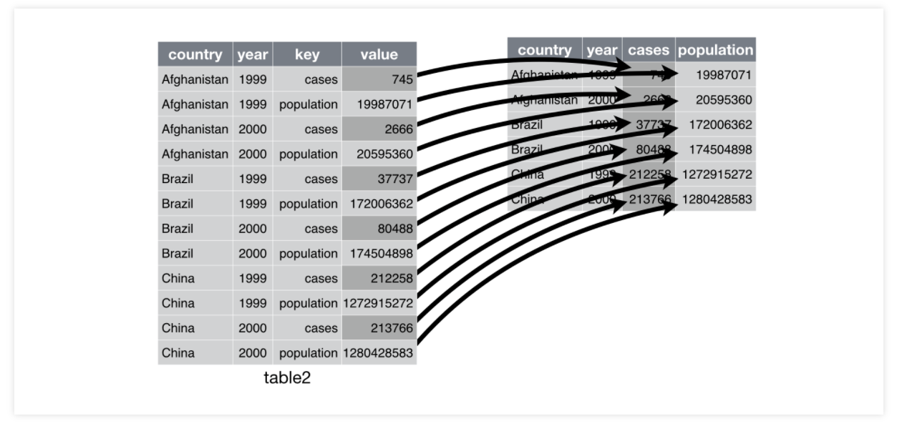
Visualizing the transformation

Slide 32
Spreading and Gathering
As you might be able to guess from the common key and value arguments, spread() and gather() are opposites of each other and can be used to reverse each other's effects
gather() makes wide tables narrower and longer, whereas spread() makes long tables shorter and wider
A general rule of thumb is that wide tables are best for looking at data, whereas tall tables are best for performing analysis.

Slide 33

Exercises to try
Why does this code fail and how can it be changed so it will execute correctly ?

Slide 34
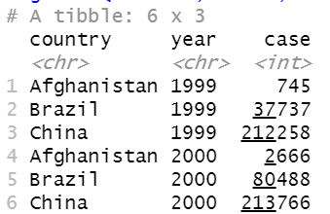
Answer
We need to put numeric column names in backticks (‘`’).
Otherwise, in this case, R will look for the 1999th and 2000th column. Since these don’t exist, we receive an error.

Slide 35
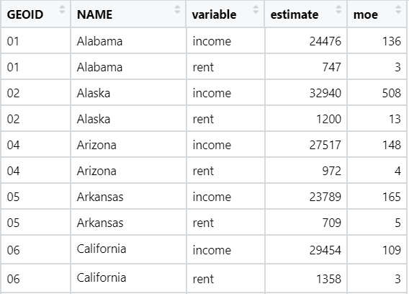
us_rent_income table

Slide 36
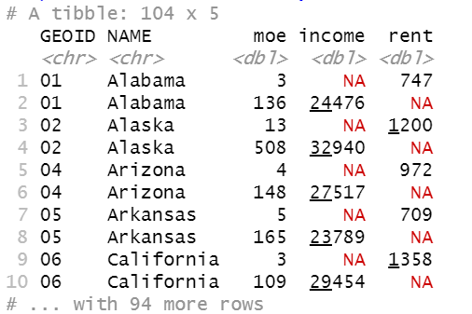
Exercises to try
Using the dataframe us_rent_income ,spread out the variable column into two separate columns containing the estimate values
spread(dataframe , key=‘col name’, value=‘col name 2’)

Slide 37
Exercises to try

Slide 38
Next Time ….
Continuing tidying datasets:
Separating
Uniting
Joining
See you then !

Slide 39
Into the Tidyverse Session 4b
Course written by Tim Hargreaves

Slide 40
Separating

Slide 41

The last untidy example
This example violates the last rule of tidy data - each value must have its own cell
As a consequence we also end up with a non-variable column rate

Slide 42
Sepatate()
We can use the separate() function to fix this issue
We will need to specify three parameters:
The name of the column that we want to split into multiple columns (rate in this case)
The names of the new columns to create (supplied as a character vector) (c(‘cases’, ‘population) in this case )
Optional- separator symbol (sep=‘/’)

Slide 43
Sepatate()
By default separate()will split values whenever it sees a non-alphanumeric character though this can be specified manually using the sep argument
We also need to specify convert = TRUE if we want tidyr to automatically convert the new columns to the correct data types (by default they would still be characters)

Slide 44
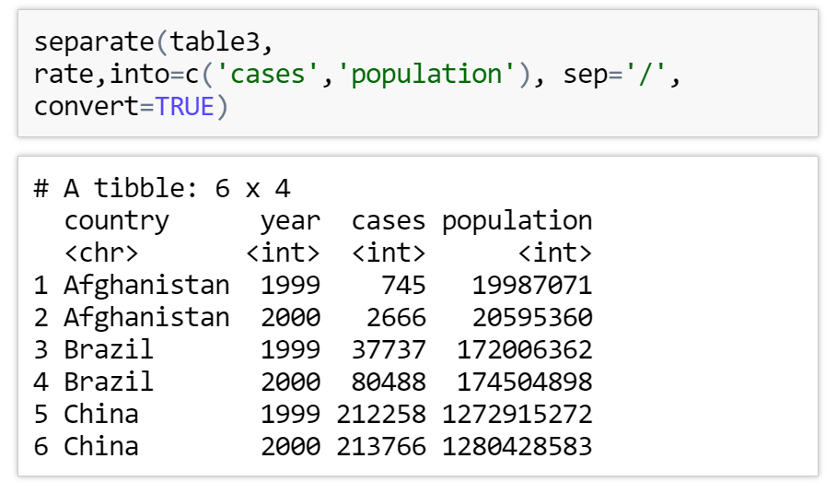
Sepatate()
We then use these parameters in a call to separate()

Slide 45
General notation
Column to separate
Data frame name
Separator symbol (/ , : ;)
Vector of new column names
Reset new columns data types

Slide 46
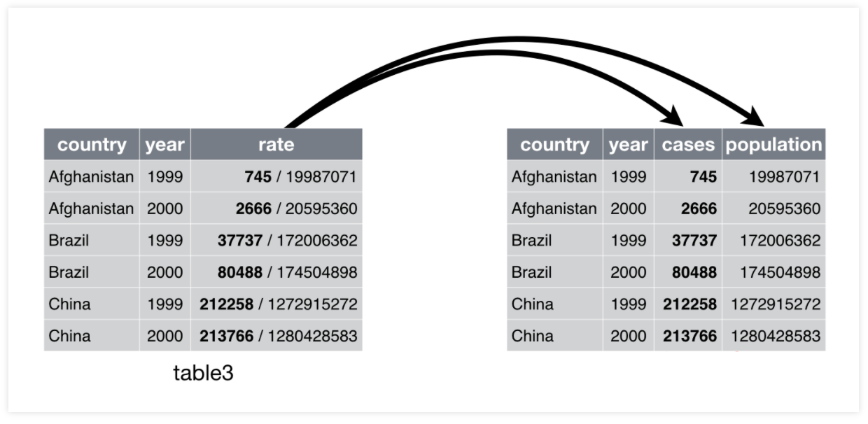
Visualizing the transformation

Slide 47
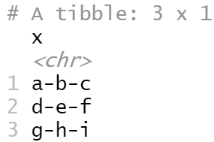
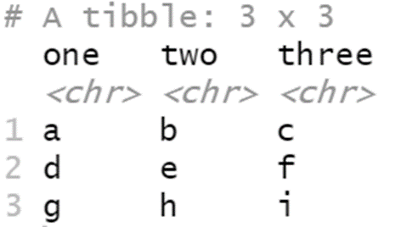
Exercise to try
Take the following tibble and separate the tibble to the same format as shown bellow
dataframe1<-tibble(x = c("a-b-c", "d-e-f", "g-h-i"))
separate(dataframe,col_to_separate,into=c(‘new_col1’,‘new_col2’),sep=‘symbol’,convert=TRUE)

Slide 48

Answers

Slide 49
Uniting

Slide 50
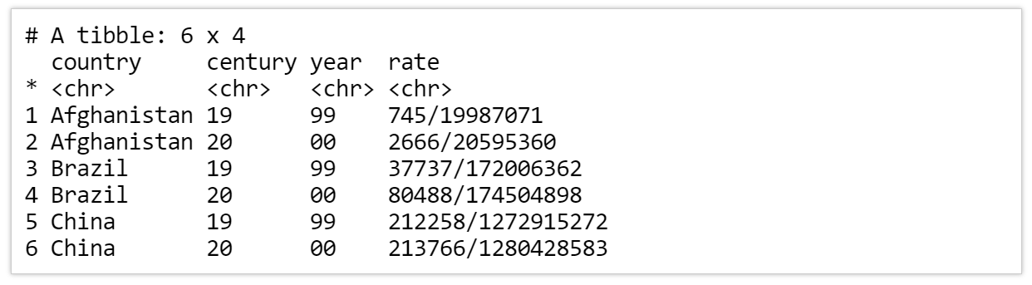
Untidy Example
we're going to look at a table we haven't seen so far table five
This violates the last rule of tidy data too but in an opposite way
Here, the value of year has been split up into two cells, one containing the century and one containing the rest

Slide 51
Unite()
We can use the unite() function to fix this issue
We will need to specify the following parameters:
The name of the new column to create
The set of columns to combine
Optionally, we can also include a sep argument to specify the separator or use the default _

Slide 52
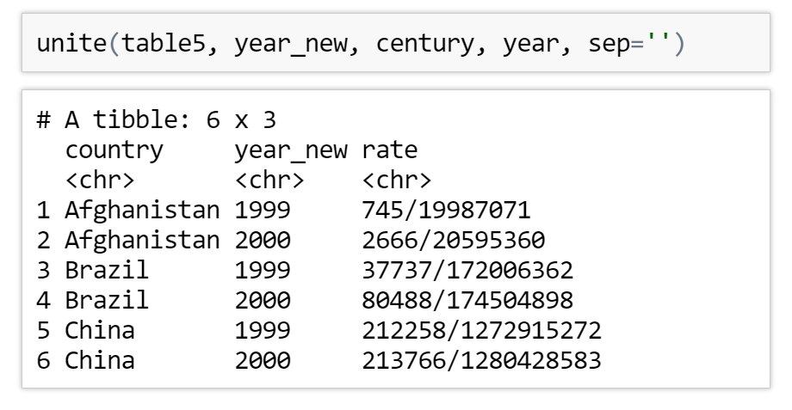
Uniting
We then use these parameters in a call to unite()
unite() does not have a convert parameter so we would have to perform this conversion manually
In this case we would use mutate(year_new = as.integer(year_new))

Slide 53
General notation
Columns to combine
Data frame name
new column name
Separator symbol (/ , : ;)

Slide 54
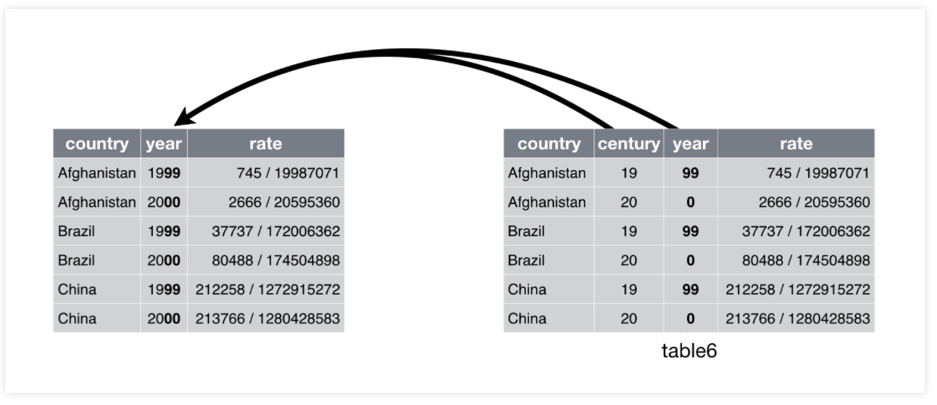
Visualising the transformation

Slide 55
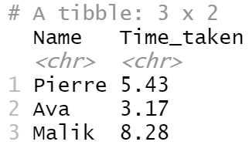
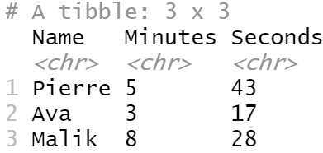
Exercise to try
Take the following tibble and unite the tibble to the same format as shown bellow
shopping_times<- tibble(Name= c('Pierre', 'Ava', 'Malik'), Minutes= c('5', '3', '8'), Seconds= c('43', '17', '28'))
unite(dataframe, new_col, old_col1, old_col2, sep=‘symbol’)

Slide 56
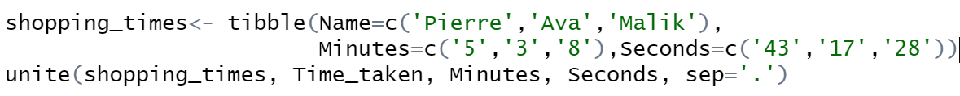

Answer

Slide 57
Joining Data

Slide 58
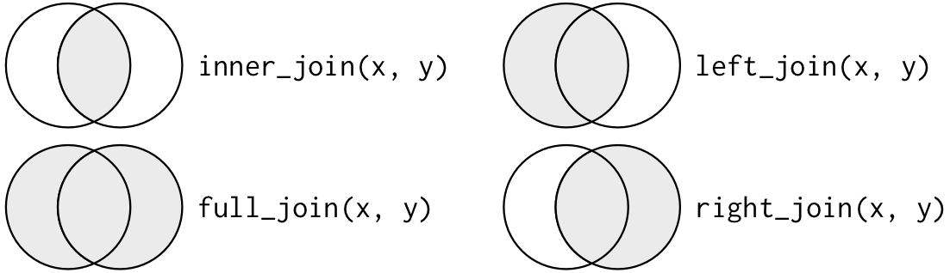
What is a mutating join ?
A mutating join allows you to combine variables from two tables
This is performed by matching observations on a collection of columns (or single column) known as the key

Slide 59
What is a mutating join ?
Keys
Table X
Observations
Table Y
Observations

Slide 60
Inputs for a mutating join
There are different types of joins which handle missing values in different ways
Any join takes three main arguments:
Dataframe
First table
Second table to join to the first
A single column name to be used as the key
The output of a join contains the shared keys as well as the other columns from both tables

Slide 61
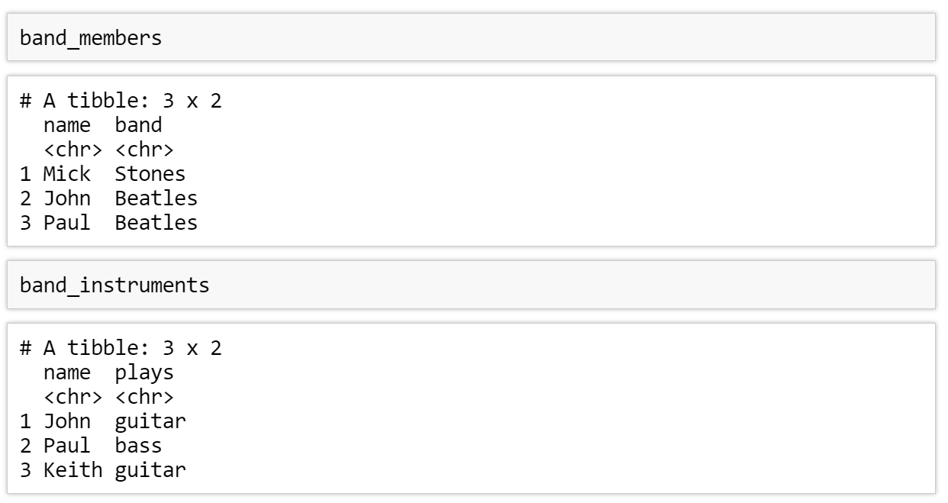
Band Membership example
We have 2 tables to join together

Slide 62
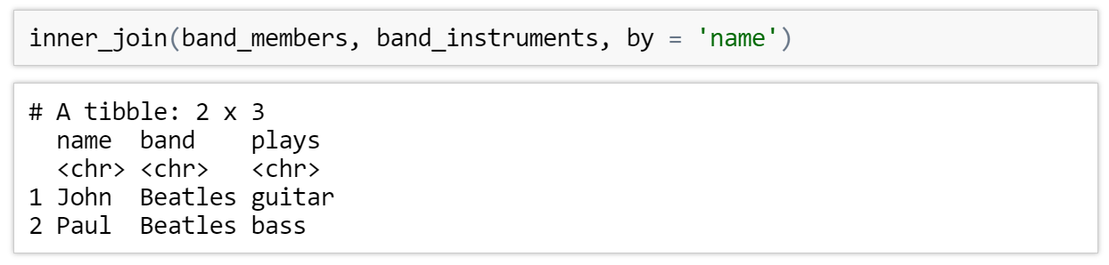
Doing an Inner Join
It matches pairs of observations whenever their keys are equal
The output of an inner join only contains rows which contained the key in both tables
Here, neither Mick nor Keith are included in the result as they don't appear in both tables

Slide 63
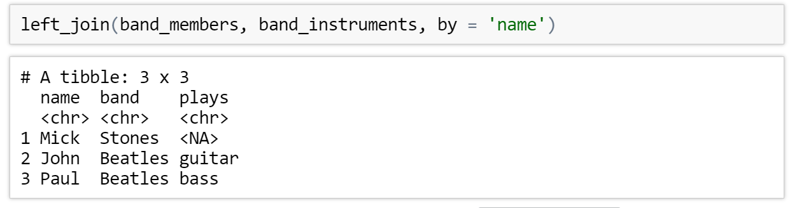
Left Join
A left join will result in a table containing every value of the key appearing in the first table stated
Any missing values will be filled in with NA
It is called a left join since the keys that are preserved come from the table used as the left argument
Here the result contains all 3 musicians featured in the band_members table

Slide 64
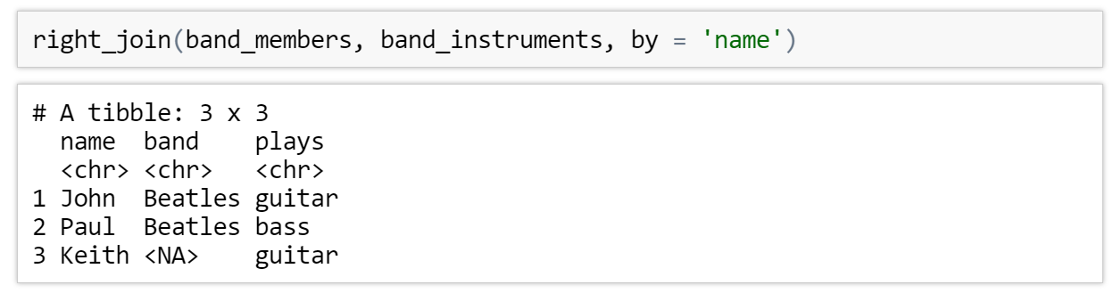
Right Join
A right join is the opposite of a left join
It preserves all keys that come from the table used as the 2nd table states
Here the result contains all 3 musicians featured in the band_instruments table
Here the result contains all 3 musicians featured in the band_members table

Slide 65
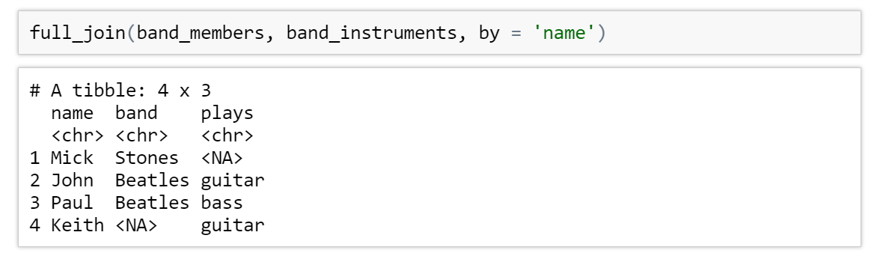
Full Join
A full join combines the behaviour of a left and right join
It creates a row in the result for every key that appears in either table
Here the result contains all 3 musicians featured in both tables

Slide 66
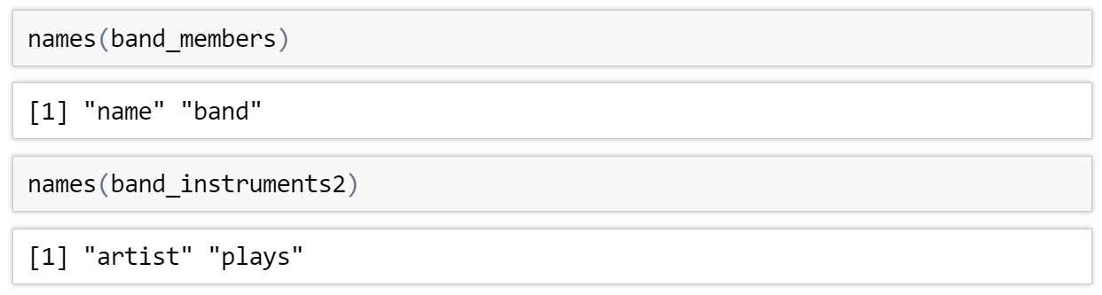
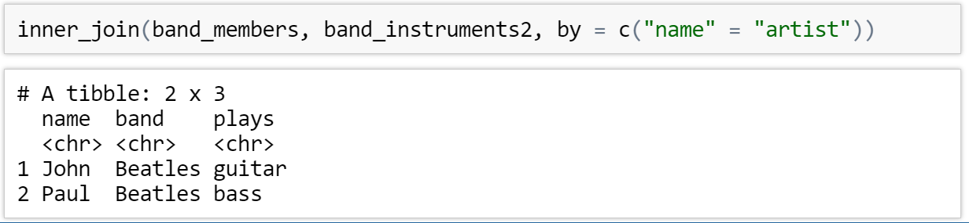
What happens if our columns are named differently ?
We can still perform joins but we have to slightly modify our syntax to the following

Slide 67
Exercises to try
Firstly install and load package dslabs then open the three datasets murders, us_rent_income
install.packages('dslabs')
library(dslabs)
murders
us_rent_income
Perform an inner join on the us_rent_income and murders dataset using state to join them by note the columns are named differently.
inner_join(dataframe1, dataframe2, by= c(column_name_1=column_name2))

Slide 68
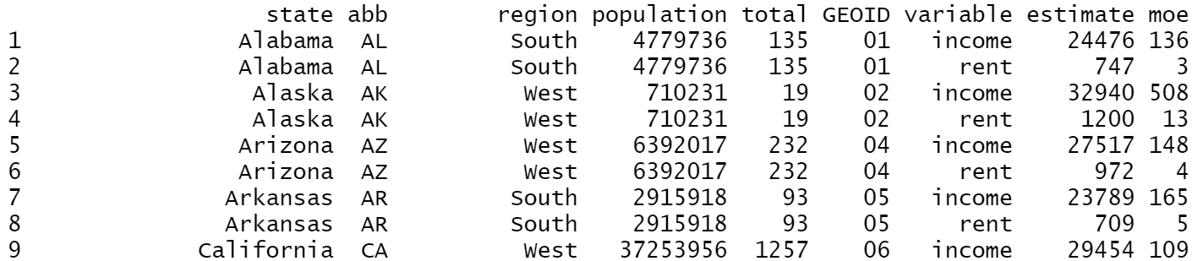
Answers

Slide 69
Next Time ….
Saving Dataframes and plots
Advanced visualisations
See you then !

