Slide 1

BetterBuddy
- Your Friendly Virtual Pet Habit Helper
By Donn

Slide 2
BetterBuddy: Your Friendly Virtual Pet Habit Helper - BetterBuddy is a fun app that turns everyday healthy habits (like drinking water or going for a walk) into a game where you care for a cute virtual animal buddy, like a dog or bird. - Instead of boring checklists, your buddy gets happy and "grows" when you succeed, making you feel good and motivated, like having a loyal pet cheering you on from your phone. - It makes self-care feel like playtime.

Slide 3
The Big Problem – Why Do We Skip Good Habits?
Most people start strong but quit after a week
Lists feel like chores: no fun or "yay" moments.
Life gets busy: forgot to drink water? No one notices or cares.

Slide 4
Games to the rescue!!
Apps like Habitica turn chores into quests and Finch has a pet bird that dances when you win.
BetterBuddy mixes both: A pet that grows with you!

Slide 5
Say hello to BetterBuddy: Your new best friend
A phone app where you name your own pet buddy (like 'Fluffy the Dog'). Feed it by doing real-life good things, like drinking water or walking.
Skip? Buddy looks sad and gently reminds you.
Win? Buddy jumps for joy and you get points (XP) to 'level up' your life.
It also has a special feature for those who are taking medication where they can track their daily dosage

Slide 6
Why it works
Pets make us feel responsible and happy, just like a real dog or cat, but digital and always there.

Slide 7
How it feels like a game
Earn stars (XP) for small wins: buy cute outfits for your buddy.
Build "streaks" (like chains of sunny days): hit 5 days? Party balloons pop!
Buddy changes mood: Grumpy if you're skipping (short, sassy notes like "Hey, lazy bones!"), bubbly if you're rocking it (cheery cheers like "You're a star!").

Slide 8


Who is it for
Anyone (especially those who take medication)!
Students get study tips; parents get quick wellness nudges.
Even if you only have 1-2 hours a day, Buddy fits your schedule.

Slide 9
Features made easy

Slide 10
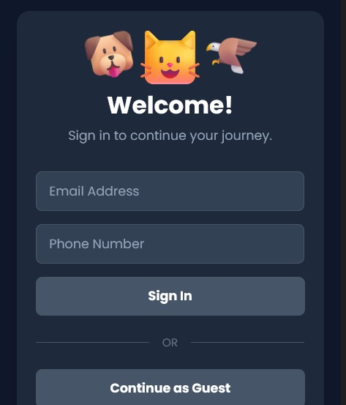
Sign in page

Slide 11
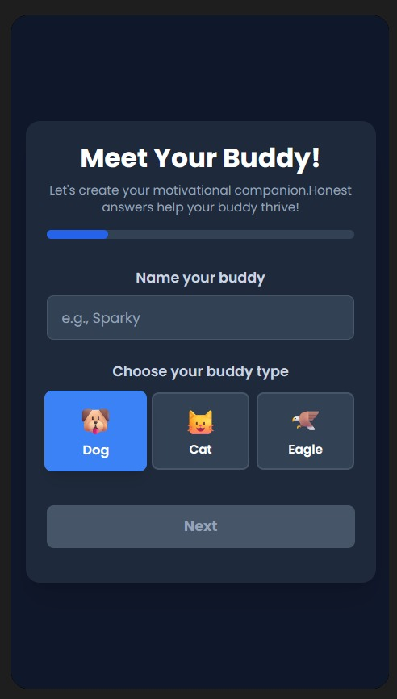
First page of onboarding

Slide 12
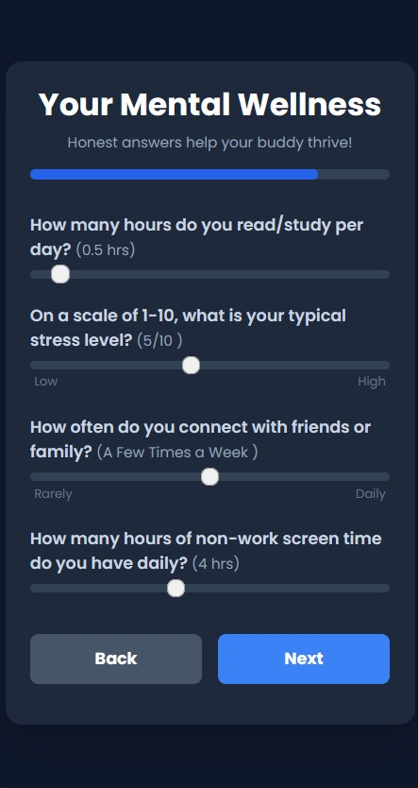
Mental health questionnaire

Slide 13
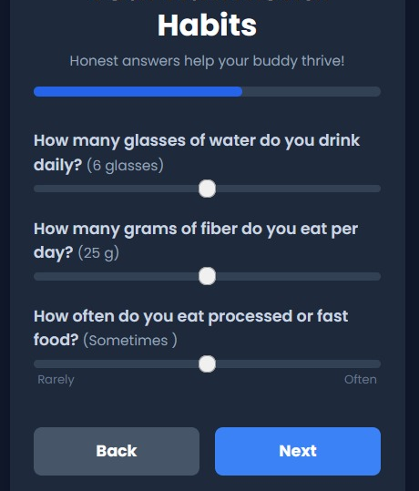
Gut health questionnaire

Slide 14
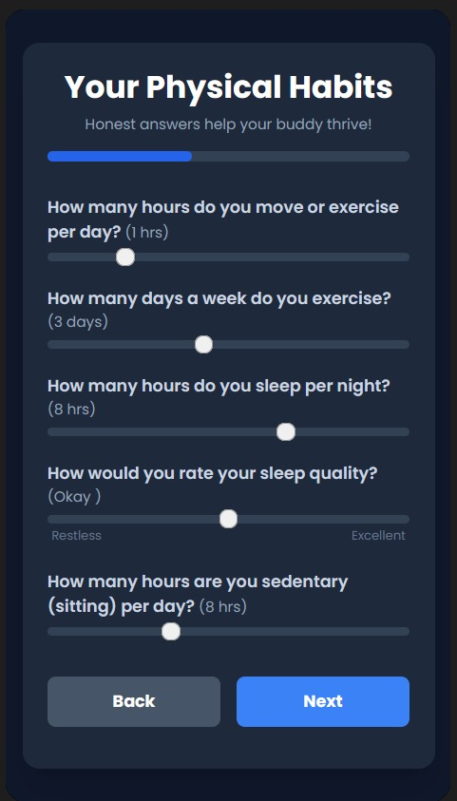
Physical health questionnaire

Slide 15
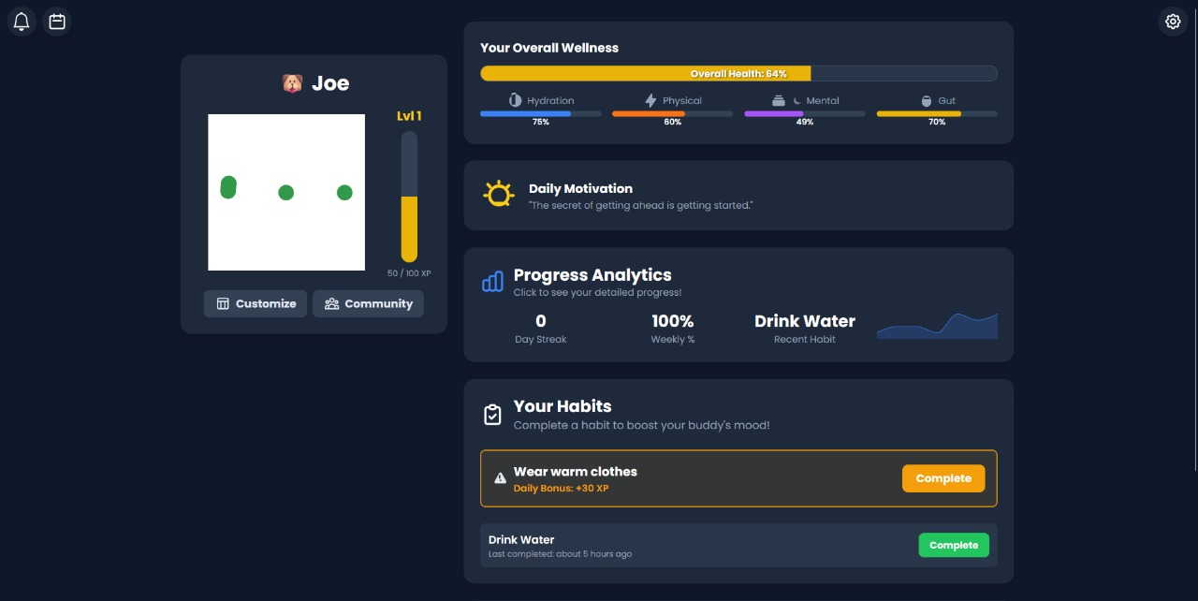
This is what the dashboard looks like. Buddy can level up along with your health. Hit the gym, hit extra xp.

Slide 16
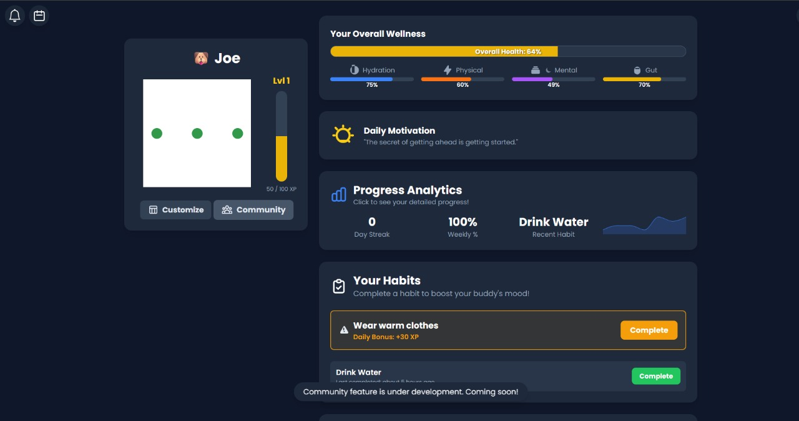
Community function will be available with further development. Challenge your fellow buddy trackers, along with your buddy, and reach greater heights.

Slide 17
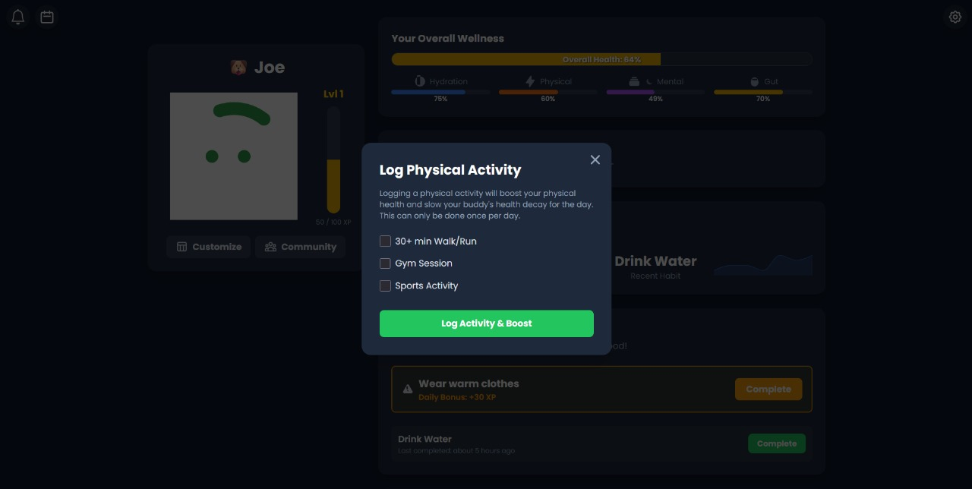
Daily compulsory physical activities

Slide 18
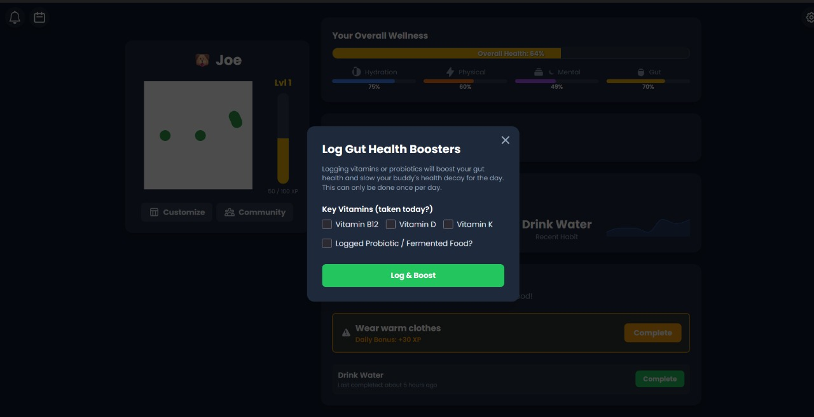
must always have a good diet to keep you and buddy alive, healthy and kicking

Slide 19
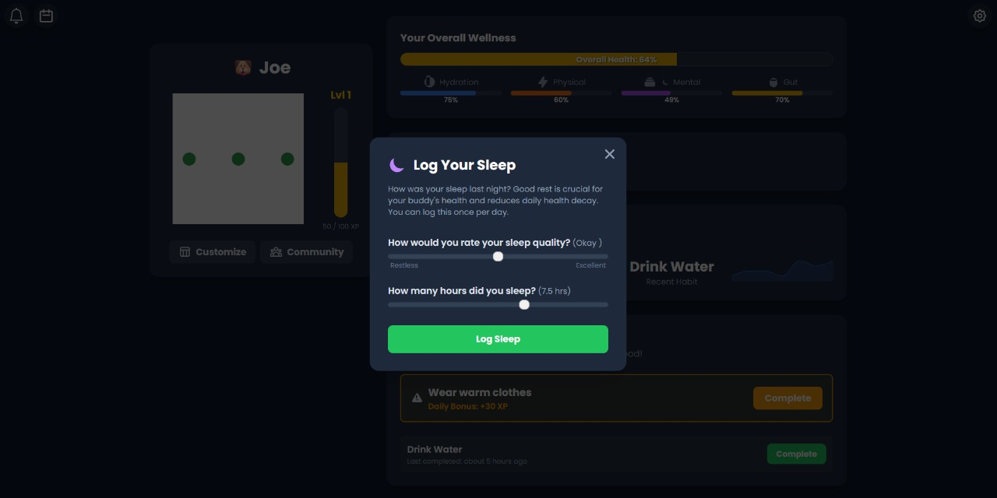
Resting affects all stats in life, so sleep in important

Slide 20
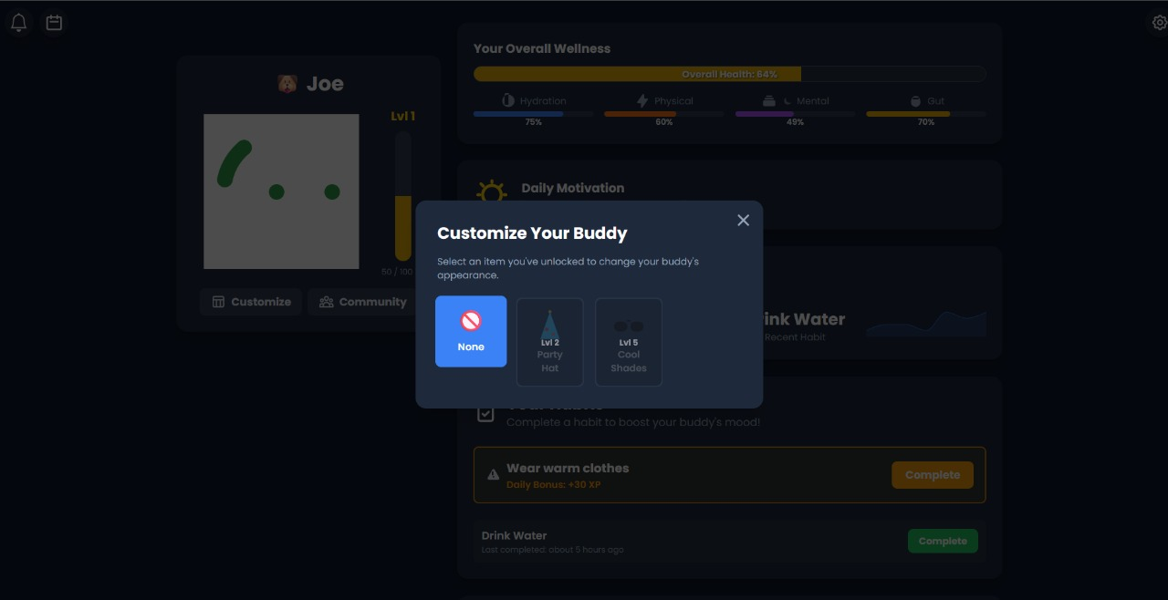
Level up Buddy (accessorise) and get rewards

Slide 21
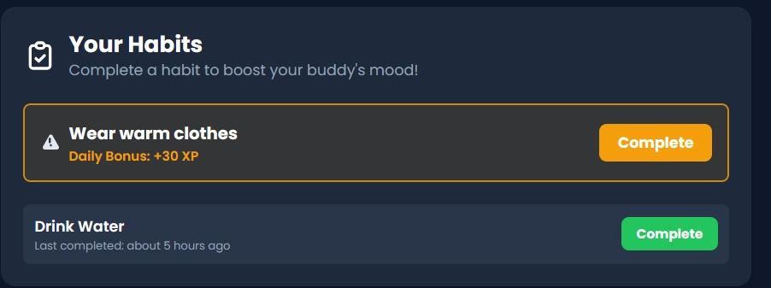
You can get random compulsory check-ins depending on weather, taking care of your buddy is taking care of yourself

Slide 22
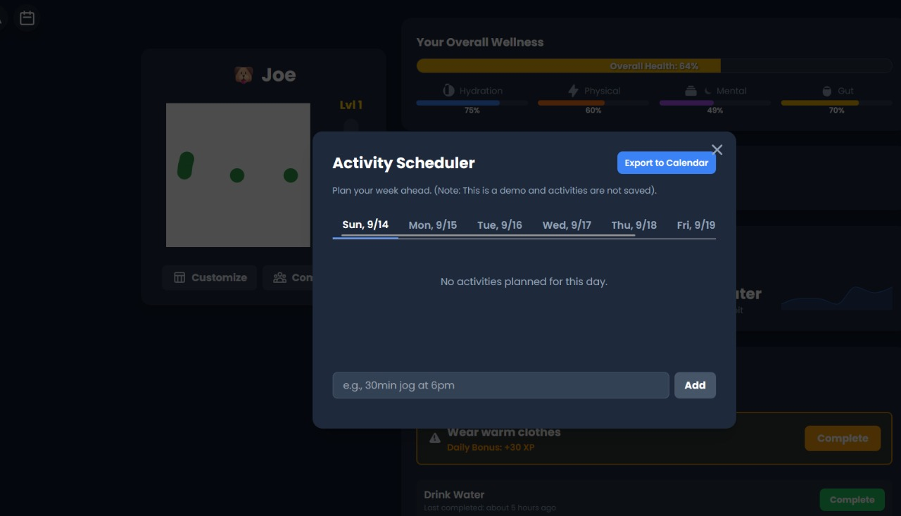
You can sync or link an external calendar to BetterBuddy to better structure your week

Slide 23
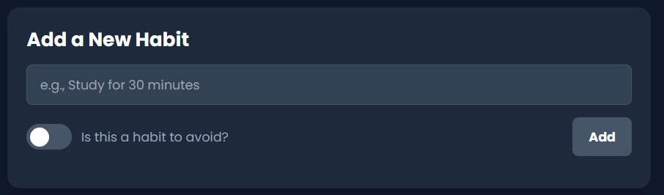
you can add both bad habits and good habits, then buddy works with you to build new better habits

Slide 24
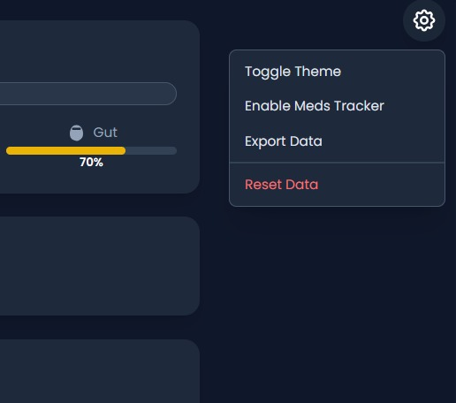
options under settings. you can enable meds tracker if you take medications

Slide 25
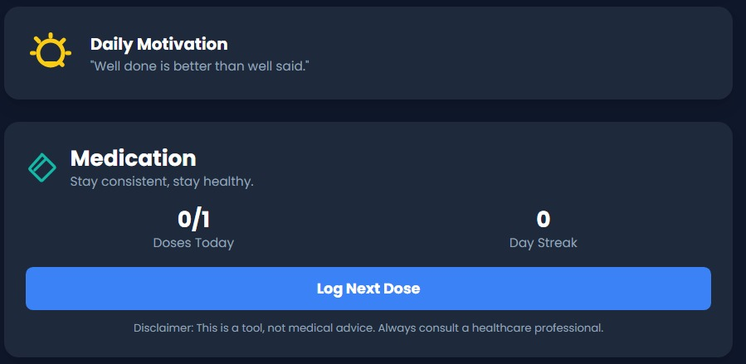
Medication tracker under daily notifications

Slide 26
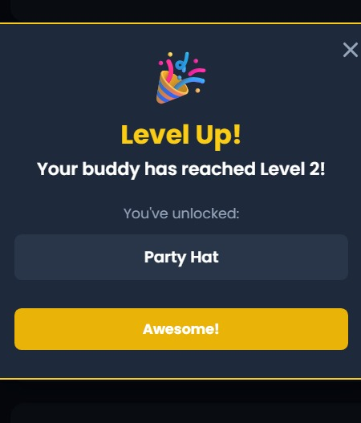
taking your medication on time gives you a boost of xp

Slide 27
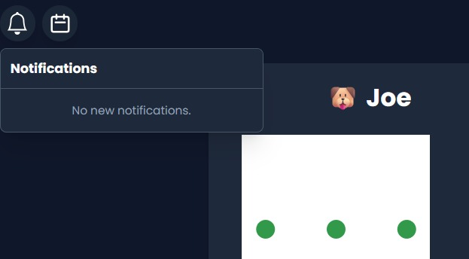
notification panel from buddy

Slide 28
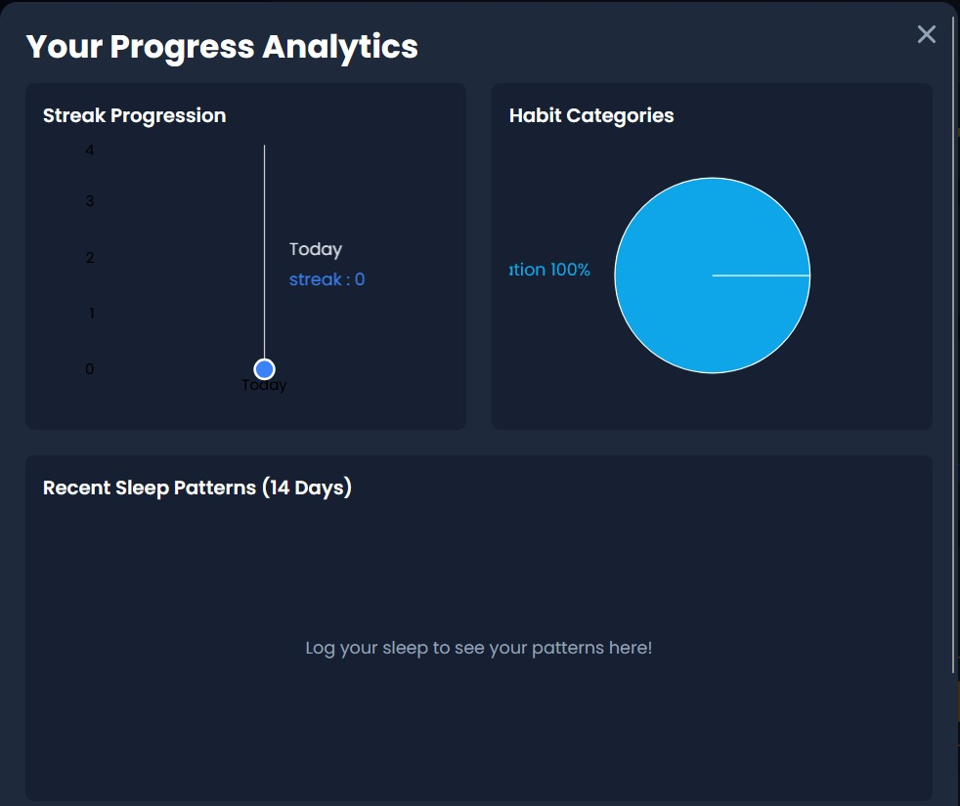
Your progress analysis, hidden feature(screen time decreases xp). All added habits are displayed here and tracked over a week

Slide 29
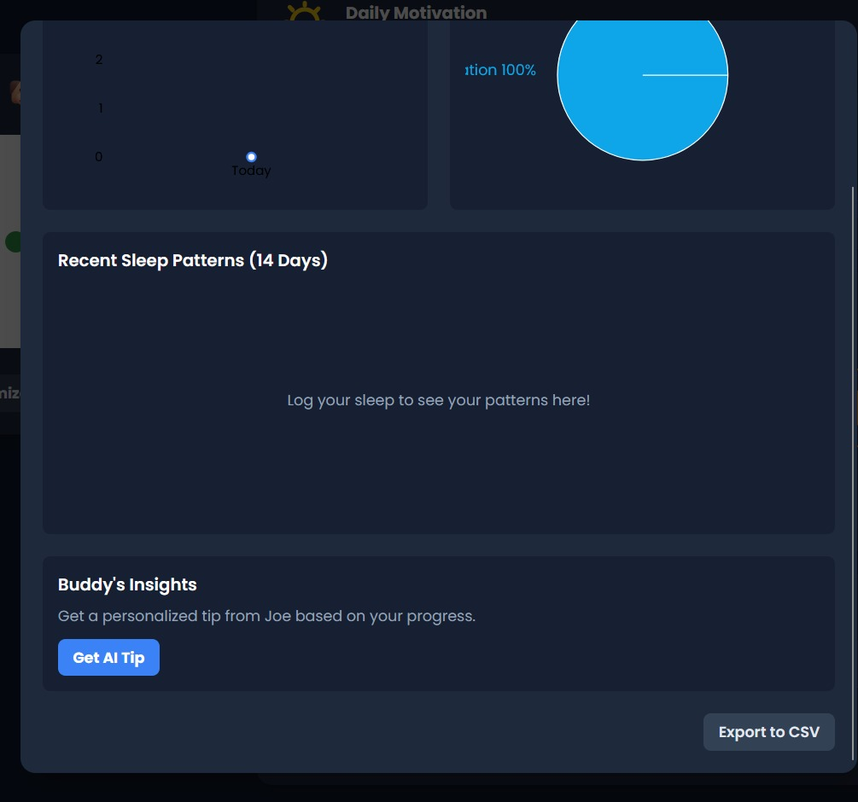
You can get advice from you buddy

Slide 30
A day in your life with Buddy
"Your Day, Buddy-Style"
Morning (sleep bar full → Buddy yawns happily)
Afternoon (walk log → bonus XP, weather hat tip)
Evening (recap quote + streak high-five).

Slide 31
Why it works?
Apps like this boost sticking power by 40% (fun rewards beat plain lists).
Pets reduce stress: like hugging a fluffy friend on your screen.
More energy from tracking, less guilt from gentle nudges.
Safe & Private : all on your phone, no sharing needed.
Free to start, with optional extras.

Slide 32
It's not nagging, it's like a supportive pal saying, 'You got this!’

Slide 33
BetterBuddy isn't just an app, it's a daily high-five for being you.

