Slide 1

Hierarchical load balancing
Ismael Alonso

Slide 2
The problem
Suppose you have a set of agents (or nodes) capable of processing “Jobs”
Any one of these agents are assigned jobs externally
Clients connect to them and send them work directly
If a subset of these agents has a bigger load than the rest the response time may degrade
There is a caveat here, we’ll get to this later
How to notice there is a problem and what to do in response?

Slide 3
The Problem
We have several options
Fully centralized load balancing
Doesn’t scale well
Fully distributed load balancing
Takes some time to reach good decisions
Can we compromise?

Slide 4
Hierarchical load balancing
Yes, we can!
We are going to form groups of nodes, each one having a leader
Any one node may only communicate with a leader or with their children
Unless… more on this later.
Child nodes can be the leaders of their own subgroup
Effectively, the hierarchy will end up looking like a tree.

Slide 5
Building the hierarchy
We now have choices
Branching factor (2 in my case)
Full tree vs complete tree vs a train wreck of a tree
Spatial locality or tunneling may influence tree building
Truth is, I arranged them as they came
Complete tree though, there is some order to my universe
How?
Remember that all nodes need to be leaves independently of whether they are leaders

Slide 6
Time to put the nodes to work
Originally three problems:
Fibo: linear
Sieve of Eratosthenes: n log(log(n))
Square sum (n²)
This turned out to be a problem to test the system
We’ll see why in a minute

Slide 7
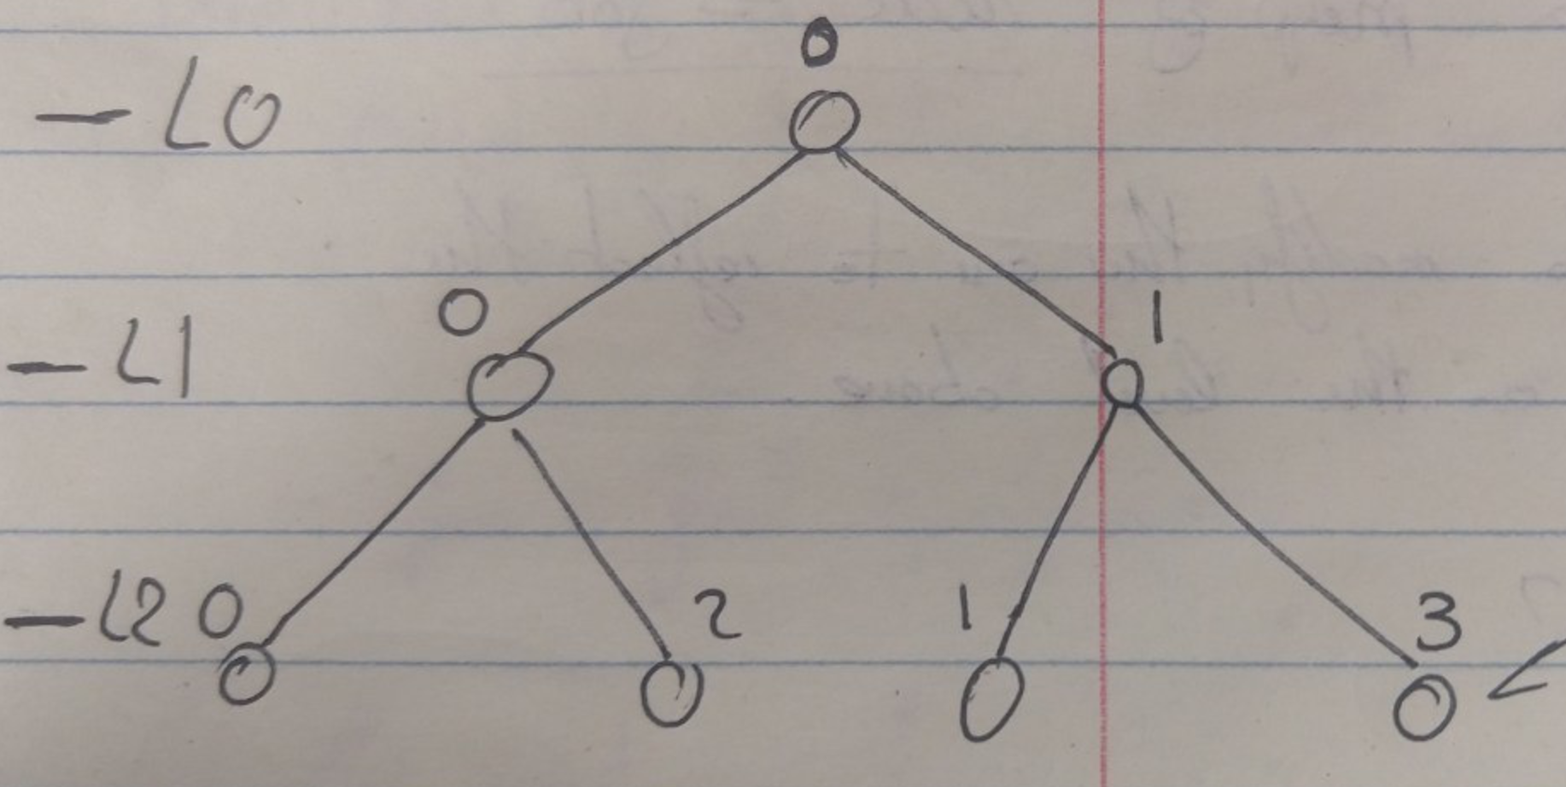
What then?
Now we need to know the load of the nodes in the hierarchy
What do you report though?
Remember this mess? → → →
1 cannot report its own to 0
0 cannot have a combined report at L0
Merge up whatever you have
Its good enough, trust me 👌

Slide 8
You got mail!
An imbalance has been found!
A node is 10% above or below average load
Freeze!
Or don’t, but you run the risk of balancing jobs that were completed at balance time
Collect all the jobs, aggregate them and pass them up
JK, just job metadata: estimated length and owner
Each leader defers decisions until its own leader has made decisions
Leaders can choose to further aggregate jobs by combining them (this is an optimization)

Slide 9
More on collection
I bet you still remember these shenanigans → → →
Aggregating the jobs is not easy, requires synchronization
Like a lot of it
Cannot pass anything up until you have a complete picture

Slide 10
Problem #1
Unless a node is over capacity, any utilization metric is worthless
Suppose you got a node at 20% capacity and another one at 70% capacity
Congrats, it’s load balancing time!
Wait, there are no jobs in the queues… wat?
To be more specific, hierarchical load balancing in this system is only good if two conditions are met simultaneously:
One node is grossly overutilized
One node is at least somewhat underutilized

Slide 11
PROBLEM #2
Okay, so, to test this thing we’ll skew the job allocation distribution.
Sure, let’s set up a thread that sends jobs to certain nodes with a frequency and an input size.
K cool:
n=1000² and T=50ms: load is 1.4x10⁻⁴% (hmmm… right…)
n=2500² and T=40ms: load is 0.01% (whalp, k)
n=6000² and T=40ms: int overflow for estimated job size (!!). Also load ~0.2 (better, but not good enough)
Ended up putting nodes to sleep while counting it as working for jobs
They got off easy, I know…

Slide 12
We have job info at the top now
RefineLB? What’s that?
As it turns out this is a Charm specific thing and I wanted to build my own
Each processor has a set of jobs it owns, ordered by size
The processors are also ordered in decreasing order of load (work allocated)
Jobs over the average load are donors
Jobs under the average load are recipients

Slide 13
Izzy’s law of loads
A node that’s already overloaded will tend to stay loaded
Don’t know if this is a thing, just a suspicion
Donors will donate until they’re under the average
Recipients will receive until they’re above the average
Repeat until there’s not longer both donors and recipients
Selected job is one that’s just under the potential room of load a recipient can take to go above
Or the one immediately above if none below

Slide 14
Propagating the changes down the pipe
A leader will communicate with all its children about the decisions made
The first level is easy, nothing external to the process really needs to be considered
I’m sure at this point we’re drinking buddies with this bad boy → → →
Whalp, there’s a few edge cases…

Slide 16
So… Agreement?
Once everyone is on the same page about what jobs we need to steal from other nodes…
We just ask for them… nicely.
Once we get what we want we resume operations and wait some time to start checking whether there is an imbalance again.

Slide 17
My system
A little overengineered, perhaps
Controllers spawn nodes in a single machine
Nodes do the work
Controllers spawn them as processes, so getting info out of them isn’t trivial
We got a dedicated logging node, started directly from a terminal we have access to
Fixed location
There is a client, just runs the show

Slide 18
My system
At some point late last week realized I didn’t have time to prep it to run in multiple machines
Single local controller spawns as many nodes as we need
Remember they don’t do real work anymore, so we can spawn virtually an unlimited amount of them
Demo?

Slide 19
Analysis
Load information is readily available and cheap to send/aggregate
To get job info, as many RTTs as levels the tree has are required
Propagating the load balancing decisions takes a variable amount of time
The big fish executes the process for as many levels as the tree has, but at the end of the process its info is final
Nodes closer to leaves must wait until the chain of command has decided what to do (up to log n RTTs)
Fetching your jobs takes one RTT

Slide 20
Questions?

