Slide 1
Cocoon: Encrypted Substring Search
Eric Chen, Izzy Gomez, Brian Saavedra, Jonatan Yucra
Notes:
Client server model for encrypted substring search

Slide 2
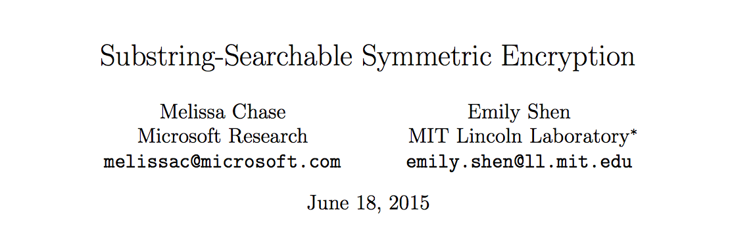
Background and Motivation
Trusting data servers (think AWS, Google, ….)
Homomorphic encryption and Substring Search
Notes:
Trusting 3rd parties with our data
I want to encrypt my own data, but still run operations on it remotely
Jonatan will talk about a higher level overview of what we’ve done

Slide 3







High Level Overview

Slide 4
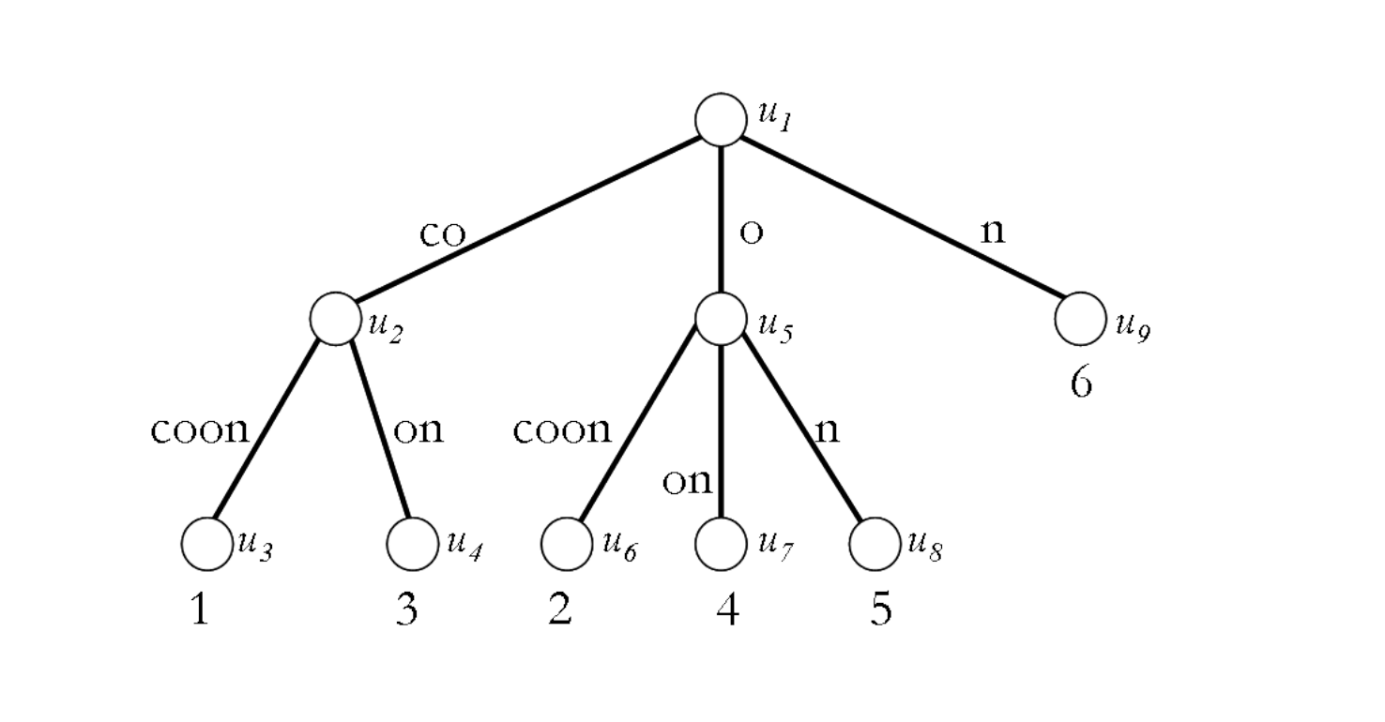
Algorithm
Suffix trees
Encrypted dictionary
3 rounds of communication

Slide 5
First Attempt
Ciphertext: D = { F_{K1}(pathLabel(u)) : Enc_{Kd}(index(u)) }
Communication: (query = “oon”)
Client sends T = F_{K1}( “oon”)
Server checks D for the key T. If exists, send D[T] back to client.
Client decrypts index = Dec_{Kd}( D[T] ).

Slide 6
Second Attempt
Ciphertext: D = { F_{K1}(initPathLabel(u)) : Enc_{Kd}(index(u)) }
C = [ Enc_{Kc}(ptxt[0]), Enc_{Kc}(ptxt[1]), Enc_{Kc}(ptxt[2]), … ]
Communication: (query = “coc”)
Client sends T1 = F_{K1}( “coc”), T2 = F_{K1}(“co”), T3 = F_{K1}(“c”)
Server checks D for the keys T1, T2, T3. Sends D[T2] back to client.
Client decrypts index = Dec_{Kd}( D[T2] ). Sends index, L = length of query
Server sends back C[ index : index + L ]
Client decrypts C[ index : index + L ] using Kc and compares to query.

Slide 7
Further improvements
Return indices of all matches
Hiding structure of the tree
Hiding string indices and leaf positions
Malicious adversaries

Slide 8
Implementation
Python script to encrypt text file
Node.js server, Express.js, Mongo
F_{K}(plaintext) = SHA256( SHA256(plaintext) + SHA256(K) )
Enc_{K}(plaintext) = AES in CBC mode with PKCS#5 padding

Slide 9
Demo

Slide 10
Analysis
Security:
Chosen Query Attack Secure (CQA2)
Security argument dependent on leakage functions
Time
Real world: 16kb file, 0.3 s to encrypt → currently super-linear growth Large constant in ciphertext size ~O(1) search → how does this grow?
Notes:
Quick analysis on security and time
Leakage functions are measures of pattern recognition in encrypted data and communication protocols

Slide 11
Questions?

