Slide 1
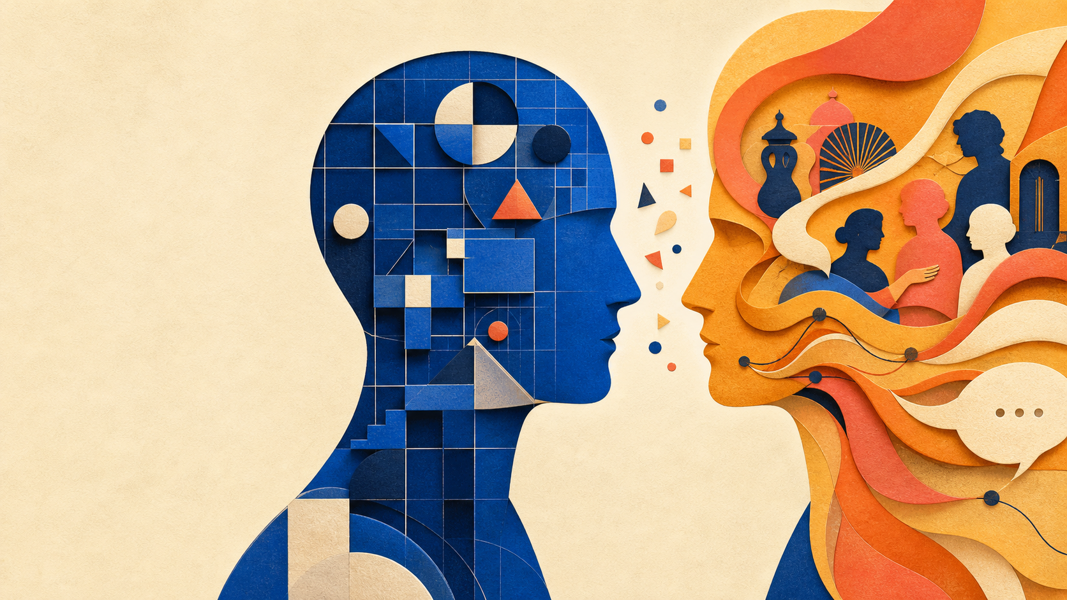
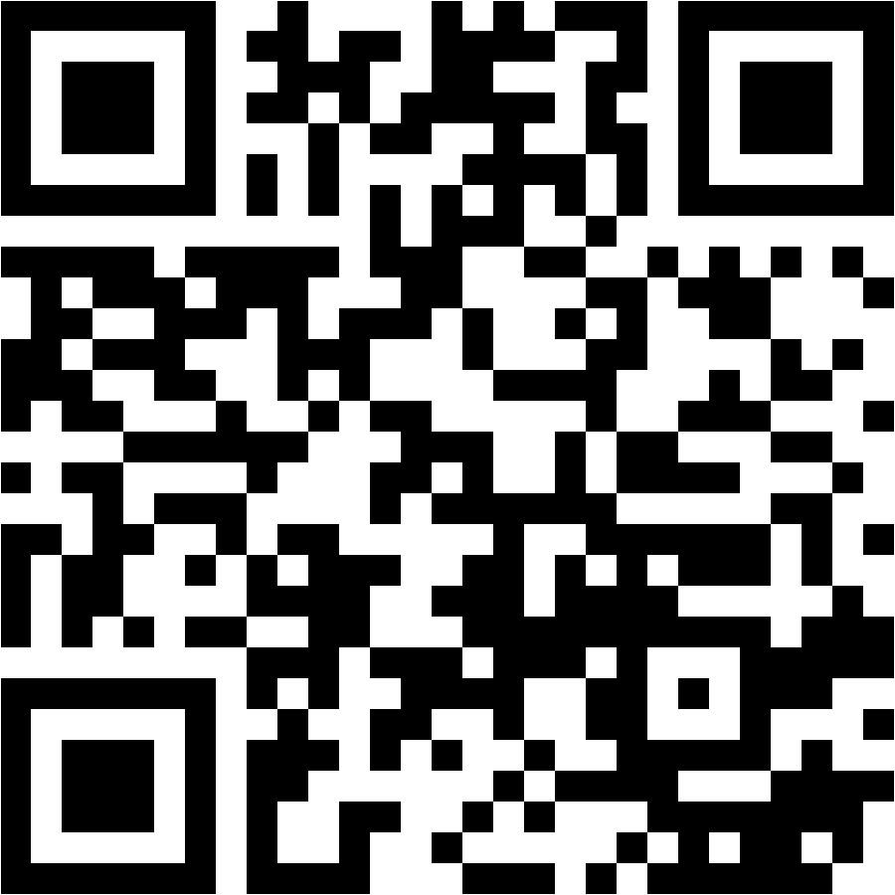
COGS 100 • WEEK 4 DAY 2 • READING 1
Celebrating
Divergence
Piaget and Vygotsky
Jerome Bruner
ONE QUESTION
How does a mind grow?
Group 8
Javen Cao — PID: A17806950
Juqy Chen — PID: A17796879
Quiz: tinyurl.com/cogs100-group8-quiz

Slide 2

COGS 100 • GROUP 8
Humans do more than adapt — we make accounts of the world
WE ADAPT
We act
in the world.
WE ALSO INTERPRET
We make theories
and stories about it.
Bruner’s question: how does development make this possible?
Source: Bruner (1997), p. 64. Slide wording is paraphrased.
02

Slide 3
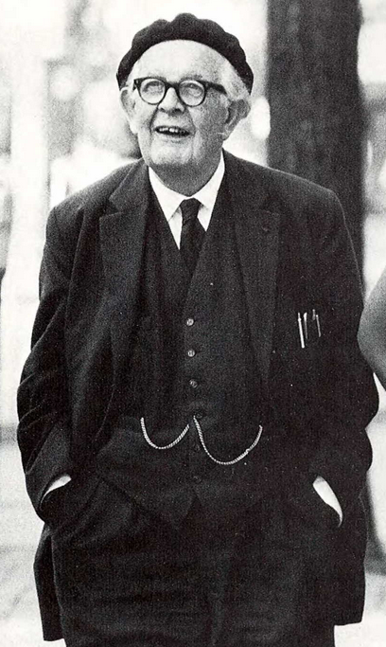
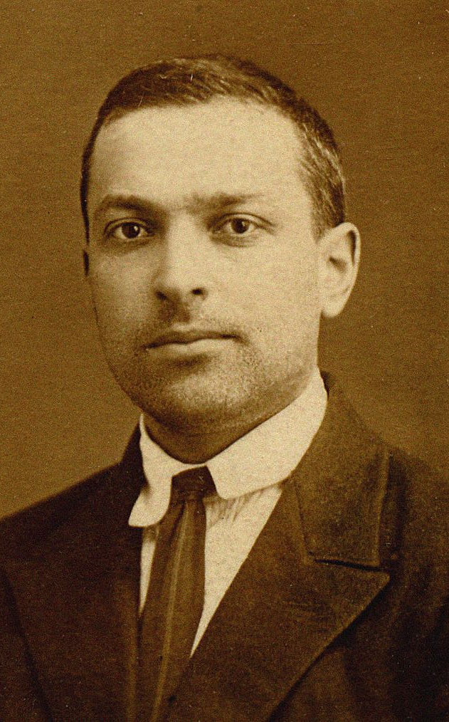
COGS 100 • GROUP 8
Piaget and Vygotsky answer the same question differently
Shared premise: the mind mediates between the external world and individual experience.
PIAGET
VYGOTSKY
Logic-like operations organize knowledge.
Culture and history become tools of mind.
Growth means stronger structures of thought.
Growth means mastering culturally embodied symbols.
The disagreement is productive: it reveals two ways of studying development.
Content: Bruner (1997), pp. 65, 68, 70–72. Photos: Wikimedia Commons, public domain.
03

Slide 4
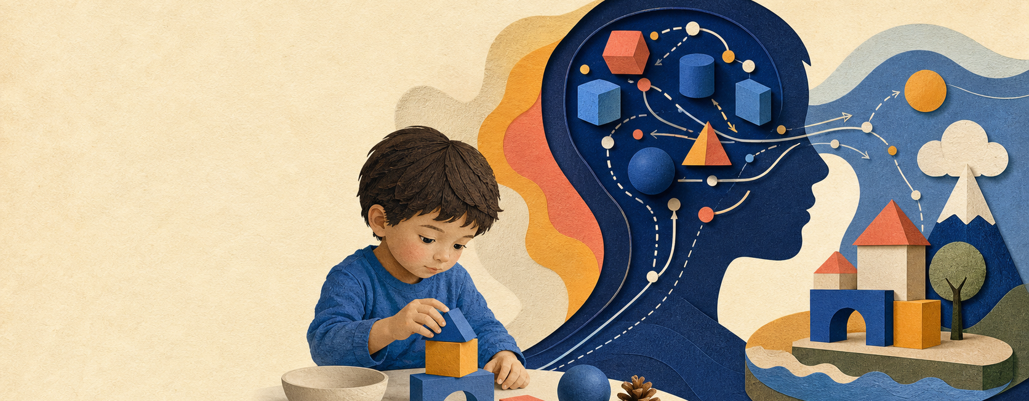
COGS 100 • GROUP 8
For Piaget, the mind organizes experience through logic-like operations
THE MIND MEDIATES
It does not simply record the world.
It organizes it.
Knowledge is built, then tested in action. Thinking helps shape what the child can know.
Source: Bruner (1997), p. 65. Slide wording is paraphrased.
04

Slide 5
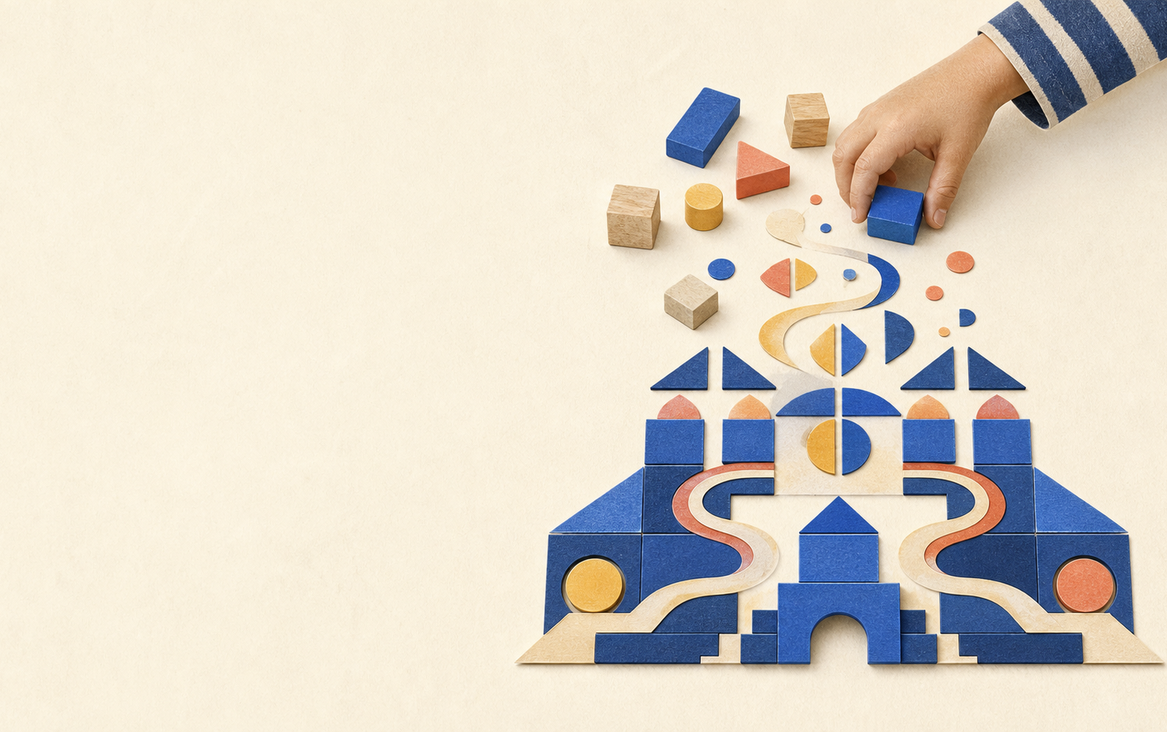
COGS 100 • GROUP 8
Piaget’s growth story: action becomes increasingly organized thought
01
Act on the world
The child starts with concrete action.
02
Carry action into thought
Thought becomes less tied to the immediate view.
03
Reflect on thought itself
Formal operations make thought an object of thought.
Disequilibration
Piaget says growth comes from the pull between fitting experience into an old structure and changing the structure to fit experience.
Source: Bruner (1997), pp. 65–66. Slide wording is paraphrased.
05

Slide 6
COGS 100 • GROUP 8
Piaget maps a stable direction of growth better than its causes
ABUNDANTLY CLEAR
LESS CLEAR OR NEGLECTED
Development follows an invariant course.
What moves development forward — and how other people and culture matter.
Piaget is strongest on the direction and systematicity of growth.
Bruner names intersubjectivity, instruction, negotiation, and cultural interpretation as the missing territory.
Bridge: If development cannot be understood only inside one individual mind, where should we look next?
Source: Bruner (1997), pp. 66–67. Slide wording is paraphrased.
06

Slide 7
COGS 100 • GROUP 8
Vygotsky starts with meaning, not a mental calculus
MIND
DEVELOPMENT
SOURCE
A process for giving experience meaning.
Mastery of higher-order symbolic systems.
Culture +
social
interaction
→
→
Meaning needs language — and the cultural context in which language is used.
A new system can reorganize earlier ideas — like algebra reorganizing arithmetic.
The central problem: How do these tools get from outside to inside?
Source: Bruner (1997), p. 68. Slide wording is paraphrased.
07

Slide 8

COGS 100 • GROUP 8
Social interaction is how culture enters thought
Outside
People act and talk together.
Between
Speech carries shared meanings.
Inside
Those meanings become tools for thinking.
Internalization is not copying. It is culture becoming a resource within the person’s own thought.
Source: Bruner (1997), p. 68. Slide wording is paraphrased.
08

Slide 9

COGS 100 • GROUP 8
The ZPD shows what guided help makes possible
The zone of proximal development is the gap between what you can do alone and what you can do with well-matched help.
Already possible
What the learner can do alone
The ZPD
The next step that becomes possible with help
Hints, sequencing, and shared attention make the help fit the learner.
The tutor helps with the next possible step; the learner still does the learning.
Source: Bruner (1997), pp. 68–69. Slide wording is paraphrased.
09

Slide 10
COGS 100 • GROUP 8
Piaget is closer to traditional cognitive science; Vygotsky to situated cognition
PIAGET
VYGOTSKY
Traditional cognitive science
Situated cognitive science
• General, logic-like structures
• Individual operations
• Explanation, verification, and invariant development
• Meaning in language and culture
• Social interaction and context
• Interpretation and situated understanding
This is a rough mapping, not a claim that either thinker fits only one box.
Source: Bruner (1997), pp. 70–72. The cognitive-science labels are interpretive applications of Bruner’s contrast.
10

Slide 11

COGS 100 • GROUP 8
Their divergence gives us two useful questions about development
PIAGET’S QUESTION
VYGOTSKY’S QUESTION
Why is development often stable?
When can collaboration open a new step?
Bruner’s conclusion: do not force a quick reconciliation — use the tension to ask better questions.
Source: Bruner (1997), pp. 70–72. Slide wording is paraphrased.
11

Slide 12
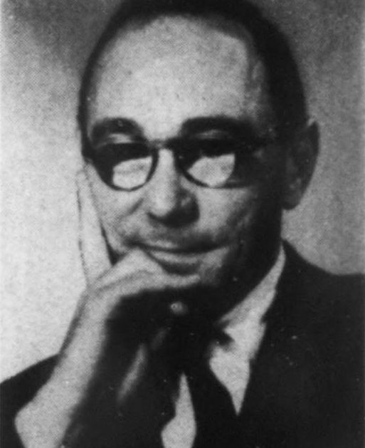
COGS 100 • GROUP 8
A growing mind is not explained
by logic alone — or culture alone.
Piaget: thought becomes more organized.
Vygotsky: culture becomes a tool for thought.
Bruner: keep both questions alive.
JEROME BRUNER
Scan for the
3-question quiz
tinyurl.com/cogs100-group8-quiz
Thank you
Reading: Bruner (1997). Bruner photo: Wikimedia Commons, public domain.
12

