Slide 1
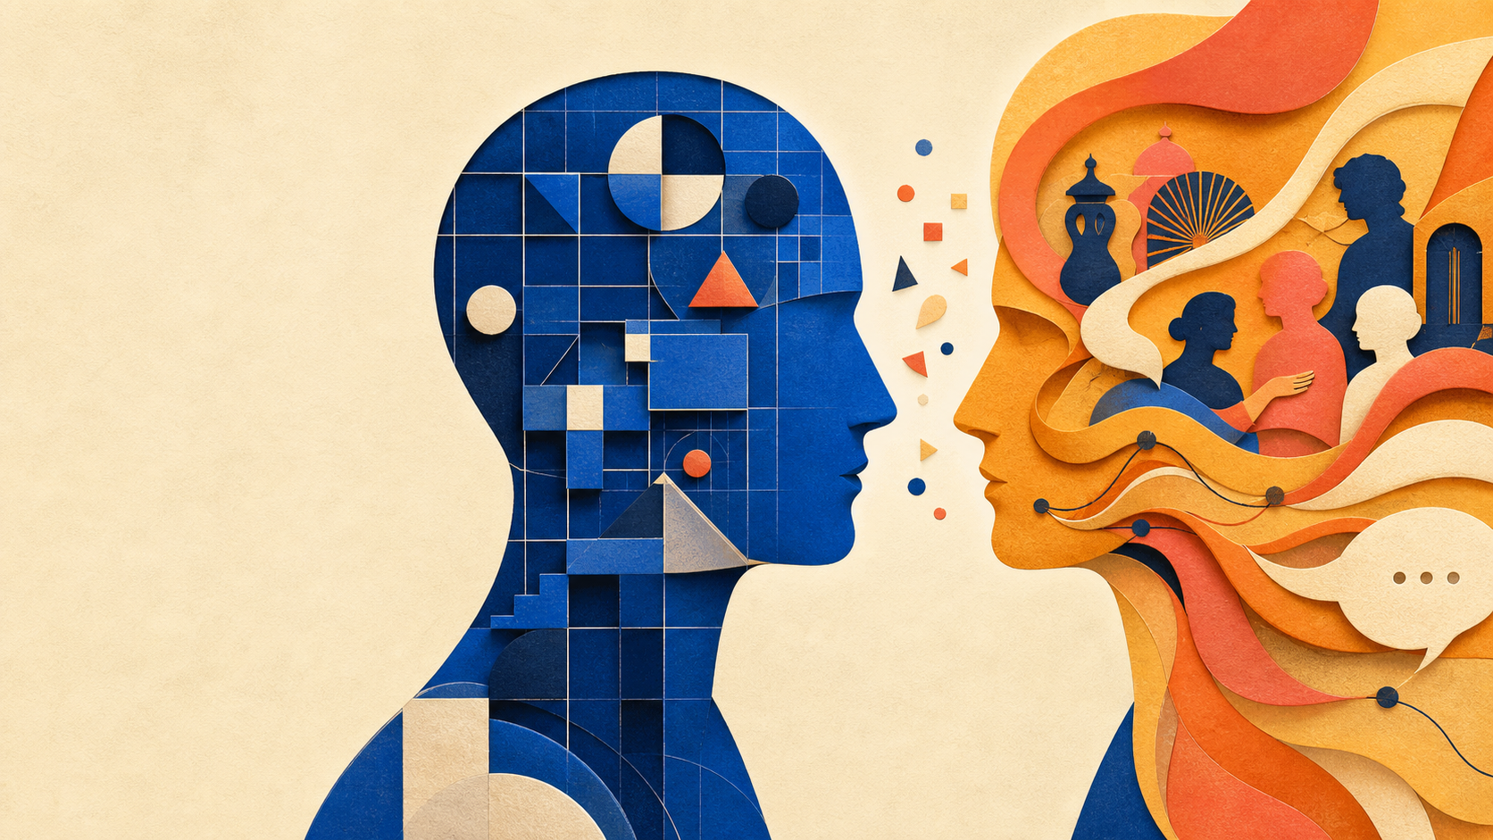

COGS 100 • WEEK 4 DAY 2 • READING 1
Celebrating
Divergence
Piaget and Vygotsky
Jerome Bruner
ONE QUESTION
How does a mind grow?
Group 8
Javen Cao — PID: A17806950
Juqy Chen — PID: A17796879
Quiz: tinyurl.com/cogs100-group8-quiz
Notes:
JAVEN — about 40 seconds
Hi everyone, I’m Javen Cao, and my groupmate is Juqy Chen. We’re Group 8, and today we’re talking about Bruner’s paper on Piaget and Vygotsky. We’ll use one simple question: how does a mind grow? Piaget and Vygotsky both care about that question, but they answer it in very different ways.
The quiz link is on this slide. Every answer shows up in our presentation.
We are not going to retell every page of the paper. Instead, we will follow the questions in this week’s learning outcomes: what each thinker says about the mind, how growth happens, and why culture and other people matter.
Before we compare the two theories, let’s start with Bruner’s question: what is special about human thinking?

Slide 2
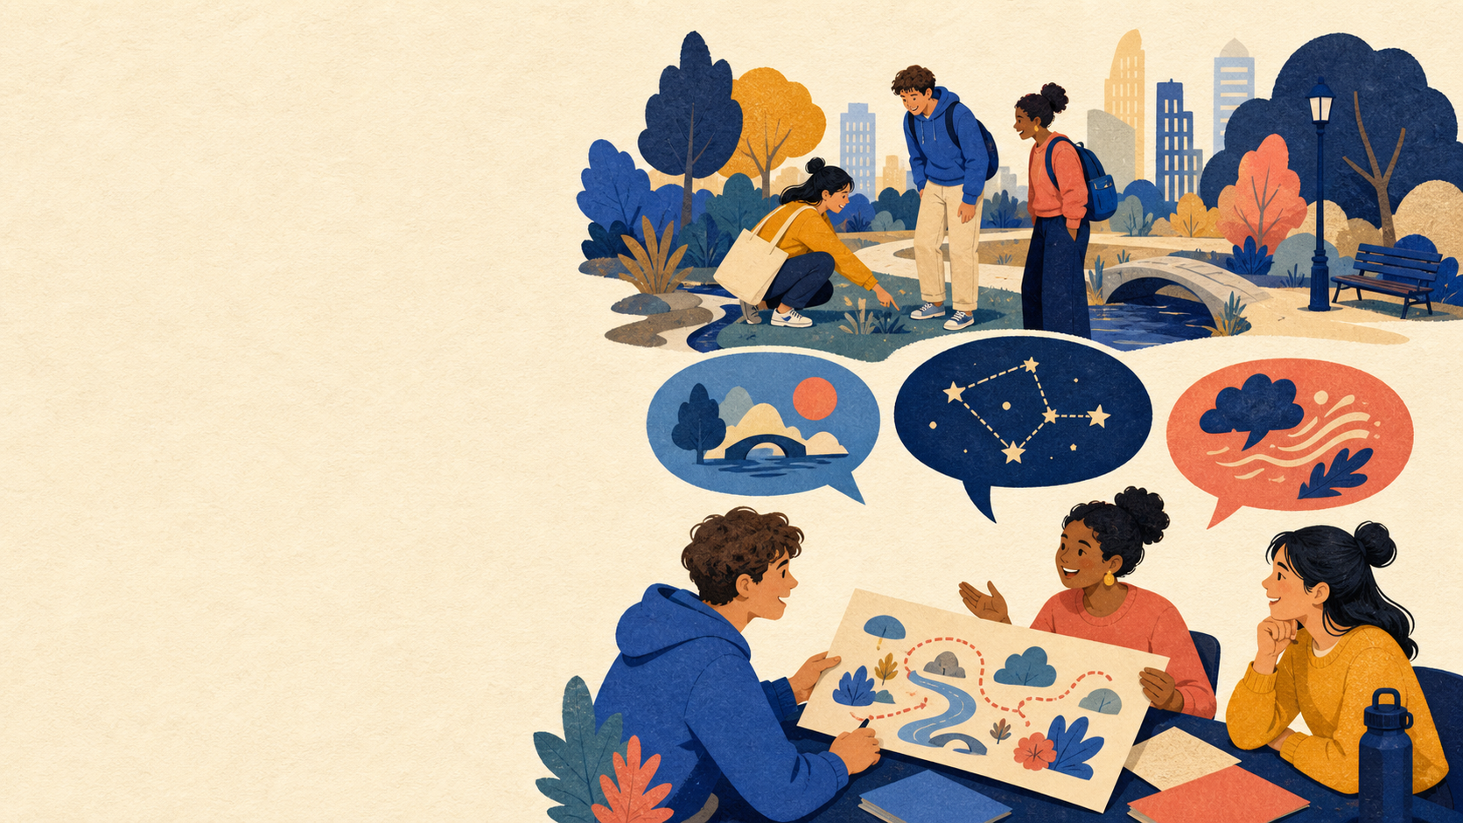
COGS 100 • GROUP 8
Humans do more than adapt — we make accounts of the world
WE ADAPT
We act
in the world.
WE ALSO INTERPRET
We make theories
and stories about it.
Bruner’s question: how does development make this possible?
Source: Bruner (1997), p. 64. Slide wording is paraphrased.
02
Notes:
JAVEN — about 1 minute 45 seconds
Bruner starts with a simple point. Lots of living things adapt to the world around them. Humans do too. But humans also do something extra: we make theories and stories about the world. We make stories about other people. We even make stories about ourselves.
That matters because stories and theories help us explain things, argue with each other, and work together. Sometimes they even give people things to fight about.
For example, two people can see the same event and still explain it in different ways. They may point to different causes, tell different stories about what matters, and then try to persuade each other. Bruner thinks this ability to make and share accounts is a big part of what makes human mental life special.
So the big development question is this: how does a child grow into someone who can build and share these kinds of accounts? Piaget gives one answer. Vygotsky gives another.

Slide 3
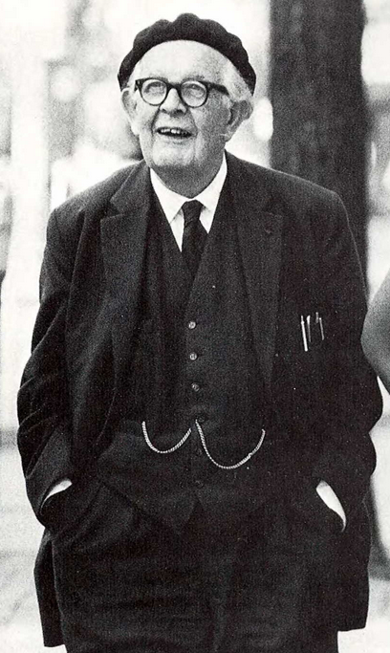
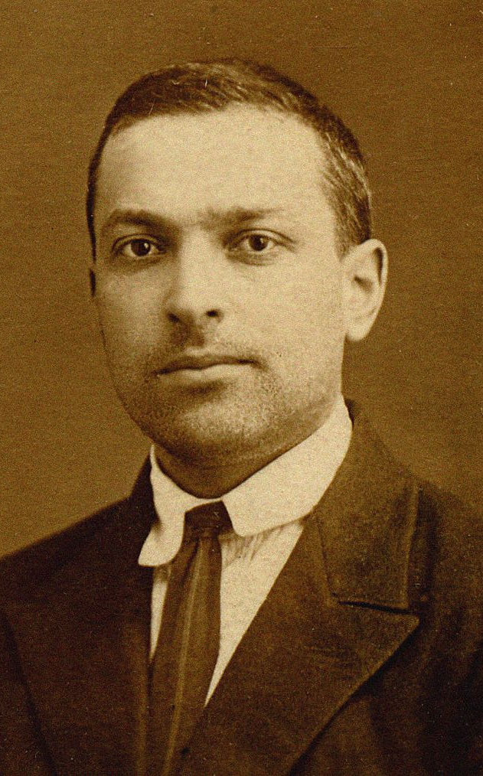
COGS 100 • GROUP 8
Piaget and Vygotsky answer the same question differently
Shared premise: the mind mediates between the external world and individual experience.
PIAGET
VYGOTSKY
Logic-like operations organize knowledge.
Culture and history become tools of mind.
Growth means stronger structures of thought.
Growth means mastering culturally embodied symbols.
The disagreement is productive: it reveals two ways of studying development.
Content: Bruner (1997), pp. 65, 68, 70–72. Photos: Wikimedia Commons, public domain.
03
Notes:
JAVEN — about 1 minute 30 seconds
Both thinkers agree on one starting point. We do not just take in the world like a camera. The mind sits between what happens out there and what we come to know.
Piaget’s big insight is logic-like operations. He thinks the child slowly builds better ways to organize experience. Vygotsky’s big insight is different. He thinks human culture and history give us tools for thinking, especially language.
You can already see the contrast in the visual. Piaget asks how one person’s thinking becomes more organized. Vygotsky asks how the things people already share, like words, symbols, and ways of teaching, become available to one person’s mind.
So this is not only a disagreement about teaching. It is a disagreement about what should be at the center of a theory of mind. Let’s start with Piaget.

Slide 4
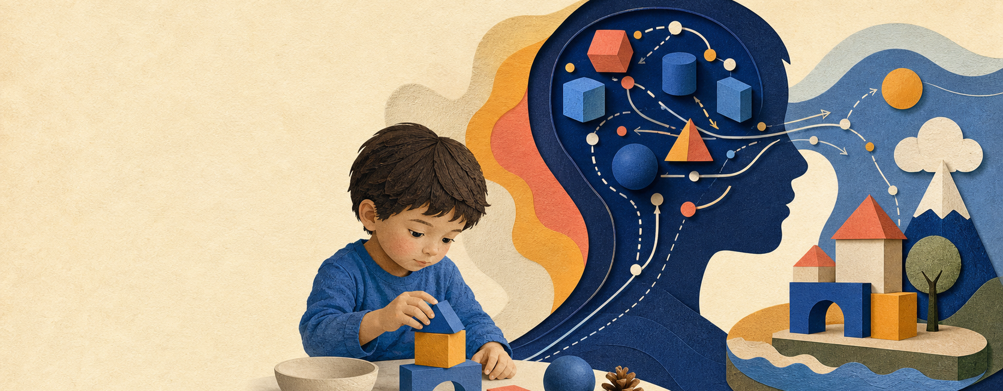
COGS 100 • GROUP 8
For Piaget, the mind organizes experience through logic-like operations
THE MIND MEDIATES
It does not simply record the world.
It organizes it.
Knowledge is built, then tested in action. Thinking helps shape what the child can know.
Source: Bruner (1997), p. 65. Slide wording is paraphrased.
04
Notes:
JAVEN — about 2 minutes
Piaget says the mind uses organized operations to make sense of experience. He does not mean that the mind is literally a calculator. He means that thinking has a structure.
For Piaget, knowledge is made, not simply found. A child acts in the world, organizes what happened, and then tests that understanding through more action. If the understanding works, it becomes part of a stronger way of thinking.
Think about a child experimenting with blocks. The child does not receive the idea of balance as a finished fact. They try something, see what falls, change the arrangement, and try again. The important point is not the blocks themselves. It is that action and thought keep shaping each other.
That is why the word “mediate” matters here. The world does not turn straight into knowledge. The child’s way of thinking helps shape what the child can know.
Those operations begin in action. Over time, they become more internal, less stuck to one immediate point of view, and more open to reflection. That leads to Piaget’s story about growth.

Slide 5
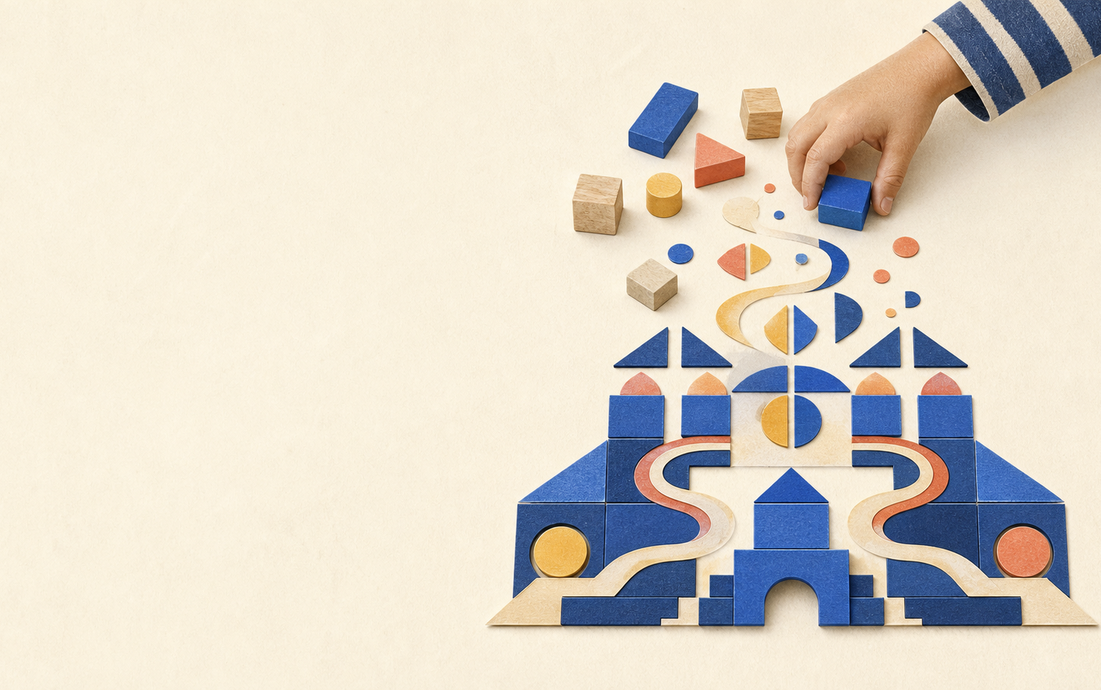
COGS 100 • GROUP 8
Piaget’s growth story: action becomes increasingly organized thought
01
Act on the world
The child starts with concrete action.
02
Carry action into thought
Thought becomes less tied to the immediate view.
03
Reflect on thought itself
Formal operations make thought an object of thought.
Disequilibration
Piaget says growth comes from the pull between fitting experience into an old structure and changing the structure to fit experience.
Source: Bruner (1997), pp. 65–66. Slide wording is paraphrased.
05
Notes:
JAVEN — about 2 minutes
Here is Piaget’s basic sequence. First, a child does things: touching, moving, sorting, and trying things out. Later, the child can carry some of those actions in thought. Then thought becomes less tied to what is right in front of the child. Eventually, the person can think about thought itself.
Piaget calls the pressure behind this growth disequilibration. Imagine you meet something that does not fit what you already think. You can try to fit it into your old idea. That is assimilation. Or you can change the old idea. That is accommodation.
Look at the blocks on the right. Imagine the child expects one arrangement to work, but the structure falls. They can treat that failure as just another version of the old pattern and keep using the same rule. That is assimilation. Or they can revise the rule, perhaps by changing which block goes underneath. That is accommodation. The surprise creates a problem for the old idea, and changing the idea solves that problem.
Piaget says the tension between those two moves pushes thinking forward. Bruner’s criticism is that the basic idea is clear, but the exact mechanism is still not fully explained.

Slide 6
COGS 100 • GROUP 8
Piaget maps a stable direction of growth better than its causes
ABUNDANTLY CLEAR
LESS CLEAR OR NEGLECTED
Development follows an invariant course.
What moves development forward — and how other people and culture matter.
Piaget is strongest on the direction and systematicity of growth.
Bruner names intersubjectivity, instruction, negotiation, and cultural interpretation as the missing territory.
Bridge: If development cannot be understood only inside one individual mind, where should we look next?
Source: Bruner (1997), pp. 66–67. Slide wording is paraphrased.
06
Notes:
JAVEN — about 2 minutes 20 seconds, then personal takeaway
Bruner gives Piaget a lot of credit. Piaget showed that development is not just a random pile of habits. It has a direction and a pattern. Bruner says one thing is very clear in Piaget’s theory: development follows an invariant course.
But another part is less clear. What actually moves a child from one stage to the next? Bruner thinks Piaget tells us more about where growth goes than about what causes it.
Bruner also thinks Piaget leaves out too much about other people. How do people understand each other well enough to teach, negotiate, and build a shared world? In Piaget’s account, culture often looks more like a challenge to the individual than a resource the individual can use.
That criticism matters because teaching is more than placing a child next to a difficult problem. A teacher can point to what matters, use words the learner already knows, and connect a new idea to a shared activity. Bruner wants a theory that can explain why those social moves sometimes change what a learner is able to do.
One thing I learned from this section is that a theory can be great at showing the direction of change and still leave the engine of change unclear.
That gap brings us to Vygotsky.

Slide 7
COGS 100 • GROUP 8
Vygotsky starts with meaning, not a mental calculus
MIND
DEVELOPMENT
SOURCE
A process for giving experience meaning.
Mastery of higher-order symbolic systems.
Culture +
social
interaction
→
→
Meaning needs language — and the cultural context in which language is used.
A new system can reorganize earlier ideas — like algebra reorganizing arithmetic.
The central problem: How do these tools get from outside to inside?
Source: Bruner (1997), p. 68. Slide wording is paraphrased.
07
Notes:
JUQY — about 1 minute 30 seconds
Hi, I’m Juqy Chen. Vygotsky also thinks the mind stands between the world and our experience. But he does not start with logic. He starts with meaning.
For Vygotsky, meaning depends on language and on the culture where that language is used. So mental growth means learning the symbolic tools that a culture already has. Think about how algebra can reorganize arithmetic. It gives you a new way to handle earlier ideas.
A symbolic tool is not just information that you memorize. It gives you a way to operate on ideas. A number line, a diagram, a word for a category, or algebraic notation can let you notice relationships that were harder to handle before.
This growth does not come from inside one child alone. It depends on cultural tools and on ongoing contact with other people. That leads to Vygotsky’s key question: how do tools that start outside us become tools inside our own thinking?

Slide 8
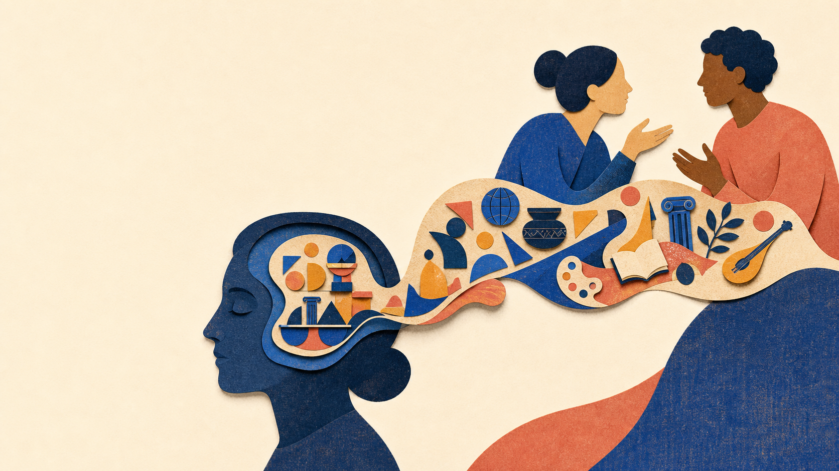
COGS 100 • GROUP 8
Social interaction is how culture enters thought
Outside
People act and talk together.
Between
Speech carries shared meanings.
Inside
Those meanings become tools for thinking.
Internalization is not copying. It is culture becoming a resource within the person’s own thought.
Source: Bruner (1997), p. 68. Slide wording is paraphrased.
08
Notes:
JUQY — about 2 minutes
For Vygotsky, mental life starts out social. People act together. They talk. They solve problems together. And speech carries shared meanings from the culture around them.
Internalization is the name for what happens next. Meanings that first show up between people become resources inside one person’s thinking.
For a simple example, imagine someone learning a new task with an adult beside them. At first, the adult says what to look for and what to do next. Later, the learner may quietly use those same kinds of prompts for themselves. The guidance has moved from a shared interaction into the learner’s own thinking.
This is not just copying someone else. Once a person has a new tool for thinking, that tool can change how older ideas fit together. It can also help the person go beyond the immediate situation.
Bruner points out that Vygotsky does not fully explain the mechanism of internalization either. But the main idea is clear: social life and cultural tools are not just outside influences. They can become part of the way a person thinks.

Slide 9

COGS 100 • GROUP 8
The ZPD shows what guided help makes possible
The zone of proximal development is the gap between what you can do alone and what you can do with well-matched help.
Already possible
What the learner can do alone
The ZPD
The next step that becomes possible with help
Hints, sequencing, and shared attention make the help fit the learner.
The tutor helps with the next possible step; the learner still does the learning.
Source: Bruner (1997), pp. 68–69. Slide wording is paraphrased.
09
Notes:
JUQY — about 2 minutes
The zone of proximal development, or ZPD, makes Vygotsky’s social view very concrete. It is the gap between what a learner can do alone and what that learner can do with useful help from someone else.
The point is not that any help works. Good help has to match the learner’s next possible step. A tutor might point out the key part of a problem, block distractions, break the task into steps, or help the learner talk through the problem.
The learner is still doing the learning. The tutor is not simply giving away the answer. The tutor notices what the learner can almost do and gives just enough support to make that next step possible.
For example, if a learner is stuck on one part of a problem, a useful tutor might ask, “What information do we already have?” They do not solve the whole problem for the learner. They help the learner see the next move, so the learner can still make it.
For Bruner, this also raises a bigger question: humans teach each other in a systematic way. What makes teaching and being taught possible in the first place?

Slide 10
COGS 100 • GROUP 8
Piaget is closer to traditional cognitive science; Vygotsky to situated cognition
PIAGET
VYGOTSKY
Traditional cognitive science
Situated cognitive science
• General, logic-like structures
• Individual operations
• Explanation, verification, and invariant development
• Meaning in language and culture
• Social interaction and context
• Interpretation and situated understanding
This is a rough mapping, not a claim that either thinker fits only one box.
Source: Bruner (1997), pp. 70–72. The cognitive-science labels are interpretive applications of Bruner’s contrast.
10
Notes:
JUQY — about 1 minute 40 seconds
Our learning outcome asks us to connect these ideas to cognitive science. This is a useful rough comparison, not a claim that either thinker fits perfectly into one modern label.
Piaget sounds closer to traditional cognitive science. He looks for general, logic-like structures inside an individual mind. He wants explanations that can be checked and tested.
Vygotsky sounds closer to situated cognitive science. He puts language, culture, history, and a particular interaction right in the middle of the story. He is more interested in how people make meaning in context.
So the difference is not simply “inside the mind” versus “outside the mind.” Both thinkers care about development. The difference is which part of the explanation they make central: Piaget highlights organized operations, while Vygotsky highlights cultural tools and interaction.
But we should not turn this into a cartoon. Piaget did not say culture never matters. And Vygotsky did not say development has no movement from concrete ideas to more abstract ones. The real difference is where each theory puts the center of explanation.

Slide 11

COGS 100 • GROUP 8
Their divergence gives us two useful questions about development
PIAGET’S QUESTION
VYGOTSKY’S QUESTION
Why is development often stable?
When can collaboration open a new step?
Bruner’s conclusion: do not force a quick reconciliation — use the tension to ask better questions.
Source: Bruner (1997), pp. 70–72. Slide wording is paraphrased.
11
Notes:
JUQY — about 1 minute 40 seconds
Bruner does not think the answer is to blend Piaget and Vygotsky into one easy theory. He thinks a good theory of development has to explain two very different things.
First, why is development often stable? Why can good teaching fail to make an immediate difference? Why is it hard to transfer learning from one setting to another? Piaget helps us look for those regularities and limits.
Second, why can development sometimes move quickly? Why can the right kind of collaboration open up a new possibility? Vygotsky helps us look for those levers of change: scaffolding, joint activity, and cultural opportunity.
This is why Bruner calls the difference a divergence, not a mistake that has to be erased. If we only ask Piaget’s question, we might miss what a good interaction can do. If we only ask Vygotsky’s question, we might miss why learning does not always transfer right away. Keeping both questions gives us a stronger way to study development.
That is why Bruner thinks their disagreement is useful. Each theory pushes the other to answer questions it might otherwise ignore.

Slide 12
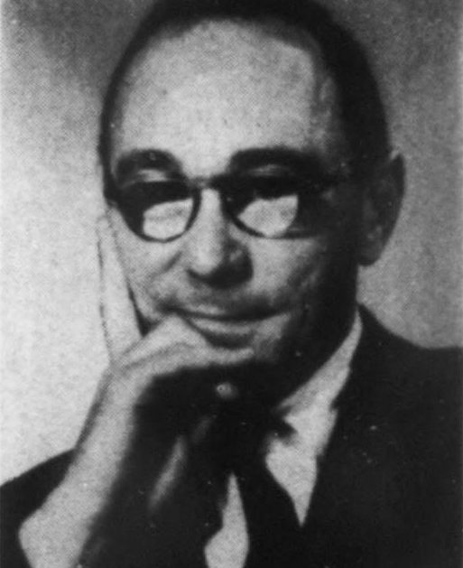
COGS 100 • GROUP 8
A growing mind is not explained
by logic alone — or culture alone.
Piaget: thought becomes more organized.
Vygotsky: culture becomes a tool for thought.
Bruner: keep both questions alive.
JEROME BRUNER
Scan for the
3-question quiz
tinyurl.com/cogs100-group8-quiz
Thank you
Reading: Bruner (1997). Bruner photo: Wikimedia Commons, public domain.
12
Notes:
JUQY — about 1 minute 15 seconds, then personal takeaway
To close, Piaget helps us see how thinking can become more organized and systematic. Vygotsky helps us see how language, culture, and other people become part of thinking.
Bruner’s main point is not that one thinker wins. Their difference is valuable because it stops us from explaining development with only logic or only culture.
One thing I learned is that even private thought can have a social history. Tools like language first live between people, and then they can become tools inside one person’s mind.
So when we look at learning, Bruner pushes us to ask both questions: what is changing in the learner’s thinking, and what people, language, or cultural tools made that change possible?
Thank you. Please remember to take the quiz using the link on the first or final slide.

