Slide 1

Milestone 2 - Python Group 1
Josh Mencsik, Bradey Lounsbury,
Justin Adie, Easton Scowden

Slide 2
Changes
-Added implementation of game rules
-Added live frame rendering
-Added Button to stop and reset generation grid
-General optimization of codebase

Slide 3




Tech Stack
Current
Upcoming
Python ( Flask framework )
Javascript
HTML5
MySQL
Docker

Slide 4
Group Member Responsibilities
Justin
-Maintaining codebase
-Helped implement game rules to board
-Added live rendering to make board animated
Josh
-Helped in implementation of game rules
-Miscellaneous contributions to codebase
Bradey
- Created issues
- Implemented “start/stop” button
- Miscellaneous contributions to codebase
Easton
Miscellaneous contributions to codebase
Continue to research all tools in tool stack

Slide 5



Tool Chain
VS Code
Git/Github
Doxygen

Slide 6


Group Member Tech Platforms
Justin - Windows / Linux
Josh - Windows
Easton - Windows
Bradey - Windows / Linux

Slide 7
Upcoming Project Goals
Milestone 3
Buttons for resetting, pausing, changing speed of board
Allow users to click on grid cells to add or remove cells
GUI upgrades
Milestone 4
Create database for grids
Create button to upload and save grids to / from database

Slide 8
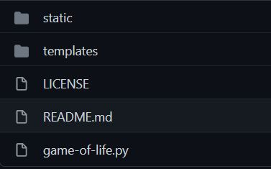
Repo Structure
For now there is only a main branch
Flask requires that we place the javascript file into the static folder and the html in the template folder

Slide 9
Workflow Structure
Each member will individually research any technologies needed and work toward completing each milestone. A member will check with the rest of the group before making any changes to allow the whole group to be aware of the progress made and any possible changes. Team meetings will be used to touch base and decide what work needs to be done for the week and who should complete it.

