Slide 1

Milestone 4 - Python Group 1
Josh Mencsik, Bradey Lounsbury,
Justin Adie, Easton Scowden

Slide 2
Changes
-Night mode
-Cell interactibilty
-Added mongo database
-Finished all buttons and modal windows
-Can upload and save grids

Slide 3
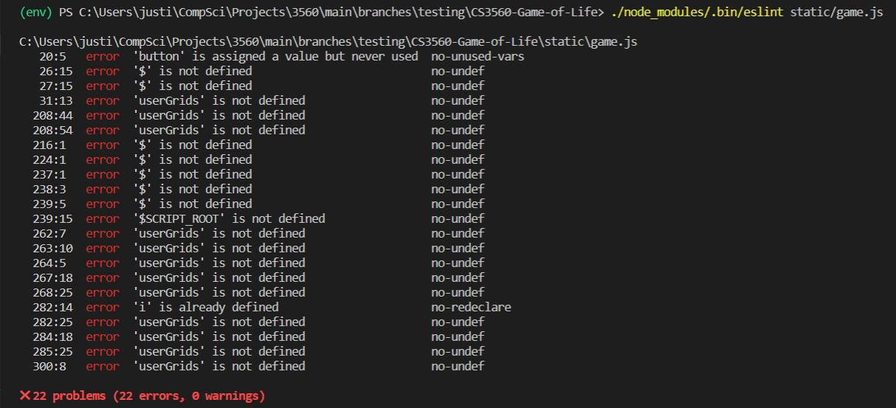
Static Analysis - ESLint

Slide 4
Results- ESLint
-Errors picked up on syntax from JQuery ($)
-Variable for “userGrids” listed as undefined ( likely because it was defined in a script in the index HTML file )
-Other Jquery related functions were flagged because they were not recognized by the linter

Slide 5
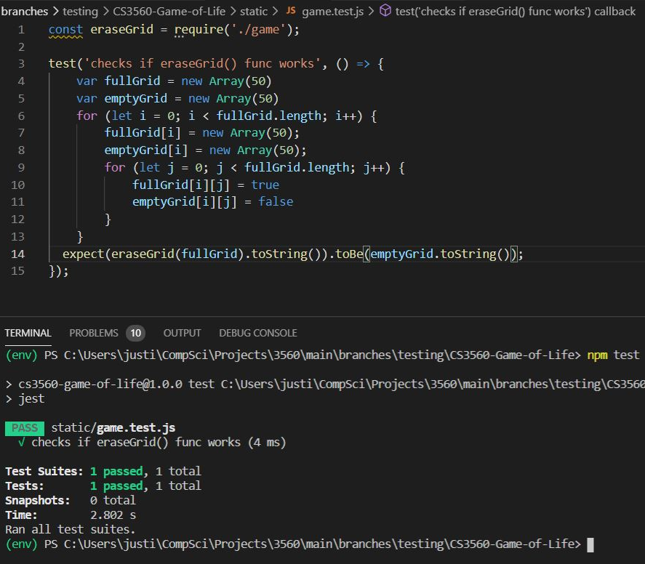
Unit Testing - eraseGrid()
Sets all cell states to false
Checks if both grids are equal by comparing the two arrays as strings
Function works as intended and runs efficiently

Slide 6

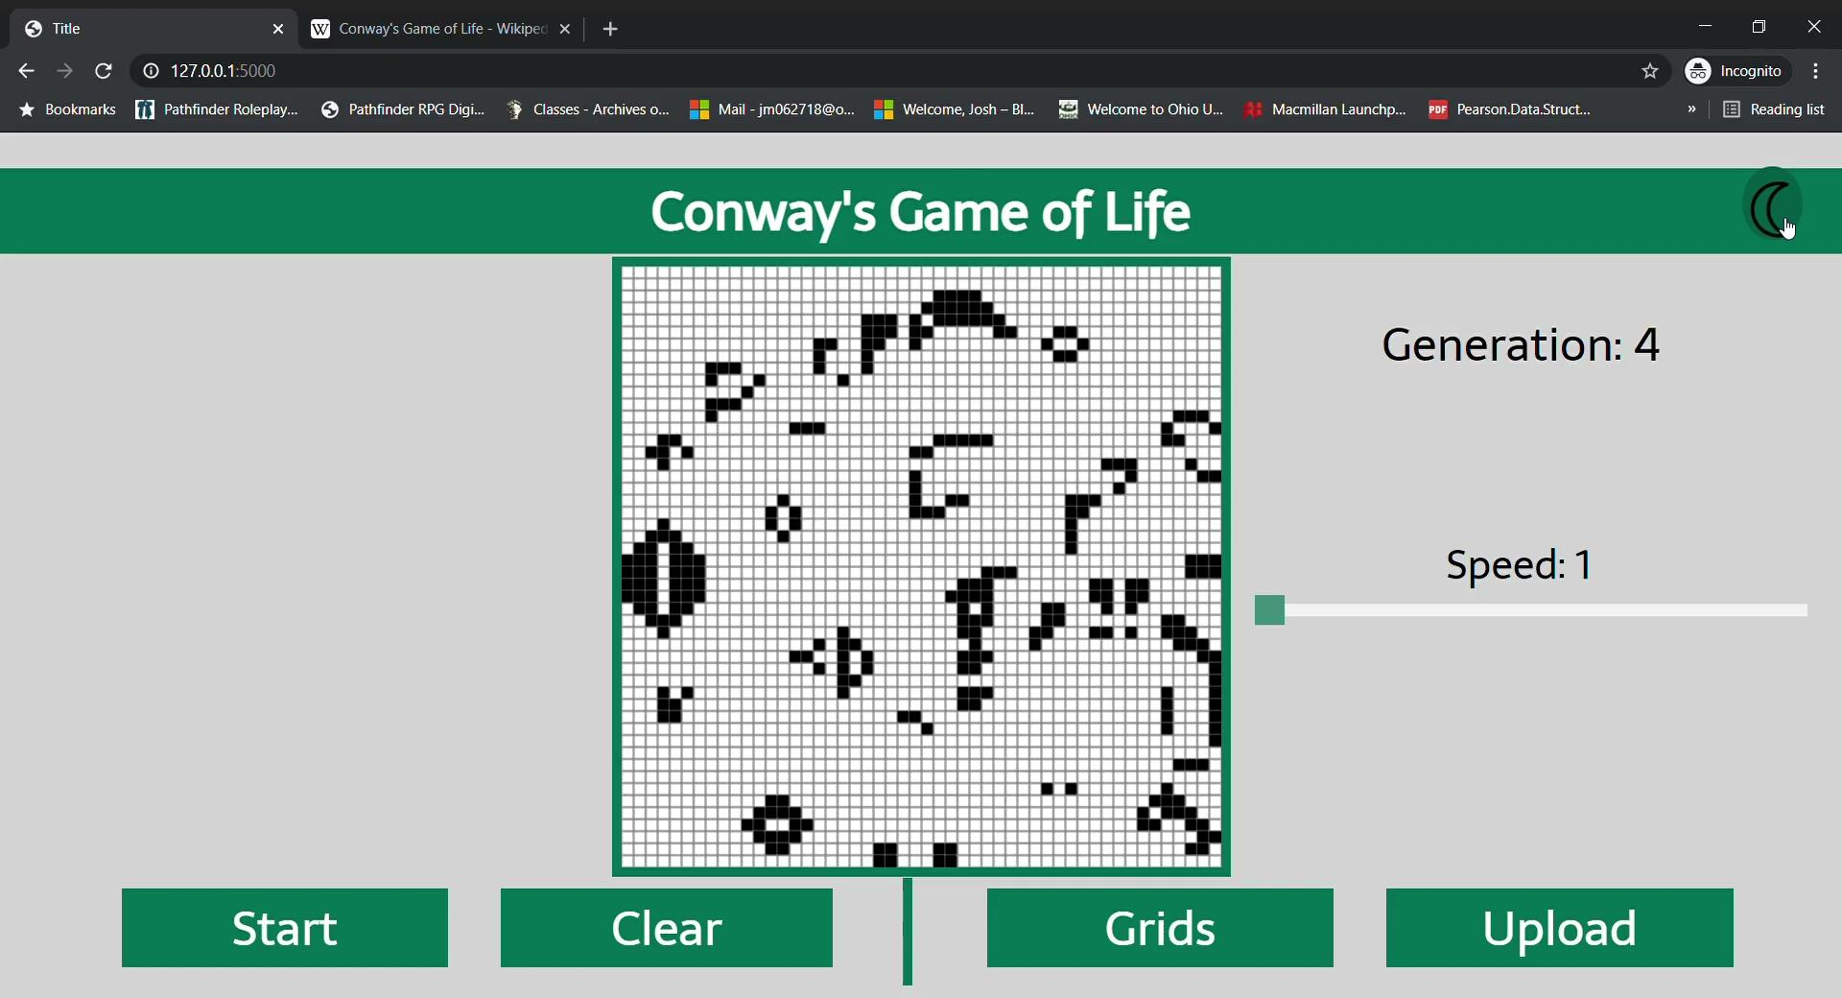
Manual Testing of GUI
Our night mode button had an issue where it didn’t update the colors of a paused grid
To fix the issue the grid just needed to be redrawn on click

Slide 7
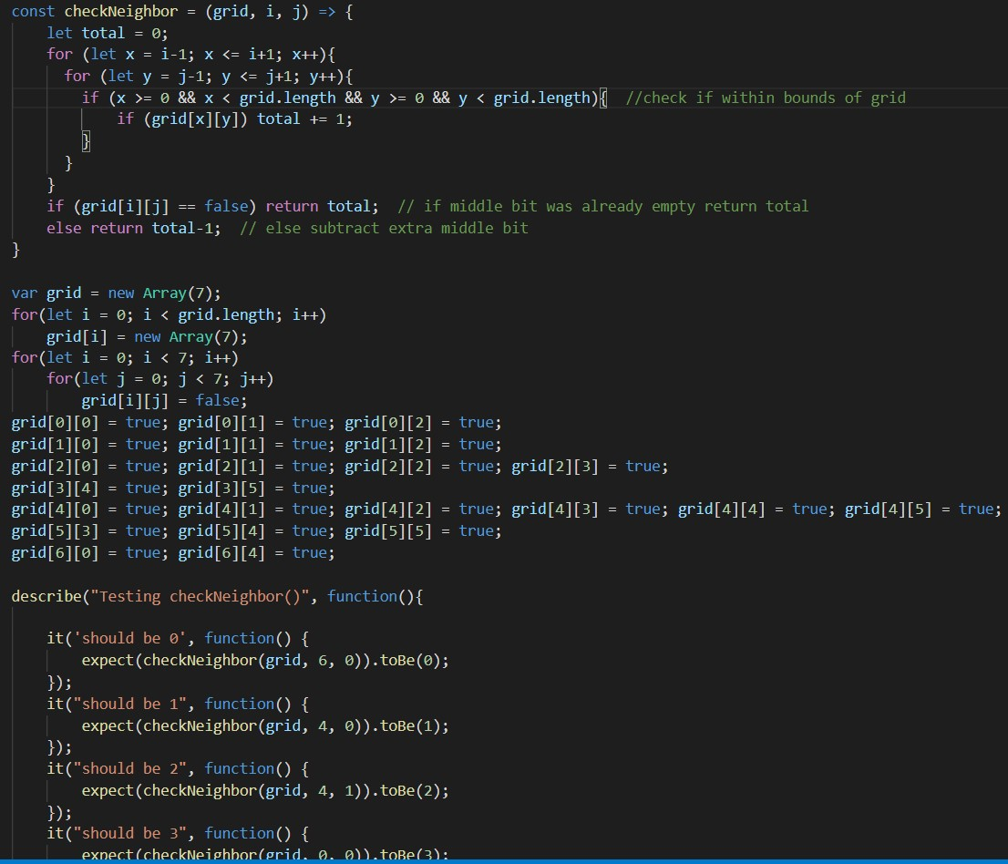
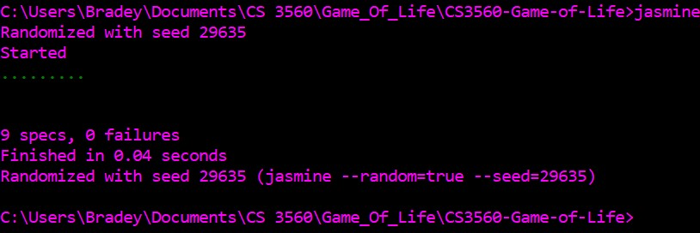
Unit Testing - checkNeighbor()
Checks how many neighbors a cell has and returns that number
Used jasmine to test
Function works properly

Slide 8



Tech Stack
Current
Deployment
Python ( Flask framework )
Javascript ( with JQuery )
HTML5
MongoDB
Heroku

Slide 9
Group Member Responsibilities
Justin
-Created backend for server objects
-Implemented Grids and Upload buttons
-Intractability of cells with mouse clicks
Josh
Fixed an issue with darkmode
Manually tested the GUI of the application
Bradey
- Added night mode
-Added feature that blocks users from accessing grids and upload button while the simulation is running
Easton
Miscellaneous contributions to codebase
Continue to research all tools in tool stack

Slide 10


Group Member Tech Platforms
Justin - Windows / Linux
Josh - Windows
Easton - Windows
Bradey - Windows / Linux

Slide 11






Tool Chain
VS Code
Git/Github
Doxygen
ESLint
Pylint
Jest
Chrome Dev Tools
Jasmine

Slide 12
Tool Reflection
Pros
Cons
Jest and ESLint easy to install with npm package manager
VS Code is easy to use and lightweight
Chrome dev tools help with profiling and debugging
Jest can be difficult to work with when doing unit testing on larger js files
ESLint sometimes flags code for errors when it doesn’t need to ( same for pylint )

