Slide 1

Milestone 3 - Python Group 1
Josh Mencsik, Bradey Lounsbury,
Justin Adie, Easton Scowden

Slide 2
Changes
-Added new GUI
-Added slider
-Added working clear button
-Fixed Start / Stop button
-Added generation counter

Slide 3
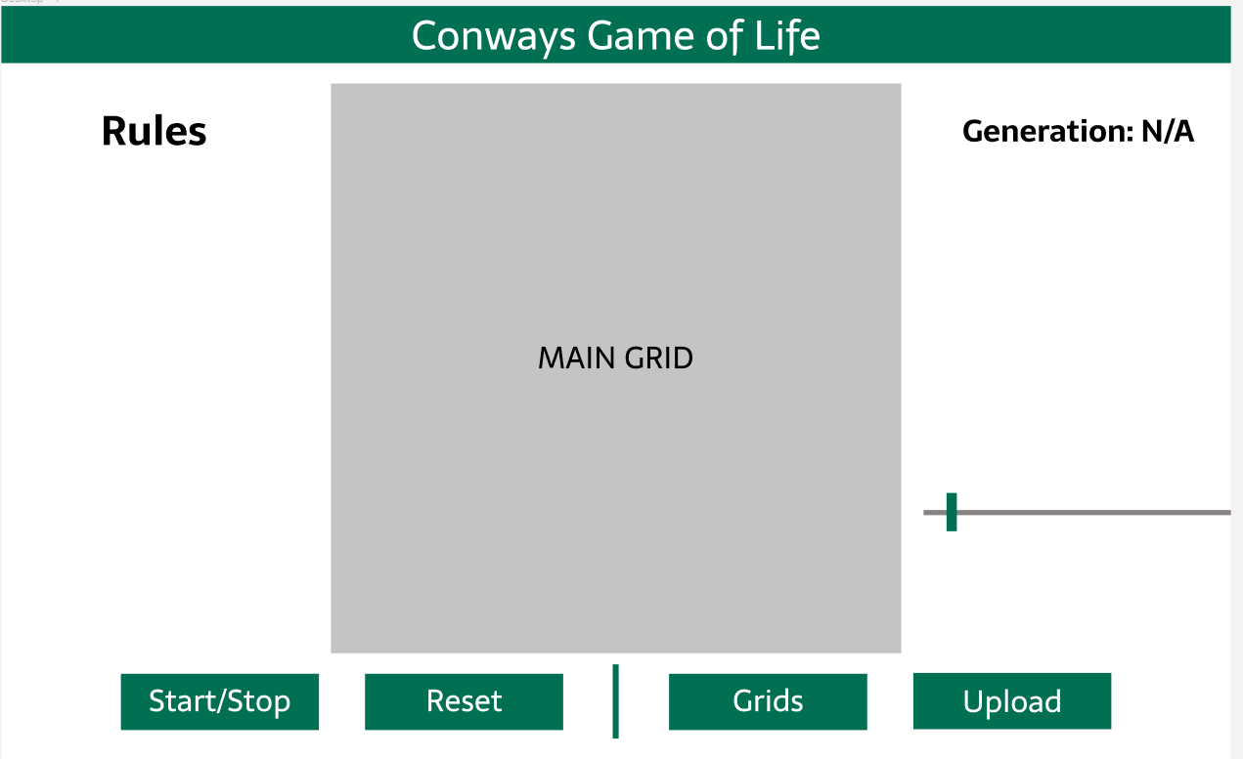
GUI Implementation - Figma Mockup

Slide 4
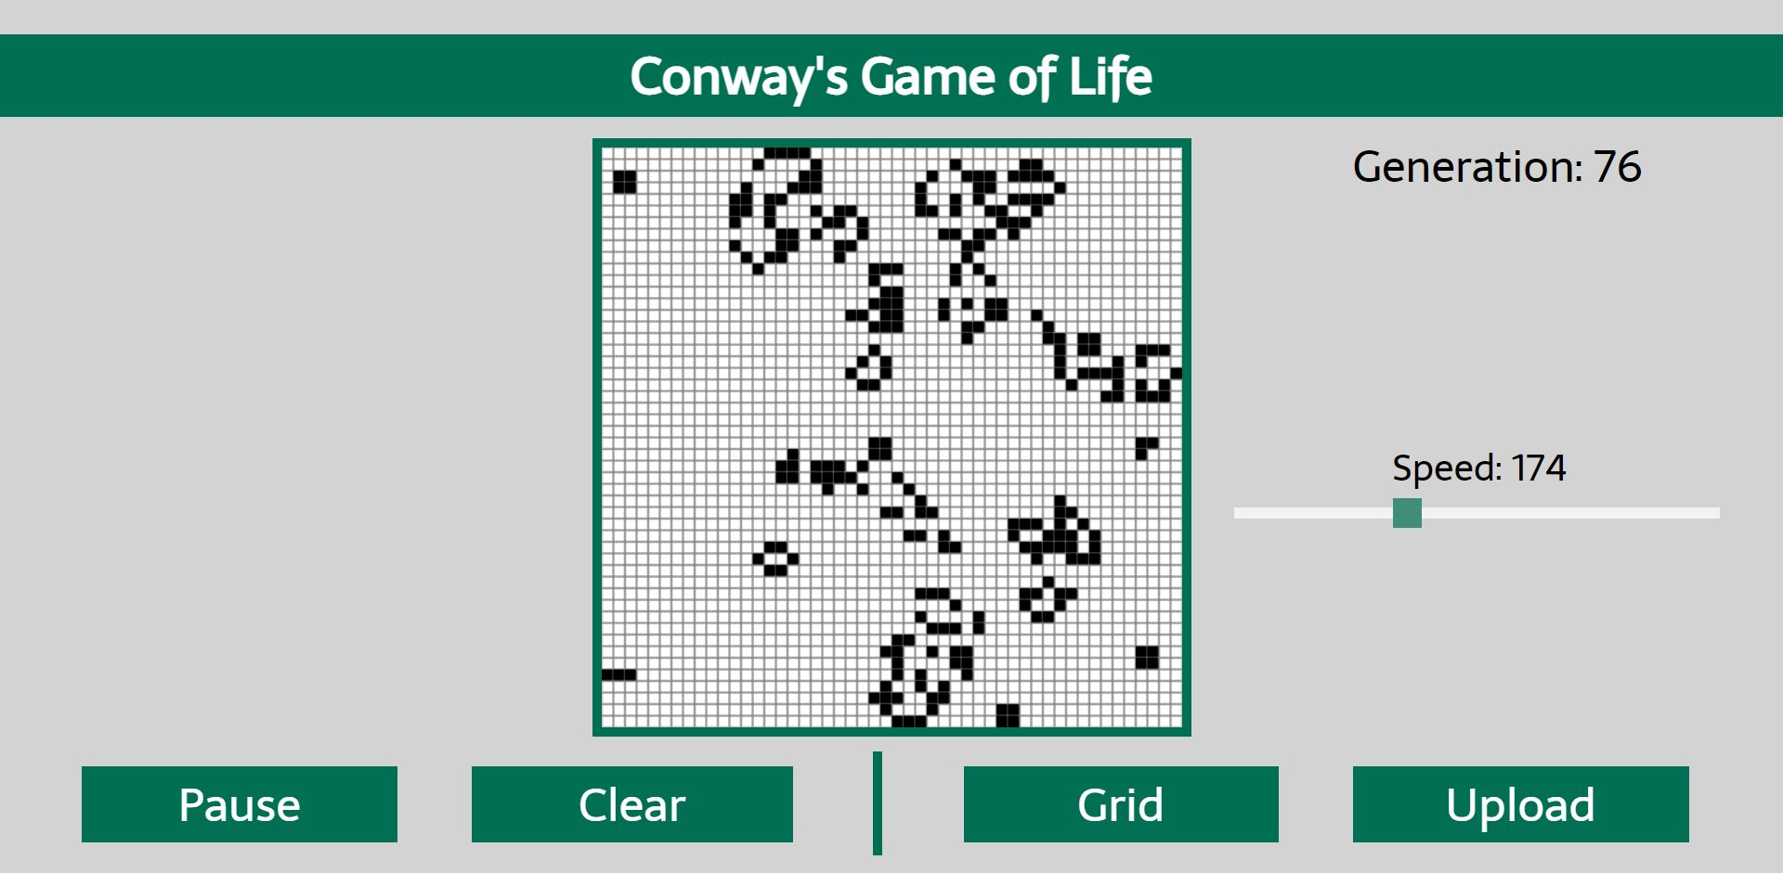
GUI Implementation - Web App GUI

Slide 5




Tech Stack
Current
Upcoming
Python ( Flask framework )
Javascript
HTML5
MySQL
Docker

Slide 6
Group Member Responsibilities
Justin
-Maintaining codebase
-GUI mockups
-Webpage GUI
-Button fixes
Josh
-Fixed slider speed
-Code optimizations
-Research on cell intractability for javascript
Bradey
- Added slider
- Added clear button
-Button fixes
-Added generation counter
Easton
Miscellaneous contributions to codebase
Continue to research all tools in tool stack

Slide 7



Tool Chain
VS Code
Git/Github
Doxygen

Slide 8


Group Member Tech Platforms
Justin - Windows / Linux
Josh - Windows
Easton - Windows
Bradey - Windows / Linux

Slide 9
Upcoming Project Goals
Milestone 4
Create database for grids
Create window for save / load buttons
Possibly add themes or a dark mode
Allow users to click on grid cells to add or remove cells (from milestone 3)
Make elements resizable for different resolutions
Milestone 5
Package source files into container
Final optimizations
Deployment

Slide 10
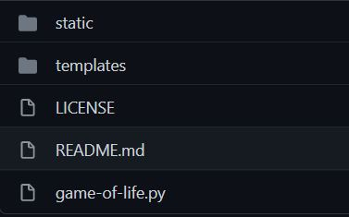
Repo Structure
For now there is only a main branch
Flask requires that we place the javascript file into the static folder and the html in the template folder

Slide 11
Workflow Structure
Each member will individually research any technologies needed and work toward completing each milestone. A member will check with the rest of the group before making any changes to allow the whole group to be aware of the progress made and any possible changes. Team meetings will be used to touch base and decide what work needs to be done for the week and who should complete it.

